Slide 1


Alpha Defence Pvt Ltd
Operational And Financial Analysis
Strategic Financials • Supply Chain Dynamics • Risk Architecture

Slide 2



Executive Summary & Key Metrics
$19.44B
$6.36B
94 / 100
53.90%
TOTAL REVENUE
GROSS MARGIN
QUALITY SCORE
ON-TIME DELIVERY
Global Operations Footprint
32.70% Corporate Margin
Stable Quality Control Index
Critical Delivery Bottleneck
Key Operational Finding: While financial scale ($19.44B) and quality standards (94/100 score) remain exceptionally strong, schedule compliance presents an operational bottleneck with nearly 46% of fulfillments experiencing schedule disruptions.

Slide 3
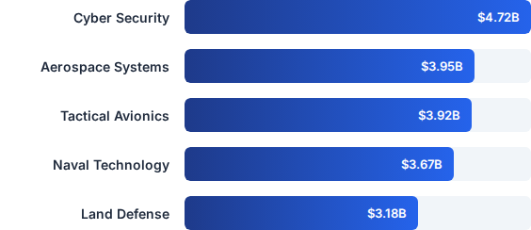
Division Financial Breakdown
Cyber Security Lead: Dominates total portfolio contract
value at $4.72B, generating $1.55B in gross margin (32.8% yield).
Air & Space Segments: Tactical Avionics ($3.92B revenue / $1.31B margin) and Aerospace Systems
($3.95B revenue / $1.29B margin) deliver high stability.
Naval & Land Divisions: Naval Technology achieves $3.67B revenue ($1.21B margin), while Land Defense represents $3.18B revenue ($1.00B margin).

Slide 4
Platform Cross-Selling Revenue
Enterprise Division | Ground Tactical | Airborne | Digital Command | Maritime
Cyber Security | $1.26B ($0.43B margin) | $1.20B ($0.38B margin) | $1.19B ($0.40B margin) | $1.07B ($0.34B margin)
Tactical Avionics | $0.83B ($0.29B margin) | $1.21B ($0.41B margin) | $0.96B ($0.31B margin) | $0.92B ($0.30B margin)
Aerospace Systems | $0.99B ($0.33B margin) | $1.11B ($0.33B margin) | $0.80B ($0.26B margin) | $1.04B ($0.36B margin)
Naval Technology | $0.99B ($0.33B margin) | $0.76B ($0.25B margin) | $0.82B ($0.27B margin) | $1.10B ($0.35B margin)
Land Defense | $1.09B ($0.36B margin) | $0.69B ($0.20B margin) | $0.63B ($0.21B margin) | $0.77B ($0.23B margin)

Slide 5
Delivery Efficiency & Logistics
Analyzing Contract Lead Times, Schedule Slippages, and International Clearance Constraints

Slide 6

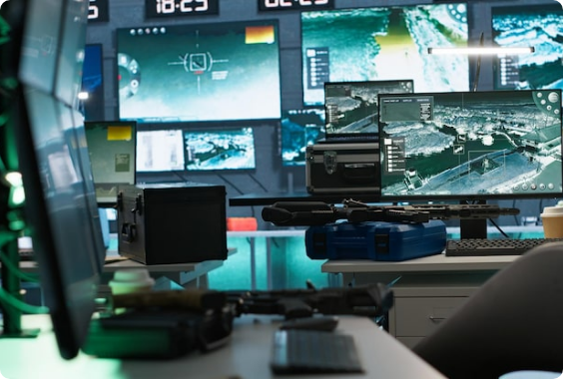
Lead Time & Schedule Slippage
Operational Dynamics
The enterprise records an average delivery lead time of 114.3 days across all contracts, with average schedule slippage of 7.3 days past agreed targets.
Highest Delays (Land Defense): Ground Tactical platforms lead schedule delays at 42.25 days, followed by Digital Command at 40.00 days.
Tactical Avionics Lag: Ground Tactical delays average 38.92 days; Digital Command averages 33.94 days.
Naval & Aerospace: Aerospace Digital Command experiences 38.91 days delay; Naval Airborne exhibits the lowest delay at 23.09 days.

Slide 7

Security Clearance Impact
Clearance Level | Fastest Fulfillments (Lead Time) | Extended Fulfillments (Lead Time) | Primary Logistics Factors
Level 1 (Standard) | Poland (93.1 days) Australia (95.4 days) Japan (97.5 days) | South Korea (135.4 days) Brazil (134.6 days) UAE (127.0 days) | Port congestion and customs processing speed in South America & Middle East.
Level 2 (Restricted) | Qatar (78.4 days) South Korea (89.7 days) | France (125.9 days) Brazil (125.1 days) Saudi Arabia (122.4 days) | Bilateral defense export compliance checks and tech transfer documentation.
Level 3 (Top Secret) | UK (97.8 days) India (98.6 days) | South Korea (140.9 days) Poland (137.5 days) Germany (137.0 days) | Extensive multi-agency audit protocols & sovereign security drag.

Slide 8






Platform Order Fulfillment Status
Ground Tactical
Airborne
Digital Command
Maritime
268 Total Orders
249 Total Orders
239 Total Orders
244 Total Orders
On Time: 145 (14.5%)
On Time: 141 (14.1%)
On Time: 128 (12.8%)
On Time: 125 (12.5%)
Delayed: 62 (6.2%)
Delayed: 60 (6.0%)
Delayed: 72 (7.2%)
Delayed: 74 (7.4%)
In Production: 41 (4.1%)
In Production: 31 (3.1%)
In Production: 22 (2.2%)
In Production: 28 (2.8%)
Testing: 20 (2.0%)
Testing: 17 (1.7%)
Testing: 17 (1.7%)
Testing: 17 (1.7%)

Slide 9


Quality & Cost Architecture
Section 3: Risk Architecture
The enterprise maintains a overall 67.3% Production Cost Ratio against a 32.7% Gross Margin across defense manufacturing assets.
High-value products such as the Threat Intelligence Node ($1.24B cost / $0.61B margin) and Tactical Data Link ($1.11B cost / $0.54B margin) anchor the high-margin technology core.
Quality scores range between 93.1 and 94.7 across product platforms, ensuring strong reliability despite cost pressures.

Slide 10
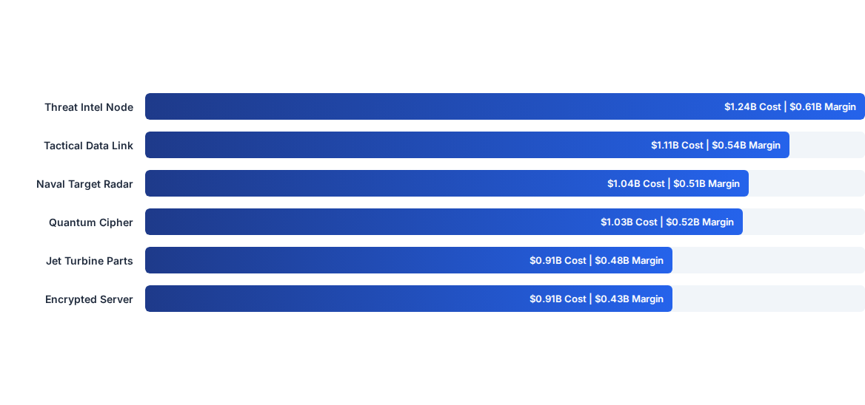
Equipment Production Cost vs Margin

Slide 11
Warranty Exposure & Risk Matrix
Risk Segment | Quality Score | Order Volume | Contract Value | Warranty Duration Revenue Exposure
 | < 90.0 (88.9 - 89.1) | 162 Orders | $3.42B | $0.78B (12-mo) • $0.64B (24-mo) • $0.52B (36-mo) • $0.77B (60-mo)
 | 90.0 - 94.9 (92.4 - 92.8) | 445 Orders | $8.46B | $1.82B (12-mo) • $1.65B (24-mo) • $1.72B (36-mo) • $1.74B (60-mo)
 | ≥ 95.0 (97.4 - 97.7) | 393 Orders | $7.47B | $1.48B (12-mo) • $1.52B (24-mo) • $1.50B (36-mo) • $1.49B (60-mo)
Risk Insight: 162 orders ($3.42B in contract value) fall in the High-Risk category (<90 QC score), requiring prioritized quality audits to mitigate potential long-term warranty liability.

Slide 12




Strategic Action Recommendations
1. Resolve Delays
2. Streamline Customs
3. Mitigate Warranty Risk
Establish dedicated operational task forces for Land Defense and Tactical Avionics Ground Tactical units to eliminate 38–42 day lead time variances.
Form pre-clearance green lanes for Level 3 Top Secret exports in high-drag destinations like South Korea (140.9d) and Poland (137.5d).
Implement targeted QA remediation for the 162 high-risk contracts ($3.42B) to reduce downstream warranty obligation claims.

Slide 13
Questions & Executive Discussion
Thank You
www.alphadefence.com
executive@alphadefence.com
Alpha Defence HQ

