Slide 1


Submitted By : Yash Sharma

Slide 2
Problem Statement
An FMCG company management has noticed that there is a miss match in the demand and supply.
Where the demand is high, supply is pretty low and where the demand is low, supply is pretty high.
In both ways, it is an inventory cost loss to the company
The higher management wants to optimize the supply quantity in every warehouse in the entire country.

Slide 3
Exploratory data analysis
The first step in solving any case study in data science is to analyze the data you have.
It helps to give a valuable understanding of the pattern and information.
EDA has a big role in the proper visualization of the data.
Proper EDA gives interesting features to your data which in turn affects our data preprocessing and model selection creation as well.

Slide 4
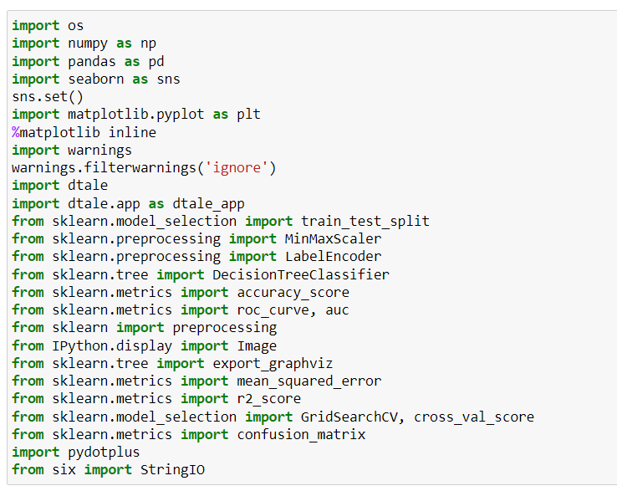
import Packages For EDA

Slide 5
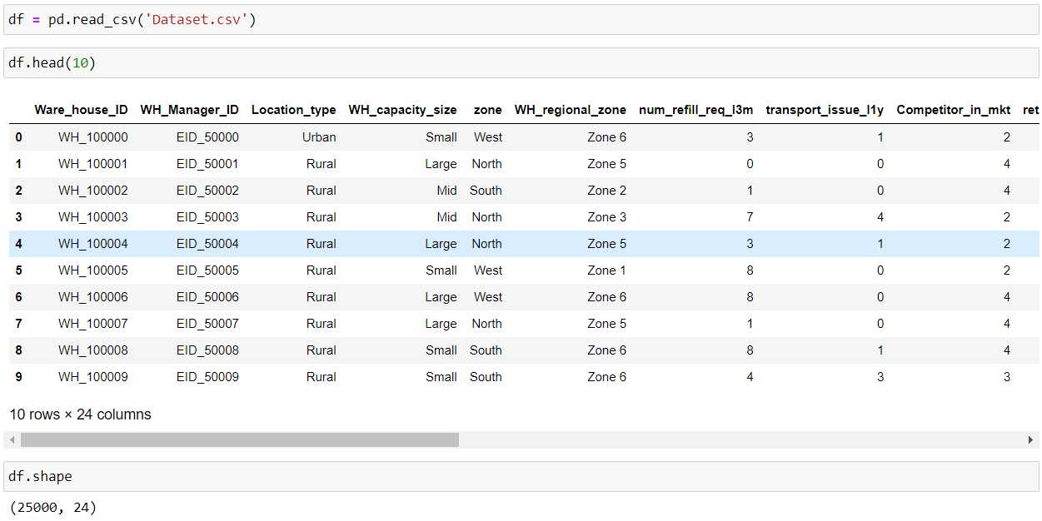
Assign Data in df Variable

Slide 6
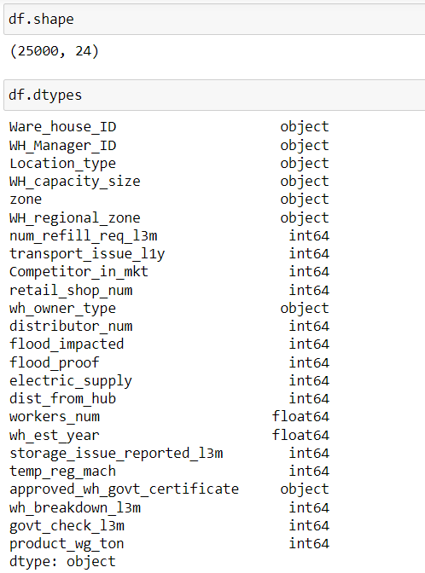
Data type in df Variable

Slide 7
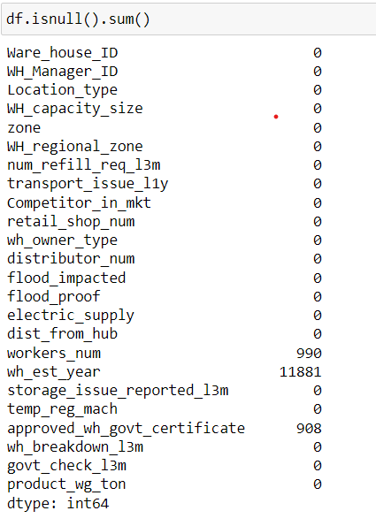
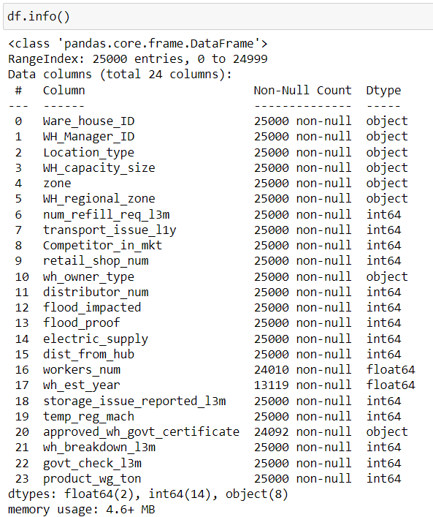
Find out null values and Info About data

Slide 8
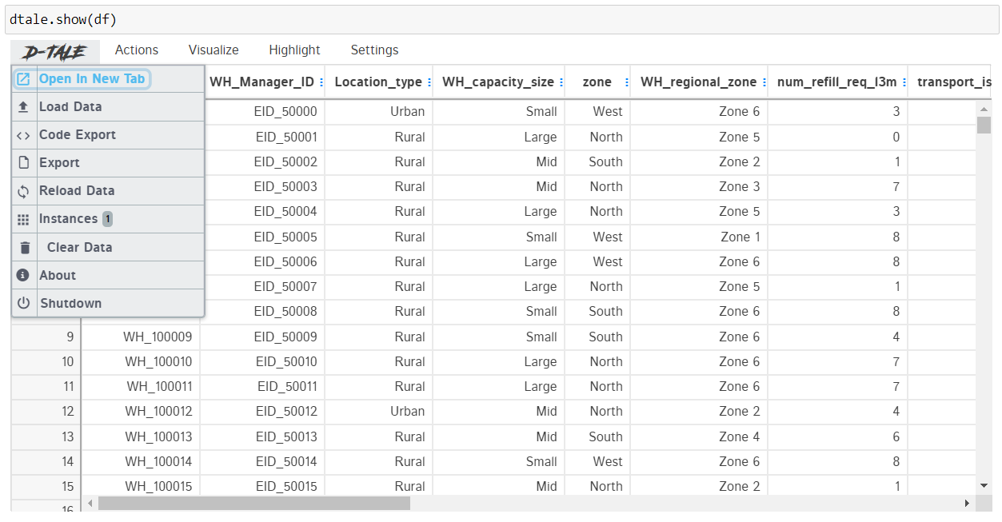
Use D-Tale Package for view & Analyze

Slide 9
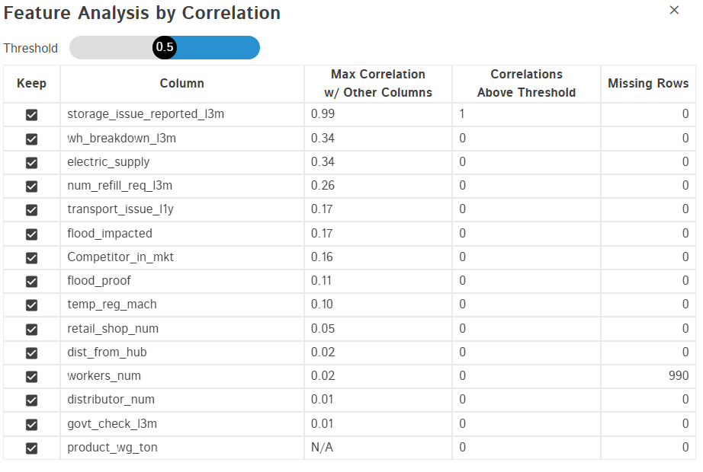
Feature Analysis By Correlation

Slide 10
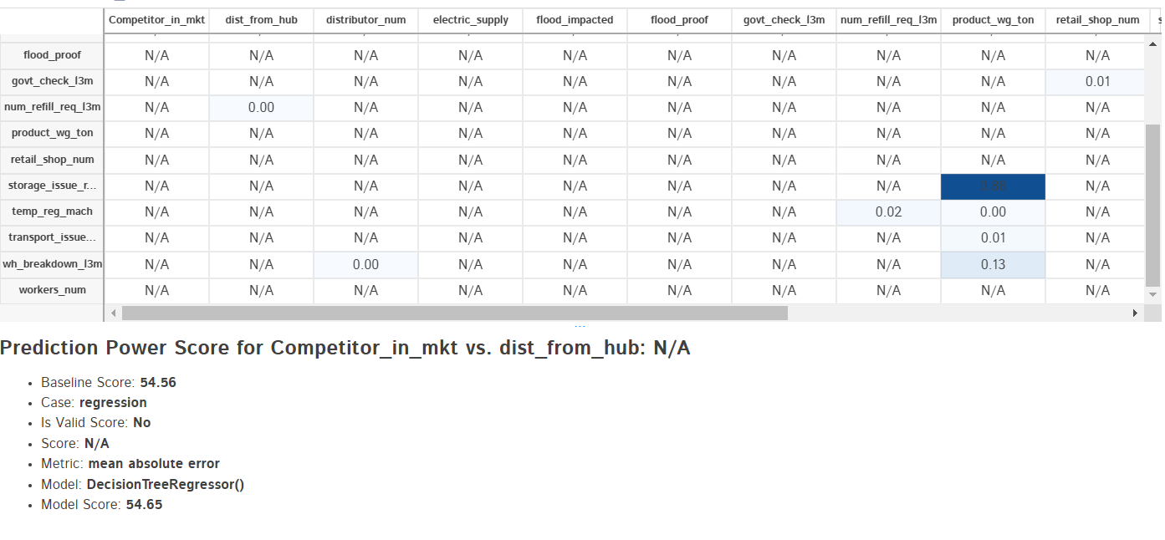
Prediction Power Score

Slide 11

Missing Values
Warehouse established year
Drop column wh_est_year( Warehouse established year) by using drop function

Slide 12
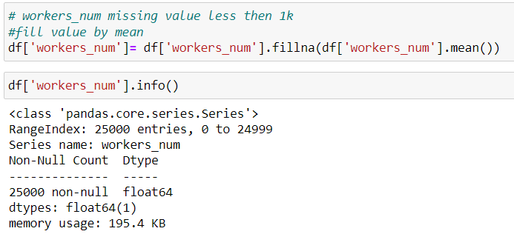
Missing Values
Number of workers working in the warehouse
Fill na values column workers_num Number of workers working in the warehouse using mean

Slide 13
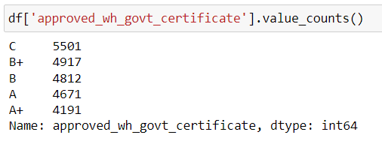
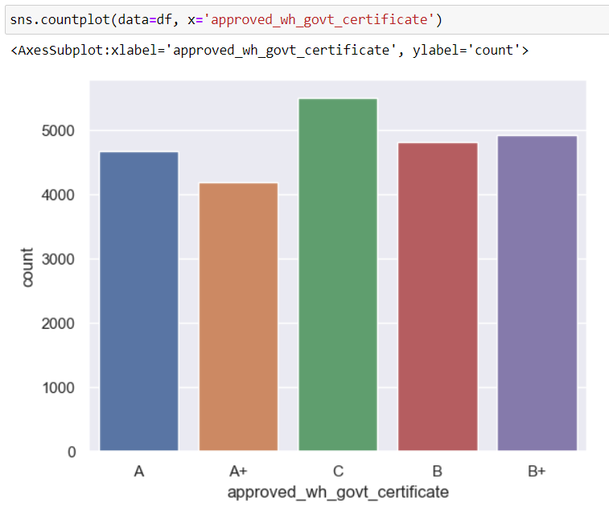
Missing Values
standard certificate issued from government regulatory body
Column approved_wh_govt_certificate
What kind of standard certificate has been issued to the warehouse from government regulatory body

Slide 14
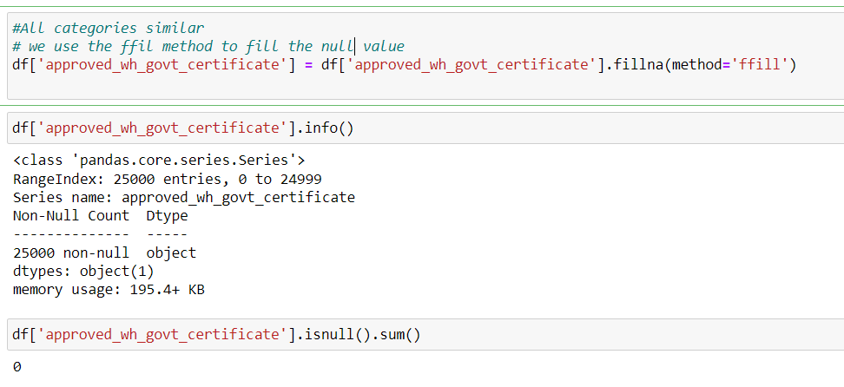
Missing Values
standard certificate issued from government regulatory body

Slide 15
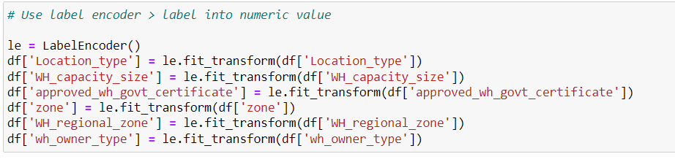
Label Encoder For Numeric values

Slide 16
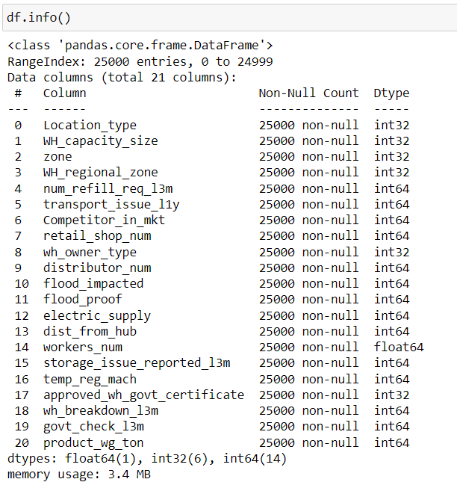
After Apply Label Encoder

Slide 17
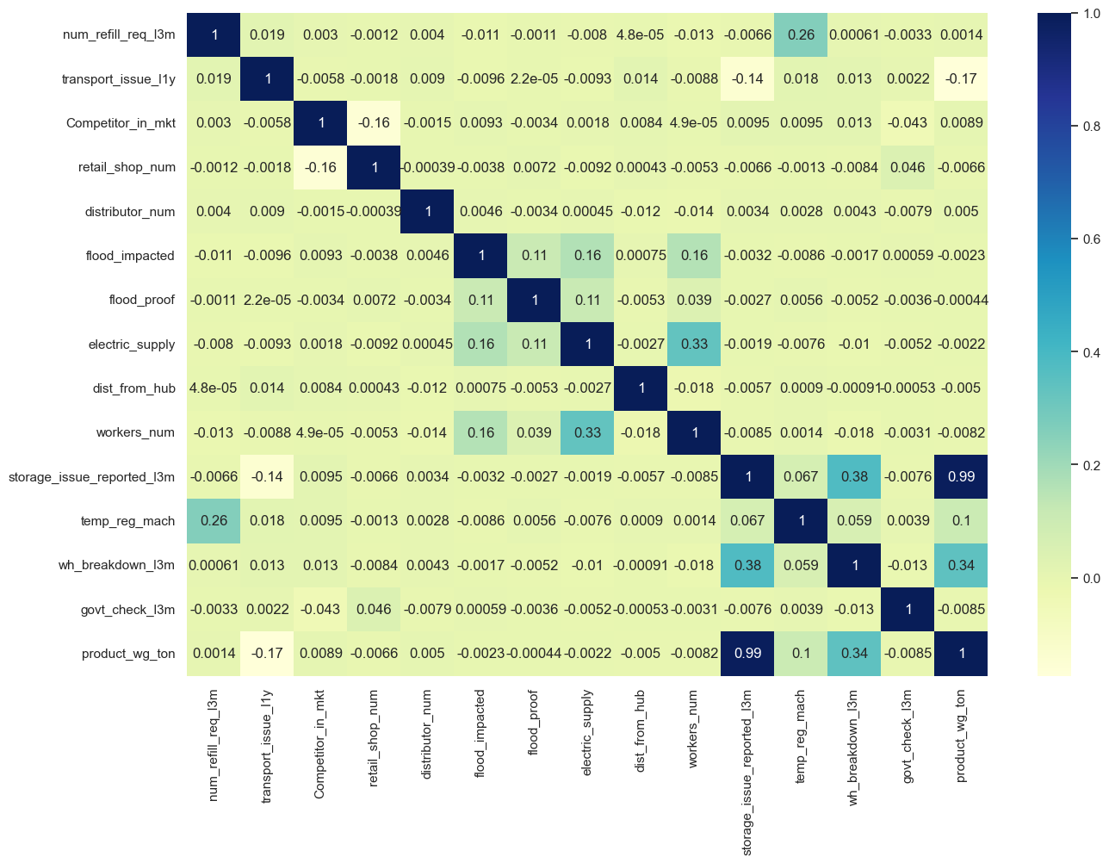
Correlation B/W Column

Slide 18
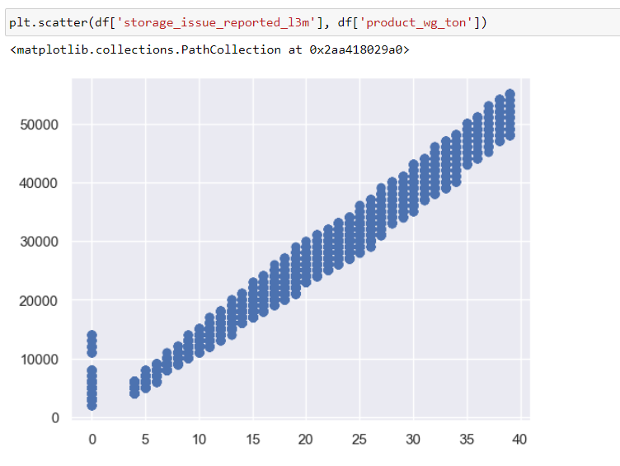
Storage Issue with Target Column

Slide 19
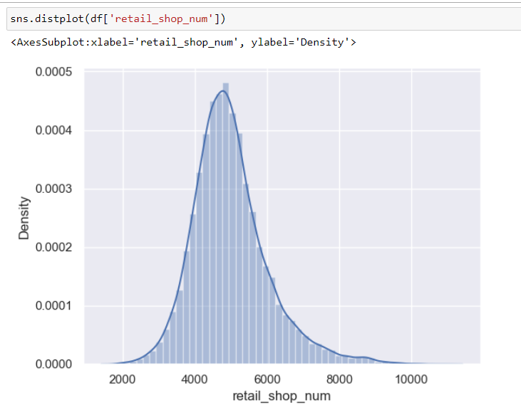
Retail Shop Number

Slide 20
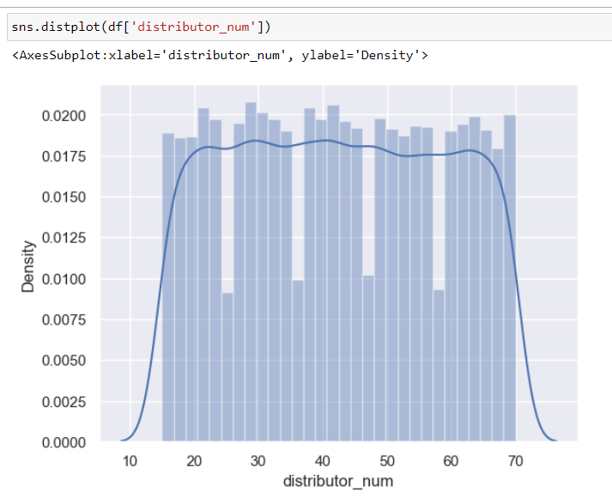
Number of distributer works in between warehouse and retail shops

Slide 21
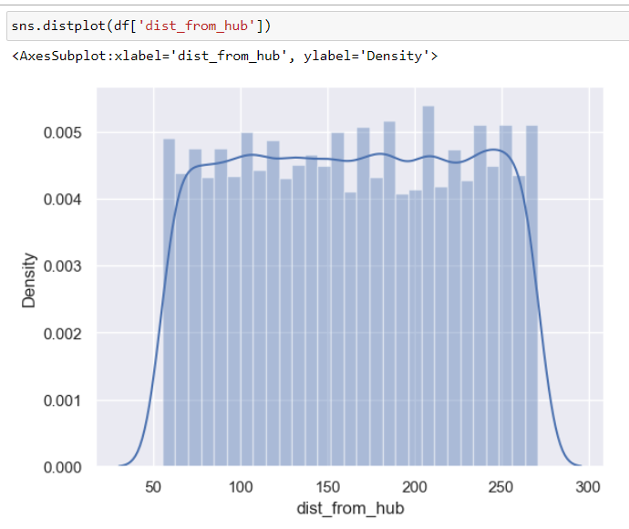
Distance between warehouse to the production hub in Kms

Slide 22
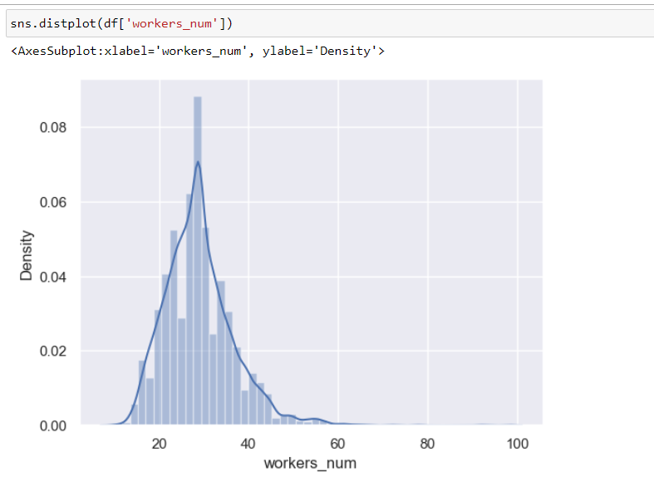
Number of workers working in the warehouse

Slide 23
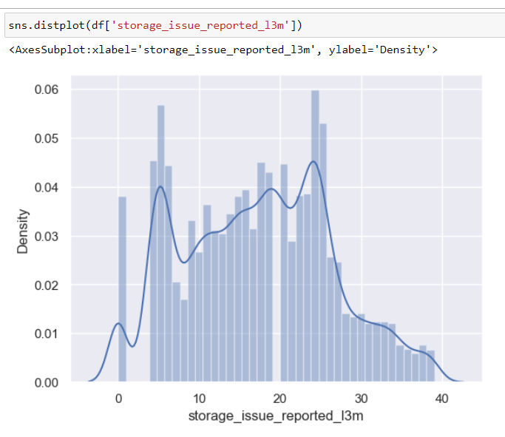
Warehouse reported storage issue to corporate office

Slide 24
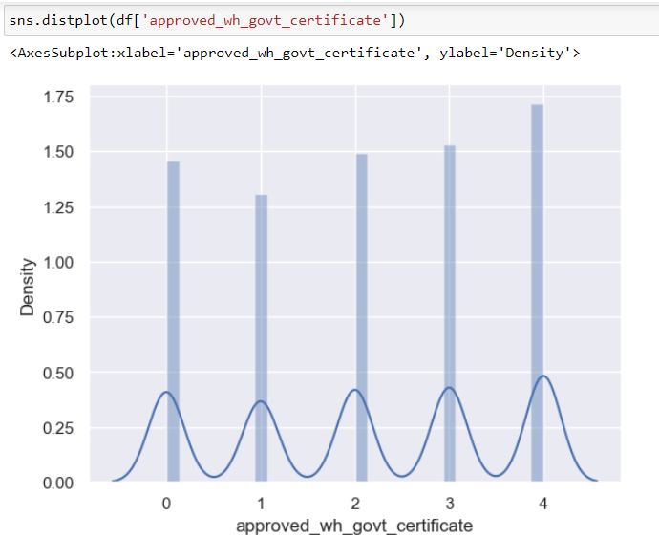
Standard certificate has been issued from government regulatory body

Slide 25
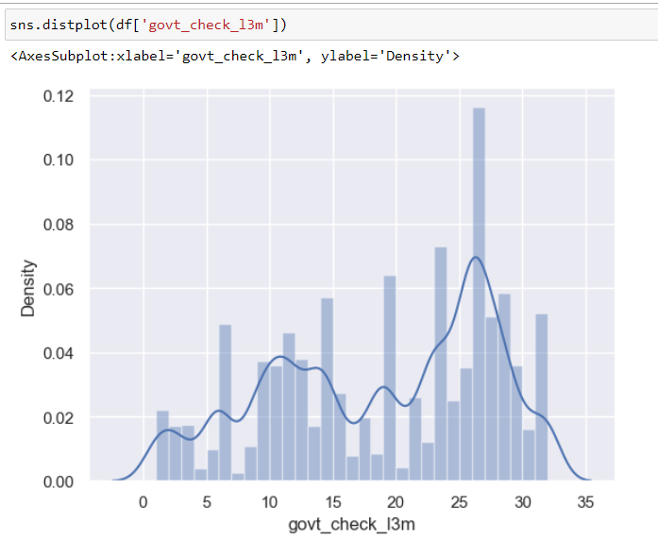
Warehouse face a breakdown

Slide 26
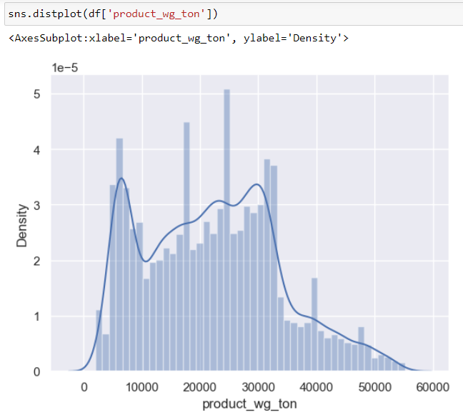
Product has been shipped in last 3 months

Slide 27

Setting Target variable

Slide 28
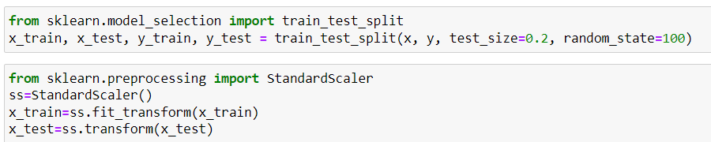
Assign?

Slide 29
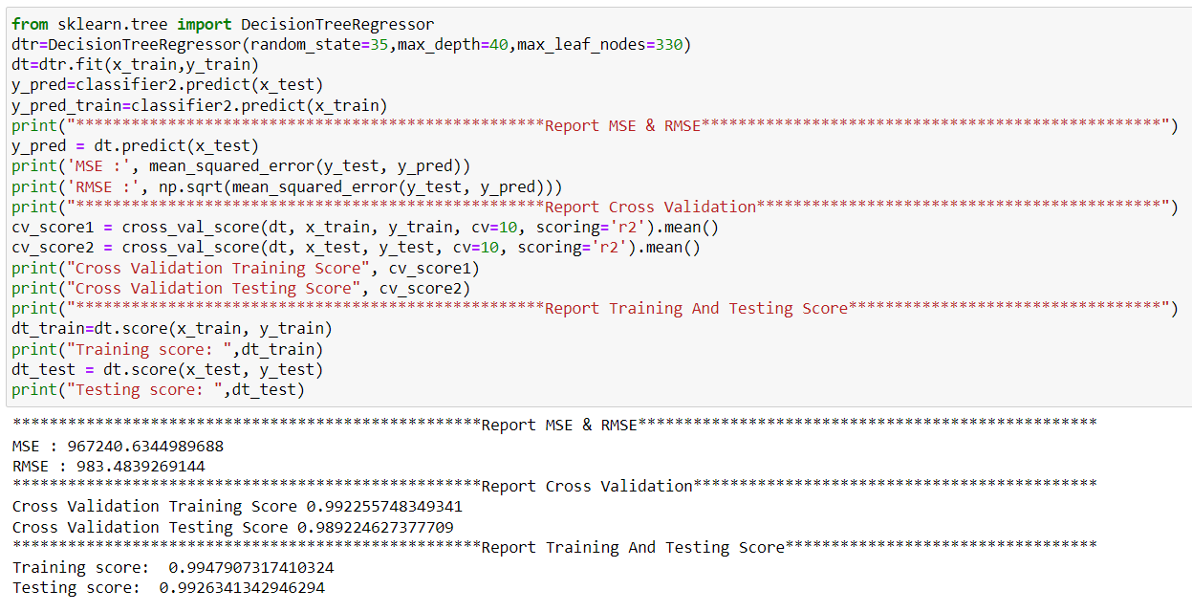
Decision Tree

Slide 30
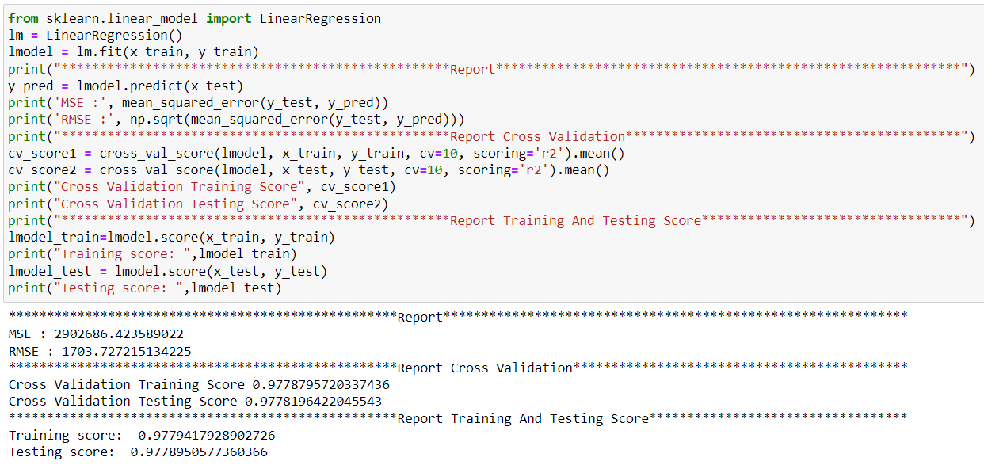
Linear Regression

Slide 31
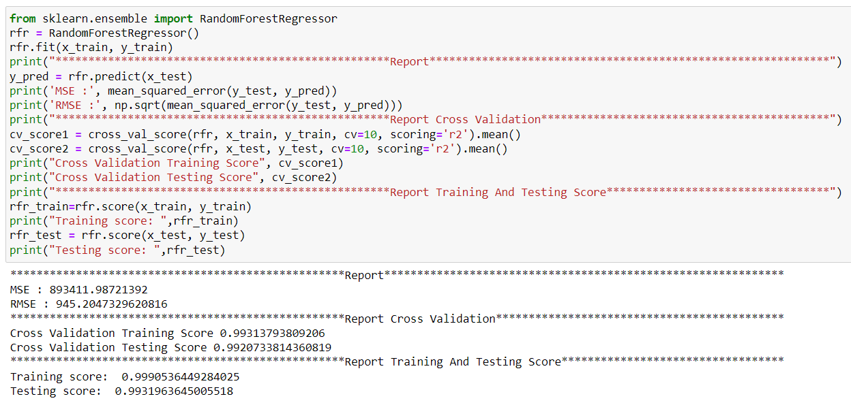
Random Forest

Slide 32
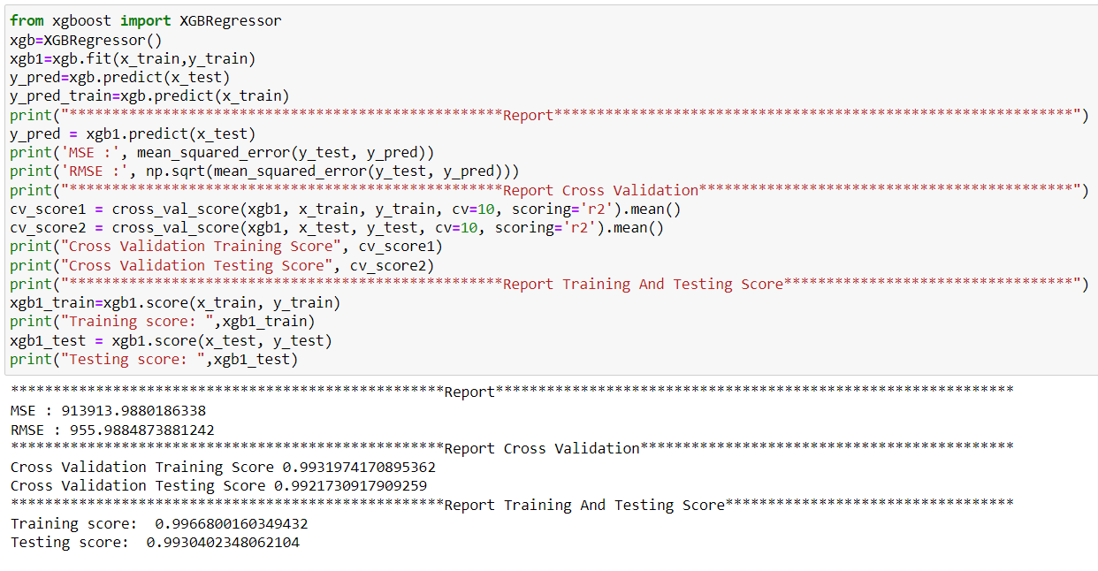
XG boost

Slide 33
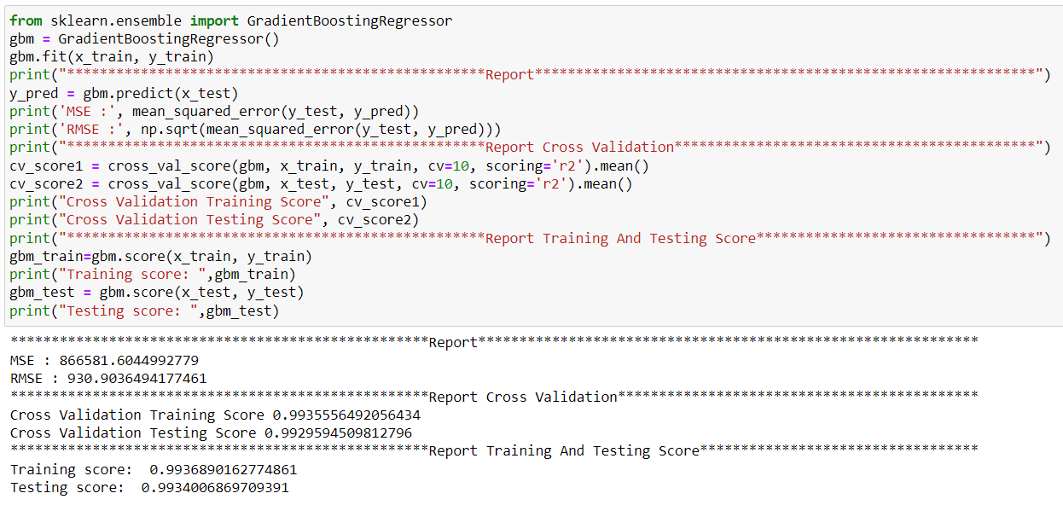
Gradient Boost

Slide 34
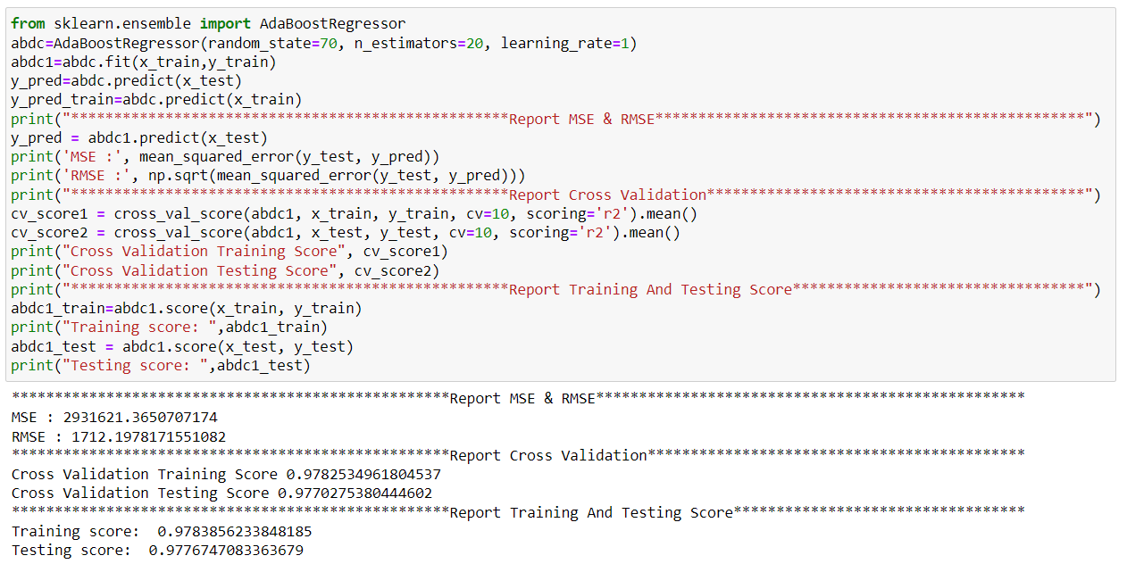
Ada Boost

Slide 35
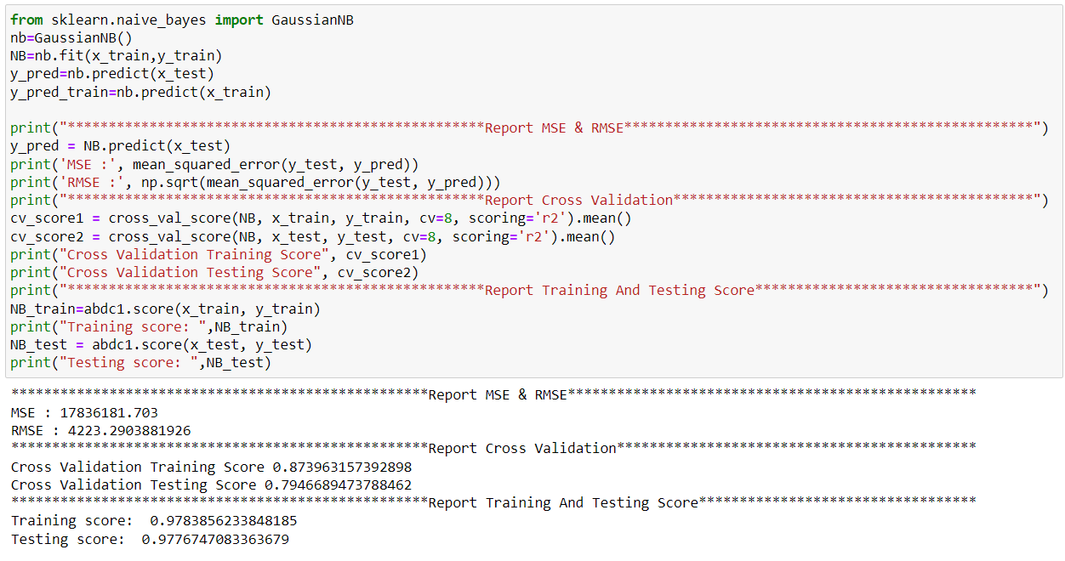
Gaussian Regressor

Slide 36
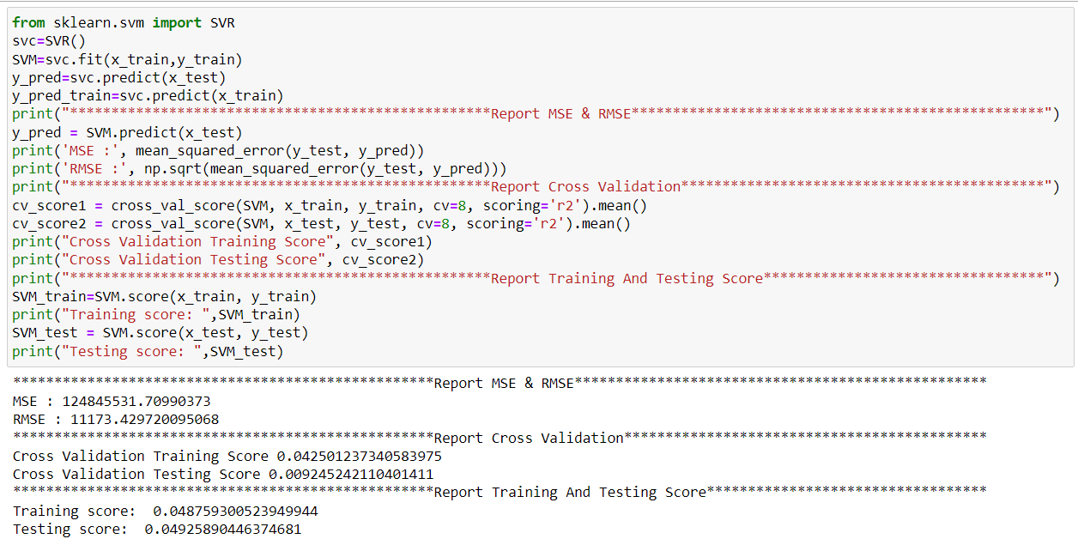
Support Vector Regression

Slide 37
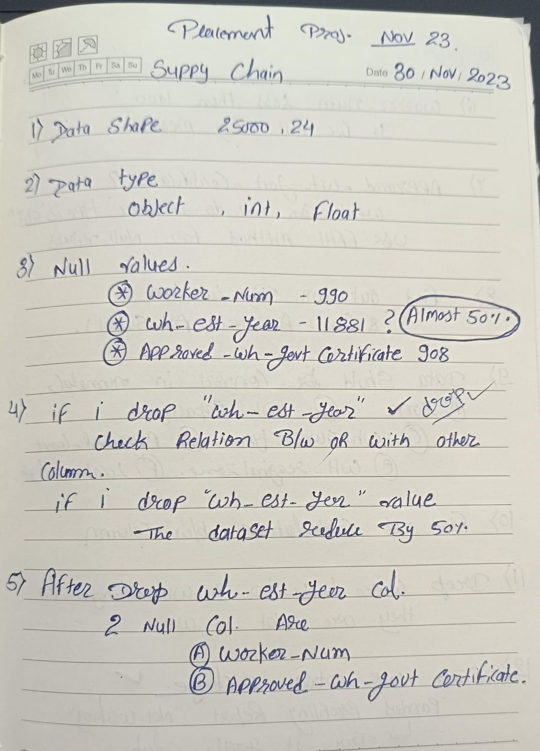

Slide 38
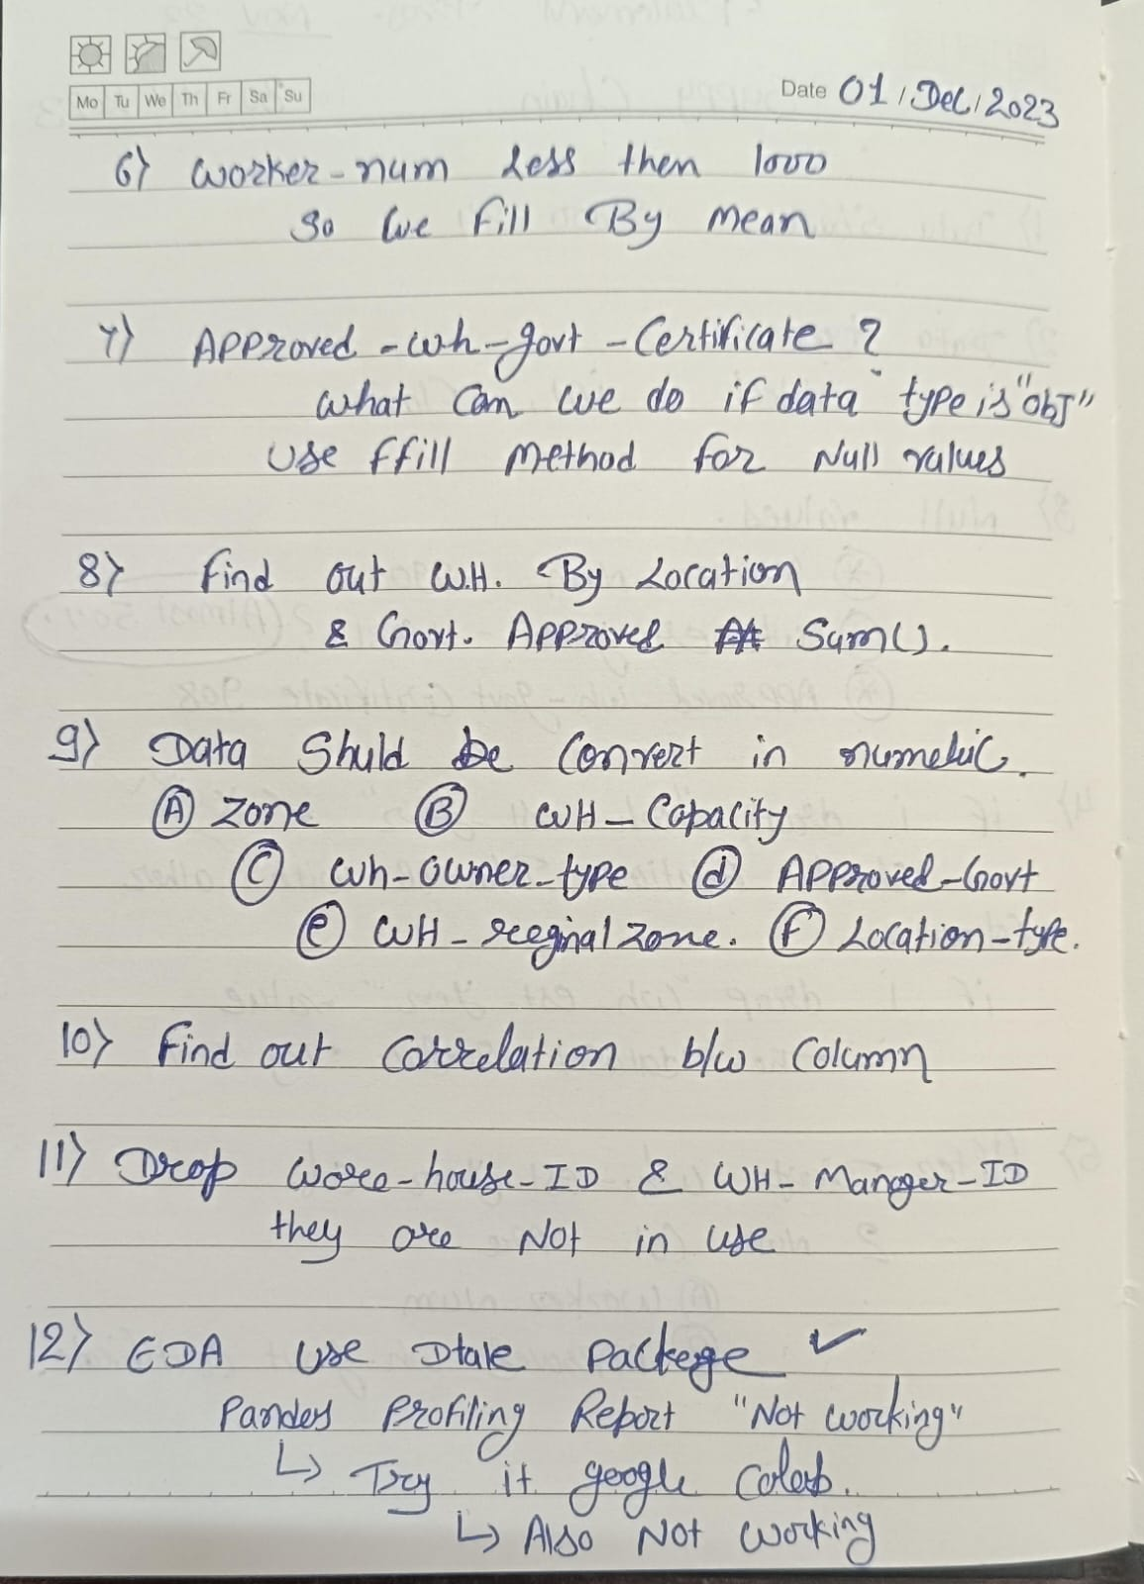

Slide 39
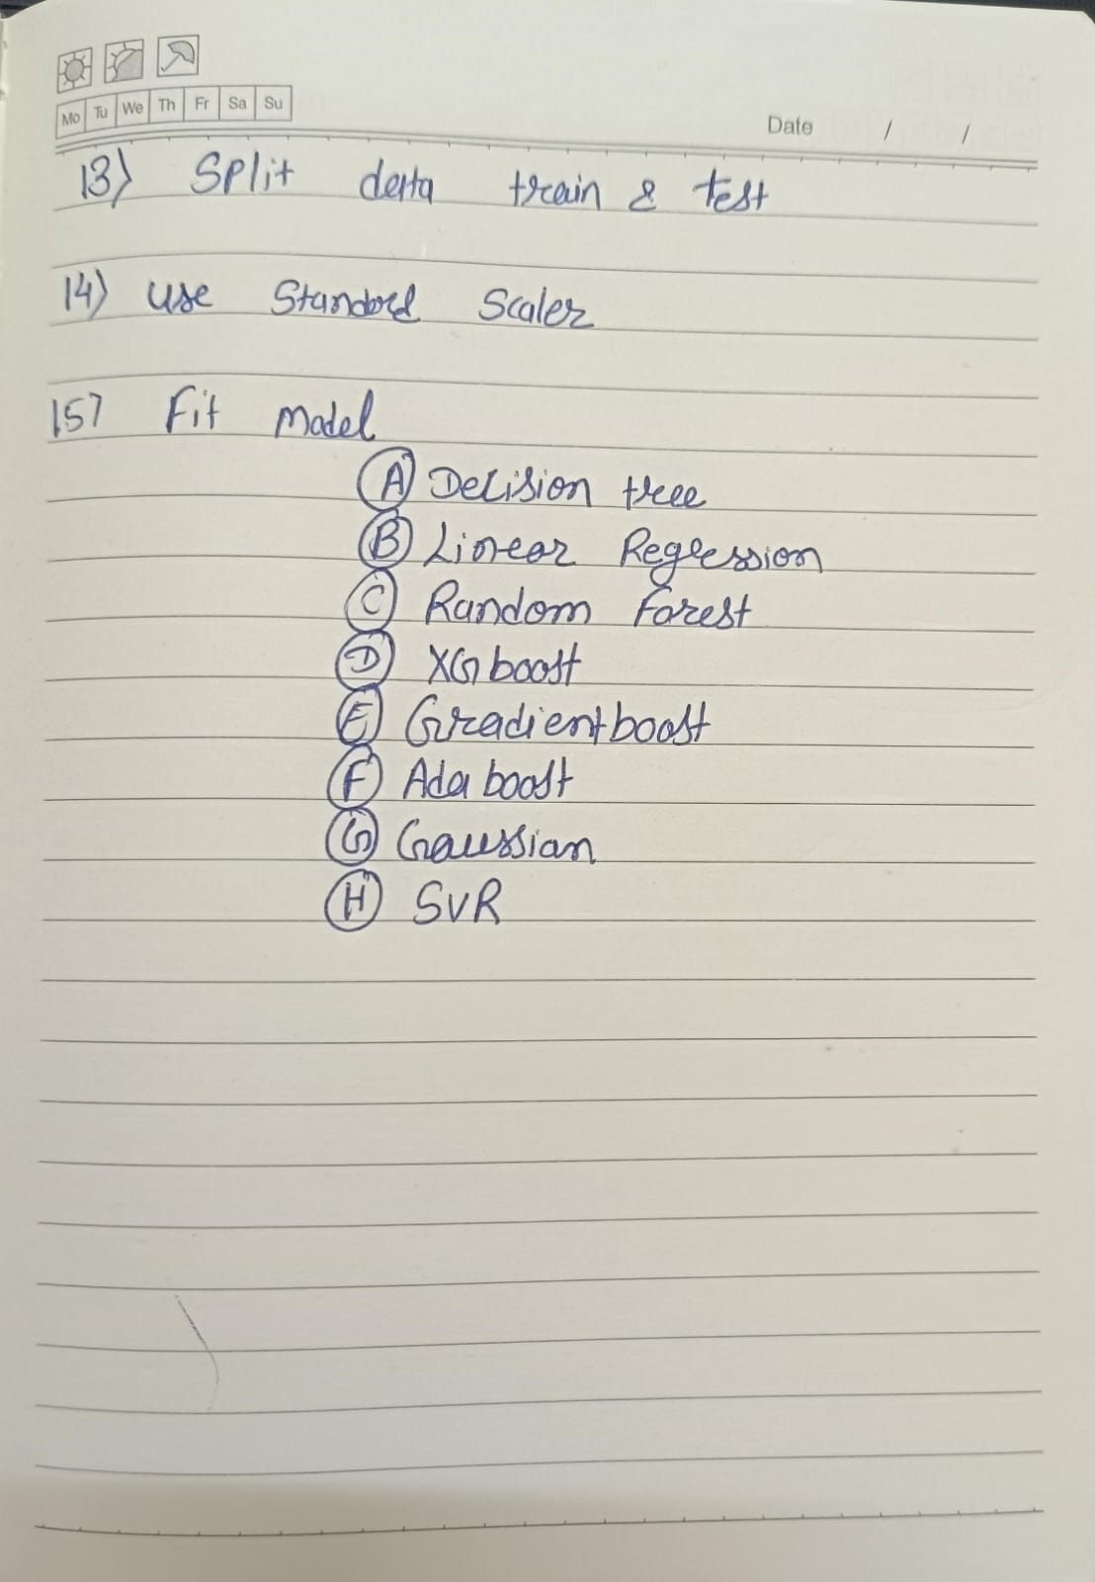

Slide 40
Conclusion
Improving supply chain efficiency plays a crucial role in any business. Operating their businesses in challenging profit margins, any type of process improvement can have a significant impact on the bottom line. Innovative technologies such as machine learning make it easier to manage the challenges of volatility and accurately forecast demand in global supply chains. Studies predict that at least 50% of global companies in supply chain operations will use transformative technologies related to AI and ML by 2023. This speaks to the growing popularity of machine learning in the supply chain industry. But, in order to take full advantage of machine learning, companies must plan for the future and begin investing in machine learning and related technologies today to benefit from increased profitability, efficiency, and resource availability in the supply chain industry.

Slide 41


