Slide 1
Dataset Info:
Credit Card Fraud Detection dataset by Kaggle: Credit Card Fraud Detection
Highly unbalanced dataset: only 0.172% transactions are TP
Only numerical inputs available: data transformed with PCA
Binary Classification of data

Slide 2
Things to keep in mind:
To look at balanced accuracy
Recall > Precision
Overfitting
Oversampling or Undersampling

Slide 3
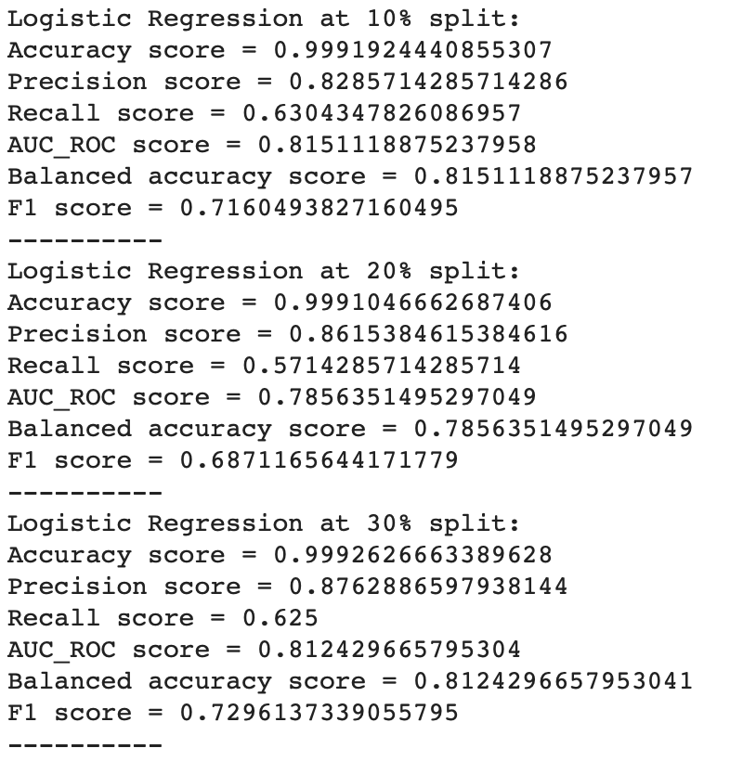
Machine Learning Techniques:
Logistic Regression
Full Data Result

Slide 4
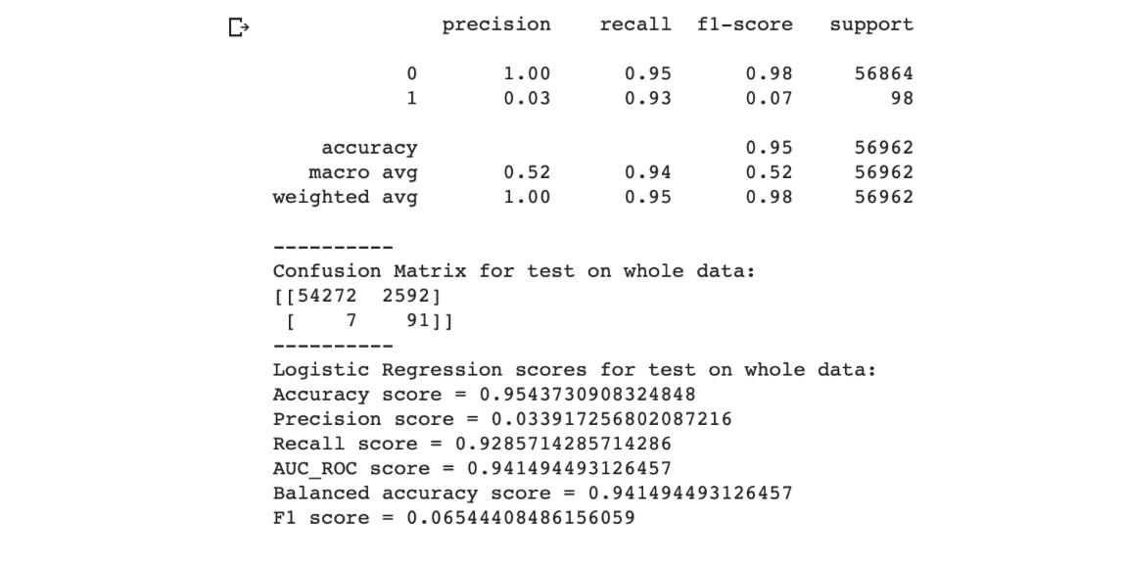
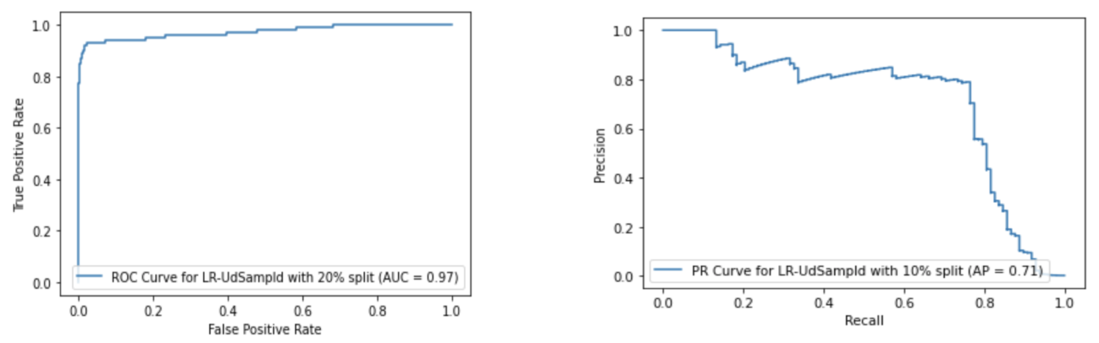
Machine Learning Techniques:
Logistic Regression with Undersampling

Slide 5
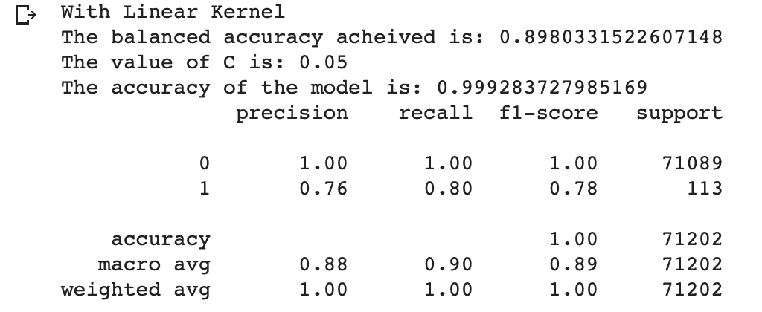
Machine Learning Techniques:
SVM Base Model

Slide 6
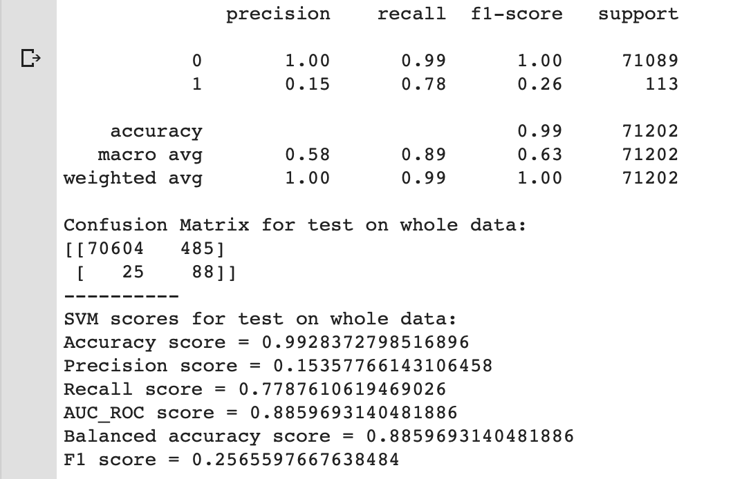
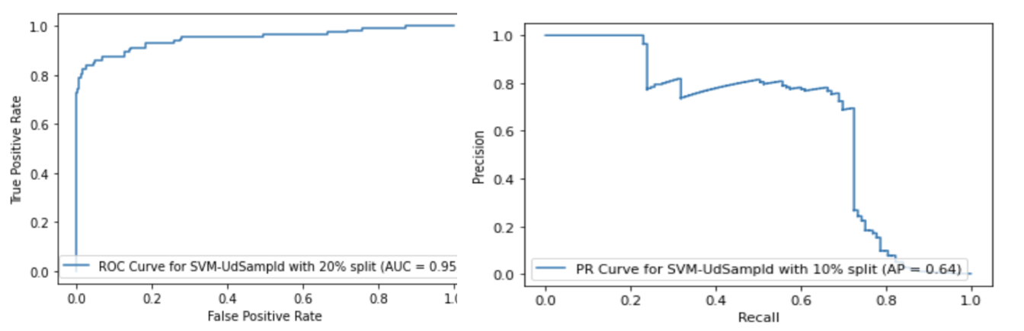
Machine Learning Techniques:
SVM with Undersampling

Slide 7
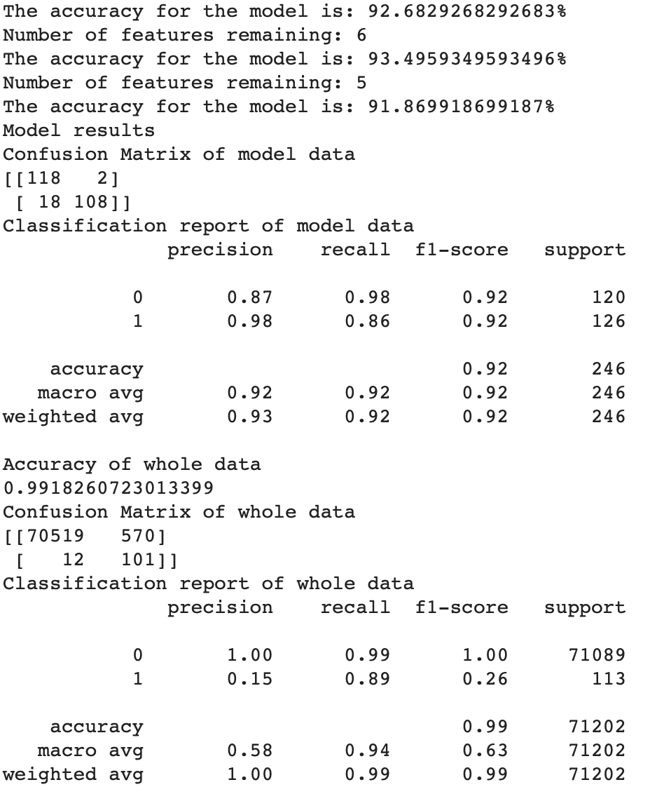
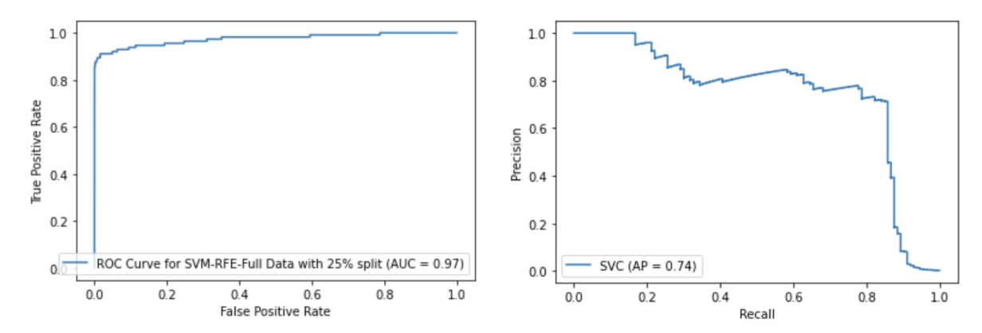
Machine Learning Techniques:
SVM with Recursive Feature Elimination (RFE)

Slide 8
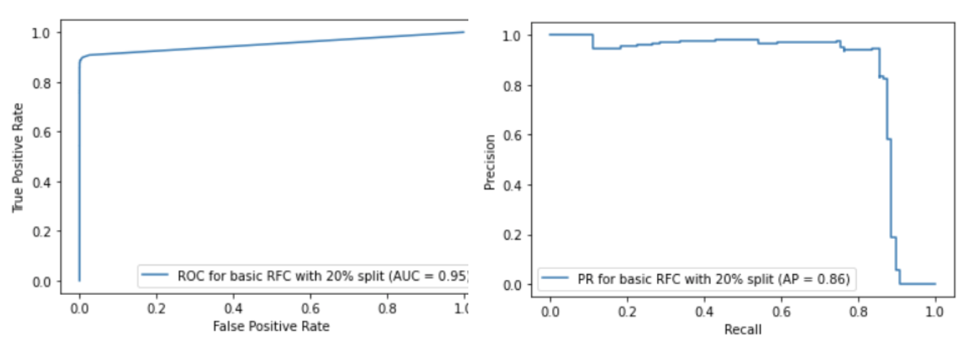
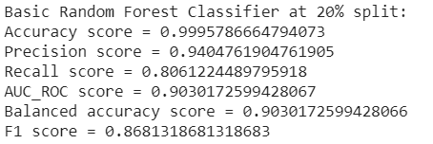
Machine Learning Techniques:
Random Forest Base Model

Slide 9
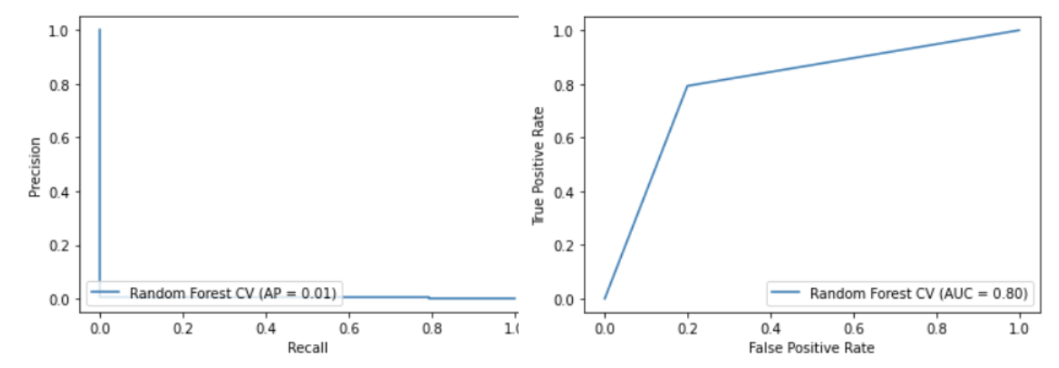
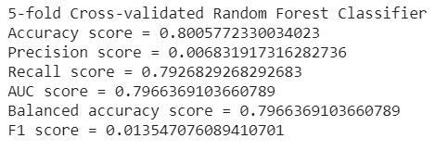
Machine Learning Techniques:
Random Forest with Cross-Validation

Slide 10
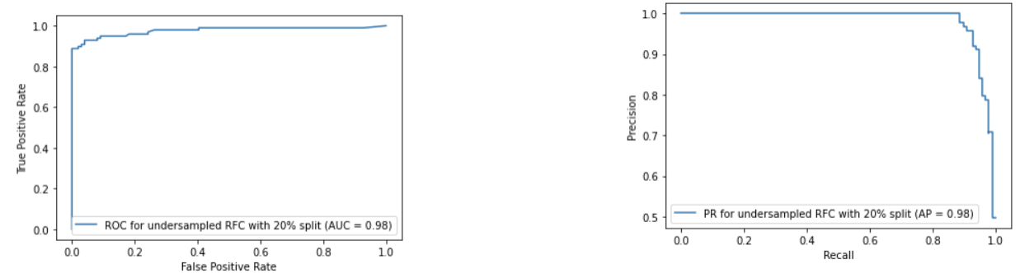
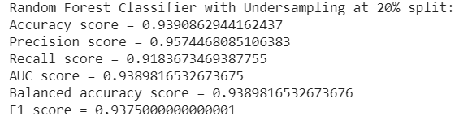
Machine Learning Techniques:
Random Forest with Undersampling

Slide 11
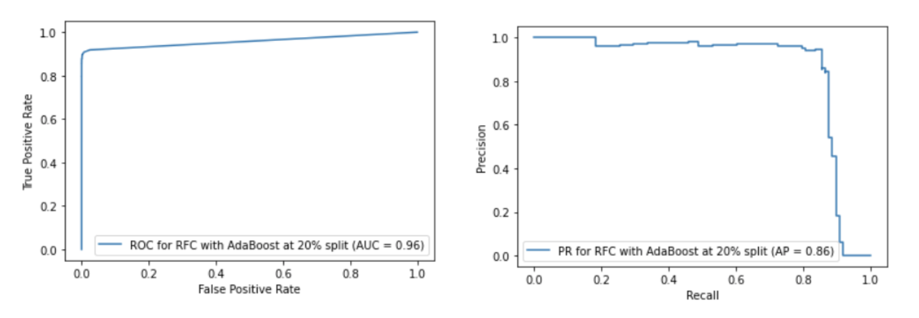
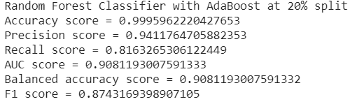
Machine Learning Techniques:
Random Forest with AdaBoost

Slide 12
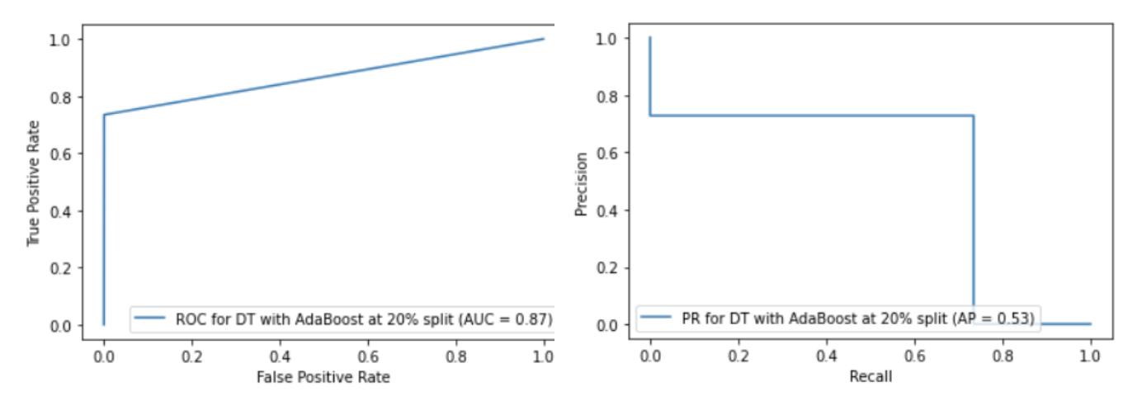
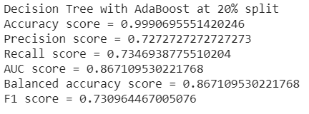
Machine Learning Techniques:
Decision Tree with AdaBoost

Slide 13
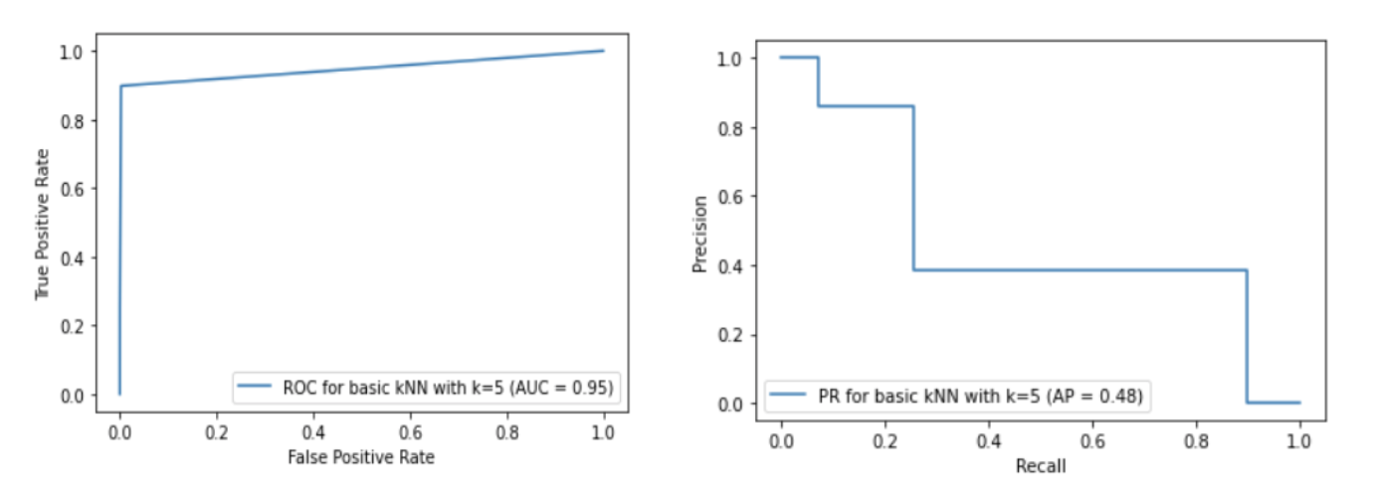
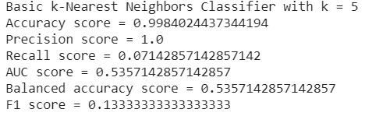
Machine Learning Techniques:
kNN

Slide 14
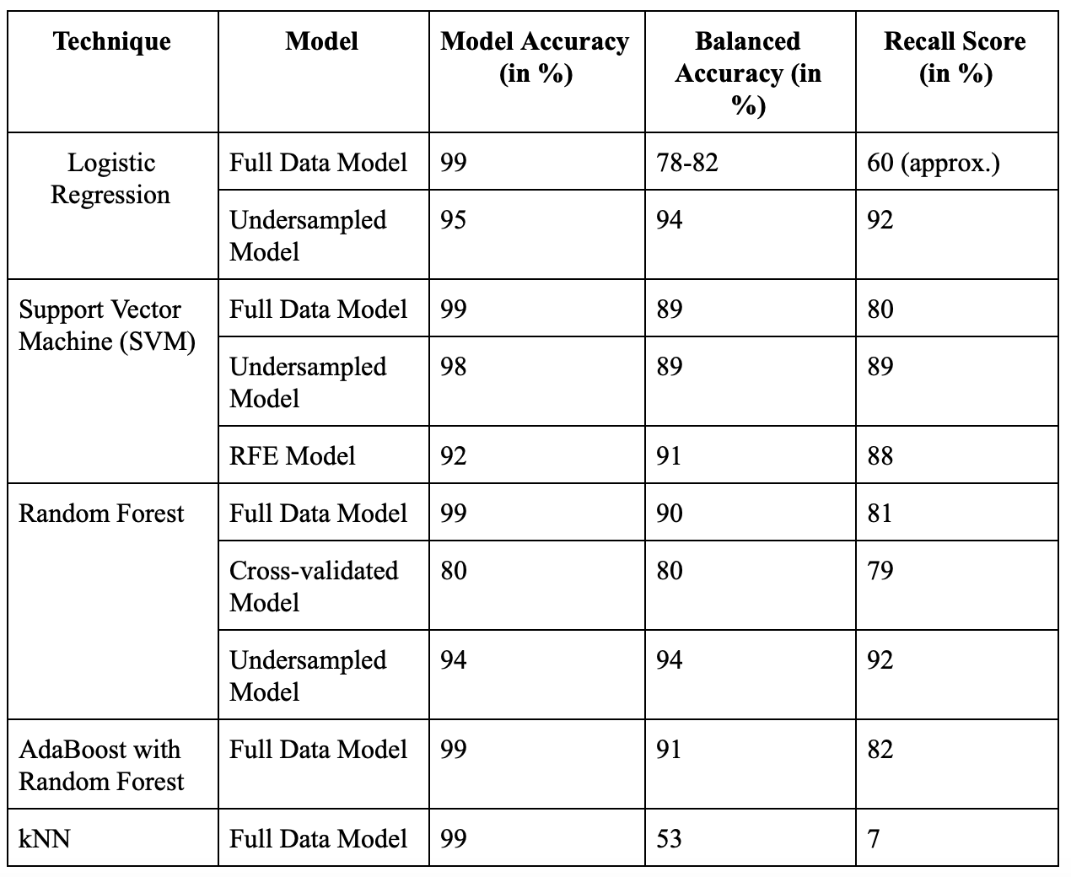
Results:

Slide 15
Conclusion:
Logistic Regression and Random Forest work best
Similar recall and balanced accuracies
Undersampling works better
Most features with little impact (RFE)
Little impact of AdaBoost
k-NN inefficient for this problem

Slide 16
Future Work:
Use of the following techniques
Undersampling (Tomken Links)
Oversampling (SMOTE)
Neural Networks (MLP)

