Slide 1
Action Spotting in Football Matches
M.Sc. Data science, Major Project
Prepared by
Yash Uday Sule (N1040923)
Under the kind guidance of
Dr. Ismahane Cheheb

Slide 2
Outline
Aim and Objectives
Background Information
Interpretation of Video
Adopted Methodology
Tools Used
Structure of Dataset
Train, Test and Valid Datasets (Features and Labels)
Deep Learning Models and its Architecture
Results
Conclusion and Challenges
Future Work

Slide 3
Aim and Objectives
Aim: The project aims to study the existing state-of-art deep learning algorithms for action spotting and developed deep learning model for detecting events in football matches by using different metrics to compute the accuracy for the developed model.
Objectives
To carry out an extensive background research of the topic “Video Understanding”.
Understanding the approaches and their methodologies for the current state-of-art algorithms.
Reviewing and reporting the short comes of the previous state-of-art algorithms.
Developing new artificial intelligence model based on deep learning techniques.
Comparing and analysing the different outcomes of the model being implemented by using different performance metrics to calculate the model accuracy.

Slide 4
Background Information
Why the project is important?
In computer vision, the area of Video understanding is growing and is quite challenging also. Videos related to football games in which spotting action events like “goals”, “substitutions” and “cards” across each video frame is quite difficult due to their sparse nature.
If efficient deep learning models are developed to captured important actions like “goals”, “substitutions”, “cards”, “penalties” from football matches videos, then it will lead to automate the process of generating highlights of the football matches.
What problem the project solves?
The designed deep learning models can detect among the video frames of football matches which one are action frames and which are non – action frames.

Slide 5
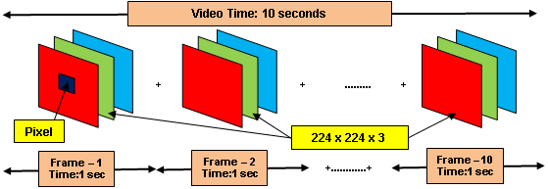
Interpretation of ViDEO
For this project, pre – extracted features using ResNET, C3D and I3D approach were used to design deep learning models. Because of which, these features are now required to pass from the pooling layers and finally through the fully connected layer to predict the outcomes.

Slide 6
Adopted Methodology
The general pipeline of designing deep neural networks using pooling techniques is as follows:
Step – 1: Extracting features from videos or images.
Step – 2: Assigning annotations for those features.
Step – 3: Applying Pooling Techniques to obtain new reduced feature matrix.
Step – 4: Passing newly obtained reduced feature matrix to the fully-connected layers.
Step – 5: Adding activation functions, dropout and output layers.
Step – 6: Compiling the model with the set parameters.
Step – 7: Train the designed deep neural network model and predict the outcomes.
Step – 8: Evaluate the performance of the model.
Step – 9: Plot necessary graphical visualizations as per the problem domain.
Max Pooling
Average Pooling
Mixed Pooling
NetVLAD Pooling

Slide 7
Tools Used
Microsoft Word: For writing the report of Major Project.
Microsoft PowerPoint: For creating Major project presentation.
Microsoft Excel: For understanding the statistics of dataset and recording experimental results.
Kaggle: For building deep learning models using Python Programming Language.
Microsoft Teams: For recording the video of the presentation.
Python Libraries Used | Purpose
os | For navigating through different folders which are present in the operating system.
json | For handling json files (In this project, Labels are in json format)
numpy | For performing numerical computations
tenserflow, keras | For developing deep learning models
matplotlib.pyplot, seaborn | For visualization
sklearn.metrics | For measuring the accuracy of the models

Slide 8
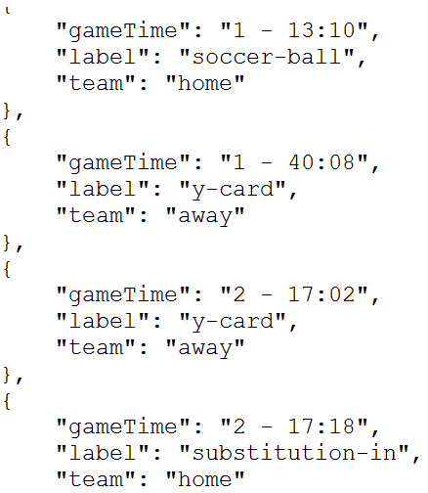
Structure of DataSet
Link to the Dataset:
Features: https://drive.google.com/drive/folders/1fYtz4rK2gkMTav4_JjZmA0ER42-rV1_s
Labels: https://drive.google.com/drive/folders/1ffjX0QU1MdPArsg-Ejm4ACp_CCa4lmFK
SoccerNet- v1 (EPL - 95 games)
2014/15
2016/17
2015/16
Game 2 - 6 (Adopted the same structure as Game 1)
ResNET / ResNET_512
2nd half
I3D / I3D_512
C3D / C3D_512
ResNET / ResNET_512
1st half
Features
Game 1: 2015-02-21 - 18-00 Chelsea 1 - 1 Burnley
C3D / C3D_512
I3D / I3D_512
Labels
Game | Game Name | Features | Labels
1 | 2015-02-21 - 18-00 Chelsea 1 - 1 Burnley | 12 | 1
2 | 2015-02-21 - 18-00 Crystal Palace 1 - 2 Arsenal | 12 | 1
3 | 2015-02-21 - 18-00 Swansea 2 - 1 Manchester United | 12 | 1
4 | 2015-02-22 - 19-15 Southampton 0 - 2 Liverpool | 12 | 1
5 | 2015-05-17 - 18-00 Manchester United 1 - 1 Arsenal | 12 | 1
6 | 2015-04-11 - 19-30 Burnley 0 - 1 Arsenal | 12 | 1
 | Total | 72 | 6
Features (.npy format)
Among the 72 features files, the files with an extension “***_PCA512” were used for developing deep learning models. Therefore, in-total 36 features files were used.
Labels (.json format)

Slide 9
Train, Test and Valid Dataset (Features and Labels)
Dataset | Total Games
Training Games | 4
Test Game | 1
Valid Game | 1
Matrix | ResNET Approach |  |  | C3D Approach |  |  | I3D Approach
 | Rows | Columns | Labels | Rows | Columns | Labels | Rows | Columns | Labels
Train_game | 44646 | 513 | 49 | 44638 | 513 | 49 | 44606 | 513 | 49
Test_game | 11486 | 513 | 9 | 11484 | 513 | 9 | 11476 | 513 | 9
Valid_game | 11246 | 513 | 6 | 11244 | 513 | 6 | 11236 | 513 | 6
Splitting Percentage
Train | 44646 | 66%
Test | 11486 | 17%
Valid | 11246 | 17%
Total | 67378 | 100%
Splitting Percentage
Train | 44638 | 66%
Test | 11484 | 17%
Valid | 11244 | 17%
Total | 67366 | 100%
Splitting Percentage
Train | 44606 | 66%
Test | 11476 | 17%
Valid | 11236 | 17%
Total | 67318 | 100%
Classification | Labels
No Action | 0
Action | 1

Slide 10
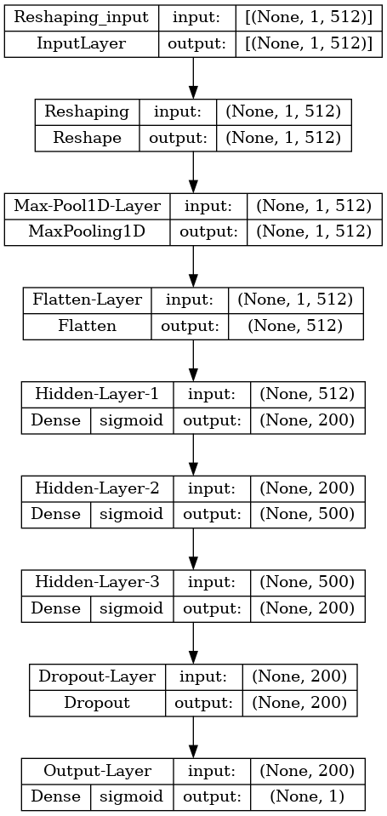
Deep Learning Models AND Its archiecture
Average Pooling
Mixed Pooling
NetVLAD Pooling
 |  | Approaches
 |  | ResNET | C3D | I3D | Total
Pooling Techniques | Max | 1 | 1 | 1 | 3
 | Average | 1 | 1 | 1 | 3
 | Mixed | 1 | 1 | 1 | 3
 | NetVLAD | 1 | 1 | 1 | 3
 | Total | 4 | 4 | 4 | 12

Slide 11
Results
Summarized results obtained after running each model 5 times and then performing an average over each of precision, recall, f1-score and accuracy for respective model over each feature.
 |  | ResNET
 |  | Precision | Recall | F1 Score | Accuracy
Pooling Technique | Max | 0.50108 | 0.6785 | 0.4605 | 0.84568
 | Average | 0.50094 | 0.672664 | 0.44938 | 0.8118
 | Mixed | 0.50132 | 0.73238 | 0.45308 | 0.82054
 | NetVLAD | 0.50072 | 0.57852 | 0.48502 | 0.93428
 |  | C3D
 |  | Precision | Recall | F1 Score | Accuracy
Pooling Technique | Max | 0.50098 | 0.7534 | 0.42314 | 0.72906
 | Average | 0.50068 | 0.66828 | 0.43268 | 0.75872
 | Mixed | 0.50088 | 0.65728 | 0.4542 | 0.82546
 | NetVLAD | 0.50096 | 0.62432 | 0.46724 | 0.87048
 |  | I3D
 |  | Precision | Recall | F1 Score | Accuracy
Pooling Technique | Max | 0.50396 | 0.69274 | 0.4987 | 0.9629
 | Average | 0.50244 | 0.63296 | 0.48714 | 0.9325
 | Mixed | 0.50064 | 0.60666 | 0.48756 | 0.94618
 | NetVLAD | 0.50344 | 0.58092 | 0.5026 | 0.98348
Best Models: ResNET features with NetVLAD pooling and I3D features with NetVLAD pooling.
Worst Models: ResNET features with Mixed pooling and C3D features with Max pooling.
An average perform was given by other models.

Slide 12
Conclusion
The ideology was to understand and study new emerging topic “Action spotting” in sporting videos related to the game of football.
Developed an artificial intelligence system that can detect if a given video frame is an action frame or a non – action frame which can further be utilized for action localization tasks.
Among the 12 models, 2 models performed better and 2 models performed worst, rest of the 8 models gave average performance.
For evaluation of models, performance metrics such as Precision, Recall and F1 – score were used.
Overall, a lot of improvement in terms of model parameters is required to achieve good results.

Slide 13
Challenges
Hardware limitations: Instead of extracting own features from the videos, pre – extracted features had to be used as an input for the designed deep learning models.
Decoding the relation between features and labels since both were having different file formats.
Understanding of different pooling mechanisms.
Generation of train, test and valid datasets.
Performing almost 60 experiments (5 per model) and markdown all the outcomes to determine which models outperforms among the 12 models.

Slide 14
Future Scope
Extracting own features from the video of football games that are available in SoccerNet Dataset and developing deep learning models using RNN and CNN.
Use of hyperparameter tunning for the developed deep learning models.
Apply the concept of Transfer learning by taking videos of football matches as an input and developed new deep learning models by changing last few layers as per the output requirements.

Slide 15


