Slide 1
S
I
G
N
LANGUAGE
RECOGNITION
SYSTEM
By:
  YASH RAJ SUMAN (2103064)
  Btech CSE

Slide 2
PROBLEM STATEMENT

Slide 3
Population of India
People with Disabilities
People with Hearing & Speaking Disability
More than 1.3 Crore
People with Problem

Slide 4




SCENARIO
DON’T KNOW
WHAT SHE TELLING ??
USES SIGN LANGUAGE
PEOPLE DON’T KNOW SIGN LANGUAGE
PERSON WHO CAN’T SPEAK

Slide 5


ONLY 1 IN 20 PEOPLE CAN INTERPRETER SIGN LANGUAGE
Certified Interpreters

Slide 6
SOLUTION

Slide 7
SIGN LANGUAGE RECOGNITION SYSTEM
USING MACHINE LEARNING AND DEEP LEARNING MODEL TO UNDERSTAND SIGN LANGUAGE

Slide 8
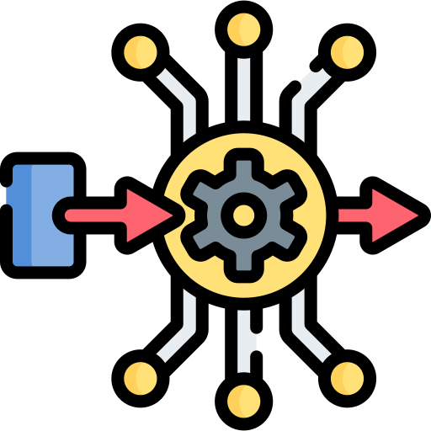
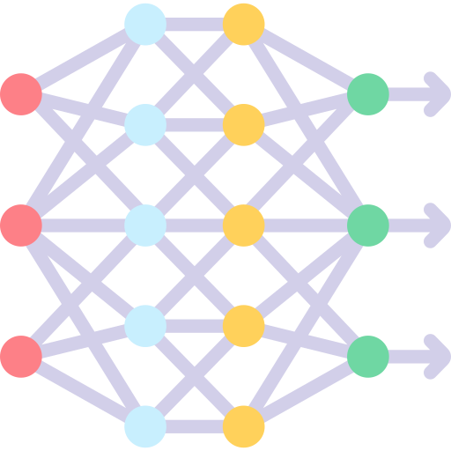

PREVIOUS SENARIO
SHE IS ASKING FOR DIRECTION
SIGN LANGUAGE RECOGNITION SYSTEM
USES SIGN LANGUAGE
IMAGE PROCESSING
FEATURE EXTRACTION
CLASSIFICATION
INTERPRETATION
PEOPLE DON’T KNOW
SIGN LANGUAGE
PERSON WHO CAN’T SPEAK

Slide 9



MAJOR ADVANTAGE & BENEFITS
Easy to use
Widely available
Inexpensive
Don’t need any prior knowledge or new training to use the system
Can be used any time, anywhere , by anybody
Don’t required any cost to use the system

Slide 10
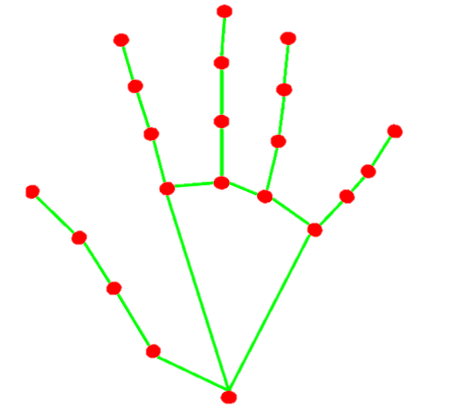

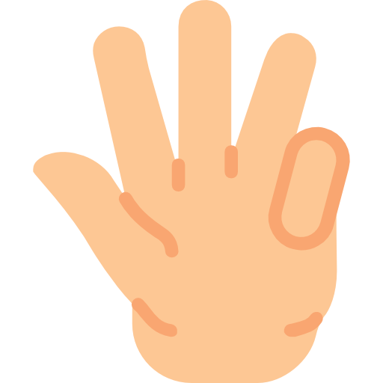





WORKING
INTERPRETATION
IMAGE PROCESSING
Once the hand sign is classified, the system interprets the meaning of the detected sign based on a predefined sign language dictionary or database.
The captured image undergoes preprocessing techniques such as noise reduction, image enhancement, and normalization to improve the quality and clarity of the hand sign.
04
01
The extracted features are then used to classify the hand sign into a specific category or class. Machine learning algorithms, such as deep neural networks or random forest classification are commonly used for classification.
In this stage, relevant features are extracted from the preprocessed image, such as landmarks, or motion information. These features help to differentiate different hand signs.
03
02
CLASSIFICATION
LANDMARK DETECTION

Slide 11
MODEL EVALUATION

Slide 12
SIGN ALPHABETS
A
B
C
D
E
F
G
H
I
J
K
L
M
N
O
P
Q
R
S
T
U
V
W
X
Y
Z

Slide 13
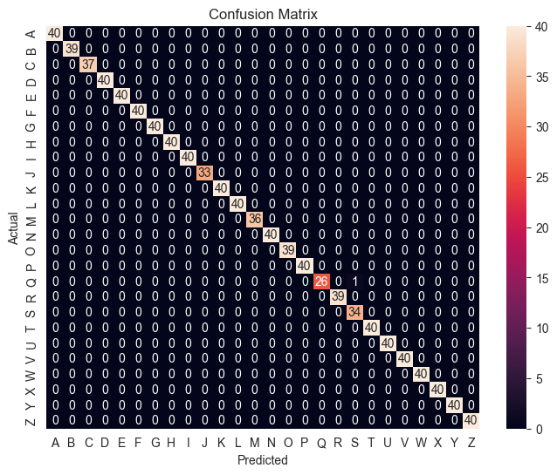
CONFUSION MATRIX

Slide 14
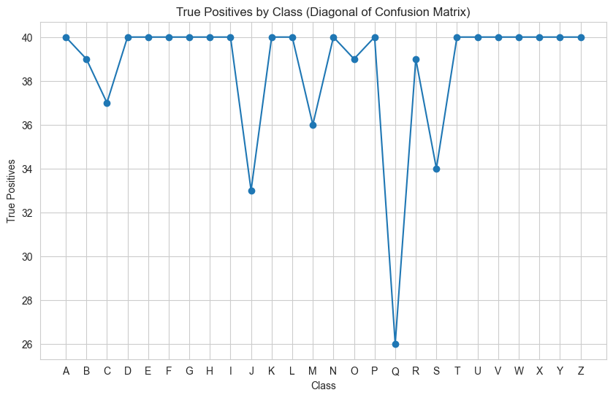
UNDERSTANDING
CONFUSION MATRIX

Slide 15
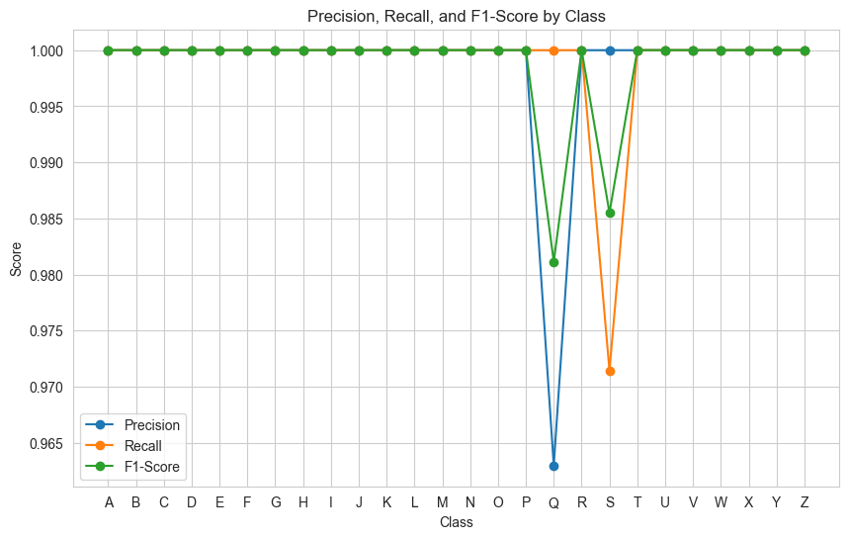
PRECISION,RECALL,
F1-SCORE

Slide 16
CONCLUSION
Above 95%
PRECISION,RECALL, F1-SCORE
Nearly 97%
Of the classes get predicted accurately
25+ Gestures
Can be easily recognized

Slide 17
T
H
A
N
K
Y
O
U

