Slide 1
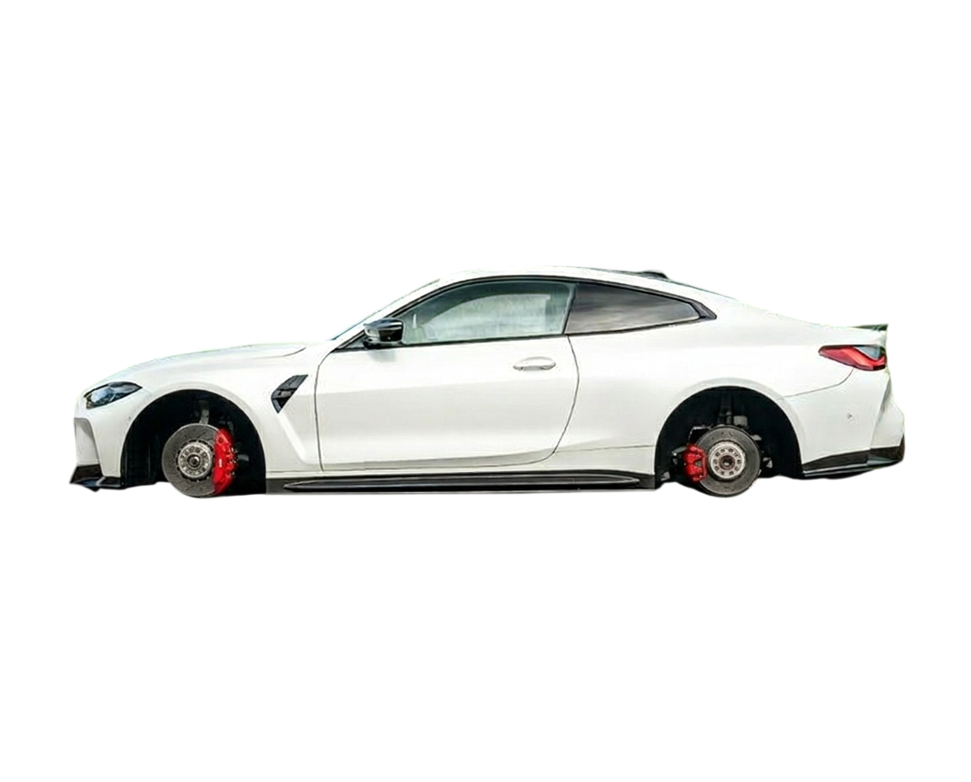

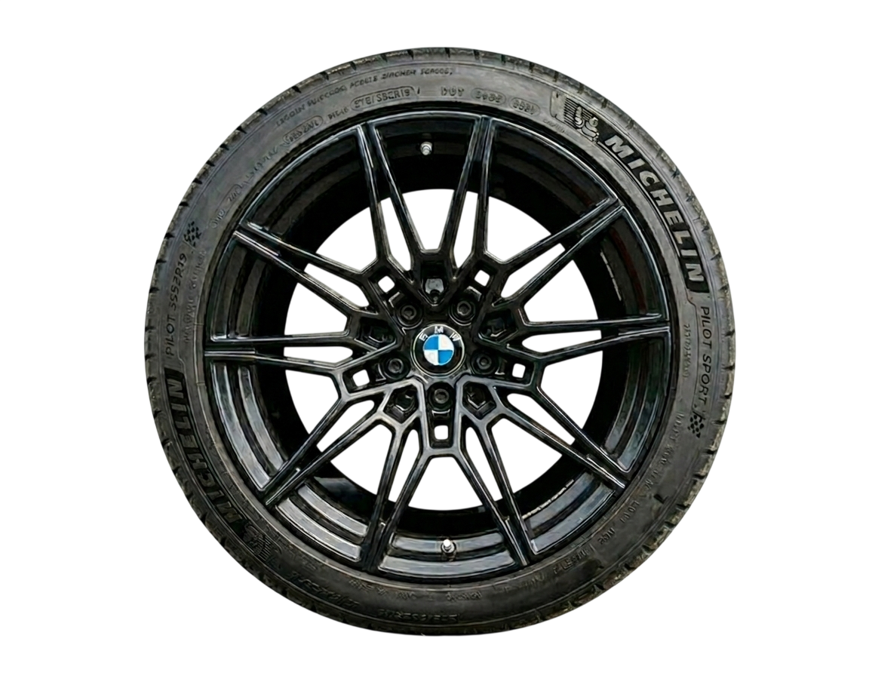
BMW i5
BMW i5
Precision meets power. 0–100 km/h in 3.8s · Dual Motor AWD · 520 km range

Slide 2
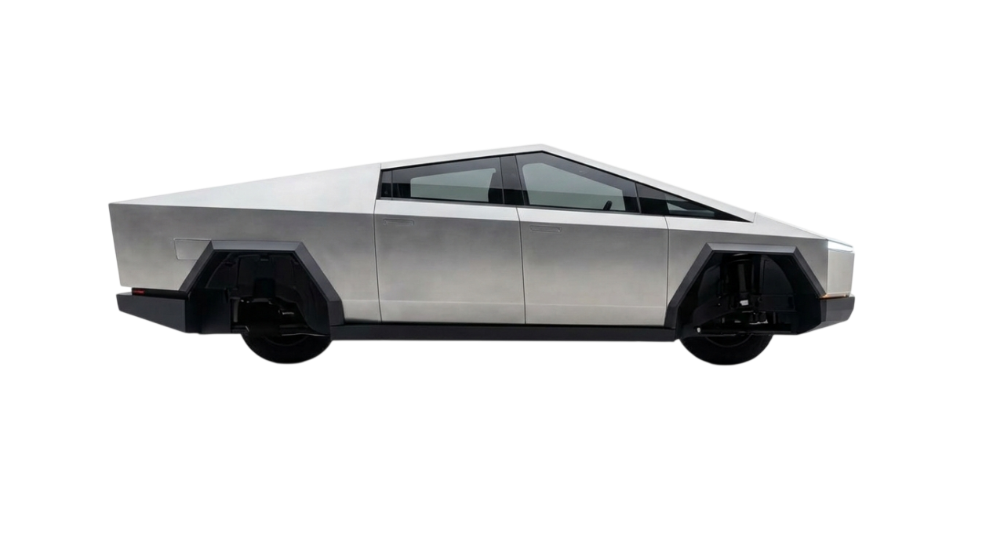
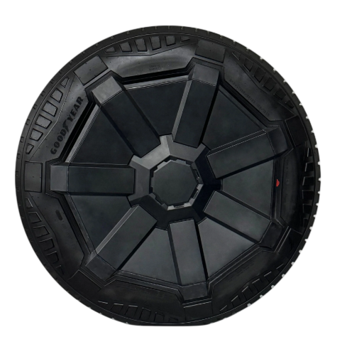
Cyber
Cyber
BMW i5
BMW i5
truck
truck
Precision meets power. 0–100 km/h in 3.8s · Dual Motor AWD · 520 km range
Rugged design. Unlimited capability. 580 km range · AWD · Ultra-durable body

Slide 3
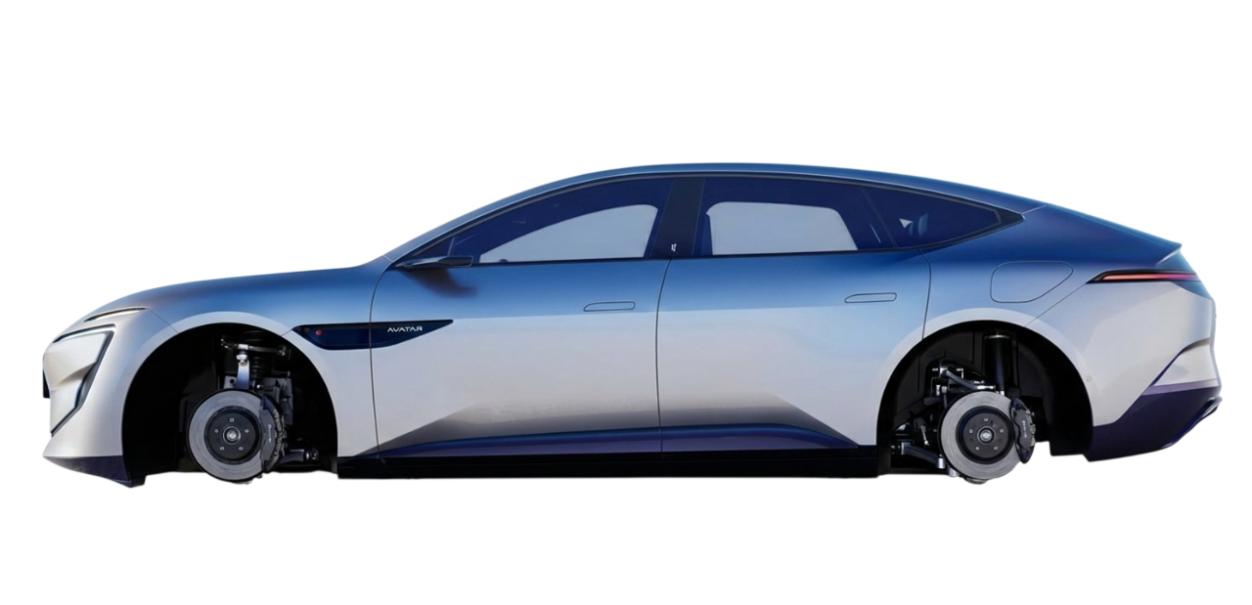
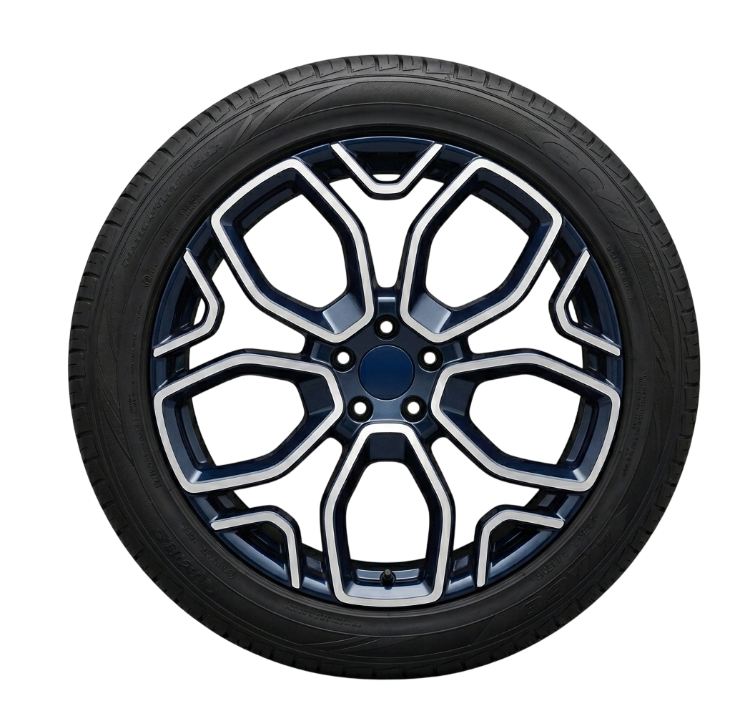
Cyber
Cyber
Avatr 12
BMW i5
Avatr 12
BMW i5
truck
truck
Rugged design. Unlimited capability. 580 km range · AWD · Ultra-durable body
Precision meets power. 0–100 km/h in 3.8s · Dual Motor AWD · 520 km range
Silent. Smart. Sophisticated. 610 km range · AI cockpit · Fast charge 30 min

Slide 4
Cyber
Cyber
Avatr 12
Avatr 12
BMW i5
BMW i5
truck
truck
Silent. Smart. Sophisticated. 610 km range · AI cockpit · Fast charge 30 min
Rugged design. Unlimited capability. 580 km range · AWD · Ultra-durable body
Precision meets power. 0–100 km/h in 3.8s · Dual Motor AWD · 520 km range

Slide 5
BMW i5
Avatr 12
Avatr 12
Silent. Smart. Sophisticated. 610 km range · AI cockpit · Fast charge 30 min
Precision meets power. 0–100 km/h in 3.8s · Dual Motor AWD · 520 km range

