Slide 1

C++ Library Management System
By Yash Tambade

Slide 2

Problem Statement
Libraries need a system to manage books efficiently. Manual management of books can cause problems such as:
Difficulty tracking issued books
Time-consuming record management
Errors in maintaining book information
Therefore, a simple digital system is required to manage library books using programming.

Slide 3
solution
To solve this problem, we developed a Library Management System using C++.
The program provides the following features:
Add new books to the library
Issue books to users
Return issued books
Display all available books
The system uses Object-Oriented Programming concepts such as classes and functions to manage book records.

Slide 4
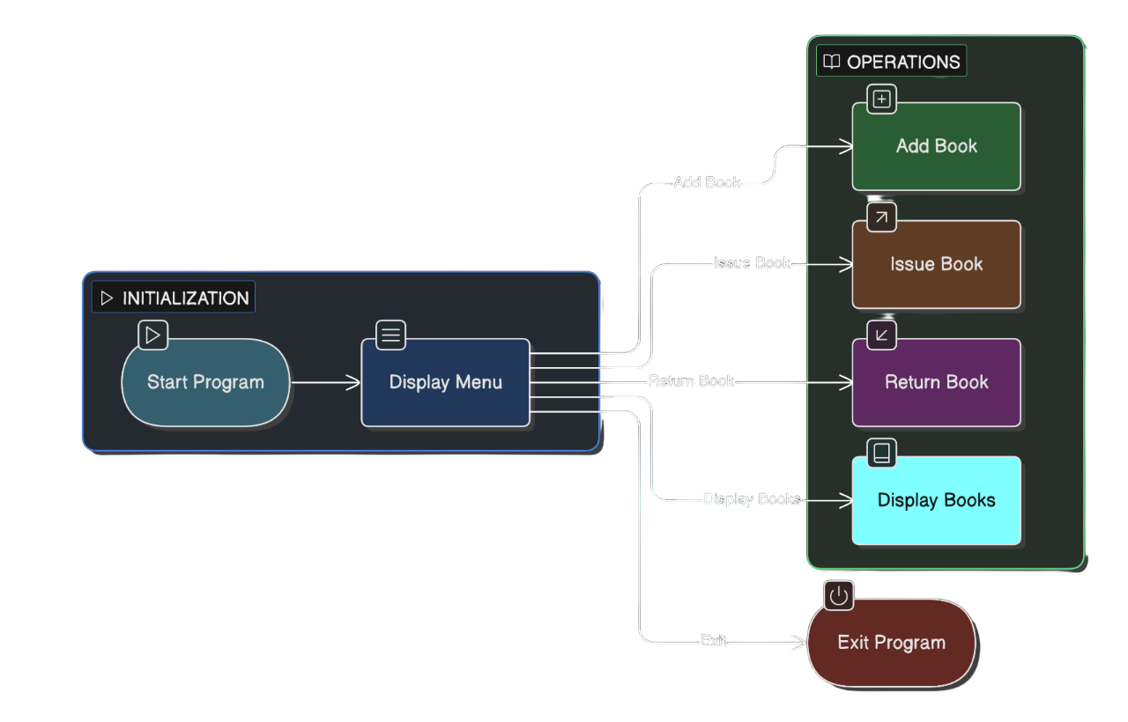
Working (Method/Mind map)
Key components used:
Class: Book
Attributes: ID, Title, Author, Issue Status
Functions: addBook(), display()

Slide 5
Conclusion
The Library Management System simplifies the process of managing books in a library.
Benefits of the system:
Easy to store book records
Simple issuing and returning process
Quick display of available books
Future improvements can include:
File storage or database integration
User login system
Graphical user interface (GUI)

Slide 6
Thank You…

