Slide 1



Contents
01
1. Introduction to Postman Lite
2. Working mechanism and code implementation
02
Javascript
Group-12 Demis Hassabis
03
3. Output and Project wrap-up

Slide 2
Contents
Postman Lite
1. Introduction to
01
1. Introduction to Postman Lite
2. Working mechanism and code implementation
02
03
3. Output and Project wrap-up
Javascript
Group-12 Demis Hassabis
Postman Lite is a lightweight tool to test REST APIs in the browser.
Works like Postman but no installation needed.
Helps students and developers quickly test API requests.

Slide 3
Contents
01
1. Introduction to Postman Lite
2. Working mechanism and code implementation
02
03
3. Output and Project wrap-up
Problem Statement for API Testing Tools
Postman Lite
1. Introduction to
Support sending GET, POST, PUT, and DELETE requests seamlessly.
01
Show status codes, response headers, and JSON output clearly
Postman Lite is a lightweight tool to test REST APIs in the browser.
Works like Postman but no installation needed.
Helps students and developers quickly test API requests.
Manage error messages effectively, including 404 Not Found.

Slide 4
Postman Lite
1. Introduction to
Problem Statement for API Testing Tools
Support sending GET, POST, PUT, and DELETE requests seamlessly.
01
02
02
Show status codes, response headers, and JSON output clearly
03
Manage error messages effectively, including 404 Not Found.
01
Postman Lite is a lightweight tool to test REST APIs in the browser.
Works like Postman but no installation needed.
Helps students and developers quickly test API requests.

Slide 5
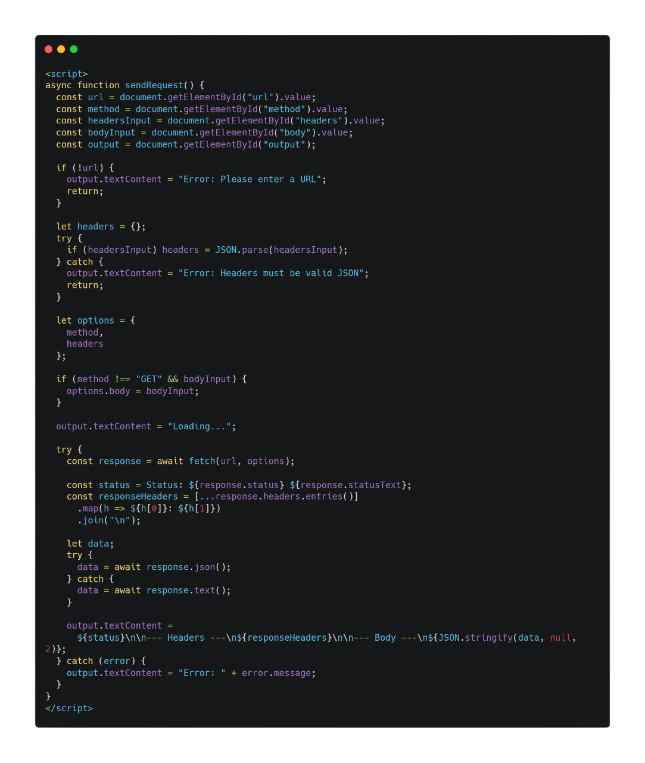
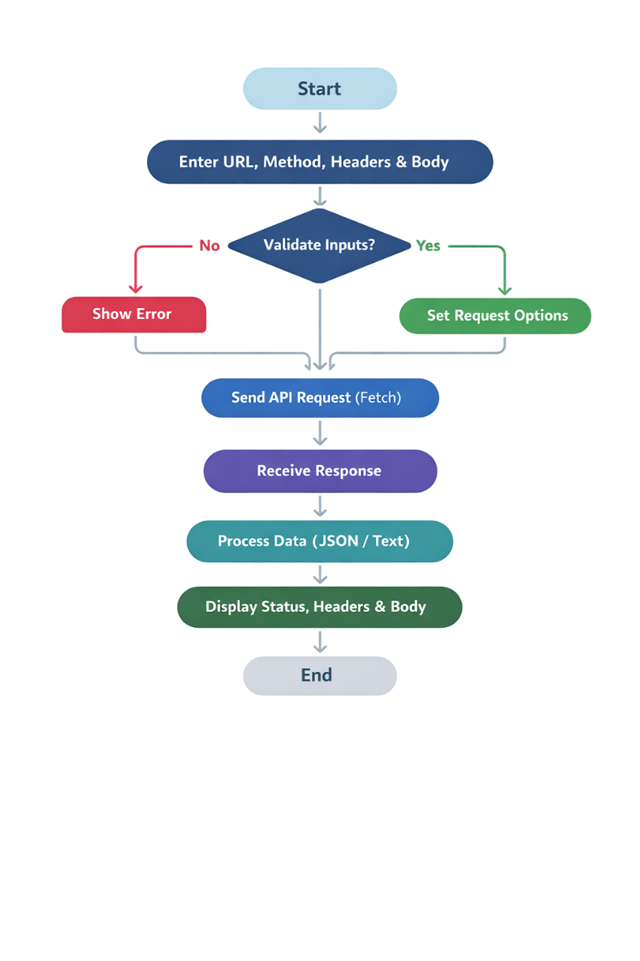
Code implementation
2. Working mechanism and
code implementation
02
Open tool in browser
Enter API URL
Choose HTTP method (GET/POST/PUT/DELETE)
Add headers/body if needed
Click Sen
Response shown with status + JSON
This JavaScript code is the core logic of Postman Lite. It reads the URL, HTTP method, headers, and body from the user and sends the request using Fetch API.
The response is displayed in the browser, showing:
Status code (e.g., 200 OK)
Response headers
Body (JSON or text)

Slide 6
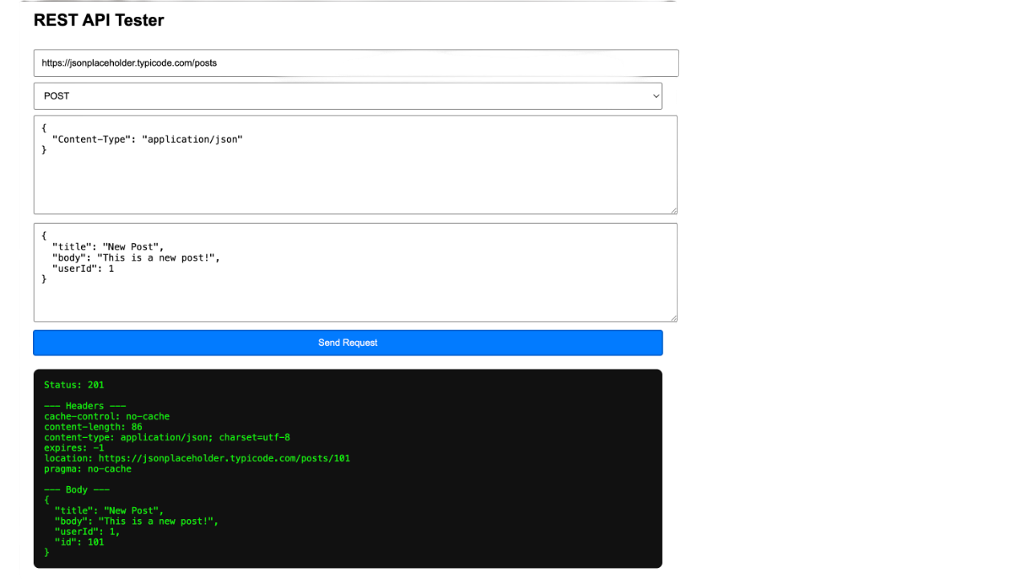
3. Output and Project wrap-up
Code implementation
This JavaScript code is the core logic of Postman Lite. It reads the URL, HTTP method, headers, and body from the user and sends the request using Fetch API.
The response is displayed in the browser, showing:
Status code (e.g., 200 OK)
Response headers
Body (JSON or text)

Slide 7
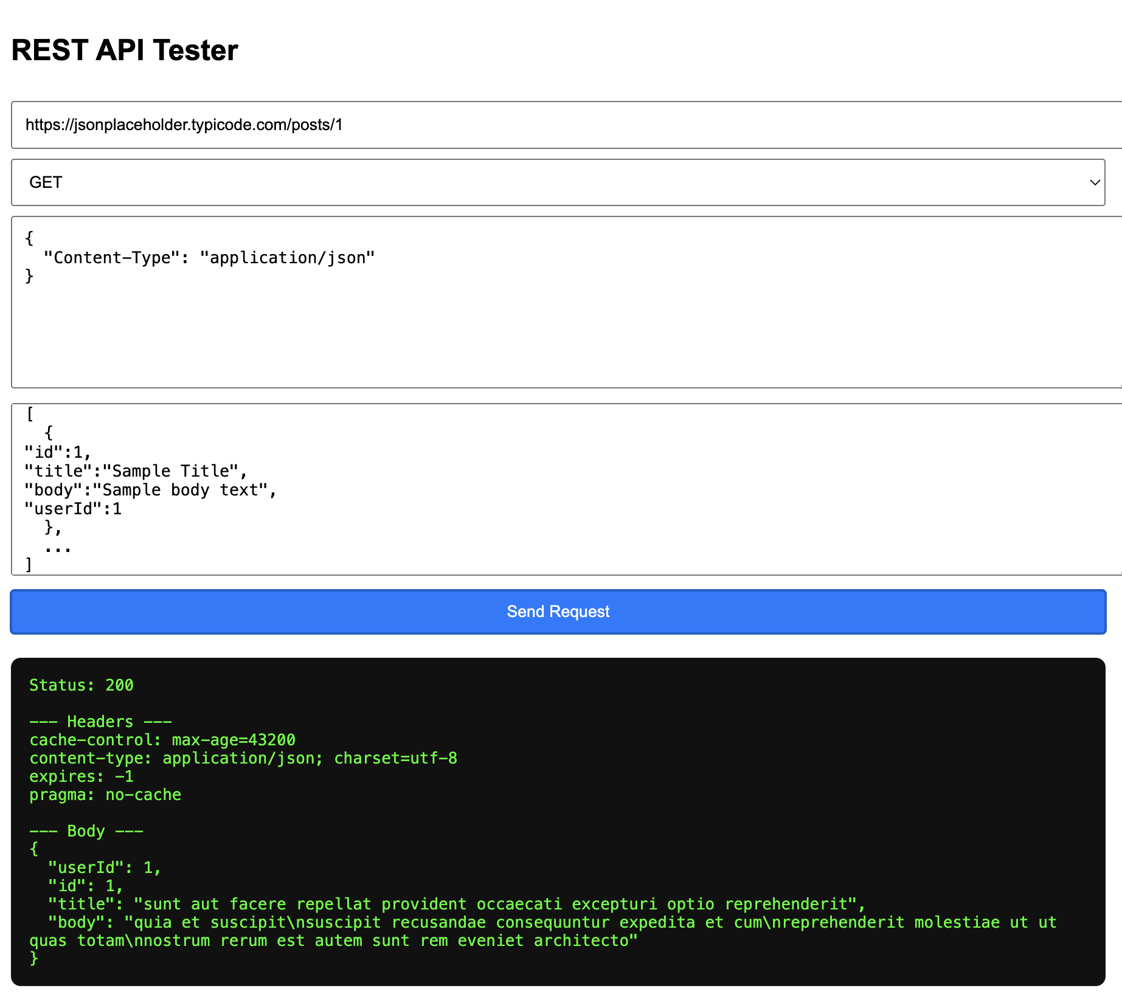
Code implementation
3. Output and Project wrap-up
Status: HTTP response code (e.g., 200 OK, 404 Not Found)
Headers: Key-value pairs from server response
Body: JSON or text data returned by the API
Errors: Clearly shown if the request fails
This JavaScript code is the core logic of Postman Lite. It reads the URL, HTTP method, headers, and body from the user and sends the request using Fetch API.
The response is displayed in the browser, showing:
Status code (e.g., 200 OK)
Response headers
Body (JSON or text)

Slide 8

Conclusion & Future Scope
3. Output and Project wrap-up
Conclusion :-
Postman Lite is a lightweight, browser-based API testing tool that allows users to send requests and view responses without installing any software. It helps students and developers quickly test APIs, understand responses, and debug errors efficiently.
Future Scope :-
Add request history to revisit past API calls
Implement dark mode for better UI
Support authentication (API keys, tokens)
Enable copy response feature for convenience
Enhance UI to be more Postman-like

Slide 9
Conclusion & Future Scope
Conclusion :-
Postman Lite is a lightweight, browser-based API testing tool that allows users to send requests and view responses without installing any software. It helps students and developers quickly test APIs, understand responses, and debug errors efficiently.
Future Scope :-
Add request history to revisit past API calls
Implement dark mode for better UI
Support authentication (API keys, tokens)
Enable copy response feature for convenience
Enhance UI to be more Postman-like
Thank You…

Slide 10
Thank You…

