Slide 1

Team Blue ~ Duck Hunt
Ashton Snelgrove
Jacob Sanders
Matthew D. Steadman
William G. Graham

Slide 2
Team Blue ~ Duck Hunt
2 Unique Instructions
  Every instruction except interupts, TBIT & SNXB
24-bit Color
NES Light Gun
2nd Player Duck Control

Slide 3
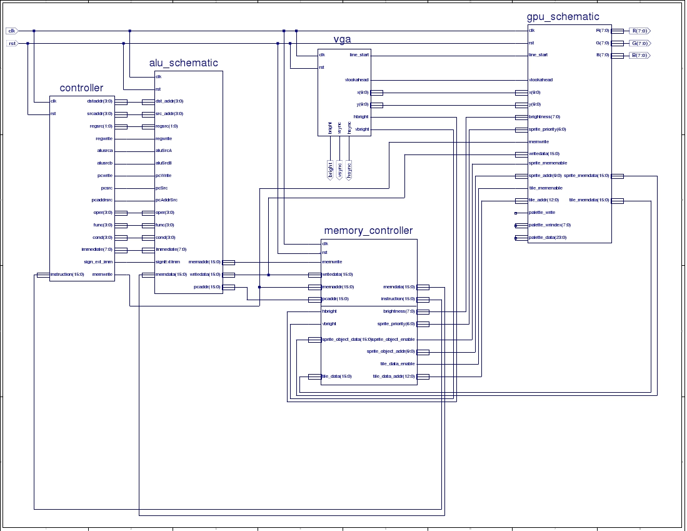
Top Level Schematic

Slide 4
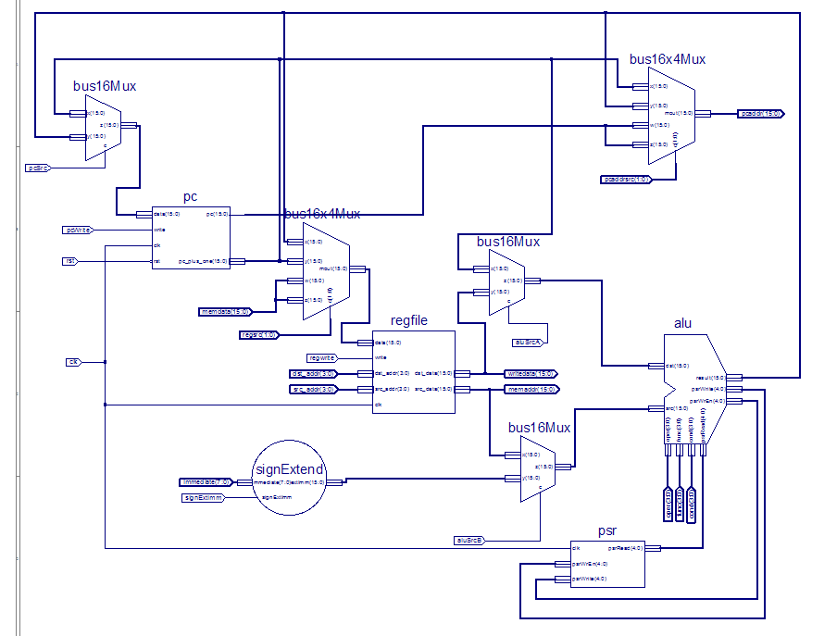
ALU Schematic

Slide 5
ALU Schematic
25,000,000 Instructions executed with no errors

Slide 6
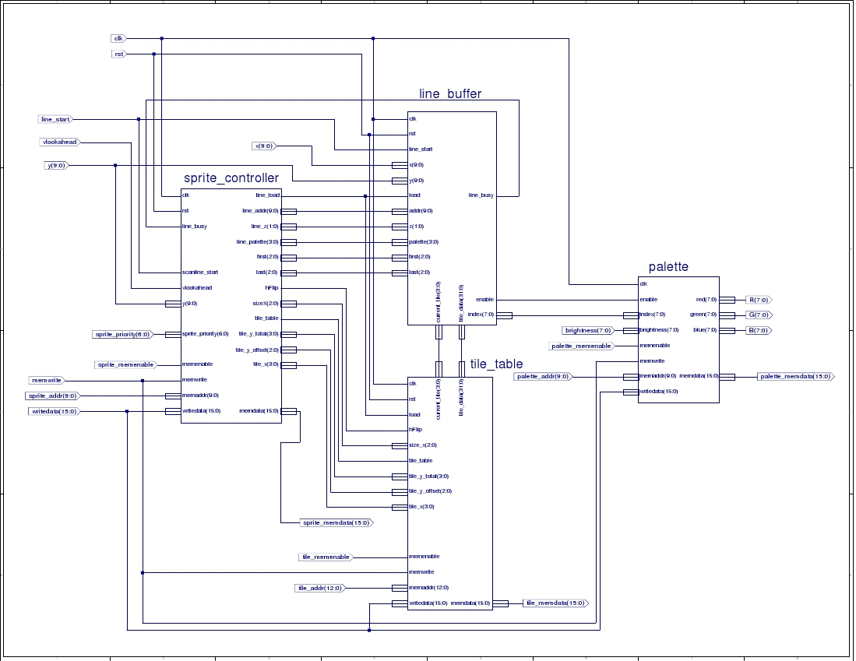
GPU Schematic

Slide 7
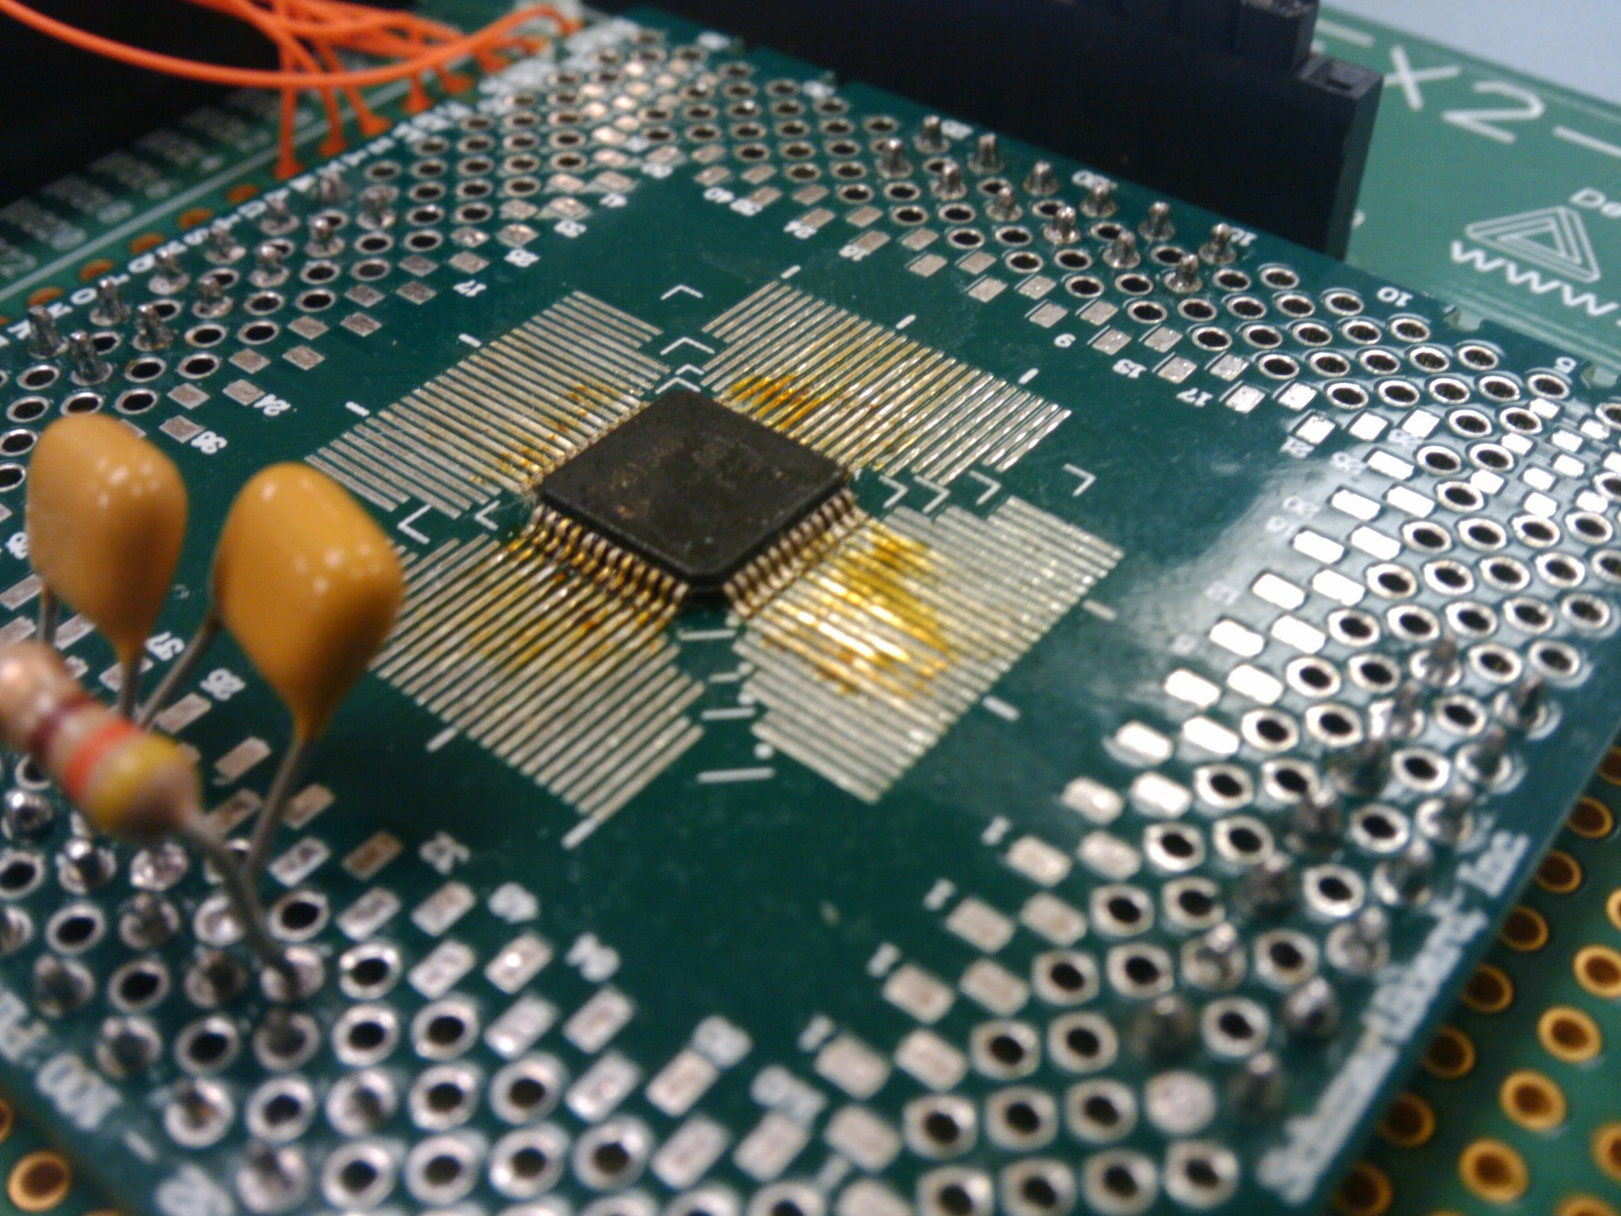
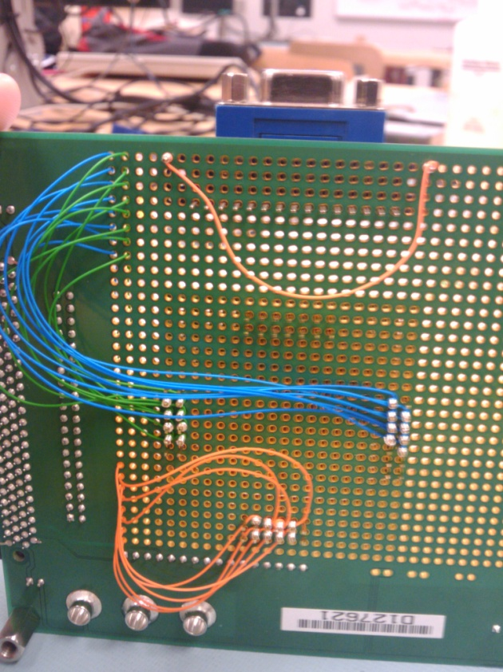
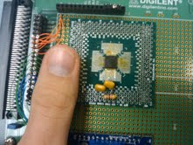
How did we get 24-bit color?

Slide 8
How we connected that tiny DAC to the board
Schamrt Board Video

Slide 9

Table
8x8 tiles 16 colors
15 colors are mapped to a 24-bit color in the color map
1 color is transparent
Allows for Super Nintendo Quality Graphics

Slide 10


Table

Slide 11
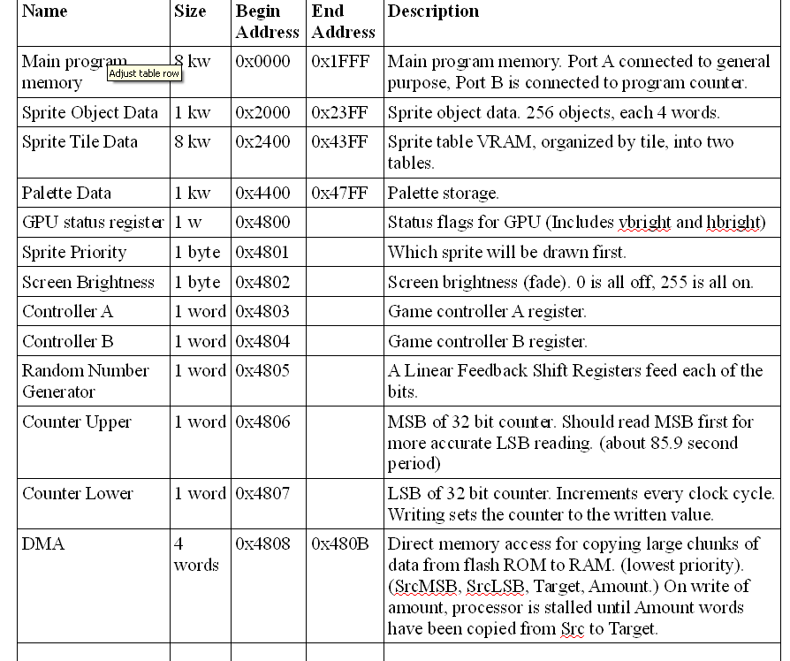
Memory Map

Slide 12
Assembler
Written in python, using tools LEX & YACC
LEX generates tokens
  Isolates segments of assembly lines creates tokens
  Counts instructions and data to calculate labels
YACC parses tokens
  Recognizes groups of tokens
  Passes to encoding stage
Python code generates bytecode

