Slide 1

Team : NoobMasters
PeriodVentures
Problem Statement :
More Immersive and Accessible Period (menstruation) Edutainment

Slide 2


The AdventureLand : Introduction
A simulated fairy-tale world edutainment game to educate girls aged 10-13 years.
Single umbrella game that strings medical, physical, emotional, psychological, societal aspects.
Task based learnings about basic menstrual health and products from Kimberly Clark.
Developing cognitive and decision-making skills based on situational quizzes.
Interactive games to fighting social stigmas and exploring medical conditions like PCOD/PCOS.
Can engage introverts as well as extroverts.

Slide 3
What’s Unique?
Story-telling mode
Inculcates humanitarian aspects like ‘Helping others’
Education on PCOD/PCOS and Anaemia for early awareness.
Menstrual health Helpline Number integrated for help.
Taboos like entering temples depicted and tackled.
Treasure hunt like ‘Timer-based’ games that add an element of thrill .
Multiplayer games can be played.

Slide 4
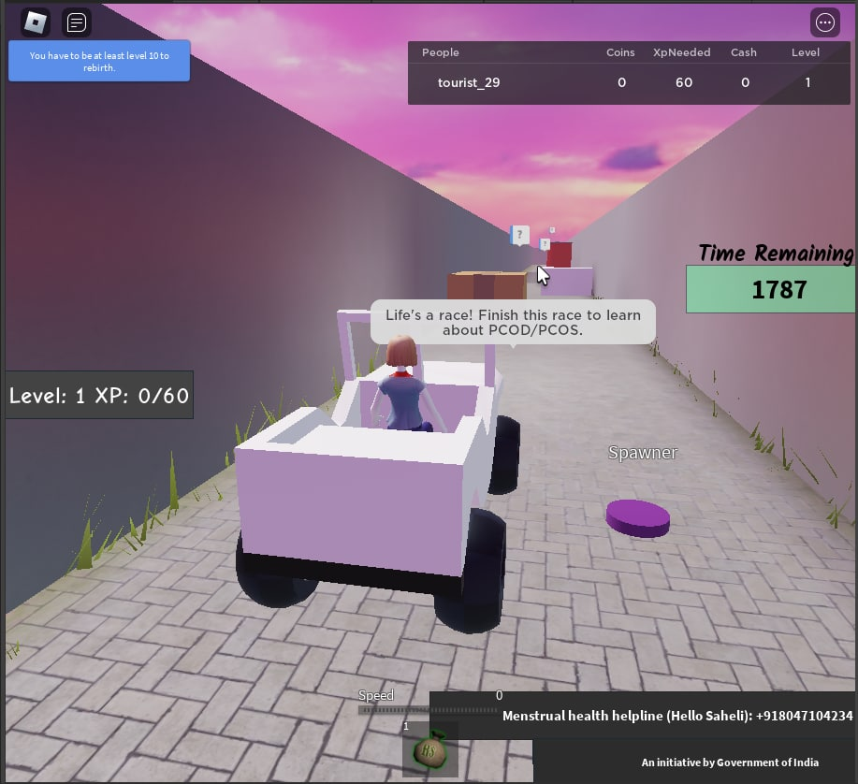
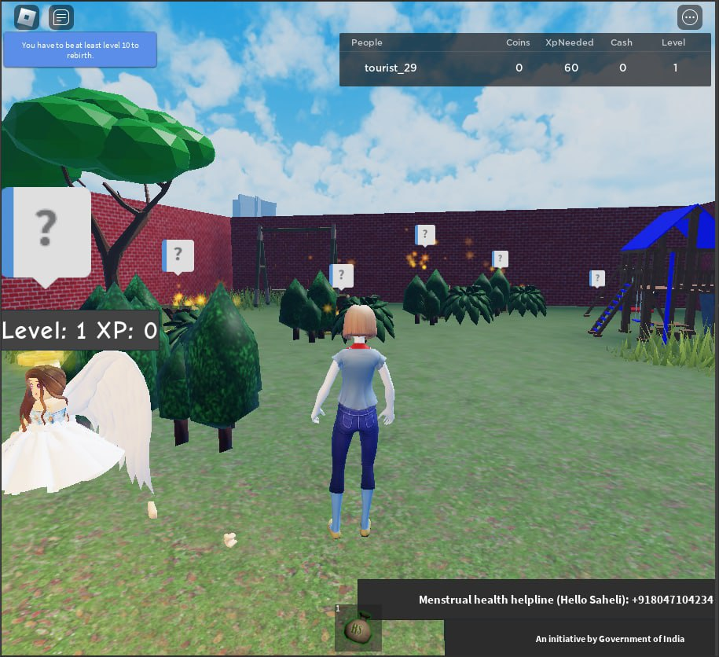
UI Screenshots !

Slide 5
Tech Stack used :
Roblox Studio
Lua programming for scripting
Inbuilt templates of Roblox
Installation Guide :
https://docs.google.com/document/d/e/2PACX-1vSRkAShEiYNx3hM-flHwVB_sBMlJwiDrjz7zIJoYpMmFIlpJBf4t-_qKk6kHrPXk8PrHu3zIZEZhRqp/pub

Slide 6
Future Plans
Leaderboard based on time.
Messaging platform for players to share experiences.
Quizzes and further games on menstrual challenges and taboos.
Realtime- doctor’s consultation.

Slide 7
Business plan
In app-advertisement of products offered by Kimeberly Clark.
Realtime doctor’s consultation can be paid .
The advanced version of the game involving timer can be sold to players at a nominal fee.
Buying and importing assets for better game experience can be commercialized in the marketplace.

Slide 8
Costs involved
Prototype Build :
Doctor’s consultation : Fees for collaboration / free online consultation(NGOs)
Development & Hosting : Open Source Software and Free Resources (like Netlify & Apptoid)
Revenue : Ads + In-App Purchases of assets at instances consistent with the storyline .
For scaling up :
Development Cost - NIL
Post-Development cost :
Web App (Hosting-149 INR/month+ Domain Name-150 INR/month) = 300 INR/month
Mobile App Publishing (Play Store –2000 INR-one time for developer’s ID + Apple Store- 8000 INR/year)
Revenue : Ads + In-App purchases

Slide 9
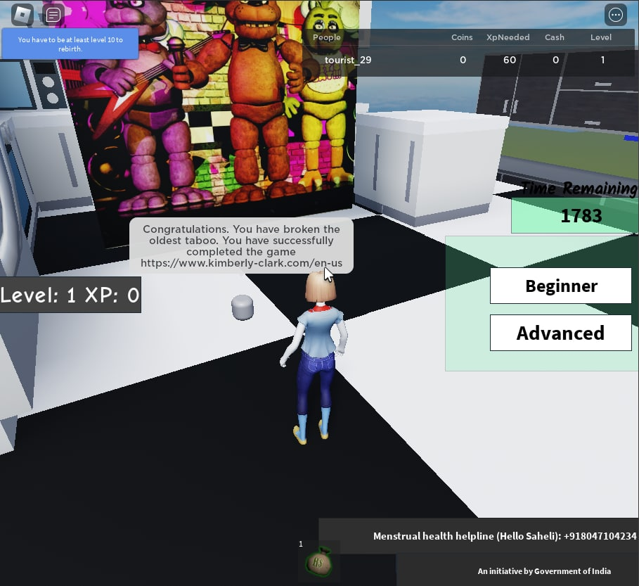
Thank You!

