Slide 1
MINEGUARD NEXUS
PREDICT • SIMULATE • PREVENT
Smart Integrated Governance
Presented By
for Mining Assets
Team S.I.G.M.A

Slide 2
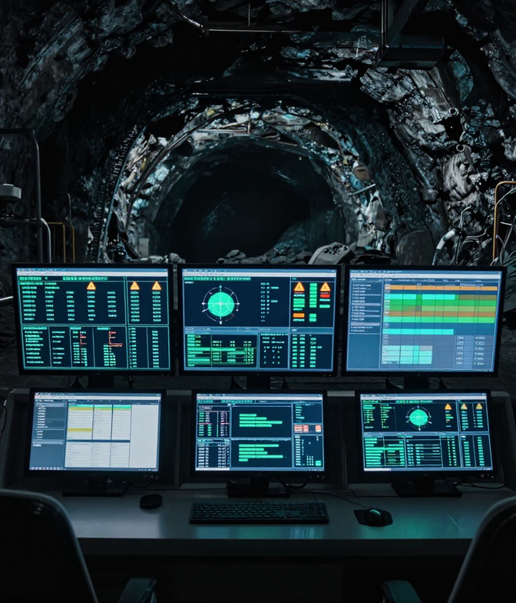
WHAT IS THE PROBLEM?
Next Slide
SIH26024 — AI-Based Smart Governance and Compliance Monitoring System for Coal Mines. Mining operations generate vast amounts of governance data: inspections, safety observations, statutory violations, corrective actions, equipment maintenance, contractor performance, and environmental records — all fragmented across disconnected systems and documents.
When critical governance signals are siloed across different platforms, mine management struggles to identify emerging compliance risks early, prioritize interventions, and maintain regulatory oversight — leaving operations vulnerable to safety failures and statutory violations.

Slide 3
CHALLENGES TO OVERCOME
Next Slide
Fragmented Inspections
Disconnected Corrective Actions
Inspection records are scattered across paper logs, spreadsheets, and siloed databases, making it impossible to track compliance status or identify recurring violations in real time.
Corrective action plans are tracked manually and independently, with no linkage to root cause findings or compliance outcomes, resulting in repeated violations and unresolved hazards.
Scattered Safety Observations
Unlinked Equipment Maintenance
Safety observations from field personnel exist in isolation, with no unified system to correlate near-miss events, hazard reports, and behavioral patterns into actionable risk intelligence.
Equipment maintenance logs are isolated from safety and compliance workflows, preventing early detection of failure patterns that could trigger safety incidents or regulatory breaches.
Siloed Statutory Violations
Isolated Contractor Performance
Statutory violation data is managed in disconnected systems across departments, creating blind spots for management and delaying regulatory response, escalating legal and operational risk.
Contractor compliance and performance data is not integrated with mine governance systems, creating accountability gaps and exposing operations to unmonitored third-party safety risks.

Slide 4

MINEGUARD NEXUS
Next Slide
MineGuard Nexus is an AI-powered smart governance and compliance monitoring platform purpose-built for modern coal mining operations. It unifies all critical operational signals — inspections, safety records, statutory compliance, and environmental data — into a single intelligent system.
Mining governance today is fragmented across disparate systems and documents, making it difficult for management to identify emerging risks early. MineGuard Nexus eliminates these silos by consolidating every governance signal into one unified, AI-driven platform that delivers real-time situational awareness.
By bringing together inspections, corrective actions, equipment maintenance, contractor performance, production data, and environmental conditions, MineGuard Nexus empowers decision-makers to predict risks, simulate scenarios, and prevent compliance failures before they occur.

Slide 5
CORE CAPABILITIES OF MINEGUARD NEXUS
Next Slide
MineGuard Nexus is built on three foundational pillars that work in concert to deliver end-to-end governance intelligence. From early risk detection to scenario modeling and proactive compliance enforcement, each capability strengthens mining oversight at every level.
Together, these pillars form a unified intelligence loop — continuously learning from operational data, simulating governance outcomes, and triggering targeted interventions before violations escalate into critical incidents.
01
Predict
02
Simulate
03
Prevent
AI-driven risk forecasting that analyzes inspection records, equipment telemetry, and compliance history to surface emerging governance risks before they escalate.
Scenario modeling engine that simulates the impact of governance decisions, regulatory changes, and operational shifts — enabling smarter, evidence-based interventions.
Proactive compliance monitoring that auto-triggers corrective workflows, flags statutory violations, and ensures continuous adherence to coal mine safety regulations.

Slide 6
WHY MINEGUARD NEXUS?
Next Slide
Unified Data Integration
Prioritized Interventions
Consolidates inspections, safety records, equipment logs, environmental data, and contractor reports into a single, unified governance intelligence platform.
Smart ranking algorithms highlight the most critical corrective actions, ensuring management focuses resources where impact is highest across all mine operations.
Early Risk Identification
Regulatory Compliance Assurance
AI-driven anomaly detection surfaces emerging governance risks before they escalate, enabling proactive mine management and reducing critical incident exposure.
Automated statutory compliance tracking and real-time audit trails ensure coal mine operations consistently meet all legal and regulatory governance mandates.

Slide 7
AI-POWERED TECHNOLOGY CORE
Next Slide
MineGuard Nexus leverages advanced machine learning algorithms to continuously analyze patterns across thousands of governance signals. The system detects anomalies, predicts compliance risks before they escalate, and delivers actionable intelligence to decision-makers in real time.
Deep learning models trained on historical mining data enable MineGuard Nexus to recognize early warning indicators across inspections, equipment health, environmental readings, and contractor performance — transforming raw data into precise risk predictions.
AI & Predictive Analytics
Smart System Integration
Pattern recognition, risk scoring, and predictive compliance modeling powered by machine learning across all mine governance data streams.
Seamless unified connectivity across inspection records, statutory documents, equipment logs, contractor data, and environmental monitoring systems.

Slide 8

MINEGUARD NEXUS
USE CASES
Next Slide
Safety Monitoring
Real-time hazard detection across mining zones using AI-powered sensors and predictive analytics to flag risks before incidents occur.
Compliance Tracking
Automated statutory reporting and audit trail generation ensuring continuous regulatory compliance with zero manual overhead.
Performance Management
Contractor and equipment optimization through data-driven KPI dashboards, maintenance scheduling, and operational benchmarking.

Slide 9
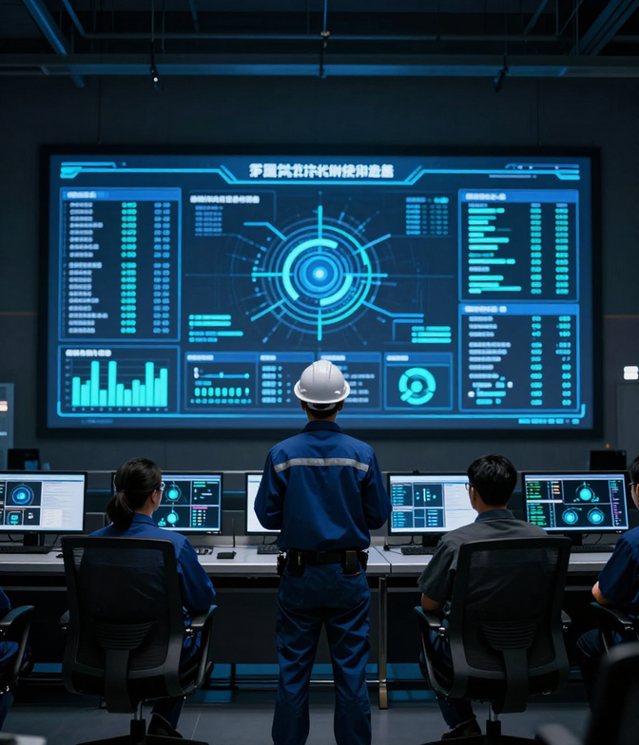
REAL WORLD IMPACT & OUTCOMES
Next Slide
Reduced Governance Risks Through Early Detection
MineGuard Nexus leverages AI-driven anomaly detection to surface emerging compliance risks weeks before they escalate, enabling proactive intervention and significantly reducing statutory violations across coal mining operations.
Streamlined Compliance Workflows
Automated inspection scheduling, corrective action tracking, and real-time regulatory alerts eliminate manual bottlenecks — cutting compliance processing time and ensuring audit-ready documentation at all times.
Enhanced Decision-Making for Mine Management
Unified governance dashboards consolidate fragmented data from inspections, equipment logs, contractor records, and environmental sensors — empowering mine managers with actionable intelligence to prioritize critical interventions.

Slide 10
S.I.G.M.A — Smart Integrated Governance for Mining Assets
MINEGUARD NEXUS
Transforming Coal Mine Governance through AI-Powered Intelligence.
Predict • Simulate • Prevent
AI-Based Smart Governance
Presented By
sigma.mineguard.nexus
Team S.I.G.M.A

