Slide 1
CS 6373 - Programming Languages
Department of Computer Science
and Engineering
Polytechnic Institute of
New York University

Slide 2
Review of Calling Functions And Variable Storage
What happens when main calls function f1? The run time system must:
Store where to return in main when f1 finishes executing
New memory needs to be allocated for
Variables declared locally in f1
Any parameters passed into f1
Activation Record stores this information

Slide 3

Storing Activation Records
Call sequence – main calls f1, f1 calls f2
Return sequence – f2 returns to f1, f1 returns to main
When executing in f2, only have access to the Activation Record of f2
When return from f2
Activation Record of f2 is not needed any more
Need the Activation Record of f1
//function prototypes not shown
int main ( ) {
f1 ( ); //call to function f1
//more code to execute …
}
void f1 ( ) {
f2 ( ); //call to function f2
//more code to execute
}
void f2 ( )
//some code to execute
}

Slide 4
Run Time Stack
Activation Records are stored on a Stack (called the Run Time Stack)
When a function is called
Push an Activation Record on the Run Time Stack
When return from a function
Pop off the top Activation Record
Go back to the calling function to the line of code that was stored within the Activation Record that was just popped off the Run Time Stack

Slide 5
Example
//note: This code doesn’t do any meaningful work
int main( ) {
int a = 5;
f1 ( a );
return 0;
}
void f1 (int n) {
int temp;
temp = n + 1;
f2 (temp);
return;
}
void f2 (int n) {
int temp;
temp = n * 5;
return;
}
Run Time Stack

Slide 6
Example
int main( ) {
int a = 5;
f1 ( a );
return 0;
}
void f1 (int n) {
int temp;
temp = n + 1;
f2 (temp);
return;
}
void f2 (int n) {
int temp;
temp = n * 5;
return;
}
a = 5 return to exit routine
AR of main
Run Time Stack

Slide 7
Example
int main( ) {
int a = 5;
f1 ( a );
return 0;
}
void f1 (int n) {
int temp;
temp = n + 1;
f2 (temp);
return;
}
void f2 (int n) {
int temp;
temp = n * 5;
return;
}
n = 5 return to line 3
temp = 6
AR of f1
a = 5 return to exit routine
AR of main
Run Time Stack

Slide 8
Example
int main( ) {
int a = 5;
f1 ( a );
return 0;
}
void f1 (int n) {
int temp;
temp = n + 1;
f2 (temp);
return;
}
void f2 (int n) {
int temp;
temp = n * 5;
return;
}
n = 6 return to line 9
temp = 30
AR of f2
n = 5 return to line 3
temp = 6
AR of f1
a = 5 return to exit routine
AR of main
Run Time Stack

Slide 9
Example
int main( ) {
int a = 5;
f1 ( a );
return 0;
}
void f1 (int n) {
int temp;
temp = n + 1;
f2 (temp);
return;
}
void f2 (int n) {
int temp;
temp = n * 5;
return;
}
n = 5 return to line 3
temp = 6
AR of f1
a = 5 return to exit routine
AR of main
Run Time Stack

Slide 10
Example
int main( ) {
int a = 5;
f1 ( a );
return 0;
}
void f1 (int n) {
int temp;
temp = n + 1;
f2 (temp);
return;
}
void f2 (int n) {
int temp;
temp = n * 5;
return;
}
a = 5 return to exit routine
AR of main
Run Time Stack

Slide 11
Example
int main( ) {
int a = 5;
f1 ( a );
return 0;
}
void f1 (int n) {
int temp;
temp = n + 1;
f2 (temp);
return;
}
void f2 (int n) {
int temp;
temp = n * 5;
return;
}
Run Time Stack

Slide 12

A Recursive Function
//note: This code doesn’t do any meaningful
//work
int main ( ) {
int a = 2;
f1 ( a );
}
void f1 (int n) {
if ( n == 0 ) //base case
return;
f1 ( n-1 ); //recursive call
}

Slide 13
A Recursive Function
int main ( ) {
int a = 2;
f1 ( a );
}
void f1 (int n) {
if ( n == 0 ) //base case
return;
f1 ( n-1 ); //recursive call
}
a = 2 return to exit routine
AR of main
Run Time Stack

Slide 14
A Recursive Function
int main ( ) {
int a = 2;
f1 ( a );
}
void f1 (int n) {
if ( n == 0 ) //base case
return;
f1 ( n-1 ); //recursive call
}
n = 2 return to line 3
AR of f1
a = 2 return to exit routine
AR of main
Run Time Stack

Slide 15
A Recursive Function
int main ( ) {
int a = 2;
f1 ( a );
}
void f1 (int n) {
if ( n == 0 ) //base case
return;
f1 ( n-1 ); //recursive call
}
n = 2 return to line 3
AR of f1
a = 2 return to exit routine
AR of main
Run Time Stack

Slide 16
A Recursive Function
int main ( ) {
int a = 2;
f1 ( a );
}
void f1 (int n) {
if ( n == 0 ) //base case
return;
f1 ( n-1 ); //recursive call
}
n = 1 return to line 8
AR of f11
n = 2 return to line 3
AR of f1
a = 2 return to exit routine
AR of main
Run Time Stack

Slide 17
A Recursive Function
int main ( ) {
int a = 2;
f1 ( a );
}
void f1 (int n) {
if ( n == 0 ) //base case
return;
f1 ( n-1 ); //recursive call
}
n = 1 return to line 8
AR of f11
n = 2 return to line 3
AR of f1
a = 2 return to exit routine
AR of main
Run Time Stack

Slide 18
A Recursive Function
int main ( ) {
int a = 2;
f1 ( a );
}
void f1 (int n) {
if ( n == 0 ) //base case
return;
f1 ( n-1 ); //recursive call
}
n = 0 return to = line 8
AR of f111
n = 1 return to = line 8
AR of f11
n = 2 return to = line 3
AR of f1
a = 2 return to =
exit routine
AR of main
Run Time Stack

Slide 19
A Recursive Function
int main ( ) {
int a = 2;
f1 ( a );
}
void f1 (int n) {
if ( n == 0 ) //base case
return;
f1 ( n-1 );
}
n = 1 return to = line 8
AR of f11
n = 2 return to = line 3
AR of f1
a = 2 return to =
exit routine
AR of main
Run Time Stack

Slide 20
A Recursive Function
int main ( ) {
int a = 2;
f1 ( a );
}
void f1 (int n) {
if ( n == 0 ) //base case
return;
f1 ( n-1 );
}
n = 2 return to = line 3
AR of f1
a = 2 return to =
exit routine
AR of main
Run Time Stack

Slide 21
A Recursive Function
int main ( ) {
int a = 2;
f1 ( a );
}
void f1 (int n) {
if ( n == 0 ) //base case
return;
f1 ( n-1 );
}
a = 2 return to =
exit routine
AR of main
Run Time Stack

Slide 22
A Recursive Function
int main ( ) {
int a = 2;
f1 ( a );
}
void f1 (int n) {
if ( n == 0 ) //base case
return;
f1 ( n-1 );
}
Run Time Stack

Slide 23
CLOSURES

Slide 24
CLOSURES
A Programming Structure?
A function ?

Slide 25
CLOSURES
A closure is a function or reference to a function together with a referencing environment—a table storing a reference to each of the non-local variables of that function. A closure allows a function to access those non-local variables even when invoked outside of its immediate lexical scope.

Slide 26
SCHEME IMPLEMENTATION
CONTENT
Functions in function
Using outer symbols
Returning functions
Closures
Uses of Closures

Slide 27
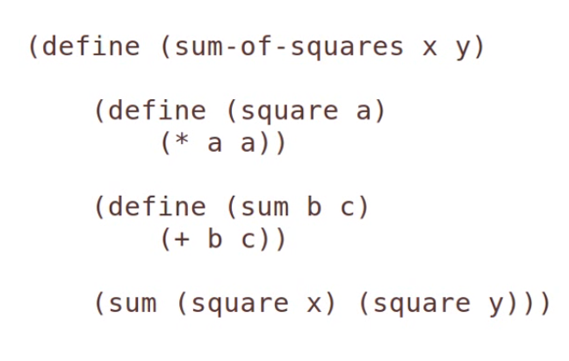
SCHEME IMPLEMENTATION
Functions in Function

Slide 28
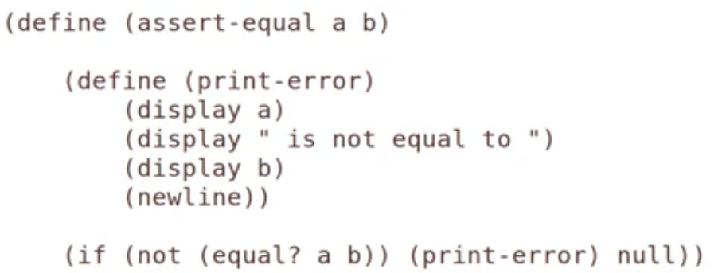
SCHEME IMPLEMENTATION
Using Outer Symbols

Slide 29
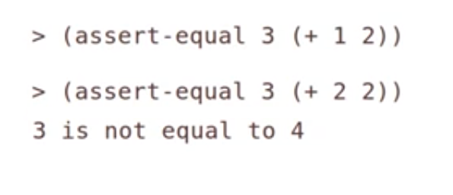
SCHEME IMPLEMENTATION
Even if display function is not taking any parameters it can access to the variables define outer function.
Using Outer Symbols

Slide 30
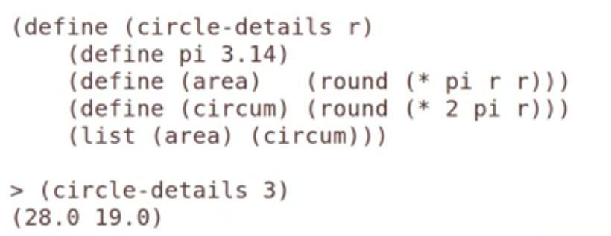
SCHEME IMPLEMENTATION
Using Outer Symbols(2)

Slide 31
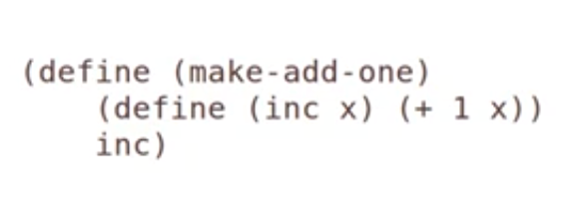
SCHEME IMPLEMENTATION
Returning Functions

Slide 32






SCHEME IMPLEMENTATION
Returning Functions

Slide 33
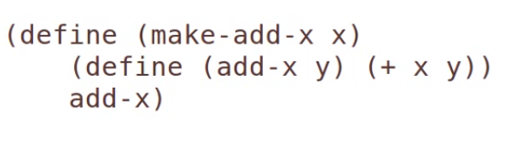



SCHEME IMPLEMENTATION
CLOSURES

Slide 34
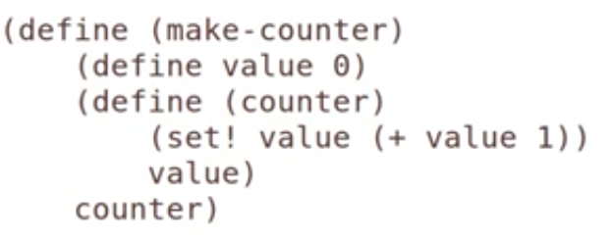
SCHEME IMPLEMENTATION
USES OF CLOSURES

Slide 35
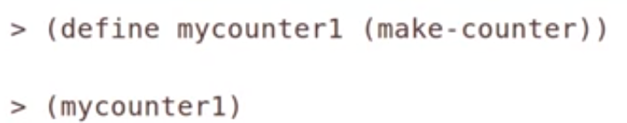



SCHEME IMPLEMENTATION
USES OF CLOSURES

Slide 36




SCHEME IMPLEMENTATION
USES OF CLOSURES

Slide 37
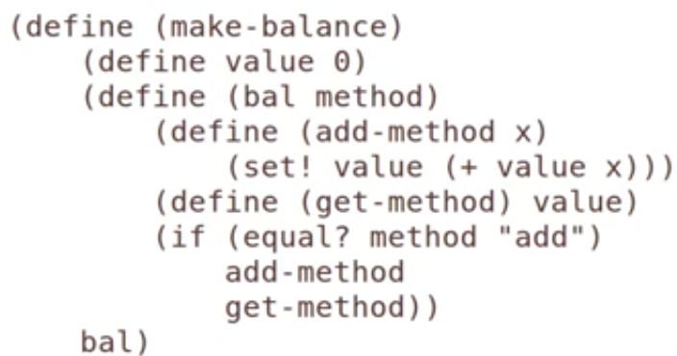
SCHEME IMPLEMENTATION
USES OF CLOSURES-TO CREATE A CLASS

Slide 38







SCHEME IMPLEMENTATION
SCHEME IMPLEMENTATION
USES OF CLOSURES-TO CREATE A CLASS

Slide 39




SCHEME IMPLEMENTATION
USES OF CLOSURES-TO CREATE A CLASS

Slide 40
PYTHON IMPLEMENTATION

Slide 41
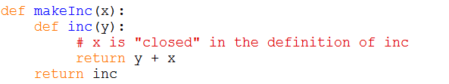
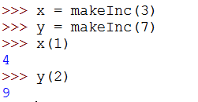
PYTHON IMPLEMENTATION
Closures in python are created by function calls. Here, the call to makeInc creates a binding for x that is referenced inside the function inc. Each call to makeInc creates a new instance of this function, but each instance has a link to a different binding of x.

Slide 42
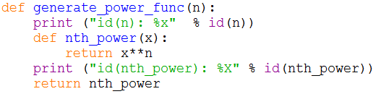
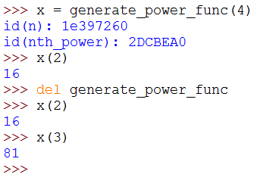
PYTHON IMPLEMENTATION

Slide 43
THANK YOU!

