Slide 1
Call Stack Revisited

Slide 2
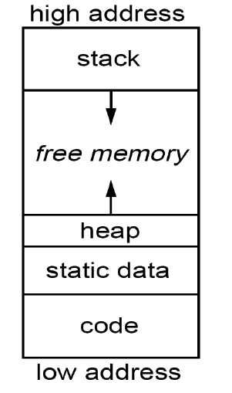
Memory Layout

Slide 3
Process Memory Layout
Each process is given physical memory called the process's virtual memory space.
A process is unaware of the details of its physical memory (i.e. where it physically resides). All the process knows is how big the chunk is and that its chunk begins at address 0.
Each process is unaware of any other chunks of VM belonging to other processes.
Even if the process did know about other chunks of VM, it's physically prevented from accessing that memory.

Slide 4
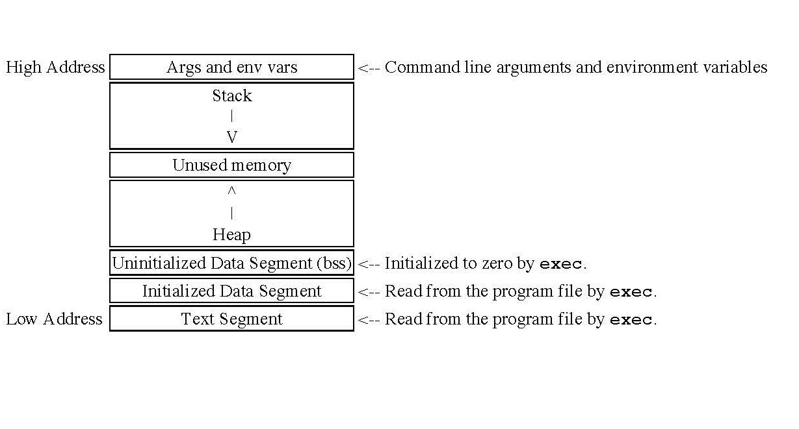
Process Memory Layout

Slide 5
Process Memory
Text Segment: The text segment contains the actual code to be executed. It's usually sharable, so multiple instances of a program can share the text segment to lower memory requirements. This segment is usually marked read-only so a program can't modify its own instructions.
Initialized Data Segment: This segment contains global variables which are initialized by the programmer.
Uninitialized Data Segment: Also named "bss" (block started by symbol) which was an operator used by an old assembler. This segment contains uninitialized global variables. All variables in this segment are initialized to 0 or NULL pointers before the program begins to execute.
The stack: The stack is a collection of stack frames. When a new frame needs to be added (as a result of a newly called function), the stack grows downward.
The heap: Most dynamic memory, whether requested via C's malloc() and friends or C++'s new is doled out to the program from the heap. The C library also gets dynamic memory for its own personal workspace from the heap as well. As more memory is requested "on the fly", the heap grows upward.

Slide 6
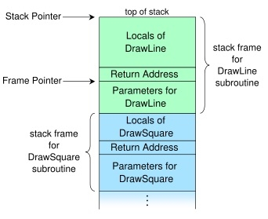
Stack Frame
DrawSquare calls DrawLine

Slide 7
Virtualization for the Educational Laboratory
Thomas Reddington
Industry Professor Computer Science
NYU Polytechnic School of Engineering
treddington@nyu.edu

Slide 8
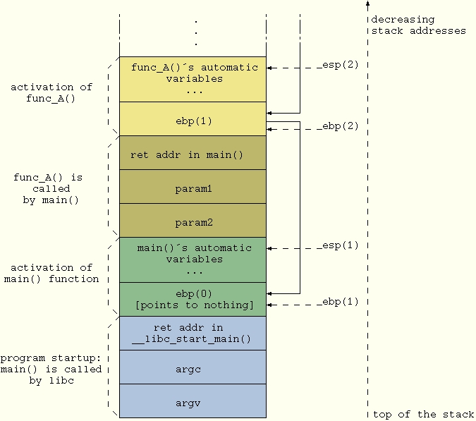
Stack Frame

Slide 9
Function Call (Windows/Intel)*
The function parameters are pushed on the stack before the function is called. The parameters are pushed from right to left.
The function return address is placed on the stack by the x86 CALL instruction, which stores the current value of the EIP register.
Then, the frame pointer that is the previous value of the EBP register is placed on the stack.
If a function includes try/catch or any other exception handling construct such as SEH (Structured Exception Handling - Microsoft implementation), the compiler will include exception handling information on the stack.
Next, the locally declared variables.
Then the buffers are allocated for temporary data storage.
Finally, the callee save registers such as ESI, EDI, and EBX are stored if they are used at any point during the functions execution. For Linux/Intel, this step comes after step no. 4.

Slide 10
THE GCC AND C CALLING CONVENTION
GCC AND C CALLING CONVENTION - STANDARD STACK FRAME
Arguments passed to a C function are pushed onto the stack, right to left, before the function is called. The first thing the called function does is push the EBP register, and then copy ESP into it. This creates a new data structure normally called the C stack frame.
GCC AND C calling convention – THE return values
A C function usually stores its return value in one or more registers.

Slide 11
Activation Records for Functions
Block of information (“frame”) associated with each function call, including:
Parameters
Local variables
Return address
Location to put return value when function exits
Control link to the caller’s activation record
Saved registers
Temporary variables and intermediate results
(not always) Access link to the function’s static parent

Slide 12
Activation Record Layout
Control link
Return address
Location of code to execute on function return
Return-result address
Address in activation record of calling block to receive returned value
Parameters
Locations to contain data from calling block
Return address
Return-result addr
Parameters
Local variables
Intermediate results
Environment pointer

Slide 13
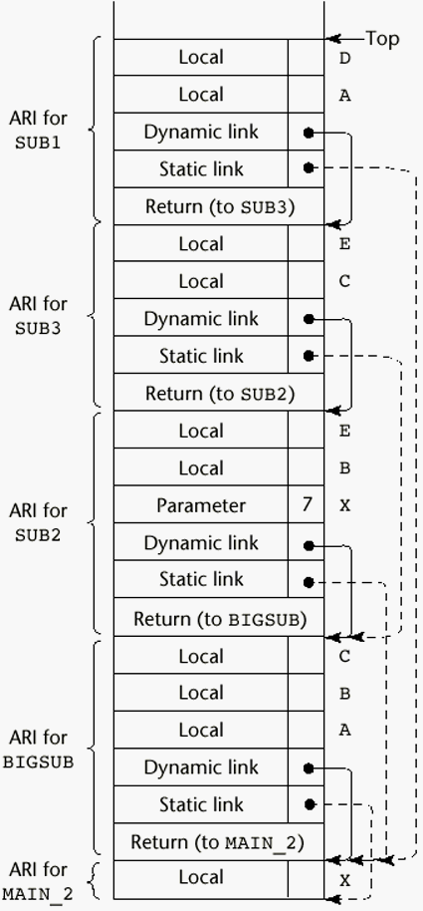
Stack Contents (Sebesta)

