Slide 1

Network Intel
Records ke beech connection.
Har lead ke saath evidence.
Internal hackathon prototype pitch
Synthetic Operation Trinetra
veil-network-intel.vercel.app
01
Notes:
Namaste judges. Ek report mein R.K. Sharma likha hai, call record mein ek phone number hai, aur transaction file mein ek account. Investigator ko samajhna hai ki yeh records kaise connected hain. Network Intel in records ko source-linked graph mein jodta hai, taaki har lead ka evidence inspect ho sake. Aaj hum synthetic Operation Trinetra dikhayenge. Final conclusion investigator ka rahega.
Sources / verification:
Repository README.md; current frontend; live production deployment verified in this task history.

Slide 2
Problem: records alag, investigation connected
01 Alag source files
02 Uncertain identity
Reports, CDR aur transactions ko
manual cross-check karna padta hai.
Similar naam ko same person maan lene
se galat connection ban sakta hai.
03 Lead ka reason
Target user
Analyst ko source aur timing ke saath
review karne layak context chahiye.
Authorized investigator / analyst
Current scope: synthetic case
Working PS: SIH26189. Official wording aur submission format ki confirmation pending.
02
Notes:
Hum jis pain point par focus kar rahe hain woh fragmented records hain. Report, CDR aur transactions alag hone se identity aur relationship ko manually cross-check karna padta hai. Hamara user authorized investigator ya analyst hai. Existing brief SIH26189 se map hota hai, lekin official PS wording aur college format abhi SPOC se confirm karna hai. Hum agency data integration ka claim nahi kar rahe.
Sources / verification:
README-PREVIOUS.md; SIH-SCOPE-FREEZE.md. PS working reference only: https://sihone.pages.dev/ps/26189 (third-party mirror, official text unverified).

Slide 3
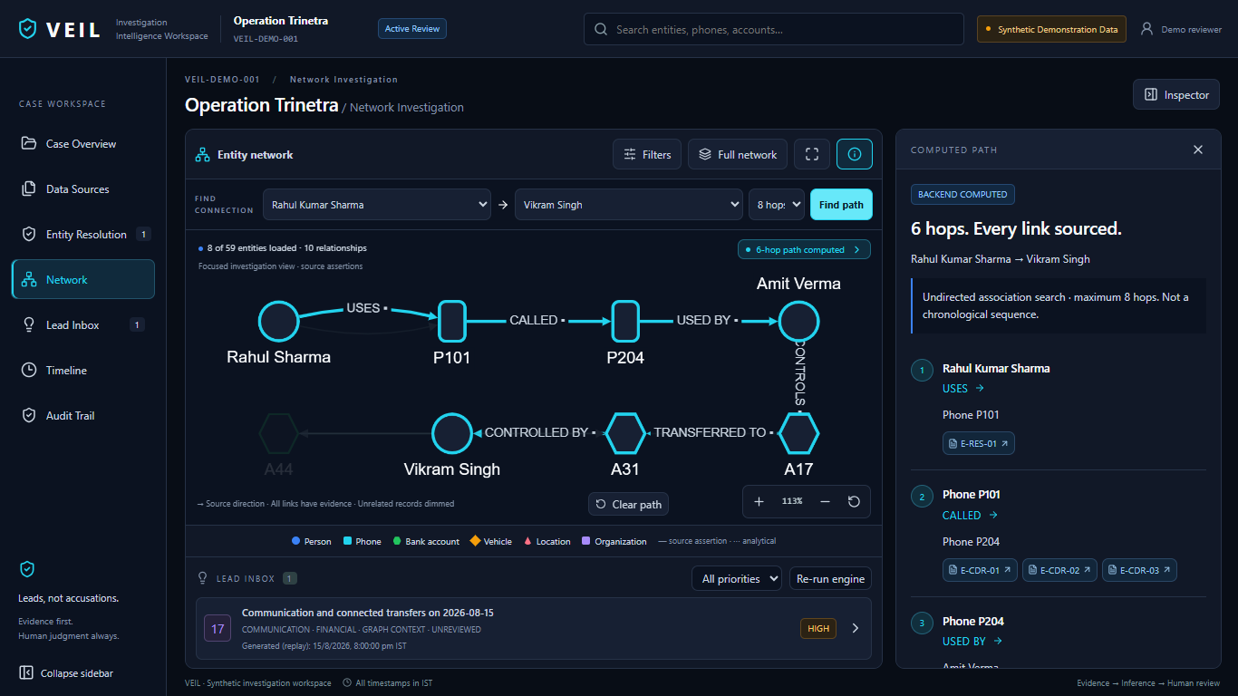
Solution: source se reviewed lead tak
Identity review
Candidate ko evidence
ke saath confirm karo.
Source-linked path
Har relationship ka
original record kholo.
Pehle captured synthetic run. Screenshot mein purana product naam VEIL hai.
03
Notes:
Yeh hamare prototype ka pehle captured run hai, jab product ka naam VEIL tha. Ab naam Network Intel hai. Screen par path backend compute karta hai. Investigator har edge ka evidence khol sakta hai. Identity review reversible hai aur lead review audit trail mein record hota hai. Is integrated workflow ko hum apna contribution keh rahe hain, world-first algorithm nahi.
Sources / verification:
artifacts/first-round/screenshots/03-network-path.png; backend/demo_paths.py; backend/resolution.py; backend/review_store.py.

Slide 4
Lead 17 ka explainable signal
3 transfers
75 minutes mein
INR 1,95,000 transfer volume
Threshold visible hai
max(5, 3 × 2) = 6 calls
11 observed calls > 6
Synthetic example. *Event day replay time tak. Transfer volume mein wahi funds dobara count ho sakte hain.
04
Notes:
Synthetic case mein pichhle saat complete din ka median do outgoing calls per day hai. Event day par replay time tak gyarah calls hain. Configured threshold max of five calls aur three times baseline hai, yani six. Isliye communication signal trigger hota hai. Teen connected transfers pachhattar minutes mein total ek lakh panchanve hazaar ka volume dikhate hain. Yeh unique funds ya money laundering ka proof nahi. Graph context aur exact source evidence ke saath system review lead banata hai.
Sources / verification:
backend/lead_engine.py Policy and run_engine; DEMO-RUNBOOK.md; tests/test_golden_flow.py. All numbers synthetic.

Slide 5
Technical approach
Input aur extraction
Controlled CSV/TXT, regex, optional spaCy NER
Graph aur identity
NetworkX paths, evidence links, reversible review
Signals aur review
Temporal rules, secondary Isolation Forest triage
Interface aur storage
React + Cytoscape, FastAPI, local SQLite
Core demo ko external AI API ki zaroorat nahi hai.
05
Notes:
Frontend React, TypeScript aur Cytoscape par hai. FastAPI typed requests serve karta hai. Structured identifiers deterministic parsers se aate hain. spaCy NER optional local model ke available hone par use hota hai, fallback bhi hai. NetworkX bounded shortest paths compute karta hai. Temporal rules main lead engine hain. Isolation Forest secondary anomaly triage hai. Local SQLite investigator decisions rakhta hai. Hum LLM, GNN ya universal Hindi OCR implemented hone ka claim nahi karte.
Sources / verification:
frontend/package.json; backend/intake_parser.py; backend/ner_service.py; backend/demo_paths.py; backend/lead_engine.py; backend/behavioral_profiler.py; api/index.py.

Slide 6
Live demo: ek case, ek evidence chain
00:00–00:20
Case aur source records
00:20–00:50
Identity match ka human review
00:50–01:15
Rahul–Vikram path
01:15–02:00
Lead 17 aur exact evidence
02:00–02:30
Review decision aur audit trail
Demo target: 2:30. Local workspace primary, captured run backup.
06
Notes:
Ab live demo kholte hain. Pehle source files dikhayenge. R.K. Sharma match ko exact phone aur vehicle evidence se review karenge. Phir Rahul se Vikram ka path compute karke Lead 17 kholenge. Transfer signal se E-TX-01 ka exact source row dikhayenge. Last mein Needs more evidence review aur audit trail dikhayenge. Har screen par sirf ek proof point. Demo ka separate target do minute tees second hai; yeh rehearsal target hai, measured claim nahi.
Sources / verification:
DEMO-RUNBOOK.md; frontend/src/components/NetworkWorkspace.tsx; local route /#/app.

Slide 7
Prototype proof aur current boundaries
101
Production se pehle
Durable hosted storage
Authenticated reviewers
Case-level access controls
Representative evaluation
Influential-node ranking validation
Backend tests passed
Synthetic inputs par implementation checks
Real-world accuracy abhi measure nahi hui
Public prototype available
Test run: 6 Sep 2026. 2 dependency warnings.
07
Notes:
Aaj tests folder ke targeted backend suite mein ek sau ek tests pass hue, do dependency warnings ke saath. Yeh correctness checks hain, real-world accuracy nahi. Public demo deploy hai aur core workspace bina sign-in khulta hai. Local review SQLite mein persist hota hai, lekin current Vercel temporary storage durable nahi hai. Official PS mein influential entities ki requirement confirm hui toh dedicated ranking abhi gap hai. Agency validation, multi-user security aur scale benchmark future work hain.
Sources / verification:
Fresh command: .venv/Scripts/python.exe -m pytest tests -q => 101 passed, 2 warnings, 22.99s. Repository inspection 2026-09-06. api/index.py uses /tmp/veil-state.

Slide 8
Selection ke baad agla milestone
Agla measurable proof
Fresh evaluation cases par entity quality,
false merges aur evidence coverage measure karna
Pilot ki foundation
Durable data aur reviewer access
Internal selection + domain mentorship
08
Notes:
Selection ke baad hamara next milestone supervised pilot readiness hai. Pehle controlled evaluation set par false merges, missed entities aur source traceability measure karenge. Hosted state ko durable storage mein shift karenge. Domain mentor ke saath task timing aur usability validate karenge. Agar official PS require karta hai toh explainable centrality ranking ko benchmark karenge. Aaj hum working vertical slice, evidence traceability aur clear hardening plan dikha rahe hain. Hamara request internal selection aur domain mentorship hai.
Sources / verification:
Proposed roadmap, not completed work. SIH-SCOPE-FREEZE.md; verified implementation gaps.

Slide 9
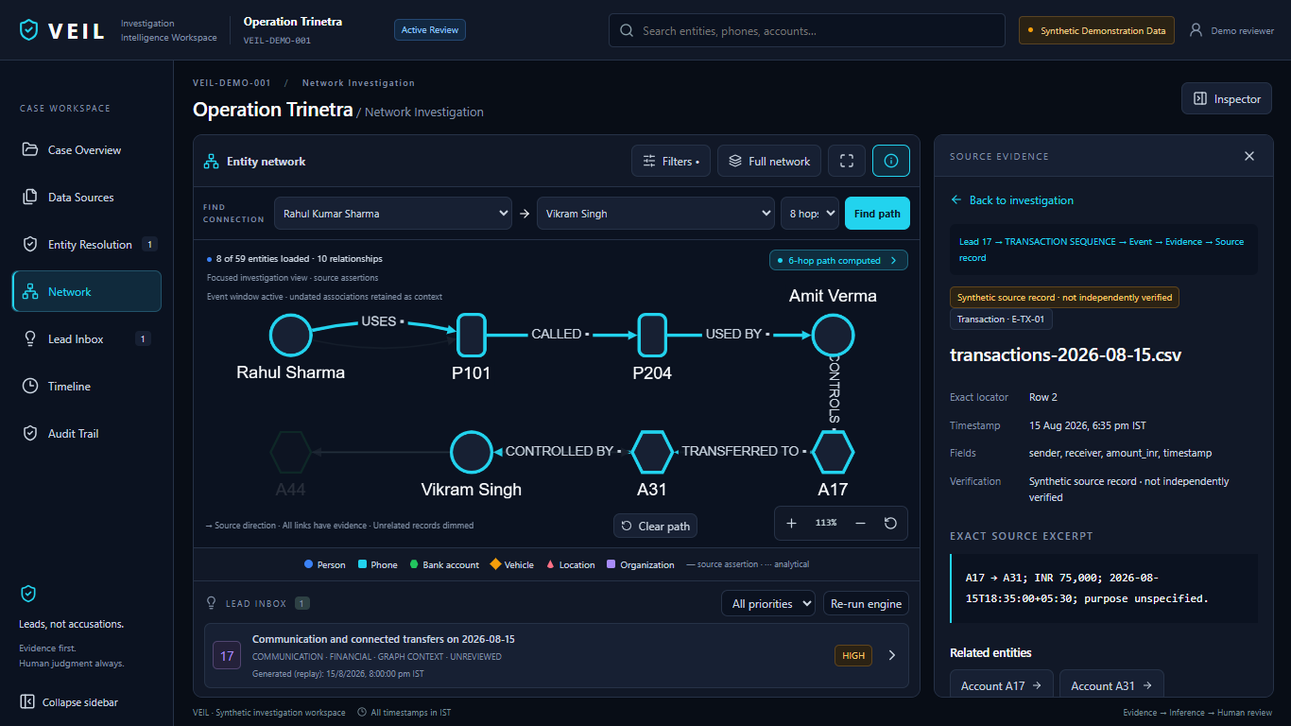
Backup: source ka exact record
Pehle captured synthetic run. Exact source locator aur verification state.
09
Notes:
Agar judge provenance pooche toh yeh backup dikhana hai. Yeh pehle captured synthetic run hai. E-TX-01 ka filename, row, timestamp aur raw excerpt inspect hota hai. Source traceability aur source ki factual correctness alag cheezein hain. Hum unverified source ko verified fact nahi bana rahe.
Sources / verification:
artifacts/first-round/screenshots/05-evidence-provenance.png; backend/demo_repository.py.

Slide 10
Backup: influence requirement ka status
Verified abhi
Next iteration
Bounded graph paths
Source-linked relationships
Local clustering feature
Explainable centrality ranking
Coverage aur stability checks
Analyst validation
Central node ka meaning context se aayega. Leadership ka automatic conclusion nahi.
10
Notes:
Public mirror mein key individuals identify karne ka requirement mila, official version confirm karna baaki hai. Active backend mein dedicated centrality ranking verify nahi hui. Existing path aur clustering coefficient influential-person detector nahi hain. Agle iteration mein degree aur betweenness ko explainable ranking ke roop mein evaluate kar sakte hain. Ranking source coverage se affected hogi aur leadership ya guilt ka label nahi hogi.
Sources / verification:
README-PREVIOUS.md; backend/demo_paths.py; backend/behavioral_profiler.py; repository search for degree, centrality, pagerank, betweenness. PS mirror: https://sihone.pages.dev/ps/26189; official confirmation pending.

Slide 11
Backup: evaluation plan
False merges
Same naam, alag identifiers par identity alag rahe
Evidence coverage
Har surfaced relationship ka locator resolve ho
Negative controls
Benign burst ko crime label na mile
Workflow timing
Same task ka manual aur assisted time compare ho
Planned evaluation. Accuracy aur time-saving percentage abhi claim nahi karte.
11
Notes:
Evaluation mein positive planted case ke saath benign controls bhi honge. Same naam aur alag phone ko false merge nahi karna chahiye. Missing source par signal suppress ya clearly flag hona chahiye. Edge remove karne par computed path badalna chahiye. Held-out records par precision recall report karenge. Task timing manual baseline aur tool-assisted flow ke saath same task par compare karenge. Targets ko achieved results nahi bolenge.
Sources / verification:
tests/test_resolution.py; tests/test_golden_flow.py; backend/lead_engine.py. Proposed additional evaluation, not measured outcome.

Slide 12
Backup: technical Q&A
Lead hardcoded hai?
Inputs synthetic hain. Result backend calculate karta hai.
AI kahan use hua?
Optional NER aur secondary anomaly triage mein.
Production-ready hai?
Public demo live hai. Hardening abhi pending hai.
Impact kitna hai?
Time-saving hypothesis ko pilot mein measure karenge.
12
Notes:
Hardcoded? Demo inputs fixed hain, lekin engine rules aur graph se result calculate karta hai. AI kahan? Optional spaCy extraction aur secondary Isolation Forest; main temporal lead deterministic hai. Deploy ready? Public prototype live hai, production storage aur security incomplete hain. Impact? Reduced cross-referencing expected benefit hai; measured saving abhi nahi. Agar answer unknown ho, verification step batao aur number invent mat karo.
Sources / verification:
backend/lead_engine.py; backend/ner_service.py; backend/behavioral_profiler.py; api/index.py.

