Slide 1

SREENIDHI INSTITUTE OF SCIENCE AND TECHNOLOGY
(AN AUTONOMOUS INSTITUTION Approved by UGC)
Yamnampet, Ghatkesar, R.R. District -501 301
DEPARTMENT OF
COMPUTER SCIENCE & ENGINEERING
DESIGN SEMINAR
On
Virtual Mouse with hand gestures Tracking using
Image processing
BATCH NO: D22
Y. Krupason (Roll No:17311A05M2)
P. Dinesh Kumar (Roll No:17311A05M3)
B. Teja Swaroop (Roll No:17311A05M5)
Under the guidance of
Internal Guide Project Coordinator Head of the Department
Mr. R. Arun Kumar Mrs. Pallepati Vasavi Dr. Aruna Varanasi

Slide 2
CONTENTS
Abstract
Introduction
Existing System
Proposed System
Software and hardware requirements
Architecture
UML diagrams
Methodology
Gestures
Output Screenshots
Conclusion and feature scope

Slide 3
ABSTRACT
The technique of establishing a process of interaction between human and computer is evolving since the invention of computer technology. A specific interactive module like a virtual mouse that makes use of Object Tracking and Gestures that will help us to interact which can be an alternative way for the traditional touch screen and the physical mouse. In this project an Object Tracking application that interacts with the system to provide mouse functionalities is created. Python and OpenCV library is used for realtime computer vision to implement the system. The camera output is displayed on the monitor. This system allows the user to navigate the system cursor using their hand bearing color caps or tapes that the computer webcam tracks and perform mouse operations like left-click, right-click, and double click using different hand gestures.

Slide 4
INTRODUCTION
The mouse is an excellent invention in HCI (Human-Computer Interaction) technology. Though wireless or Bluetooth mouse technology is invented still, that technology is not completely device free.
A Bluetooth mouse has the requirement of battery power and connecting dongle. Presence of extra devices in a mouse increases the difficulty to use it.
The proposed mouse system is beyond this limitation. This paper proposes a virtual mouse system based on HCI using computer vision and hand gestures.
So the proposed mouse system eliminates device dependency in order to use a mouse. Therefore it can be proved beneficial in order to develop HCI technology.

Slide 5
EXISTING SYSTEM
S. NO | Year | Name | Authors | Algorithm Used | Accuracy with plain background | Accuracy without plain background | Drawbacks
1. | 2020 | Virtual Mouse Using Object Tracking | Prof. Monali Shetty , Christina Daniel, Manthan Bhatkar | HVM, SVM | 80-84% | 30-35% | Time taken to detect is nearly 20 sec
2. | 2020 | Gesture Recognition Based Virtual Mouse | Sugnik Roy Chowdhury, M.D. Anto Praveena | Convex Hull algorithm | 75-85% | 75-85% | Continuous finger movement results in stress in fingures

Slide 6
EXISTING SYSTEM
S. NO | Year | Name | Authors | Algorithm Used | Accuracy with plain background | Accuracy with plain background | Drawbacks
3. | 2019 | Design and Development of Hand Gesture Based Virtual Mouse | Kabid Hassan Shibly, Samrat Kumar Dey | HCI (human computer interaction) and computer vision | 78-85% | 40-42% | Less accuracy and system recognition of colours is poor
4. | 2019 | Virtual Mouse Control by Webcam for the Disabled | Reyhan Seher, Mazlum UNAY | Eye ball Tracking using mathlab | 82-90% | 82-90% | Eye blinking may occur random

Slide 7
EXISTING SYSTEM
S. NO | Year | Name | Authors | Algorithm Used | Accuracy with plain background | Accuracy with plain background | Drawbacks
5. | 2019 | Cursor Control Using Eye Ball Movement | Vandana Khare, S.Gopala Krishna | Pupil movement detected using open source computer vision | ~80% | ~80% | The eye movement converted into voltage and time graph, normal webcam can’t be used.

Slide 8
PROPOSED SYSTEM
The system proposed is a Computer Vision-based mouse cursor control system, which uses hand gestures that are being captured from a webcam through an HSV color detection technique.
Python and OpenCV library is used for realtime computer vision to implement the system. This system is quite easy to use and also easy to grasp an understanding of how to perform different operations.

Slide 9
SOFTWARE REQUIREMENTS
64-bit Operating System: Windows 8 or Higher
Jupyter Notebook/ Google Colab
Python version >3.0,PyAutoGUI,OpenCV

Slide 10
HARDWARE REQUIREMENTS
A good condition Webcam
RAM preferably >8GB
GPU Processing Unit
Memory space >500GB for faster training of data

Slide 11
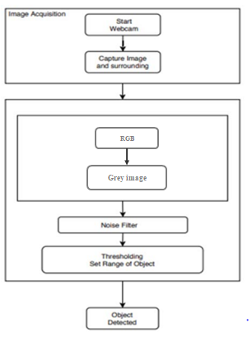
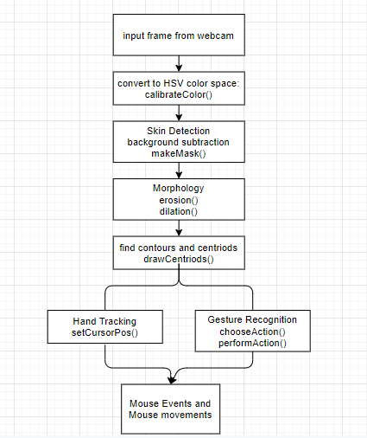
Architecture
Old Architecture(of base paper) New Architecture

Slide 12
Use Case Diagram
Use case diagram consists of four actors
User
Webcam
System
Screen
Roles of those actors are explained in the diagram.

Slide 13
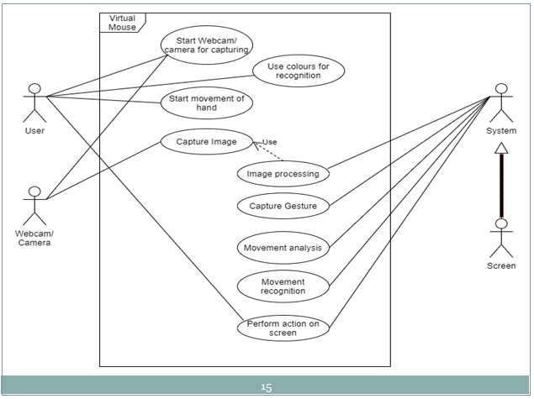

Slide 14
Class Diagram
The class diagram is the main building block of object-oriented modelling.
In the diagram, classes are represented with boxes that contain three compartments.
Class name
Attributes
Operations

Slide 15
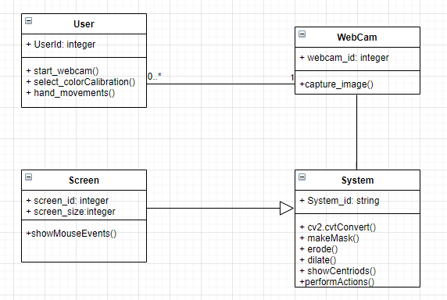

Slide 16
Activity Diagram
Activity diagrams are graphical representations of workflows of stepwise activities.
Activity diagrams are constructed from limited number of shapes, connected with arrows.
The most important shape types:
Rounded rectangles represent actions.
Bars represent the start or end of concurrent activities.
A black circle represents the start of workflow.

Slide 17
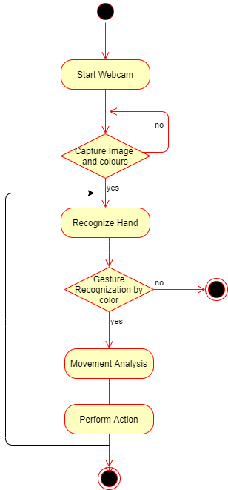

Slide 18
Sequence Diagram
A sequence diagram is an interaction diagram that shows how objects operate with one another and in what order.
Sequence diagrams are sometimes called event diagrams or event scenarios.

Slide 19
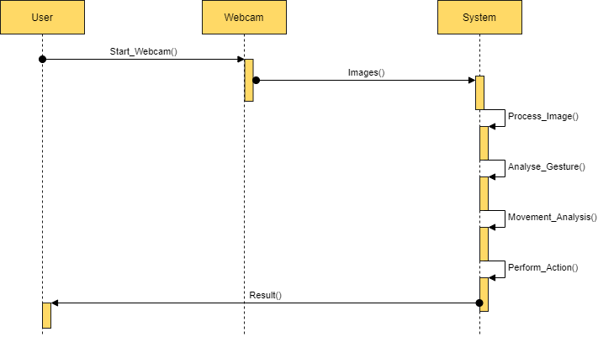

Slide 20
Methodology
HSV color space - a cylindrical color model that remaps the RGB primary colors into 3D (hue, saturation, and value).
Hue specifies the angle of the color on the RGB color circle. A 0° hue results in red, 120° results in green, and 240° results in blue.
Saturation controls the amount of color used. A color with 100% saturation will be the purest color possible, while 0% saturation yields grayscale.
Value controls the brightness of the color. A color with 0% brightness is pure black while a color with 100% brightness has no black mixed into the color.

Slide 21
2. Background subtraction was then performed to remove the face and other skin color objects in the background.
3. Morphological opening is useful for removing small objects from an image while preserving the shape and size of larger objects in the image.(erosion and dilation)
4.Cursor Position recognition – using distance calculation
i. mouse movements ii. mouse Events

Slide 22
Error rate formula
-to set cursor position
If the cursor movement is voluntary then
pos = centriod + 0.7*(previous_pos - centriod)
if the cursor movement is because of vibration of hand or involuntary then
pos = centriod + 0.1*(previous_pos - centriod)

Slide 23
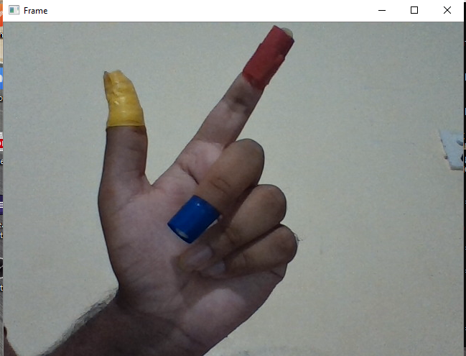
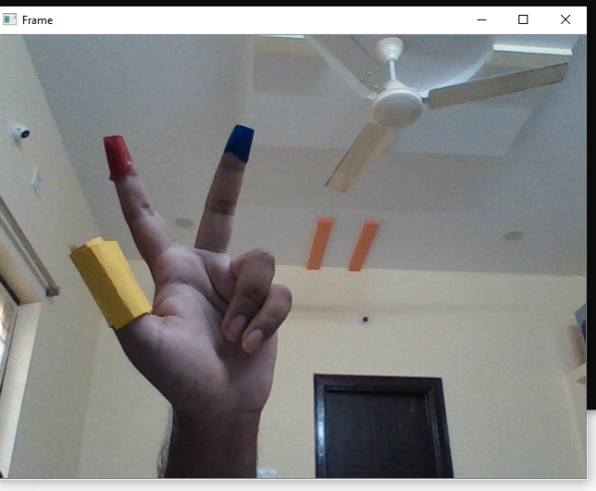
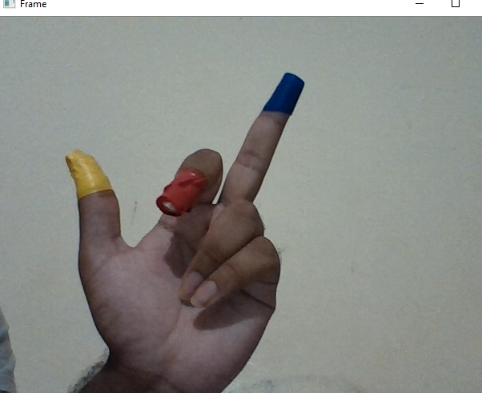
Gestures
Scroll up
Free movement of cursor
Scroll Down

Slide 24
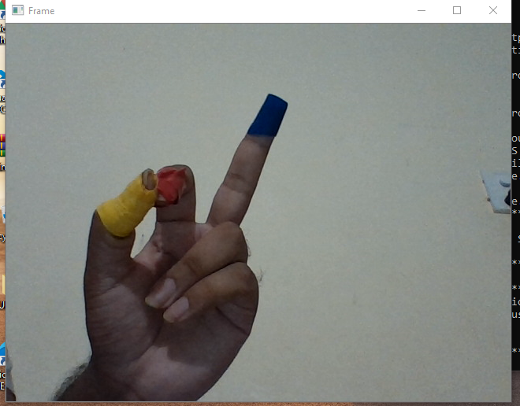
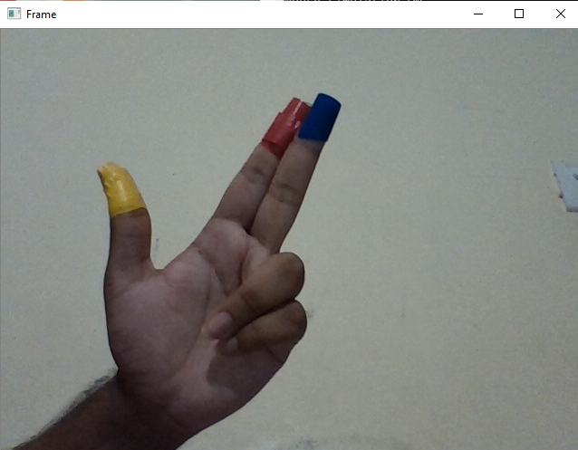
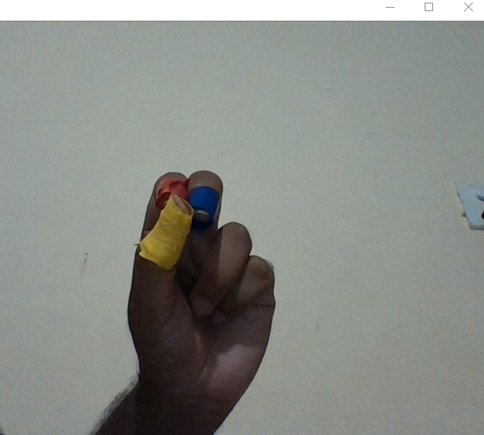
Right Click
Left Click
Drag

Slide 25
Output screenshots

Slide 26
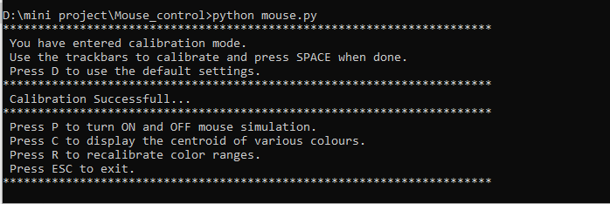

Slide 27
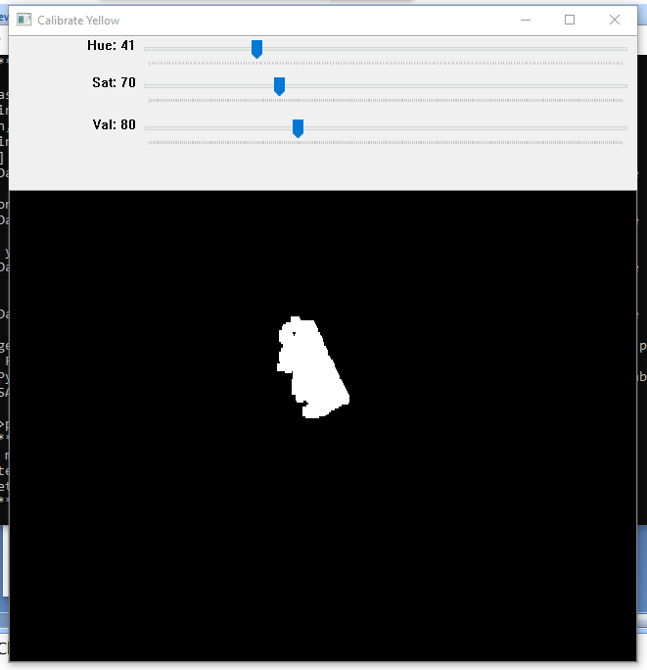
Calibrating Color: Yellow

Slide 28
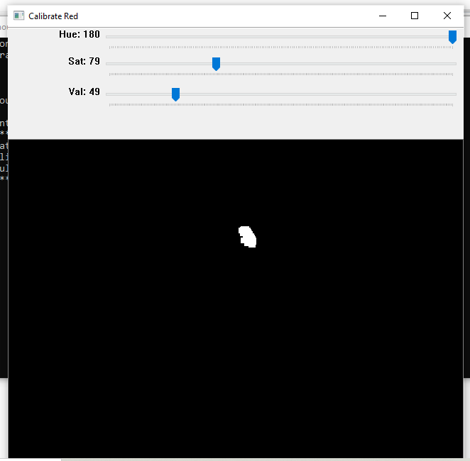
Calibrating Color: Red

Slide 29
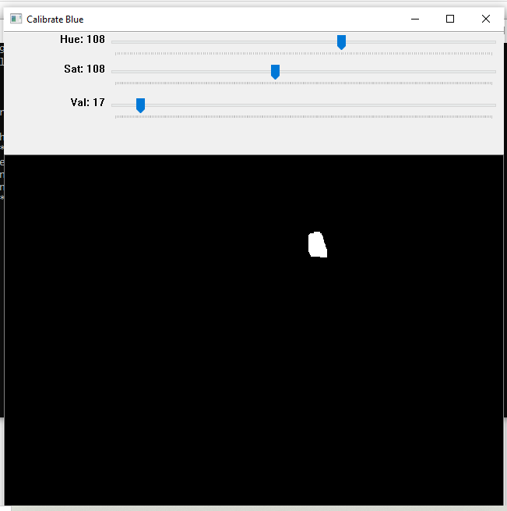
Calibrating Color: Blue

Slide 30

Capturing Frame

Slide 31
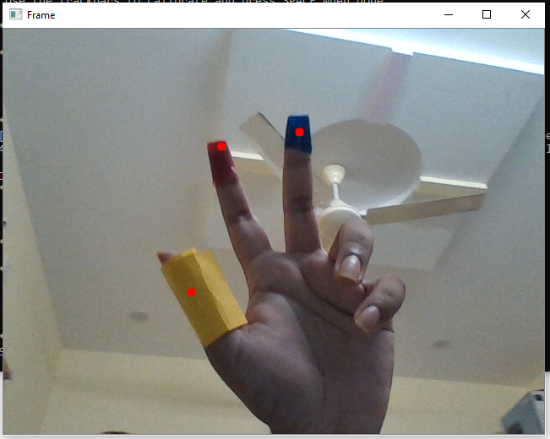
Centriods Detection

Slide 32
Conclusion
The vision based cursor control using hand gesture system was developed in Python language, using the OpenCV library. The system could control the movement of a Cursor by tracking the users’ hand.
Cursor functions were performed by using different hand gestures. The system has the potential of being a viable replacement for the computer mouse, however due to the constraints encountered; it cannot completely replace the computer mouse.
There are different tools for gesture recognition. A new Object tracking hand gesture recognition algorithm that overcomes the challenges for the detection of hand gesture images is developed

Slide 33
Future Work
The major constraint of the system is that it must be operated in a well-lit room. This is the main reason why the system cannot completely replace the computer mouse, since it is very common for computers to be used in outdoor environments with poor lighting condition.
It can be further developed with AR technology for more human-machine interaction.
More Gestures can be developed where each unique gesture can open certain applications.

Slide 34
References
https://ieeexplore.ieee.org/document/9137854
Proceedings of the Fifth International Conference on Communication and Electronics Systems (ICCES 2020) IEEE Conference Record # 48766; IEEE Xplore ISBN: 978-1-7281-5371-1
https://towardsdatascience.com/tagged/dilation-and-erosion?gi=8c4b4c9578c
https://globalaihub.com/image-processing-color-spaces-rgb-hsv-and-cmyk-%F0%9F%8C%88/

Slide 35


