Slide 1
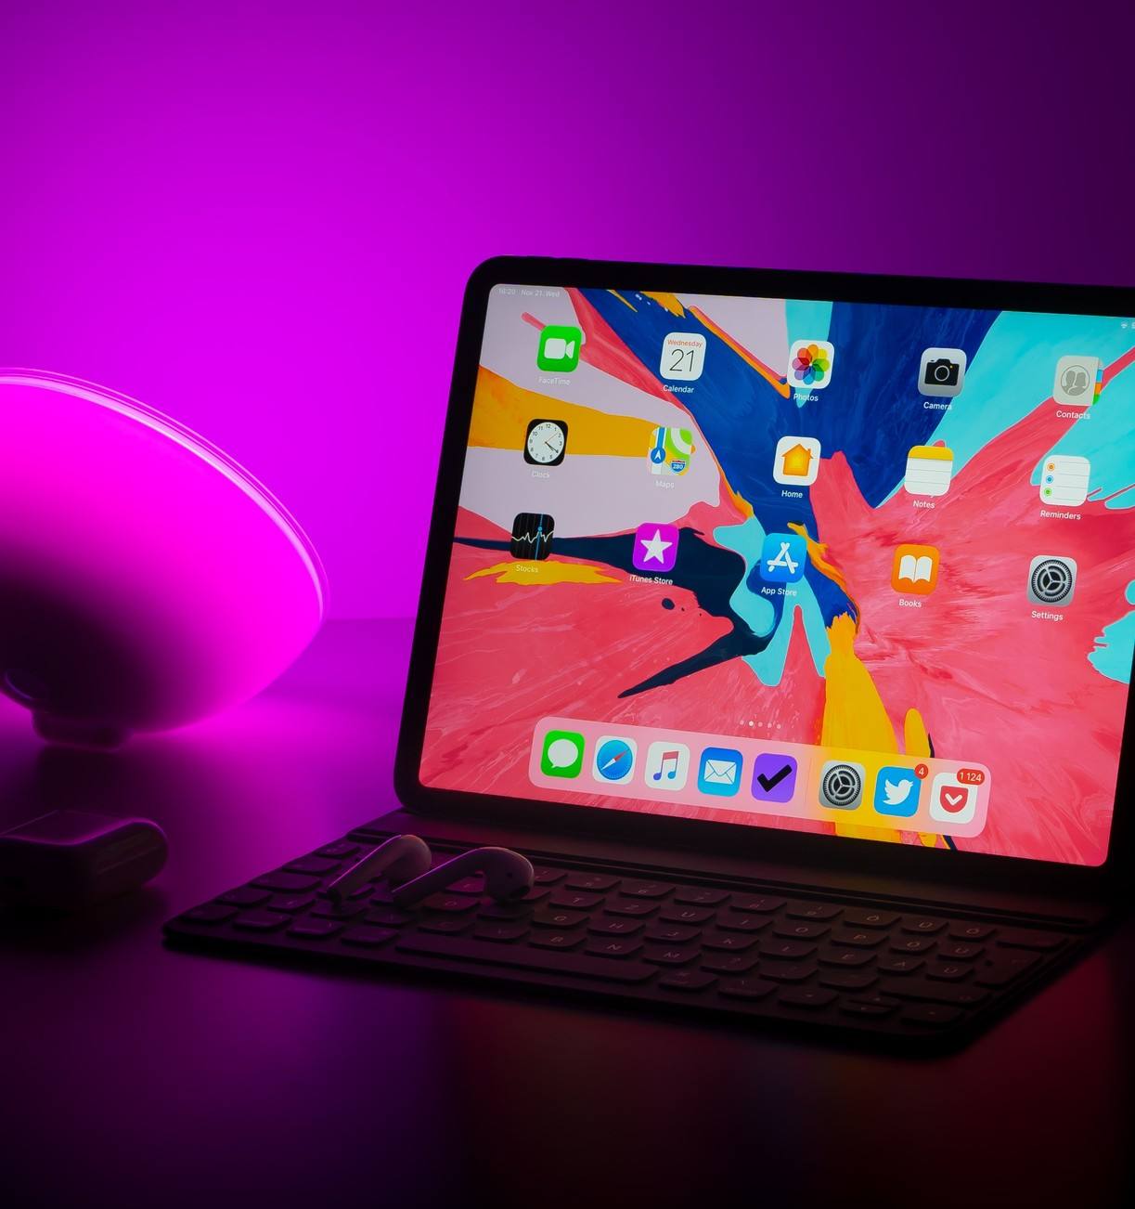
Geek Buzz⚡
YASHU BHASIN 2010992497
G-17

Slide 2
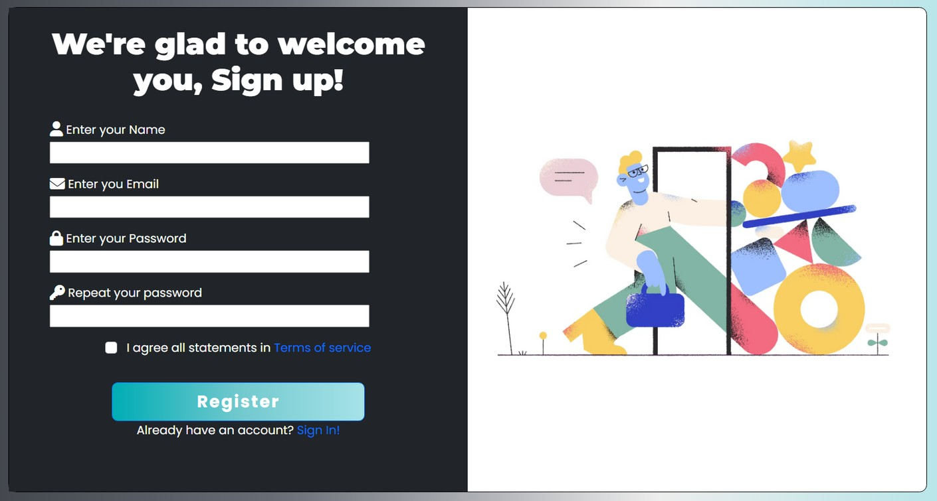
Sign Up Page
For the Sign Up page, inputs tags are used to collect data like Name, Email Id, Password. Display Flex Box is used to give a beautiful layout to the page.

Slide 3
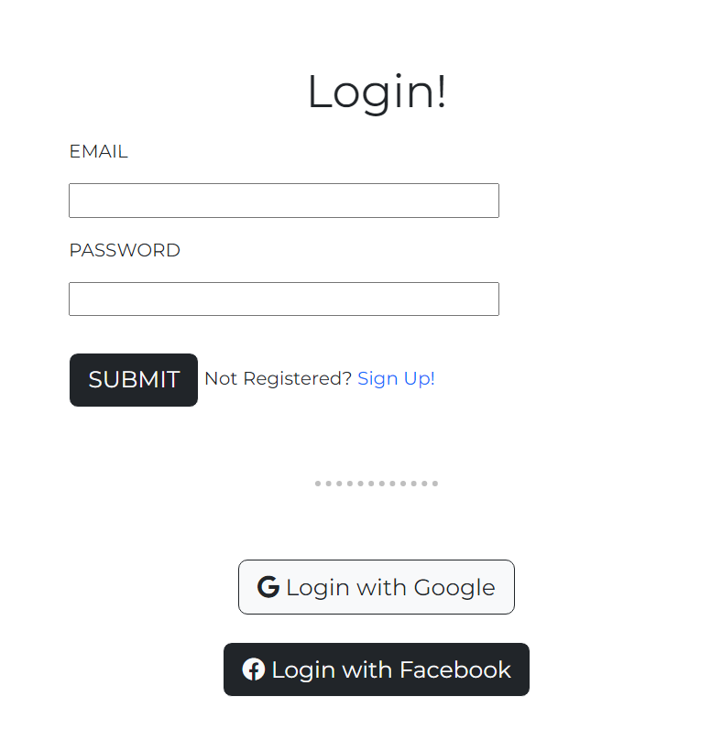
Login Page
Input Tags are used to take Email and Password as inputs. Submit button directs the user to home page.
Input tags
The whole layout is set though flexbox display to make it look neat and even.
Flex Box
Font Awesome icons are used for the Login Buttons of Google and Facebook.
Font Awesome

Slide 4
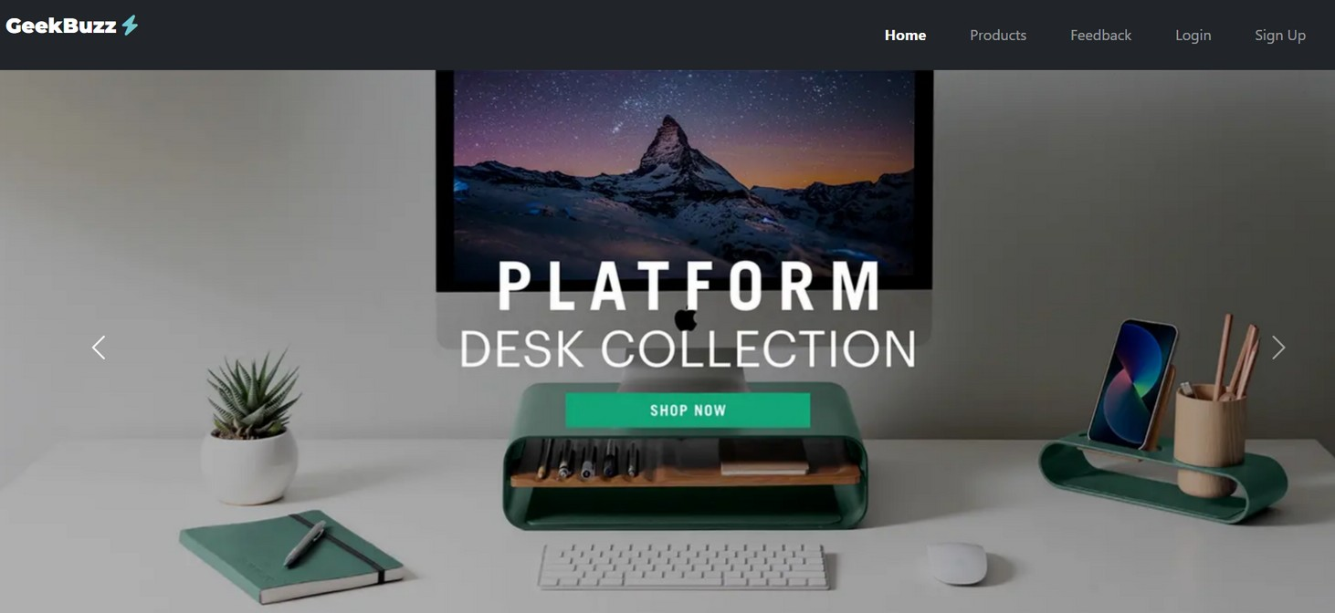
Home Page
Bootstrap Carousel contributes to a crossfade slideshow effect. Using Bootstrap makes the home page completely responsive.
The Navbar is using Bootstrap classes to create a clean and responsive navigation. The navbar is equipped with a hamburger icon for smaller screens.

Slide 5
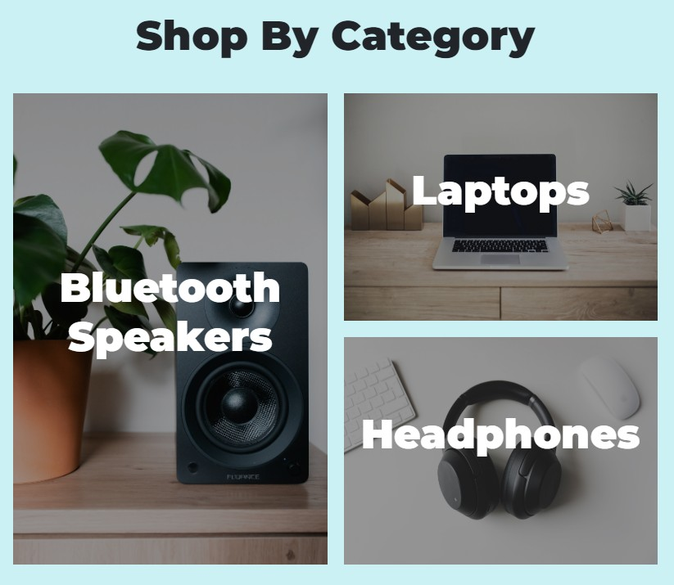
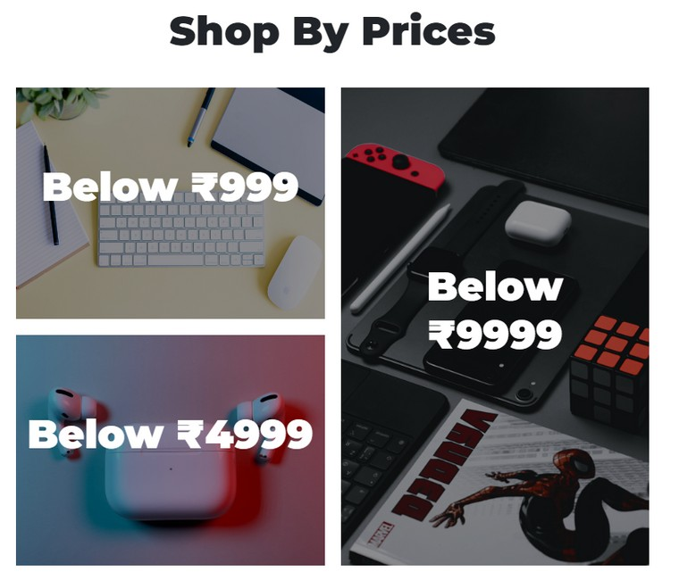
CSS Grid Layout
On the home page, Css Grid Layout is used to display products in a photoframe like grid look.

Slide 6
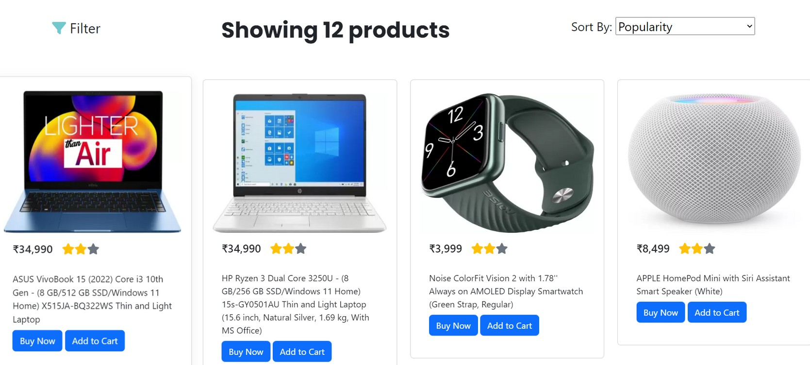
Products Page
Bootstrap Cards
Bootstrap Cards are used for product box along with button tags.
Flex Box
The cards are displayed using flexbox layout and is completely responsive.

Slide 7
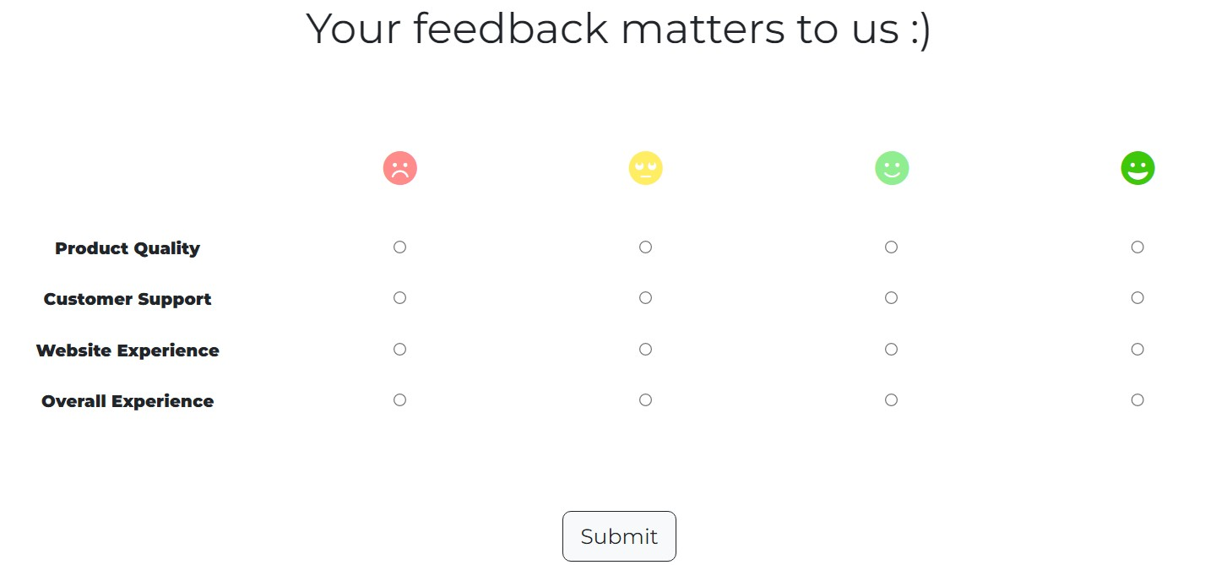
Feedback Page
The Feedback Page is implementing a table layout using the html <table> tag. Some cell padding is provided to keep the content equidistant and neat. Font Awesome icons give the page a clean and minimalistic look.

Slide 8

THANK YOU

