Slide 1
Data Science Project
Sentiment Analysis based on Tweets
By, 112003022 Yash Burbure
112003023 Yash Chandak
112003024 Jayraj Charane

Slide 2
Extraction - SNSCRAPE - a scraper for social networking services import snscrape.modules.twitter as sntwitter sntwitter.TwitterSearchScraper(query).get_items()
Sentiment Analysis Tool - VADER (Valence Aware Dictionary and sEntiment Reasoner) - specifically designed to analyze social media posts, customer reviews, etc
Filtering -
removed @mentions, #hashtags, urls from tweet-text
Tokenization, removed english stop words, lemmatization

Slide 3
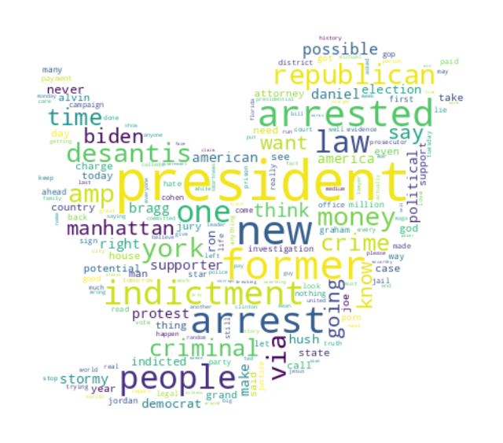
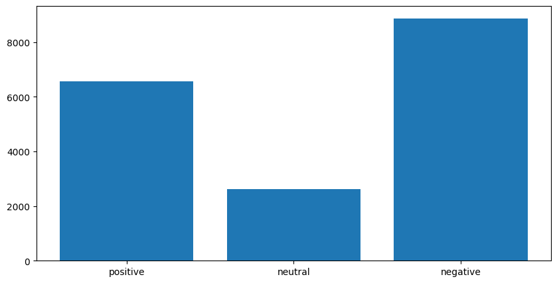
Analysis -
% positive negative and neutral tweets.
Word Cloud to gain knowledge of issues/concerns/domains of tweets of users.

Slide 4
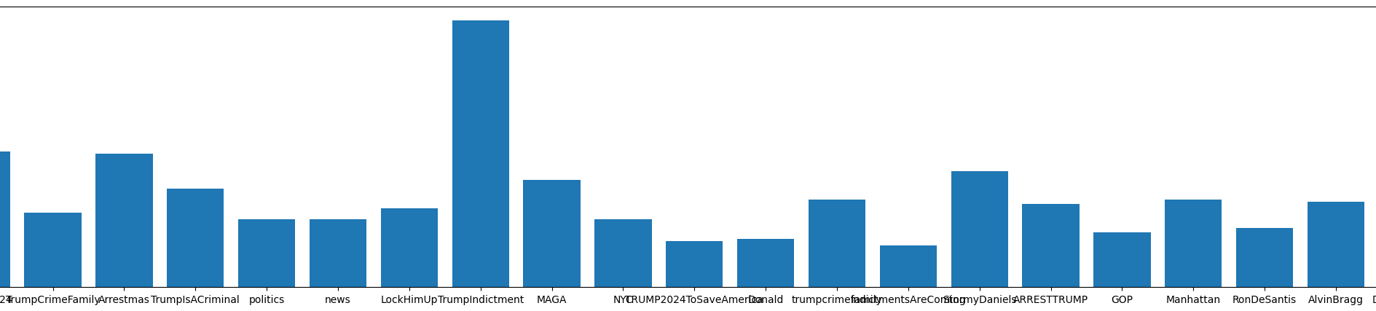
3. Top #hashtags with frequencies.

Slide 5
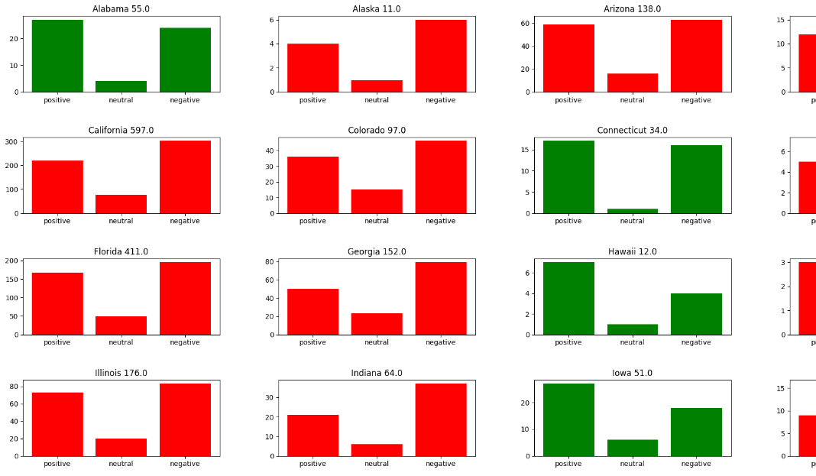
@political campaign application -
State wise sentiment analysis.
Analysis over time for the contendant/party.

