Slide 1

TOPIC STEERING OPEN-ENDED CHATBOT
Mid Semester Presentation
By
Yash Burbure 112003022
Yash Chandak 112003023
Jayraj Charane 112003024
Under the Supervision of
Prof. Archana Patil
7ᵗʰ March 2024
Department of Computer Engineering and Information Technology
COEP Technological University
Forerunners in Technical Education
1

Slide 2
Introduction
Motivation:
Chatbots have permeated every sector, from e-commerce and healthcare to banking and education, showcasing their versatility and impact. Their ability to offer real-time assistance, personalized interactions, and seamless integration across platforms underscores their significance in revolutionizing customer experiences and optimizing operational efficiency.
Department of Computer Engineering and Information Technology
COEP Technological University
Forerunners in Technical Education
2

Slide 3
Introduction
After conducting a brief literature survey on various chatbots available, we observed a gap in the exploration of target-guided conversation within open-ended chats.
Problem Statement:
An open-ended chat conversation system which can naturally steer discussions toward a specified topic.
Department of Computer Engineering and Information Technology
COEP Technological University
Forerunners in Technical Education
3

Slide 4
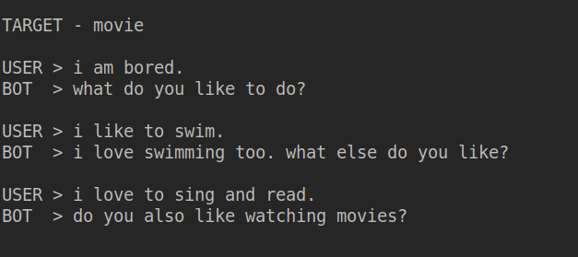
Introduction
Example of a target-guided conversation
Department of Computer Engineering and Information Technology
COEP Technological University
Forerunners in Technical Education
4

Slide 5
Introduction
Applications
Combining topic steering capability with dynamic target topic selection can be used for many application.
For promotional and advertising purposes where in the target advertisement topic will be dynamically set based on user conversation.
Department of Computer Engineering and Information Technology
COEP Technological University
Forerunners in Technical Education
5

Slide 6
Related Work
AUTHOR | YEAR | TITLE | OBSERVATION
Jianheng Tang, Tiancheng Zhao, Chenyan Xiong , Xiaodan Liang , P. Xing, Zhiting Hu | 2019 | Target guided open domain conversation | Researchers use Personachat dataset, neural based for keyword prediction and retrieval strategies for producing responses.
Jinghui Qin, Zheng Ye, Jianheng Tang, Xiaodan Liang | 2020 | Dynamic Knowledge Routing Network for Target guided open domain conversation | Proposes DKRN for better topic prediction; enhances retrieval performance for meaningful conversations.
Target-Guided Open-Domain Conversation Planning | 2022 | Target-Guided Open-Domain Conversation Planning | Uses ConceptNet to find next topic for response and generative model for producing responses.
Department of Computer Engineering and Information Technology
COEP Technological University
Forerunners in Technical Education
6

Slide 7
Research Gap
The idea of directing open-domain conversations towards particular topics has been relatively underexplored.
Some approaches excel in facilitating smooth transitions but struggle to reach the intended topic while some are good at achieving the target topic but may lack a natural flow in dialogue.
Department of Computer Engineering and Information Technology
COEP Technological University
Forerunners in Technical Education
7

Slide 8
Solution
The solution to steer conversation towards a specified topic involves 4 steps,
1. Identifying current conversation topic -
POS tagging + relatedness value from ConceptNet
Example,
Suppose the utterance is “India is a great country.” and target topic is “Ganga”
Candidate keywords : ('PROPN', 'India', 2), ('ADJ', 'great',0.5), ('NOUN', 'country',2)
Current keyword : India
Department of Computer Engineering and Information Technology
COEP Technological University
Forerunners in Technical Education
8

Slide 9
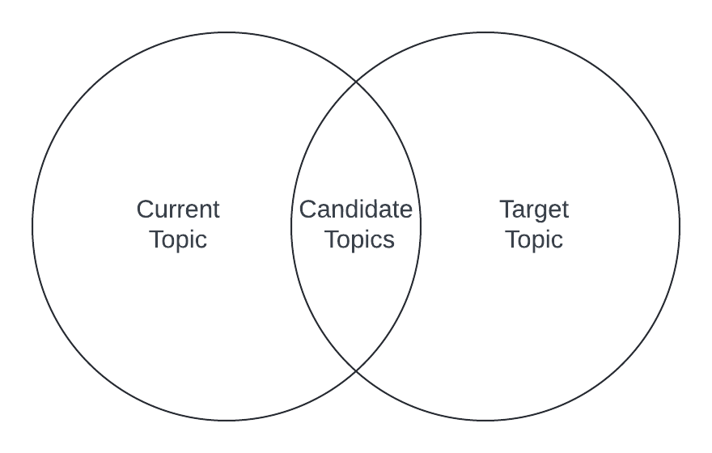
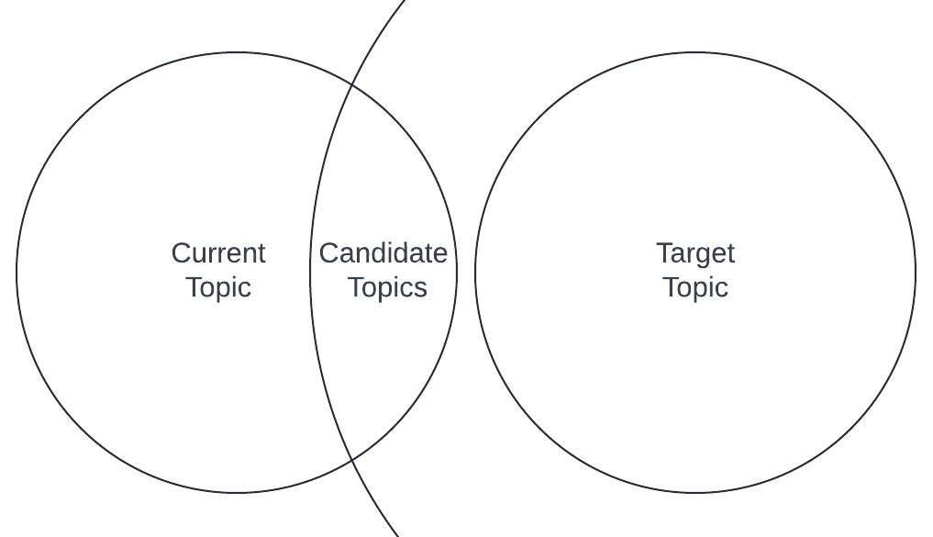
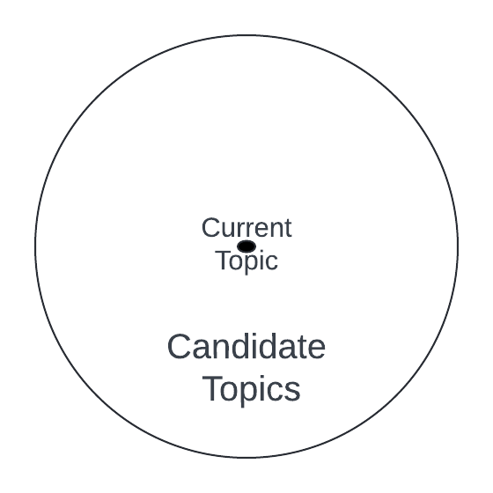
Solution
2. Finding candidate topics for response from ConceptNet - The intersection method
1st hop - 1st hop 1st hop - 2nd hop 1st hop only
Department of Computer Engineering and Information Technology
COEP Technological University
Forerunners in Technical Education
9

Slide 10
Solution
3. Selecting topic that approaches target -
ConceptNet's relatedness value to determine the distance between two words or topics.
Choose topic that is closest to target topic.
4. Generating response based on conversation history and selected keyword (topic) -
conversation _history and selected_keyword is provided as input to fine-tuned DialoGPT model
Department of Computer Engineering and Information Technology
COEP Technological University
Forerunners in Technical Education
10

Slide 11
Solution
Fine-Tuning DialoGPT-medium (Pretrained Response generation model)
PersonaChat dataset - Crowdworkers engage in natural conversations embodying assigned personas, covering various topics like work, family, personal interests, etc.
We extract keyword for each utterance using TF-IDF scores and POS weights.
Created training data by combining conversation history with extracted keyword of reply as input, and the reply for last utterance as output.
{ conv_history[-5:] } KW { keyword_of_reply } -> { reply }
The model was trained on 109697 conversations.
Department of Computer Engineering and Information Technology
COEP Technological University
Forerunners in Technical Education
11

Slide 12
Solution
Why ConceptNet for finding next topic for response?
Why relatedness value?
Why intersection method?
=> analysis.csv
Department of Computer Engineering and Information Technology
COEP Technological University
Forerunners in Technical Education
12

Slide 13
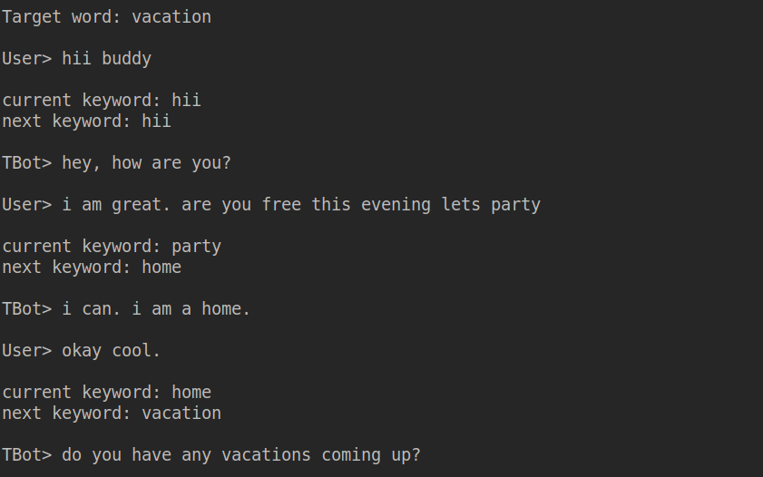
Example Chats
Target topic “vacation” was achieved in 3 responses of our chatbot
Department of Computer Engineering and Information Technology
COEP Technological University
Forerunners in Technical Education
13

Slide 14
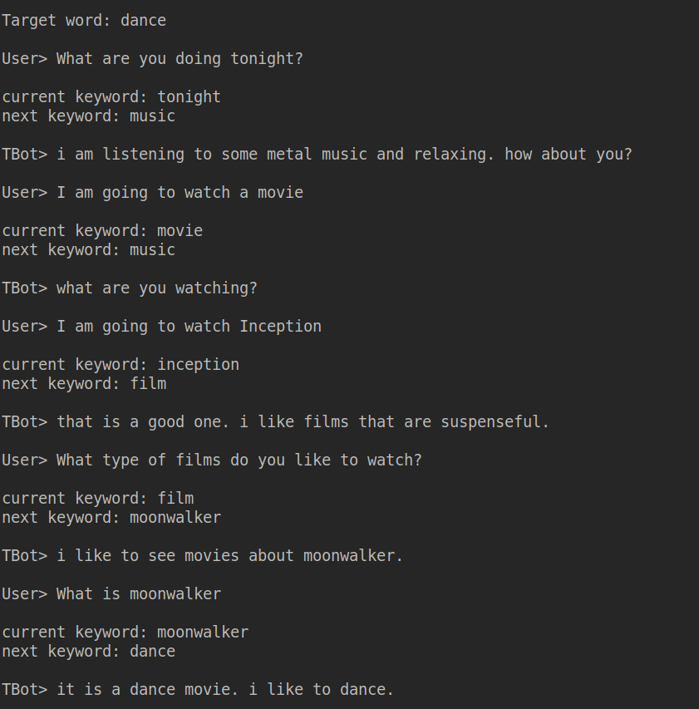
Example Chats
Target topic “dance” was achieved in 5 responses of our chatbot
Department of Computer Engineering and Information Technology
COEP Technological University
Forerunners in Technical Education
14

Slide 15
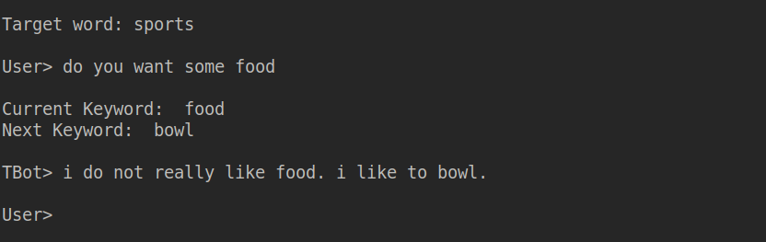
Example Chats
we see an abrupt topic transition from food to bowl (sports). This is due to the fact that “bowl” is related to both food and sports but with different meanings. It can be a bowl of rice or bowl in cricket
Department of Computer Engineering and Information Technology
COEP Technological University
Forerunners in Technical Education
15

Slide 16
Experimental Setup
We utilized Kaggle's P100 GPU, equipped with 16GB of dedicated graphics memory, alongside 29GB of RAM for training and experimentation.
Our cloud storage platform was Kaggle's storage service
PyTorch framework along with the Transformers library to fine-tune the DialoGPT model.
Department of Computer Engineering and Information Technology
COEP Technological University
Forerunners in Technical Education
16

Slide 17
Results
Performance of fine-tuned DialoGPT,
The aim was to produce responses that contains the keyword given in input,
We accept words having similarity greater or equal to 0.9 calculated from wordnet.
The length of test data was 552
Number of Epochs | Keyword Present | BLEU¹⁻⁴ | ROUGE-L | Cosine Similarity
1 | 70.29 | 7.39 | 27.79 | 86.12
2 | 60.14 | 7.65 | 27.70 | 86.02
3 | 54.53 | 10.58 | 29.08 | 86.56
Department of Computer Engineering and Information Technology
COEP Technological University
Forerunners in Technical Education
17

Slide 18
Results
Observations in automated chats
We conducted 50 conversations between our topic steering chatbot and BlenderBot-400M-distill by randomly selecting the target topic and initiating the conversation. The conversation length was capped to 8 responses by our chatbot.
Our chatbot successfully directed the conversation towards the target topic in 21 instances.
Nevertheless, in many unsuccessful conversations, our chatbot identified the target topic as the next keyword for its response, but it failed to incorporate it effectively.
self_play_50_convs
Department of Computer Engineering and Information Technology
COEP Technological University
Forerunners in Technical Education
18

Slide 19
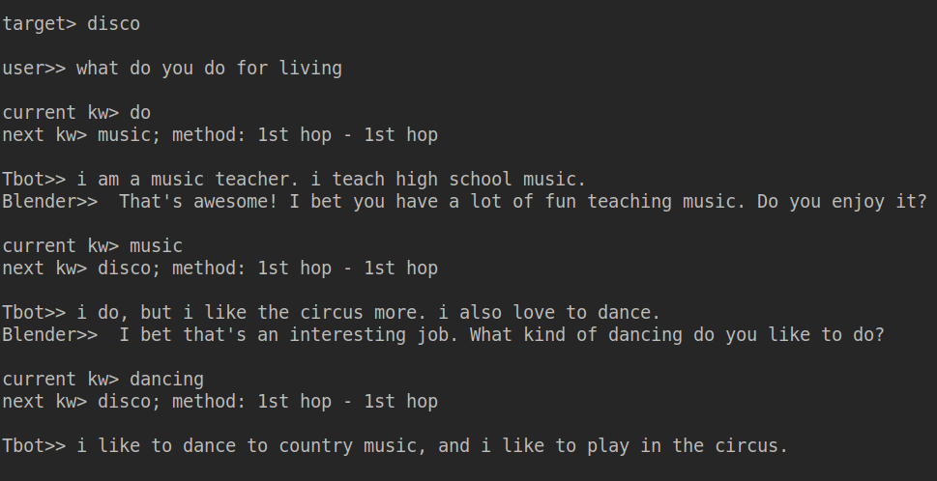
Results
Department of Computer Engineering and Information Technology
COEP Technological University
Forerunners in Technical Education
19

Slide 20
Conclusion and Future scope
We tried to develop an effective target-oriented topic steering open-ended conversation system.
Our proposed intersection method to find the next topic of response using ConceptNet reduced the search space and facilitated a seamless transition in conversation.
Our chatbot was able to reach target topic in 40% of chats. The major reason for this low score is the fact that fine-tuned DialoGPT fails to incorporate the given input keyword in generated response effectively.
Employing a larger model can enhance the fluency of responses and increase the likelihood of successfully generating a reply based on the given input keyword.
Also a larger database can help in generating more better responses in complex scenarios.
Department of Computer Engineering and Information Technology
COEP Technological University
Forerunners in Technical Education
20

Slide 21
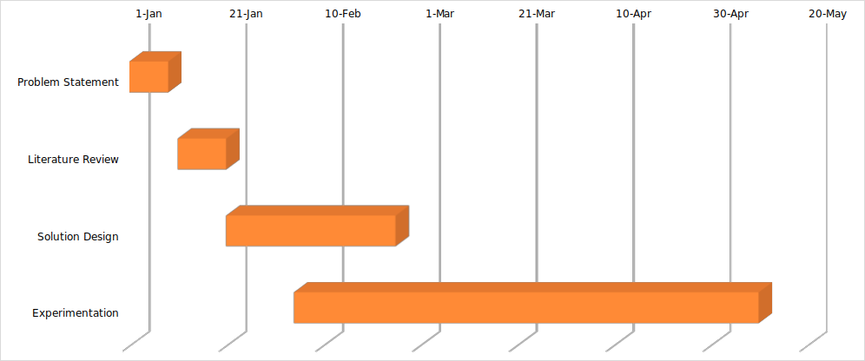
Development Timeline
Department of Computer Engineering and Information Technology
COEP Technological University
Forerunners in Technical Education
20

Slide 22
References
1. Yosuke Kishinami, Reina Akama, Shiki Sato, Ryoko Tokuhisa, Jun Suzuki, and Kentaro Inui. Target-guided
open-domain conversation planning. arXiv preprint arXiv:2209.09746, 2022.
2. Chin-Yew Lin. Rouge: A package for automatic evaluation of summaries. In Text summarization branches
out, pages 74–81, 2004.
3. George A Miller. Wordnet: a lexical database for english. Communications of the ACM, 38(11):39–41, 1995.
4. Kishore Papineni, Salim Roukos, Todd Ward, and Wei-Jing Zhu. Bleu: a method for automatic evaluation of
machine translation. In Pierre Isabelle, Eugene Charniak, and Dekang Lin, editors, Proceedings of the 40th
Annual Meeting of the Association for Computational Linguistics, pages 311–318, Philadelphia, Pennsylvania, USA, July 2002. Association for Computational Linguistics.
Department of Computer Engineering and Information Technology
COEP Technological University
Forerunners in Technical Education
21

Slide 23
References
5. Jinghui Qin, Zheng Ye, Jianheng Tang, and Xiaodan Liang. Dynamic knowledge routing network for
target-guided open-domain conversation. In Proceedings of the AAAI Conference on Artificial Intelligence, volume 34, pages 8657–8664, 2020.
6. Robyn Speer, Joshua Chin, and Catherine Havasi. Conceptnet 5.5: An open multilingual graph of general
knowledge. In Proceedings of the Thirty-First AAAI Conference on Artificial Intelligence, 2017.
7. Jianheng Tang, Tiancheng Zhao, Chenyan Xiong, Xiaodan Liang, Eric P. Xing, and Zhiting Hu. Target-guided
open-domain conversation. In Proceedings of the 58th Annual Meeting of the Association for Computational Linguistics, 2020.
8. Saizheng Zhang, Emily Dinan, Jack Urbanek, Arthur Szlam, Douwe Kiela, and Jason Weston. Personalizing
dialogue agents: I have a dog, do you have pets too? arXiv preprint arXiv:1801.07243, 201
Department of Computer Engineering and Information Technology
COEP Technological University
Forerunners in Technical Education
22

Slide 24
Thank You
Department of Computer Engineering and Information Technology
COEP Technological University
Forerunners in Technical Education
23

