Slide 1
VERSION CONTROL SYSTEM (VCS) INTRODUCTION

Slide 2
What is version control?
Basic functionality:
Keep track of changes made to files over time
Merge the contributions of multiple developers
Allow you to recover old file changes when ever you want
Benefits:
  Facilitates backups
  Increased productivity (vs manual version control)

Slide 3
Additional benefits
Accountability
  who wrote the code?
  do we have the rights to watch it?
Record Keeping

Slide 4
More Benefits
Employers use version control – and many (maybe most?) use git
Git is professional grade – learn it now!

Slide 5
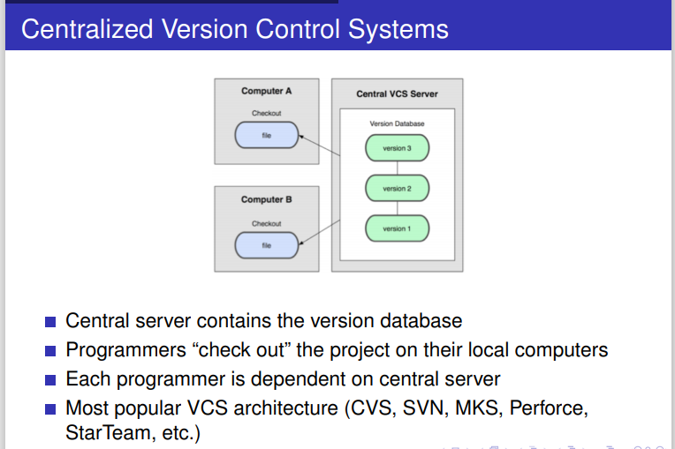
Centralized VCS:

Slide 6
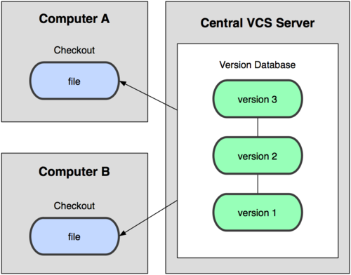
Centralized Version Control : SVN
Subversion is like this

Slide 7
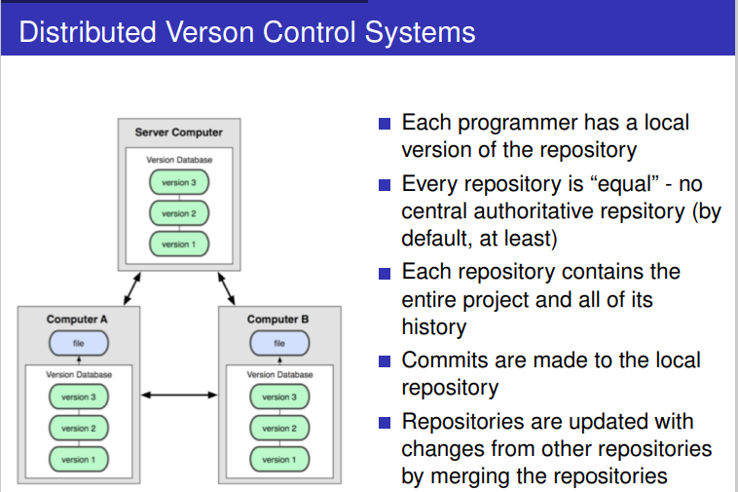
Distributed VCS :

Slide 8
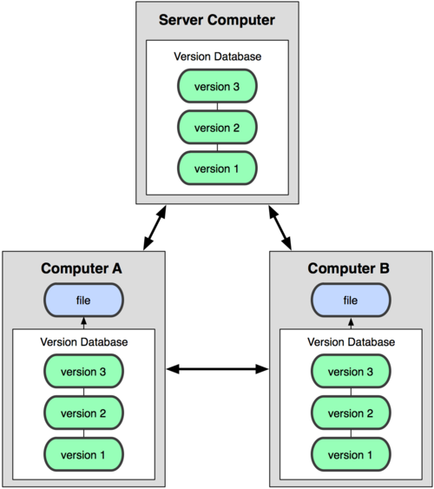
Distributed Version Control : GIT

Slide 9
GIT

Slide 10
GIT BASICS
Summarizing the demo

Slide 11
Created in 2005 by Linus Torvalds
Probably the leading DVCS in use today

Slide 12
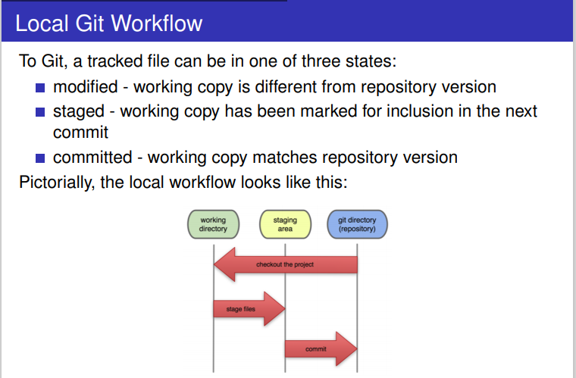
Git Workflow :

Slide 13
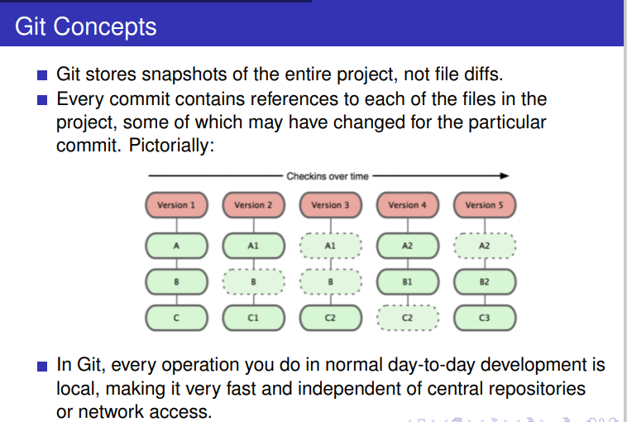
Git Concepts :

Slide 14
Simple command line
Open Git Bash terminal
Where am I??
  pwd – print working directory
How do I move around??
  cd – change directory
  cd c:/csm_classes – change to a specific path
  cd .. – change to parent directory.
What files are there?
  ls – list files/directories
  ls - l – list with details

Slide 15
More command line
Use up/down arrow to select/repeat commands
Click on icon in top left corner to change properties of the command window OR edit (e.g., copy, paste)
May be able to use tab completion

Slide 16
Tell Git who you are
Update your Git config one time only to know Git about you and Your mail
  git config --global user.name “your name”
  git config --global user.email “your client email”
  For Example , I can use below for GIT Global Configuration
git config --global user.email "kirankumarrv0990@gmail.com"
git config --global user.name "KiranKumar“
Once you are done , you can see Global Configuration list with below command
git config --list

Slide 17
Adding a new SSH key to your GitHub account
Generate ssh keys with ssh-keygen -t rsa command from your Git Bash (From Laptop ) and copy public key from the specified path.
Copy the SSH public key from specified location (like /C/Users/Kiran/.ssh/id_pub)
2.In the upper-right corner of any page, click your profile photo, then click Settings.
3.In the user settings sidebar, click SSH and GPG keys.
4.Click New SSH key or Add SSH key.
5.In the "Title" field, add a descriptive label for the new key.
6.Paste your key into the "Key" field.

Slide 18
Clone a repository using the command line
From the Github repository, click + in the global sidebar and select Clone this repository under Get to work.
Copy the clone command (either the SSH format or the HTTPS). ...
https://github.com/kirankumar77/payment.git
3.From a terminal window, change to the local directory where you want to clone your repository.
Example: Perform below command from GitBash to Download Repo
git clone https://github.com/kirankumar77/payment.git

Slide 19
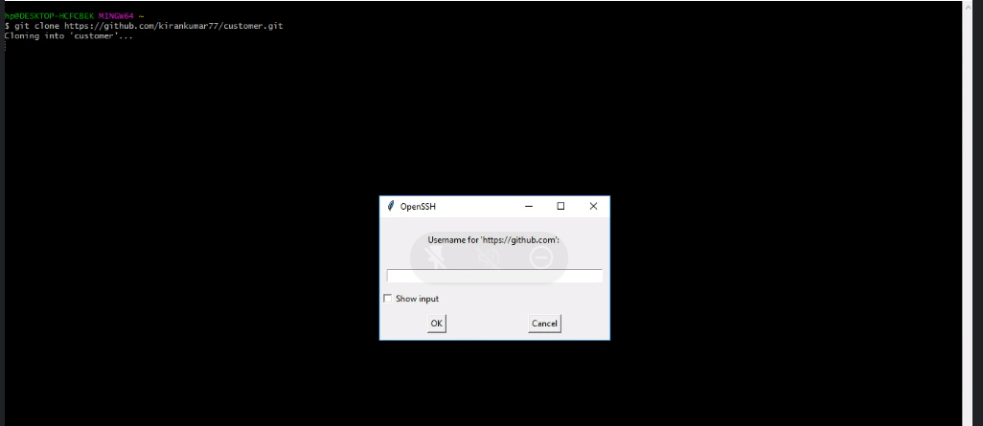
GIT Clone (Private Repo) : It will ask username and password of a particular owner during the clone and with out username/password , no chance to clone that private repo

Slide 20
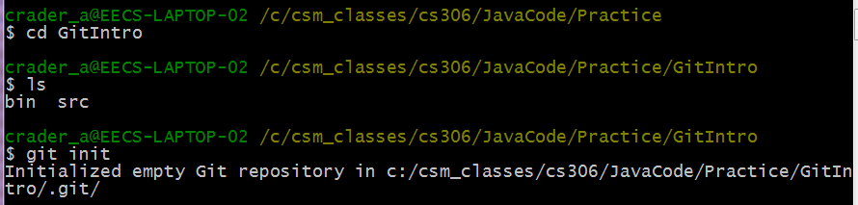
Getting started :
Create a Java Project (mine is GitIntro)
cd into project directory
git init
Create a class (mine is HelloGit)

Slide 21
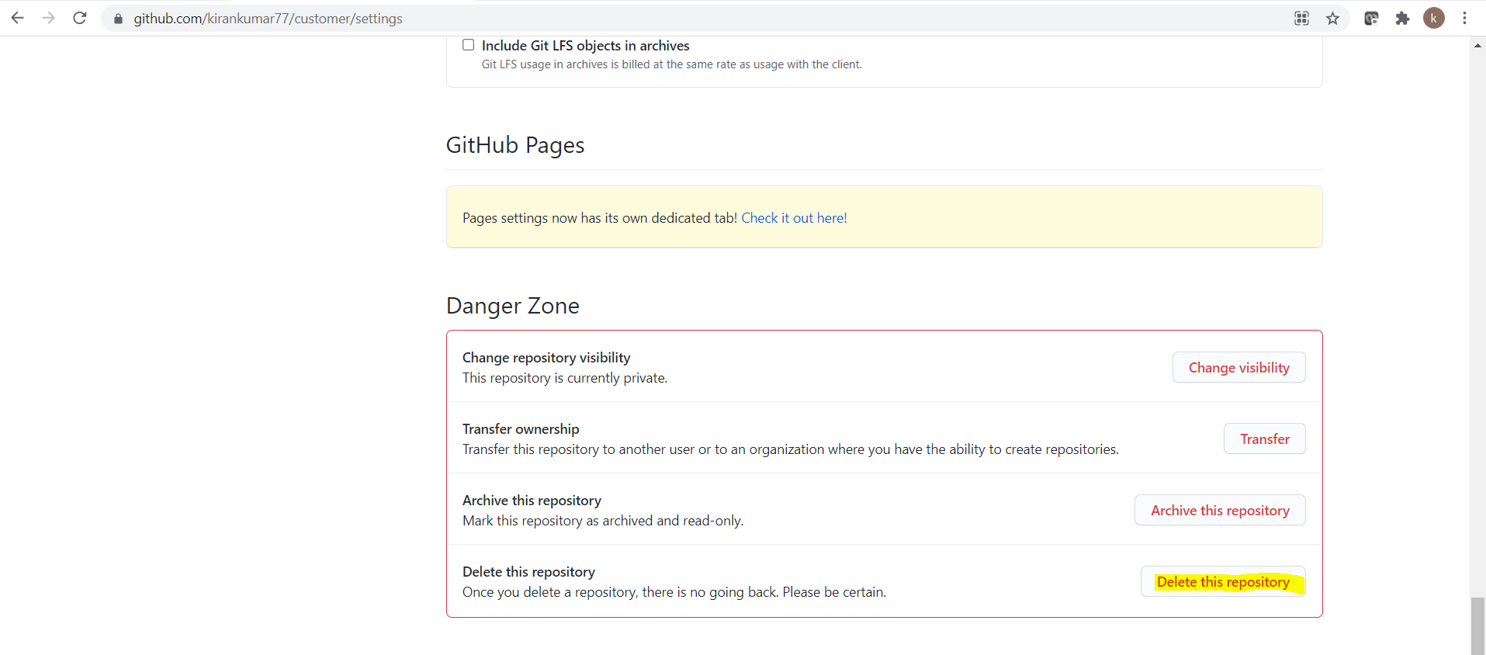
How to Delete Repo from Github:
Go to Github -> select Repo which you want to delete –> select settings –> come to bottom of the page and there you can see below info and select Delete this repository

Slide 22
Branch Creation Commands:
git branch -a -> will give branch list
git branch video -> create new branch
git checkout video -> switched to video branch
git checkout -b audio -> create new branch and switched to that branch

Slide 23
.gitignore
It’s important to tell Git what files you do not want to track
Temp files, executable files, etc. do not need version control (and can cause major issues when merging!)
https://help.github.com/articles/ignoring-files
Example (place in root of repo):
  *.class
  .project
  .classpath
  .settings/
repo
ignore
eclipse
exec
What is a hidden file?

Slide 24
.gitignore practice:
[root@centos-jenkins payment]# cat .gitignore (git wont track .txt files )
*.txt
[root@centos-jenkins payment]# vi maven.txt
[root@centos-jenkins payment]# ls
maven.txt README.md src.java test.txt
[root@centos-jenkins payment]# git add maven.txt
The following paths are ignored by one of your .gitignore files:
maven.txt
Use -f if you really want to add them.
fatal: no files added

Slide 25
More .gitignore :
# Directories #
/build/
/bin/
target/
# OS Files #
.DS_Store
*.class
# Package Files #
*.jar
*.war
*.ear
*.dba
# Windows image file caches
Thumbs.db
# Folder config file
Desktop.ini
# OSX
.DS_Store
.svn
# Eclipse
*.pydevproject
.project
.metadata
bin/**
tmp/**
tmp/**/*
*.tmp
*.bak
*.swp
*~.nib
local.properties
.classpath
.settings/
.loadpath
/src/main/resources/rebel.xml

Slide 26

Local Operations
Why might you want to stage files?

Slide 27
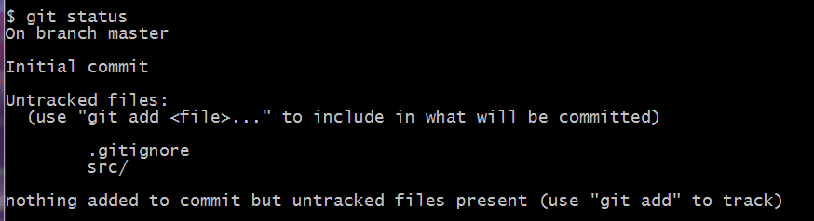
What’s the status?
Nothing tracked yet.
get used to reading helpful messages

Slide 28
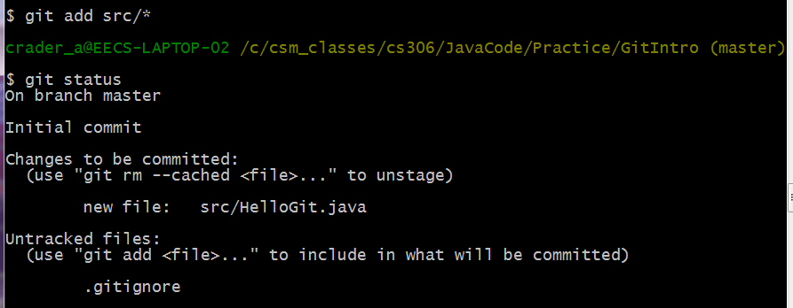
Let’s track a file
git add – tells git to track a file

Slide 29
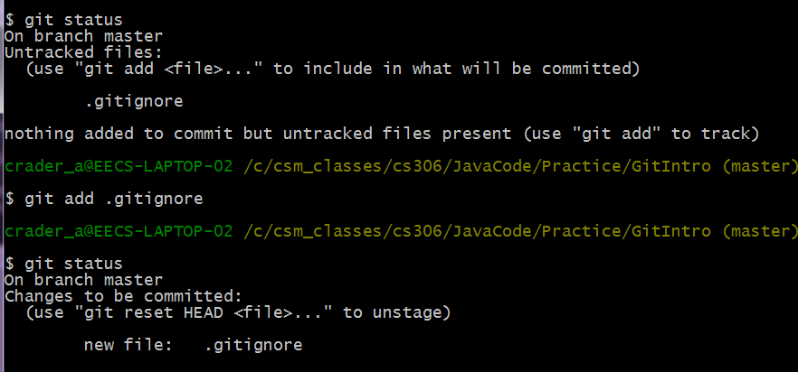
Also good to commit .gitignore
often desirable to have no untracked files

Slide 30
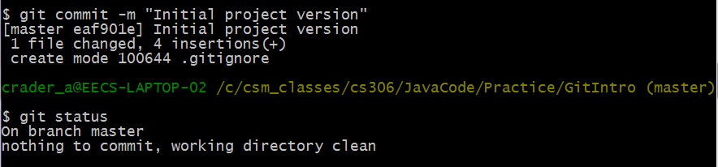
Commit the file to the Git database
When you commit, you must provide a comment (if you forget, Git will open a text editor so you can write one).

Slide 31
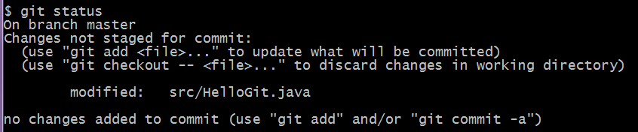

What if you change the file?
Notice more helpful hints Git provides.
You could add to the staging area, OR add & commit in one step.
Be careful if you add to the staging area and then make more changes – the file can appear as both staged and unstaged. For now, I suggest doing –am

Slide 32
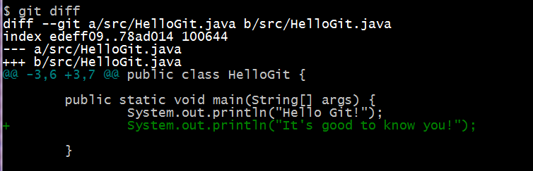
You made some changes – but what did you do?
This command compares your working directory with your staging area.
These are the changes that are not yet staged.

Slide 33
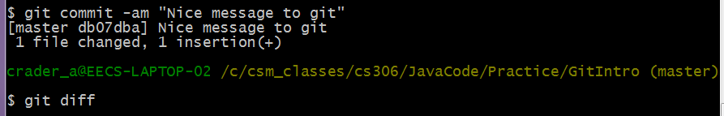
What if you’ve committed all your changes?
diff doesn’t have anything to display

Slide 34
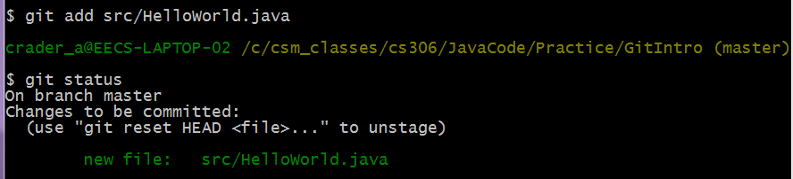
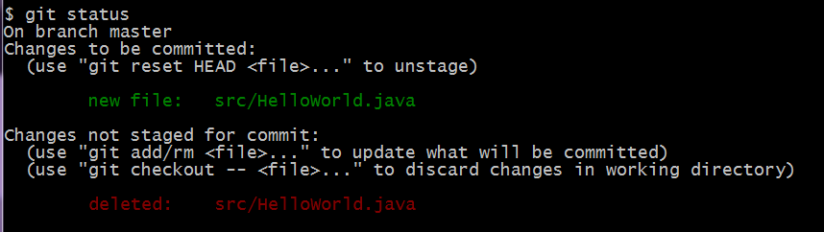
What if I remove a file?
File added not committed
Now I remove HelloWorld.java from inside Eclipse

Slide 35
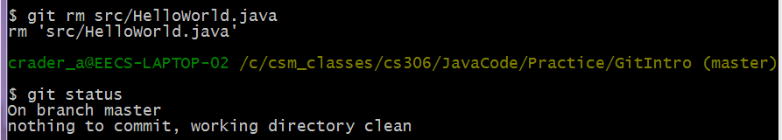
removal, continued
This removes the file from being tracked. If you’ve already committed,
the file is still in the database. -- see github tutorials for info on this.

Slide 36
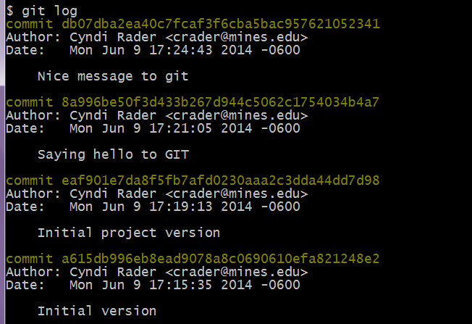
So what all have I done?
There are many useful options for git log.

Slide 37
git log options
Can specify a format, such as:
  git log --pretty=oneline
  MORE options, see documentation
Can filter, such as:
  git log --since=2.weeks
  includes filters like –since, --after, --until, --before, --author etc
Can redirect output to file, such as:
  git log >> gitlog.txt
  .

Slide 38
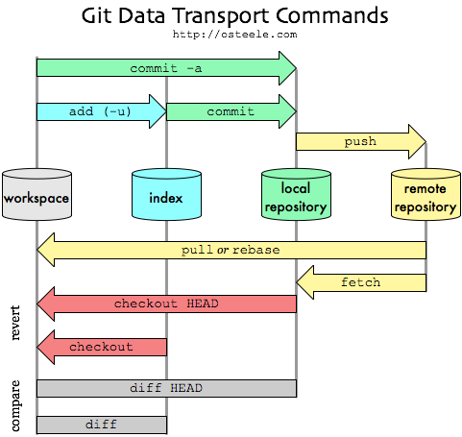
The Big Picture

Slide 39
Quick Summary for git bash
cd to your project or source directory
  cd = change directory. Example:
  cd cs306
  cd MyProjects
  cd GitDemo
ls (shows a list of files in that directory)
git init (creates .git repo)
git add src/* (tracks all files in source directory)
git commit -am “Initial commit” (adds files to repo)
git status (see what files have been modified, etc.)
git diff (see what changes you’ve made to files)
git log (see list of commits)

Slide 40
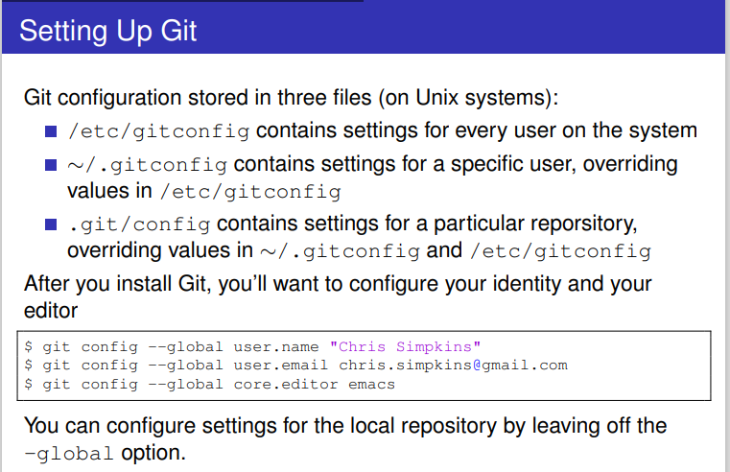
Git Setup from Git Bash:

