Slide 1

Analysis and Prediction of Marketing Campaign Effectiveness
Group 1
Jai Bhala
Yash Dodia
Sunny Grover
Deeba Haider
Karan Mehta
Anshuman Pradhan

Slide 2
Problem Context and Objectives
Data of a Portuguese banking institution that focuses on Bank’s telemarketing campaign.
Contains details about previous campaigns, related client attributes and outcome of previous campaigns.
In today’s highly competitive world, positive feedback to marketing campaigns are very low. Targeted marketing campaigns can provide better results.
What factors contribute to identify targeted audience for Bank’s Term deposit?
Objectives:
Analyze and understand the factors that contribute to customer subscribing to Bank’s Term Deposit.
Develop different models based on predictive analysis techniques to find the best fit.
Understand the effectiveness of previous marketing campaigns to plan future campaigns accordingly for better outcome.

Slide 3
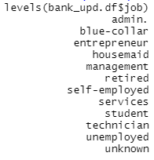





Dataset Description
The dataset contains the details of direct marketing campaigns (phone marketing) of a Portuguese banking institution. The data provides insights to bank client’s attributes, bank campaign’s attributes and the Outcome variable indicating if the bank term deposit product was subscribed or not.
Dataset - bank-full.csv (Source: https://archive.ics.uci.edu/ml/datasets/Bank+Marketing)
The dataset has 45,211 observations and 17 variables.
Client’s Attributes:
Variable Name | Description | Variable Type
age | Age of customer | Continuous
job | Type of Job of customer | Categorical
marital | Marital status of the customer | Categorical
education | Education level of the customer | Categorical
default | If customer has credit in default? | Categorical
balance | Balance of the customer | Continuous
housing | If customer has housing loan? | Categorical
loan | If customer has personal loan? | Categorical

Slide 4

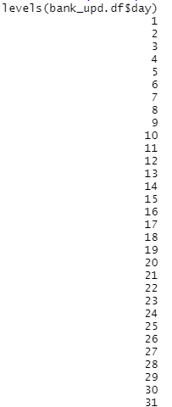
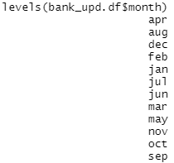

Dataset Description
Campaign Attributes:
Outcome Variable:
Variable Name | Description | Variable Type
contact | contact communication type | Categorical
day | last contact day of the week | Categorical
month | last contact month of year | Categorical
duration | last contact duration, in seconds | Continuous
campaign | number of contacts performed during this campaign and for this client | Continuous
pdays | number of days that passed by after the client was last contacted from a previous campaign | Continuous
previous | number of contacts performed before this campaign and for this client | Continuous
poutcome | outcome of the previous marketing campaign | Categorical
Variable Name | Description | Variable Type
Y | has the client subscribed a term deposit? | Categorical (Yes / No)

Slide 5


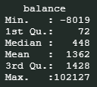
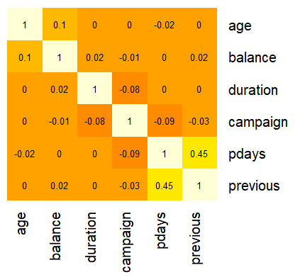
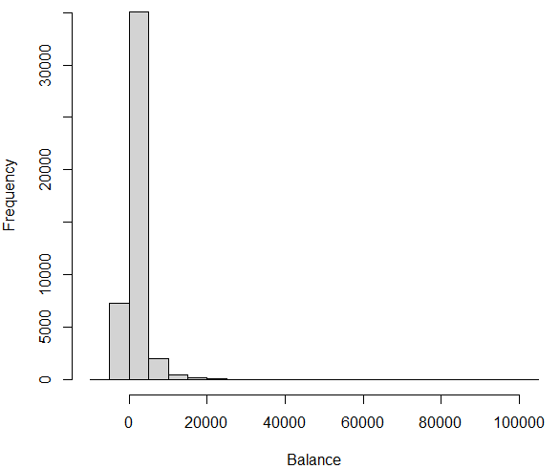
Initial Analysis
Most of the variables are categorical variables, we converted those variables using as.factor().
29% of the data for Contact variable falls under ‘unknown’ category.
Most of the data for poutcome variable falls under ‘unknown’ category
Balance variable contains negative values and most of the clients have balance less than 12500.
Between all numeric variables, only pdays and previous variables have some level of relationship but not so strong to exclude anyone of these variables
Partitioned the data into Training data (60% - 27,127 rows)
and Validation data (40% - 18,084 rows)

Slide 6
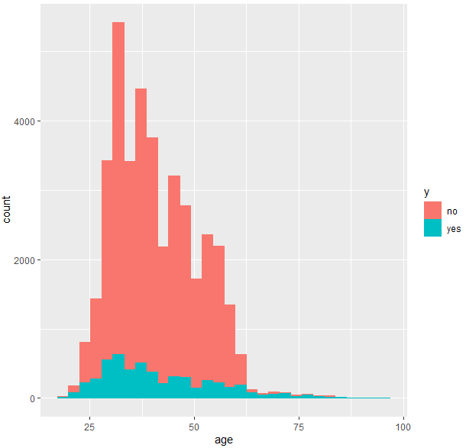
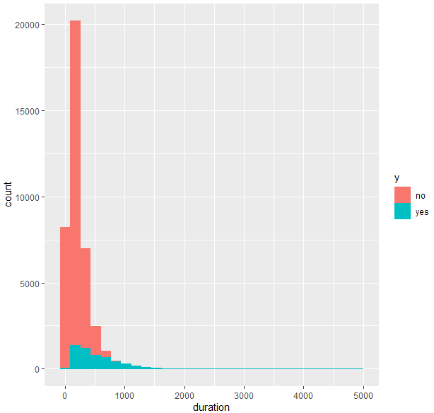
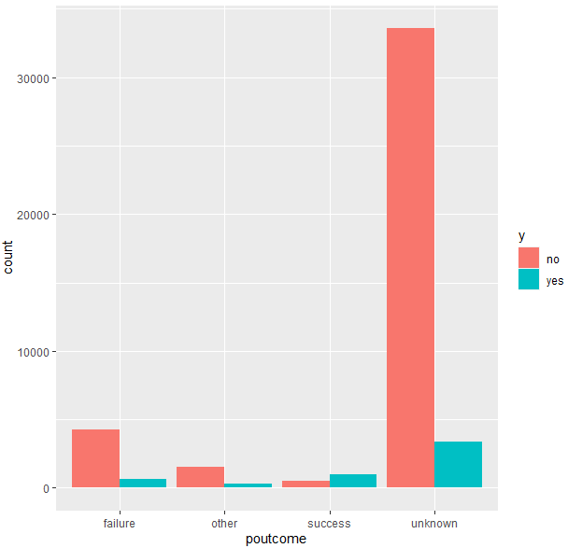
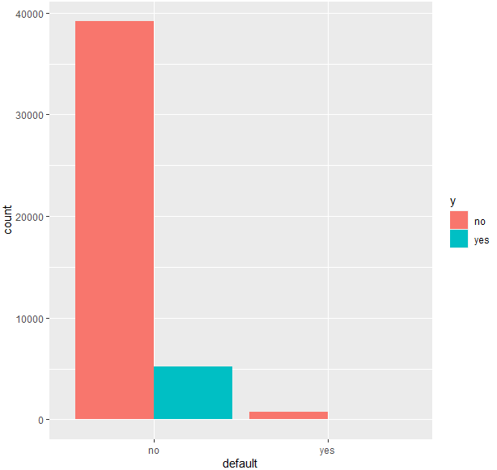
Initial Analysis
Most of the clients Below age of 25 years and over the age of 60 years tends to accept Term Deposit offer.
The duration of call seems to highly influence the outcome variable. Longer duration call results into successful subscription of Term deposit.
Not a good variable to be included in Model.
The poutcome seems to have good influence on the outcome variable. If the client subscribed to bank’s product in last campaign, there are high chances they will subscribe to the Term Deposit.
Clients that have credit in default do not tend to choose the Term Deposit.

Slide 7
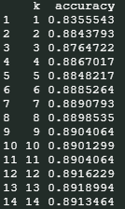
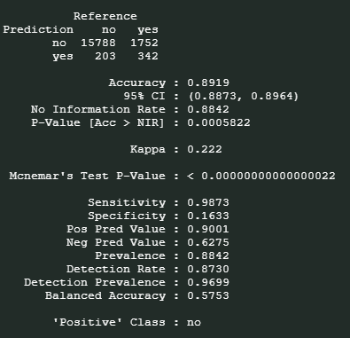
Analysis and Results
kNN:
Excluded contact (due to large values being ‘Unknown’), day (Due to no influence on Outcome variable) and duration (as duration will not be known for any new call) variables.
Identified k=13 as the best k based on accuracy (89.19%).
With K=13, achieved:
Accuracy = 89.19%
Sensitivity = 98.73%
Specificity = 16.33%

Slide 8
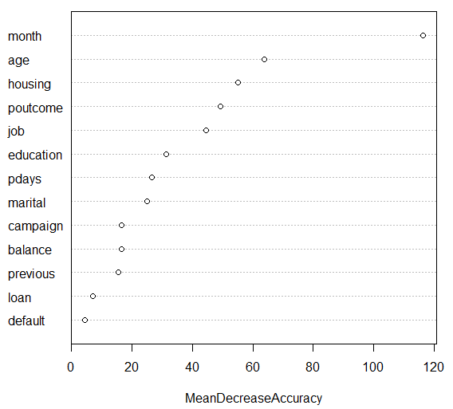
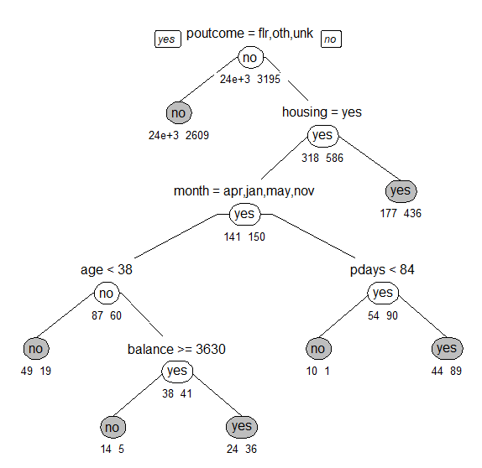
Analysis and Results
Classification Tree:
Identified the best CP value (0.0018) and developed pruned tree based on that.
Achieved 89.48% accuracy with 98.89% sensitivity and 17.57% specificity with the best pruned tree.
To further increase the accuracy, we applied Random Forest technique and identified important variables to predict the outcome.
Achieved 89.39% accuracy with 98.15% sensitivity
and 22.49% specificity with the random forest.

Slide 9
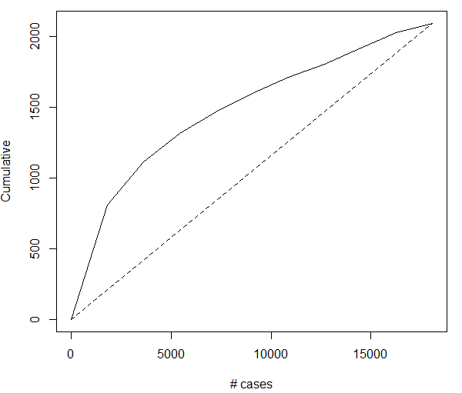

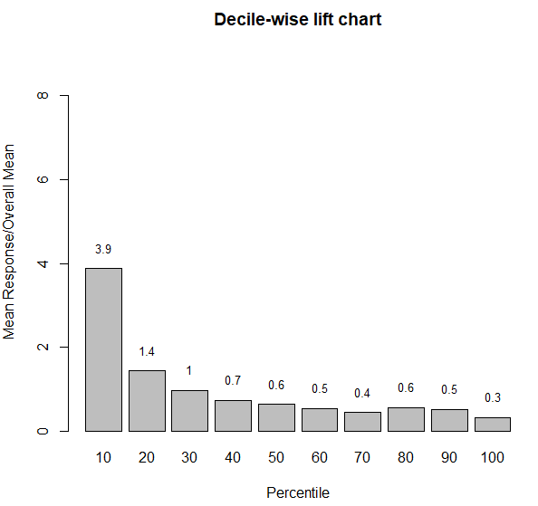
Analysis and Results
Logistic Regression:
Employed logistic regression model and achieved 89.36% accuracy with 98.71% sensitivity and 17.96% specificity .
Co
Co2
Decile

Slide 10
Comparison of different methods
kNN
Classification Tree
Logistic Regression
From 1-14, k= 13 gave us the best accuracy when running k-NN at 89.18%, and the lowest accuracy was 83.55% at k= 1
Very close in accuracy to our pruned tree but still less.
Having higher values of accuracy than k-NN and Logit, our best pruned tree seems to be the best method in predicting whether a customer will subscribe to a bank’s Term deposit.
poutcome, housing, pdays, month, age and balance are the predictors used in our classification tree.
Even with a lower accuracy given by random forest, it is still a higher accuracy than k-NN and Logit.
When running Logit, the Decile Chart bars did have a consistent decline but with a slight increase of 0.1 at the 80th percentile.
Accuracy for both Logit and k-NN were very close to our pruned tree but still less; specificity for all 3 methods were relatively the same, with only a difference in range of about 2%
Our initial assumption aout the Title word count may affect sales, turned out to be true.

Slide 11
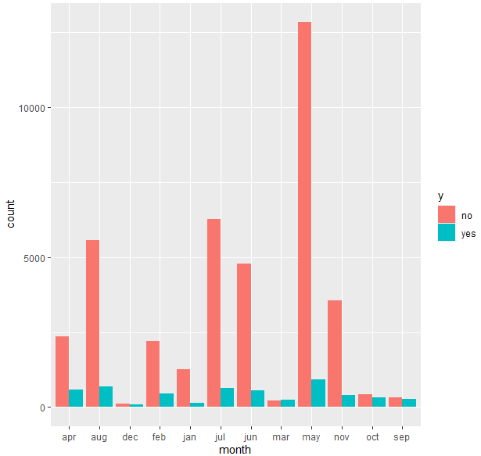
Conclusion and Recommendations
Classification tree method provided the best accuracy among kNN, Classification Tree and Logistic regression.
Month, Age, Housing and pOutcome variables has most influence in determining the outcome variable.
March month being the financial year-end turned out to be the best time to conduct Marketing campaign.
Clients with last successful campaign, having housing loan contacted outside the months of (Apr, Jan, May and Nov) and last contacted more than 84 days ago, are good targeted audience for Term Deposit.

