Slide 1
Group 7 - Final Project
Jai Bhala
Yash Dodia
Sunny Grover
Deeba Haider
Karan Mehta
Anshuman Pradhan

Slide 2
Overview
Over the past decade, the prices in the housing market have increased dramatically in all parts of the Bay Area. Several young prospects have been waiting quite a few years now to be able to purchase a standard single family home with these prices. It is almost given that any standard, single-family home in the Bay Area is not less than $1.5 million. In this first part of our project, we have used data scraping and cleaning to gather information about various aspects of the several home listings found on Zillow.com.

Slide 3
Steps Followed
Web Scraping
Data Cleaning
Exploratory Analysis
Conclusion
Model Creation

Slide 4
Web Scraping
Loaded the data from first four pages for 20 defined cities.
Extracted the URLs for each of the listed properties and extracted the attributes like street address, city, state, zipcode, latitude and longitude, price, YearBuilt, LotSize, HomeType, Zestimate, Bedrooms, Bathrooms, LivingArea, HOA, BrokerageName, LastSoldPrice, HomeStatus, Parking.

Slide 5
Web Scraping - Technical Challenges
Problem:
Zillow has a built-in security system where if you hit their website repeatedly, they would block you for a few hours.
Solution:
Made the header requests as close as possible to a regular user.
Implemented a randomized delay between request calls
After every page, sleep for 2 seconds
After every property links, sleep between 2 to 10 seconds

Slide 6
Dataset Overview
713 listing records from 20 cities in Bay Area.
19 Attributes related to listing Address, specifications, Broker Information and Price.
Attributes of Text, Numeric, Categorical data types.

Slide 7
Data Cleaning
Extracted the data from website and then converted it into a csv file. Used the same csv file to load the data back into a data frame.
Removed the duplicates using the df.drop function.
Removed the records where the street address was not available.
Checked the missing values and removed / replaced them using df.isna() and df.dropna().
Checked and updated the data types using df.dtypes function.

Slide 8
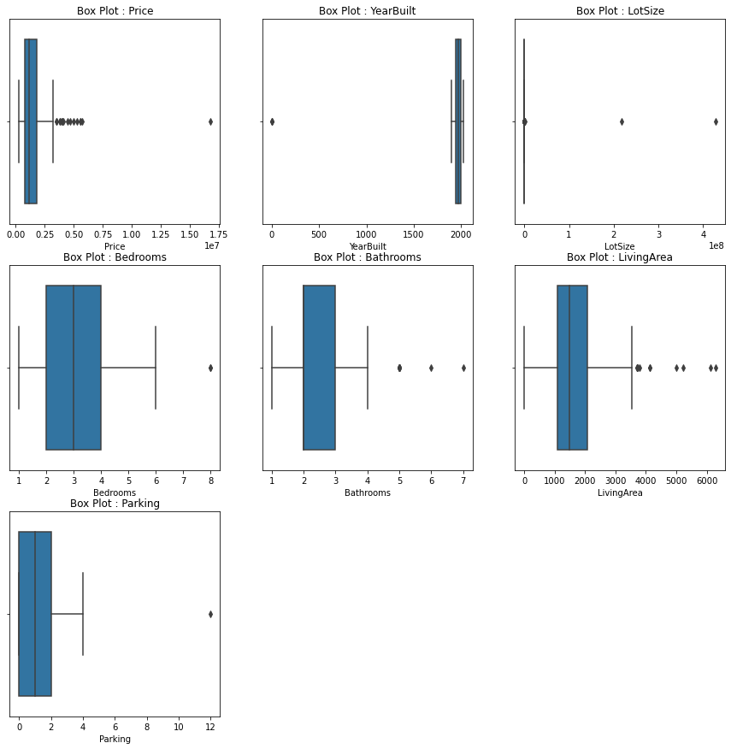
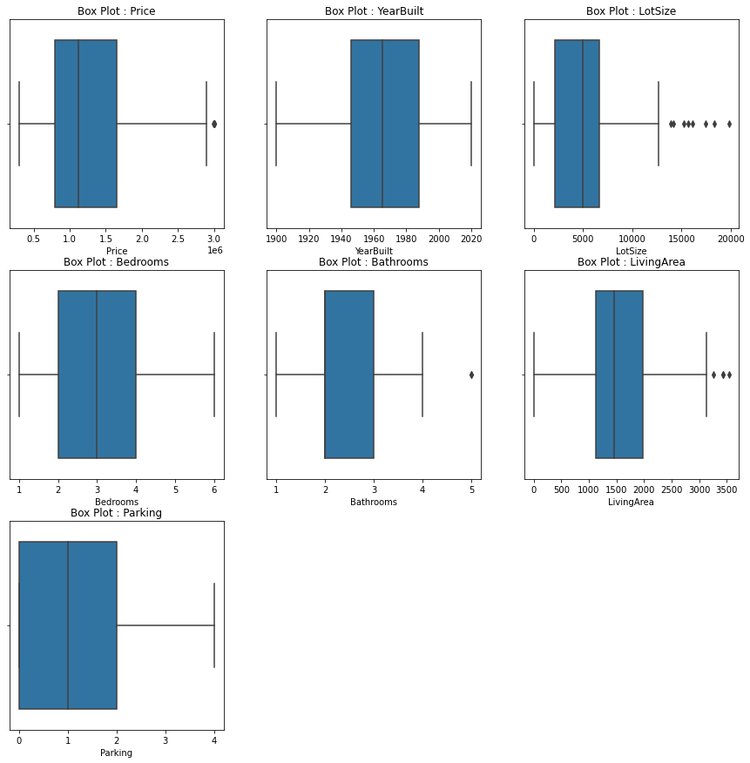
Outlier - Data Cleaning
Used a box plot to identify the outliers using seaborn and matplotlib.
Using the above libraries we were able to identify the outliers and remove them.
Created a new box plot to re-verify the outliers.

Slide 9
Research Questions Overview
Upon completion of the first part of this project, which was collecting and cleaning the data of home listings obtained from the zillow website, we had the following research questions:
The Most Famous city in term of Property listing
Which city in Bay Area has the highest appreciation ratio
The Most Famous city in term of Property Median price
Broker with highest number of property listings
Median price by Home Type
Best city for a particular home type
Most significant attribute that impacts Price

Slide 10
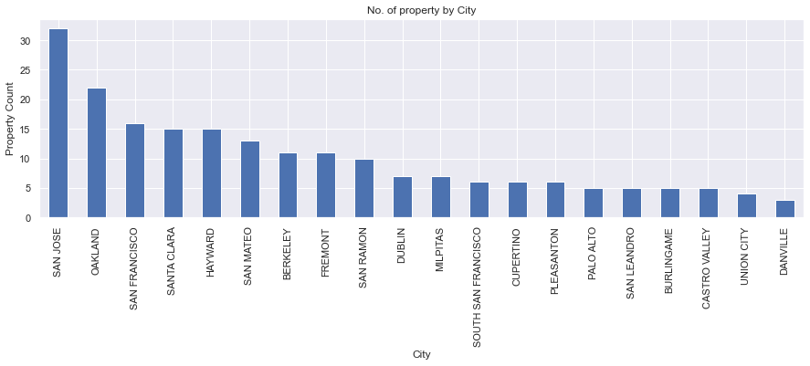
The most famous city in terms of property listing
Based on the numbers of property by city as seen above, we can see that San Jose is the most famous city in the Bay Area in terms of property listings. Seeing as how they have both suburban and urban areas in the city, it makes sense that they are the city with the most listings.

Slide 11
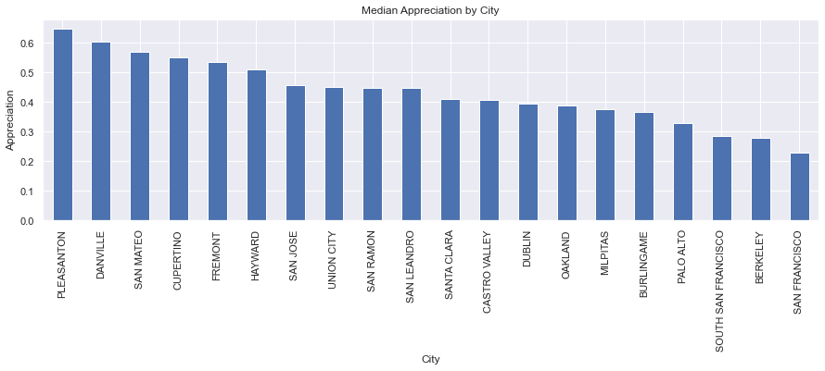
City in Bay Area with highest appreciation ratio
While several Bay Area cities have their homes appreciate in value rapidly, Pleasanton has the highest appreciation ratio of them all coming in at about 0.65. However, not too far behind are Danville, San Mateo, and Cupertino with appreciation ratios of no less than 0.55.

Slide 12
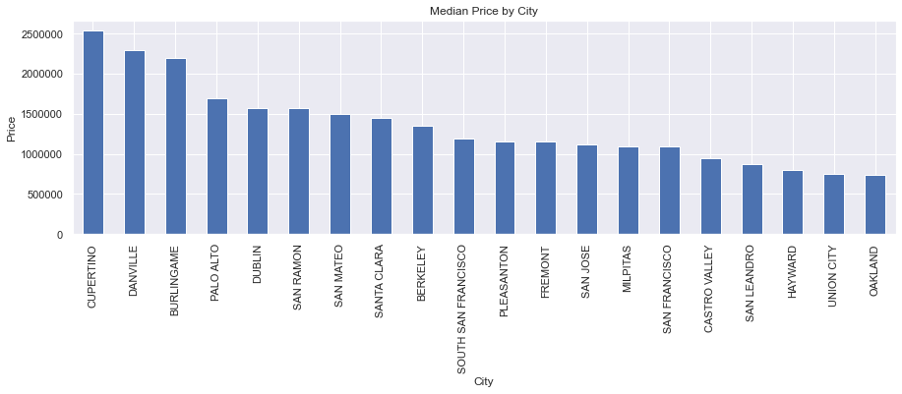
Most Famous city in term of Property Median price
Based on the bar chart above, we can see that Cupertino is the most famous Bay Area city in terms of Property Median price.

Slide 13
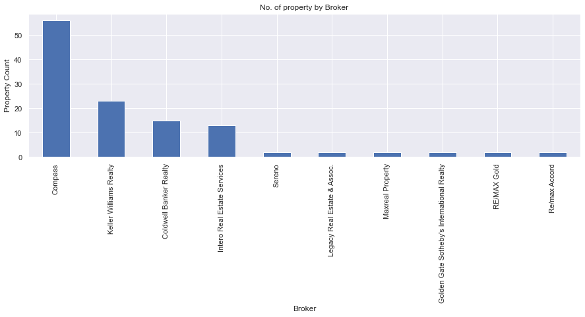
Broker with highest number of property listings
Compass is the brokerage that has the most listings and dominates Zillow’s websites of Bay Area property listings. Interestingly enough, it wasn’t Re/Max or Coldwell Banker, as we initially thought that would dominate the listings as those are most often the brokerage ads we see around the cities.

Slide 14
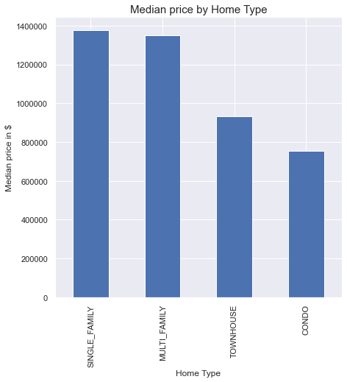
Median price by Home Type
For Single-Family homes, the median price is around 1.35 million
For Multi-Family homes, the median price is around 1.31-1.32 million
For Townhomes, the median price is around 900,000
For Condos, the median price is around 750,000

Slide 15
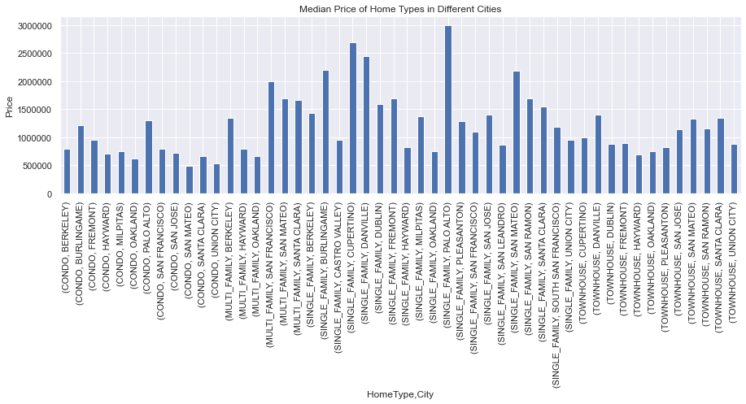
Best city for a particular home type
Since our question is asking what is the best city for a particular home type and our bar chart reflects the median price of home types in different cities, we are qualifying the best cities for a certain home type as the cities with the lowest median price. The best cities for Condos, Multi-Family homes, Single-Family homes, and Townhomes are San Mateo, Oakland, Oakland, and Hayward respectively. However, on the opposite end of the “best” definition with an understanding of “best” being the more luxurious cities, the best cities for Condos, Multi-Family homes, Single-Family homes, and Townhomes are Palo Alto, San Francisco, Palo Alto, and Danville respectively.

Slide 16
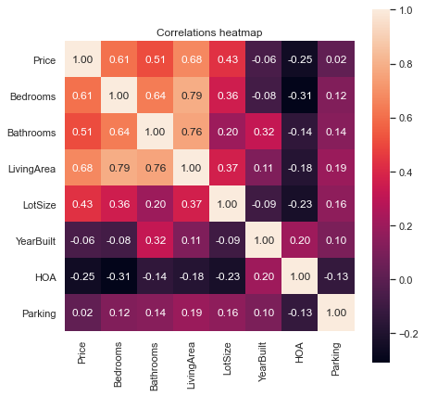
Most significant attribute that impacts Price
As seen on the heatmap, the attribute of a home that holds the most significance in impacting a home’s price is Living Area, coming in at a high 0.68 correlation on the heatmap. Bedrooms and Bathrooms are also significant factors in impacting a home’s price in the Bay Area, coming in at a correlation of 0.61 and 0.51 respectively, but fall short behind Living Area.
HOA price has a negative correlation with the price of home (-0.25)

Slide 17
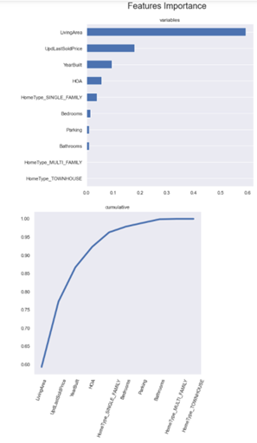
Model Formulation
Lastsoldprice attribute was updated to accommodate missing values.
Bedrooms, Bathrooms, Living Area, HOA, Year Built, Home Type, UpdLastSoldPrice, and Zestimate were the first attributes added to the Model.
The data was then divided into two groups: training and testing.
dtf train was used to fill in missing data for the lastsoldprice attribute.
The hometype attribute was replaced by a dummy variable.
Data from training and testing were scaled.
The "LivingArea," "UpdLastSoldPrice," "YearBuilt," and "HOA" attributes were discovered to be influential for the new model's feature selection.

Slide 18
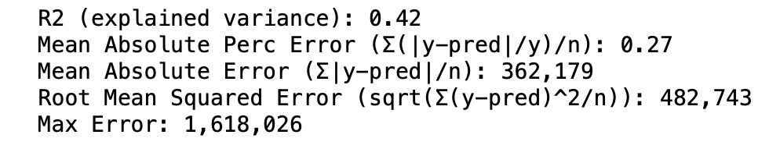
Model Formulation(Contd.)
Used Gradient Boosting and Linear Regression model to predict the price.
GB model was found to be better model when compared to linear regression model.

Slide 19
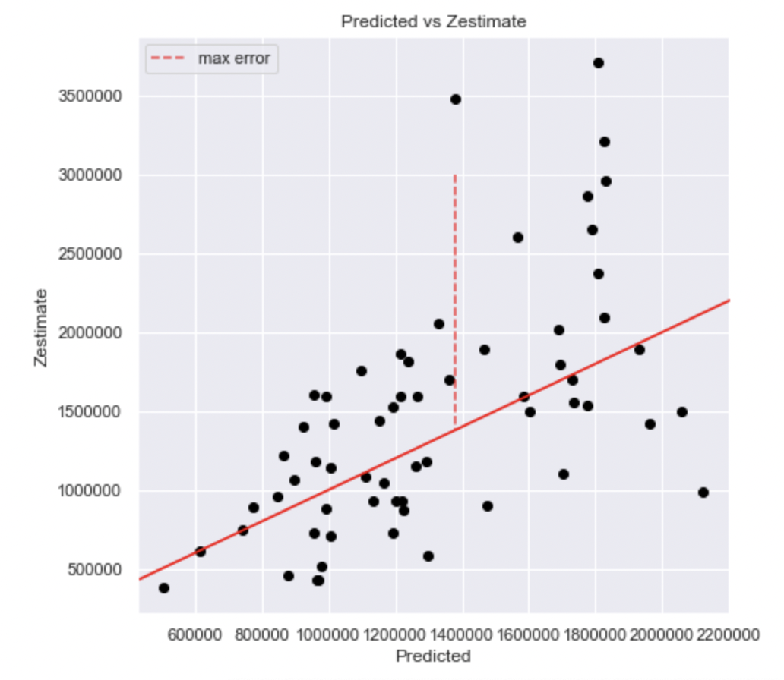
Observation and Conclusion
Comparing the predicted price with zestimate, in most of the cases the zestimate is more than the predicted price.
The possible reason for higher zestimate value could be the
Limited number of observations in the dataset
Lower number of attributes in the model to predict the price.

