Slide 1



REV HIRE

Slide 2
TABLE OF CONTENTS
PROJECT OVERVIEW
PROJECT GOALS
FEATURES
ARCHITECTURE
ERD DIAGRAM
PROJECT SNAPSHOTS
TECHNLOGIES USED
CHALLENGES FACED
CONCLUSION

Slide 3
PROJECT OVERVIEW
RevHire is a job portal application designed to connect job seekers with employers on a single centralized digital platform. The system enables candidates to build professional resumes, explore job opportunities using advanced search filters, and apply seamlessly with a single click. On the employer side, the platform allows efficient job posting, applicant tracking, and recruitment decision-making.

Slide 4
PROJECT GOALS
The main goal of this project is to build a secure and scalable job portal system that:
Simplifies job searching and hiring
Provides structured resume management
Enables role-based access control
Implements secure authentication
Maintains application tracking with real-time status updates

Slide 5
EMPLOYER FEATURES
Creating and editing job postings
Setting deadlines and salary ranges
Closing or reopening job listings
Viewing applicant details including resumes and cover letters
Updating application statuses
Filtering candidates based on skills, education, or experience
Tracking applicant counts per job

Slide 6
JOB SEEKER FEATURES
They can securely register and login.
They can create and manage their profile.
They can build a structured textual resume.
They can also upload a PDF or DOCX resume.
They can search jobs using advanced filters.
Apply for jobs with one click.
Track application status.
Save jobs to favorites.
Receive notifications.

Slide 7
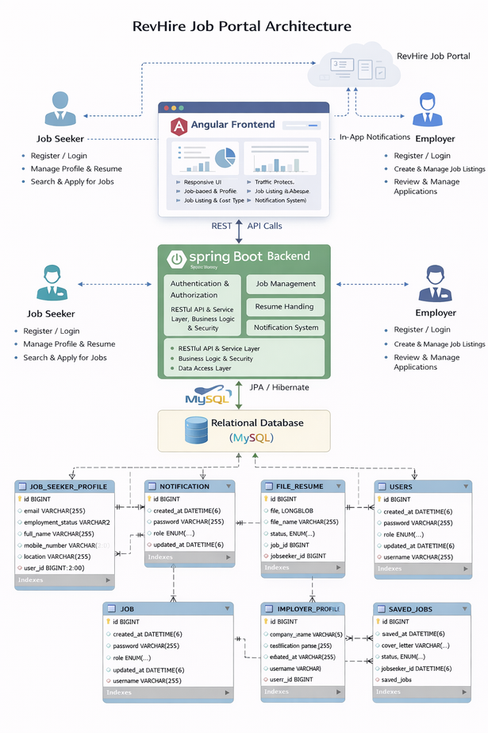
ARCHITECTURE
RevHire is built as a full-stack monolithic application, consisting of:
Frontend: Responsive UI built with Angular
Backend: RESTful APIs developed using Spring Boot
Database: Relational database (MySQL) for structured data storage
Security: Role-based authentication and authorization (JWT-based)
Deployment: Web-based deployment (Localhost/Cloud-ready)
All modules (authentication, job management, resume handling, notifications) are integrated into a single deployable backend service.

Slide 8
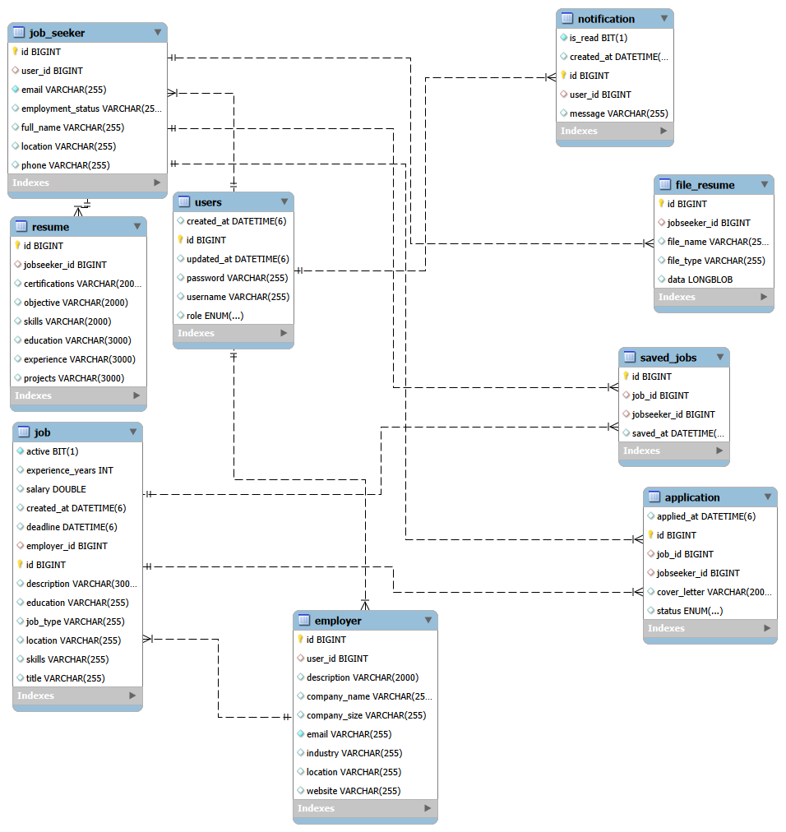
ERD DIAGRAM

Slide 9
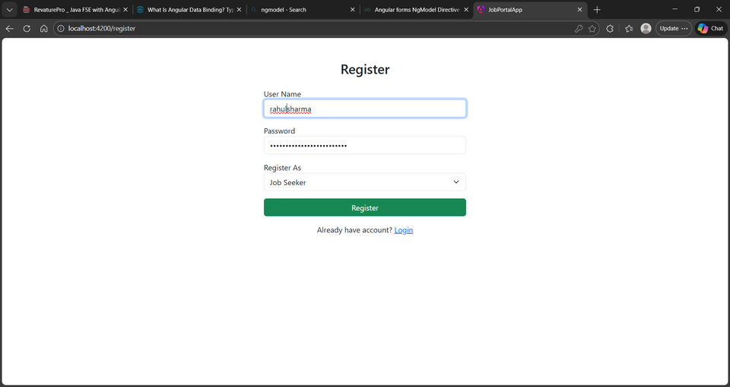
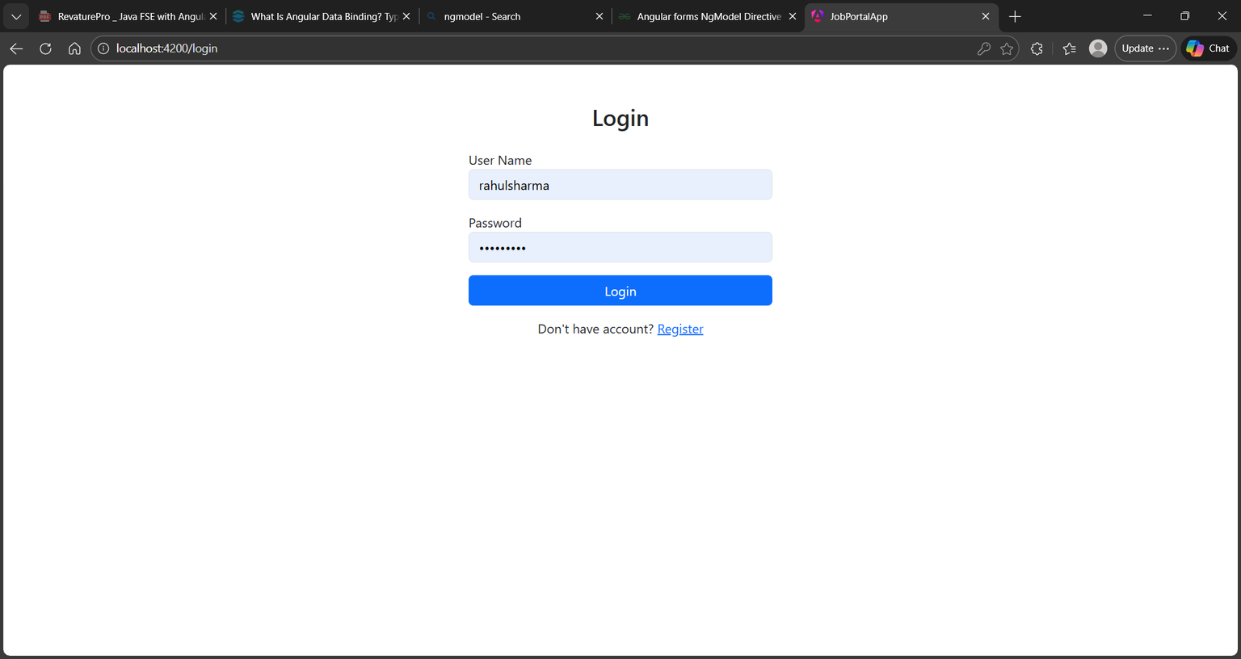
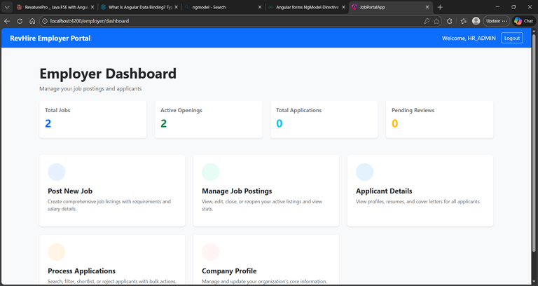
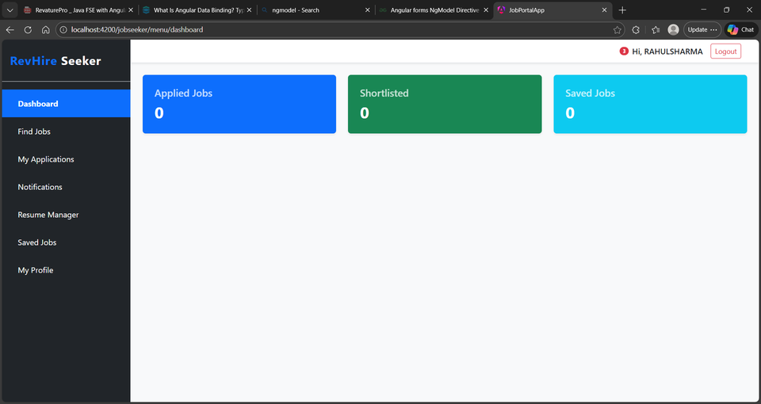
PROJECT SNAPSHOTS

Slide 10
TECHNOLOGIES USED
Frontend
Angular – Component-based UI development
TypeScript – Strongly typed scripting language
HTML5 & Bootstrap for user interface
Axios for REST API integration
Backend
Spring Boot – RESTful API development & business logic
Spring Security – Authentication & role-based authorization
JWT authentication
Maven – Dependency management
Database
MySQL – Relational database management
JPA / Hibernate – ORM for entity mapping and database operations

Slide 11
CHALLENGES FACED
During development, I faced challenges such as:
Handling role-based authorization correctly
Managing complex entity relationships
Implementing dynamic search filters
Handling file upload validation

Slide 12
CONCLUSION
To conclude,RevHire is a fully functional job portal application that provides end-to-end recruitment workflow for both job seekers and employers.It demonstrates full-stack development skills including backend logic, database design, security, and user interface design.
In the future, this application can be enhanced with features like email notifications, AI-based resume scoring, and interview scheduling.

Slide 13
THANK YOU

