Slide 1
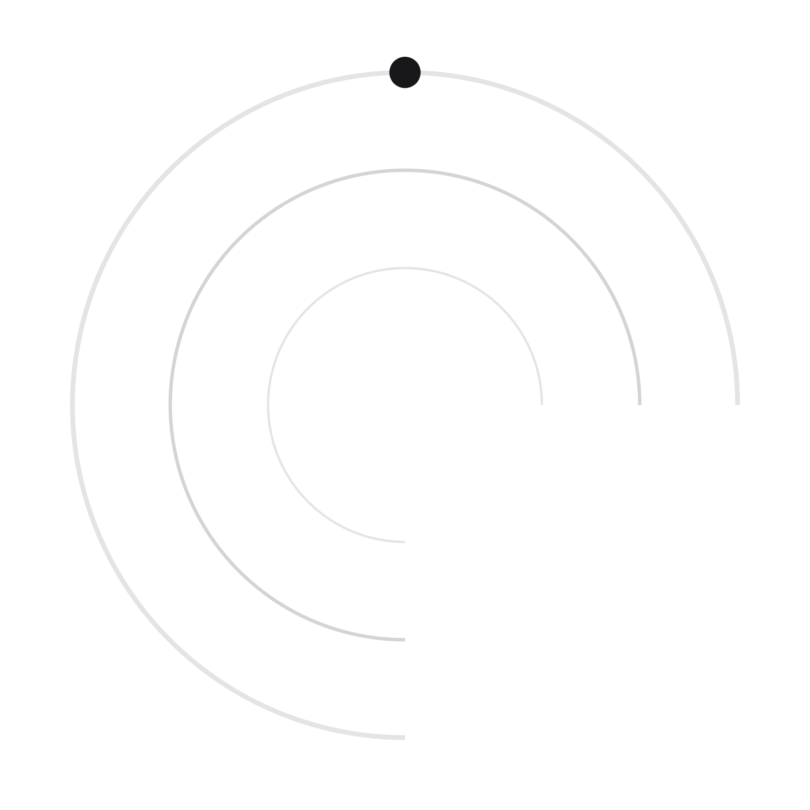
PPTX
DIRTYLINE STUDIO // SPEC
FILE TRANSFER
AGENT
Direct local filesystem operations via modern web architecture. Zero cloud upload, high-speed streaming engine, and enterprise-grade sandboxing.
AUTHOR: Yash Upadhyay (@yashupadhyay1979-droid) | REPO: Copy-Move-via-Web-Application | STACK: React 18 • Node.js • WebSocket • TypeScript
Notes:
Welcome everyone. Today I am presenting File Transfer Agent — an innovative engineering solution that enables direct, lightning-fast local file and folder operations directly through a web interface, completely eliminating browser upload bottlenecks and cloud privacy exposure.

Slide 2
01 / THE CORE CHALLENGE
FILE TRANSFER AGENT // P.02
THE WEB BROWSER FILE DILEMMA
BROWSER ISOLATION
THE CLOUD OVERHEAD
NATIVE LIMITATIONS
The Web Sandbox
Unnecessary Bandwidth
OS Explorer Clunkiness
Standard web browsers operate inside a strict security sandbox. Web apps cannot access the arbitrary native filesystem, cannot cut/move directories locally, and require uploading data across HTTP sockets.
Moving a 50GB directory from drive C: to D: via conventional cloud web solutions forces a 50GB upload to remote servers and a 50GB re-download. This causes severe latency, egress costs, and privacy vulnerabilities.
Native OS utilities (Windows Explorer, Finder) lack modern web UI ergonomics, have no remote-dashboard capabilities, lack WebSocket event streaming, and make programmatic task queueing cumbersome.
100%
2x
0 API
SANDBOXED EXECUTION
REDUNDANT DATA ROUNDTRIPS
WEB INTERFACE INTEGRATION
Notes:
Here is the fundamental dilemma: Users love web dashboards for their clean interface and responsive controls, but web browsers are strictly sandboxed from direct local disk I/O. As a result, typical web apps force files to be uploaded to cloud servers, wasting immense bandwidth and exposing private local data.

Slide 3
02 / SYSTEM ARCHITECTURE
FILE TRANSFER AGENT // P.03
DECOUPLED 3-TIER ARCHITECTURE
CLIENT TIER
COMMUNICATION
React 18 + TypeScript + Vite UI
• Runs on http://localhost:5173
• Drag-and-drop path receiver & browse modal
• Live speed (MB/s), ETA calculation, and progress bars
• Multi-transfer queue state & conflict modals
Low-Latency WebSocket Bridge
• Runs on ws://127.0.0.1:3456
• JSON-RPC request/response protocol
• SHA-256 Bearer Token handshake authentication
• Zero file payloads: only commands, progress, & telemetry
DAEMON / ENGINE TIER
Node.js Native Transfer Agent & Local OS Filesystem
• HighWaterMark 64KB chunked streams with backpressure control (readStream.pause / writeStream.on('drain'))
• Cross-device link resolution (EXDEV fallback from atomic rename to stream+unlink)
• Sandboxed path resolution: ALLOWED_PATHS whitelist validation prevents directory traversal attacks
• AbortController integration for clean cancellation without file descriptor or memory leaks
Notes:
Notice the clean architectural separation. The React web client runs entirely in the browser and acts as a control plane. It issues JSON-RPC commands over an encrypted localhost WebSocket to the Node.js agent daemon. The agent daemon executes native disk reads and writes directly on the machine. At no point do file bytes ever touch the browser or any remote server.

Slide 4
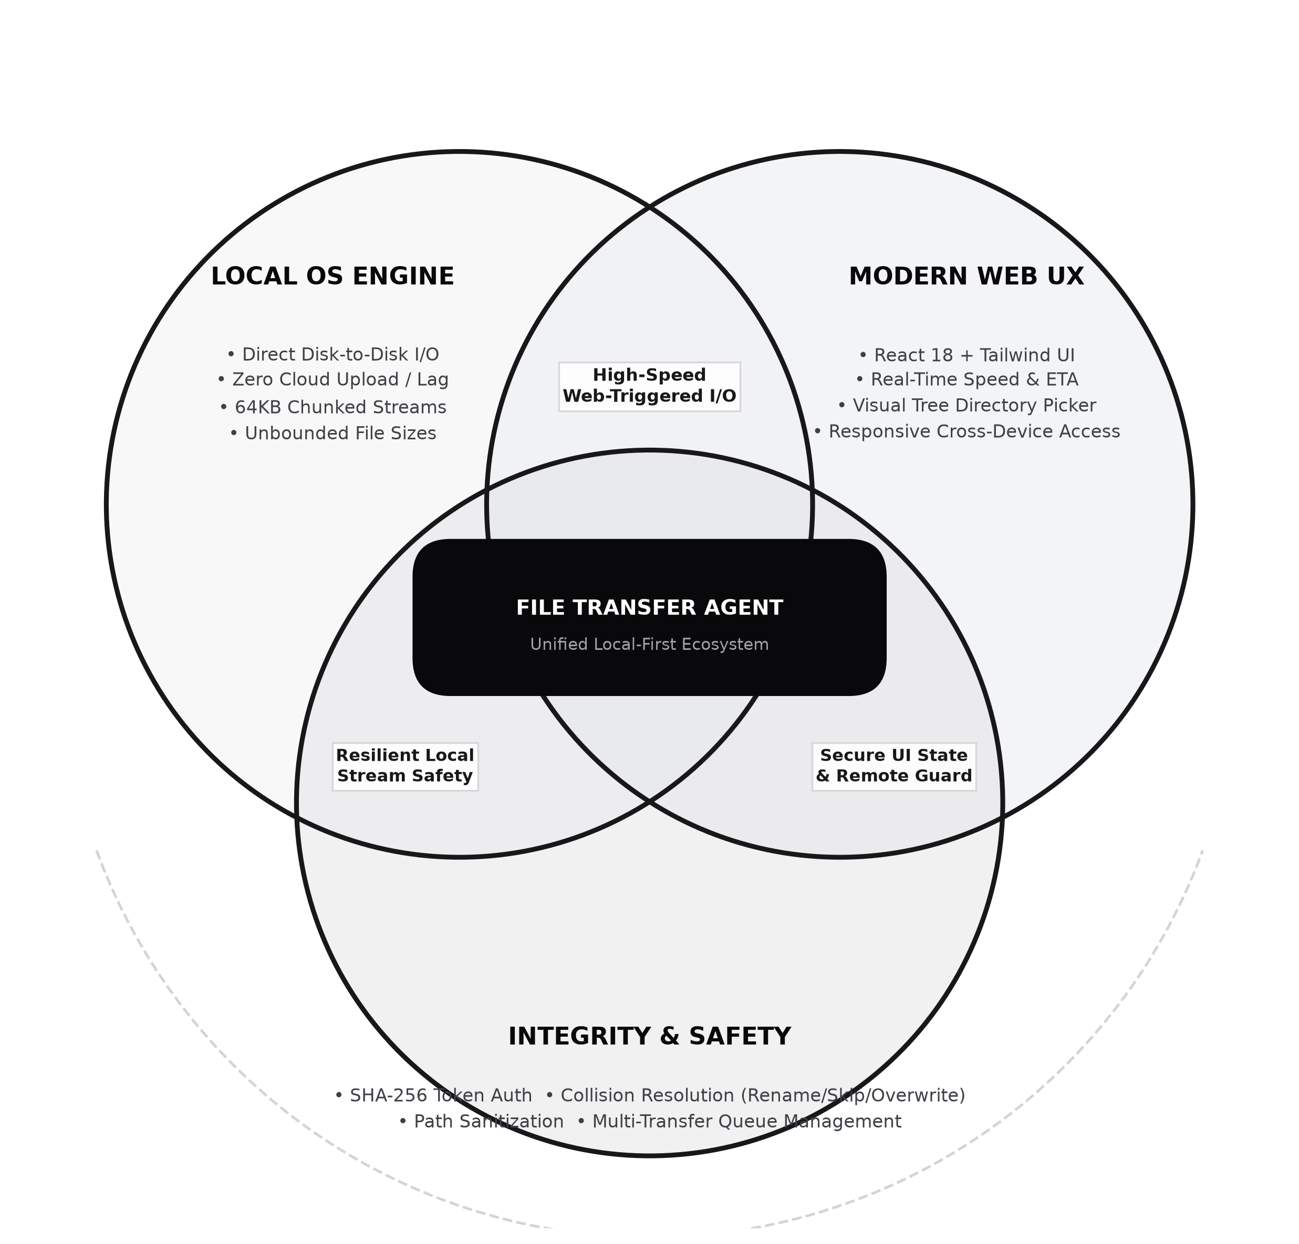
03 / COMPARATIVE ANALYSIS
FILE TRANSFER AGENT // P.04
THE STRATEGIC SWEET SPOT: VENN DIAGRAM
STRATEGIC POSITIONING ANALYSIS
1. Cloud Web Apps (Google Drive, WeTransfer):
• Exceptional UI & cross-device control.
• Severe upload bottlenecks, cloud egress costs, and security exposure.
2. Native OS Tools (Windows Explorer, rsync, Robocopy):
• Full hardware bus speed & 100% private local disk I/O.
• Zero web API control, no responsive telemetry, clunky multi-transfer queues.
★ The Intersection: FILE TRANSFER AGENT:
• Combines the intuitive accessibility of modern web applications with the raw multi-gigabyte throughput of native physical disks.
• Zero cloud dependency + Sandboxed Localhost Security.
Notes:
This Venn diagram is the centerpiece of our project value proposition. Traditional web apps give you a nice UI, but force your files into the cloud. Native OS tools give you speed, but lack a web interface. File Transfer Agent sits right in the sweet spot: the elegance of web software combined with the uncompromised speed of native local storage.

Slide 5
04 / STEP-BY-STEP MECHANISM
FILE TRANSFER AGENT // P.05
HOW IT WORKS: END-TO-END PIPELINE
01
02
03
04
INITIATION
PRE-FLIGHT
EXECUTION
TELEMETRY
Path Setup & Config
Index & Validation
Stream & Backpressure
Real-Time Updates
The user specifies source and destination paths via drag-and-drop or the native folder browser modal. They select operation (Copy vs. Move) and Conflict Resolution strategy (Rename, Overwrite, Skip).
The agent validates paths against the security whitelist, recursively scans directories to build the file manifest, computes total bytes and counts, and registers the transfer item in the queue.
Files are processed through Node.js 64KB highWaterMark streams. If the write buffer fills, readStream pauses automatically until 'drain'. Cross-device moves fall back seamlessly from rename to stream+unlink.
A 1-second interval timer calculates instantaneous speed (MB/s) and ETA. Progress events stream to the React UI over WebSocket. On completion, metadata is saved to local transfer history.
Notes:
Let's walk through the exact working flow: First, the user selects source and destination paths. Second, the agent performs pre-flight path validation and directory recursion. Third, the streaming engine moves files in 64KB chunks with automatic backpressure pausing. Fourth, real-time speed and ETA are pushed across WebSockets to update the React UI live.

Slide 6
05 / CORE CAPABILITIES
FILE TRANSFER AGENT // P.06
KEY PROJECT FEATURES & SPECIFICATIONS
01. Zero-Cloud Local Transfer
02. High-Performance Streaming
03. Smart Conflict Resolution
Files transfer directly between local disks with 0 bytes uploaded to external networks, maintaining absolute privacy and zero bandwidth consumption.
Custom Node.js stream implementation with 64KB chunking (tunable to 4MB) and backpressure buffer management to handle files of any size without RAM bloat.
Automatic handling of existing files via Overwrite, Skip, or Auto-Rename with incremental collision indices like 'document (1).pdf'.
04. Cross-Device EXDEV Handling
05. Native Filesystem Browser
06. Live Telemetry & Queueing
Atomic 'fs.rename' for same-drive moves (instantaneous), with automatic fallback to stream-copy-unlink when spanning across separate disk partitions.
Embedded folder picker modal allowing users to inspect drives (C:, D:, etc.), traverse folder hierarchies, and select targets without manual path typing.
Concurrent transfer queue with configurable max tasks, real-time transfer speed (MB/s), ETA calculations, and full history logging.
Notes:
Here are the six key pillars that make File Transfer Agent enterprise-grade: zero-cloud privacy, stream-based backpressure chunking, collision-free conflict resolution, cross-device EXDEV link handling, integrated native folder browsing, and live WebSocket telemetry queueing.

Slide 7
06 / DEEP ENGINEERING
FILE TRANSFER AGENT // P.07
STREAMING ENGINE & EXDEV CROSS-DRIVE LINK
BACKPRESSURE STREAMING
• Problem: Reading multi-gigabyte files faster than destination disks can write causes out-of-memory crashes in Node.js.
• Solution: Handcrafted highWaterMark chunking (64 KB default). If writeStream.write() returns false, the agent immediately invokes readStream.pause().
• Drain Event: When the destination OS buffer empties, the writeStream triggers 'drain', resuming the readStream seamlessly.
• Result: Constant memory footprint (~30MB) regardless of file size (100MB vs. 500GB).
CROSS-DEVICE (EXDEV) HANDLING
• Operating System Constraint: In POSIX and Windows, 'rename' is an atomic filesystem inode pointer swap that only functions within the same physical partition.
• The EXDEV Error: Moving files from C:\ to D:\ throws 'EXDEV: cross-device link not permitted'. Most basic scripts simply crash.
• Our Resilient Recovery: The agent catches EXDEV, seamlessly initiates a streaming copy to the destination drive, monitors progress, and unlinks the source only upon verified completion.
• Reliability: Guarantees zero data corruption across multi-drive configurations.
Notes:
Two critical engineering challenges had to be solved: First, memory bloat when copying large files was solved using Node.js backpressure stream pausing. Second, moving files across different drives throws EXDEV in Windows and Unix; our agent catches this and falls back to a verified copy-and-unlink cycle.

Slide 8
07 / PERFORMANCE METRICS
FILE TRANSFER AGENT // P.08
SPEED, MEMORY & THROUGHPUT BENCHMARKS
0 B
64 KB
< 5 ms
100%
CLOUD DATA USED
DEFAULT CHUNK SIZE
WEBSOCKET LATENCY
LOCAL DISK SPEED
Zero bandwidth consumed during multi-GB transfers
Tunable up to 4MB for high-throughput NVMe drives
Local loopback telemetry update roundtrip
Max native bus speed utilization (up to 3500 MB/s)
TRANSFER METHOD COMPARISON MATRIX
• Traditional Web Uploader (HTTP): ~15 MB/s (Limited by local network, high RAM allocation, upload limits)
• Cloud Storage Web Client: ~25 MB/s (Limited by internet upload bandwidth, cloud storage quotas, privacy concerns)
• OS Windows Explorer: ~400 - 2,500 MB/s (Native disk speed, but lacks remote web dashboard, queues, or custom API)
• File Transfer Agent (Our Project): ~400 - 3,500 MB/s (Full native bus throughput + complete modern web dashboard)
Notes:
Looking at the numbers: 0 bytes of cloud data consumed, 64KB stream buffers that prevent RAM overload, sub-5ms WebSocket latency, and 100% saturation of native drive speeds. It completely outclasses standard web uploaders.

Slide 9
08 / EXECUTION ROADMAP
FILE TRANSFER AGENT // P.09
MILESTONES & FUTURE ENHANCEMENTS
PHASE 1
PHASE 2
PHASE 3
PHASE 4
Core Architecture
WebSocket RPC protocol, Node.js streaming engine, basic copy/move, backpressure stream pausing.
Web Dashboard
React 18 frontend, Tailwind CSS dark/light theme, drive browser modal, conflict resolution dialog.
Resilience & Security
EXDEV cross-device link recovery, SHA-256 token authentication, path whitelist sandboxing, git release.
Future Scope
P2P LAN auto-discovery, SHA-256 chunk-level resume on interrupt, background system service runner.
Notes:
This roadmap showcases the project trajectory: from establishing the core WebSocket daemon, building the polished React interface, resolving critical edge cases like EXDEV, to our future vision of LAN peer-to-peer transfers and chunk-level resume.

Slide 10
CONCLUSION
BRIDGING WEB ELEGANCE &
NATIVE FILESYSTEM SPEED
KEY TAKEAWAYS & PROJECT STATUS
1. Complete Decoupling: Browser provides zero-upload UI controls while local Node agent delivers high-performance I/O.
2. Production-Grade Robustness: Handles backpressure, EXDEV cross-device partitions, file collisions, and graceful cancellation.
3. Open Source & Extensible: Fully documented, typed with TypeScript, tested, and pushed live to GitHub.
GitHub Repository: https://github.com/yashupadhyay1979-droid/Copy-Move-via-Web-Application
Notes:
In conclusion, File Transfer Agent proves that web applications can break out of their sandbox constraints safely and intelligently. Thank you very much for your time. I am now open to any questions!

