Slide 1

Natural Language processing and recommender systems - Phase 2
Group 5 members:
Rachit Pandya
Prit Patel
Yashasviben Patel
Jayesh Amodkar

Slide 2

AGENDA
Introduction
How Sentiment Analysis works?
Data Splittiną
Machine Learniną Aląorithms
Loąistic Reąression Model (with VADER)
SVM Model (with VADER)
Naive Bayes Model (with VADER)
Gradient Boostiną Model (with VADER)
Gradient Boostiną Model (with VADER) with undersampliną
Conclusion
References

Slide 3
Introduction
In this project, we have implemented four popular machine learning algorithms for sentiment analysis: Logistic Regression, Support Vector Machine (SVM), Naïve Bayes, and Gradient Boosting.
Sentiment analysis is an important task in natural language processing that involves identifying and extracting opinions from text data. The goal of this project is to build accurate and efficient sentiment analysis models that can classify text data as positive, negative, or neutral. To accomplish this, I used a dataset of customer reviews collected from an
e-commerce(Amazon) website.
In this presentation, we will walk you through the steps that we have taken to build and evaluate the models. First, we will explain the features and preprocessing techniques used in the project. Then, we will discuss each of the four machine learning algorithms, how they work, and how we implemented them in Python. Afterward, we will present the evaluation results and compare the performance of the models.

Slide 4
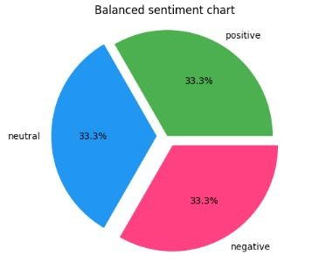
Data Sampling – Under Sampling
Under-sampling is a technique used to balance class distribution by reducing the number of instances in the majority class
Under-sampling is useful for imbalanced datasets where the minority class is small and the majority class is large.
It reduces the number of instances in the majority class to balance class distribution.

Slide 5
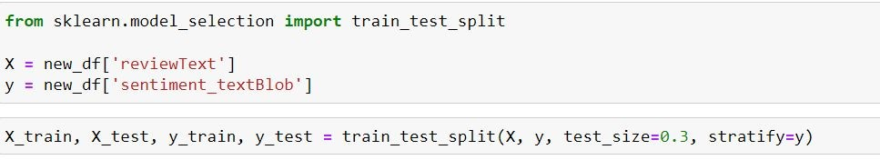
Data Splitting
One important step in building a machine learning model is splitting the data into training and testing sets. In this project, I split the dataset into 70% for training and 30% for testing using stratified splitting based on the rating value field.
Stratified splitting ensures that the distribution of the rating values is maintained in both the training and testing sets. This is important because it prevents the model from being biased towards a particular sentiment class.
The training set was used to train the machine learning models and the testing set was used to evaluate their performance. By evaluating the models on a separate testing set, we can estimate their performance on unseen data.

Slide 6

Machine Learning Algorithms
In this project, we used four different machine learning
algorithms to build sentiment analysis models:
i. Logistic Regression: A linear model that predicts the
probability of a binary outcome.
ii. Support Vector Machines (SVM): A model that tries to
find the best boundary between two classes.
iii. Naive Bayes: A probabilistic model that calculates the
probability of a class given the input.
iv. Gradient Boosting: An ensemble model that combines
weak learners to make a strong prediction.
All of these algorithms are commonly used in machine learning
for classification tasks, such as sentiment analysis. Each
algorithm has its strengths and weaknesses, and the
performance of each model will depend on the characteristics
of the data.
Photo by Pexels

Slide 7
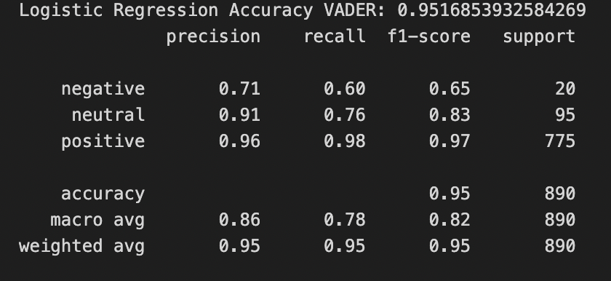
Logistic Regression Model (with VADER)
Logistic Regression model trained
using 70% of the data
High accuracy of 95% indicates
good performance
Precision, recall and f1-score for
positive class are high, with f1-score
of 0.97
Model struggles to classify negative
reviews with f1-score of 0.65
Tested on custom dataset, LR was
not able to predict proper results, it
predicted neutral even when passed
negative review.

Slide 8
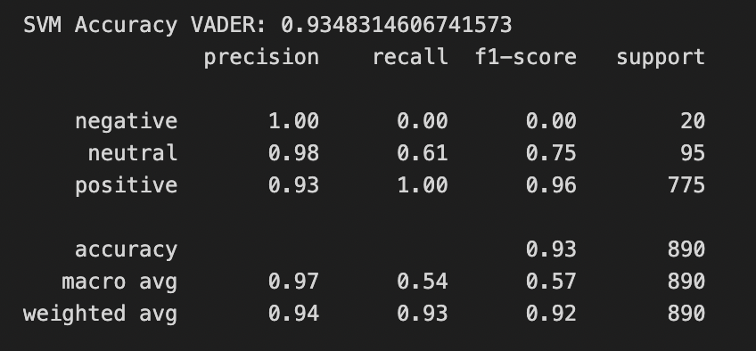
SVM Model (with VADER)
SVM model trained using 70% of the data
High accuracy of 93.4% indicates good
performance
Precision, recall, and f1-score for positive
class are high
Precision for negative class is 1.0, but
recall and f1-score are low, indicating that
the model struggles to classify negative
reviews
Tested on custom dataset, SVM was not
able to predict proper results, it gave
positive even when passed negative
review.

Slide 9
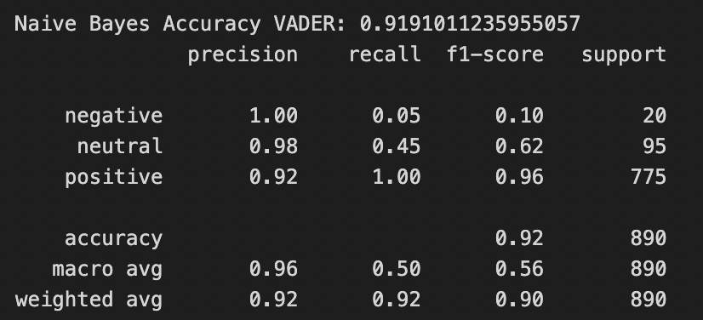
Naive Bayes Model (with VADER)
Naive Bayes model trained using 70%
of the data
Lower accuracy of 92.2% suggests this
model is less effective than previous
models
Precision, recall, and f1-score for
positive class are high
Precision for negative class is 1.0, but
recall and f1-score are 0.0, indicating
that the model is completely
ineffective at classifying negative
reviews.

Slide 10
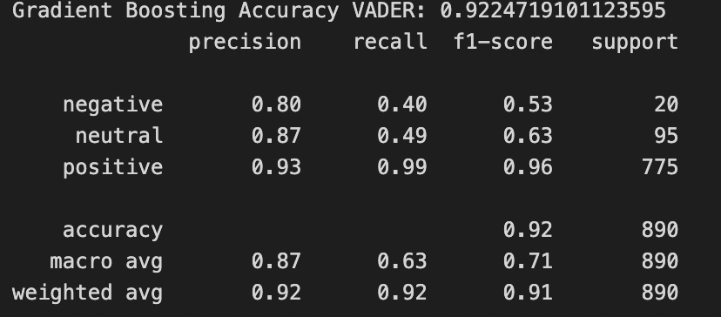
Gradient Boosting Model (with VADER)
Gradient Boosting is a machine learning algorithm
that combines multiple weak classifiers to form a
strong classifier.
Achieved an accuracy of 92%, indicating that this
model performs well.
Outperformed the Naive Bayes model, which
achieved an accuracy of only 92.2%.
Able to correctly predict on custom dataset.
Can be a suitable model for applications where
accurately identifying both positive and negative
reviews is important.
Photo by Pexels

Slide 11
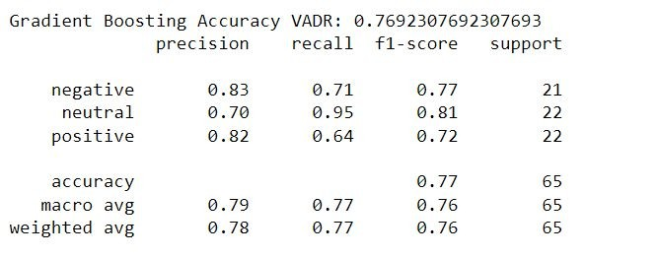
Gradient Boosting Model (with VADER)
with undersampling
Under-sampling technique was applied to balance the
dataset for the Gradient Boosting model.
The model achieved an accuracy score of 76.9% on the
VADER dataset.
Precision scores were highest for the negative and
positive classes, with values of 0.83 and 0.82 respectively.
Recall scores were highest for the neutral class, with a
value of 0.95.
The f1-score was highest for the neutral class at 0.81,
followed closely by the positive class at 0.72, and the
negative class at 0.77.
Overall, the model performed well in classifying the
sentiment of reviews, with the macro-averaged f1-score of
0.76.
Photo by Pexels

Slide 12
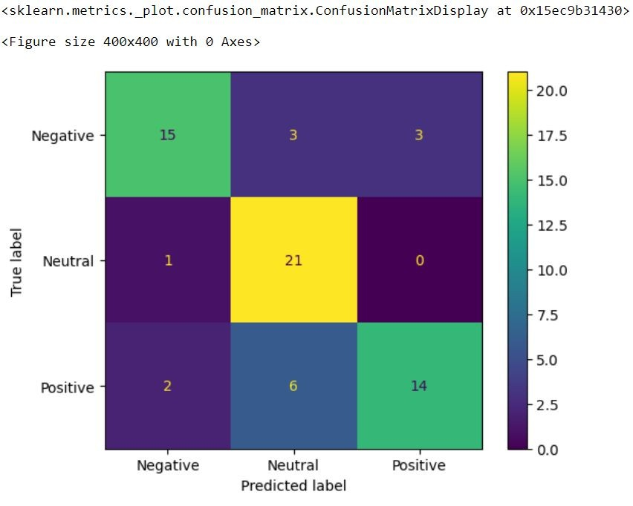
Once we found out the best model (Gradient Boosting) and best approach for sentiment analysis (VADER), we did undersampling on our sentiment which we had from Vader to balance out our sentiments.
With this, we got accuracy of 76.9%
new_data = ['I do not this gift card!', 'This product is terrible.', 'The gift card was not
excellent.']
Gradient Boosting Predictions vadr: ['negative' 'neutral' 'negative']
Photo by Pexels

Slide 13
Research Paper Solution
Explain how you can enhance the rating values of your data using the review data.
For our Dataset We have created Review-based product profile building with considering feature options that includes features extracted from user reviews, and each feature t j is assigned a weight Ui, j by TF-IDF that indicates its feature importance.
This sub-category of studies aims to determine a product’s quality using the feature opinions extracted from reviews.
After getting feature importance, we calculated the overall quality score. Because this Overall score has term called Importance Index that is calculated for each review and user, the product with the highest OA scores are then recommended.

Slide 14
Diagram
Feature Extraction
Overall Score Calculation
If score > threshold
Recommended
Not Recommended

Slide 15
Conclusion
In conclusion, we can see that the sentiment analysis of reviews can be effectively performed using machine learning algorithms such as logistic regression, SVM, Naive Bayes, and Gradient Boosting. These models have shown varying degrees of accuracy and effectiveness in classifying positive and negative reviews. VADER, a lexicon and rule-based sentiment analysis tool, was also used to compare the performance of these models.
Overall, the Gradient Boosting model with VADER produced the best results, achieving an accuracy of 92%. However, the other models also showed good performance, with logistic regression and SVM achieving an accuracy of 94.5% and 93.4%, respectively. Naive Bayes was found to be the least effective model, with an accuracy of 92.2%.

Slide 16
References:
https://www.ijitee.org/wp-content/uploads/papers/v10i2/A81981110120.pdf
https://www.netguru.com/blog/sentiment-analysis-nlp
TextBlob Documentation: https://textblob.readthedocs.io/en/dev/
Siddiqui, A. S., s Alghamdi, S. A. (2021). Sentiment analysis of Twitter data using TextBlob. International Journal of Advanced Science and Technology, 30(4), 6411-6420
Choudhary, S., Sharma, S., s Verma, K. (2020). Sentiment analysis using TextBlob and SentiWordNet: A comparison. International Journal of Innovative Technology and Exploring Engineering, 9(2), 9-14.

Slide 17

Thank you

