Slide 1
EMOTION-BASED
MUSIC RECOMMENDATION SYSTEM
USING CONVOLUTIONAL NEURAL NETWORKS
Team Members
Saurav Thakur
Aayush Shakya
Yashuv Baskota
Bibek Thapa

Slide 2
Contents
Introduction
The Importance of Emotion in Music
Dataset
How Emotion-Based Music Recommendation Systems Works
Dataset Samples
A Possible Approach
Experiment Tracking
Conclusion

Slide 3
Introduction
Music has always been a way for us to express our emotions, whether it's through singing along to a favorite song or dancing to a catchy beat. But what if there was a way for technology to help us find music that matches our mood?
This is where emotion-based music recommendation systems enters. These innovative systems use advanced technologies like convolutional neural networks to analyze the emotion of the user and recommends music that matches your current mood. In this presentation, we'll explore how these systems work, why they're important, and the benefits they offer to listeners.

Slide 4
The Importance of Emotion in Music
Music has the power to evoke a wide range of emotions in listeners. From joy and happiness to sadness and melancholy, music has the ability to connect with us on a deep emotional level.
When it comes to recommending music to listeners, it's important to consider the role of emotion. After all, music is not just about sound - it's about feeling. By taking into account the emotional impact of different songs and genres, we can create more personalized and meaningful music recommendations for our users.

Slide 5
Dataset
The dataset that we will be using for this project is downloaded from kaggle and is called FER-2013, one of the most popular datasets for facial expression recognition research. The dataset was created by collecting the results of a Google image search for various emotions. The dataset provides a valuable resource for training emotion recognition models.
Similarly, for the music recommendation component of the project, the music dataset used to identify moods is sourced from Kaggle and is titled "Spotify Music Data to Identify Moods."

Slide 6
How Emotion-based Music recommendation systems works
We will train a CNN model where our dataset consists of wide range of facial expressions representing seven different classes of emotions: Angry, Disgust, Fear, Happy, Sad, Surprise, and Neutral.
Based on the model we trained, we will capture the emotion of the user and the model will analyze the emotions of the user and then the music is then suggested using the music dataset. The music dataset consists of 19 columns, each providing valuable information for identifying the moods associated with music tracks.

Slide 7
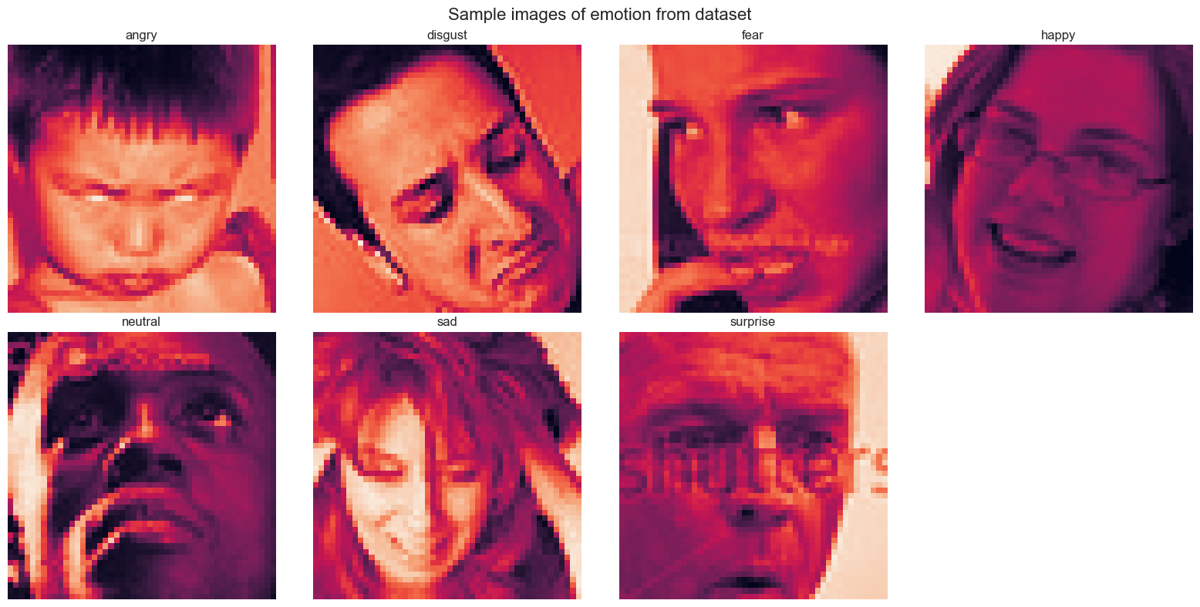
Dataset Samples

Slide 8
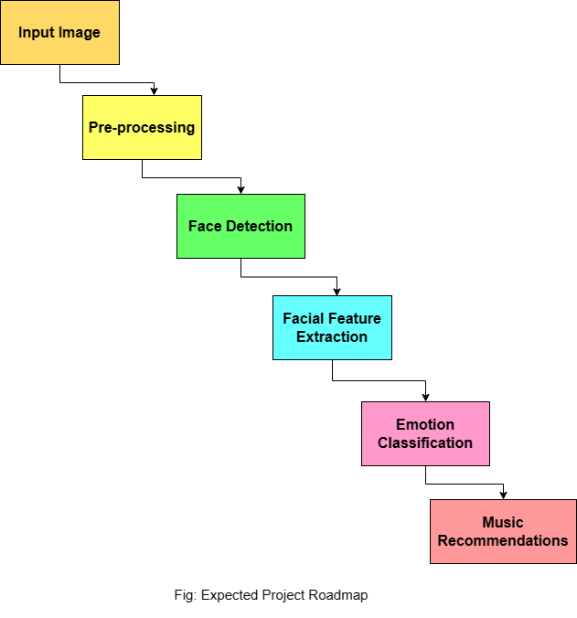
A possible approach

Slide 9

Experiment Tracking
We intend to monitor the experimentation phase of our project using ML Flow, an in-depth experiment tracking tool. It will make it simple for us to keep track of the many settings and configurations we employ in our tests, as well as the results of those studies.

Slide 10
Conclusion
In conclusion, emotion-based music recommendation systems have the potential to revolutionize the way we discover and enjoy music. By taking into account the emotional impact of music on listeners, these systems can provide personalized recommendations that truly resonate with each individual user.
Not only do these systems improve the user experience, but they also have the potential to increase engagement and revenue for music streaming platforms. As the technology continues to evolve and improve, we can expect to see even more innovative applications of emotion-based music recommendation systems in the future.

