Slide 1
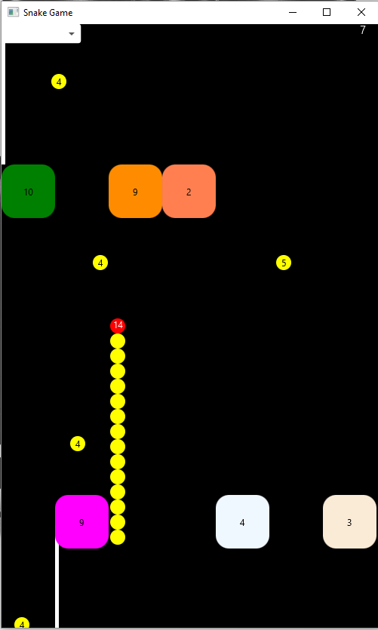
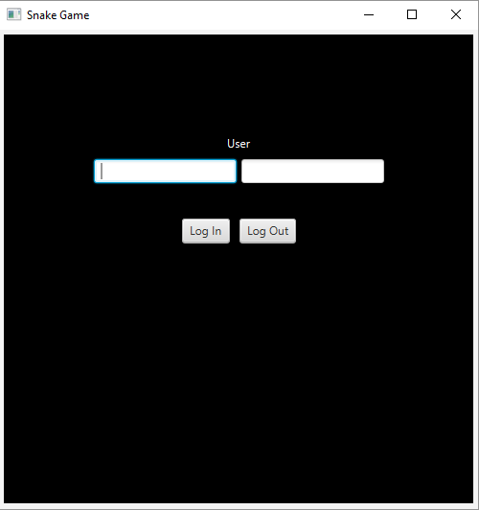
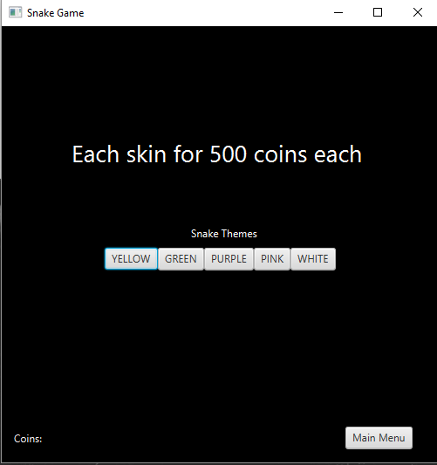
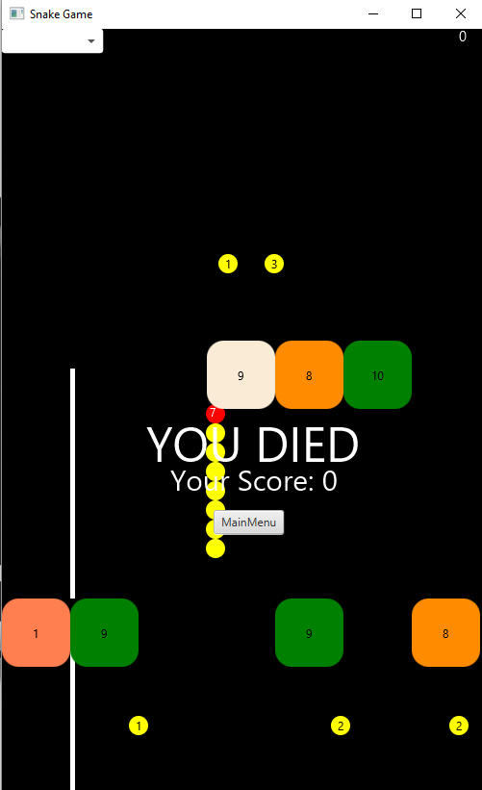
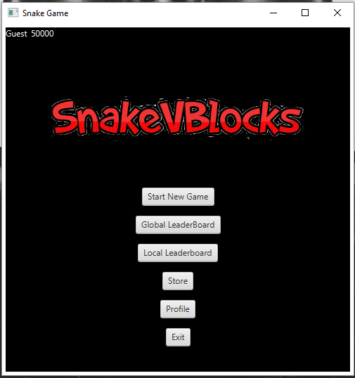
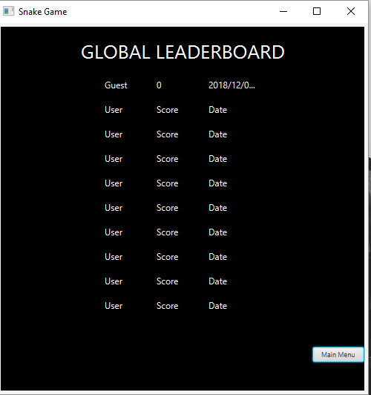

SCREENSHOTS

Slide 2
Concepts Used
Multithreading
Serialization-Deserialization
JavaFX
Design Patterns: Singleton
OOPS

Slide 3
Individual Efforts
Vidit Jain
Yashvardhan Singh
Main menu, Leaderboards, Store, Resume game and Profile and their functionalities.
Serialization-Deserialization using threading
Firebase linkup and companion android app
The actual gameplay and its functionalities.

Slide 4
Bonus
Ability to store the details of multiple users, with a global leaderboard and the ability to login to respective profiles using their username and password.
Store from which skins for the snake can be purchased using coins for each user and applied.
Ability to control the snake from any android phone using a companion app provided instead of using the keyboard.

