Slide 1

Codefury 2020
Together We Thrive.

Slide 2

Team Members
Kunal Porwal ( Team Leader )
Jayesh Chaudhari
Sanul Raskar
Rohitkaran Adusumalli
Suyog Khochikar
Aniket Wattamwar
Rasi Wani
Mrunal Kakirwar
Pranav Shirude

Slide 3
Application Features
A web based app for online bidding
Buyer Portal
Active products for bidding
History of user bought product
Seller Portal
Adding products for bidding
Scheduling an auction
View of Products posted by respective Seller
Scheduling auction
Start and End time of Auction
Logging for each action

Slide 4
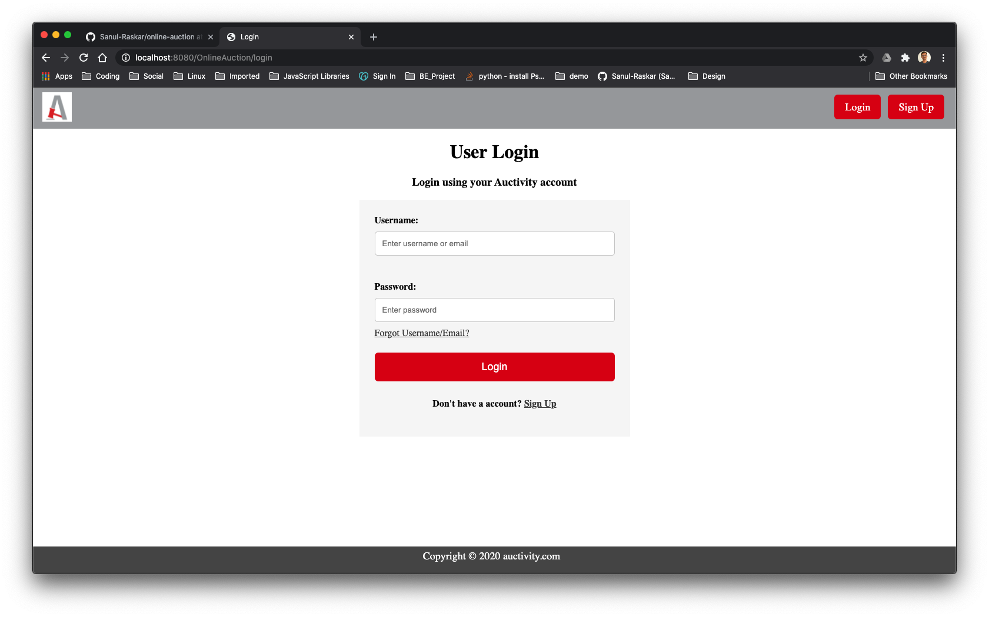
UI Snapshots

Slide 5
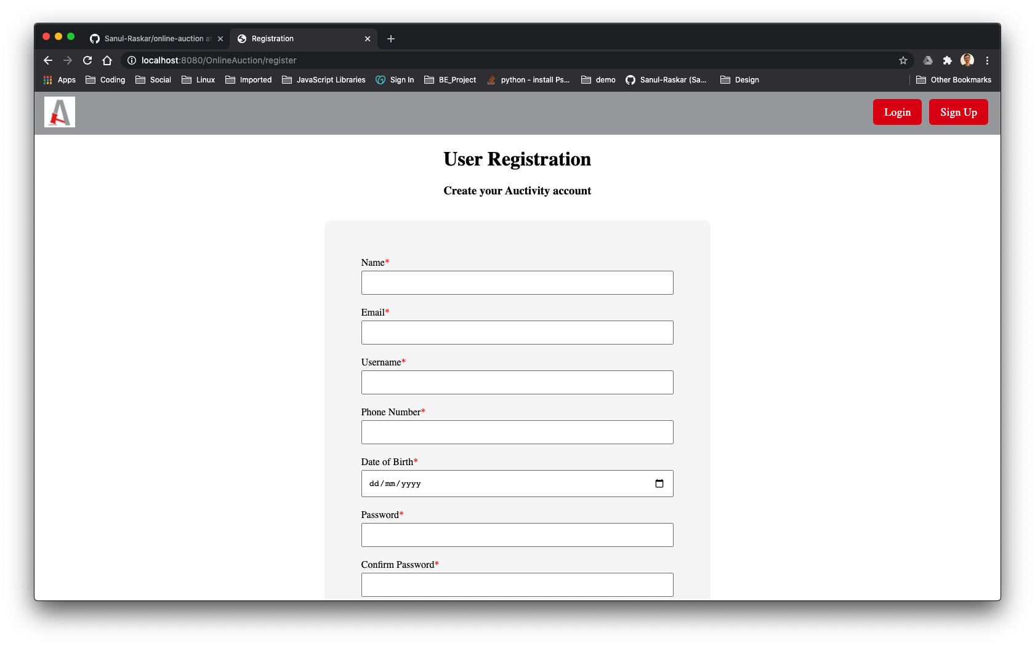
UI Snapshots

Slide 6
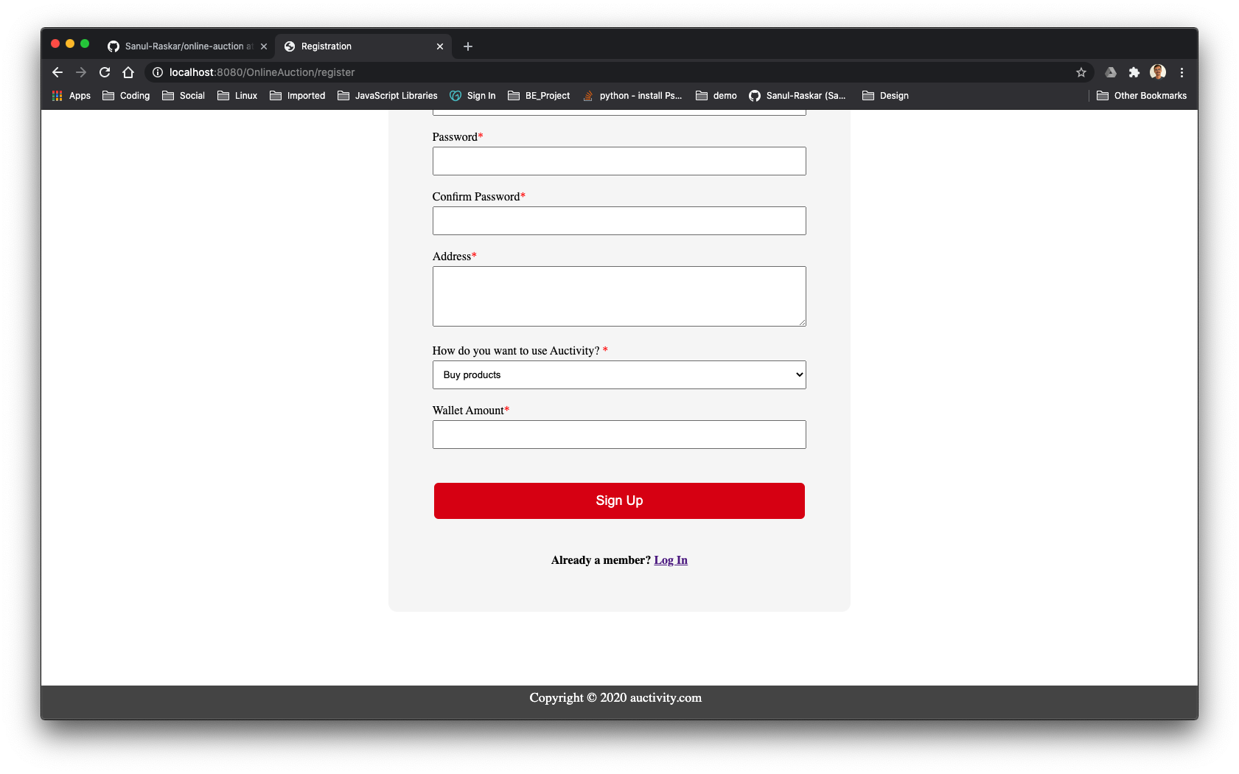
UI Snapshots

Slide 7
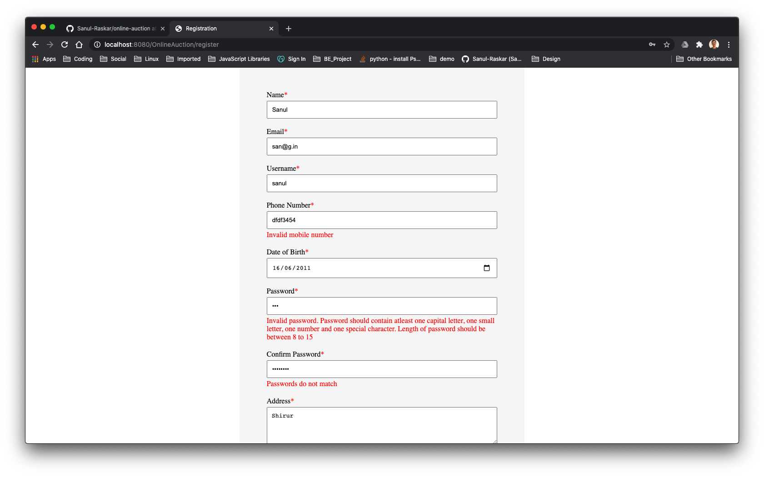
UI Snapshots

Slide 8
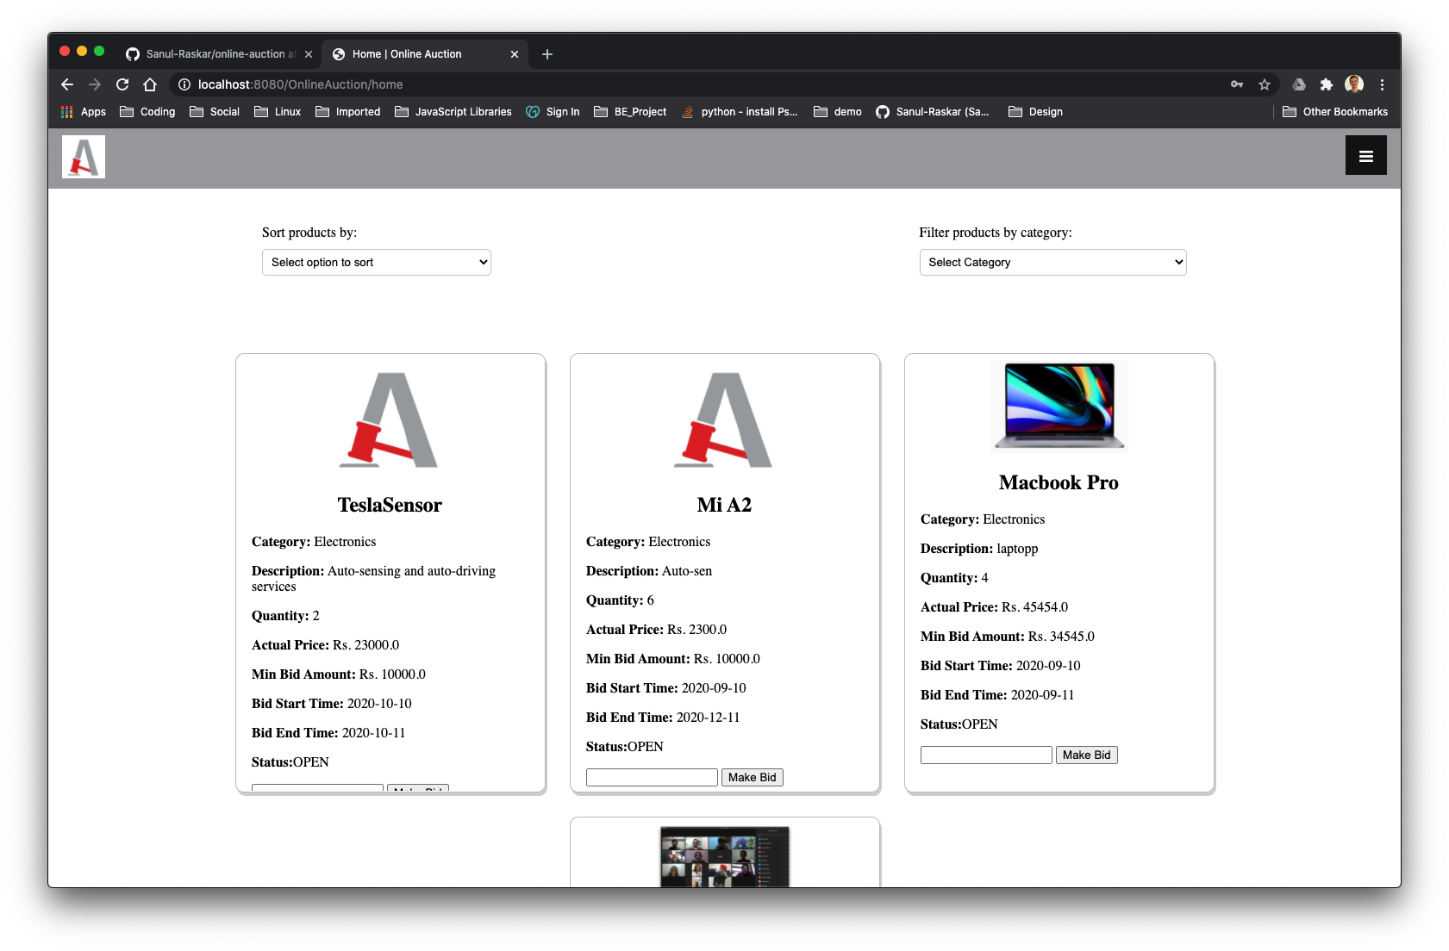
UI Snapshots

Slide 9
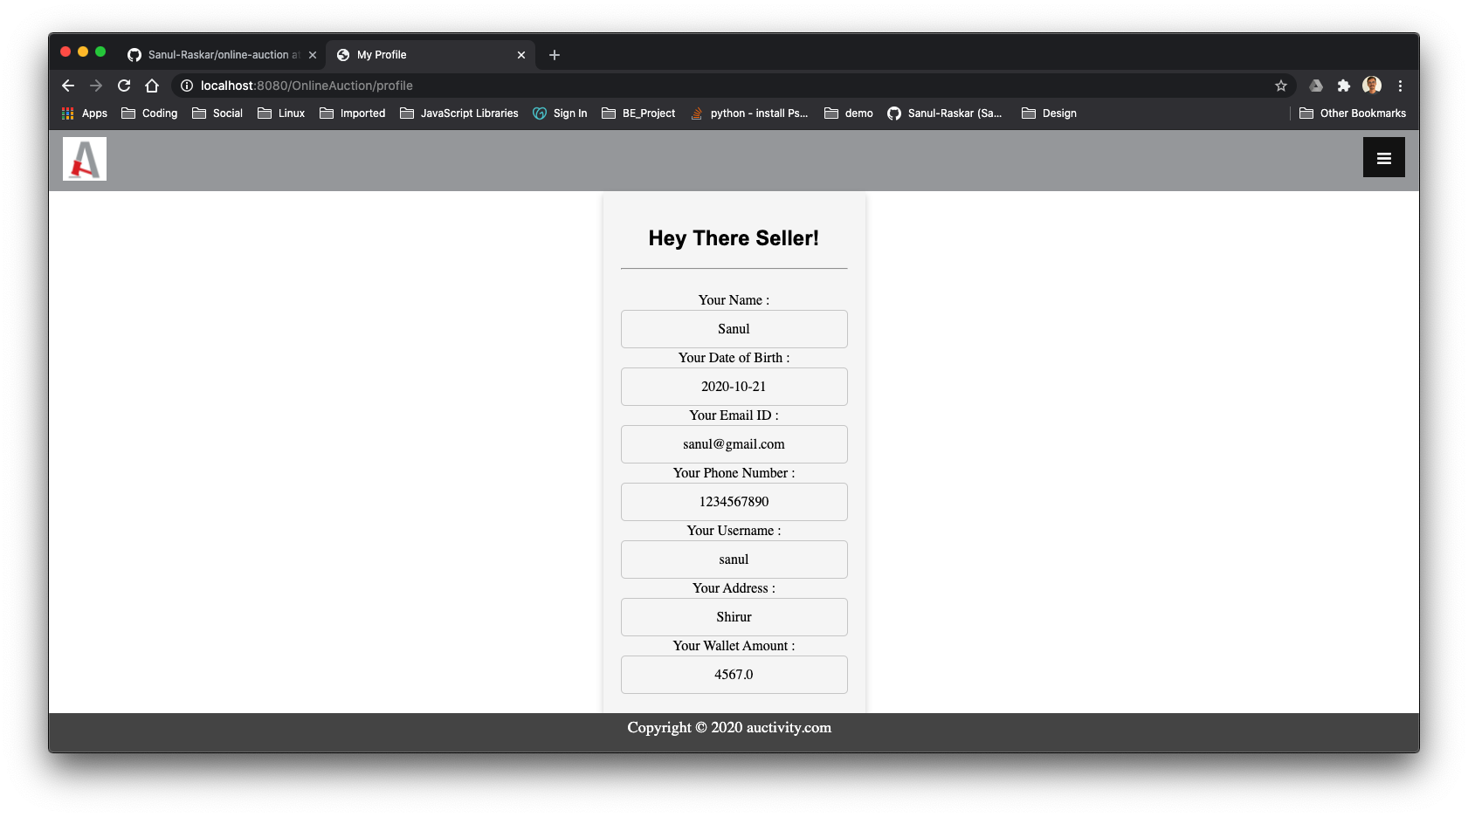
UI Snapshots

Slide 10
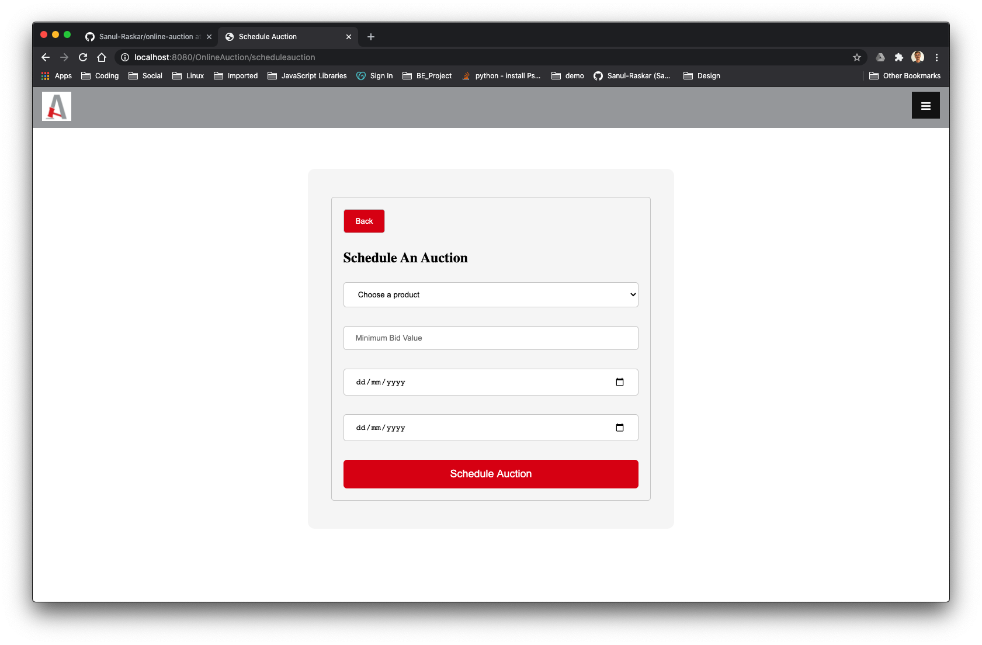
UI Snapshots

Slide 11

Learning
Concepts
Tools
Collaboration
Java
JSP
HTML, CSS
Javascript
Servlets
SQL
Derby Database
Github
Github (CLI & Desktop)
Eclipse EE
VS code
Trello
Draw.io
Github
Zoom

Slide 12

Thank You ;
-Team BitByBit

