Slide 1
SQL Injection with Protection
A Defence-in-Depth Study & Multi-Variant Live Prototype
DAS — Project Element 4 · Team of 4
YashVardhan Gupta · 230905442 Sheldon Rodricks · 230905324
Lakshya Agrawal · 230905552 Aditya Aryan Sahu · 230905560
Dept. of Computer Science & Engineering, Manipal Institute of Technology, MAHE
SQLi Defence Lab · DAS PE4 · SQL Injection with Protection
1

Slide 2
OVERVIEW
The problem & what we built
• SQL injection (SQLi) = untrusted input parsed as SQL code.
• OWASP Top-10 injection category for 20+ years; still bypassing commercial WAFs (Qu et al., 2024).
• Root cause: confusion of DATA and CODE.
• Our thesis: no single control is enough — protection must be LAYERED.
• Deliverables:
  – 10-paper literature survey (2023–2026)
  – Research gap → objective
  – Live prototype: 1 vulnerable + 5 protection variants
Attack in one line
Username:
admin' OR '1'='1' --
Resulting query:
SELECT ... WHERE username='admin'
OR '1'='1' --' AND password='x'
→ password check commented out → attacker is admin.
SQLi Defence Lab · DAS PE4 · SQL Injection with Protection
2

Slide 3
LITERATURE SURVEY
10 peer-reviewed papers (2023–2026)
Author(s) | Year | Venue (publisher) | Method / key result
Crespo-Martínez et al. | 2023 | Computers & Security | Flow-based ML (LR), >97% DR
Alghawazi et al. | 2023 | Mathematics (MDPI) | RNN autoencoder, 94% acc
Thalji et al. | 2023 | IEEE Access | AE-Net + XGBoost, 0.99
Alotaibi & Vassilakis | 2023 | Future Internet (MDPI) | SDN-based WAF
Arasteh et al. | 2024 | Neural Comput. & Appl. (Springer) | Gray-Wolf feature select, 99.68%
Paul et al. | 2024 | J. Info. Sec. & Appl. (Elsevier) | CNN-LSTM detect+prevent, 97% F1
Qu et al. | 2024 | IEEE TIFS | AdvSQLi — bypasses 7 WAFs
Bakır | 2025 | Arabian J. Sci. Eng. (Springer) | Embedding fusion, 0.998 F1
Floris et al. | 2025 | IEEE TIFS | Adv-robust WAF, +85% robustness
Ahmed & Al-dabag | 2026 | Computers (MDPI) | Multi-embed + Flask WAF, 0.9987
SQLi Defence Lab · DAS PE4 · SQL Injection with Protection
3

Slide 4
RESEARCH GAP → OBJECTIVE
What is still unsolved
• Field has largely solved OFFLINE detection (0.94–0.99 accuracy).
• Gap 1 — Adversarial robustness: WAFs & ML detectors bypassable (Qu 2024).
• Gap 2 — Generalization: single-dataset models fail on obfuscated / unseen payloads.
• Gap 3 — Detection ≠ Prevention: few integrate secure-coding + learning as one pipeline.
• Gap 4 — Deployment cost: heavy models add latency in-line.
Our objective
Design, implement & evaluate a DEFENCE-IN-DEPTH login that combines more than one protection variant, and show on one payload battery that:
(i) the vulnerable baseline is trivially bypassed;
(ii) each control blocks it while legit login still works;
(iii) layered = strongest coverage at < 1 ms query cost.
SQLi Defence Lab · DAS PE4 · SQL Injection with Protection
4

Slide 5
PROTOTYPE DESIGN
One attack, five defences
Vulnerable
String concatenation — input parsed as code
V1 Parameterized
? placeholders — input bound as data
V2 Allow-list
Regex whitelist rejects bad input early
V3 ORM
SQLAlchemy — parameterized by construction
V4 Hashing
Salted PBKDF2 — no plaintext compare
V5 Signature WAF
Regex/heuristic gateway blocks payloads
Stack: Flask + SQLite + SQLAlchemy + Werkzeug. The WAF layer can be toggled ON for ANY mode.
SQLi Defence Lab · DAS PE4 · SQL Injection with Protection
5

Slide 6
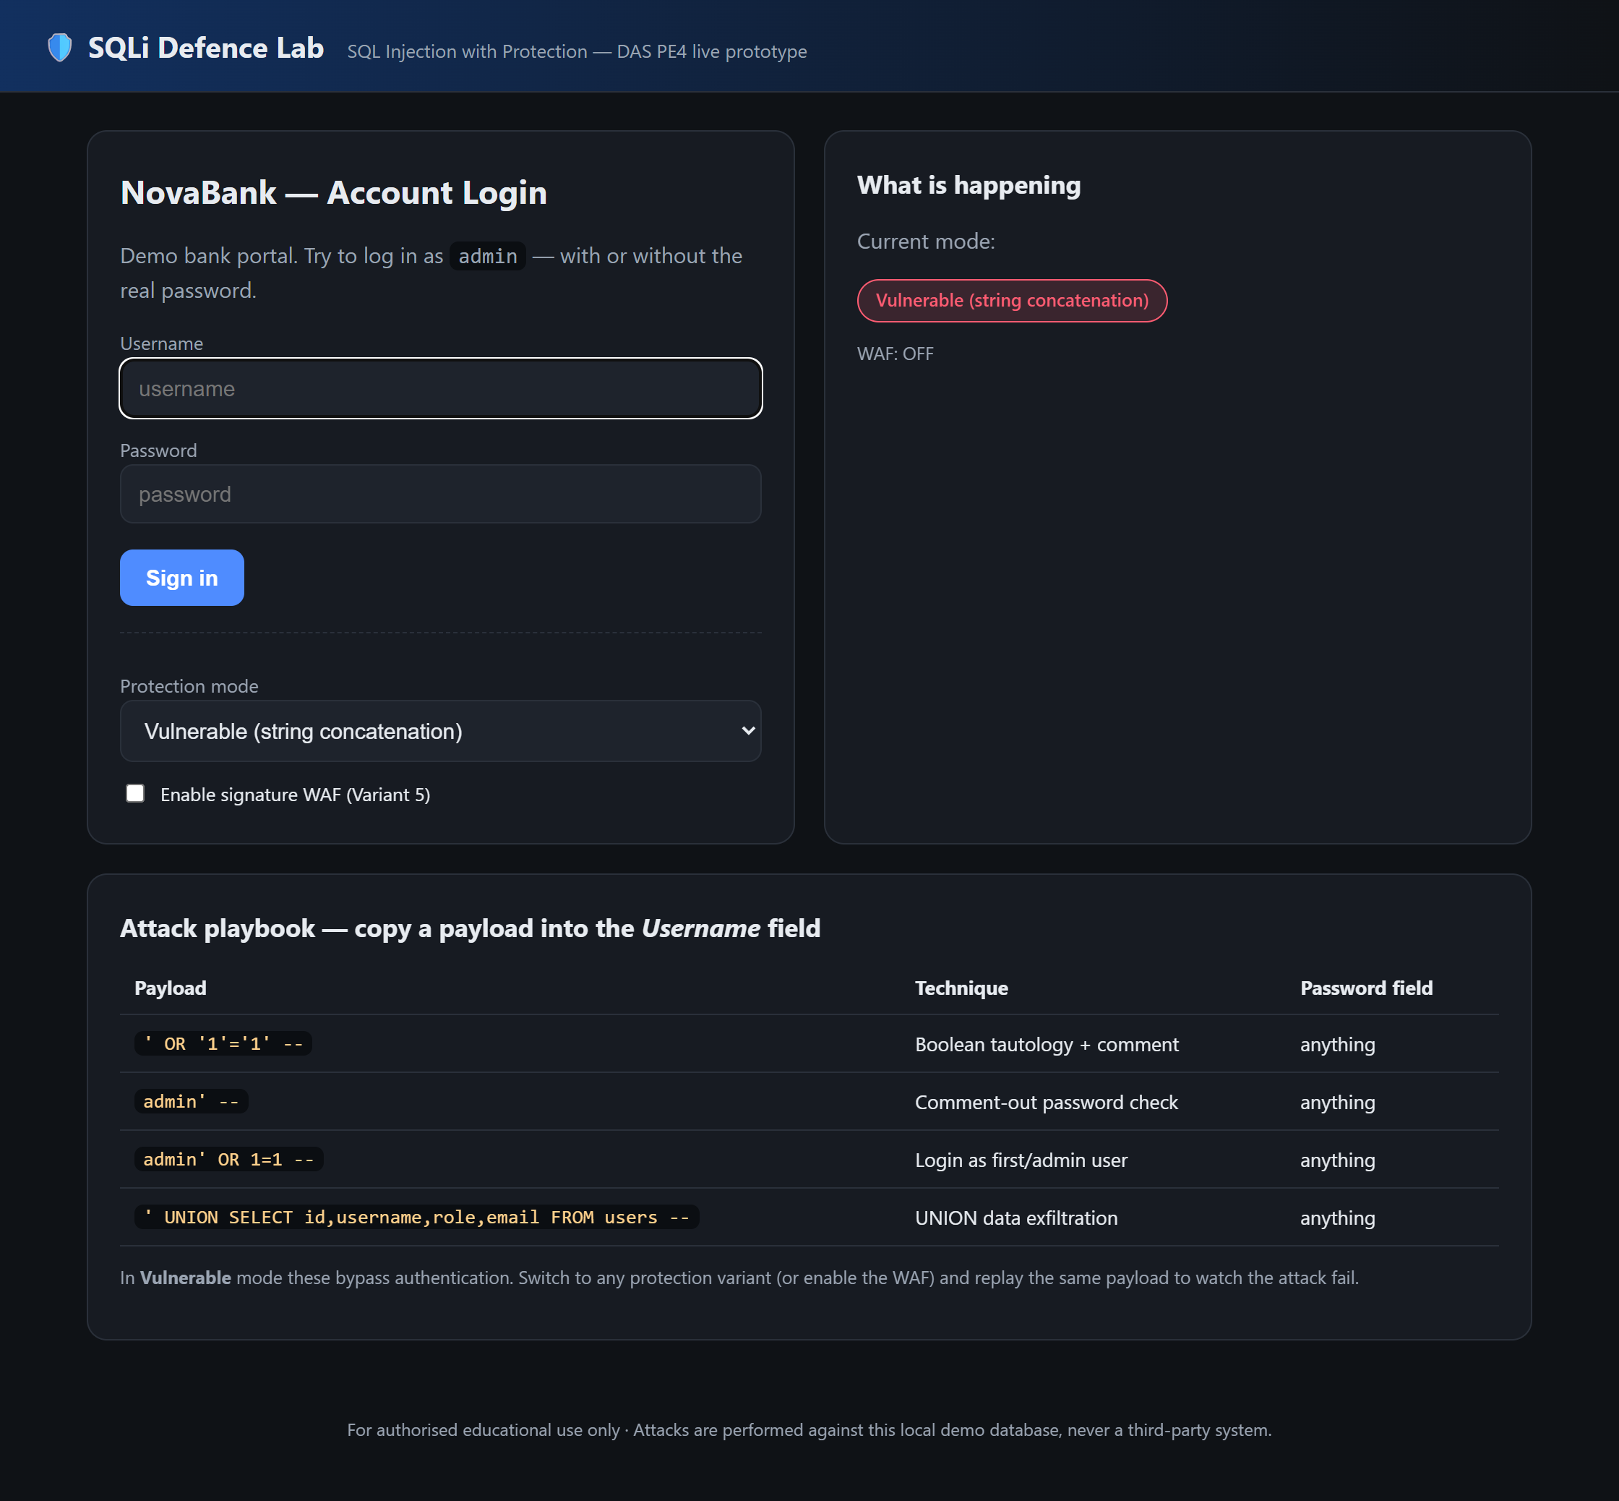
LIVE DEMO · STEP 1
Start the app & open the login
• Run: python app.py
• Open http://127.0.0.1:5000
• Left = NovaBank login. Right = 'What is happening' panel.
• Bottom = attack playbook with copy-paste payloads.
• Mode selector defaults to 'Vulnerable'.
Ready to attack.
Fig. 1 — Login page (Vulnerable mode).
SQLi Defence Lab · DAS PE4 · SQL Injection with Protection
6

Slide 7
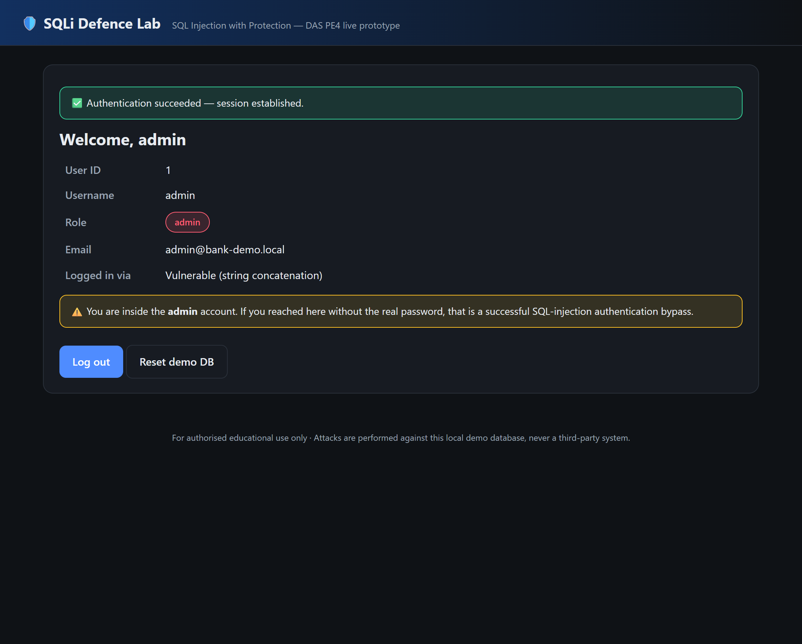
LIVE DEMO · STEP 2
Attack the vulnerable baseline
• Mode = Vulnerable, WAF = OFF.
• Username: admin' OR '1'='1' --
• Password: anything (e.g. x)
• Click Sign in.
• Query's password check is commented out.
⛔ Bypassed — attacker is admin.
Fig. 2 — Authenticated as admin with NO valid password.
SQLi Defence Lab · DAS PE4 · SQL Injection with Protection
7

Slide 8
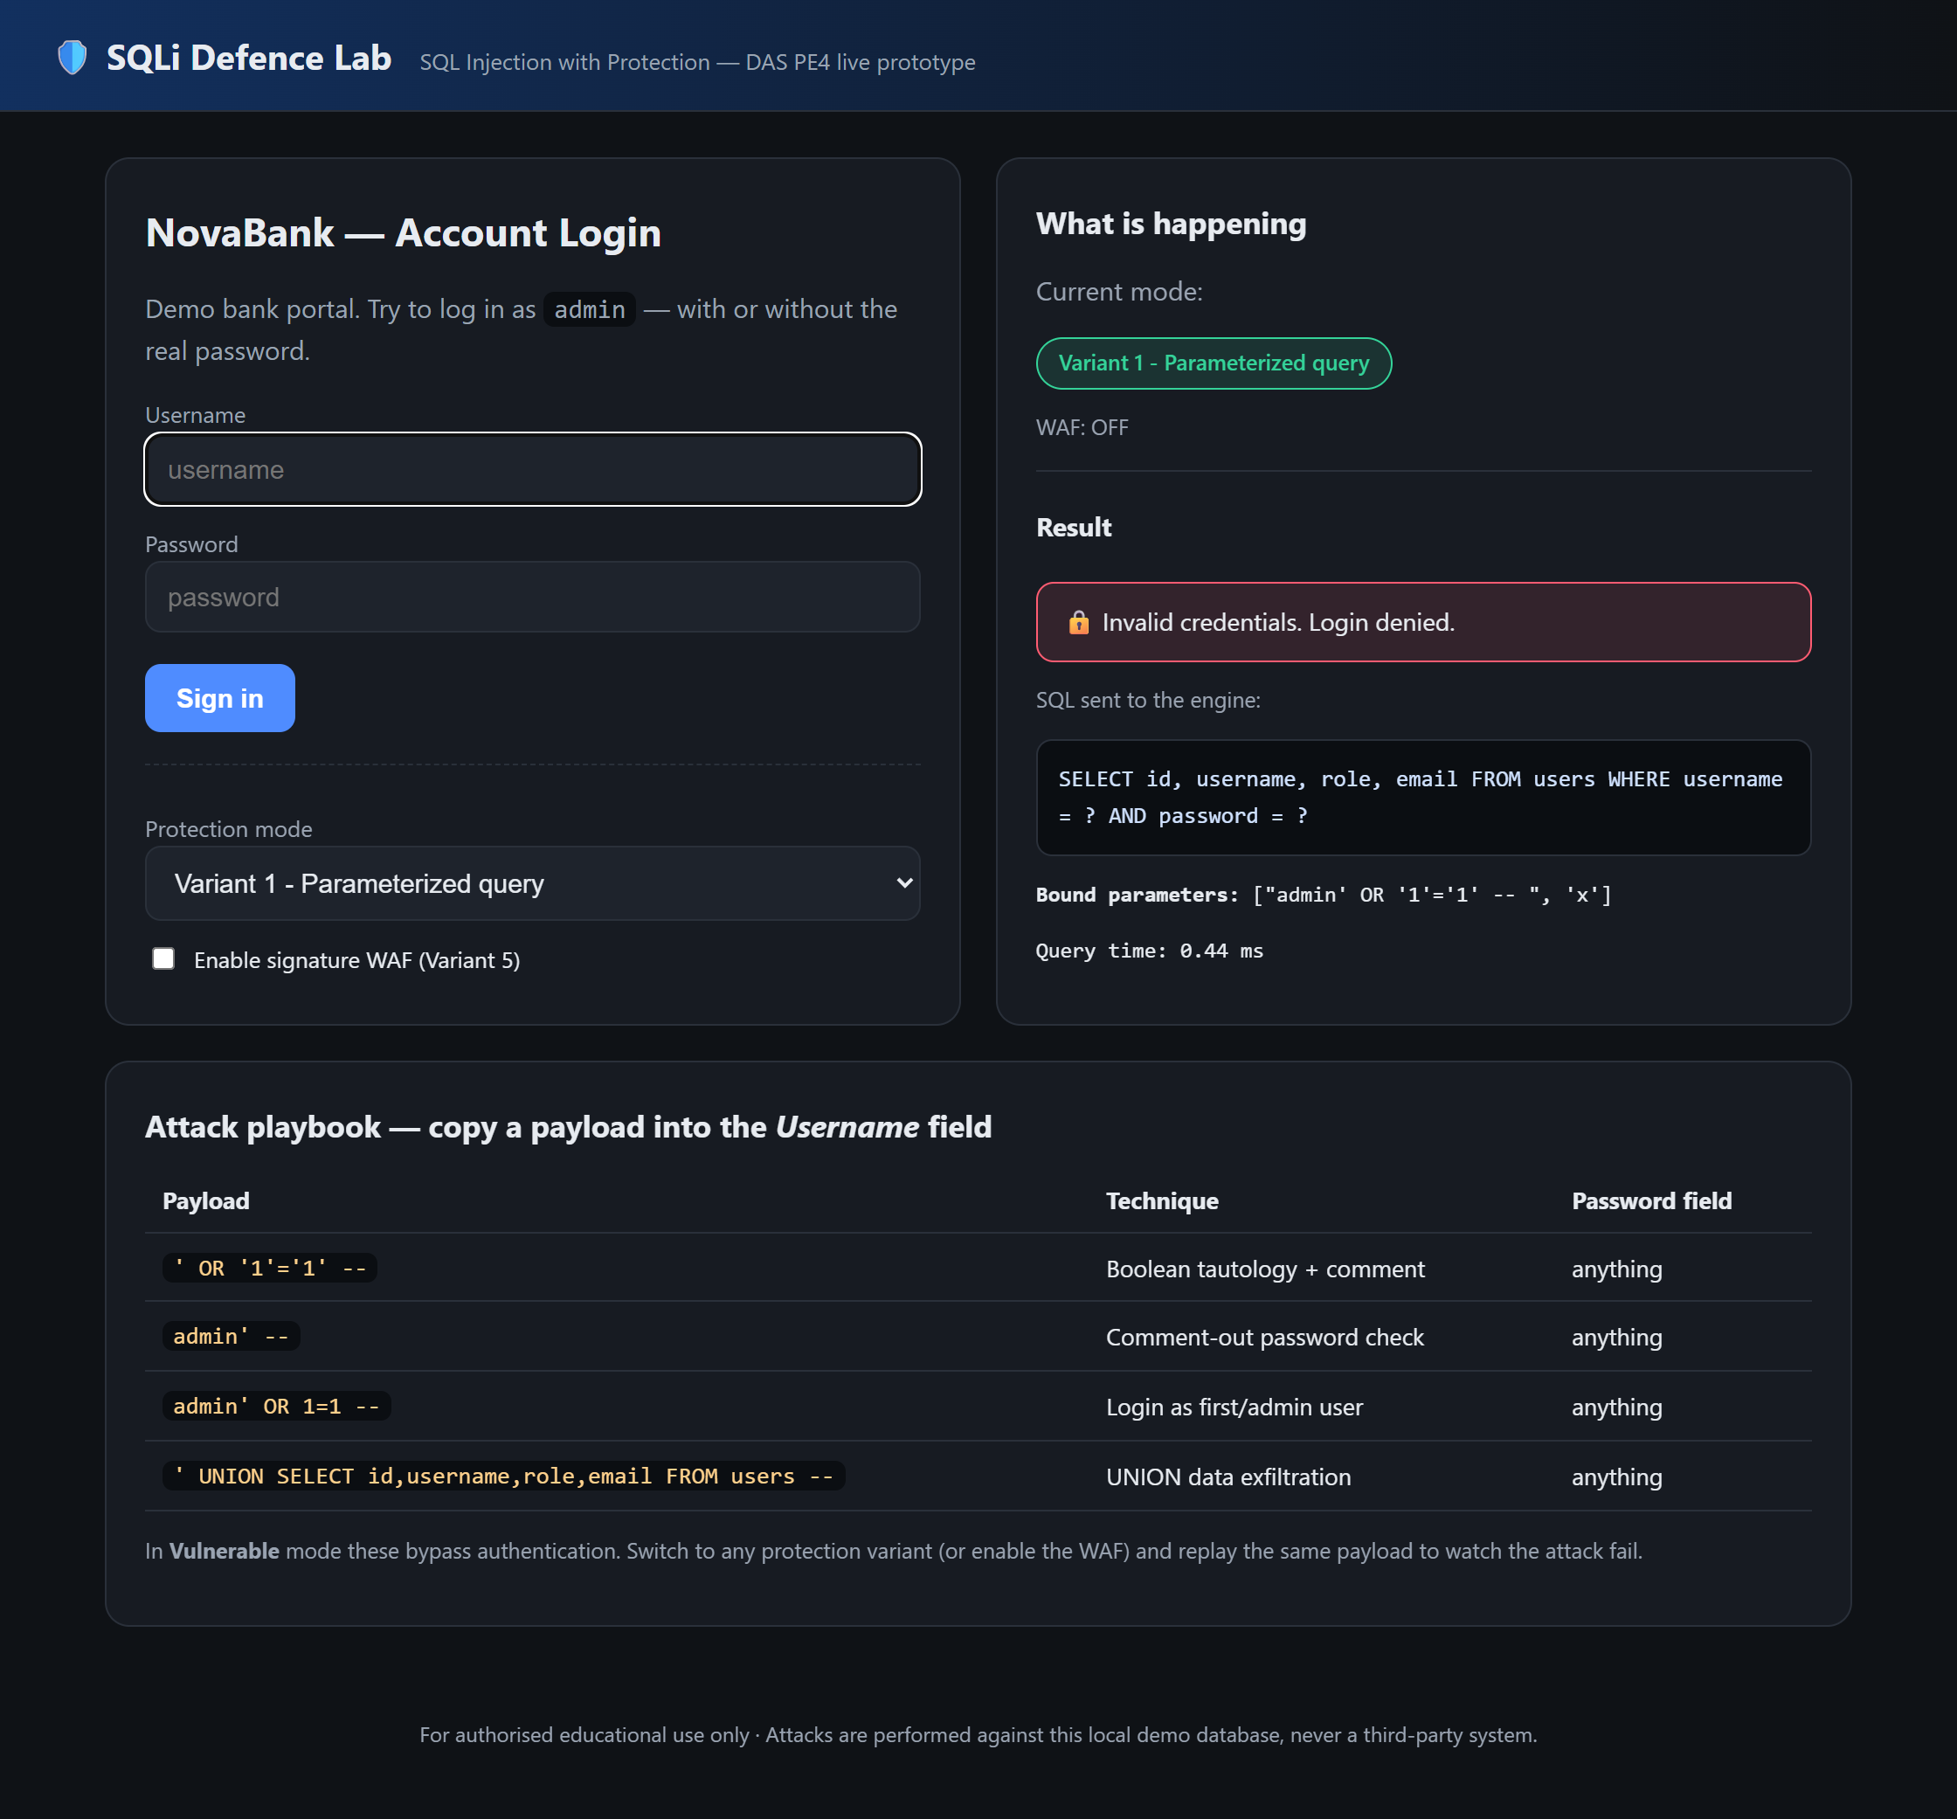
LIVE DEMO · STEP 3
Variant 1 — Parameterized query
• Switch Mode = Parameterized.
• Replay the SAME payload.
• Input is bound as a parameter, not SQL.
• Panel shows: params = ["admin' OR '1'='1' -- ", "x"]
• The query structure is unchanged.
✅ Blocked — attack neutralised.
Fig. 3 — Payload treated as literal data; login denied.
SQLi Defence Lab · DAS PE4 · SQL Injection with Protection
8

Slide 9
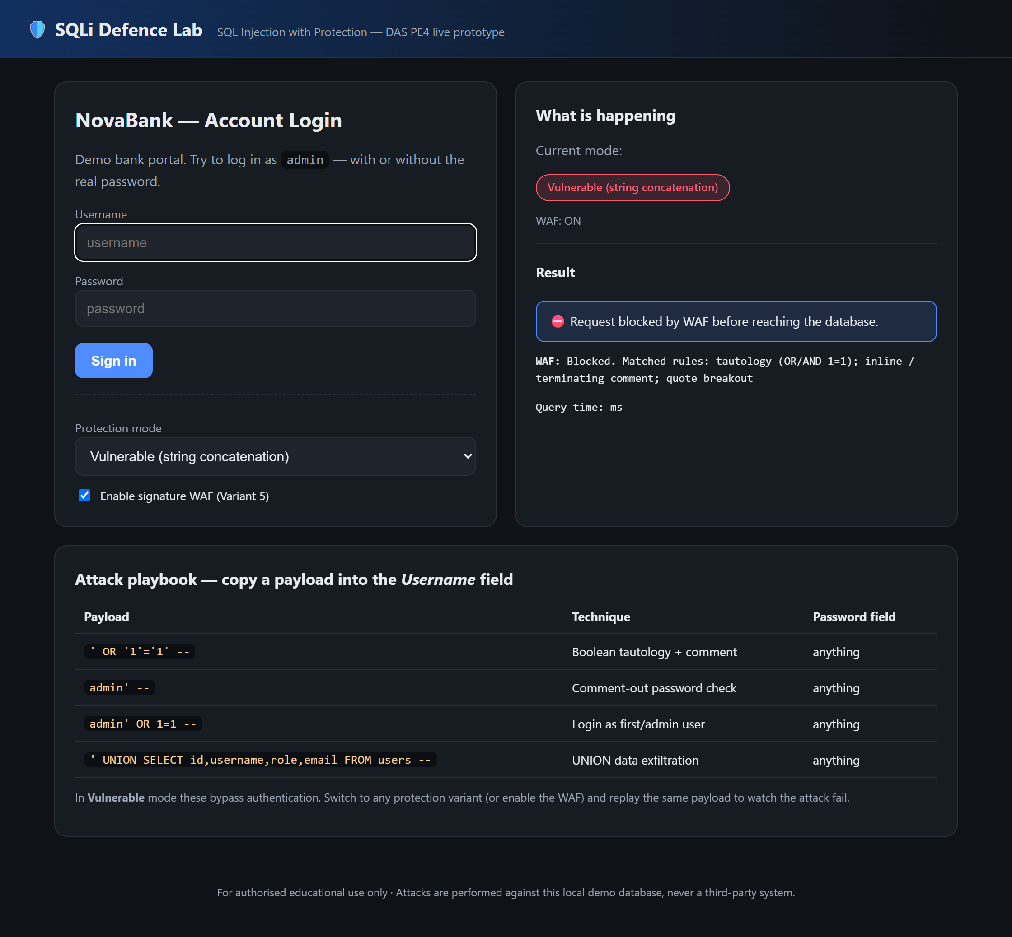
LIVE DEMO · STEP 4
Variant 5 — Signature WAF
• Enable 'Signature WAF' checkbox.
• Replay the SAME payload (any mode).
• WAF matches: tautology + comment rules.
• Request is blocked BEFORE the database.
• Mirrors OWASP CRS / ModSecurity approach.
✅ Blocked at layer 0.
Fig. 4 — WAF blocks the request at the gateway.
SQLi Defence Lab · DAS PE4 · SQL Injection with Protection
9

Slide 10
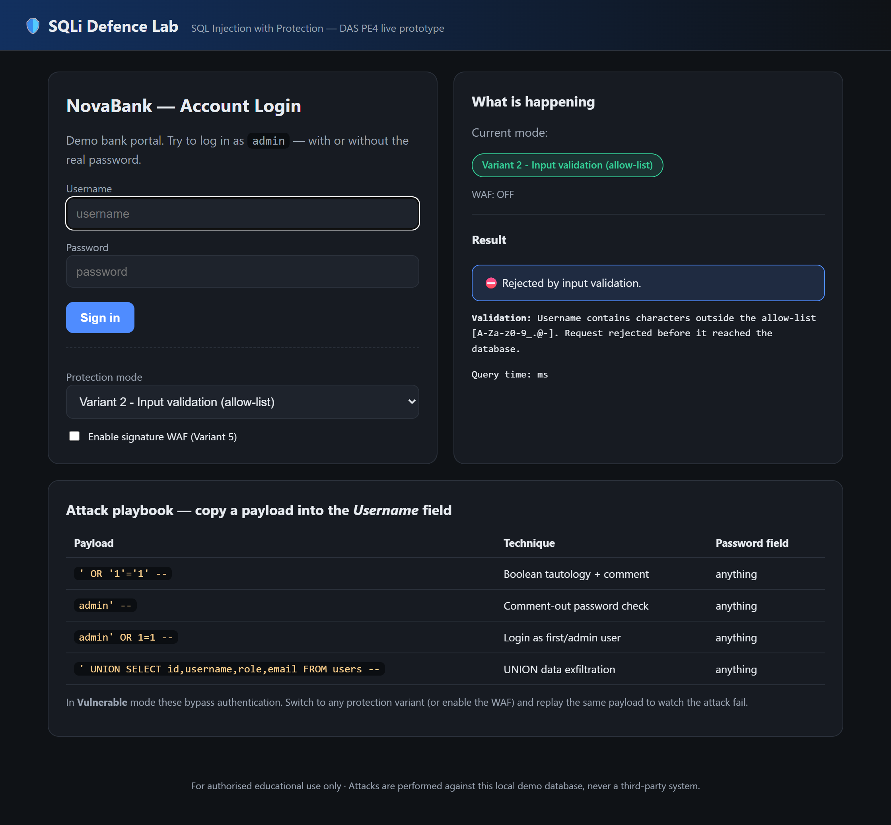
LIVE DEMO · STEP 5
Variant 2 — Allow-list validation
• Switch Mode = Allow-list.
• Payload has ' and spaces → outside allow-list.
• Rejected before any query is built.
• Regex: ^[A-Za-z0-9_.@-]{1,32}$
• Legit usernames still pass.
✅ Rejected early.
Fig. 5 — Input rejected by validation.
SQLi Defence Lab · DAS PE4 · SQL Injection with Protection
10

Slide 11
RESULTS
Same payload, every mode (automated selftest.py)
Mode | WAF off: bypass? | WAF on: bypass? | Legit login
Vulnerable | YES | No | —
Parameterized | No | No | OK
Allow-list | No | No | OK
ORM | No | No | OK
Hashed | No | No | OK
Only the vulnerable baseline (WAF off) is bypassed. Every protection variant blocks the attack; legitimate logins keep working. Measured query time < 1 ms.
SQLi Defence Lab · DAS PE4 · SQL Injection with Protection
11

Slide 12
CONCLUSION
Takeaways & future work
• Root-cause controls (parameterization, ORM, hashing) are effectively FREE and defeat SQLi.
• Validation + WAF add cheap early rejection — but are evadable, so never rely on them alone.
• Strongest posture = stack a root-cause control WITH hashing AND a WAF (defence in depth).
• Future work: add an adversarially-trained detection layer (cf. Floris et al., 2025);
  – evaluate against mutated / blind payloads (cf. Qu et al., 2024).
Run it yourself
pip install -r requirements.txt
python app.py
python selftest.py
Repo: docs/ · report/ · prototype/ · demo/
SQLi Defence Lab · DAS PE4 · SQL Injection with Protection
12

Slide 13
Thank you — Questions?
SQL Injection with Protection · Defence-in-Depth Live Prototype
SQLi Defence Lab · DAS PE4 · SQL Injection with Protection
13

