Slide 1


BUTTONS-BOOKMARKS
POWER-BI

Slide 2
INTRODUCTION
In Power BI, bookmarks are a feature that allows you to capture and save the current state of a report page, including filters, slicers, visibility of visuals, and the arrangement of data. This feature enables users to quickly return to specific views or configurations of their report.
Buttons in Power BI are interactive elements that users can click to trigger actions. When combined with bookmarks, buttons can significantly enhance the interactivity of a report.
By assigning bookmarks to buttons, you can create a seamless navigation experience where users can switch between different views or states of the report with a simple click.
By combination is particularly useful for creating guided analytics, storytelling, and dynamic reporting environments, allowing users to explore data from various perspectives without needing to manually adjust filters or settings.

Slide 3
STEPS
Step 1: Create Your Visuals :-
Ensure you have all the visuals ready on different report pages or within the same page. For example, you might have visuals for yearly, quarterly, and monthly data.
Step 2: Create Bookmarks :-
Go to the "View" tab and enable the "Bookmarks Pane" and "Selection Pane.“
Set up your report view as you want it to be saved in the bookmark (e.g., showing yearly data)
In the "Bookmarks Pane," click "Add" to create a new bookmark and name it (e.g., "Yearly Data").
Repeat these steps to create bookmarks for Quarterly and Monthly views.

Slide 4
Step 3: Create Buttons
Go to the "Insert" tab and click on "Buttons.“
Choose a button type (e.g., Blank, Left Arrow, Right Arrow, etc.).
Place the button on your report canvas and resize/move it as needed.
Right-click the button and select "Edit text" to label it (e.g., "Yearly Data," "Quarterly Data," "Monthly Data").
Step 4: Assign Bookmarks to Buttons
Select the button you want to assign a bookmark to.
In the "Visualizations" pane, go to the "Action" tab and toggle "Action" to On.
In the "Type" dropdown, select "Bookmark.“
In the "Bookmark" dropdown, select the corresponding bookmark (e.g., "Yearly Data" for the Yearly Data button).
Repeat these steps for each button, assigning them to their respective bookmarks.

Slide 5
Step 5: Test Your Buttons :-
Click on each button with CTRL key to ensure they navigate to the correct bookmarks and update the visuals accordingly.
Optional Step: Create a Toggle Effect :-
You can create a toggle effect between different bookmarks for a more dynamic experience:
Create two buttons (e.g., "Show Yearly Data" and "Show Monthly Data").
Set up the bookmarks so that one hides the yearly data visual and shows the monthly data visual, and vice versa.
In the "Selection Pane," manage the visibility of visuals to match each bookmark’s state.
Assign the appropriate bookmarks to each button as described above.

Slide 6
EXAMPLE
Here's a practical example assuming you have visuals for yearly, quarterly, and monthly data:
Set up the Yearly Data view:
Show only the Yearly Data visual.
Create a bookmark named "Yearly Data.
Set up the Quarterly Data view:
Show only the Quarterly Data visual.
Create a bookmark named "Quarterly Data.
3. Set up the Monthly Data view:
Show only the Monthly Data visual.
Create a bookmark named "Monthly Data.
4. Insert and configure buttons:
Insert three buttons and label them "Yearly Data," "Quarterly Data," and "Monthly Data."
Assign the "Yearly Data" bookmark to the "Yearly Data" button, "Quarterly Data" bookmark to the "Quarterly Data" button, and "Monthly Data" bookmark to the "Monthly Data" button.

Slide 7
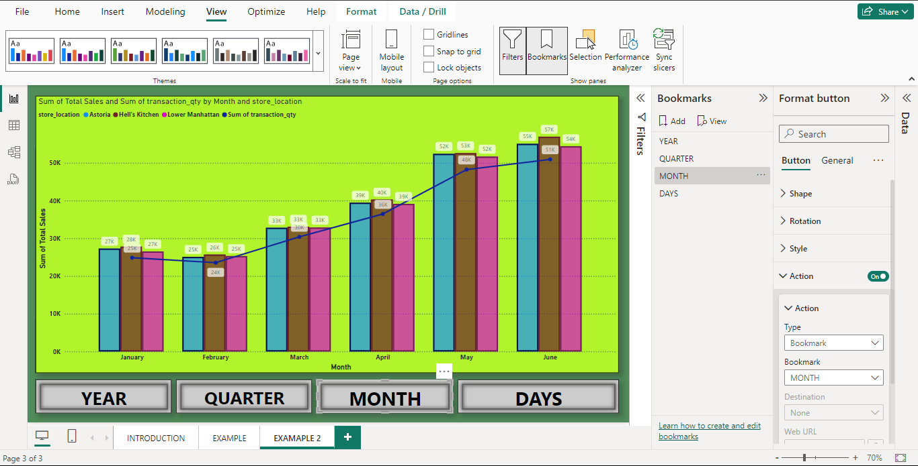
PREVIEW

Slide 8
SUMMARY
By following these steps, you create a Power BI report with interactive buttons that navigate to different bookmarks, enhancing the user's ability to switch between different views of the data. This approach improves the user experience, making it easier to explore and analyze the report content.
Using buttons and bookmarks together in Power BI allows you to create a dynamic and interactive reporting experience. Users can easily navigate through different views and states of the report with a single click, making it easier to analyze data from various perspectives. This combination is particularly powerful for storytelling, guided analytics, and enhancing the overall usability of your Power BI reports.

Slide 9
THANK YOU

