Slide 1
Acoustic Underwater Communication
Thomas BOUSTON | Elyne FERREIRA DA COSTA | Yashveen JOOTUN
28 / 03 / 2024
Notes:
- Thomas -

Slide 2
Presentation Overview
Introduction and Context
Project Specifications
Technical Solution
Conclusion
Notes:
- Thomas -

Slide 3

Project client: Mooring Solution Startup
Introduction and Context
Directed by two Centrale Marseille engineers
Markets connected devices for boating industry
Sells connected buoy against anchor slippage
Notes:
- Elyne -

Slide 4
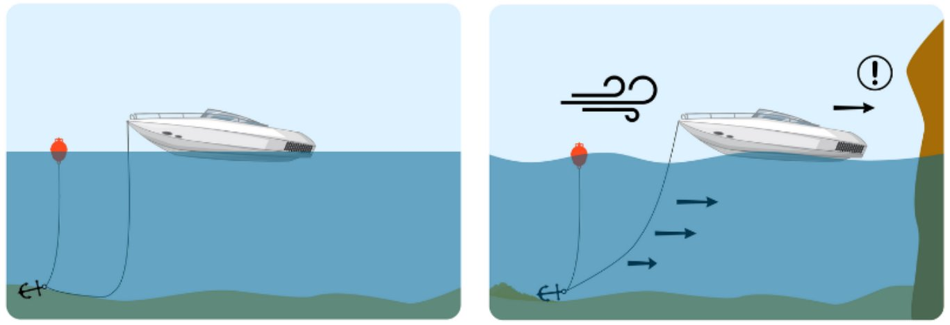
Project Context
Introduction and Context
Anchor slippage: source of accidents
Connected buoy: notifies owner
Suitable for leisure boats
Notes:
- Elyne -

Slide 5




Project Objective
Introduction and Context
New technology: anchor-based solution
Key challenge: underwater communication
Present submarine communication proof of concept
Notes:
- Elyne -

Slide 6

POC: two devices communicating underwater
Project Specifications
Constraints
Minimal distance: 3 meters
Data transmission frequency: 1 hertz
Volume of data to send: 1 byte
Devices on battery
Notes:
- Elyne -
Préciser que le POC n’existe pas, qu’on n’a pas eu le temps de tester tout dans son ensemble

Slide 7
State of Art: existing technologies
Project Specifications
Waves comparison
Parameters | Electromagnetic (RF) | Optical | Acoustic
Attenuation | 3,5 – 5 dB/m | 0,39 dB/m | 0,1 – 4 dB/Km
Emitter size | 0,5 meters | 0,1 meters | 0,1 meters
Distance | 10 meters | 100 meters | Kilometers
Notes:
- Elyne -

Slide 8
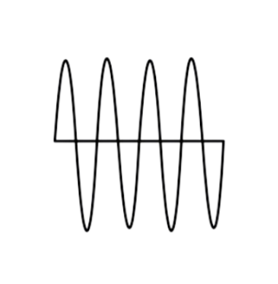



Acoustic Signal Transmission
Technical Solution
Device 1
Device 2
Emitter transducer
Receiver transducer
Notes:
- Thomas -
Transducer principle: transform an electrical signal into an acoustic signal and conversly

Slide 9
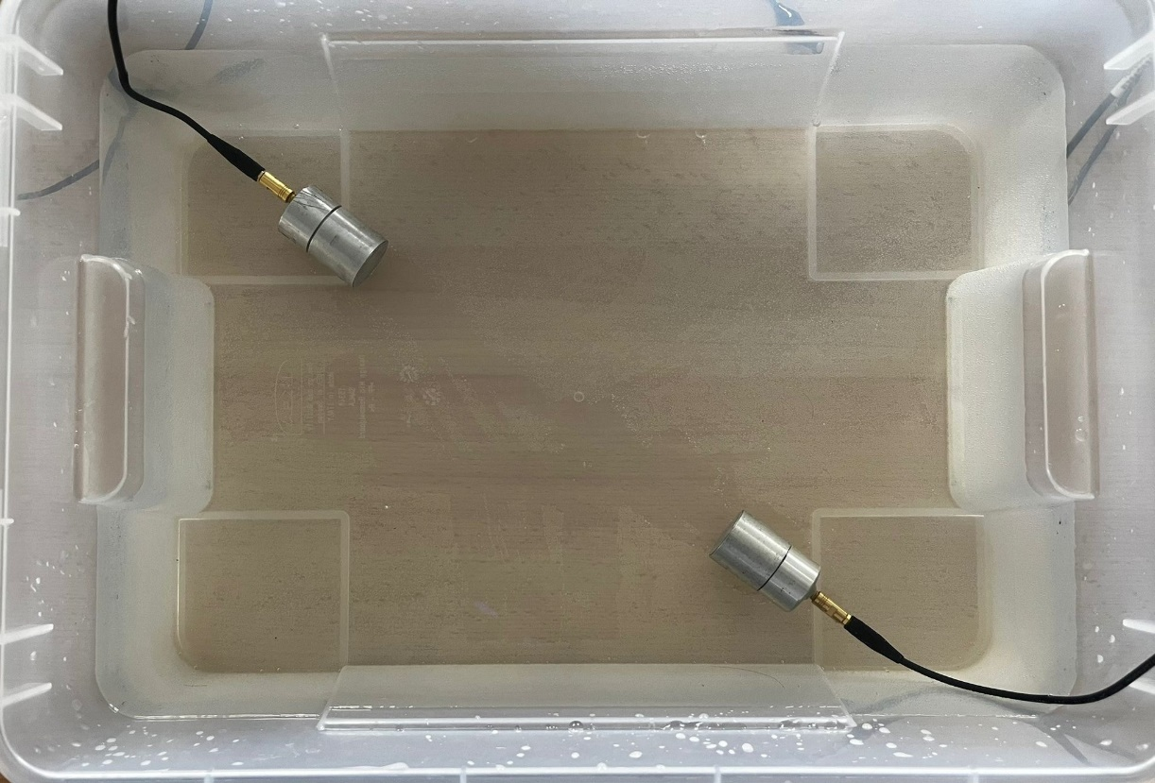
Acoustic Signal Transmission: testing environment
Technical Solution
Notes:
- Thomas -
The working environment

Slide 10
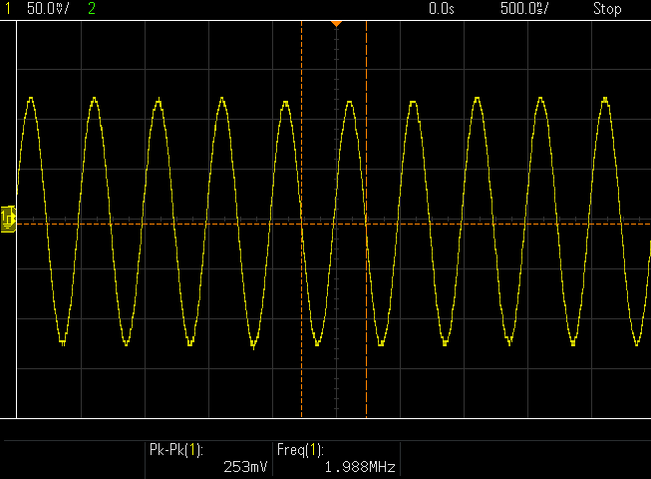
Acoustic Signal Transmission: resulting signal
Technical Solution
Notes:
- Thomas -
The resulting signal
Strong attenuation

Slide 11
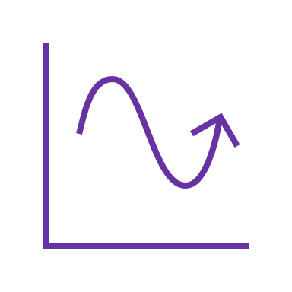
Signal Encoding: Frequency Modulation
Technical Solution
Principle
Representing 0s and 1s
Alternating signal frequencies
Creating patterns
Notes:
- Yash -
-send a message microcontroller to another with transducers, signal encoded.
-specific signal patterns were selected to represent binary 0s and 1s
-alterning frequencies inside the signal

Slide 12
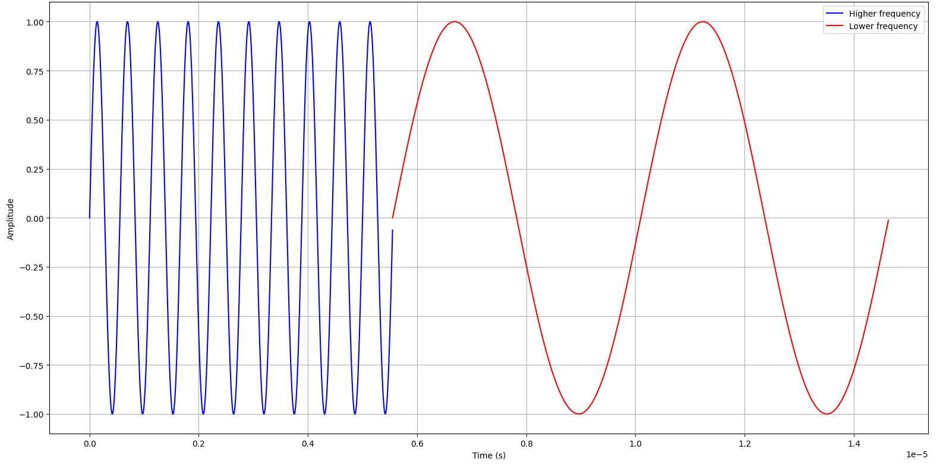
Signal Encoding: Frequency Modulation
Technical Solution
Notes:
- Yash -
-this method is called frequency modulation.
-The straightforward approach involved choosing two distinct frequencies and alternating the signal between them.
-blue signal has a higher frequency then the red signal

Slide 13
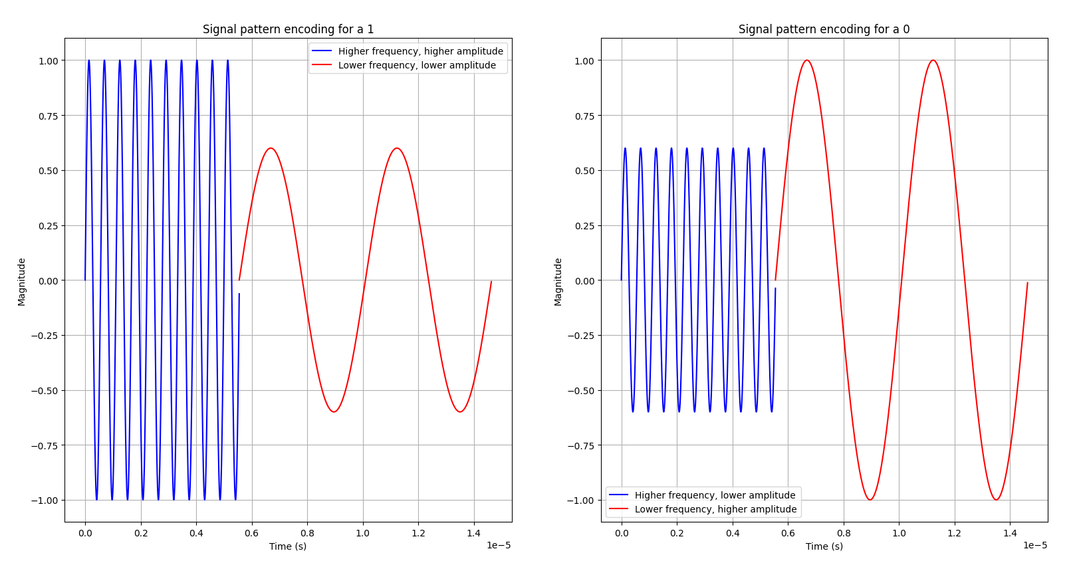
Signal Encoding: Frequency Modulation
Technical Solution
Notes:
- Yash -
patterns chosen, distiguish the order of the freq
-to determine the pattern encoding for a 1 bit or a 0 bit.
-One method was to provide different magnitude for both frequencies.
-The left plot shows a blue wave with both high magnitude and high frequency
followed by a red wave with both low magnitude and low frequency.
-The right plot shows a blue wave with a low magnitude but high frequency followed by a red wave with a high magnitude but low frequency.

Slide 14
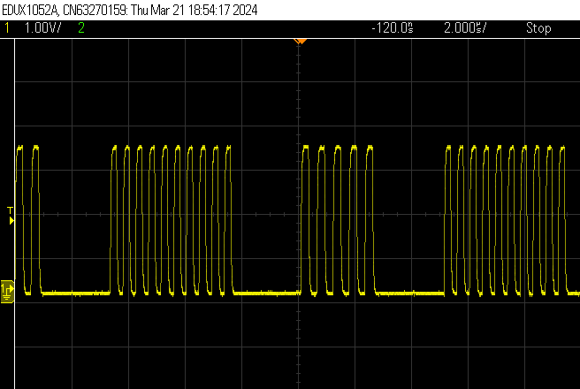
Signal Generation
Technical Solution
Frequencies selection
Transducer maximum magnitude at 2MHz
Bandwidth : 1.5-2.5MHz
2.22MHz & 1.78MHz
PWM
STM32F401RE
Notes:
- Yash -
-transducers emit a maximum magnitude signal at 2MHz.
-However, the bandwidth falls within a range from 1.5MHz to 2.5MHz.
-In other words, sending a signal with a frequency close to 2MHz mitigates the strength of the wave but remains usable.
-The selected frequencies : 1.78MHz and 2.22MHz.
-it seemed relevant to use STM32 boards which are better suited for signal generation and signal processing.
-a technique called Pulse Width Modulation (PWM)

Slide 15
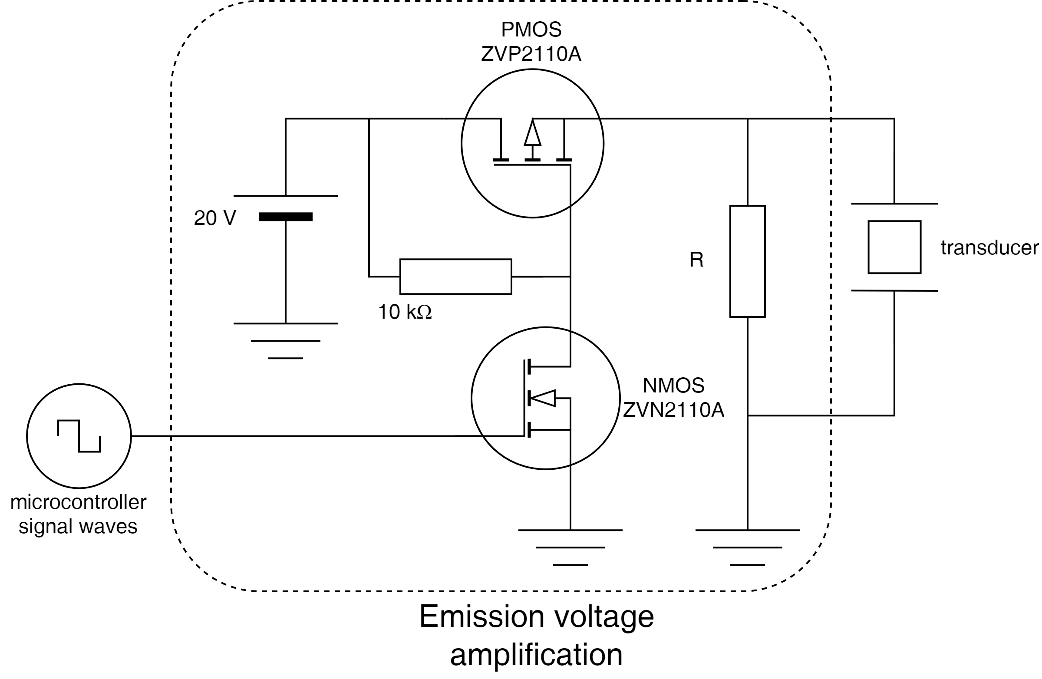
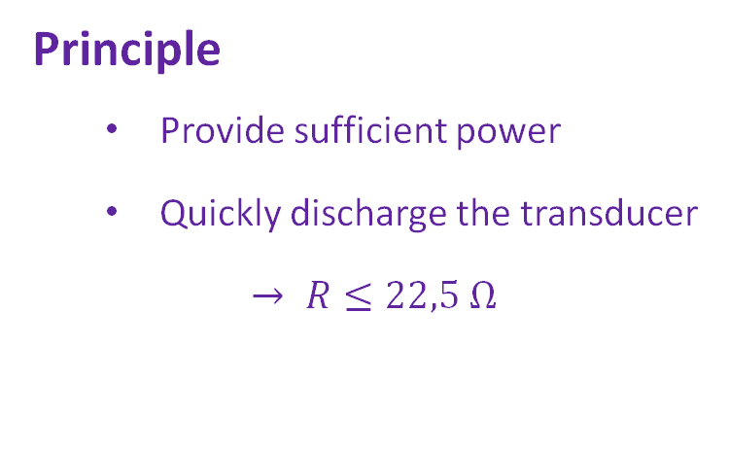
Signal Generation: Amplification
Technical Solution
Principle
Provide sufficient power
Quickly discharge the transducer
$→ R≤22,5 Ω$
Notes:
- Thomas -
Auxiliary system
Transducer compared to capacitor: add a resistor sized to quickly….

Slide 16
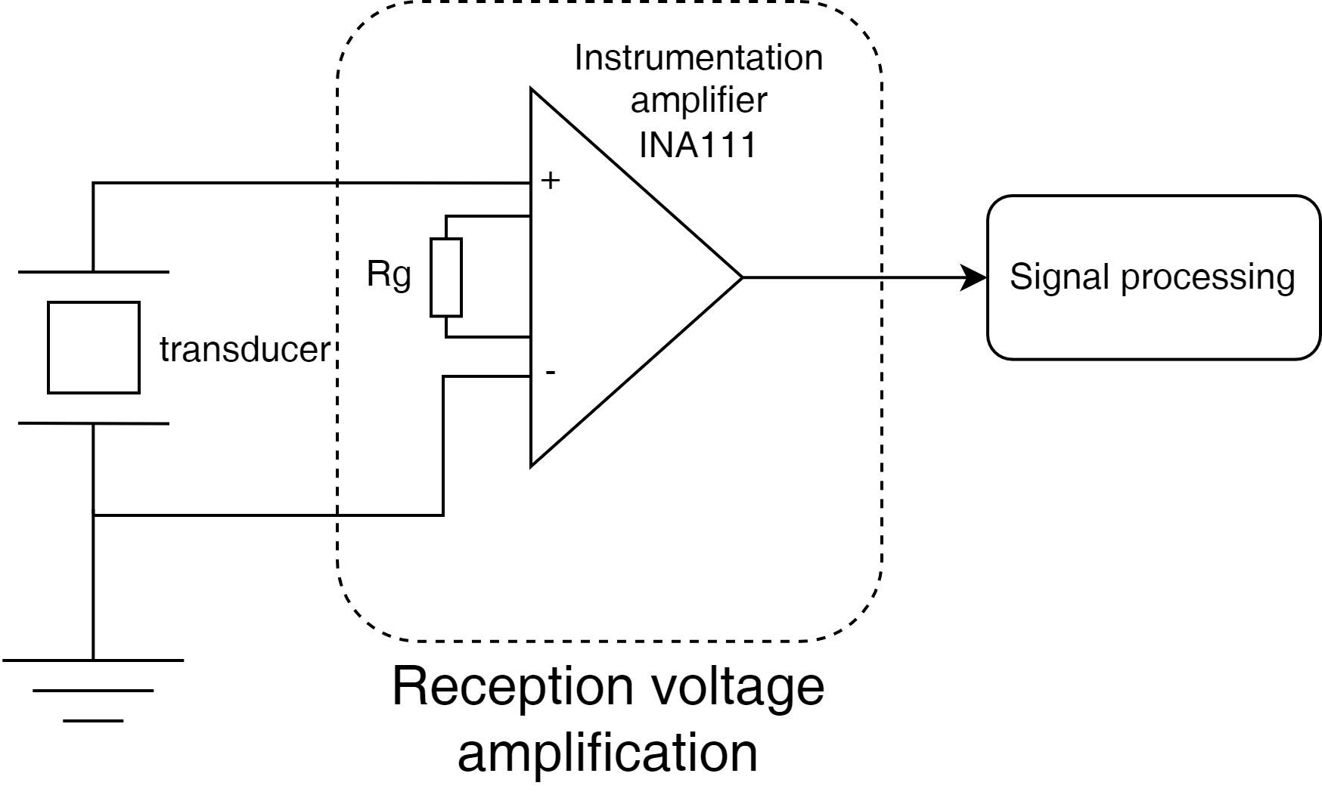
Signal Reception: Amplification
Technical Solution
Principle
Amplify small signals
Gain controlling resistor
High Gain-Bandwidth product
(at 2MHz, G=10)
Notes:
- Thomas -
G = 1+50k/Rg : pour G = 6 Rg = 50

Slide 17
Signal Amplification
Technical Solution
Notes:
- Thomas -

Slide 18
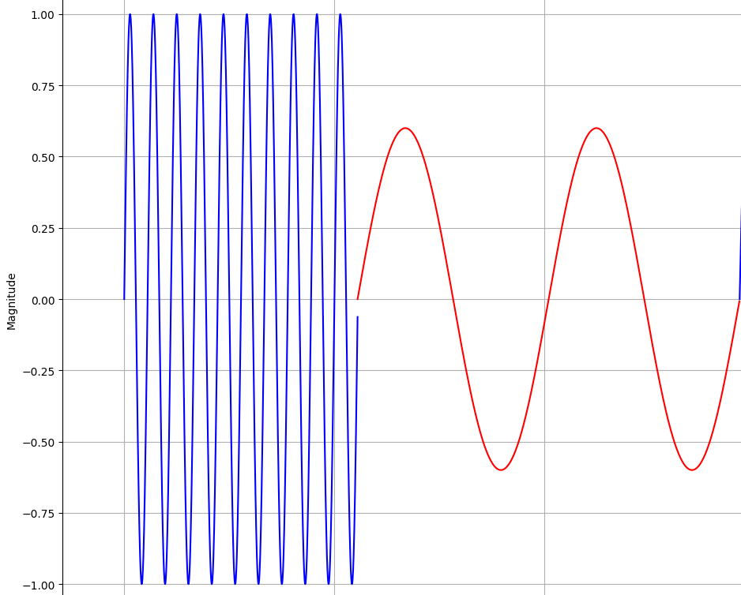
Signal Reception: Demodulation
Technical Solution
Notes:
- Elyne -

Slide 19
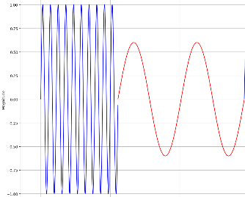
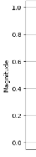
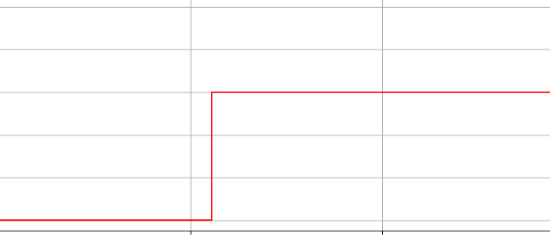
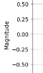
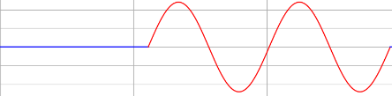
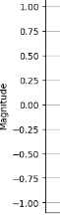



Signal Reception: Analog Filtering and Stabilization
Technical Solution
Analog Filtering
Stabilization
Bandpass Fc = 1,8 MHz
Peak Detector
To STM32 board
Received signal
Bandpass Fc = 2,2 MHz
Peak Detector
Notes:
- Elyne -

Slide 20
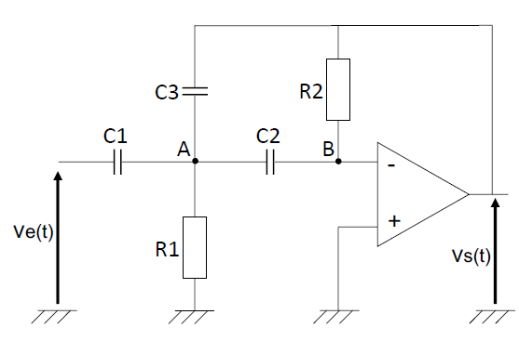
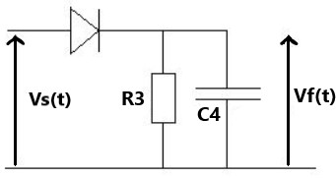
Signal Reception: Rauch Structure & Peak Detector
Technical Solution
For 1,8 MHz
R1 = R2 = 1.25043 x 10⁵ Ω
C1 = C2 = C3 = 1pF
R3 = 555 Ω
C4 = 1nF
Rauch Structure
Peak Detector
Notes:
- Elyne -

Slide 21
Signal Reception: Abandoned Idea
Technical Solution
Components could not operate at 2 MHz
Initial circuits with 20 kHz received signal
Used operational amplifier: LPM6132
Used instrumentation amplifier: INA111
Notes:
- Elyne -

Slide 22
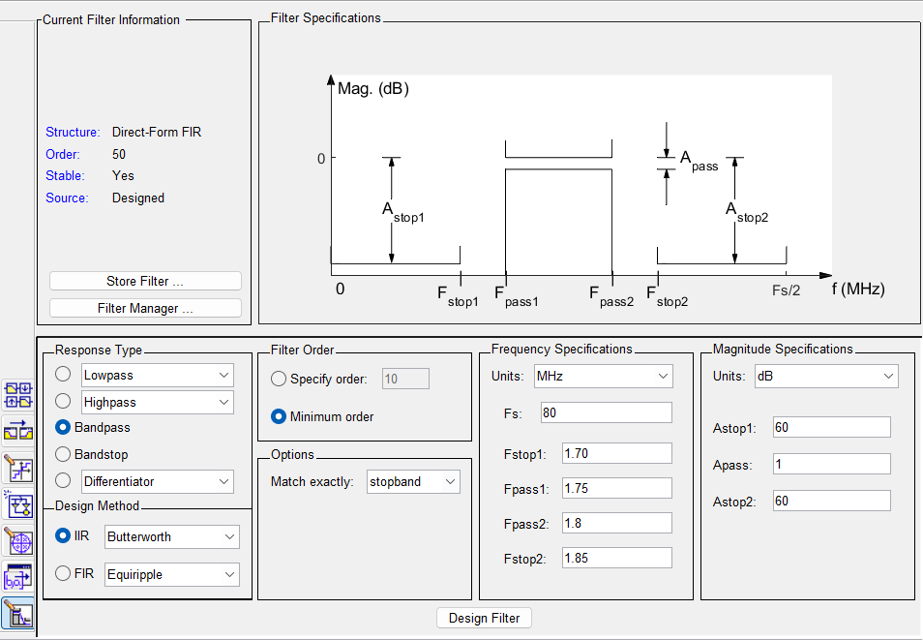

Signal Reception: Digital Filtering
Technical Solution
Principle
Filter Design tool
Bandpass filter generation
Notes:
- Yash -
-analog filter might not work for very high frequencies, one solution is to use a digital filter.
-Digital filters = systems that perform mathematical operations on signal.
-allows the signal to be modeled as required / any of the physical component mentioned for an analog filter.
-digital filters SOMETIMES introduce delay & can also alter the waveform of the signal.
-MATLAB and the tool Filter Design.

Slide 23
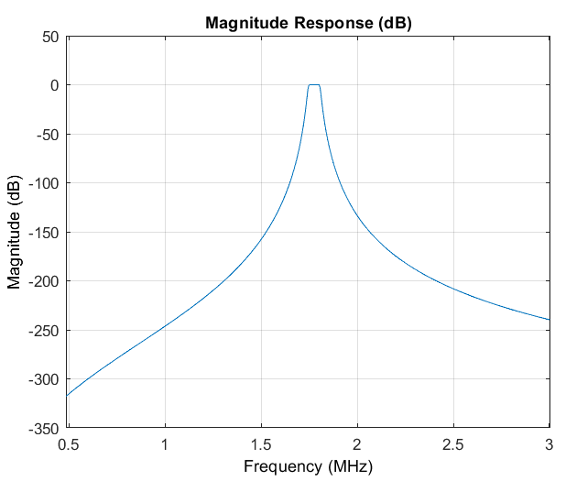
Signal Reception: Digital Filtering
Technical Solution
Analysis
Filter response Bode plot
Filter coefficients
C language code generation
Notes:
- Yash -
-generates Bode plot
-gives the filter coef that defines the behaviour of the filter
-can generate C language code for specific STM32 boards

Slide 24
Signal Reception: Decoding Half Patterns
Technical Solution
Half Pattern Substractions
1,8 MHz Signal
1
3
1
2
Pattern Result
1 bit or 0 bit
2,2 MHz Signal
2
4
3
4
Notes:
- Elyne -

Slide 25
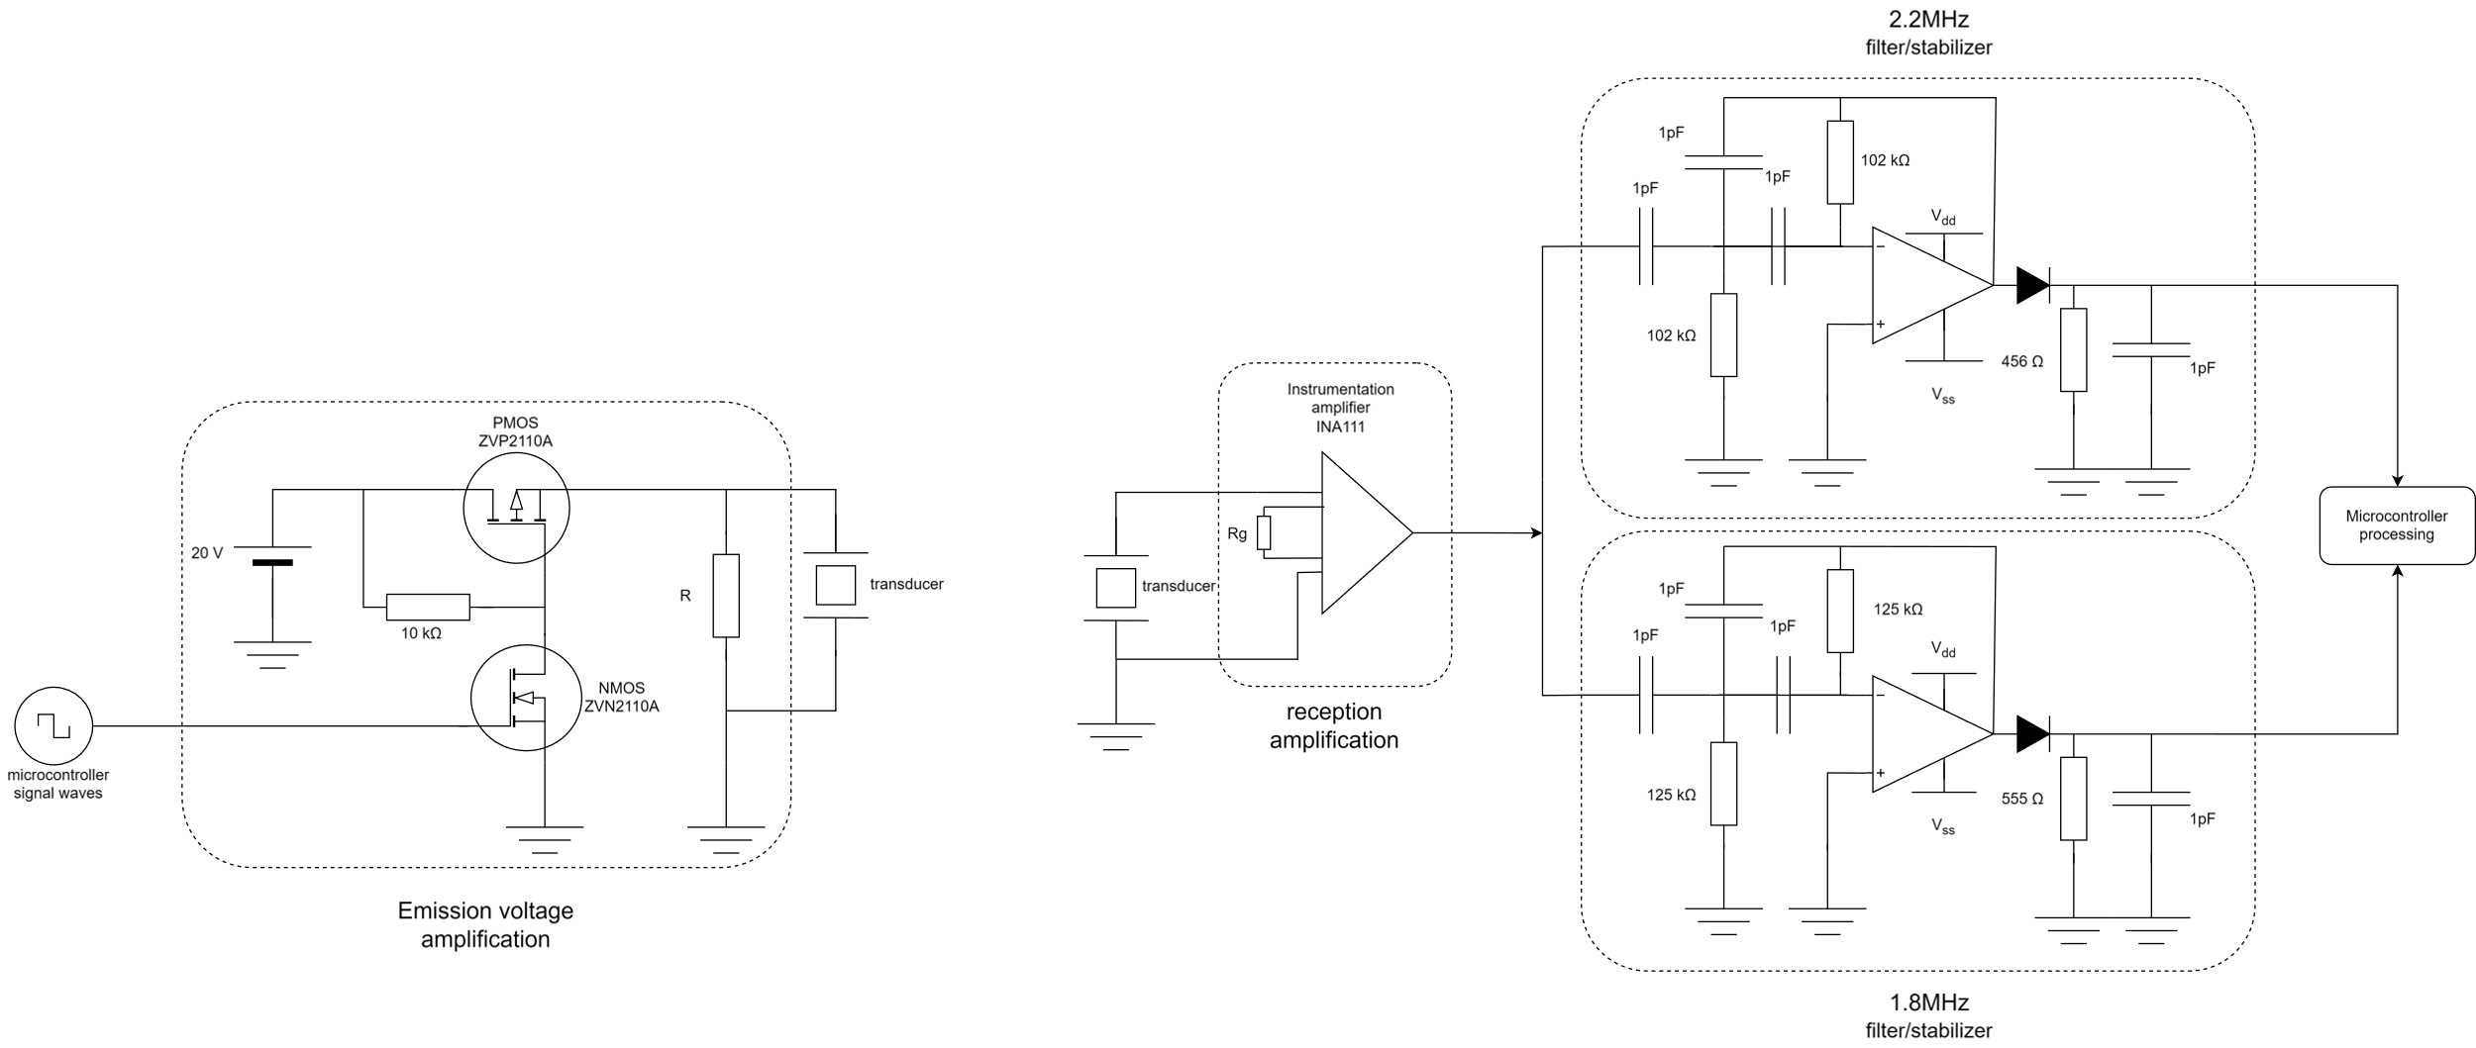
Final technical solution
Technical Solution
Notes:
- Yash -

Slide 26



Encountered Difficulties
Conclusion
High cost
High frequency component behaviours
Lack of acoustic expertise
Notes:
- Thomas -

Slide 27




Potential Improvements
Conclusion
Understanding analog filter behavior over VHF
In situ experiments & encapsulation
Message robustness
Distance measuring mode
Notes:
Yash –
-Understanding analog filter:
-refining its structure ensure optimal functionality
-optimizing the performance of the filter.
-In situ trials and transducers adjustment
-Conduct experiments in saline environnement particularly in ocean
-distance higher than 3m
-trying with box encapsulation : transducers echo
-Message robustness :
-reliability
-integrity of the message
-Project specification was to be able to measure distances with the 2 transducer non

Slide 28
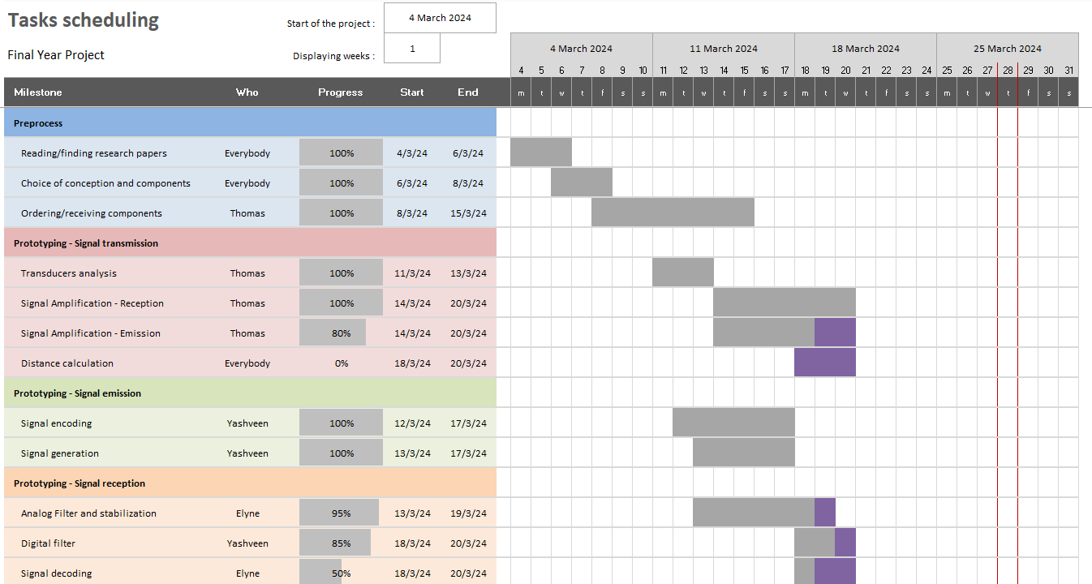
Conclusion
Notes:
- Elyne -

Slide 29
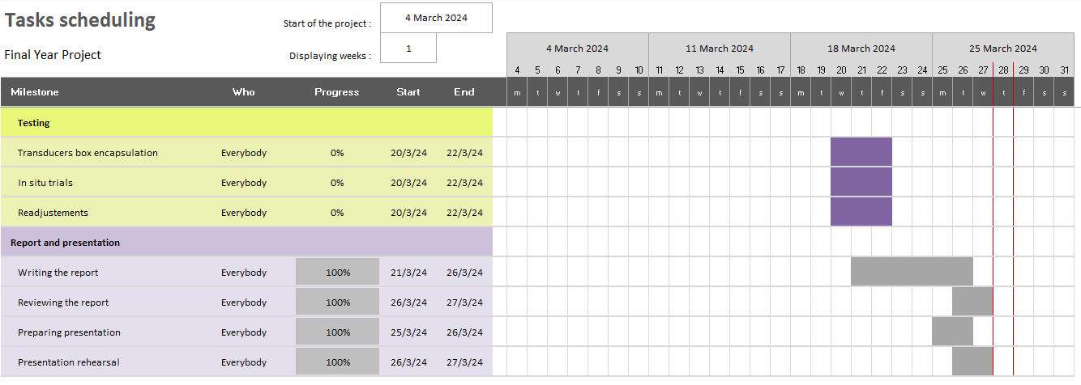
Conclusion
Notes:
- Elyne -

Slide 30




General insights
Conclusion
Opportunity to open minds
A lot of uncertainty
Lack of time
Unmet specifications
Notes:
- Elyne -

Slide 31
Thank you

Slide 32
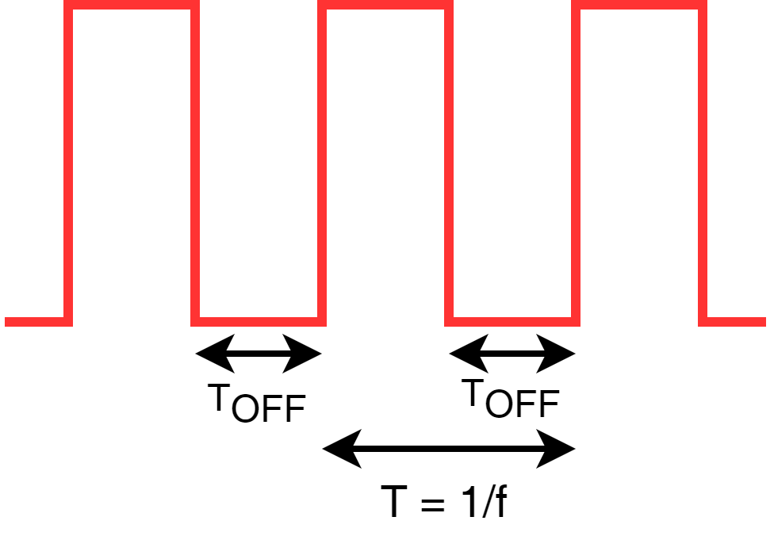
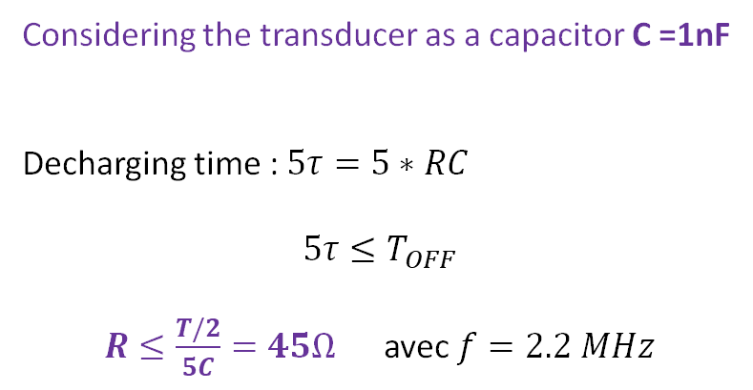
Signal Generation: Amplification
Appendices
Considering the transducer as a capacitor C =1nF
Decharging time :$5τ=5∗RC$
$$5τ≤T_{OFF}$$
$R≤\frac{T/2}{5C}=45Ω$ avec $f=2.2 MHz$
Notes:
- Thomas –

Slide 33
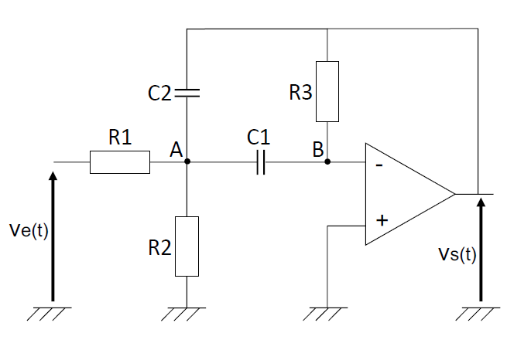
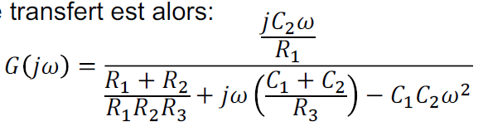
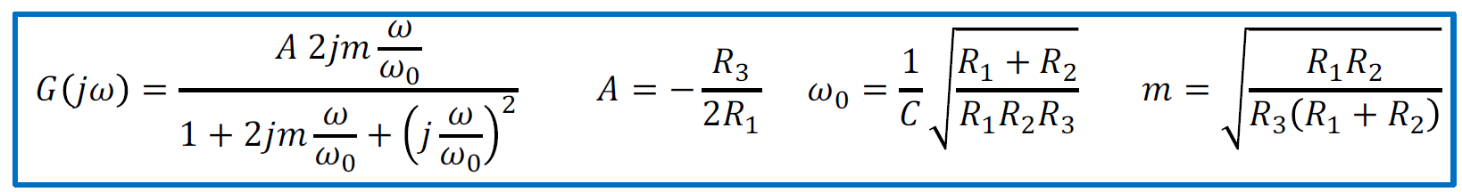
Signal Reception: Rauch Structure
Appendices
Canonical Form when C = C1 = C2

Slide 34

Signal Reception: Rauch Structure
Appendices
Considering R = R1 = R2 = R3: $F_{c}=\frac{ω_{o}}{2π}=\frac{1}{2πC} \sqrt{\frac{2}{R^{2}}}$
Considering C = 1pF: R $=\frac{1}{2πC} \sqrt{\frac{2}{{(2πF_{c}C)}^{2}} }≈1,250{.10}^{5}Ω$

Slide 35

Signal Reception: Peak Detector
Appendices
Charging and decharging time : $t= 5.τ= 5.R4.C3$

Slide 36
Half pattern decoding pseudocode
Appendices
Get result after filtering & comparison // half pattern comparison
if result < 0 then
Red signal magnitude > Blue signal magnitude
else
Blue signal magnitude > Red signal magnitude
end if
if ARefMin −0.1×ARefMin <= result <= ARefMin +0.1×ARefMin then
1/2pattern magnitude = Min signal magnitude
else if ARefMax − 0.1 ∗ ARefMax <= result <= ARefMax + 0.1 ∗ ARefMax then
1/2pattern magnitude = Max signal magnitude
end if

