Slide 1

.
ABSTRACT:
The dataset contains information about the matches team India has played. The BCCI wants to make predictions regarding the winning prospects to make team India win.
Yashveer Kothari .A
POST GRADUATE PROGRAM IN DATA SCIENCE AND BUSINESS ANALYTICS
CAPSTONE PROJECT
ON
CRICKET PREDICTION

Slide 2
PRESENTATION CONTENT
INTRODUCTION
DATA PREPARATION
EXPLORATORY DATA ANALYSIS
MODEL BUILDING
MODEL TUNNING
MODEL SELECTION
CONCLUSION
RECOMMENDATION

Slide 3
INTRODUCTION
Main aim is to create Machine Learning models which correctly predicts a win for the Indian Cricket Team.
Developing a model to extract and provide actionable insights and recommendation.

Slide 4
PROBLEM STATEMENT
BCCI has hired an external analytics consulting firm for data analytics. The major objective of this tie up is to extract actionable insights from the historical match data and make strategic changes to make India win. Primary objective is to create Machine Learning models which correctly predicts a win for the Indian Cricket Team.
Details of the next 10 matches are given in the dataset which is India is going tom play You have to predict the result of the matches and if you are getting prediction as a Loss then suggest some changes and re-run your model again until you are getting Win as a prediction. You cannot use the same strategy in the entire series, because opponent will get to know your strategy and they can come with counter strategy. Hence for all the below 5 matches you have to suggest unique strategies to make India win. The suggestions should be in-line with the variables that have been mentioned in the given data set. Do consider the feasibility of the suggestions very carefully as well.

Slide 5
WORK FLOW OF PREDICTION PROCESS
Data Collection
Data Exploration
Data Cleaning
Data Pre-Processing
Model Building
Model Evaluation

Slide 6
Data dictionary
VARIABLES | DESCRIPTION
Game_number | Unique ID for each match
Result | Final result of the match
Avg_team_Age | Average age of the playing 11 players for that match
Match_light_type | type of match: Day, night or day & night
Match_format | Format of the match: T20, ODI or test
Bowlers_in_team | how many full-time bowlers has been player in the team
Wicket_keeper_in_team | how many full-time wicket keepers has been player in the team
All_rounder_in_team | how many full-time all-rounders has been player in the team
First_selection | First inning of team: batting or bowling
Opponent | Opponent team in the match
Season | What is the season of the city, where match has been played
Audience_number | Total number of audiences in the stadium
Offshore | Match played within country or outside of the country
Max_run_scored_1over | Maximum run scored in 1 over by team
Max_wicket_taken_1over | Maximum wicket taken in 1 over by team
Extra_bowls_bowled | Total number of extras bowled by team
Min_run_given_1over | Minimum run given by the bowler in one over
Min_run_scored_1over | Minimum run scored in 1 over by team
Max_run_given_1over | Maximum run given by the bowler in one over
extra_bowls_opponent | Total number of extras bowled by opponent
player_highest_run | Highest score in the match by one player
Players_scored_zero | Number of players out on zero run
player_highest_wicket | Highest wickets taken by single player in match
Total 2929 matches result for all three format (T20, ODI, Test) are part of this dataset.
We have total 23 variable present in the dataset in which 3 datatypes are given float64(9), int64(4), object (10). We have ‘Result’ as target variable.

Slide 7
DATA PREPARATION
MISSING VALUE TREATMENT
LABEL ENCODING AND FEATURE SELECTION
Conversion of categorical into numerical variables, using dummy encoding
OUTLIER TREATMENT
Variables in the dataset contain invalid values (Avg_team_Age), whereas variables for other outliers seem to be real
SCALING AND DATA IMBALANCE
Scaling performed before fitting KNN model to reduce the variation and synthetic minority over sampling technique to overcome from imbalance data issue.
Any variable in the dataset having empty or null values, is not considered in the model building process
Feature selection is done using Filter technique

Slide 8
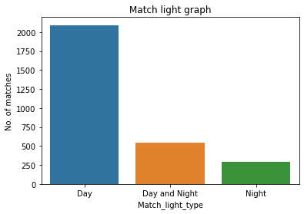
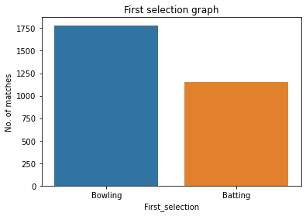
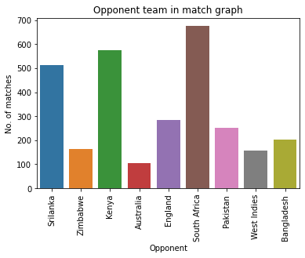
EXPLORATORY DATA ANALYSIS -UNIVARIATE
Most of the matches are played in the Day time and least in the night time.
Indian team selects bowling first than batting first after winning the toss.
India has played majority of the matches against South Africa and least against Australia.

Slide 9
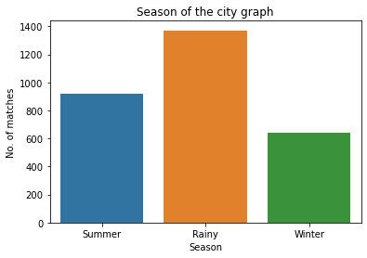
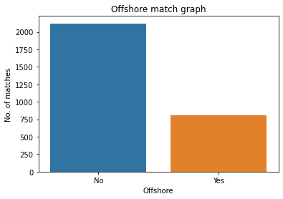
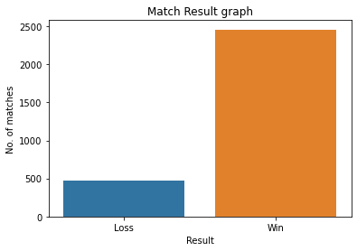
UNIVARIATE ANALYSIS CONTD…
Majority of the matches played are in the rainy season.
Games were played more in Indian soil than foreign lands.
Matches won are more than 50% and the losses.

Slide 10
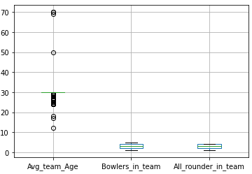
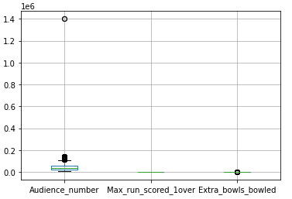
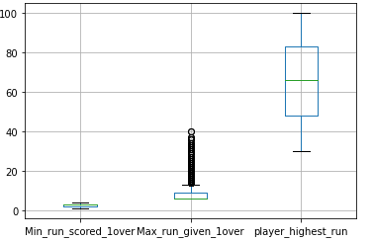
UNIVARIATE ANALYSIS CONTD…
There are outliers in the following variables which are later treated accordingly:
Avg_team_Age
Audience_number
Extra_bowls_bowled
Max_run_given_1over

Slide 11
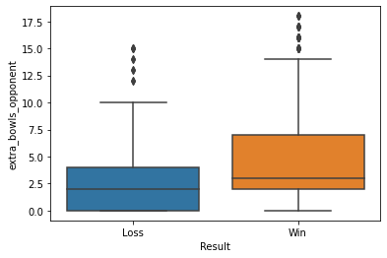
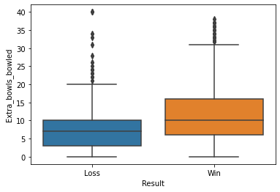
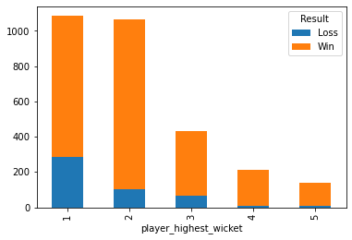
BI-VARIATE ANALYSIS
The median of extra bowls opponents is higher for win, If the extra bowls opponents is higher than 16 then India will win the match as per the data set. If the extra bowls opponents are higher than 10 then chances of winning the match is more.
As per data when you bowl 40 extra bowls India is definitely will lose the match.
The chances of winning the match are high when the 2 wickets are taken by a single player.

Slide 12
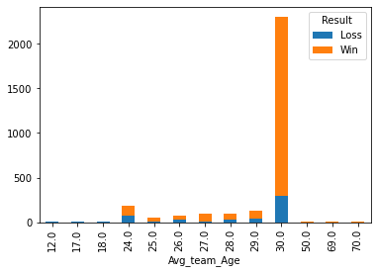
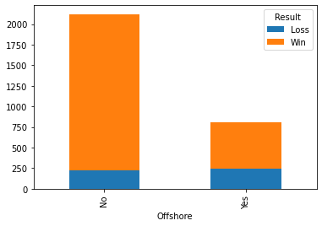
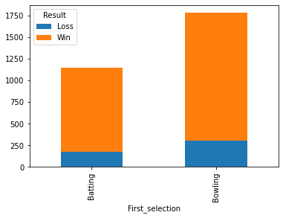
BI-VARIATE ANALYSIS CONTD…
India has the highest win with average team age at 30.
The performance of the Indian team is good when played on the home ground.
Most of the matches are won when selected to bowl first.
.

Slide 13
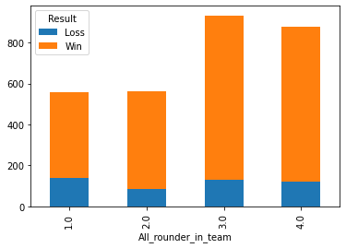
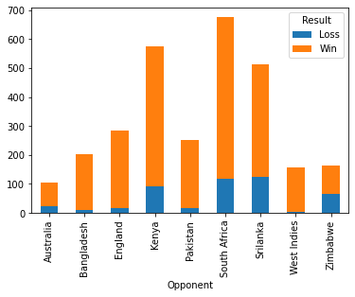
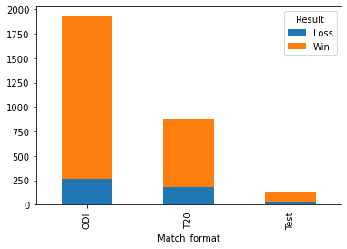
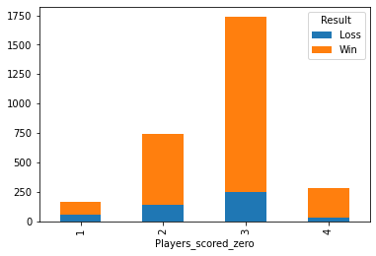
BI-VARIATE ANALYSIS CONTD…
Winning percentage is higher when matches are played with 3 to 4 all-rounders in the team.
India team is performing well against West Indies, Bangladesh, England and Pakistan India team wining rate is less against South Africa, Sri Lanka, Zimbabwe and Australia.
Indian team has a good performance in ODI format as compared to both the formats Winning rate is higher in ODI format and lesser in T20 and test.
Indian team has the highest wining rate when there are 3 players scored zero and lowest when there is one player scored zero

Slide 14
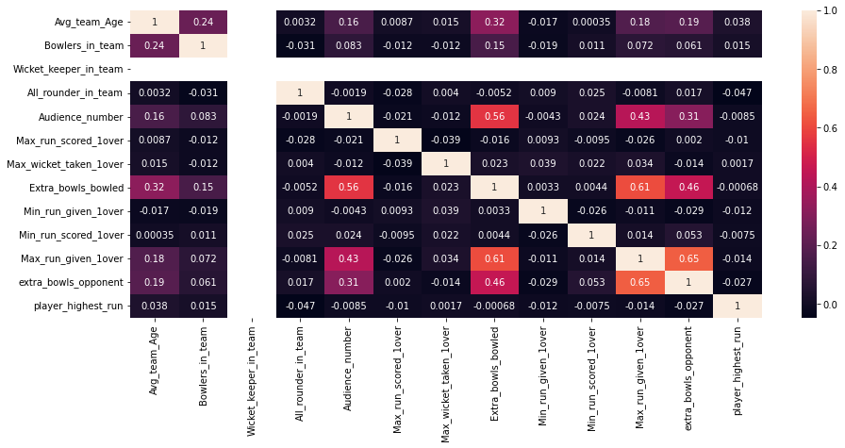
EXPLORATORY DATA ANALYSIS - MULTIVARIATE
Can see multicollinearity among some variable.
Extra bowl opponent is highly correlated with maximum run given an over.
We can also see negative correlation between extra bowl bowled and all rounder in team

Slide 15
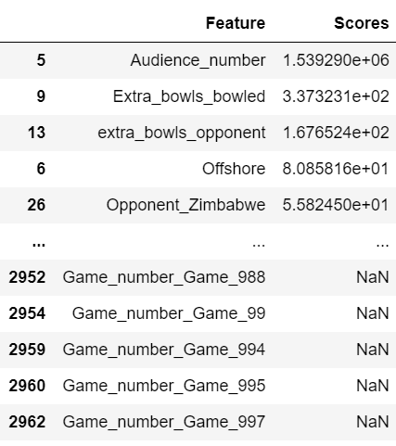
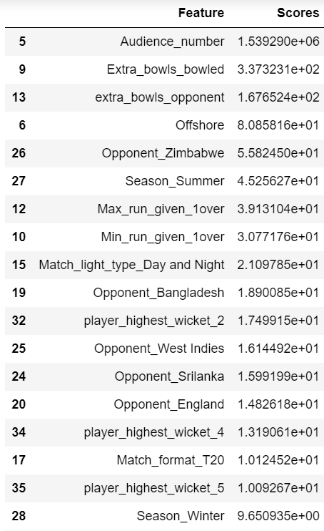
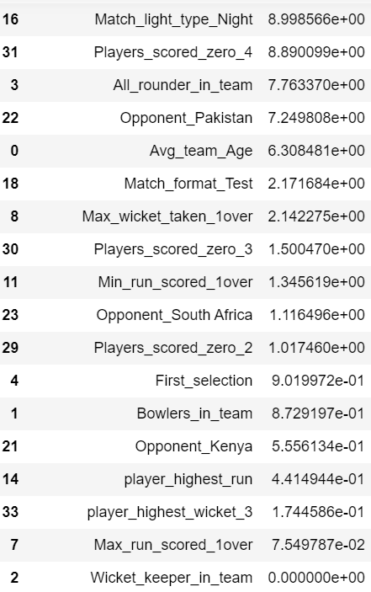
FEATURE SELECTION
Eliminating wicket Keeper as it is insignificant
Eliminating Game number variable

Slide 16
FEATURE SELECTION contd…
Chi-square test is used to determine the relationship between the predictor and target variable.
In Feature selection, we aim to select the features which are highly dependent on the target variable.
Higher the chi-square value indicate that the feature is more dependent on the target variable and can be select for model training.
Chi-square score for Game number is null. So, we eliminate non-significant variable Game number.
After second iteration we find Wicket keeper as non-significant variable as per chi-square test and same we can in the heat map. So, both the variable has been eliminated to train our model with remaining predictor.

Slide 17
MODEL SELECTION
In this case study “Result” variable is used as the Target and it is categorical in nature
The following classification models will be performed:
Logistic Regression.
Linear Discriminate Analysis (LDA).
KNN.
Decision tree (CART).
Random Forest
Naïve Bayes
Artificial Neural Network (ANN)
Ensemble (Bagging, ADA Boosting, Gradient Boosting)

Slide 18
EVALUATION PARAMETERS
ACCURACY
Correctly classified point in test data and total number of points in the test data
RECALL
The ratio of total positive predicted by the model to the total actual positive.
PRECISION
Out of the total positive, what percentage are predicted positive
F-1 SCORE
It is the harmonic mean of precision and recall. It takes both false positive and false negatives into account

Slide 19
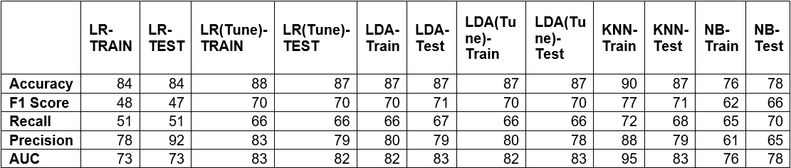
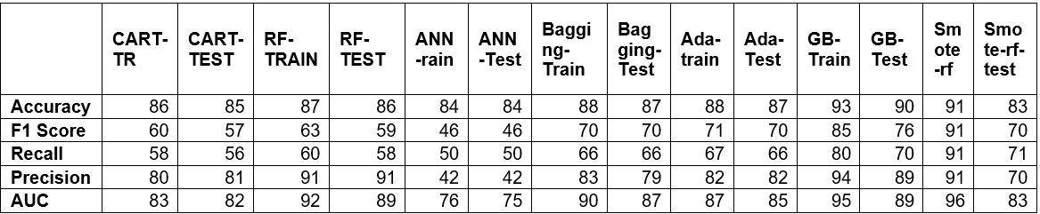
MODEL EVALUATION
In this case our most important matrix is Recall because we must predict winning for the Indian team and must reduce the false predicted records.
All model except Gradient Boost model is giving 90% Accuracy and 70% of recall.
Hence Gradient Boosting model is selected, which is an ensemble technique.
It sequentially add the misidentified predictors and under-fitted predictions to the ensemble, ensuring the errors identified previously are corrected.
Gradient Boost Model has less False ‘+ve’ and False ‘-ve’ for both win and loss Classes. Compare to other model it has Higher Precision, Recall and Accuracy for both Train and Test.

Slide 20
CONCLUSION
Out off 2121 matches India only loose 227 Matches while playing within the country.
India has a high probability of winning at home Ground.
In the first batting situation, the team wins 33% of the time and loses only 0.06% of the time.
In the first bowling situation, team wins 51% of the time and loses 10% of the time.
When playing in daylight, winning chances increase by 60%.
In ODIs, the team has won 1666 games out of 1935.
Playing with more than 2 all-rounder in a team increases winning chances by more than 50%.
Team won 1201 matches in Rainy condition out off 1371.
Its show Rain helps bowler to get some extra advantage in his bowling.

Slide 21
RECOMMENDATION
Try to collect more some more predictor, like total score, bowling style etc. for better Model
Try to add more than 3 all-rounders in the team that will improve the team performance.
If team opt for bowling first with an Avg team age of 30, with 4 bowlers in the team has higher chance to win against England in test match in Rainy season in England
If team opt for bowling first with an Avg team age of 30, minimum 3 bowlers in the team, scoring average 15 runs per over has higher chance to win against Australia in T20 match in Winter season in India.
If team opt for Batting first with an Avg team age of 30, with 3 bowlers in the team and at least one player should score century has higher chance to win against Sri Lanka in ODI match in Winter season in India.
.

