Slide 1

ABSTRACT:
An automobile company has collected 3 years of data. They want to analyse the data and understand the different insights about their data and customer behaviour.
SUMMARY:
The project aims at finding the buying patterns of the customers of an automobile company by giving them recommendations customized market strategies for different segments of data.
Yashveer Kothari .A
POST GRADUATE PROGRAM IN DATA SCIENCE AND BUSINESS ANALYTICS
MARKET RETAIL ANALYTICS MILESTONE 1

Slide 2
TABLE OF CONTENTS
PROBLEM STATEMENT
DATA ANALYSIS 1. data info, description, summary. 2. Univariate, bivariate &multi variate analysis
CUSTOMER SEGMENTATION USING RFM ANALYSIS 1. Tools used & predictions 2. output table 3. KNIME workflow
RFM INFERENCES AND IDENTIFIERS 1. BEST CUSTOMER 2. CUSTOMER ON THE VERGE OF CHURNING 3.LOST CUSTOMERS 4. LOYAL CUSTOMERS

Slide 3
PROBLEM STATEMENT
An automobile parts manufacturing company has collected data of transactions for 3 years. They do not have any in-house data science team, thus they have hired you as their consultant. Your job is to use your magical data science skills to provide them with suitable insights about their data and their customers.

Slide 4
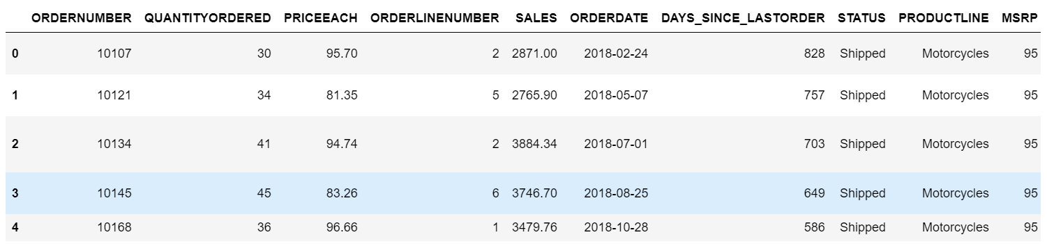
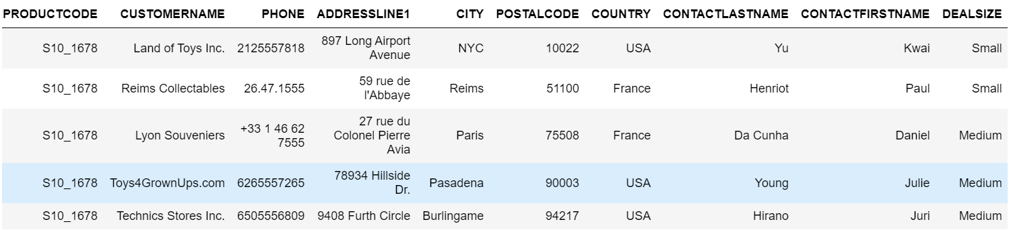
DATA ANALYSIS – DATASET SAMPLE

Slide 5
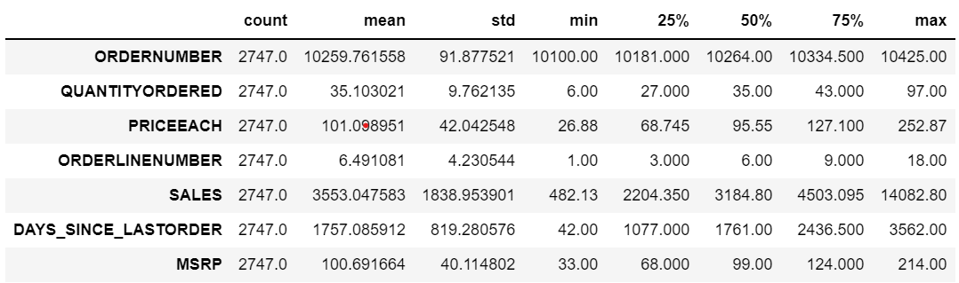
DATA ANALYSIS – DATASET DESCRIPTION
The highest quantity ordered is 97nos. and the lowest quantity ordered is 6nos.
The highest MSRP is Rs.214 and lowest is Rs.33 (Assumption that it is INR).
There are customers who haven’t purchased for the past 10 years and the last of purchase (min) is 45 days.
The highest sale value is Rs. 14082 and the lowest sale value is Rs.482.13.
The highest price of a product is Rs. 252.87 and the lowest price of a product is Rs.6.

Slide 6
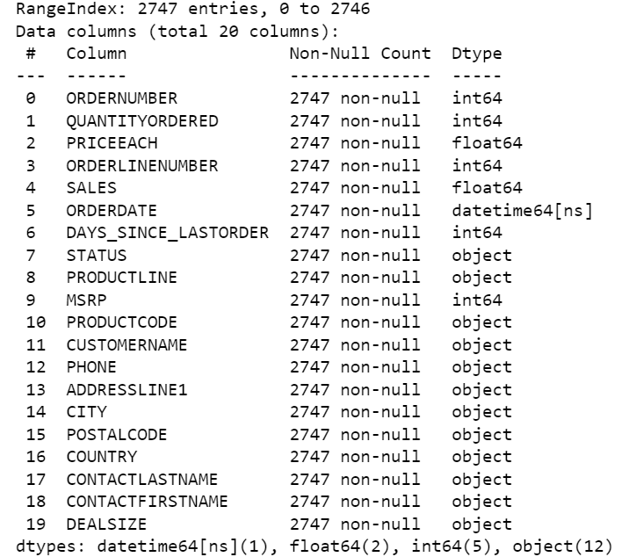
DATA ANALYSIS – DATASET INFORMATION
The dataset has 2747 entries and 20 variables.
Among the 20 variables there are: 12 categorical, 7 Numerical and 1 Date and time
There are no missing values and duplicates in the dataset.

Slide 7
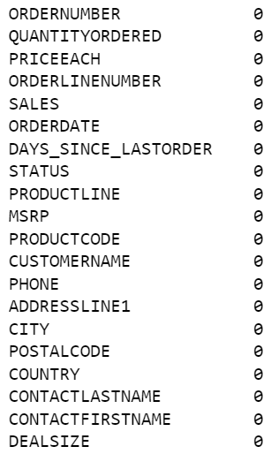
DATA ANALYSIS – MISSING VALUE AND DUPLICATES
There are no missing values and duplicates in the dataset.

Slide 8
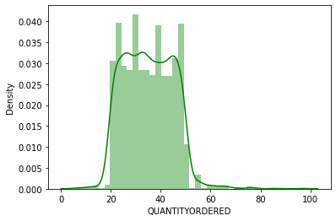
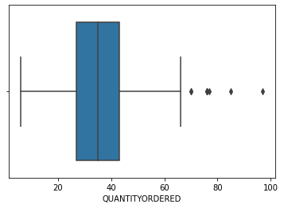
DATA ANALYSIS – BOXPLOT AND DISTRIBUTION PLOT FOR QUANTITY ORDERED VARIABLE
The variable is not normally skewed as seen in the above distribution plot.
As per the boxplot there are lots of outliers.
It is assumed to not remove the outliers as the data is regarding three years, so the quantity ordered shall be in different magnitude from customer to customer.

Slide 9
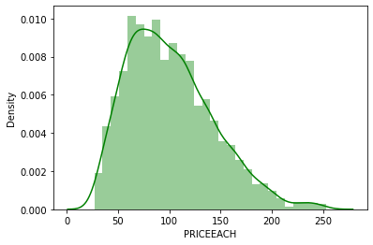
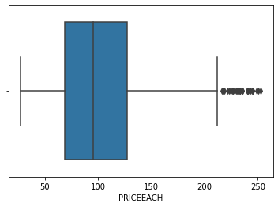
DATA ANALYSIS – BOXPLOT AND DISTRIBUTION PLOT FOR PRICE EACH VARIABLE
The distribution plot shows that the variable is normally distributed and slightly right skewed.
There are outliers in the variable as per the boxplot.
It is assumed to not remove the outliers as the data is regarding three years, so the price each shall be different from customer to customer and product to product.

Slide 10
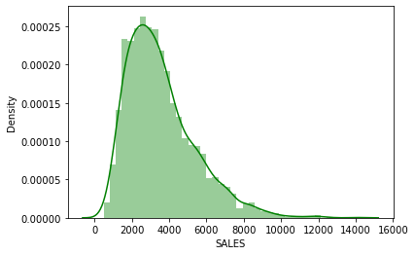
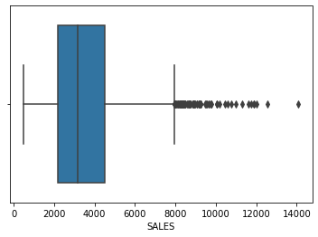
DATA ANALYSIS – BOXPLOT AND DISTRIBUTION PLOT FOR SALES VARIABLE
The variable is right skewed as per the distribution plot.
There are lots of box plot.
Outliers are not removed assuming there might be outliers because the data is a three year data and the prices of the products vary largely and the quantities ordered also vary.

Slide 11
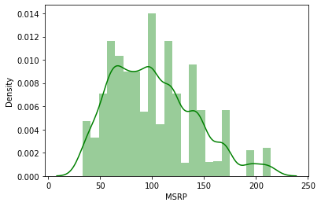
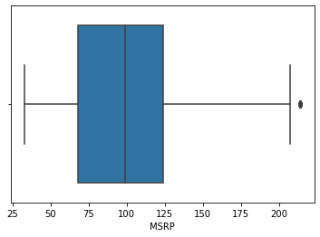
DATA ANALYSIS – BOXPLOT AND DISTRIBUTION PLOT FOR MSRP VARIABLE
The variable is not normally distributed.
The are outliers in the variable as per the boxplot.
The outliers are not removed –Assumption.

Slide 12
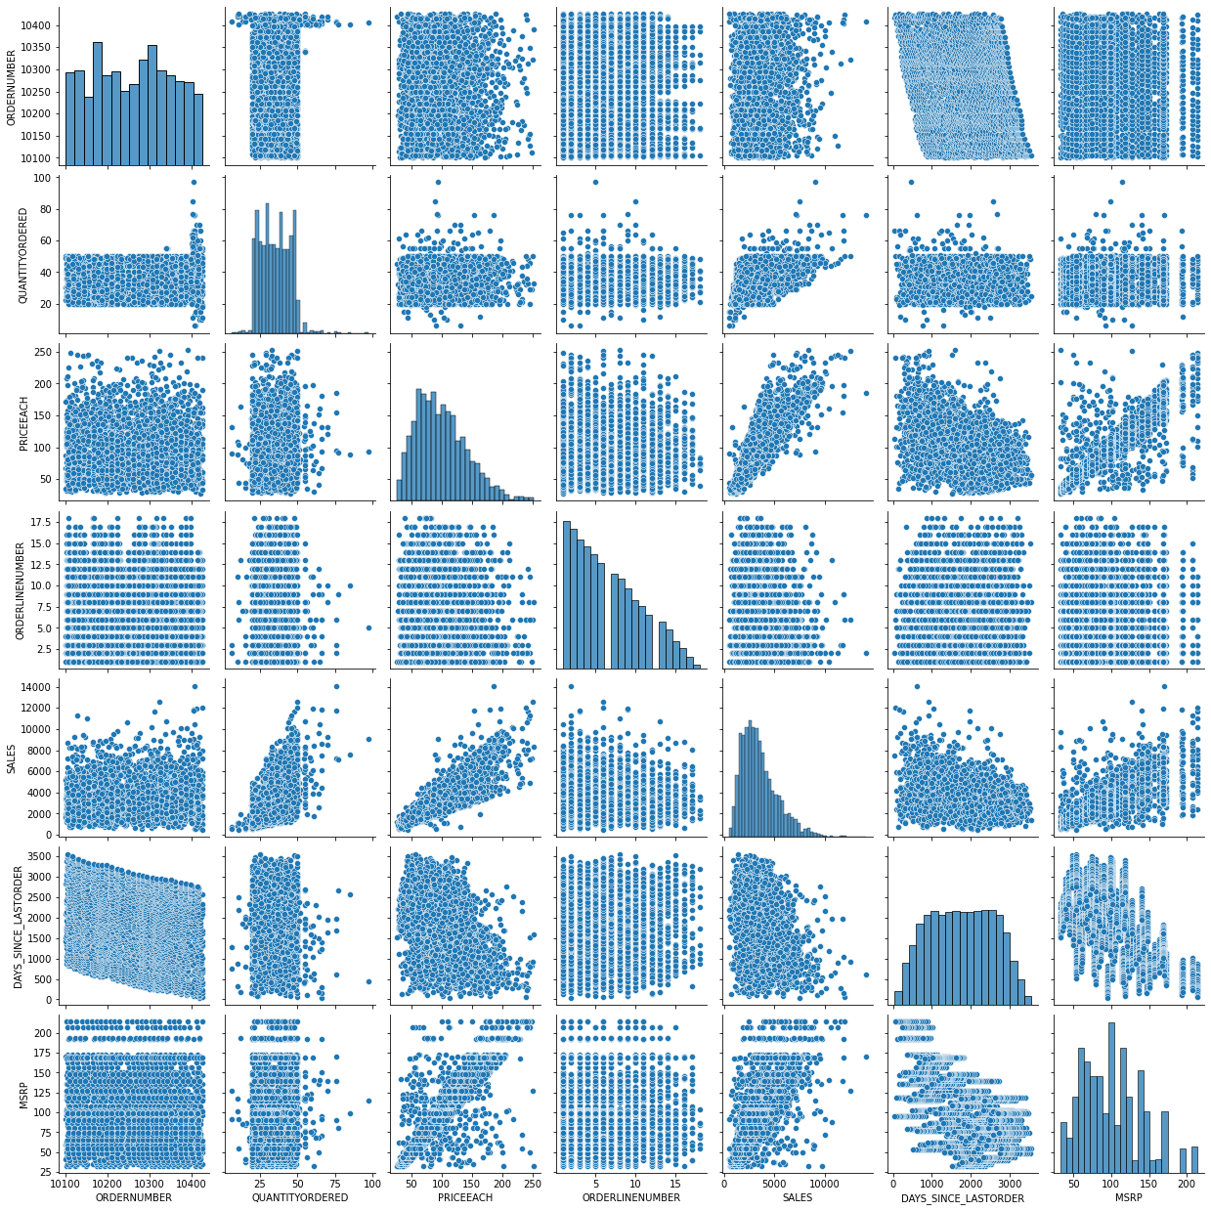
DATA ANALYSIS - PAIRPLOT

Slide 13
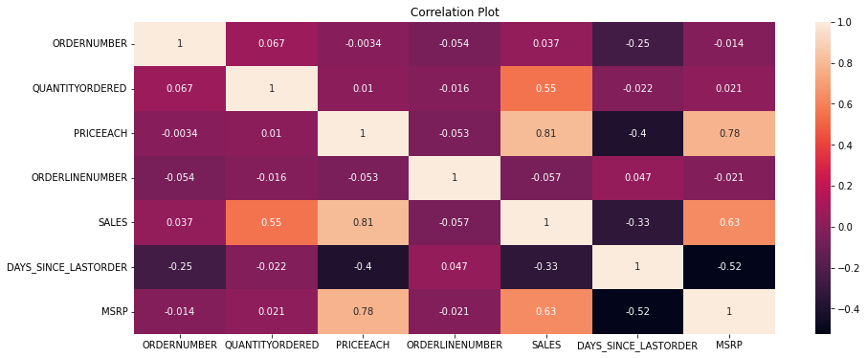
DATA ANALYSIS – CORRELATION PLOT/HEATMAP
There is high correlation between Price each, MSRP and Sales may be because they are price of the products, the price of each product effects the sales and the MSRP effects price each as the margins are set as per the MSRP.
Sales and MSRP are also correlated because the price changes in MSRP will effect the sales as margins might change the end price.
Quantity ordered and sales are also correlated because products sold increases the sales turnover and increasing overall sales also.

Slide 14
EXPLORATORY DATA ANALYSIS
Exploratory data analysis (EDA) is an approach of analyzing data sets to summarize their main characteristics, often using statistical graphics and other data visualization methods.
Tableau link: https://public.tableau.com/app/profile/yashveer8746/viz/MRA1AutomobileSales_Data/TotalsalesProductlinewise?publish=yes

Slide 15
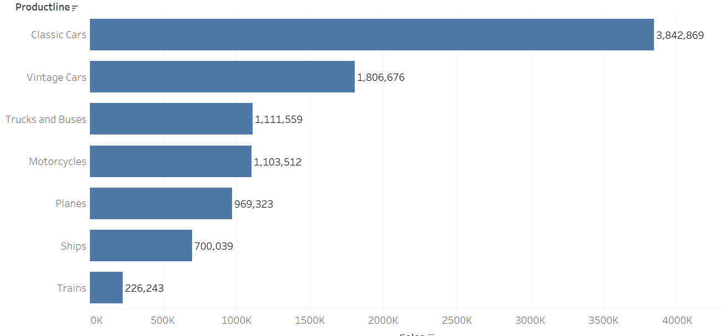
TOTAL SALES IN DIFFERENT PRODUCT LINE

Slide 16
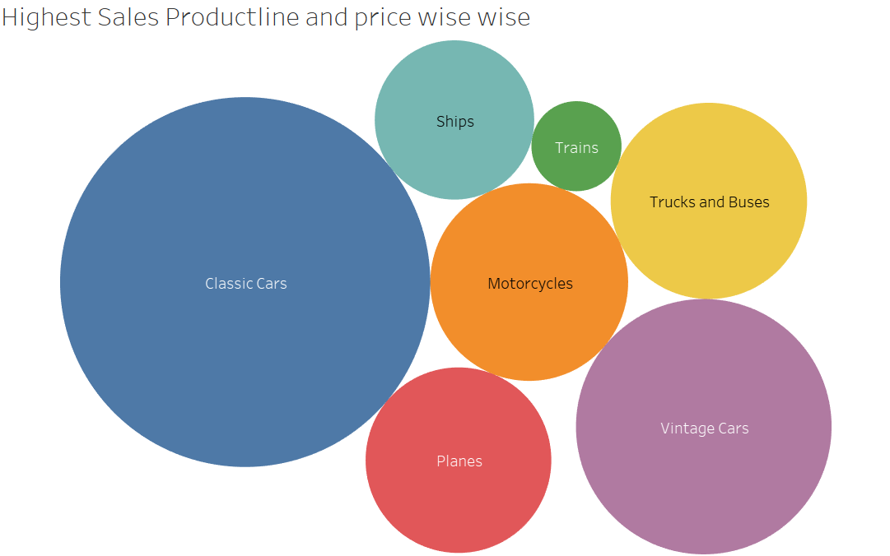
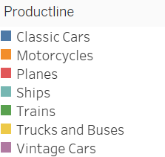
TOTAL SALES PRICE WISE

Slide 17
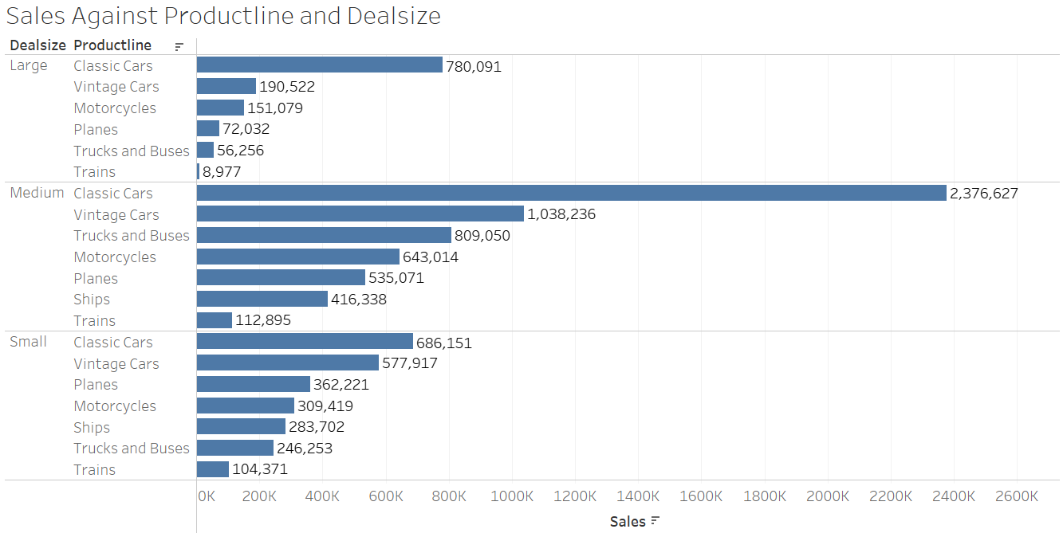
SALES AGAINST PRODUCT LINE & DEAL SIZE

Slide 18
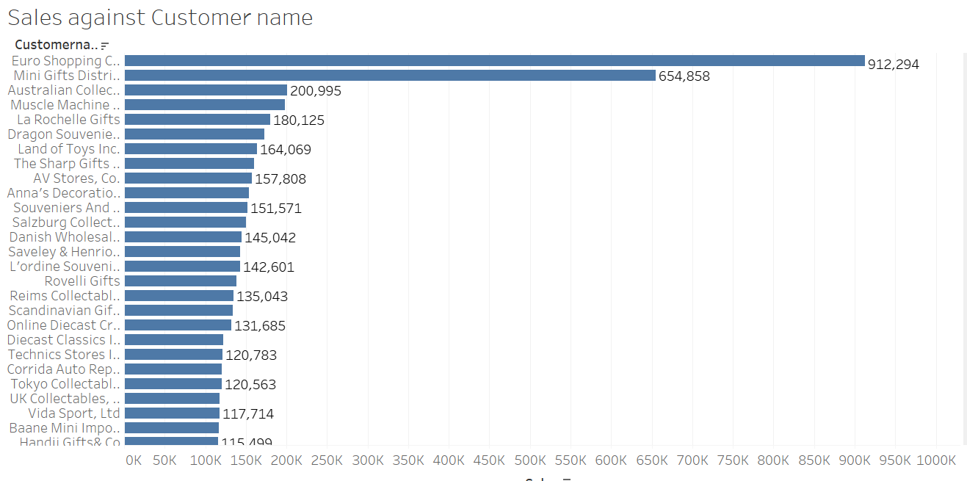
SALES WISE CUSTOMER NAME

Slide 19
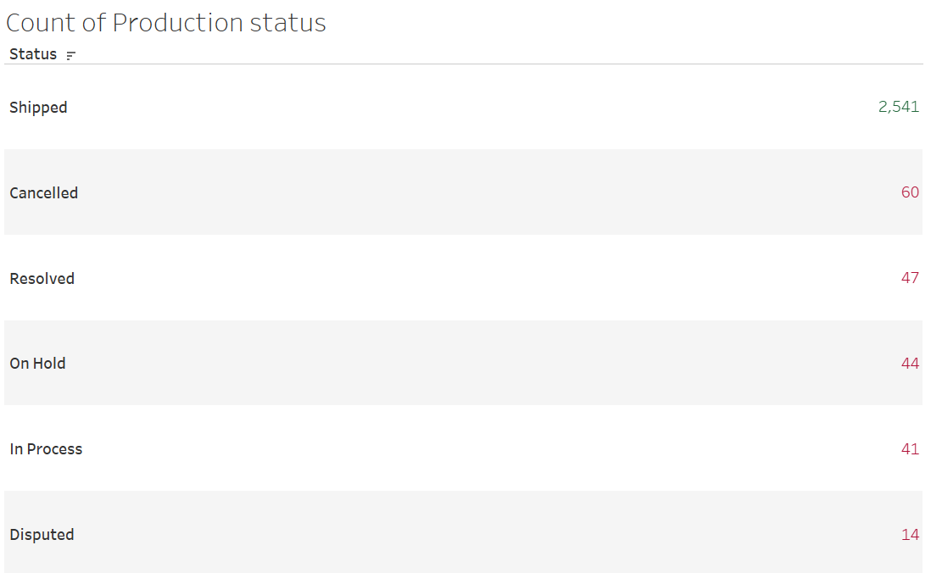

PRODUCTION STATUS COUNT

Slide 20
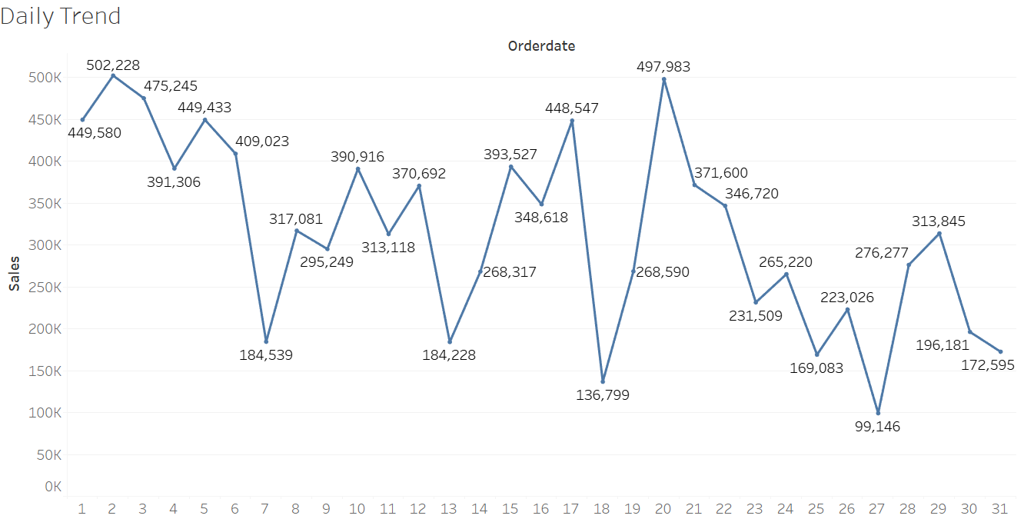
DAILY SALES TREND

Slide 21
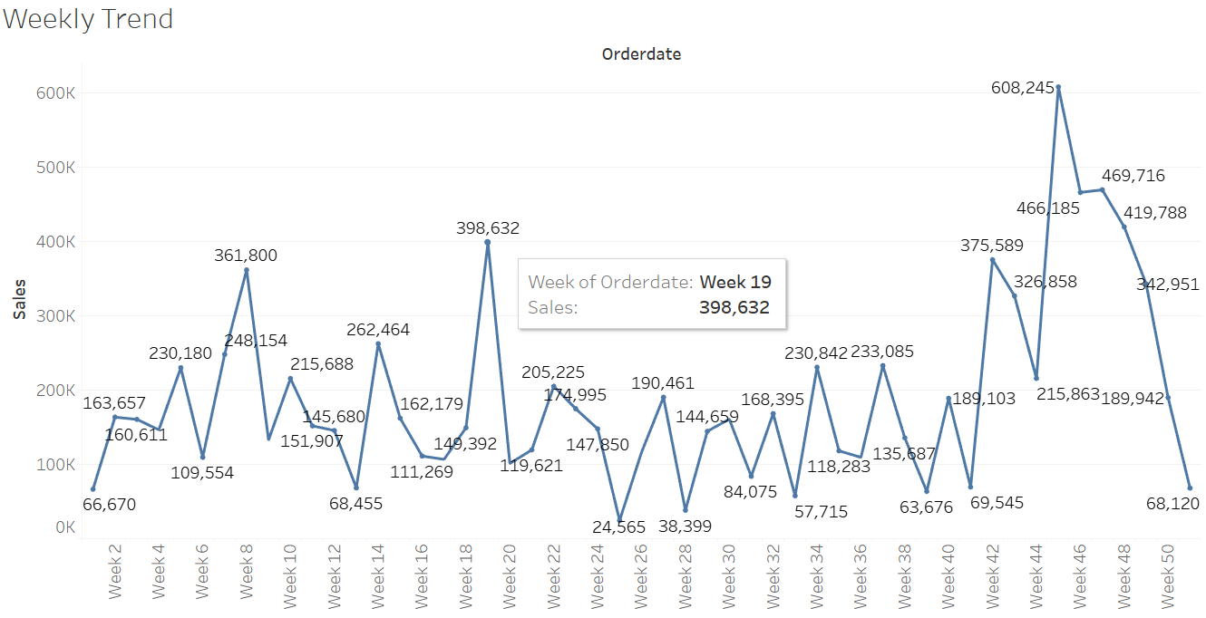
WEEKLY SALES TREND

Slide 22
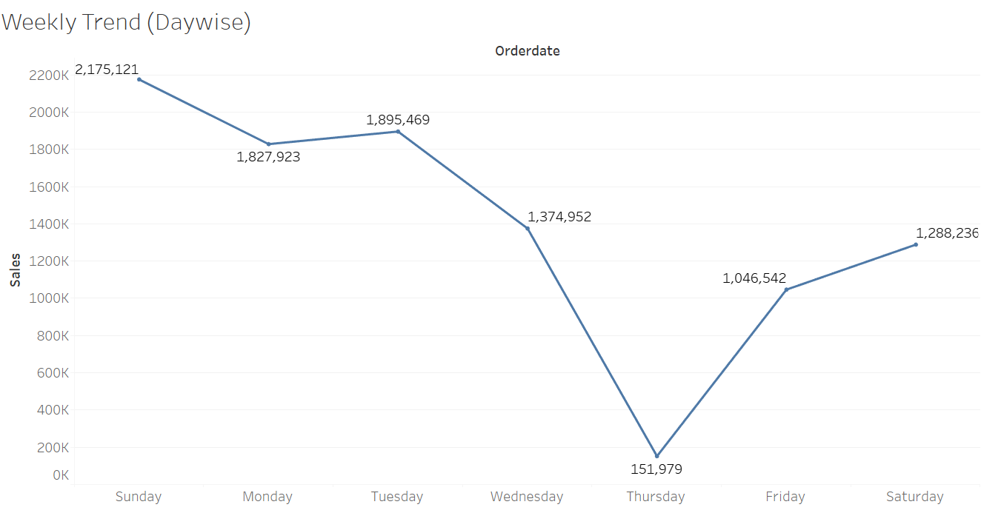
WEEKLY SALES TREND DAY WISE

Slide 23
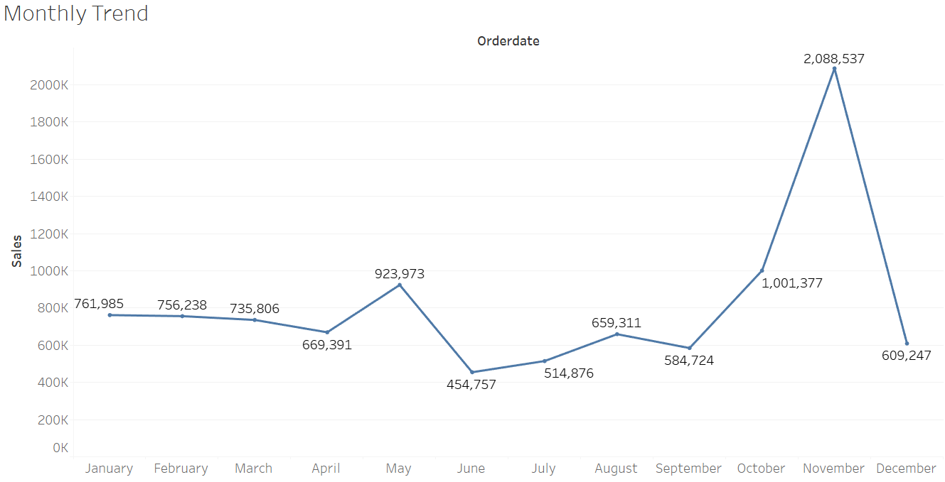
MONTHLY SALES TREND

Slide 24
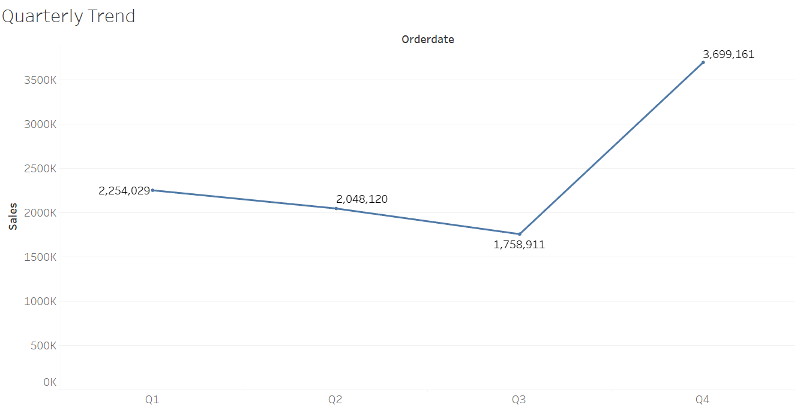
QUARTERLY SALES TREND

Slide 25
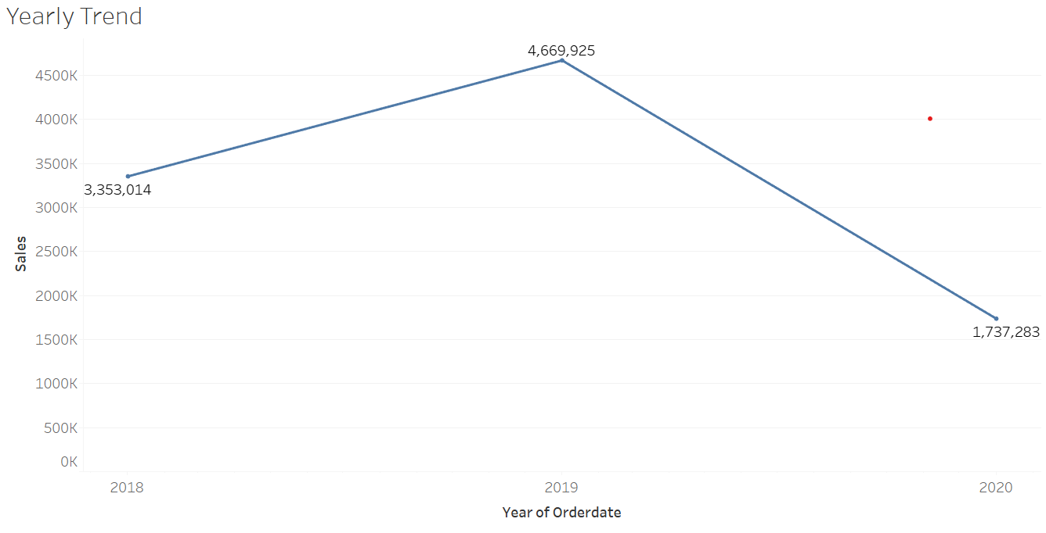
YEARLY SALES TREND

Slide 26
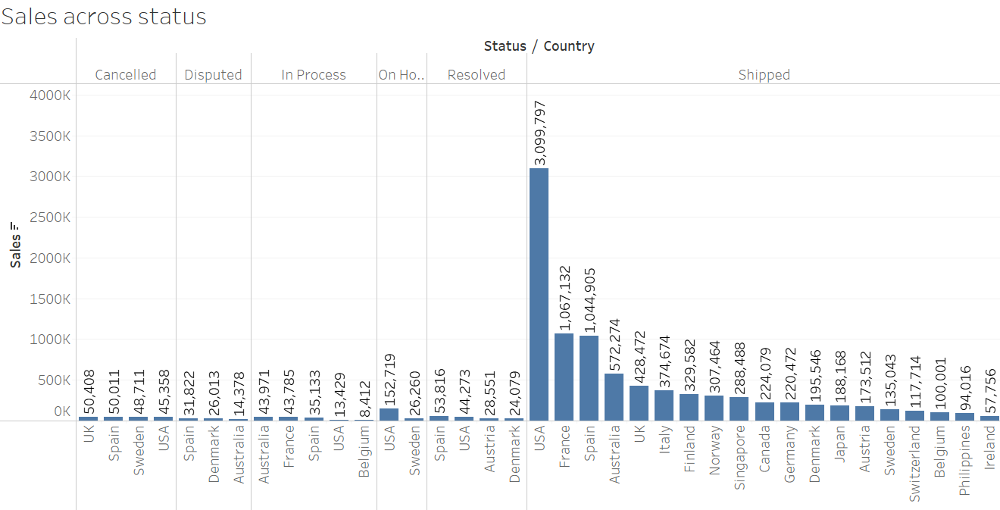
SALES ACROSS STATUS

Slide 27
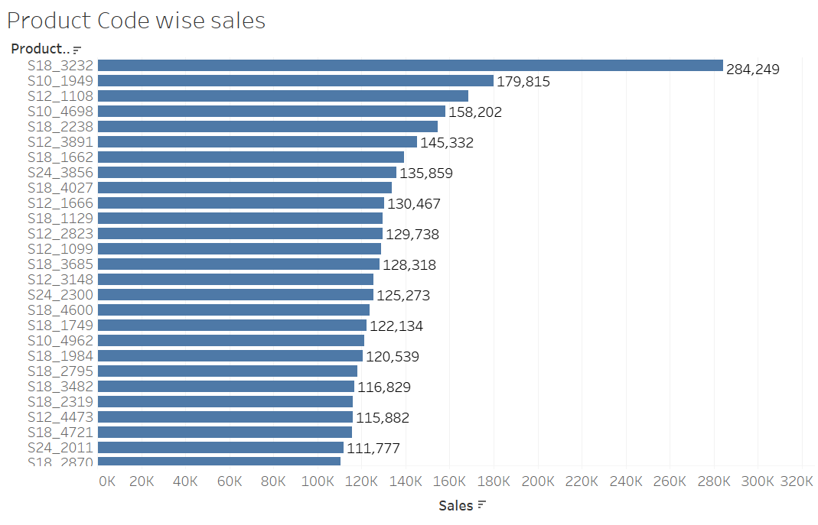
PRODUCT CODE WISE SALES

Slide 28
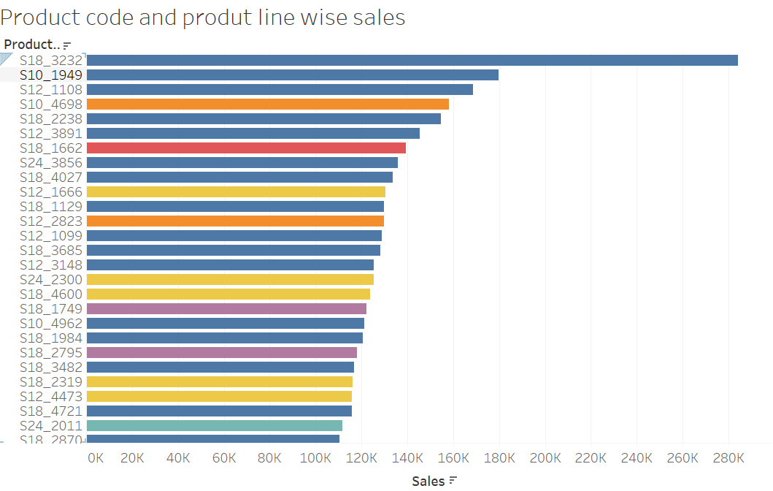
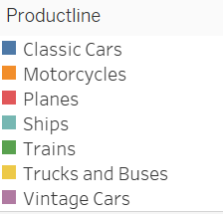
product code and line wise sales

Slide 29
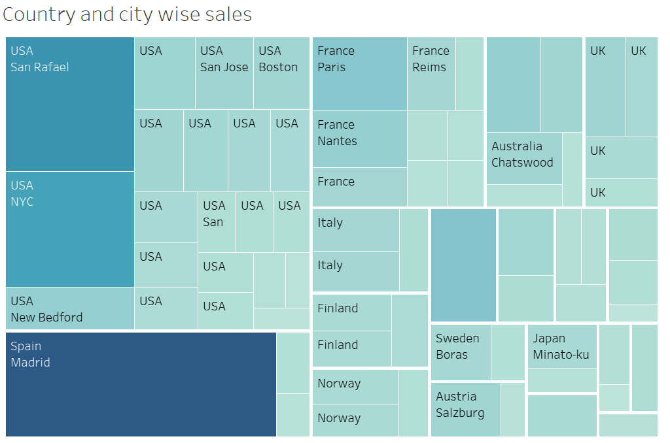

COUNTRY AND CITY WISE SALES

Slide 30
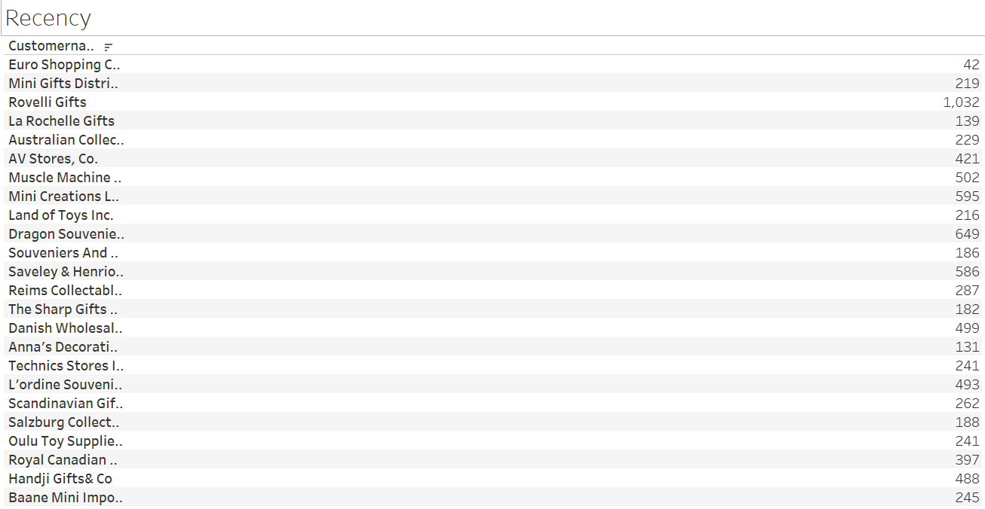
RECENCY

Slide 31
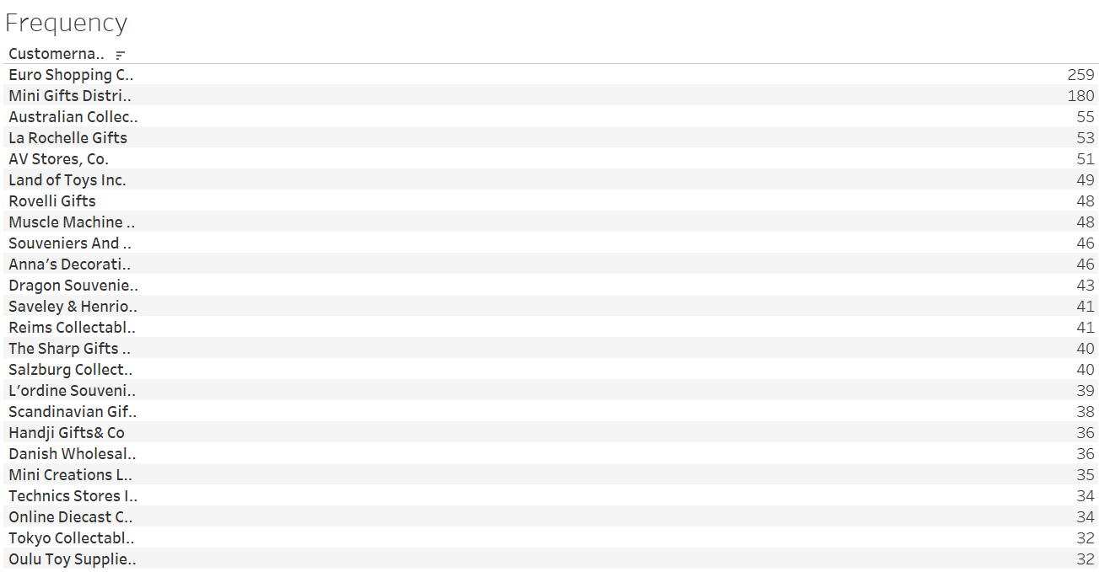
FREQUENCY

Slide 32
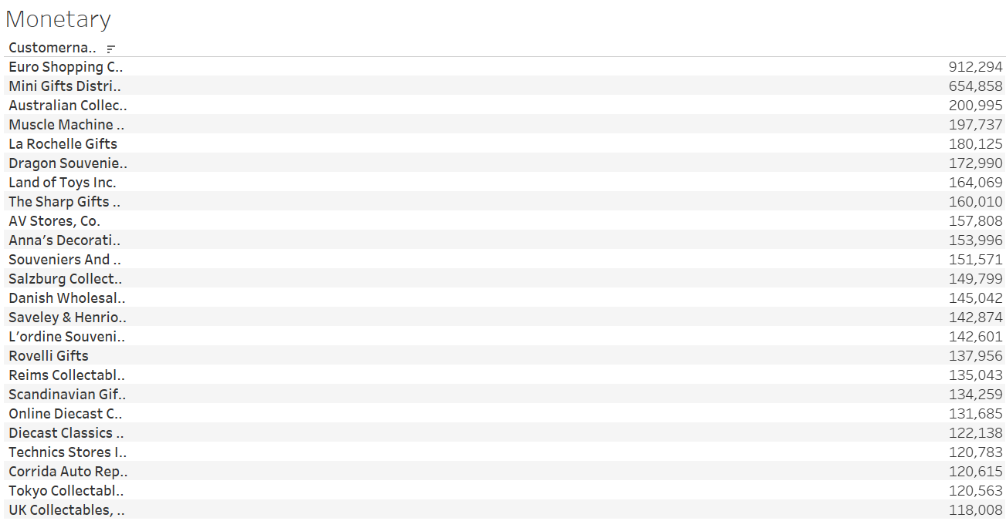
MONETARY

Slide 33
INFERENCES FROM THE ABOVE EDA
Classic cars seem to have the highest sales whereas trains being the lowest.
Medium deal size tend to deliver much higher sales as compared to small and large deals.
The best customer as per sales is Euro shopping channel.
Classic cars are the most purchased and sold products among all.
USA has the highest sales compared to other countries.
City Madrid in Spain has the highest sales as compared to other cities.
The sales of large size deal is almost remain stagnant over the years and it can be presumed that company should focus on getting large size chunk projects.
Since the company is customer driven because major sales happen through few customers, so therefore the customers should focus more on customer scouting in a rationale way because in case there is customer churn it will have a huge impact on the company overall.

Slide 34
INFERENCES CONTD.
9. Sales are maximum during the 4th quarter of the year, therefore to increase the sales throughout the year / all quarters offers or discounts can be given to the customers.
10. Countries having low sales can prefer to have EMI facilities to increase the overall sales.
11. There are many cancelled orders comparatively, more data will be required to understand the reason. For now it can be suggested to resolve the disputed pending orders so that they do not get cancelled and increase the chances of churning.

Slide 35
CUSTOMER SEGMENTATION USING RFM ANALYSIS
What is RFM?
RFM analysis is a marketing technique used to quantitatively rank and group customers based on the recency, frequency and monetary total of their recent transactions to identify the best customers and perform targeted marketing campaigns. The system assigns each customer numerical scores based on these factors to provide an objective analysis. RFM analysis is based on the marketing adage that "80% of your business comes from 20% of your customers.“
KNIME tool is used for RFM analysis & Customer Segmentation.
Predictions made:
Max(order date): Taken as Recency value.
Count of quantity ordered for a particular customer is taken as Frequency value.
Sum of sales made through a particular customer is taken as Monetary value.

Slide 36
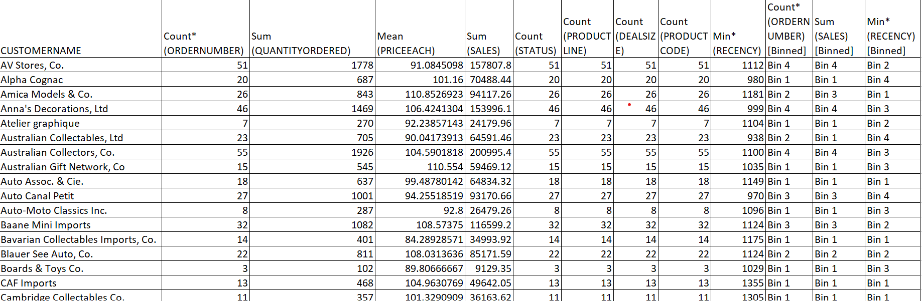
OUTPUT TABLE HEAD

Slide 37
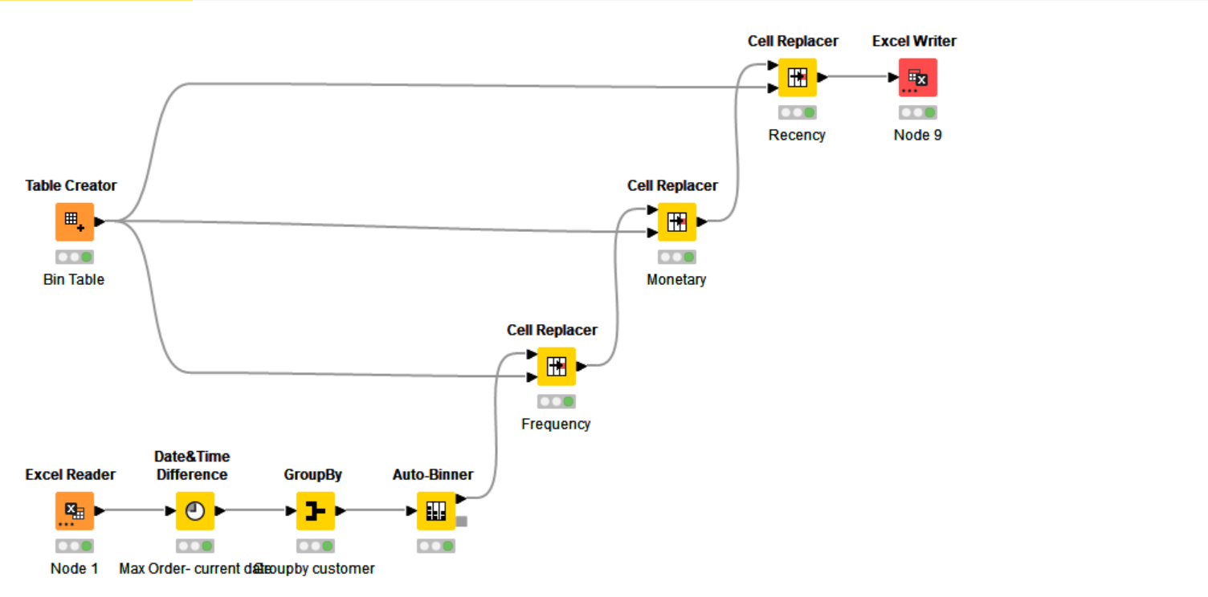
KNIME WORKFLOW

Slide 38
INFERENCES FROM RFM ANALYSIS AND IDENTIFIED SEGMENTS
BEST CUSTOMERS.
EURO SHOPPING CHANNEL
ANNA’S DECORATION LTD
ONLINE DIECAST CREATIONS CO.
SOUVENIRS AND THINGS CO.
SALZBURG COLLECTABLES

Slide 39
CUSTOMERS ON THE VERGE OF CHURNING
DHANISH WHOLESALE IMPORTS
REIMS COLLECTABLES
DRAGON SOVENIRS LTD
MUSCLE MACHINE INC
LAND OF TOYS INC.

Slide 40
LOST CUSTOMERS
ALPHA COGNAC
MINI AUTO WERKE
AUSTRALIAN GIFT NETWORK
GIFT IDEAS CORP.
AUTO MOTO CLASSIC INC.

Slide 41
LOYAL CUSTOMERS
1. EURO SHOPPING CHANNEL
2. ANNAS DECORATIONS LTD
3. ONLINE DIECAST CREATIONS CO.
4. UK COLLECTABLES LTD.
5. OULU TOY SUPPLIES INC.

Slide 42
ALL MODELS ARE WRONG BUT SOME ARE USEFUL
- George .E. P. Box

