Slide 1


University Network with Multiple Subnets

Slide 2

University Network with Multiple Subnets
A Secure Campus Network with VLANs, an Edge Firewall and Layer-2 Security
Technologies: Cisco Packet Tracer | VLAN | Inter-VLAN Routing | DHCP | DNS | ACL | SSH | ASA Firewall | NAT | DMZ | DHCP Snooping | DAI

Slide 3

Abstract
This project presents a secure university campus network designed using Cisco Packet Tracer. The network divides departments into separate VLANs and subnets, enables controlled inter-VLAN communication using Router-on-a-Stick, and provides DHCP, DNS, web and FTP services. Security is enhanced using ACLs, SSH, port security, BPDU Guard, and unused-port isolation. Two extensions add an ASA edge firewall with NAT and a DMZ, and Layer-2 security (DHCP snooping, DAI, port security) demonstrated with a live attack lab.

Slide 4
Introduction:
University networks require separate and organized communication between departments.
VLANs and subnetting are used to logically separate departments and reduce unnecessary traffic.
Router-on-a-Stick enables communication between different VLANs through a single router interface.
Network services such as DHCP, DNS, Web and FTP provide essential campus functionality.
ACLs, SSH, port security and BPDU Guard improve network security and access control.
An ASA firewall with NAT and a DMZ protects the campus from the Internet.
DHCP snooping, DAI and port security stop attacks launched inside a classroom.

Slide 5
Literature Survey:
Existing Technology | Purpose in Our Project
VLAN (Virtual LAN) | Logically separates university departments into different networks.
IP Subnetting | Assigns a unique subnet to each department for organized addressing.
Router-on-a-Stick | Enables communication between multiple VLANs using one router interface.
DHCP | Automatically provides IP addresses, gateway, and DNS to client PCs.
DNS | Allows users to access services using names instead of IP addresses.
Access Control Lists | Restricts unauthorized communication between selected departments.
Port Security & BPDU Guard | Protects access ports from unauthorized devices and rogue switches.

Slide 6

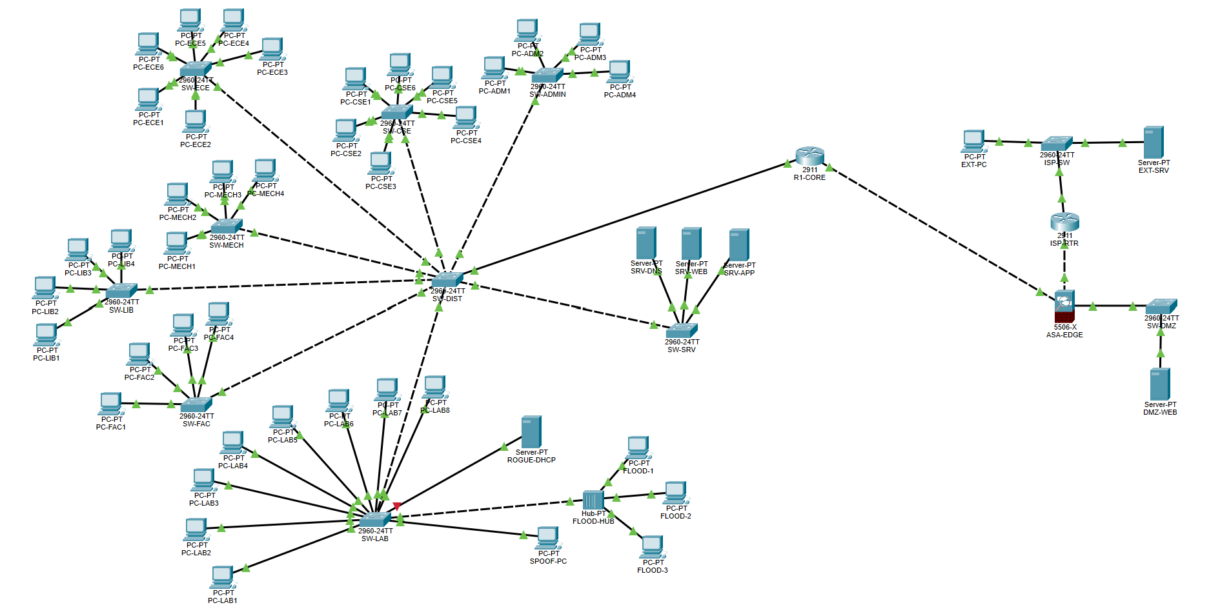



Proposed Architecture:
Cisco 2911: inter-VLAN routing, DHCP
ASA 5506-X firewall + DMZ
11 Cisco 2960 switches
8 VLANs + Management VLAN
DNS, Web and FTP servers
Simulated ISP and Internet
Attack lab for Layer-2 security
62 devices, 61 links

Slide 7





Technologies Used:
Networking
Cisco Packet Tracer 9.0.1
VLAN
802.1Q Trunking
Router-on-a-Stick
Inter-VLAN Routing
Network Services
DHCP
DNS
HTTP/Web Server
FTP
Security
Access Control Lists (ACL)
SSH
Port Security
BPDU Guard
VLAN 999 for unused ports
Hardware/Devices
Cisco 2911 Router
Cisco 2960 Switches
PCs
Servers

Slide 8
Extension 1: Edge Firewall and DMZ:
Firewall Feature | What It Does in Our Project
Security zones | Inside (campus) = 100, DMZ = 50, outside (Internet) = 0. A lower level cannot start connections to a higher one
PAT | The whole campus reaches the Internet as one public address, 203.0.113.2
Static NAT + DMZ | Public web server 172.16.100.10 is published as 203.0.113.10
Outside ACL | The Internet may reach only the web server, and only on HTTP
Stateful inspection | Only replies to connections the campus started are let back in
Split DNS + SSH | Each side gets the right address for the website; firewall managed only from Admin

Slide 9
Extension 2: Layer-2 Security:
Attack (Attack-Lab Device) | Defence and Result
Rogue DHCP (ROGUE-DHCP) | DHCP snooping trusts only the uplink: rogue offers dropped, and its port err-disabled by the rate limit
DHCP starvation | Rate limit of 10 DHCP packets per second on every user port
ARP spoofing (SPOOF-PC) | Dynamic ARP Inspection checks ARP against snooping bindings (configured; not enforced by Packet Tracer)
MAC flooding (FLOOD-HUB + 3 PCs) | Port security, 1 MAC per port: only one PC got an address, 21 violations counted
Where applied | All 7 departmental access switches; attack lab beside SW-LAB

Slide 10
Testing and Results:
Part A (campus): VLANs, DHCP, DNS, web, ACLs, SSH and port security all verified.
Extension 1 (firewall): 18 / 18 tests passed, including 5 attacks correctly blocked.
Extension 2 (Layer-2): 12 / 13 tests passed.
Rogue DHCP stopped twice: offers dropped and its port shut. MAC flooding blocked with 21 violations.
Packet Tracer limitation: DAI is accepted but not enforced in PT 9.0.1; the configuration is correct for real switches.
Final network: 62 devices and 61 links, every configuration saved and documented.

Slide 11
Expected Output:
Successful communication between devices within the same VLAN.
Controlled communication between different VLANs.
Automatic IP assignment to departmental PCs using DHCP.
Successful DNS resolution for university services.
Access to Web and FTP services through the server network.
Restricted access between selected departments using ACLs.
Secure remote device management using SSH.
Detection and restriction of unauthorized devices using Port Security.
Isolation of unused switch ports for improved security.
Campus reaches the Internet through NAT; the Internet reaches only the public website.
A compromised DMZ server cannot reach the campus.
Rogue DHCP and MAC-flooding attacks are blocked by the access switches.

Slide 12

Conclusion:
The university network provides structured VLAN-based communication, centralized services and inter-VLAN routing, and secures them at three levels: ACLs between departments, an ASA firewall with NAT and a DMZ at the Internet edge, and Layer-2 protection on the access switches. All 18 firewall tests and 12 of 13 Layer-2 tests pass; the remaining one is a Packet Tracer limitation. The result is a reliable, manageable and defended campus network.

Slide 13

Thank You

