Slide 1



ScamShield AI
Detecting Scams, Protecting People
You've WON $5,000! Claim now: bit.ly/xyz123
AI-Powered • Real-time • On-device
Scanning message…
Likely Scam
94% confidence
Hey, are we still on for lunch?
Presented By:
Sakshi Shah (IU2341230078)
Yashvi Ghaghda (IU2341230090)
Guided By:
Prof. Anjali Chopra
CSE Department, IITE

Slide 2
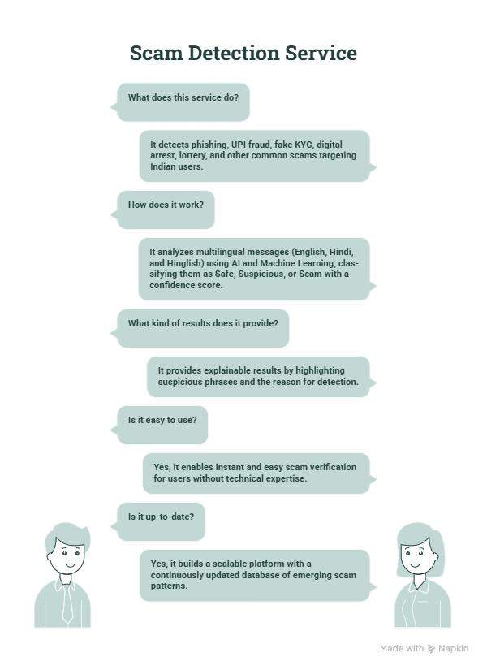
Project Objectives
The primary objective of ScamShield AI is to develop an AI-powered WhatsApp scam detection system specifically designed for the Indian digital ecosystem.
The proposed system focuses on identifying fraudulent messages written in English, Hindi, Gujarati, and Hinglish, addressing a significant gap in existing scam detection solutions, which primarily support English-language content.
ScamShield AI

Slide 3
ScamShield AI
Literature Review
Tool | Type | Key Characteristic
Norton Genie | Standalone app (paid) | English-only; explicitly does not evaluate scams in other languages
Bitdefender Scamio | WhatsApp/web chatbot (free) | Requires account signup mid-flow; does not analyze non-English text, explicitly asking users to translate messages into English first
Trend Micro ScamCheck | Web tool (limited free) | Character limit issues; missed phishing scams in independent tests
McAfee Scam Detector | Bundled in security suite | Full features gated behind subscription; strong on links, weaker on plain text
Google Messages / Phone AI | On-device (Android) | Built-in, proactive, but general-purpose not India-scam-specialized
Meta AI (in WhatsApp) | General assistant | Reactive user must think to ask; not a dedicated scam-checking flow
Sources: official product pages, independent reviewer testing (Safety Detectives, KSL News), and hands-on testing conducted for this project.

Slide 4
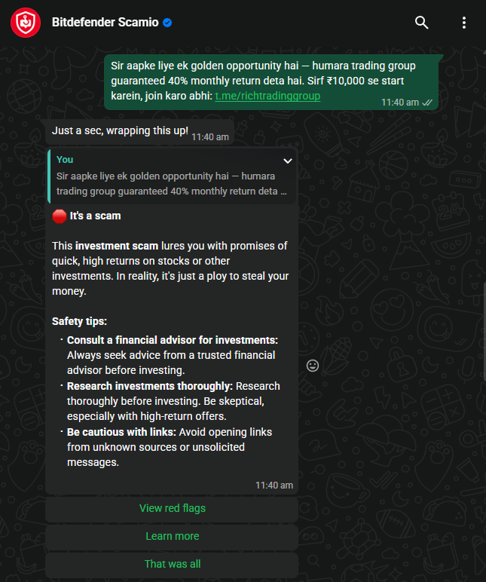
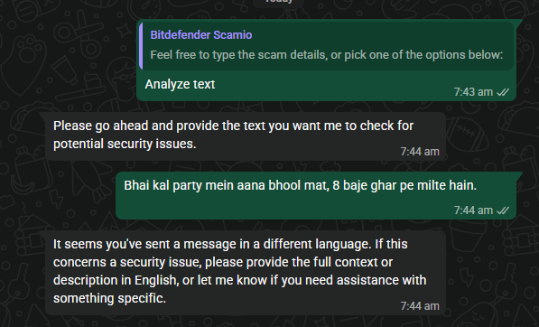
ScamShield AI
Research Gap
We didn't just read reviews we tested Bitdefender Scamio directly with real scam-style messages.
Generic, templated explanations: Even when correctly flagged, explanations never named the specific scam type (e.g., "digital arrest"), never quoted the actual phrases used, and never flagged the isolation tactic ("don't tell anyone").
Refuses to process plain conversational Hinglish: When sent a harmless personal message ("Bhai kal party mein aana bhool mat..."), Scamio did not analyze it — it flagged the text as being in "a different language" and asked the user to translate it into English before it could help.

Slide 5
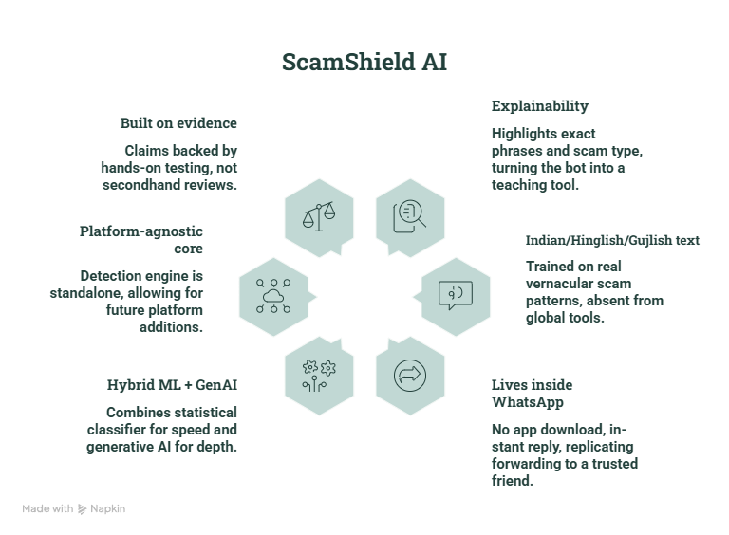
ScamShield AI
Project Novelty

Slide 6
ScamShield AI
Technologies Used
Layer | Tool
Language | Python
Classic ML | scikit-learn (TF-IDF + Logistic Regression)
Generative AI | Anthropic / OpenAI API
API Framework | FastAPI
WhatsApp Connector | Twilio WhatsApp Sandbox API
Database | PostgreSQL
Dashboard | Streamlit
Hosting | Render (App + PostgreSQL)

Slide 7




ScamShield AI
How the AI Detects a Scam
Every incoming message flows through a lightweight detection pipeline in real time.
1
2
3
4
5
Message
Received
Feature
Extraction
NLP + ML
Classifier
Pattern
Match
Verdict &
Alert
Incoming text is captured on-device
Links, urgency words, sender patterns
Transformer model scores intent
Cross-checked vs known scam database
Safe / Suspicious / Scam label shown

Slide 8
ScamShield AI
See It In Action
A message arrives, gets scanned instantly, and the chat updates with a clear verdict.
Urgent! Your electricity will be disconnected today. Pay now: payelec-in.info
Urgent! Your electricity will be disconnected today. Pay now: payelec-in.info
AI analyzing…
ScamShield AI
Scam Detected
94% confidence · phishing link
Report • Block sender • Ignore
Before — message just arrived
After — verdict delivered

Slide 9
Chat Smarter. Stay Safer.
ScamShield AI keeps the conversations you trust free of the messages you shouldn't.
Thank you, Questions?
ScamShield AI

