Slide 1

C-Lab
Yashvi Shah
Zaara Shaikh
Sahil Soni
Waman Vyas
Dikshant Bhatti

Slide 2
Agenda
1
2
3
4
5
Importance
Objectives
Semester Applications
Study Design & Overview
Results

Slide 3
Importance
C programming language is a widely used language in the field of computer programming.
It’s simplicity, efficiency, and versatility make it a powerful tool for developing a wide range of applications.
This project aims to develop a website that provides high-quality tutorials for beginners to advance coders in the C programming language.
C-Lab

Slide 4
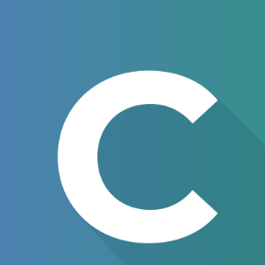
Objectives
To provide a comprehensive learning platform for C programming language.
Being different person having different learning habit, different types of tutorials like audio, video or text materials would be available for all topics.
To provide a code generator for certain basic codes and logic in C language.

Slide 5
Work from Semester Syllabus
Table or Grid system: to create the basic placement of main components of website.
CSS and Bootstrap: to create navigation bar and sidebar.
JavaScript: to create Code Generator feature.
Basic HTML: to add buttons and text.
Basic CSS: to provide colour scheme to the website.

Slide 6
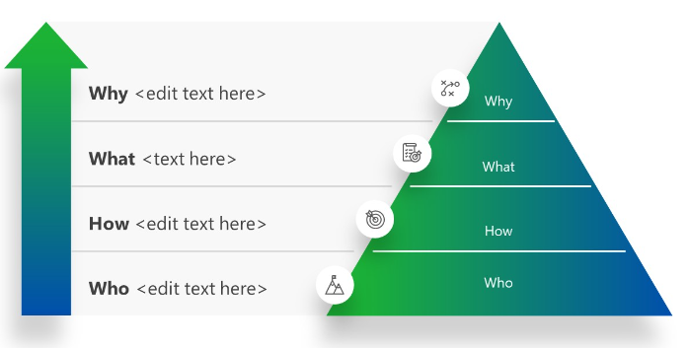
Study Design
To provide a multi purpose Learning Platform
Learning and Community Building Website like Replit
Using HTML, CSS and JS and Market Research
Students, Coders, Recruiters

Slide 7
Overview/Analysis
Research: Research will be conducted on the best teaching techniques for the C programming language, the most common mistakes made by beginners, and the most popular functions used in the C programming language.
Content Development: High-quality tutorials will be developed, covering different aspects of the C programming language. The tutorials will be created using various teaching techniques such as audio, video, and text materials and practical examples.
Code Generator Feature: A code generator feature will be developed that will enable users to generate code for the functions they want to create in the C programming language.
Testing: The website and code generator feature will be tested to ensure that they are functioning correctly and are user-friendly.
Launch: launch will be done after adding all the future features.
Timeline: The project along with current objectives will be completed with-in 3-4 months.

Slide 8
Results of Research
“
Further knowledge in JS.
API for IDE
Technique to contract and expand a div in HTML using JS and CSS.
Exploring more deep aspects of Bootstrap to make website user friendly.
”

Slide 9
Implications of Results
“
Creation of Code Generator and Dark Mode.
Adding Text editor.
Creating a collapsing sidebar using a button.
Creating Dropdown Menus.
Dynamic Tests and TGML(Test Generated Merit Lists).
”

Slide 10
Lessons Learned
Constant learning.
Team work.
University Education is not Enough, should learn day to day according to New tech introduced.
Patience, Dedication, Perfection and Willingness.
None code is perfect, improvement and innovations can made by research and experience.

Slide 11
Thank you

