Slide 1
Digital Image Watermarking and Extraction
Group 20

Slide 2
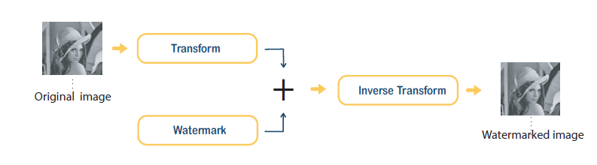
INTRODUCTION
Digital watermarking system for image
Low or middle frequency coefficients
Comparison over Cryptography/Steganography
Embeddings, Detection, Extraction
I: Additive, Substitutive
II: Blinding, Non-blinding watermark
III: Extraction
S. Boujerfaoui, R. Riad, H. Douzi, F. Ros, and R. Harba, “Image Watermarking between Conventional and Learning-Based Techniques: A Literature Review,” Electronics, vol. 12, no. 1, Art. no. 74, Jan. 2023.

Slide 3
LITERATURE REVIEW
Hybrid: Spatial + Transformed
Learning Based
Robustness:
30 dB ≤ PSNR ≤ 50 dB: High Fidelity
PSNR > 40 dB: Nearly identical to the human eye
PSNR < 30 dB: Visible distortions
IID sequences drawn from Gaussian distribution
Retrieval of original image, and number of coefficients involved in watermark extraction

Slide 4
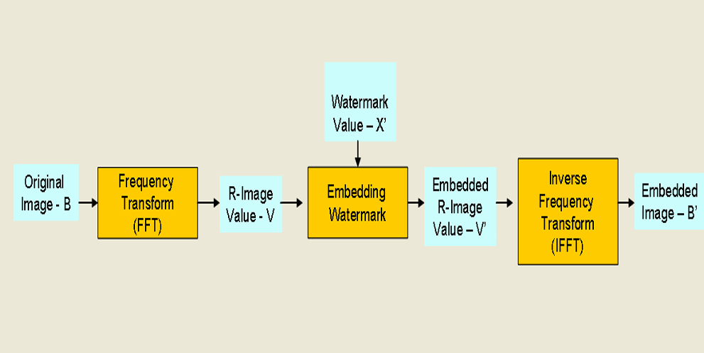
METHODOLOGY
Image Transformation into frequency domain using Fast Fourier Transform(FFT)
Coefficient selection for watermark embedding
Embedding the watermark by adding the watermark image to the selected coefficients
Image reconstruction
Inverse Fast Fourier Transform(IFFT) of the Image to convert into spatial domain
C. M. Pun, “PDM: A Novel DFT-Based Digital Watermarking System for Images,” in Proc. 8th Int. Conf. on Signal Processing (ICSP), Beijing, China, 2006.

Slide 5
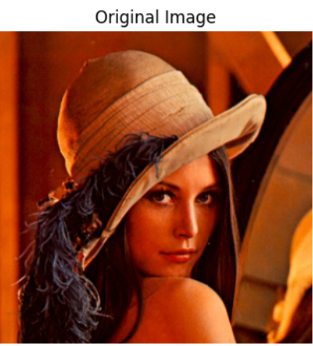
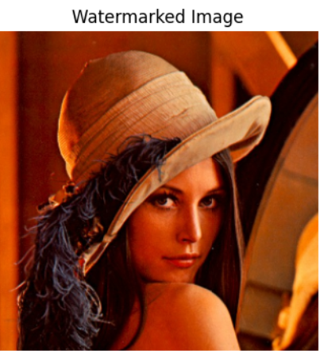
RESULTS
DFT Watermarking results:
PSNR: 51.68 dB
SSIM: 0.9981

Slide 6
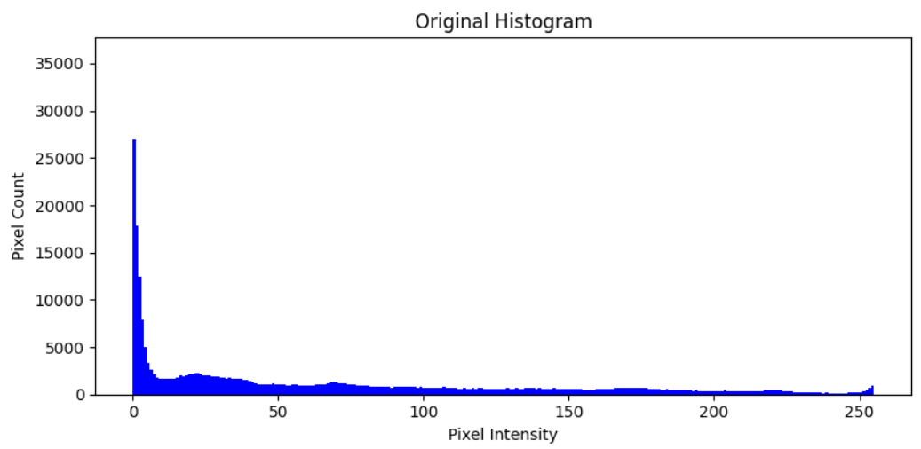
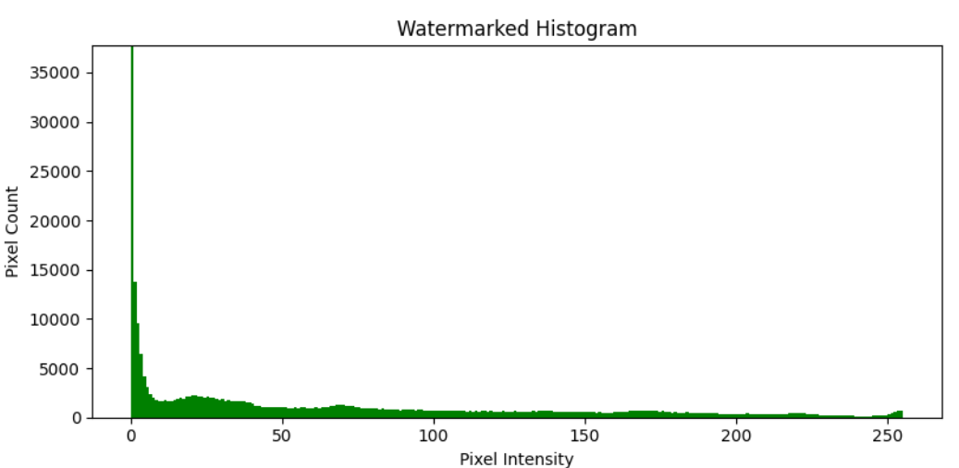

Slide 7
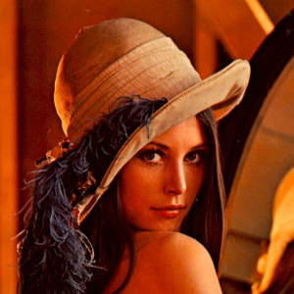
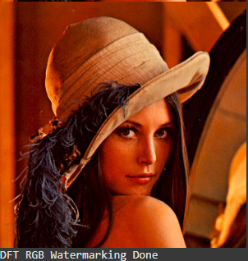
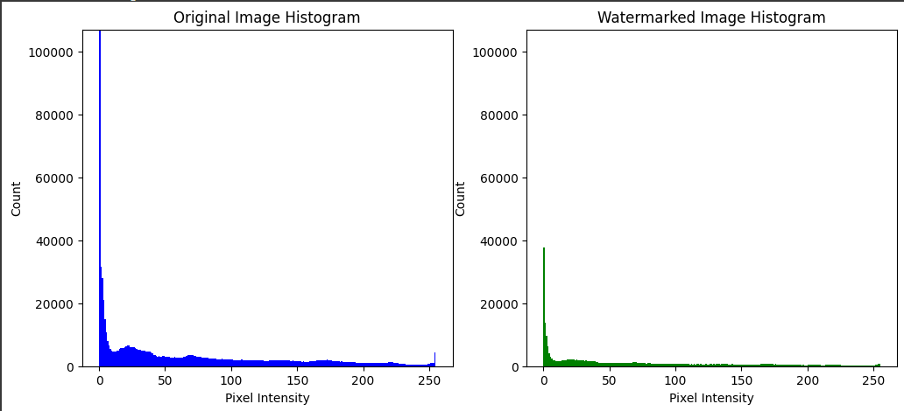
CONCLUSION
The proposed DFT based watermarking:
Keeps image quality high
Is robust against filtering, compression and noise
The watermark was embedded in mid to high magnitude DFT coefficients
Effectively balances security, imperceptibility and robustness and hence is suitable in digital media authentication.

Slide 8
NEXT SET OF WORK
Implement watermark extraction using inverse DFT
Test robustness against noise, compression, and rotation
Evaluate using PSNR, SSIM, and correlation metrics
Compare DFT, DCT, and DWT techniques
Create a custom dataset and generate result visuals
Perform visual and quantitative validation of extracted watermark

Slide 9
REFERENCES
Cox, I.J., et al., Secure spread spectrum watermarking for multimedia. IEEE Trans. Image Processing, 1997. 6: p. 1673-1687.
Chen, B.; Wornell, G.W. Quantization index modulation: A class of provably good methods for digital watermarking and
information embedding. IEEE Trans. Inf. Theory 2001, 47, 1423–1443.
3. Pardhu, T.; Perli, B.R. Digital image watermarking in frequency domain. In Proceedings of the 2016 International Conference on
Communication and Signal Processing (ICCSP), Tamilnadu, India, 6–8 April 2016; pp. 0208–0211.
4. Darwish, S.M.; Al-Khafaji, L.D.S. Dual watermarking for color images: A new image copyright protection model based on the
fusion of successive and segmented watermarking. Multimed. Tools Appl. 2020, 79, 6503–6530.
5. Kang, X.; Chen, Y.; Zhao, F.; Lin, G. Multi-dimensional particle swarm optimization for robust blind image watermarking using
intertwining logistic map and hybrid domain. Soft Comput. 2020, 24, 10561–10584.
6. S. Boujerfaoui, R. Riad, H. Douzi, F. Ros, and R. Harba, “Image Watermarking between Conventional and Learning-Based Techniques: A Literature Review,” Electronics, vol. 12, no. 1, Art. no. 74, Jan. 2023.
7. C. M. Pun, “PDM: A Novel DFT-Based Digital Watermarking System for Images,” in Proc. 8th Int. Conf. on Signal Processing (ICSP), Beijing, China, 2006.

