Slide 1
FIELD LAB · A WEBSITE THAT TEACHES HCI BY MAKING YOU USE IT
Don't read about HCI.
Touch it.
HCI 06.103.115 · IIT Guwahati · Dr. Samit Bhattacharya
github.com/yashvigala/HCI

Slide 2
§ WHAT THIS PROJECT IS
A website about HCI
that is also HCI.
THE IDEA
Most HCI lessons are essays. They tell you what Fitts's Law is, what Nielsen's heuristics are. You read, nod, forget. So I built the opposite — a single web page where each principle is a working tool. You don't read about Fitts's Law; you drag a target and feel the math change.
WHY THIS WAY
A site that teaches HCI is also a chance to use HCI. Every button, layout choice, and interaction in the site itself was a chance to obey the rules I was teaching — or to break them. The site is the proof I understood the material, because building it required me to apply it.
WHAT YOU'LL SEE NEXT
Eight short demos — one per major HCI principle — followed by an honest audit of where the site fails its own rules and what I fixed. The whole thing is one HTML file: no frameworks, no libraries, ~70KB. View source and read the JavaScript if you don't believe me.
FIELD LAB · HCI 06.103.115
02 / 18

Slide 3
§ THE EIGHT TOOLS
One page. Eight tools. Scroll to use them.
§ 01
§ 02
§ 03
§ 04
Fitts
Hick
Gestalt
Norman
How long does it take to click a button? Drag the sliders and find out.
More choices = slower decisions. Time yourself across 2, 4, 8, and 16 options.
Why do dots look like groups? Toggle four perception rules and watch.
Why bad doors confuse you. Three demos: doors, stove knobs, button feedback.
§ 05
§ 06
§ 07
§ 08
Nielsen
KLM
Color
A11y
Ten rules of good interfaces. Each shown broken vs fixed in tiny mock-ups.
Predict how many seconds your task will take, before you ever build it.
Pick two colours. See if they pass the official accessibility tests.
Become a blind / colour-blind / motion-sensitive user — for a minute.
FIELD LAB · HCI 06.103.115
03 / 18

Slide 4
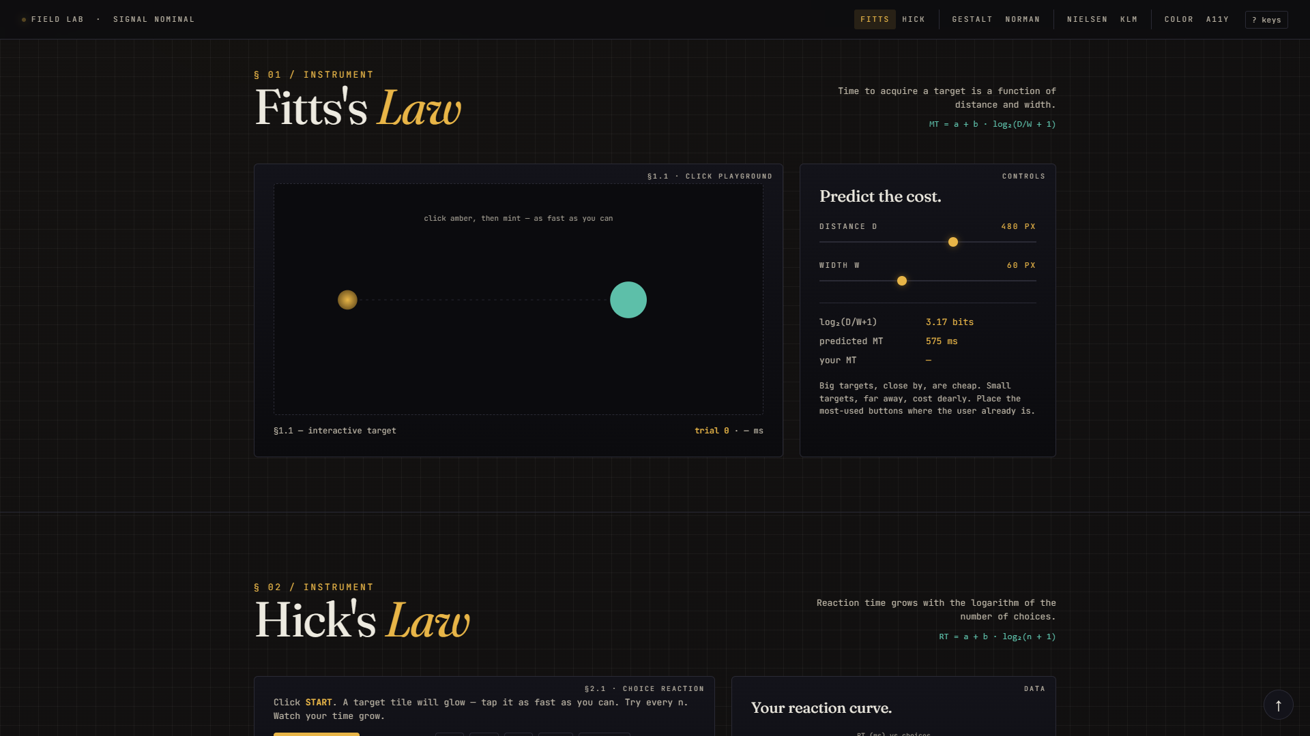
§ 01 / FITTS
Fitts's Law
Big buttons that are close are easy to hit. Small ones far away are hard.
WHAT IT SAYS
How long it takes to click a button depends on two things: how far away it is from your cursor, and how big it is. The further or smaller the target, the longer the click. The exact relationship is mathematical — there's a formula.
WHY IT MATTERS
On phones, your thumb hovers near the bottom. So put your most-tapped button there, and make it big. Spotify's play button is huge for a reason. Tiny X to close a banner ad? Designed to be hard to hit. The math is real.
IN THE DEMO
Two sliders — distance and target width. Click the amber dot, then race to the mint dot. The site shows the predicted time and your actual time side by side. Make the target small and far — watch both numbers grow.
FIELD LAB · HCI 06.103.115
04 / 18

Slide 5
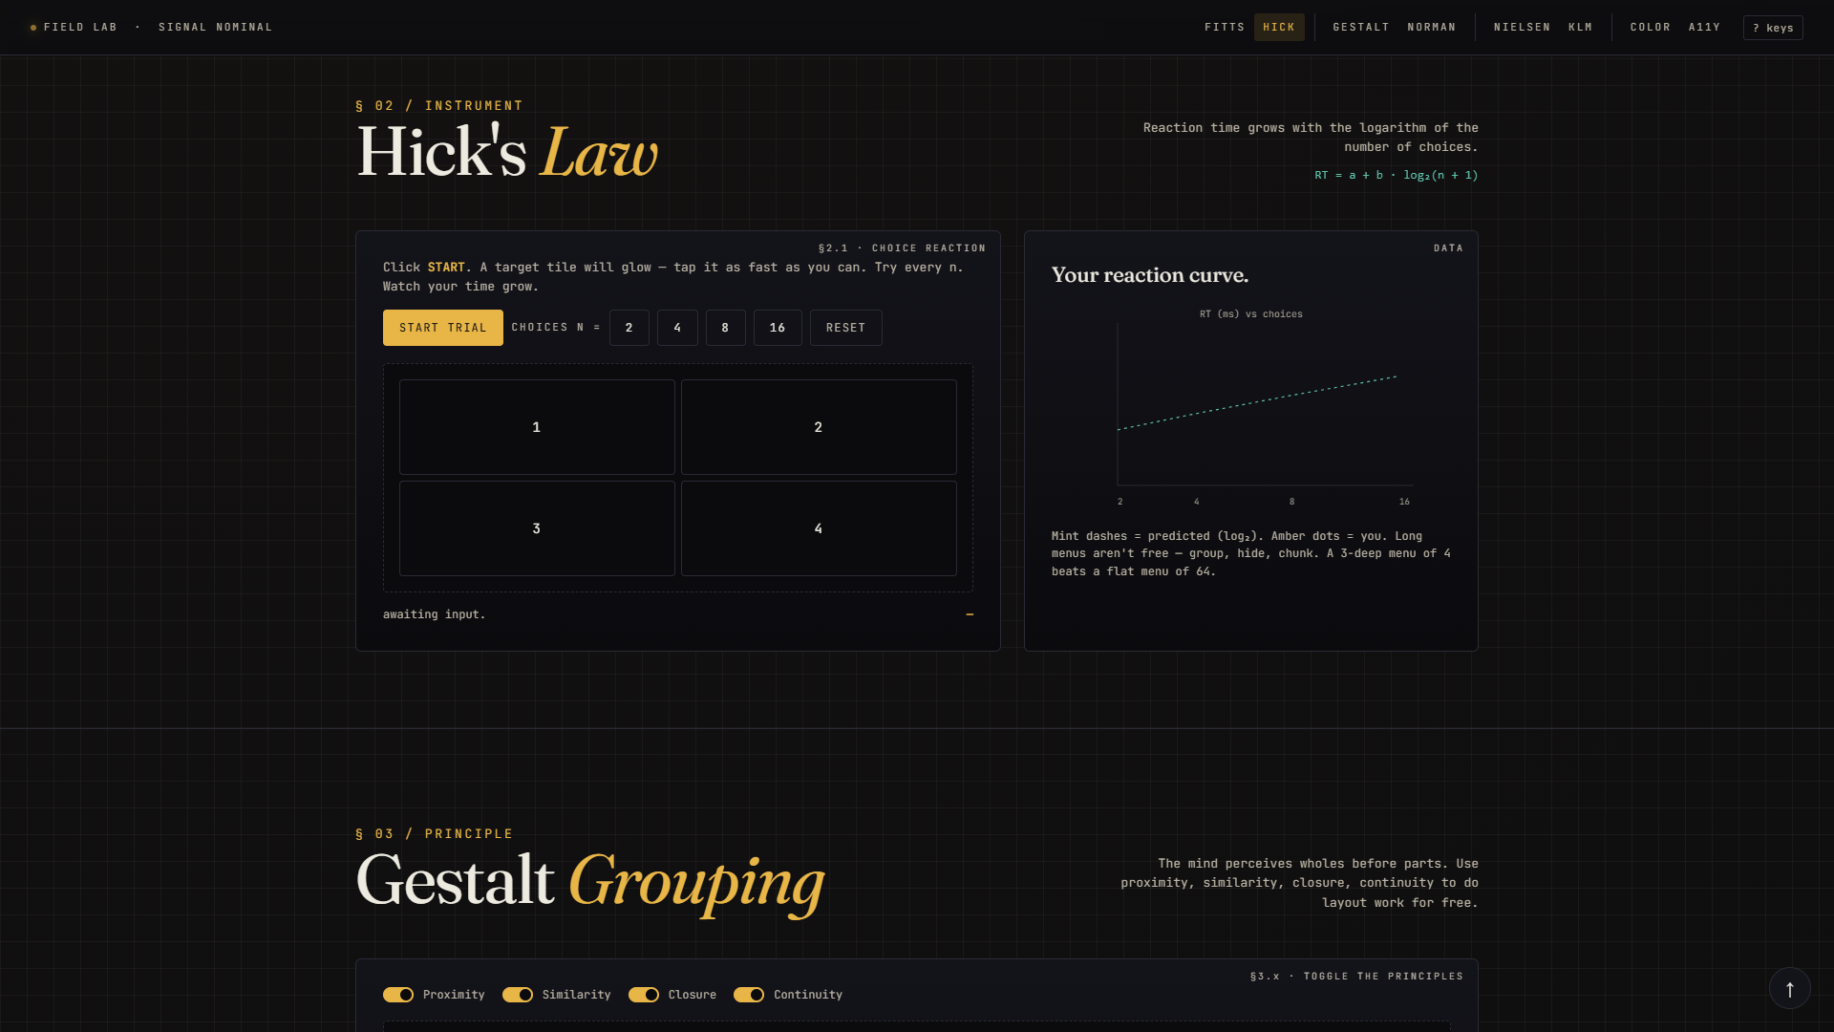
§ 02 / HICK
Hick's Law
More choices = slower decisions.
WHAT IT SAYS
When you give the user 2 buttons, they pick fast. 8 buttons, slower. 16, slower still — and the slowdown is logarithmic, not linear. So adding more choices keeps making things worse, just at a slowing rate.
WHY IT MATTERS
Don't dump 50 menu items in a flat row. Group, hide, tier. Three folders of 10 items beats one wall of 30 — the user finds things faster, even though there's an 'extra step.' The biggest menu killer is no hierarchy.
IN THE DEMO
Pick a number of choices: 2, 4, 8, or 16 tiles appear. Hit START — one tile glows. Tap it as fast as you can. Your reaction time gets plotted against the curve the math predicted. Try all four; watch the curve.
FIELD LAB · HCI 06.103.115
05 / 18

Slide 6
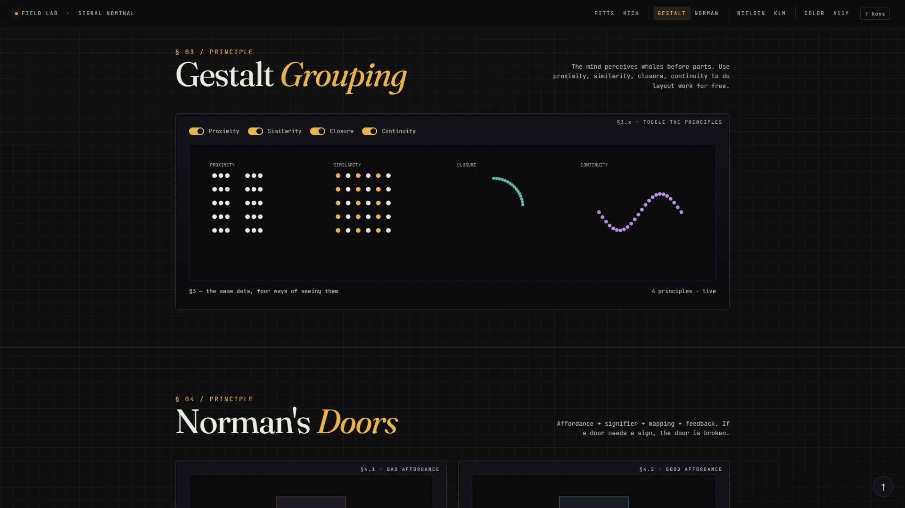
§ 03 / GESTALT
Gestalt Grouping
Your brain groups things before it reads them.
WHAT IT SAYS
Things close together feel related (proximity). Things that look the same feel related (similarity). Incomplete shapes still register as shapes (closure). Smooth lines are followed (continuity). Your brain does this work automatically — before you've read a single word.
WHY IT MATTERS
Use whitespace to group form fields, not borders. Use the same shape for the same kind of button. Stop drawing boxes around everything — proximity does the grouping for free. Good interfaces lean on perception rather than fighting it.
IN THE DEMO
Same set of dots, four toggles. Turn proximity OFF — clear columns dissolve into a uniform grid. Turn closure OFF — the circle becomes a scatter. You can literally watch the grouping appear and disappear.
FIELD LAB · HCI 06.103.115
06 / 18

Slide 7
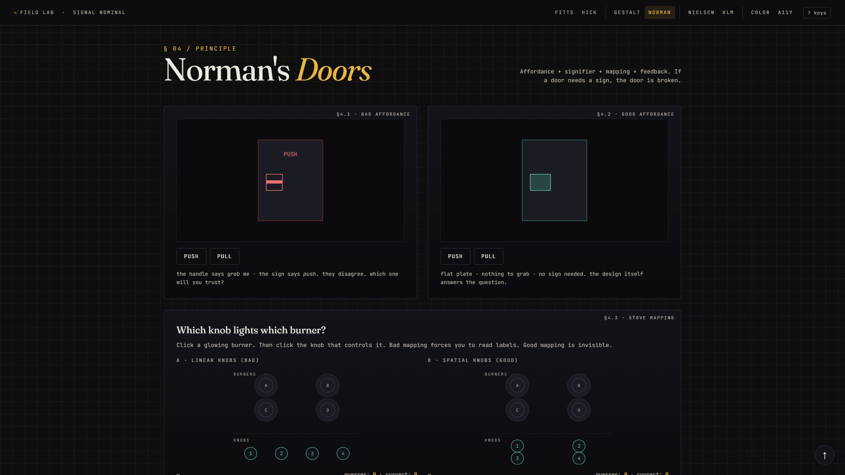
§ 04.A / NORMAN
Norman's Doors
If a door needs a sign, the door is broken.
WHAT IT SAYS
A flat plate on a door tells your hand to push. A graspable handle tells your hand to pull. When the design and function match, you don't need a label. When they don't — when a handle says 'pull me' but the sign says 'push' — the world fights you, every single day.
WHY IT MATTERS
Same with software. A button should look pressable. A draggable item should look draggable. Stop adding instructional copy on top of broken designs. Redesign the thing so the design itself is the instruction.
IN THE DEMO
Two doors. The bad one has a graspable handle BUT a 'PUSH' sign — pulling actually opens it. Click 'Push' and the door shakes; click 'Pull' and it swings open. The conflict you feel is the entire lesson.
FIELD LAB · HCI 06.103.115
07 / 18

Slide 8
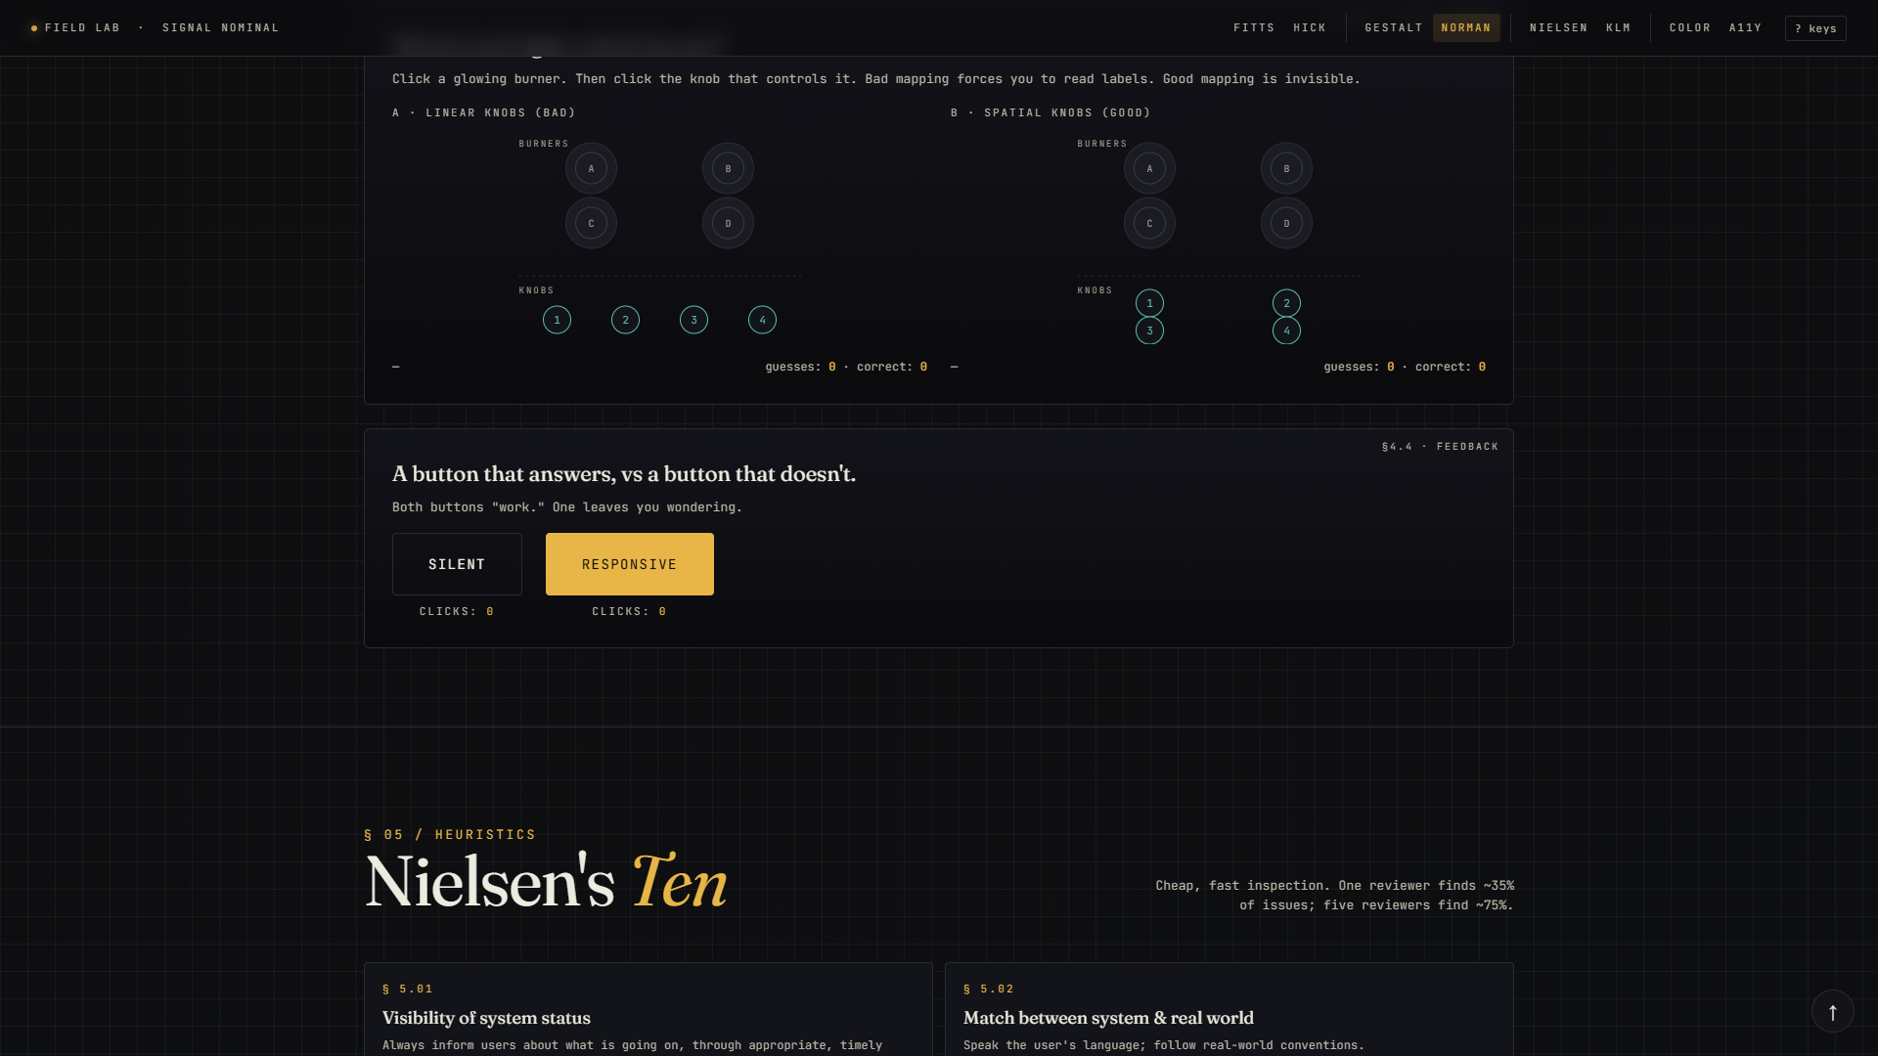
§ 04.B / MAPPING
Stove Mapping
Knobs should look like the things they control.
WHAT IT SAYS
If your stove burners are arranged in a 2x2 grid, your knobs should ALSO be in a 2x2 grid — directly underneath. Then 'top-left knob' obviously controls 'top-left burner.' No labels needed. The position itself is the answer.
WHY IT MATTERS
Volume sliders next to the speakers. Brightness next to the screen. The seat-adjustment buttons in modern cars are shaped like the seat. Spatial layout is half the design — and bad spatial design is why every kitchen has a 'wait, which knob is this?' moment.
IN THE DEMO
Two stoves. The bad one has burners in 2x2 but knobs in a flat row — you must read the labels. The good one has knobs in 2x2 directly below — position alone tells you. Pick a burner letter, then guess its knob.
FIELD LAB · HCI 06.103.115
08 / 18

Slide 9
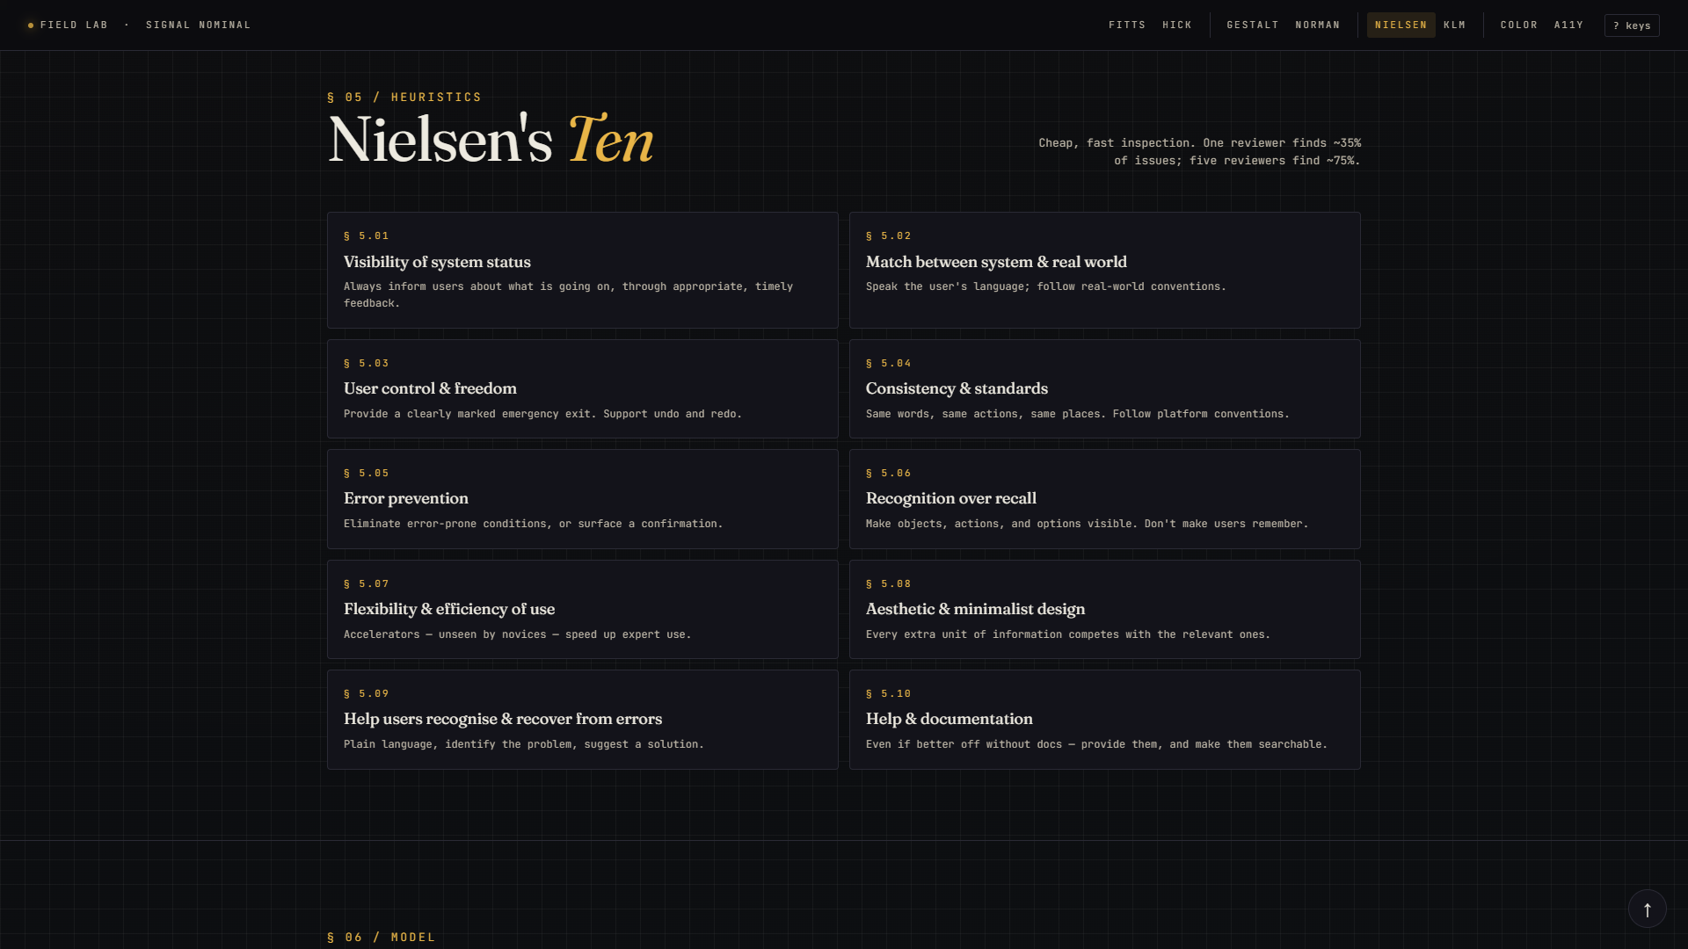
§ 05 / NIELSEN
Nielsen's Ten
Ten short rules every interface should follow.
WHAT IT SAYS
In 1994 Jakob Nielsen wrote ten rules for usable design. Things like "always tell the user what the system is doing" and "make important options visible." Five reviewers going through your design with these ten rules will catch about 75% of all usability problems.
WHY IT MATTERS
It's a checklist — cheap, fast, before you ever bring in real users. Heuristic evaluation is the most cost-effective usability technique that exists, and these ten rules are the standard checklist worldwide.
IN THE DEMO
Ten clickable cards, one per rule. Click any to open a modal that shows what 'broken' looks like next to what 'fixed' looks like for that rule — drawn as actual mini-UIs. The next slide shows one example.
FIELD LAB · HCI 06.103.115
09 / 18

Slide 10
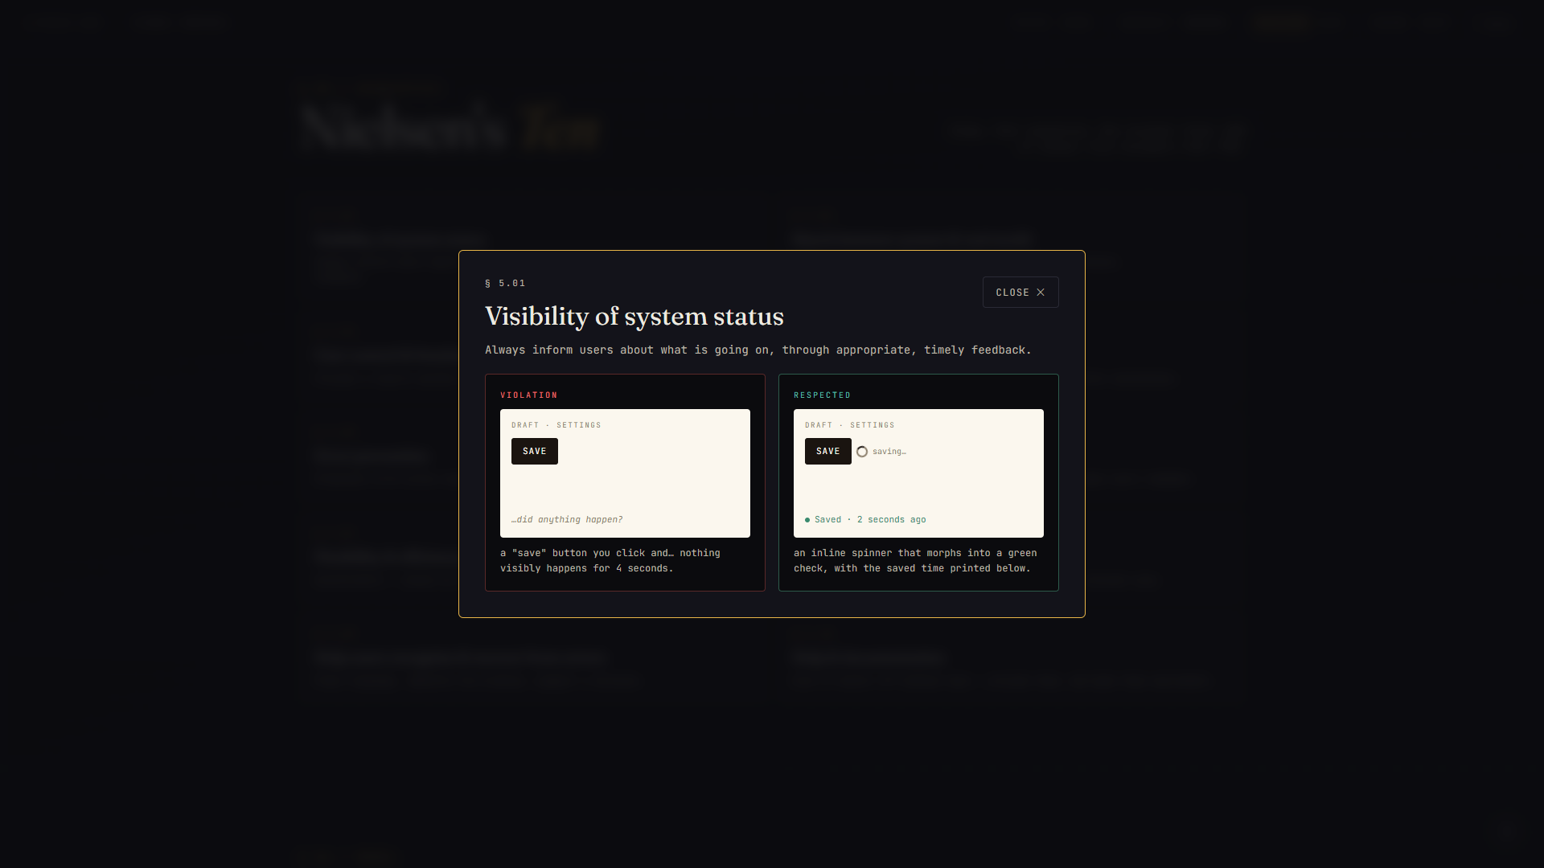
§ 05 / NIELSEN — A SINGLE RULE, EXPANDED
Rule 1: always tell the user what's happening.
FIELD LAB · HCI 06.103.115
10 / 18
On the LEFT (broken): a SAVE button you click and… nothing visibly happens. Did it work? Is it loading? You don't know. On the RIGHT (fixed): SAVE → tiny spinner → "Saved · 2 seconds ago" appears below. Same button — completely different experience. Multiply this by ten rules and you have twenty mini-UIs.

Slide 11
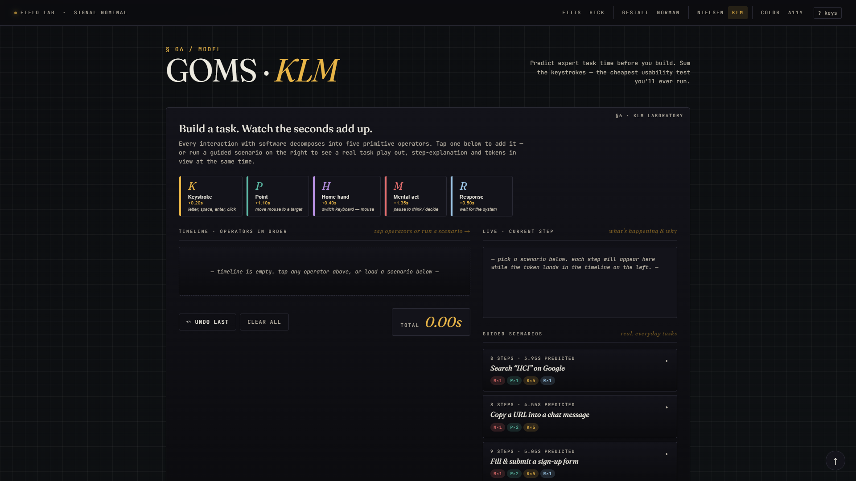
§ 06.A / GOMS · KLM
GOMS · KLM
Predict how many seconds your task will take — before you build it.
WHAT IT SAYS
Every interaction with software breaks down into 5 tiny operations: pressing a key (K = 0.20s), moving the mouse (P = 1.10s), switching hand from keyboard to mouse (H = 0.40s), pausing to think (M = 1.35s), and waiting for the system to respond (R = ~0.50s). Add them up — that's your task time.
WHY IT MATTERS
If your sign-up flow needs 7 keystrokes plus 2 mental pauses, that's about 4 seconds — before the user has even completed it. If a competitor's flow needs 2 seconds, you've already lost. KLM tells you this before you write the code, which is when fixing it is cheap.
IN THE DEMO
Five operator buttons across the top. Tap any one — a token appears below showing what it added (+0.20s) and the running total (= 0.20s). Build a fake task by tapping operators in sequence. The total at the right grows live.
FIELD LAB · HCI 06.103.115
11 / 18

Slide 12
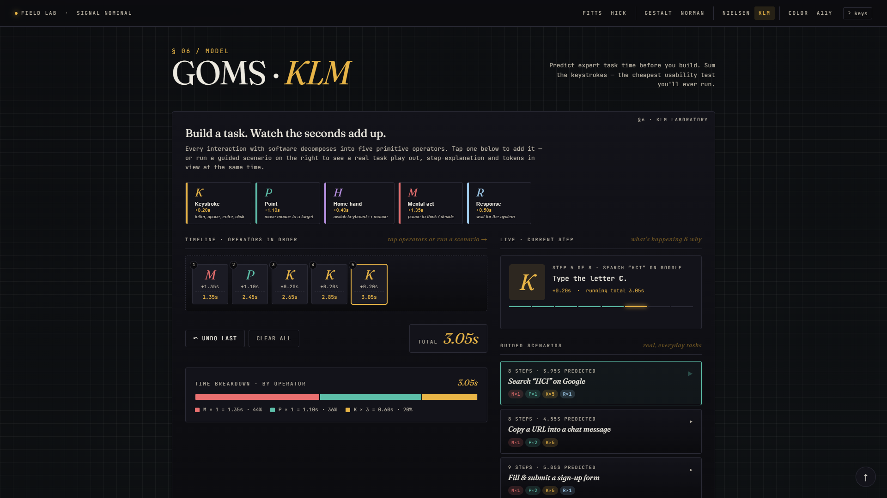
§ 06.B / KLM — A REAL TASK, IN SLOW MOTION
Three guided scenarios you can play.
FIELD LAB · HCI 06.103.115
12 / 18
Click "Search HCI on Google" and watch a real task play out one step at a time. Tokens land in the timeline on the left while the explanation panel on the right reads "Step 4 of 7: Type the letter C — that's a keystroke, +0.20s, running total now 2.85s." By the end you can see exactly where the seconds went — and which steps you could remove with smarter design (like one-tap reorder, or autocomplete).

Slide 13
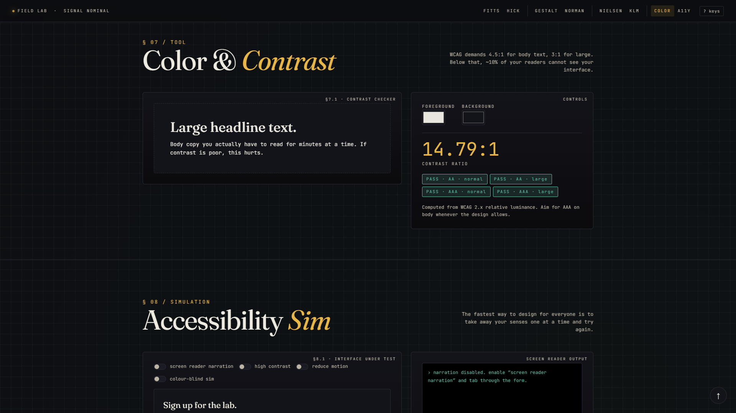
§ 07 / COLOUR
Colour & Contrast
About 10% of your readers literally cannot see your interface.
WHAT IT SAYS
WCAG (the official accessibility standard) demands a contrast ratio of 4.5:1 between text and background — 3:1 for large headings. Below that, people with low vision can't read your site. The ratio is computed from the relative brightness of the two colours.
WHY IT MATTERS
It's not a nice-to-have. It's the law in many countries (Europe, parts of the US, India's draft accessibility rules). It costs nothing to fix during design. It costs a lot to fix after launch. The cheapest accessibility win you'll ever get.
IN THE DEMO
Two colour pickers — foreground and background. The site computes the WCAG ratio in real time and stamps four pass / fail badges (AA / AAA × normal / large text). Drag a colour into a fail and watch the badges flip red.
FIELD LAB · HCI 06.103.115
13 / 18

Slide 14
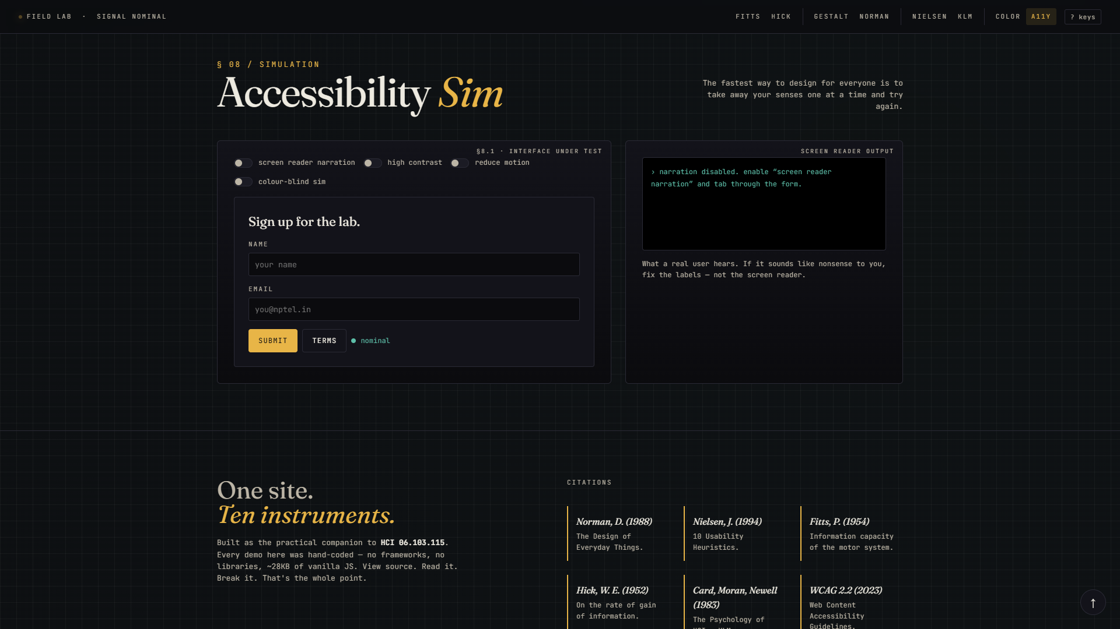
§ 08 / A11Y
Accessibility Sim
Become a different user for a minute.
WHAT IT SAYS
Most designers are sighted, hearing, full-mobility, working in good light, with steady hands. Most users, most of the time, are not all of those things. The fastest way to design for everyone is to take away your senses — one by one — and try the interface again.
WHY IT MATTERS
If your form doesn't work with a screen reader, blind users can't sign up. If your error message is red-on-grey only, colour-blind users miss it entirely. These bugs are invisible to you until you simulate them. After 60 seconds in this section, you'll never ship them again.
IN THE DEMO
Four toggles. Screen-reader narration speaks each label aloud through your speakers — actually uses the browser's Speech Synthesis API. High contrast strips colour. Reduce motion cancels animations. Colour-blind filter shows a protanope view. Toggle each and tab through the form.
FIELD LAB · HCI 06.103.115
14 / 18

Slide 15
§ AN HONEST AUDIT
Does the site practise what it teaches?
Honest answer — only partially. Here's the audit, before and after I fixed it.
WHAT IT GOT RIGHT
WHAT IT GOT WRONG
✓ Sections grouped clearly with consistent card layouts.
✓ KLM operator buttons show name, cost, and a real example — no need to memorise.
✓ Every button gives a visible click response within milliseconds.
✓ Restrained palette, one demo per section — no clutter.
✓ Every tool has a one-line caption explaining what it does.
✗ Top nav was 8 cramped tiny links — exactly what Fitts's Law says to avoid.
✗ Same nav had 8 flat choices — which is what Hick's Law says is slow.
✗ While scrolling, you couldn't tell which section you were in (no active highlight).
✗ Pressing Esc didn't close any modal dialog (broke user-control rule).
✗ Three different numbering systems (§, FIG., H) — broke the consistency rule.
✗ Body text contrast was 6.5:1 — fails the AAA standard the site itself was teaching.
FIELD LAB · HCI 06.103.115
15 / 18

Slide 16
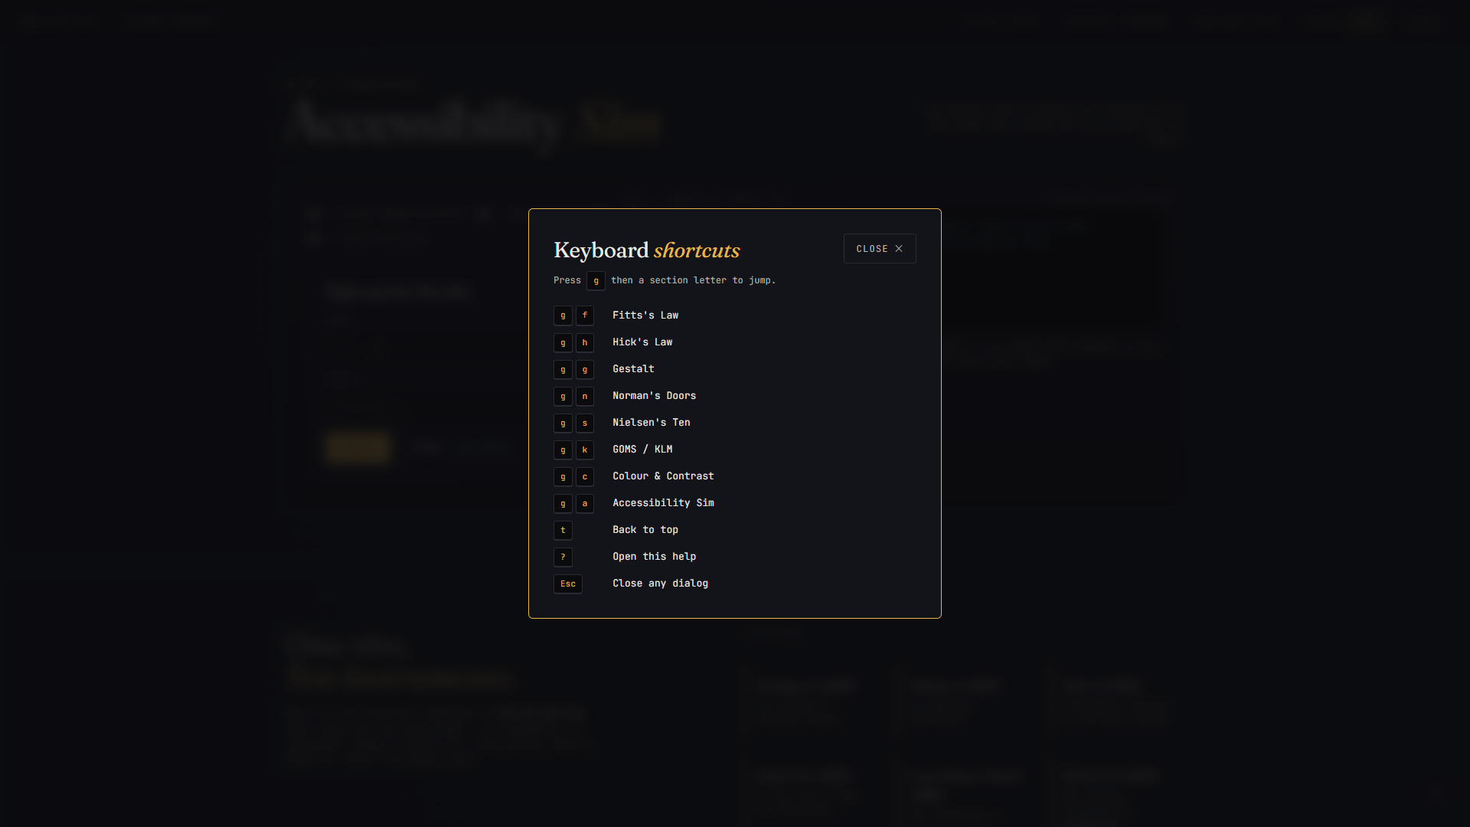
§ FIVE THINGS I FIXED
Then I fixed the lab.
01
Fixed the cramped top nav
Grouped 8 links into 4 buckets — Laws, Form, Process, Quality. Bigger hit targets, with the current section now highlighted as you scroll.
02
Added keyboard shortcuts
Press Esc to close any dialog · ? to see the shortcut list · "g" then a letter to jump to a section · "t" to scroll back to top.
03
Added a back-to-top button
A small floating button appears once you've scrolled. One click sends you back up — no more endless mouse-wheeling.
04
Bumped text contrast to AAA
Changed the muted-grey text from #A39E92 to #BCB5A6. Now passes WCAG AAA at 9.6:1 — was 6.5:1 before, which the site itself was flagging as a fail.
the new keyboard-shortcuts overlay
05
Unified the numbering
Replaced three different markers (§, FIG., H) with one — § for everything. Sections are § 01, figures are § 1.1, heuristics are § 5.01. One language, one system.
FIELD LAB · HCI 06.103.115
16 / 18

Slide 17
§ THE WHOLE THING IN NUMBERS
No frameworks.
No build step.
One file.
No React, no jQuery, no npm install for the user. Just open index.html and it works — even offline. View source and read every line.
1
~70KB
0
index.html
total weight
dependencies
self-contained
unminified
no libraries
8
20
9.6:1
interactive tools
mini mock-ups
body contrast
one per principle
two per Nielsen rule
WCAG AAA
FIELD LAB · HCI 06.103.115
17 / 18

Slide 18
TRY IT YOURSELF
Visit the lab.
yashvigala.github.io/HCI/lab/
Source: github.com/yashvigala/HCI
"If a door needs a sign, the door is broken."
Pratham Prasoon · HCI 06.103.115 · IIT Guwahati · Spring 2026

