Slide 1
FIELD LAB · A FIELD LABORATORY OF HCI PRINCIPLES
Don't read about HCI.
Touch it.
HCI 06.103.115 · IIT Guwahati · Dr. Samit Bhattacharya
github.com/yashvigala/HCI

Slide 2
§ THE BRIEF
If a door needs a sign,
the door is broken.
— Donald A. Norman, The Design of Everyday Things
The goal:
Prove I understood every principle by building a working instrument for each one. Don't write about Fitts's Law — build a tappable target. Don't paraphrase Nielsen — show ten broken UIs side-by-side with their fixes.
FIELD LAB · HCI 06.103.115
02 / 18

Slide 3
§ EIGHT INSTRUMENTS
On one page.
§ 01
§ 02
§ 03
§ 04
Fitts
Hick
Gestalt
Norman
Drag the target. Live MT prediction.
Choice-reaction timer; RT vs log₂(n+1).
Toggle proximity, similarity, closure.
Doors, mapping, feedback — three demos.
§ 05
§ 06
§ 07
§ 08
Nielsen
KLM
Color
A11y
10 heuristics · violation vs respected.
Operator playground + guided scenarios.
Live WCAG checker, AA / AAA badges.
Real screen-reader audio + 4 sim toggles.
FIELD LAB · HCI 06.103.115
03 / 18

Slide 4
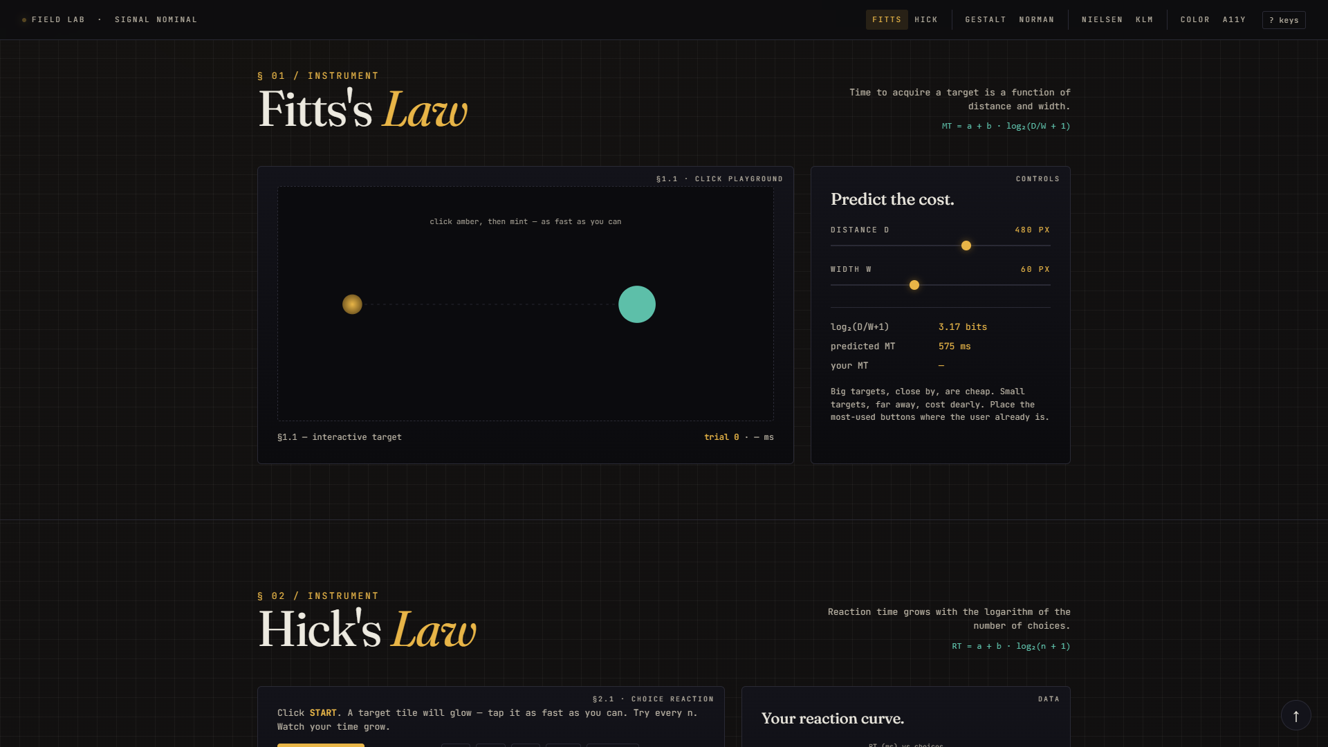
§ 01 / FITTS
Fitts's Law
Time to acquire a target is a function of distance to it and its width.
MT = a + b · log₂(D/W + 1)
Drag the sliders to change distance and width. Click amber, then mint as fast as you can. The site computes both the predicted movement time and your actual measured time, so you see the law working in real time.
FIELD LAB · HCI 06.103.115
04 / 18

Slide 5
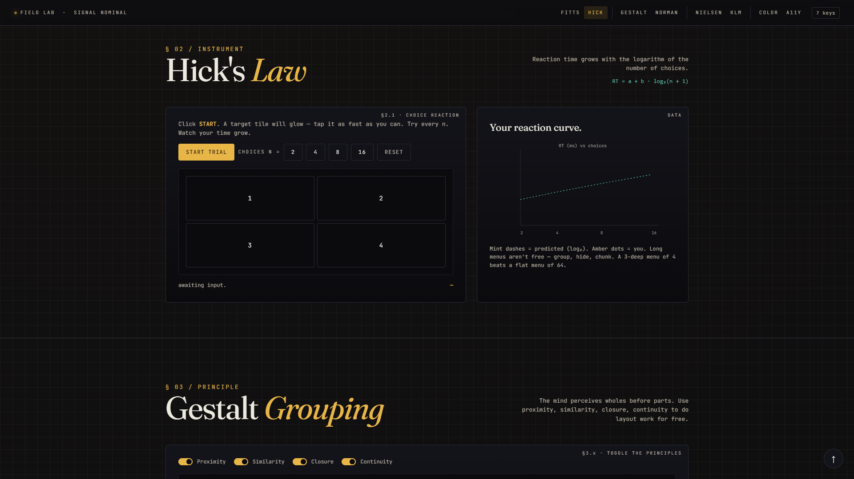
§ 02 / HICK
Hick's Law
Reaction time grows with the logarithm of the number of choices.
RT = a + b · log₂(n + 1)
Pick n = 2, 4, 8 or 16, hit START, and tap the glowing tile. Each trial plots your RT against the predicted log₂ curve. Long flat menus aren't free — group, hide, chunk.
FIELD LAB · HCI 06.103.115
05 / 18

Slide 6
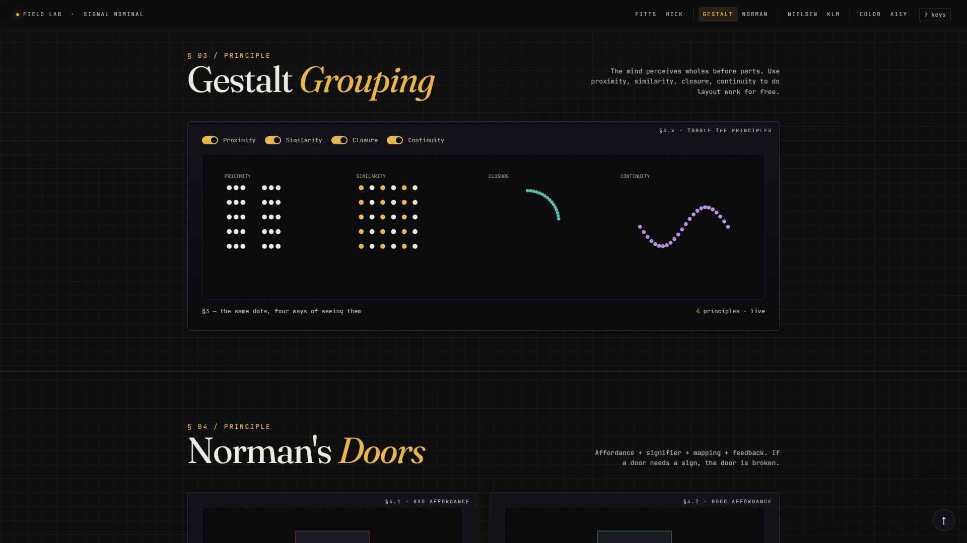
§ 03 / GESTALT
Gestalt Grouping
Proximity · similarity · closure · continuity. The brain perceives wholes before parts.
Four toggles drive the same set of dots through four perceptual lenses. Turn proximity off and the columns dissolve. Turn closure off and a circle becomes a scatter of points.
FIELD LAB · HCI 06.103.115
06 / 18

Slide 7
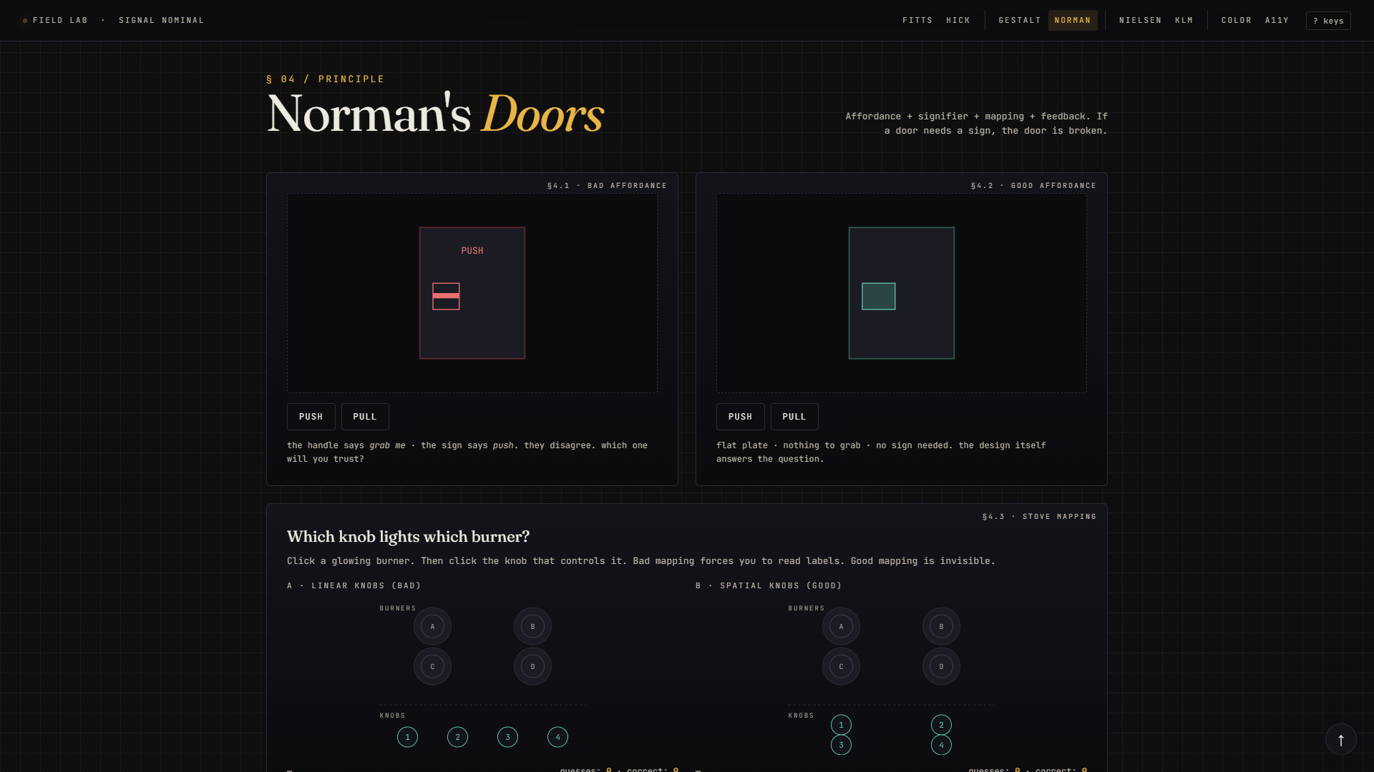
§ 04.A / NORMAN
Norman's Doors
Affordance · signifier · mapping · feedback. If a door needs a sign, the door is broken.
Two doors. The bad one wears a "PUSH" label but has a graspable handle that begs to be pulled — pulling actually opens it. The good one has a flat plate, no sign, and only pushes. The conflict is the lesson.
FIELD LAB · HCI 06.103.115
07 / 18

Slide 8
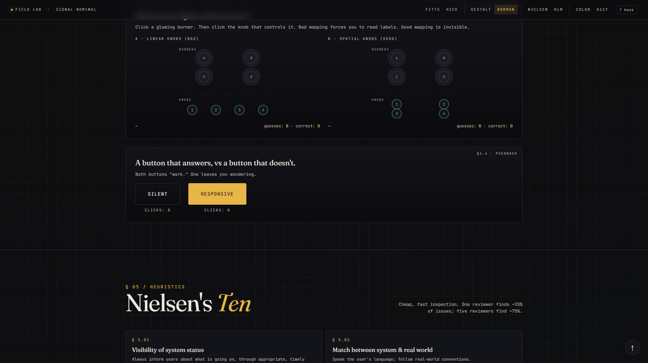
§ 04.B / MAPPING
Stove Mapping
Spatial correspondence between control and effect — knobs that mirror the burners.
Two stoves: bad has burners in 2×2 but knobs in a row, breaking spatial mapping. Good keeps both in 2×2 — the position of each knob is its label. Click a burner letter, then guess its knob.
FIELD LAB · HCI 06.103.115
08 / 18

Slide 9
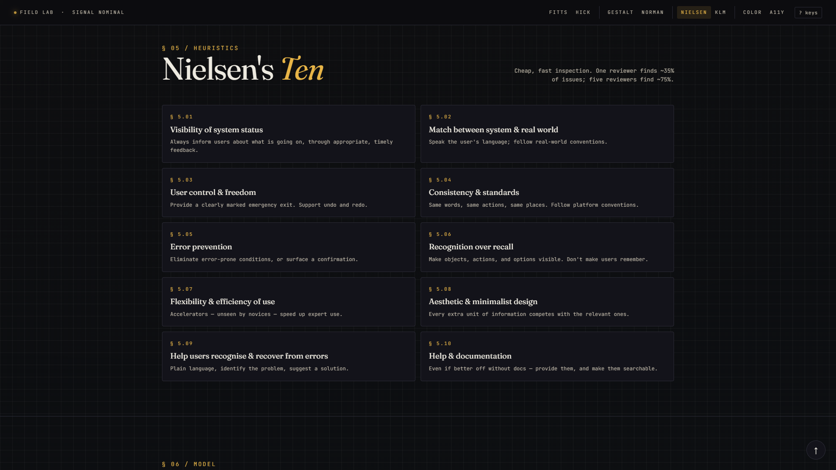
§ 05 / NIELSEN
Nielsen's Ten
Cheap, fast inspection. One reviewer finds ~35% of issues; five find ~75%.
All ten heuristics, each as a clickable card. Click any card to open a modal with side-by-side visual mockups — the broken UI vs the fixed one — for that heuristic. The principle is taught by showing, not telling.
FIELD LAB · HCI 06.103.115
09 / 18

Slide 10
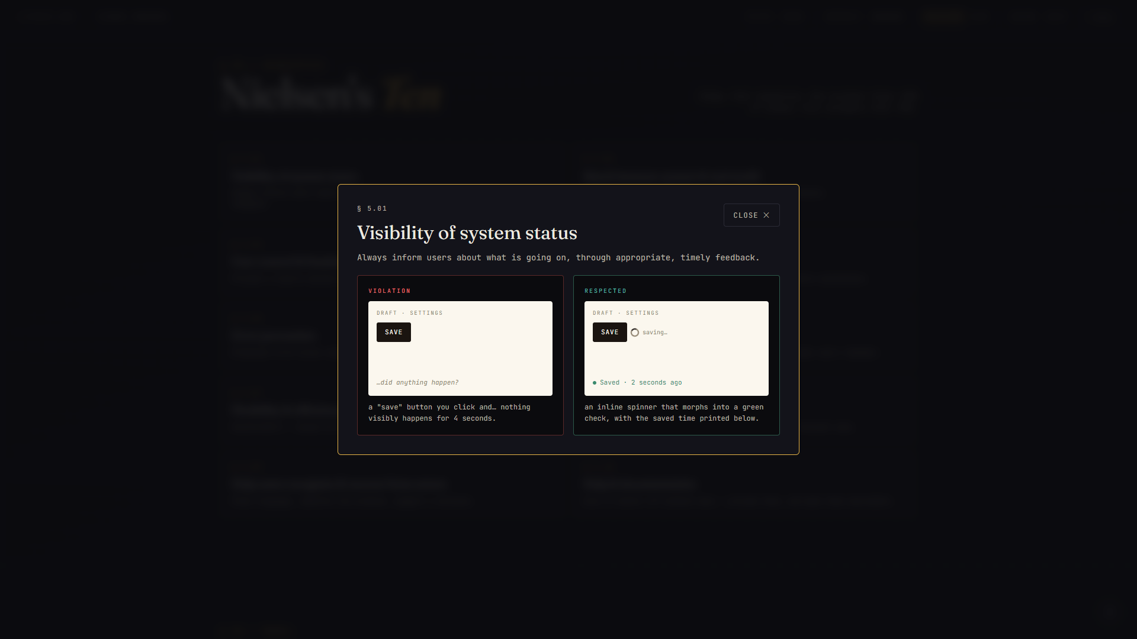
§ 05 / NIELSEN — A SINGLE HEURISTIC
Each heuristic, demonstrated.
FIELD LAB · HCI 06.103.115
10 / 18
"Visibility of system status" — silent SAVE button on the left vs SAVE → spinner → "Saved 2s ago" on the right. Ten heuristics, twenty mini UIs, all hand-drawn in CSS — no images.

Slide 11
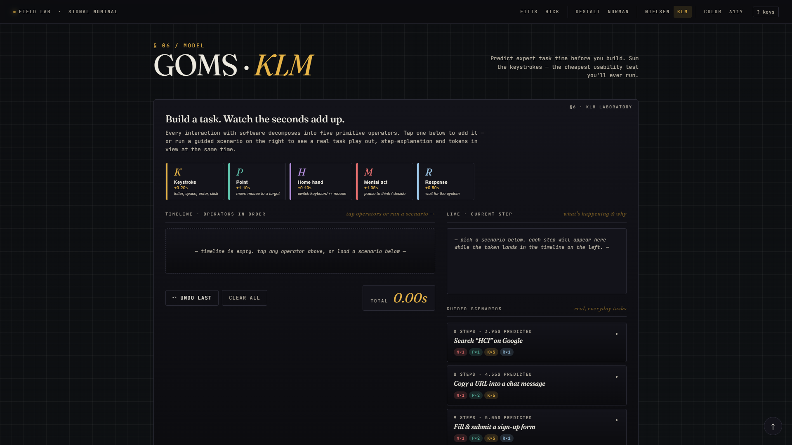
§ 06.A / GOMS · KLM
GOMS · KLM
Predict expert task time before you build. Sum the keystrokes — the cheapest usability test you'll ever run.
Five primitive operators (K, P, H, M, R), each a button with name, cost, and a real-world example. Tap any one to add a token to the timeline — each token shows what it added and the running total.
FIELD LAB · HCI 06.103.115
11 / 18

Slide 12
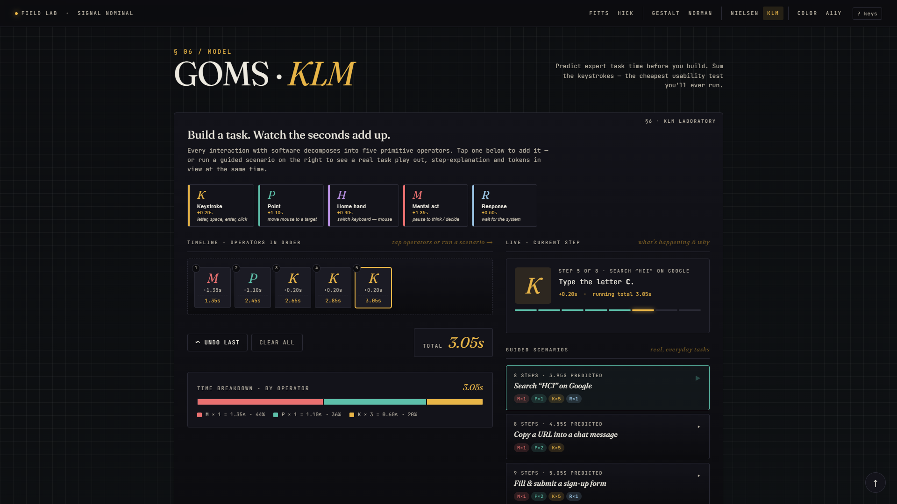
§ 06.B / KLM — GUIDED SCENARIO
Three guided scenarios.
FIELD LAB · HCI 06.103.115
12 / 18
"Search HCI on Google" plays back step-by-step — tokens land in the timeline on the left while the right panel reads "Step 4 of 7: Type the letter C · +0.20s · running total 2.85s." A stacked bar shows what proportion is mental act vs keystroke.

Slide 13
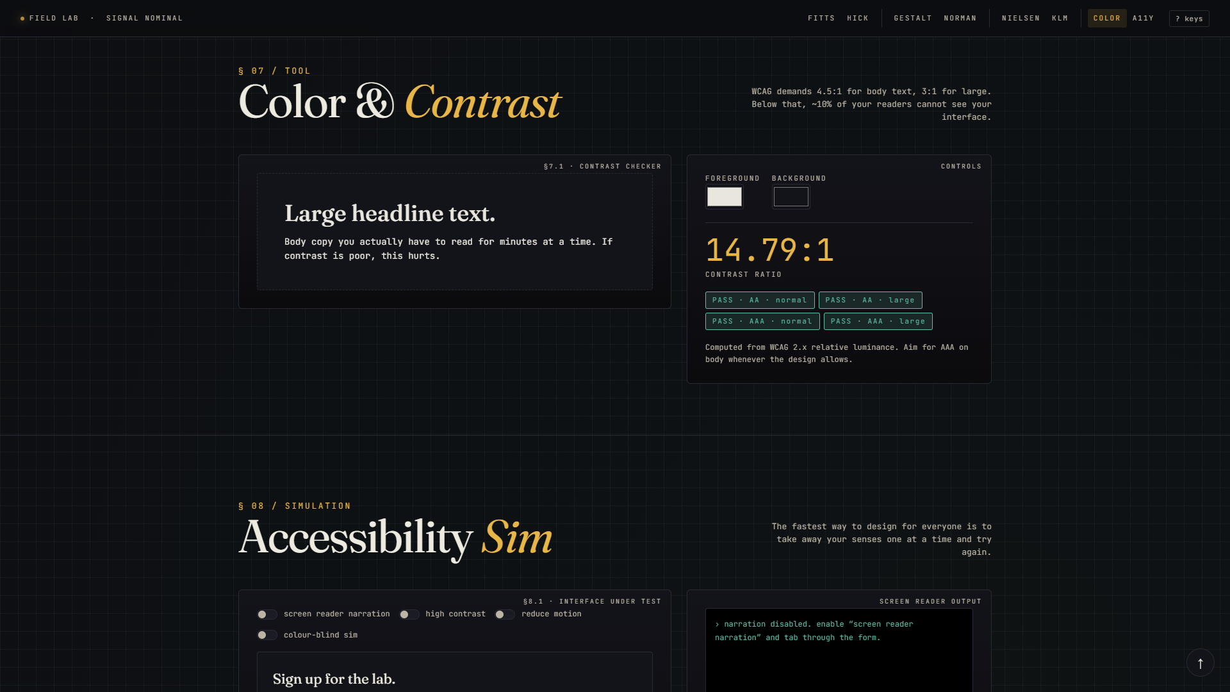
§ 07 / COLOUR
Colour & Contrast
WCAG demands 4.5:1 for body text, 3:1 for large. Below that, ~10% of your readers cannot see your interface.
Two colour pickers — foreground and background. The site computes the WCAG 2.x relative luminance ratio in real time and stamps four pass / fail badges (AA / AAA × normal / large).
FIELD LAB · HCI 06.103.115
13 / 18

Slide 14
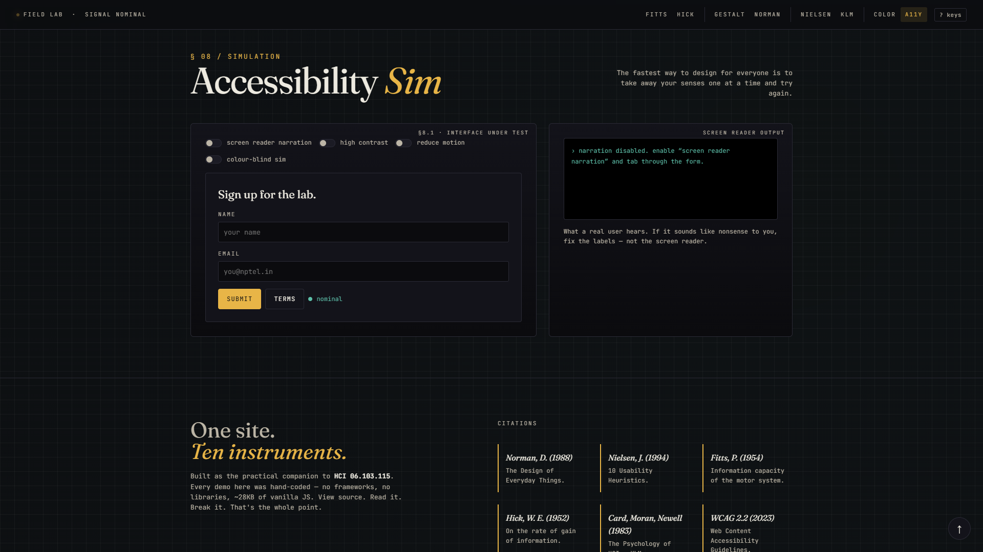
§ 08 / A11Y
Accessibility Sim
The fastest way to design for everyone is to take away your senses one at a time and try again.
Four toggles let you experience the form as four different users. Screen-reader narration speaks each label aloud through your speakers (real Speech Synthesis API). High contrast desaturates and amplifies. Reduce motion cancels animations. The colour-blind filter shows a protanope view.
FIELD LAB · HCI 06.103.115
14 / 18

Slide 15
§ AUDIT
Does the site practise what it teaches?
PRACTISES THE PRINCIPLES
VIOLATES THEM
✓ Gestalt — sections + cards in one shape language
✓ Recognition (H6) — KLM operator buttons show name + cost + example
✓ Feedback — buttons hit-animate; tokens slide in; bar updates live
✓ Minimalism (H8) — restrained palette; one demo per section
✓ Help (H10) — every instrument has a one-line caption
✗ Fitts — top nav was 8 cramped 11 px links in the corner
✗ Hick — same nav: 8 flat choices with no grouping
✗ Visibility (H1) — no active-section indicator on scroll
✗ User control (H3) — Esc didn't close modals
✗ Consistency (H4) — three numbering systems: §, FIG., H
✗ WCAG — body text at 6.5:1 (failed AAA)
FIELD LAB · HCI 06.103.115
15 / 18

Slide 16
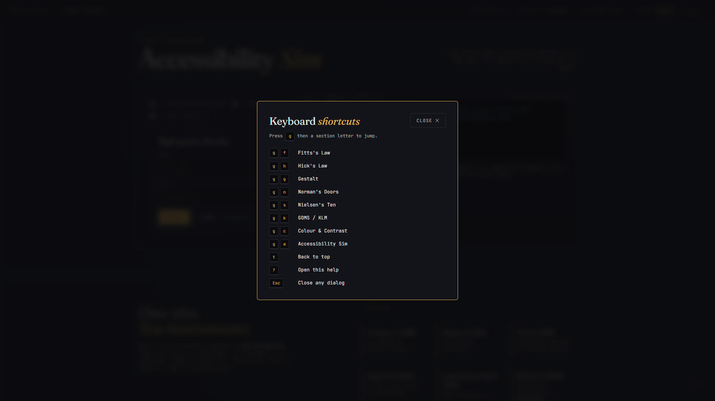
§ FIVE FIXES
Then I fixed the lab.
01
Grouped 4-bucket nav
Laws · Form · Process · Quality. Bigger hit targets, active-section highlight on scroll.
02
Keyboard shortcuts
Esc closes modals · ? opens overlay · g+letter jumps · t back to top.
03
Back-to-top button
Floating affordance after 700px scroll, with focus-visible state.
04
WCAG AAA contrast
paper-dim lightened #A39E92 → #BCB5A6. 6.5:1 → 9.6:1.
the new ?-keys overlay
05
Unified numbering
One symbol throughout: § 01 sections · § 1.1 figures · § 5.01 heuristics.
FIELD LAB · HCI 06.103.115
16 / 18

Slide 17
§ BY THE NUMBERS
No frameworks.
No build step.
One file.
1
~70KB
0
index.html
total weight
dependencies
self-contained
unminified
no jQuery, no React
8
20
9.6:1
instruments
mini mockups
body contrast
one per principle
two per heuristic
WCAG AAA
FIELD LAB · HCI 06.103.115
17 / 18

Slide 18
FIELD LAB · LIVE
Visit the lab.
yashvigala.github.io/HCI/lab/
github.com/yashvigala/HCI
"If a door needs a sign, the door is broken."
Pratham Prasoon · HCI 06.103.115 · IIT Guwahati · Spring 2026

