Slide 1

JHU Healthcare Design Competition
SurgeSentinel: A Risk-Stratified Remote Monitoring System for Post-Cesarean Wound Care
Cornell University
04/11/26
AUTHORS
Srinjoy Chatterjee · Yashvi Gupta · Anjali Katta · Sarah Satani

Slide 2
Our Value Proposition
“
3-15% of 1.2M annual U.S. C-section patients develop complications, yet a critical post-discharge "black box" leaves high-risk mothers without monitoring when infections most often emerge.
SurgeSentinel uses Al-driven wound image analysis to generate personalized risk scores, enabling early triage and reducing readmissions and travel burden.
“
THE PROBLEM
THE SOLUTION
THE BENEFIT
High-risk post-cesarean patients self-monitor complex surgical wounds for weeks with no clinical oversight.
SurgeSentinel uses Al image analysis and personalized risk scoring to flag
infections early and route alerts directly to surgeons.
Earlier detection, fewer readmissions, and zero travel - for patients,
surgeons, and health systems
2

Slide 3
Clinical Need
3–15%
Complication rate
(Wang et al., 2025)
WHAT IS THE NEED?
Cesarean delivery is the most frequently performed major surgery worldwide
3-15% of patients experience surgical site complications (infection, dehiscence, seromas, hematomas)
Risk factors (obesity, pregestational diabetes, advanced maternal age) impair healing
Current care does not differentiate between standard and high-risk recovery trajectories
$3.3B
Annual SSI cost burden
(CDC/AHRQ)
1.2M+
C-sections performed annually in the U.S.
(CDC NCHS, 2023)
WHY IS THIS NEED IMPORTANT?
1.2M+ C-sections annually in the U.S.
Surgery duration > 1 hour more than doubles infection risk
Gestational diabetes increases emergency C-section rates (1.52x)
Rural patients face delayed care → local infections become systemic
SSis drive readmissions, lost wages, and economic strain
“
High patient volumes necessitate constant, effective, and efficient post-surgical wound monitoring.
“
- Dr. Daulat Reshamwalla, OBGYN | Evergreen Surgery
3

Slide 4
Clinical Need - Current Solutions & Gaps
HOW IS THE NEED CURRENTLY ADDRESSED?
THE CARE GAP
WHERE COMPLICATIONS OCCUR
In-person follow-up at 6 weeks post-discharge
Patient-initiated nurse hotline / telehealth for symptom reporting
Wound care clinic referral when complications escalate
⚠ Infection Window
Surgery
Discharge
6-Week
Follow-up
WHY ARE CURRENT SOLUTIONS INADEQUATE?
No longitudinal data between discharge and 6-week visit - a 42-day "black box”
Exhausted new parents must self-identify clinical signs (erythema, edema) without expertise
Geographic barriers in rural maternity deserts delay presentation until infections become systemic
Critical Risk Window: Days 4-7 | Unmonitored Period: Days 1-42
Most SSIs present Days 4-7 post-op
(AJOG, 2025; British Journal of Nursing, 2024)
“
“
Remote monitoring provides essential oversight during the 14-day window where the most dangerous recovery gaps exist.
- Dr. Newton de Faria | Cornell University
4

Slide 5
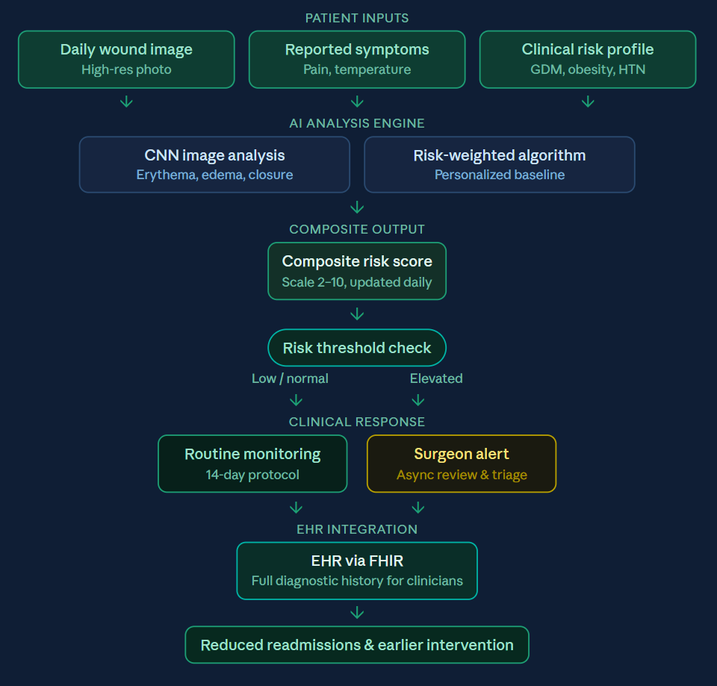
Our Solution
PROPOSED SOLUTION
SYSTEM ARCHITECTURE / PRODUCT OVERVIEW
Al-powered RPM for 14-day post-cesarean wound surveillance
CNN detects erythema, edema & closure from daily images
Personalized risk score: image data + GDM, obesity, HTN profile
Elevated scores trigger surgeon alerts for early triage
HOW IT ADDRESSES THE NEED
Continuous monitoring vs. episodic 6-week follow-up
Al quantification vs. subjective patient self-assessment
Individualized risk stratification based on clinical history
Asynchronous surgeon triage - no patient travel required
FHIR-integrated findings embedded directly into EHR
5

Slide 6



The Solution - Use Case & Value Proposition
PATIENTS
CLINICIANS
HEALTH SYSTEMS
WHO THEY ARE
WHO THEY ARE
WHO THEY ARE
Post-cesarean mothers, especially high-risk (GDM, obese, rural)
OB surgeons, wound care nurses
Rural hospitals, academic medical centers, Medicaid-heavy systems
HOW THEY USE IT
HOW THEY USE IT
HOW THEY USE IT
Daily photo capture + 1-minute symptom survey via mobile app
Review AI-flagged risk alerts asynchronously; sign off on healthy recoveries
FHIR/EHR integration as a discharge protocol add-on
VALUE DELIVERED
VALUE DELIVERED
VALUE DELIVERED
Recovery confidence
Fewer ER visits
No travel burden
Chronological data stream - proactive triage
Improved documentation and earlier intervention
Reduced risk of adverse outcomes
Reduced avoidable readmissions & costs
Lower operational costs
Scalable triage with minimal clinical burden
6

Slide 7
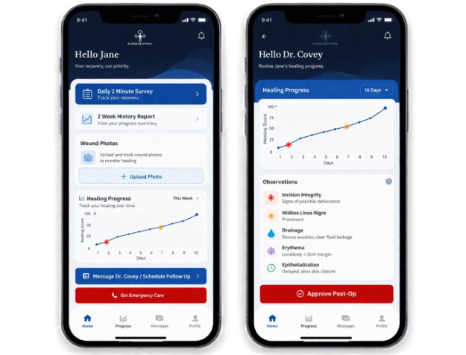
The Solution — Evidence & User Validation
TECHNICAL / BENCH EVIDENCE GENERATED
COMPELLING USER FEEDBACK
CNN-based risk scoring prototype internally validated across risk levels (1-10)
Automated pipeline generates structured physician reports (risk, findings, recommendations, patient guidance)
Integrates wound imaging with vitals (temperature, glucose) for multimodal risk assessment
“
SurgeSentinel addresses a gap that health systems have struggled to close for years; post-discharge wound monitoring in underserved populations. This is exactly the kind of AI-driven solution that hospital leadership will want at the table.
— Dr. Nick Fabrizio, Retired Health System Executive/Consultant
“
USER RESEARCH & VALIDATION
SSI rates following C-section range from ~ 3-15%, with higher risk in vulnerable populations
Risk factors include GDM, obesity (2-3x higher SSI risk), and prolonged operative time
Dual patient + clinician interface prototyped
Rural access gaps delay follow-up, increasing complication severity at presentation
7

Slide 8
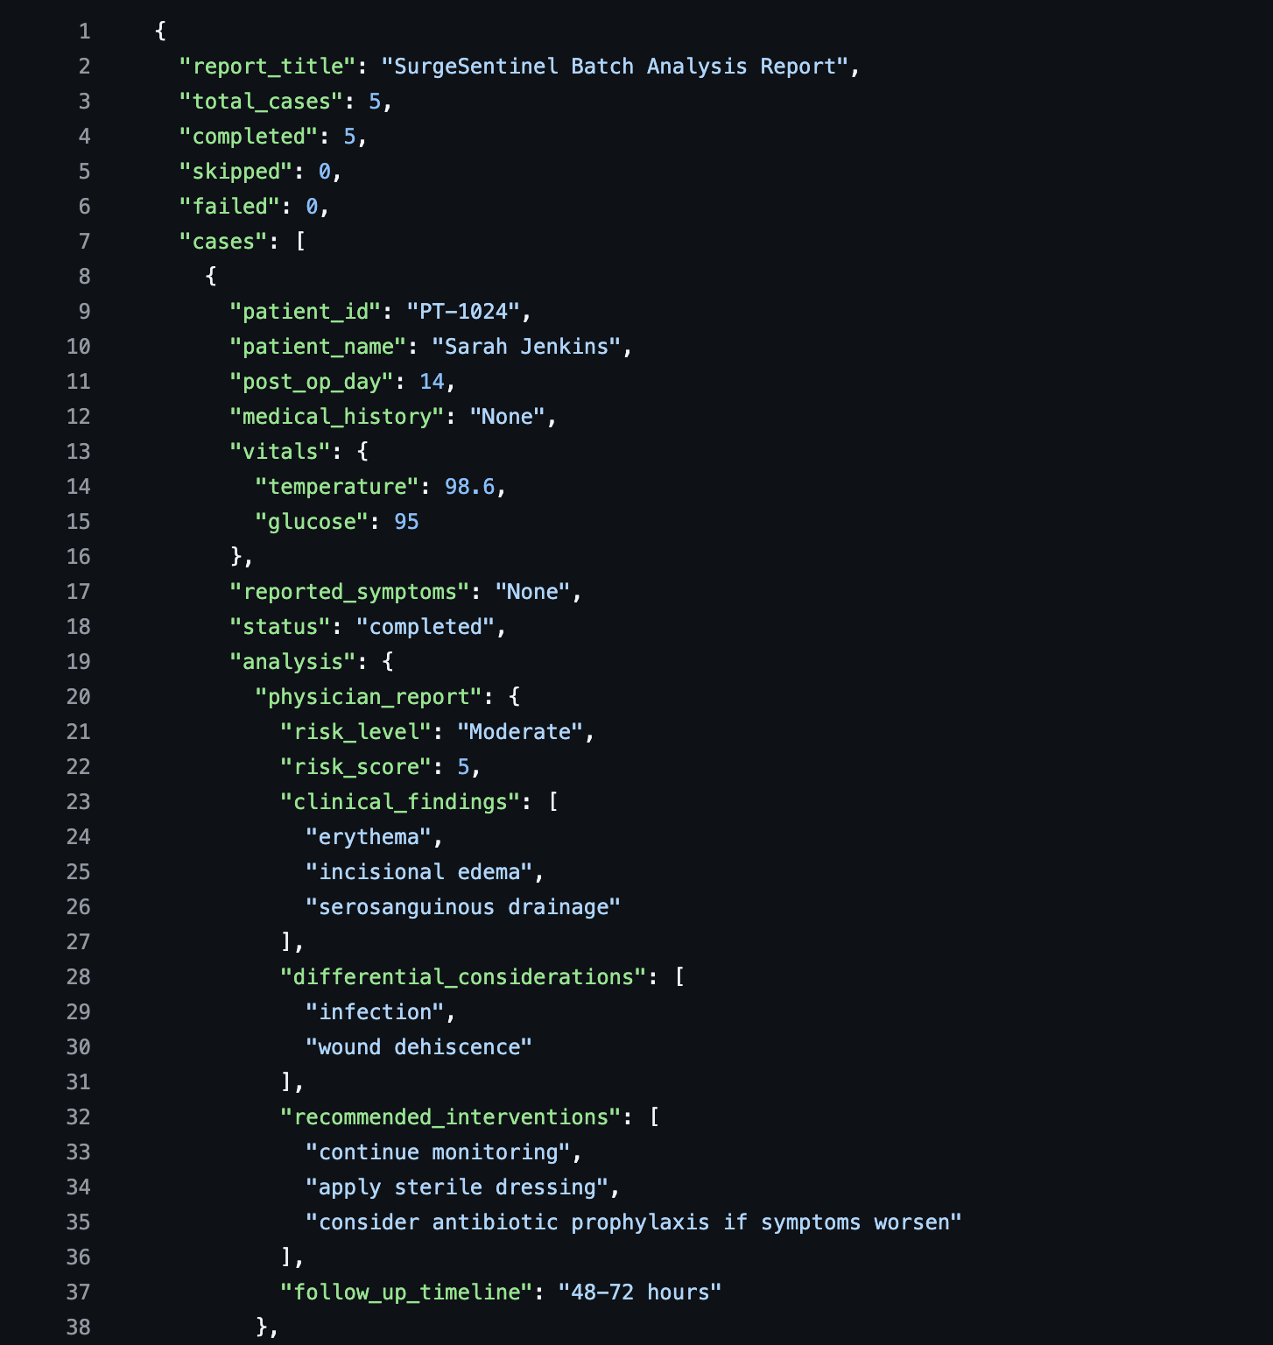
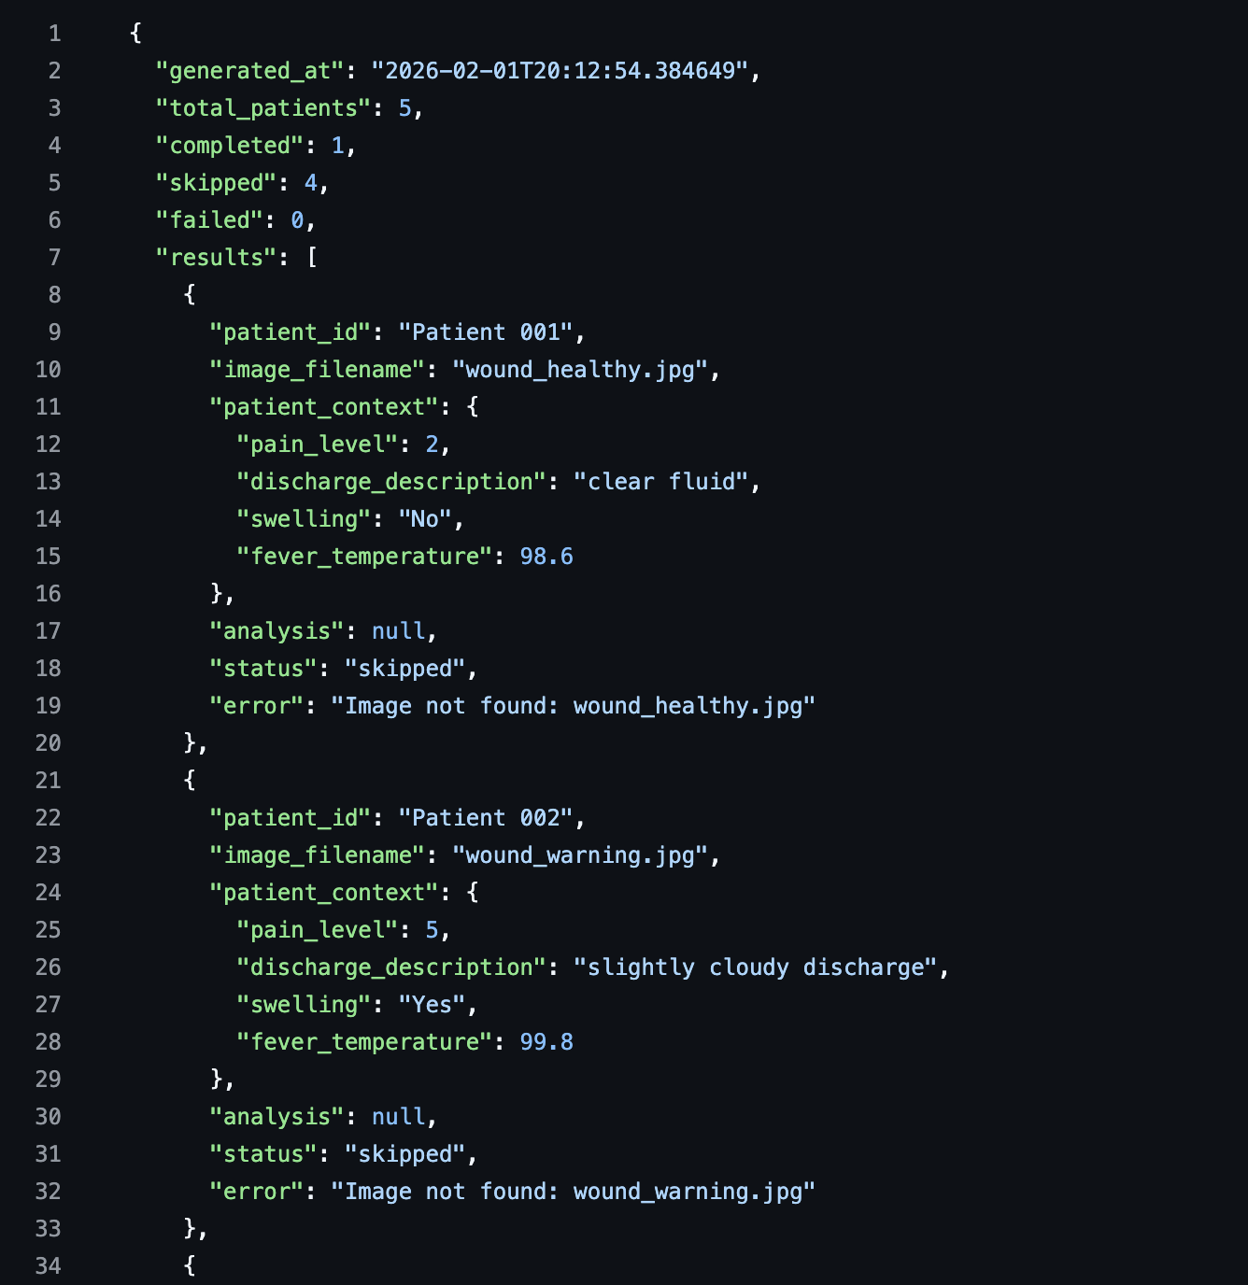
Code Implementation
INPUT: PATIENT PROFILES
OUTPUT: EHR & PATIENT FEEDBACK
7

Slide 9
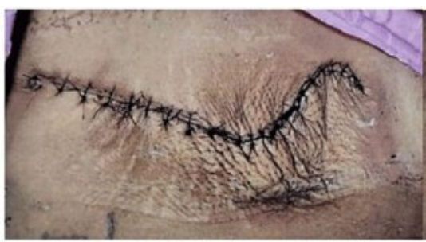
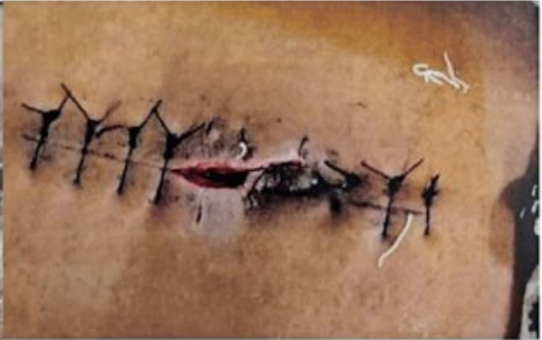
Sample Input Images
CATEGORIZATION: HEALTHY
CATEGORIZATION: SEVERE
7

Slide 10
MAIN INTELLECTUAL PROPERTY COMPONENTS
INTELLECTUAL
PROPERTY
01
02
03
Risk-Weighted Scoring Algorithm
CNN Wound Analysis Model
Asynchronous Clinical Workflow
SURGESENTINEL
Novel method combining patient risk factors (BMI, GDM, HTN, surgery duration)
Real-time wound imaging > generates personalized infection risk score
Patentable process
Trained architecture quantifying erythema, edema & wound approximation from consumer images
Calibrated across multi-ethnic skin tones
Protectable through a patent.
Novel digital triage process that synchronizes longitudinal data with electronic health records
Allows surgeons to asynchronously review and sign off on recoveries
PROTECTION STRATEGIES
LAYER
MECHANISM
WHAT IT COVERS
FDA Class Il Software Medical Device (SaMD)
Target
PRIMARY
Utility Patent
Risk-stratification algorithm & image-to-risk scoring method
SECONDARY
Trade Secret
Model weights, proprietary training dataset, scoring thresholds
SUPPORTING
Copyright
All source code and software
BRAND
Trademark
"SurgeSentinel" name and logo
IP STRENGTH + COMPETITION ANALYSIS
Obstetric-specific RPM - no known direct AI competitor in post-C-section wound monitoring
Multi-ethnic training dataset
8

Slide 11
Product Development Strategy
TECHNICAL FEASIBILITY
TECHNICAL RISKS
RISK MITIGATION
CNN prototype trained and tested
Dual patient/physician interface built
Batch JSON analysis pipeline generating structured clinical reports demonstrated
Model generalizability across skin tones
Consumer image quality variability
EHR integration complexity
Multi-ethnic data set sourced from diverse OB centers (built into training phase)
In-app lighting guidance and image quality gating
FHIR R4 Standard API design from day one
MANUFACTURING & DELIVERY
FUNDING REQUIRED
Cloud SaaS, iOS/Android app, HIPAA-compliant infrastructure, FHIR/EHR layer. No physical manufacturing necessary.
$1,500,000 Funding Stage
Algorithm refinement, clinical pilot, FDA pre-submission package, engineering team
SIMPLIFIED TIMELINE · GANTT CHART
Algorithm Dev
Q1 Y1
Q3 Y1
Q1 Y2
Q3 Y2
Q1 Y3
Pilot Study
FDA Submission
Commercial Launch
9

Slide 12
The Market — Size, Growth & Customer
TAM
SAM
SOM
Total Addressable Market
Serviceable Addressable Market
Serviceable Obtainable Market
$4.5 B
$820 M
$45 M
Global surgical site infection management & RPM market (Grand View Research, 2024)
U.S. hospital-based RPM for obstetric patients within Medicaid-covered systems
Initial 3-year target: rural hospital systems in 10 states + academic OB programs
TARGET CUSTOMER & KEY MARKET TRENDS
MARKET GROWTH RATE - Surgical Site Infection Control
Primary Customer: Hospital system procurement/OB department heads/Telehealth platform integrators
Trend #1: Surgical site infection management & RPM market growing at 8.73% CAGR (2024-2033)
Trend #2: CMS expanding RPM reimbursement codes - 2025 & 2026 rule updates lower billing thresholds and add new CPT codes
Trend #3: 5.5+ million women in counties with no or limited maternity care access, driving demand for remote obstetric monitoring
8.73% CAGR
Grand View Research, 2024–2033
BARRIERS TO ENTRY
FDA clearance timeline, clinical validation requirements, EHR integration complexity, multi-ethnic dataset sourcing
10
Notes:
https://www.grandviewresearch.com/industry-analysis/surgical-site-infection-control-market-report
https://www.marketsandmarkets.com/Market-Reports/remote-patient-monitoring-market-77155492.html

Slide 13
The Market — Competitive Landscape
COMPETITIVE MATRIX · KEY DIFFERENTIATORS
Company / Solution
Wound AI
OB-Specific
Rural Access
EHR Integration
Risk Stratification
SurgeSentinel ★
✓
✓
✓
✓
✓
EKare
✓
✗
✗
✓
✗
Mayo Clinic AI Tool
✓
✗
Partial
✗
✗
Vohra Wound Care
Partial
✗
✗
✓
Partial
Current Standard: Manual Wound Checks
✗
✗
✗
✗
✗
HOW WE DIFFERENTIATE
PROTECTION AGAINST 2ND-GEN PRODUCTS
Only end-to-end solution designed for the OB surgical pathway
Personalized risk model incorporating prenatal clinical history (GDM, BMI, HTN, surgery duration) not just generic scoring
Asynchronous surgeon workflow built for rural care where travel is the barrier
Utility patent on core algorithm filed prior to public disclosure
Multi-ethnic proprietary dataset requires years + clinical partnerships to replicate
FDA SaMD clearance + EHR integrations create durable switching costs
11

Slide 14
Pathway to Market
REGULATORY PATHWAY
REIMBURSEMENT STRATEGY
FDA Class II SaMD - 510(k) preferred; De Novo if no predicate found
Predicate: eKare inSight or Mayo Clinic SSI AI model
Required data: Algorithm sensitivity/specificity, skin-tone bias analysis, prospective clinical validation
Status: FDA Pre-Submission (Q-Sub) meeting recommended before submission
Risk: Novel OB-specific AI may lack predicate → Mitigation: De Novo + multi-site evidence package with Predetermined Change Control Plan (PCCP)
CPT codes: 99453 (~$22), 99454 (~$47), 99457 (~$52), 99458 (add-on)
Coverage: Medicare Part B (80%); NY Medicaid covers 99453 & 99454 (HD modifier) for maternity RPM
Likelihood: Moderate-High - existing RPM codes applicable; OB-specific Medicaid precedent established
Risk: Payer reluctance for novel AI → Mitigation: Health-economic dossier (~$3.3B annual SSI burden)
BUSINESS MODEL
PROPOSED CLINICAL STUDIES
Primary: SaaS subscription (per monitored patient/month)
Revenue streams: Per-use clinical consultation fees; de-identified dataset licensing
GTM: Direct to rural hospital systems & Medicaid ACOs → expand via RPM platforms & academic OB programs
Pilot (Study 1): N = 50-75, single academic OB site; endpoint: algorithm sensitivity vs. physical exam at 7 & 14 days post-C-section
Pivotal (Study 2): N = 300+, 3-5 sites; endpoints: SSI detection rate, time-to-diagnosis, 30-day readmission
Timeline: 12 months enrollment + 6 months follow-up
Sites: 1 urban academic OB center + 2 rural community hospitals
PI: OB/Gyn or MFM physician (TBD, rural health affiliation preferred)
12

Slide 15




Management Team
Anjali Katta
Sarah Satani
[ Photo ]
Chief Executive Officer
Chief Operations Officer
Biomedical Engineering M.Eng student with clinical experience as a nurse assistant and research in neural engineering, including AI-driven tools for autonomic pain assessment.
Health Administration graduate student with hands-on experience in global health operations at Cleveland Clinic and a course she designed on AI integration in healthcare administration.
Yashvi Gupta
Srinjoy Chatterjee
[ Photo ]
Chief Medical Officer
Chief Technology Officer
Biomedical Engineering M.Eng student with clinical tool-building experience spanning injectable delivery systems and AI-driven medical waste management platforms.
BME M.S. graduate with systems engineering expertise applied to medical technology, including an AI-powered application for ICU bed management.
ADVISORS · BOARD MEMBERS
Dr. Daulat Reshamwalla
Dr. Newton De Faria
Dr. Nick Fabrizio
OB/GYN | Evergreen Surgery
Director of Biomedical Engineering | Cornell
Retired Health System Executive/Consultant
Contributed firsthand obstetric and surgical expertise to ground SurgeSentinel's clinical design in real-world C-section care, shaping wound assessment protocols and informing the clinical validation strategy.
Contributed two decades of industrial leadership and biomedical expertise to guide SurgeSentinel’s clinical strategy and regulatory pathway as the project transitions from a technical prototype toward clinical validation and future market integration.
Contributed decades of health system leadership to guide SurgeSentinel's go-to-market approach, reimbursement strategy, and pathway toward adoption within hospital networks and Medicaid ecosystems.
13

Slide 16
Key Takeaways
01
Up to 15% of C-sections face complications, the world's most frequent major surgery.
02
AI surveillance during the 14-day post-op window closes the dangerous "black box" period during recovery.
03
$45 million market addressing the need to reduce costly hospital readmissions and travel burdens for patients in rural maternity deserts.
04
Strong IP: proprietary risk-weighted algorithms and multi-ethnic datasets deliver non-biased, personalized diagnostic triage.
CONTACT
Anjali Katta
[ak2839@cornell.edu]
Automates triage via EHR integration, reducing clinical over-utilization while flagging high-risk anomalies.
425-698-9544
05
SurgeSentinel | Cornell University

Slide 17
References
Berg, S. (2025, May 16). What doctors wish patients knew about getting a cesarean section. American Medical Association. https://www.ama-assn.org/public-health/population-health/what-doctors-wish-patients-knew-about-getting-cesarean-section#:~:text=%E2%80%9CNearly%201.2%20million%20women%20have,C%2Dsection%20may%20be%20needed
Zuarez-Easton, S., Zafran, N., Garmi, G., & Salim, R. (2017). Postcesarean wound infection: prevalence, impact, prevention, and management challenges. International journal of women's health, 9, 81–88. https://doi.org/10.2147/IJWH.S98876
Shambhu, S. (2024, December). Criteria for placental examination for obstetrical and neonatal providers - American Journal of Obstetrics & Gynecology. JOINT COMMISSIONTM. https://www.ajog.org/article/S0002-9378(22)02295-5/fulltext
“[Insert compelling quote from a clinician, patient advocate, or potential customer who validated the solution concept during discovery interviews.]”
— [Name, Role]

