Slide 1


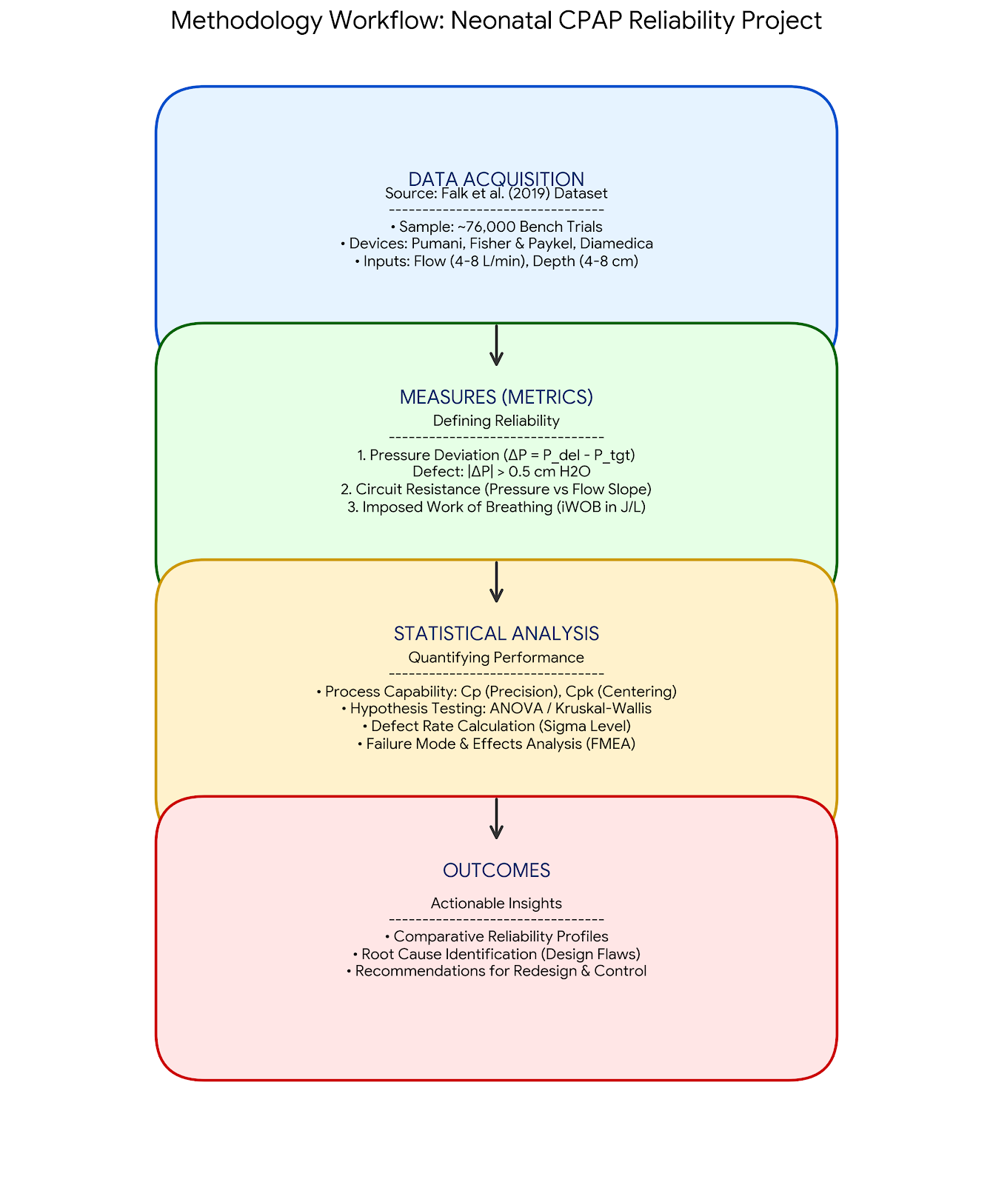
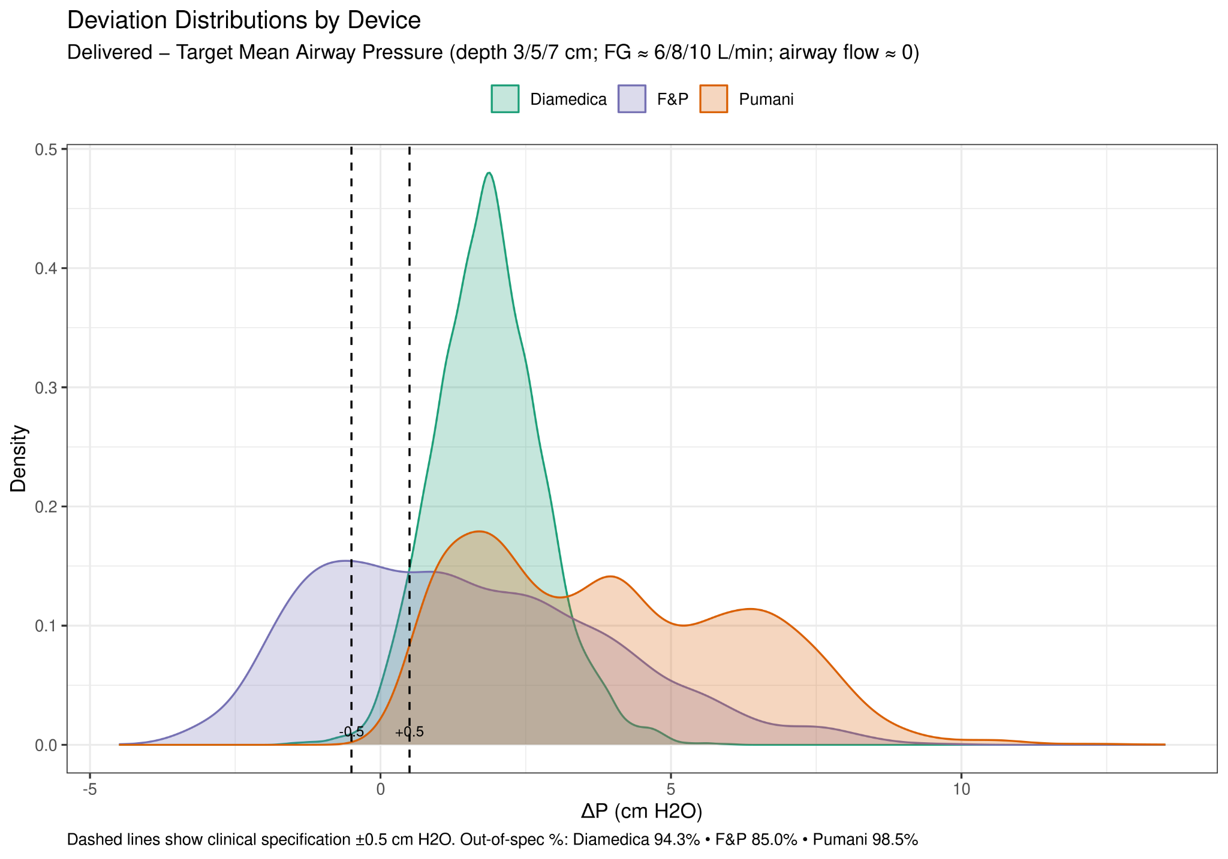
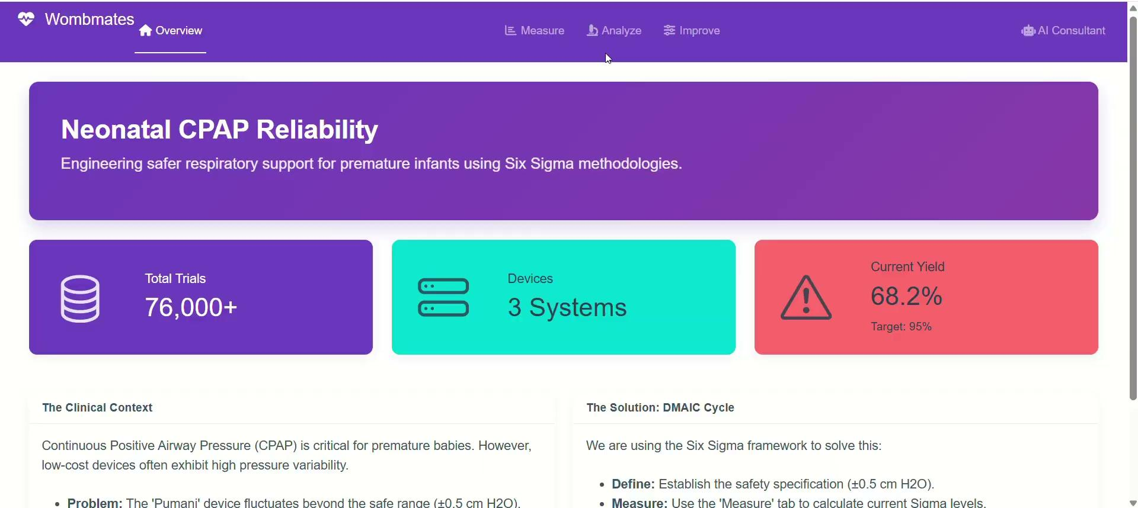
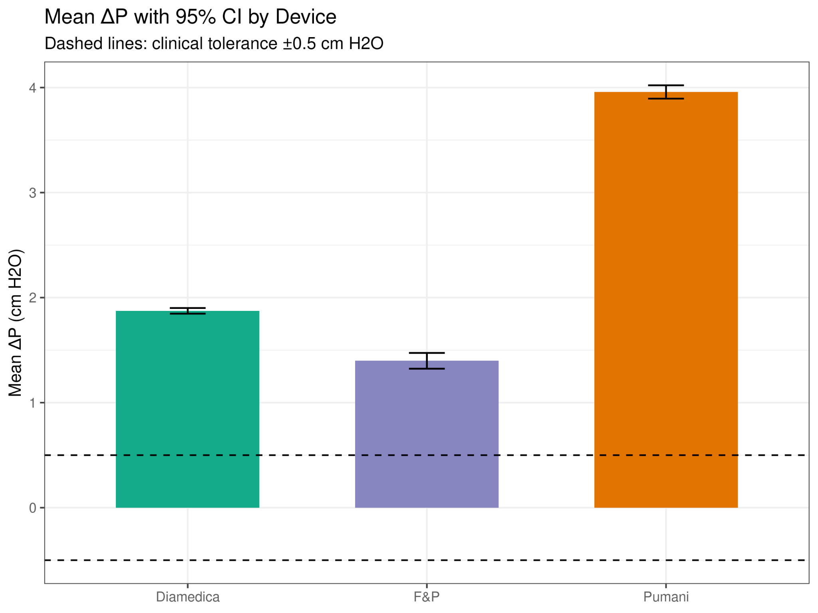
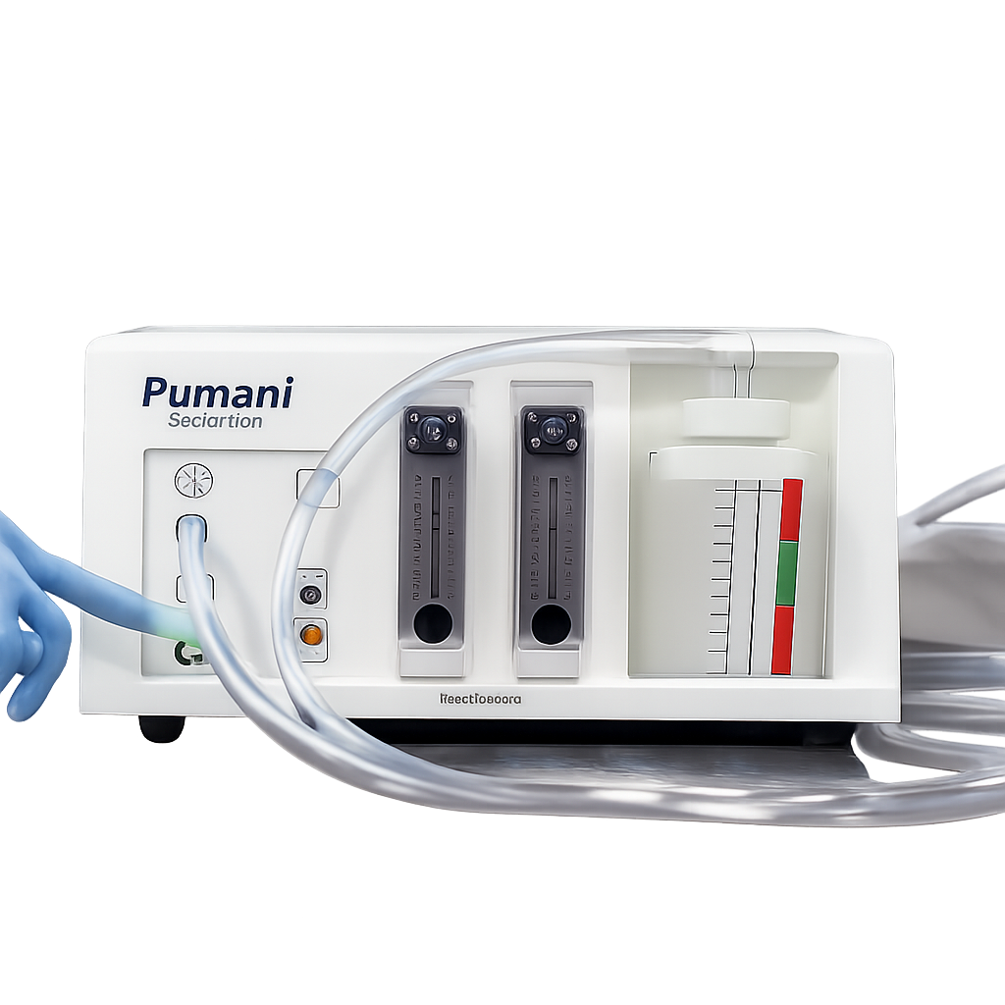
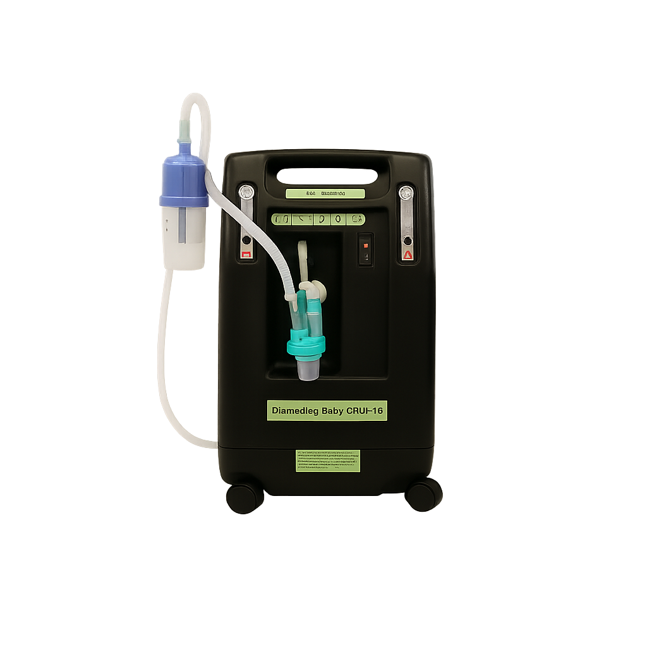
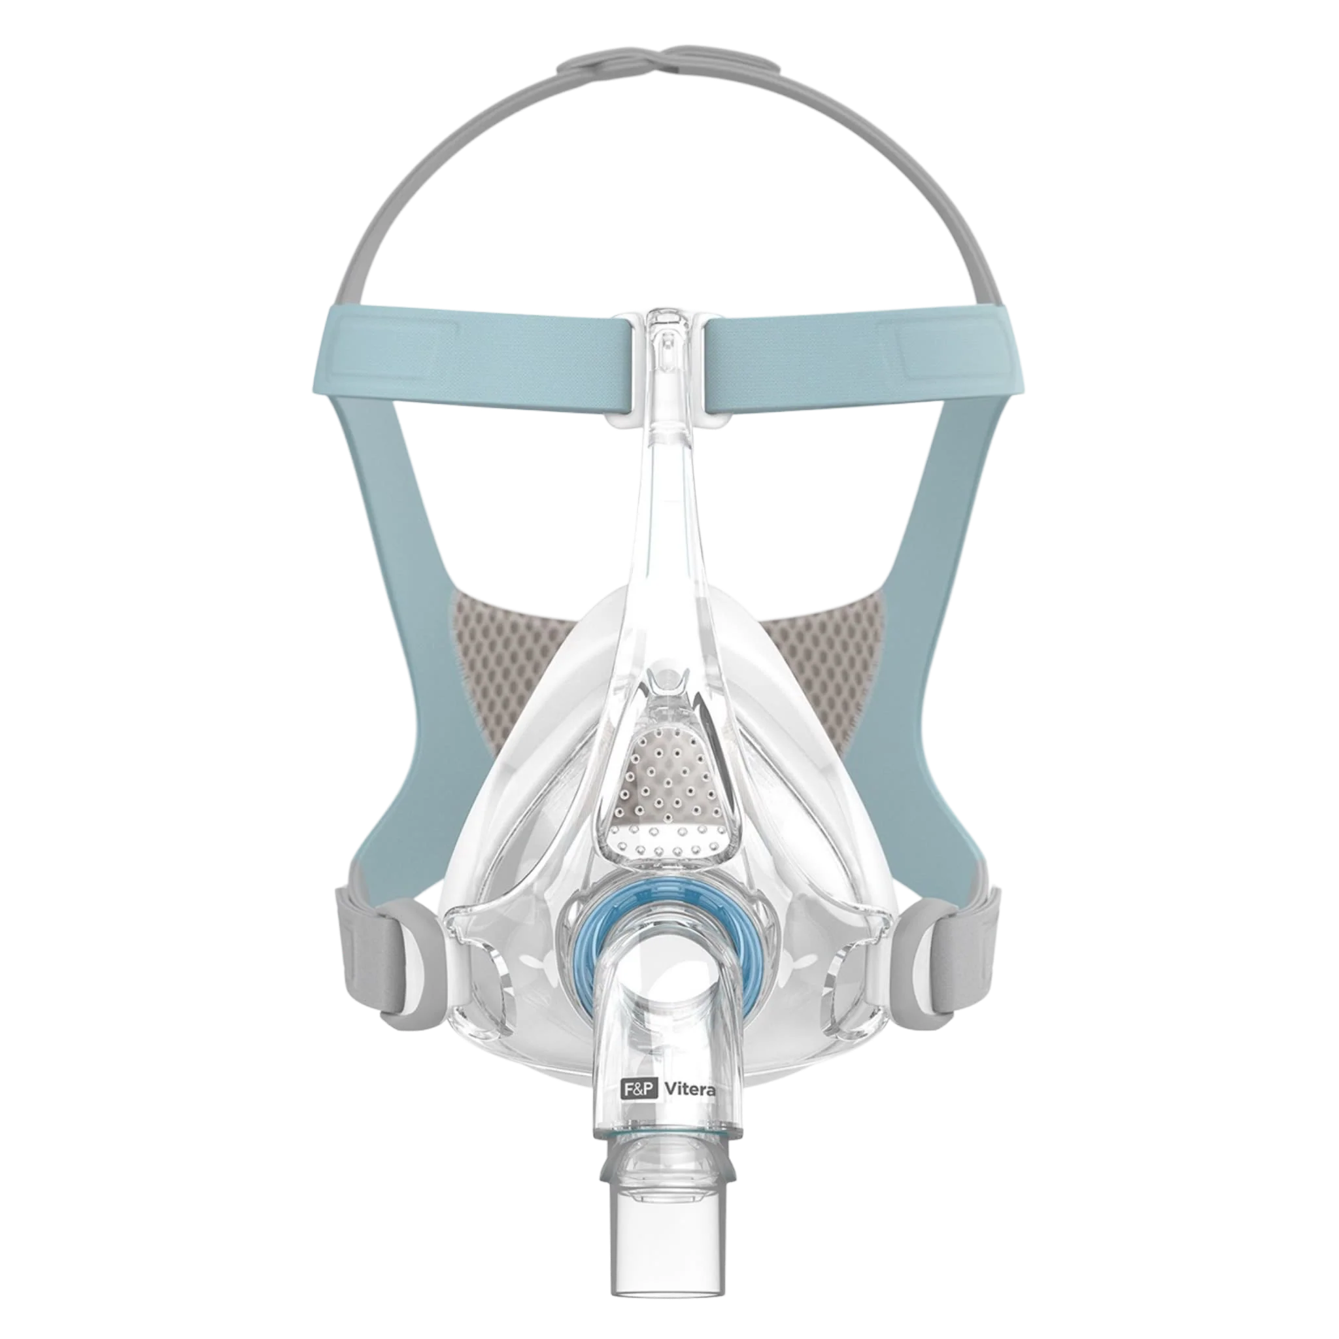
Research Question:
Is there a significant difference in process capability among the Pumani, Fisher & Paykel, and Diamedica CPAP systems in maintaining airway pressure within ±0.5 cm H₂O of the clinical target?
Background:
Unstable airway pressure in non-invasive CPAP systems increases the risk of treatment failure for neonates
Pressure Pumani to Fisher & Paykel and Diamedica water depth or flow rate during continuous use
Inconsistent performance leads to higher hospital costs, greater staff workload, and more patient complications
Ongoing reliability issues could reduce clinician and funder confidence in Pumani, limiting adoption in low-resource settings
Comparing Pumani to Fisher & Paykel and Diamedica CPAP systems is essential for identifying performance gaps and guiding targeted improvements
Use bench-test data and DMAIC analysis to identify improvements that enhance neonatal respiratory safety in low-resource settings
Platform: Built “Wombmates,” an R Shiny Six Sigma dashboard to identify reliability gaps in neonatal life-support devices
Insight: Found elevated circuit resistance as the root cause of pressure instability, reducing process yield to 68%
Impact: Developed a predictive simulator showing that targeted hardware fixes can restore performance to >95%
Low-cost CPAP with higher pressure variability
Designed for low-resource hospitals
Gold-standard system
Known for stable & precise airway pressure delivery
Durable, reliable bubble CPAP
Widely used in global health settings
Improving Reliability of Neonatal CPAP Devices
SYSEN 5300 - Systems Engineering and Six Sigma | Cornell University, College of Engineering | Fall 2025
Srinjoy Chatterjee sc2827@cornell | Yashvi Gupta yg678@cornell | Shreya Dandwate sd2284@cornell| Daniella Ameh daa245@cornell
Introduction
Methods
Results
1
3
2
4
Dashboard
Figure 4. Delivered Pressure Deviation (ΔP) Distributions by Device
Diamedica stays closest to ± 0.5 cm H₂O, Fisher & Paykel shows moderate spread, Pumani is wide and right-shifted, indicating frequent over-pressurization
Objectives
Acknowledgements
Dr. Kaminsky’s surgical practice is predominantly focused on oncologic reconstructions, utilizing techniques such as elliptical excisions and Mohs repairs to treat skin malignancies like basal cell carcinoma. Beyond cancer care, a significant portion of his caseload involves complex wound closures and specialized nerve procedures, such as Targeted Muscle Reinnervation (TMR).
Figure 1. Pumani Bubble CPAP
Figure 2. Fisher & Paykel Bubble CPAP
Figure 3. Diamedica Bubble CPAP
Figure 5. Mean ΔP by Device with 95% CI
Diamedica stays closest to target, Fisher & Paykel shows moderate deviation, Pumani exhibits the highest mean over-pressurization beyond the ±0.5 cm H₂O limit

