Slide 1
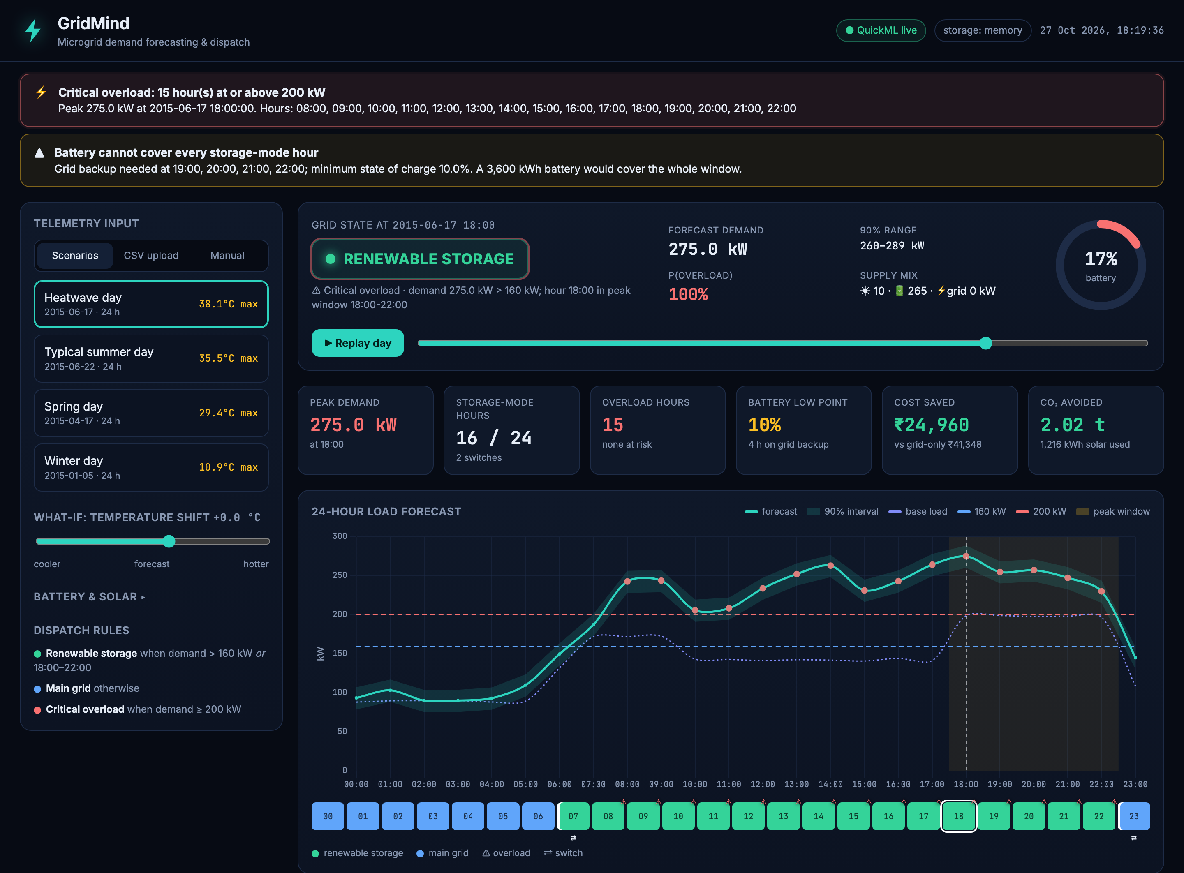
HACKSPHERE 3.0 · ZOHO CATALYST
GridMind
Smart Energy Microgrid & Demand Forecasting
Forecasts the next 24 hours of demand with Catalyst QuickML, switches between the main grid and battery storage, and warns before an overload.
RMSE
R²
APPSAIL
8.7 kW
0.97
LIVE
⚡ GridMind · HackSphere 3.0 · Zoho Catalyst
01 / 06

Slide 2
PROBLEM STATEMENT
Every hour, a microgrid must pick its power source
Forecast
Switch
Alert
Predict hourly demand (kW) for the next 24 h from temperature, humidity and solar irradiance telemetry.
Use renewable battery storage when demand > 160 kW or during the 18:00–22:00 peak; otherwise the main grid.
Raise a critical overload alert for any hour forecast at or above 200 kW.
WHY IT'S HARD
92 → 215
+8–11
−0.94
45.9 kW
kW, night vs evening peak
kW per °C above 24 °C
humidity ↔ temperature r
starter baseline RMSE
⚡ GridMind · HackSphere 3.0 · Zoho Catalyst
02 / 06

Slide 3
SOLUTION ARCHITECTURE
QuickML predicts, AppSail runs the rest
ZOHO CATALYST
OAuth + endpoint key
Inputs
AppSail · Flask
QuickML
Controller
Battery sim
Browser: CSV, form, scenario
predict.py evaluator
Clean & validate
feature builder (11 features)
Linear Regression endpoint
+ SHAP explainer
Grid ↔ storage rules
overload alerts
SoC, sizing advisor
₹ cost, CO₂
Dashboard + /api/predict served from the same AppSail app — no separate Slate host, no cross-origin auth
Secrets stay server-side
Train/serve parity
Honest degradation
OAuth refresh token + endpoint key live in AppSail env vars, never in the repo. Evaluators need no credentials.
One feature module builds the QuickML training CSV and every live request. Live endpoint within 0.83 kW of reference.
Dashboard falls back to a local mirror model and says so; /api/predict returns 502 instead of faking QuickML.
⚡ GridMind · HackSphere 3.0 · Zoho Catalyst
03 / 06

Slide 4
MODEL PERFORMANCE
Physics-informed features beat every tree model
RMSE
ROLLING-ORIGIN CV · RMSE kW ON UNSEEN FUTURE HOURS · LOWER IS BETTER
8.7 kW
GridMind linear
8.96
QuickML test split
Tuned boosting (raw)
9.93
R²
0.97
Gradient boosting
10.23
QuickML test split
Random forest
11.45
MAE
Default boosting (raw)
13.55
6.9 kW
Starter baseline
45.94
QuickML test split
Why linear wins: hourly base-load profile + cooling degrees above 24 °C split by time of day. Linear terms extrapolate into hotter test days; trees flatten out. 80% lower error than the starter baseline.
⚡ GridMind · HackSphere 3.0 · Zoho Catalyst
04 / 06

Slide 5
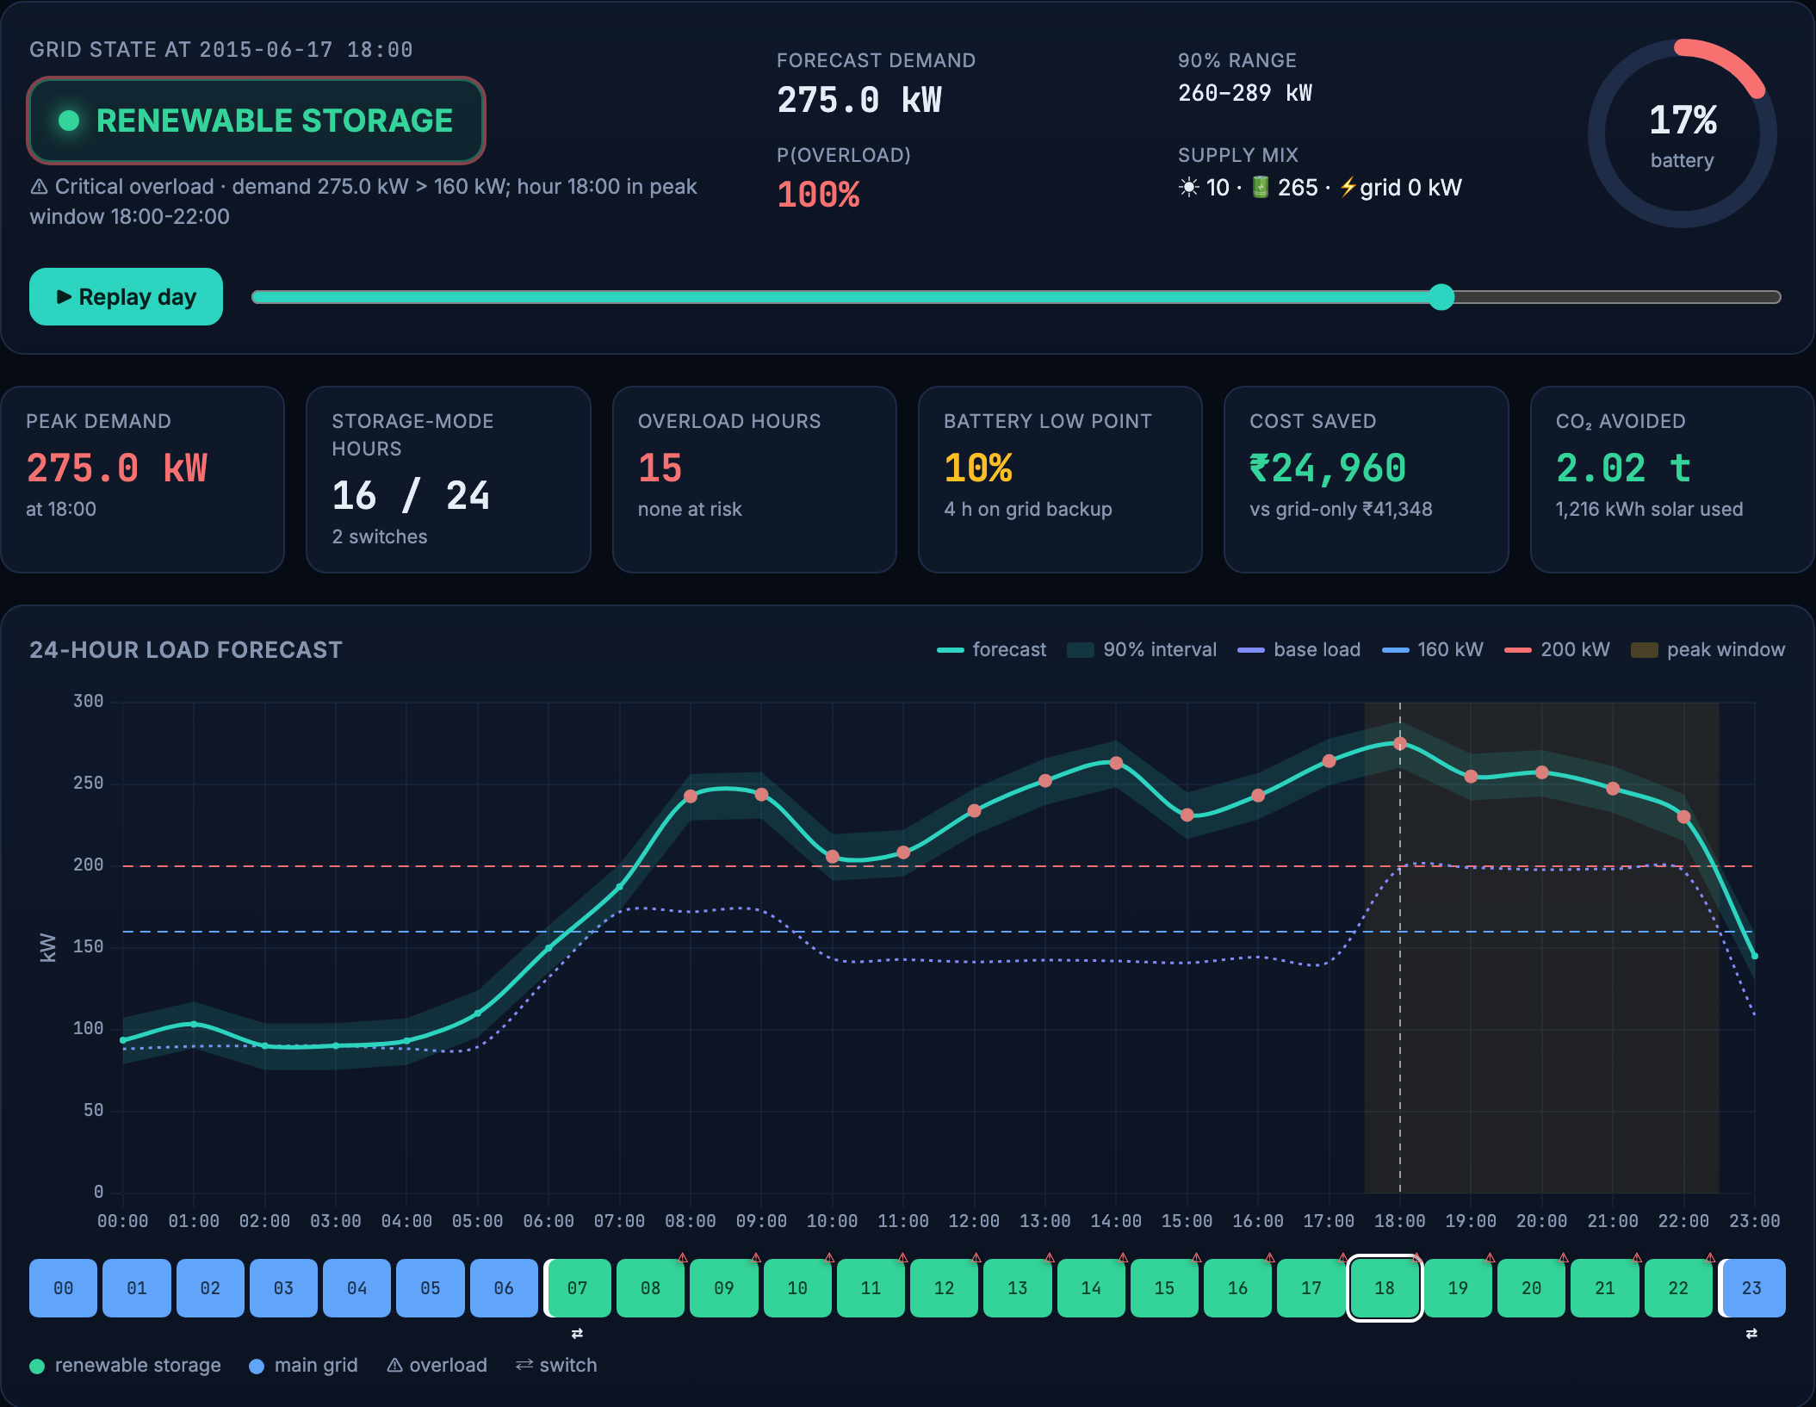
LIVE DASHBOARD
From a forecast to an operating plan, in one screen
Battery SoC & sizing advisor
Hour-by-hour state of charge with solar charging; finds the smallest battery that covers every storage hour.
What-if temperature slider
Shift temperature −8 to +6 °C and watch load, alerts and the battery plan re-plan live.
Cost savings in ₹
Time-of-day tariffs vs running on the grid all day — ₹24,960 saved on the heatwave scenario.
CO₂ avoided
2.02 t avoided on the heatwave day from 1,216 kWh of solar.
Explainable + uncertain
QuickML SHAP attributions per hour, 90% intervals and P(overload).
⚡ GridMind · HackSphere 3.0 · Zoho Catalyst
05 / 06

Slide 6
RESULTS
Deployed, verified, and ready to try
TEST_EVAL.PY
RMSE VS BASELINE
LIVE PARITY
OVERLOADS FLAGGED
SUCCESS
−80%
0.83 kW
15 h
1,000 predictions via QuickML
45.9 → 8.96 kW on future data
QuickML vs reference model
heatwave scenario, 275 kW peak
● TRY IT LIVE
gridmind-50047185567.development.catalystappsail.in
POST /api/predict · prediction API used by predict.py
GitHub github.com/yashviharia/GridMind
Pick “Heatwave day”, drag the what-if slider, click any hour for its explanation.
⚡ GridMind · HackSphere 3.0 · Zoho Catalyst
06 / 06

