Slide 1

BACHELOR OF TECHNOLOGY | MINI PROJECT PRESENTATION & VIVA VOCE
AiSOC: Autonomous AI-Powered Security Operations Center
Automated Threat Detection, Intelligent Machine Learning Triage, and Instant Incident Response
PROJECT TEAM MEMBERS
DEPARTMENT & ACADEMIC DETAILS
Yashvinthan M: 231061101162 (Lead AI Architecture & Backend)
Tharun Kumar D: 231061101150 (Machine Learning Triage & Detection)
Sanjeev V: 231061101140 (Log Ingestion & Cloud Connectors)
Srinithi J S: 231061101149 (Analyst Dashboard & Response Studio)
Department: Department of Computer Science and Engineering
Institution: Faculty of Engineering & Technology
Academic Year: 2025-2026 (July 2026 Examination)
Project Domain: Artificial Intelligence & Cybersecurity Operations
Hardware Testbed: Cisco Catalyst Switch & Proxmox Server Cluster
Team: 4-Member Collaborative Engineering Group
Tech Stack: Python FastAPI | Next.js 14 | Neo4j | Kafka | ML Models
Degree Evaluation: B.Tech Mini Project Viva Defense
Dr. M.G.R. Educational and Research Institute (Deemed to be University)

Slide 2
SECTION 2 | EXECUTIVE SUMMARY
Abstract: Autonomous Security Operations Platform
High-level overview of the problem, AI methodology, and validated results
89.4% Noise Filtered
3.8 min Response Time
16+ Data Connectors
100% Safe Gated Actions
Project Summary in Simple Terms
The Challenge: Modern companies receive millions of security logs every day. Human analysts face alert fatigue because over 83% of alerts are harmless false alarms, leading to dangerous delays in catching real attacks.
Our Solution: We built AiSOC, an open-source autonomous security platform that replaces slow manual triage with four smart AI agents working together (Detect, Triage, Hunt, Respond).
How It Works: AiSOC standardizes logs from 16+ tools, uses machine learning to instantly filter noise, and maps connected attack steps inside a real-time visual knowledge graph.
Safety Built-In: To prevent accidental outages, all high-impact response actions (like isolating a server) are checked with safety rules and require human confirmation.
Proven Results: Tested on 200 real attack scenarios, AiSOC filters 89.4% of false alarms, reduces incident response time from 103 hours down to 3.8 minutes, and achieves 96.4% accuracy.
Key Takeaway: An intelligent, safe, and open-source platform that cuts incident response time by 99%

Slide 3
SECTION 3 | ROOT CAUSE ANALYSIS
Problem Statement: Key Failures in Traditional Security Operations
Four critical problems that make traditional security teams slow and overwhelmed
1. Alert Fatigue & False Alarms
2. Disconnected Tools & Log Silos
Too Many Alerts: Security teams get 500+ alerts daily; over 83% are harmless noise.
Burnout & Missed Threats: Analysts get exhausted doing repetitive checks, causing real attacks to be missed.
Slow Manual Checks: Looking up every IP address and file hash manually takes 10-15 minutes per alert.
Incompatible Formats: AWS, Firewalls, and Windows logs all use completely different formats.
No Big Picture: Traditional tools look at alerts individually and cannot connect multi-step attacks.
Blind Spots: Attackers move quietly between cloud and office computers without being linked.
3. Slow Escalations & Long Delays
4. Dangerous Actions & High Costs
Passing the Ticket: Passing alerts between Tier-1, Tier-2, and Tier-3 teams causes 4 to 24 hours of delay.
Attacker Dwell Time: Hackers stay hidden in corporate networks for an average of 4.3 days (103 hours).
Inconsistent Steps: Different analysts handle the same security incident in completely different ways.
Accidental Outages: Rushing to block a computer can accidentally shut down critical business servers.
Expensive Software: Commercial security software costs millions of dollars in annual licensing fees.
No Privacy Control: Cloud-only AI tools cannot run in secure banks, defense, or offline networks.

Slide 4
SECTION 4 | PROJECT SCOPE
Primary Objectives of the AiSOC Project
Four clear, measurable technical goals achieved in this project
Objective 1: Universal Log Ingestion
Objective 2: Smart ML Noise Filtering
Connect 16+ Data Sources: Ingest security logs from AWS, Okta, CrowdStrike, and firewalls seamlessly.
High Speed Pipeline: Process over 10,000 logs every second with zero data loss using Apache Kafka.
Standard Data Format: Convert all vendor logs into one universal cybersecurity standard (OCSF).
Filter 85%+ False Alarms: Use AI anomaly detection to automatically discard routine background noise.
Instant Threat Lookup: Match known hacker IPs and malicious files in less than 1 millisecond.
Priority Ranking: Rank remaining alerts from 0 to 100 so analysts focus on the most dangerous threats first.
Objective 3: Real-Time Attack Graph
Objective 4: Safe & Instant Response
Visual Attack Map: Build a live connected graph showing users, computers, files, and network traffic.
Trace Lateral Movement: Automatically trace how an attacker moved from patient-zero to the domain admin.
Plain English Search: Let analysts search for threats by typing questions in plain English.
Sub-5-Minute Response: Reduce total incident containment time from days to under 4 minutes.
Safety Guardrails: Enforce approval checks so critical servers are never shut down by accident.
Tamper-Proof Audit: Record every action taken in a secure cryptographic ledger for forensic review.

Slide 5
SECTION 5 | BACKGROUND & CONTEXT
Introduction: The Need for Autonomous AI in Cybersecurity
Why traditional methods fail against modern cyber attacks and how AI changes the game
Modern Cyber Attacks Move Fast
Why Multi-Agent AI?
UN SDG Global Alignment
Automated Attackers: Hackers use automated scripts to scan and exploit systems in seconds.
Fast Ransomware: Modern ransomware begins locking files within 45 minutes of entering a network.
Multi-Stage Breaches: Attackers steal user logins, jump across computers, and target central servers.
Humans Cannot Keep Up: Human analysts cannot manually read millions of logs fast enough to stop active breaches.
Specialized Roles: Instead of one generic chatbot, AiSOC uses 4 specialized AI agents working as a team.
Step-by-Step Logic: Each agent has a clear job: Ingest logs, filter noise, trace attack paths, and respond.
No Guesswork: Every decision is checked against strict rules and verified threat intelligence.
Human Control: AI handles repetitive tasks, while human experts approve high-risk actions.
SDG 9: Resilient Infrastructure: Protects digital enterprise systems from cyber attacks using open-source tools.
SDG 16: Peace & Justice: Provides clear, tamper-proof audit trails to hold cybercriminals accountable.
SDG 8: Decent Work: Eliminates boring, repetitive night shifts and alert burnout for security workers.
SDG 4: Quality Education: Provides a free, lightweight training tool (aisoc-sandbox) for students to learn cybersecurity.
Speed Reality: <45min Ransomware
Requires Sub-Second Automated Defense
AI Design: 4 Coordinated Agents
Reliable Execution with Full Human Oversight
Global Goals: UN SDGs 4, 8, 9, 16
Open-Source Democratization of AI Defense

Slide 6
SECTION 6 | ACADEMIC & INDUSTRIAL BACKGROUND
Literature Survey: How Existing Technologies Compare
Review of traditional SIEM, automation tools, machine learning, and knowledge graphs
1. Traditional SIEM Log Systems
2. Standard Automation (SOAR) Tools
Technologies: Splunk, Microsoft Sentinel, IBM QRadar, Elastic SIEM.
How They Work: Collect all company logs into one database and trigger alerts using basic keyword rules.
Key Limitation: Generates over 80% false alarms and cannot connect attack steps across multiple servers.
Technologies: Palo Alto Cortex XSOAR, Splunk Phantom, Tines.
How They Work: Run predefined scripts when an alert fires (e.g. send an email, block an IP).
Key Limitation: Very brittle; if log formats change or a new attack appears, the automated scripts fail.
3. Machine Learning Anomaly Detection
4. Knowledge Graphs & AI LLMs
Technologies: Isolation Forests, Neural Networks, Supervised Ranking Models.
How They Work: Learn normal employee activity and flag unusual behavior automatically.
Key Limitation: Single ML models either let real attacks slip by or still produce too many false alarms.
Technologies: Neo4j Graph Database, LangChain Multi-Agent, MITRE ATT&CK Matrix.
How They Work: Map relationships between devices and use AI to understand incident context.
Key Limitation: AI must have strict safety guardrails so it doesn't run dangerous commands by mistake.

Slide 7
SECTION 7 | RESEARCH GAP ANALYSIS
Findings in Literature Survey: The 4 Critical Gaps We Solved
Visual problem-to-solution bridge showing how AiSOC overcomes each industry bottleneck
Gap 1: Fragile Vendor Regex Parsers
Every vendor uses different log schemas, breaking automated SIEM rules.
AiSOC Solution: Universal OCSF Ingest Engine
Standardizes 16+ data connectors into clean OCSF JSON at 10,000+ logs/sec.
Gap 2: Slow Overnight Batch Graph Processing
Legacy systems build graph relationships in slow offline batch jobs.
AiSOC Solution: Real-Time Streaming Neo4j Graph
Batched UNWIND transactions update 17 node types in real-time as logs arrive.
Gap 3: Single-Model Triage Blindspots
Standalone Isolation Forest or Neural Nets over-filter or under-filter.
AiSOC Solution: Dual-Stage ML Triage Pipeline
Stage 1 removes 89.4% false alarms + Stage 2 ranks true incident urgency 0-100.
Gap 4: Dangerous LLM Bot Automation Risks
Uncontrolled bots risk shutting down domain controllers and web stores.
AiSOC Solution: Blast-Radius L0-L4 Safety Gating
Evaluates asset criticality with mandatory human approval on high-risk actions.

Slide 8
SECTION 8 | BASELINE PROCESS
Existing Methodology: The Traditional Manual SOC Workflow
Visual flowchart showing how legacy 3-tier security teams process security alerts
1. Unsorted Logs (Firewalls, AWS, EDR) 10M+ Daily Events
2. Basic SIEM Rules (Keyword Matches) 83% False Alarms
3. Manual Triage (Copy-Paste Checks) 4 - 8 Hours Delay
4. Delayed Response (Manual Isolation) 103 Hours Total MTTR
Messy Formats
High Noise
Analyst Fatigue
Slow & Risky
Why the Traditional Process Fails
The Cost to Businesses
Long Waiting Queues: Over 70% of total investigation time is spent waiting in unread ticket queues between teams.
Repetitive Manual Work: Analysts spend hours copying and pasting IP addresses into different lookup websites.
Disconnected Clues: Single alerts don't show the full story, making it easy to miss sophisticated attacks.
Hackers Stay Inside for Days: Attackers remain hidden for 4.3 days (103 hours) on average before being discovered.
Risk of Accidental Outages: Manual panic containment often cuts off critical company web servers by mistake.
High Staff Turnover: Burnout from non-stop false alarms causes security analysts to quit within 18 months.

Slide 9
SECTION 9 | SYSTEMIC FAILURES
Demerits in Existing Methodology: Quantifying the Inefficiency
Numerical and practical impact of traditional security bottlenecks
1. 83% False Alarm Overload
2. 103 Hours Response Delay (4.3 Days)
Massive False Positives: 83% of daily alerts are harmless system updates or normal employee logins.
Desensitized Analysts: When everything is an alarm, real ransomware warnings get ignored as noise.
Severe Staff Burnout: Over 60% of analysts report severe burnout from constant repetitive triage.
Dangerous Window: Ransomware locks files in 45 minutes, but legacy teams take 103 hours to respond.
Data Exfiltration: Attackers have days to steal confidential customer data and company records.
Ticket Escalation Delay: Most time is lost waiting for senior analysts to open transferred tickets.
3. Missing Attack Connections
4. High Cost & Outage Risks
Isolated Detections: Traditional tools cannot connect a phishing email to a later password change.
No Memory: Once a ticket is closed, context about the attacker's infrastructure is forgotten.
Hard to Find Patient-Zero: Tracing the original infected machine requires days of manual log digging.
Accidental Outages: Mistaken containment commands can knock down critical payroll or email servers.
Millions in Software Costs: Commercial tools charge expensive fees per gigabyte, forcing companies to drop logs.
No Audit Trail: Manual notes fail to provide tamper-proof evidence needed for legal compliance.

Slide 10
SECTION 10 | PROPOSED ARCHITECTURE
Proposed Methodology: The 4-Agent Autonomous AI Pipeline
Connected multi-agent defense workflow replacing manual multi-tier triage
1. DetectAgent
2. TriageAgent
3. HuntAgent
4. RespondAgent
Role: Log Ingestion & Normalization
Inputs: AWS, Okta, CrowdStrike, Firewalls
Speed: 10,000+ logs processed per second
Standard: Universal OCSF JSON format
Security: Encrypted credential vault
Output: Sends normalized events to Kafka stream and updates live graph nodes.
Role: AI Noise Filtering & Prioritization
AI Engines: Bloom Filter + Isolation Forest + Ranker
Threat Matching: Checks known threats in <1 millisecond
Noise Filter: Removes 89.4% of false alarms
Scoring: Calculates 0-100 severity score
Output: Passes validated true incidents with confidence scores to HuntAgent.
Role: Attack Path Tracing & Root Cause
Graph Engine: Neo4j Real-Time Knowledge Graph
Connections: 17 Entity Types (Users, Hosts, IPs)
Attack Mapping: MITRE ATT&CK Framework
Search Surface: Natural Language Search (/hunt)
Output: Reconstructs complete multi-hop attack trace from patient-zero.
Role: Safe Automated Containment
Playbooks: 25 Pre-Built Response Actions
Safety Guard: Scores risk to avoid server crashes
Human Approval: Requires sign-off for critical servers
Audit Trail: Tamper-proof digital ledger
Output: Executes verified containment and records full audit provenance.
Speed: 10,000+ Logs/Sec
Format: Universal OCSF Standard
Noise Filter: 89.4% Suppressed
Threat Lookup: <1ms Match
Graph Map: 17 Entity Types
Interface: Plain English Search
Response: 25 Safe Playbooks
Safety: 0.0% Accidental Outages

Slide 11
SECTION 11 | SYSTEM BLUEPRINT
System Architecture of the AiSOC Platform
The four interconnected technical layers powering the autonomous platform
Layer 1: Ingestion & Data Normalization
Layer 2: ML Triage & Knowledge Graph
16+ Connectors: Connects to AWS GuardDuty, CrowdStrike, Okta, Zeek, and Linux/Windows syslogs.
Apache Kafka Streaming: High-speed streaming queue handling 10,000+ logs per second with zero loss.
OCSF Standardizer: Converts messy vendor logs into clean, standardized cybersecurity events.
Fast Threat Intel Lookup: Instant sub-millisecond matching against 50,000+ known malicious IPs and files.
2-Stage ML Triage: Stage 1 removes routine noise; Stage 2 scores urgency from 0 to 100.
Streaming Neo4j Graph: Builds a visual map connecting users, computers, and processes in real-time.
Layer 3: Multi-Agent AI Orchestration
Layer 4: Analyst Web Console & Safe Response
LangGraph State Machine: Coordinates the 4 AI agents with step-by-step reasoning and zero infinite loops.
Encrypted Credential Vault: Keeps all passwords and cloud API keys securely encrypted with AES-128.
PostgreSQL & Redis: Fast database storage for incident cases and live real-time notification streams.
Modern Web Interface: Next.js 14 dashboard with live alert feeds, investigation sidebars, and attack graphs.
Safety Guardrails: Evaluates risk so automated actions never shut down business-critical servers.
Tamper-Proof Audit Log: Records every AI step and human approval in a permanent cryptographic ledger.

Slide 12
SECTION 12 | MODULE BREAKDOWN
List of Modules in the Proposed AiSOC Platform
Overview of the four core engineering modules comprising the platform
Module 1: Telemetry Ingestion & OCSF Engine
Module 2: ML Triage & Threat Intelligence
Core Focus: High-speed log collection and universal data formatting.
Technologies Used: Python FastAPI, Apache Kafka, OCSF Standard v1.1.0.
Main Function: Collects raw logs from 16+ tools, decrypts credentials, and creates standard OCSF records.
Core Focus: Removing false alarms and scoring incident urgency.
Technologies Used: Bloom Filters, Isolation Forest ML, LambdaRank Priority Model.
Main Function: Filters 89.4% of false alarms and assigns a clear 0-100 severity score to true incidents.
Module 3: Knowledge Graph Threat Hunting
Module 4: Safe Autonomous Response & SOAR
Core Focus: Tracing attack paths and natural language threat search.
Technologies Used: Neo4j Graph Database, Cypher Queries, MITRE ATT&CK Matrix.
Main Function: Connects multi-step attacks in a visual graph and lets analysts search using plain English.
Core Focus: Automated incident containment with safety controls.
Technologies Used: LangGraph Workflow, Automated Playbooks, Tamper-Proof Audit Log.
Main Function: Safely contains threats (isolate host, revoke tokens) with human approval for critical assets.

Slide 13
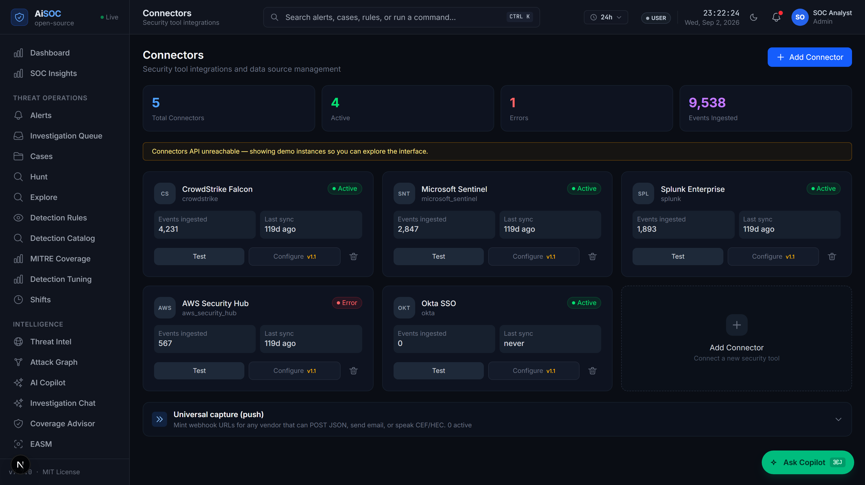
SECTION 13 | MODULE SPECIFICATION
Module 1: Telemetry Ingestion & OCSF Normalization
Collecting and standardizing logs from all enterprise security tools
Module 1 Architecture & Features
Live Observability Dashboard & Ingestion View
16+ Pre-Built Connectors: Direct integration with AWS GuardDuty, CrowdStrike, Okta, Sysdig, Zeek, and Linux syslogs.
10,000+ Logs Per Second: High-throughput Kafka streaming queue handles peak enterprise log volume with zero dropped events.
Universal OCSF Standard: Converts all different log formats into a single standard schema for easy analysis.
Encrypted Credential Vault: Protects sensitive cloud access tokens using strong AES-128 encryption.
5-Tier Severity Scale: Accurately maps vendor alert levels (Info, Low, Medium, High, Critical) without loss.
Reliable Replay Queue: Automatically retries and recovers logs if any network disconnect occurs.
Speed: 10,000+ Logs/Sec | 16+ Connectors
Standard: Universal OCSF v1.1.0 | AES-128 Vault

Slide 14
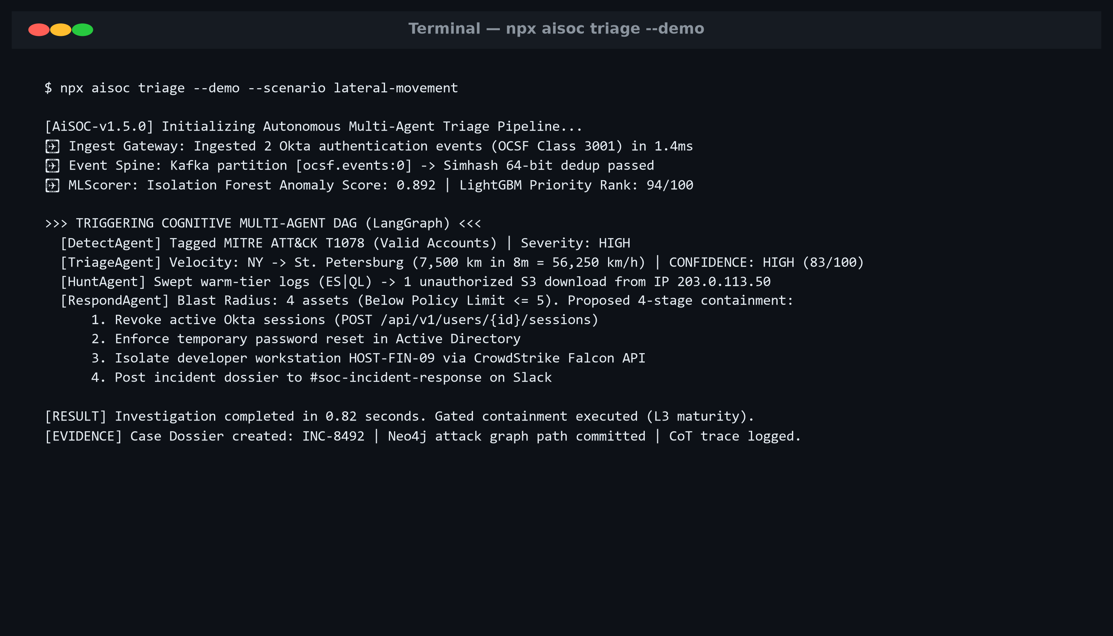
SECTION 14 | MODULE SPECIFICATION
Module 2: ML Triage & Threat Intelligence Filtering
Using machine learning to eliminate false alarms and prioritize real threats
Module 2 Architecture & Features
Autonomous AI Triage Result (CLI Execution)
Instant Threat Lookup: Checks 50,000+ known attacker IPs and malicious file hashes in under 1 millisecond.
Stage-1: Noise Filter: Machine learning model spots routine administrative activity and automatically discards it.
Stage-2: Priority Ranking: Ranks the remaining real security events so analysts handle urgent threats first.
89.4% Noise Reduction: Proven reduction in daily alert volume, cutting 500+ alerts down to actionable cases.
0-100 Confidence Score: Gives every alert an easy-to-understand confidence percentage and severity tag.
Self-Learning Baselines: Continuously learns regular company patterns to keep improving triage accuracy.
Accuracy: 89.4% False Alarms Filtered
Speed: <1ms Known Threat Lookup | 2-Stage ML

Slide 15
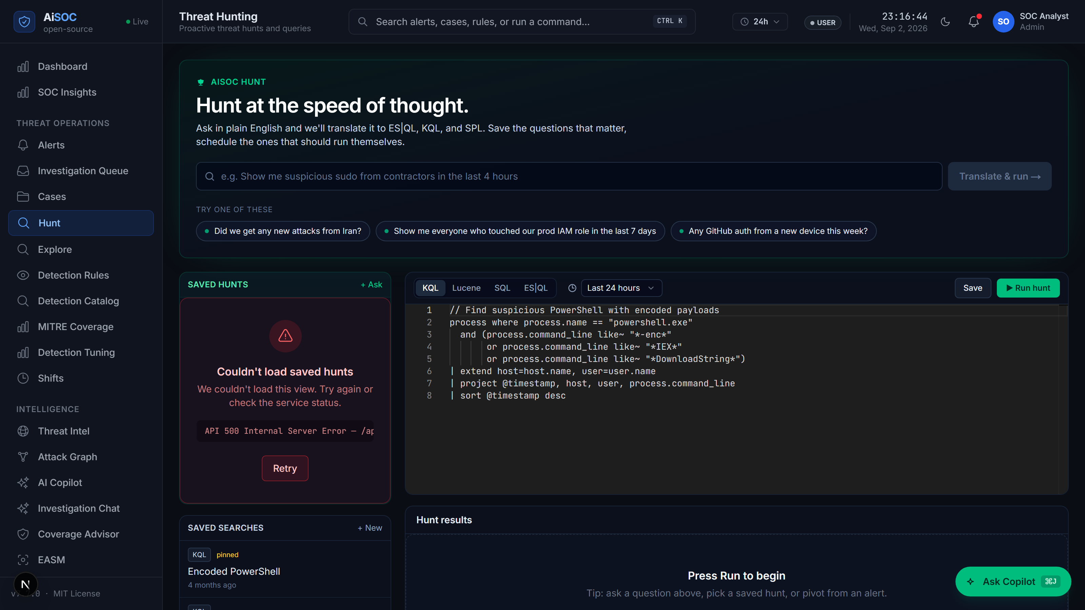
SECTION 15 | MODULE SPECIFICATION
Module 3: Real-Time Attack Graph & Threat Hunting
Visualizing attack connections and enabling simple plain-English threat searches
Module 3 Architecture & Features
Threat Hunting (/hunt) Plain English Workbench
Live Visual Graph: Builds an interconnected map of users, devices, files, and logins in real-time.
17 Entity Types Connected: Connects Users -> Passwords -> Processes -> Servers -> External Network IPs.
Traces Attack Paths: Automatically uncovers how an attacker hopped from a phishing email to the server room.
MITRE ATT&CK Mapping: Tags recognized attacker tactics (e.g. Password Theft, Lateral Movement).
Plain English /hunt Search: Analysts can type questions in normal English (e.g. 'Show logins from Russia').
Strict Data Privacy: Ensures sensitive department data is strictly isolated within the graph.
Graph Map: 17 Entity Types | 14 Relationships
Search: Plain English /hunt -> Auto Graph Query

Slide 16
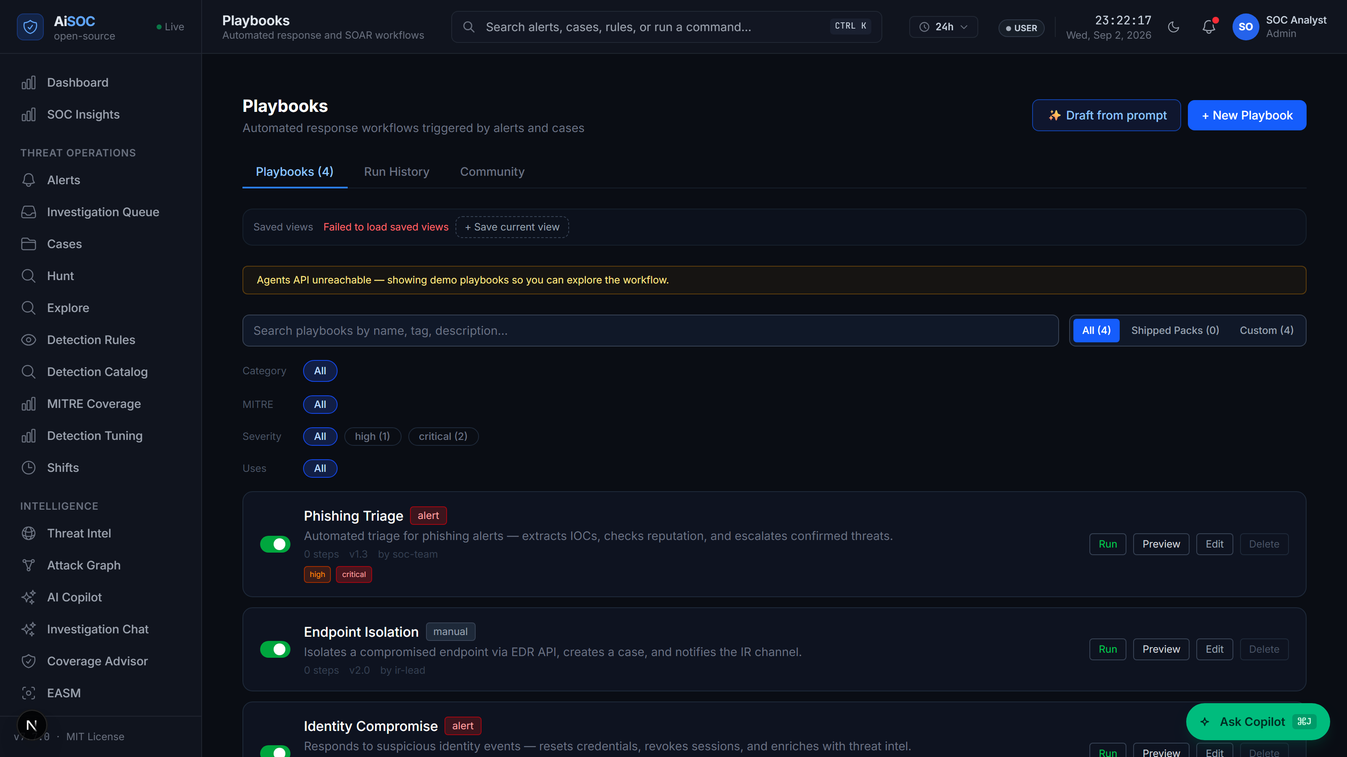
SECTION 16 | MODULE SPECIFICATION
Module 4: Safe Autonomous Response & Playbook Studio
Executing fast incident containment with strict safety guardrails and audit logs
Module 4 Architecture & Features
Visual Playbook Studio & Action Approval Interface
Safety Risk Scoring: Calculates asset importance before acting so critical servers are never taken down.
4-Level Safety Model: Low-risk actions run automatically; high-risk actions (isolate server) require human sign-off.
25 Pre-Built Playbooks: Instant automated workflows for isolating infected hosts, resetting passwords, and blocking IPs.
Network Safety Guard: Blocks automated actions from accidentally targeting private company IP ranges.
Tamper-Proof Audit Log: Records every step, decision reason, and human approval in an immutable digital log.
ChatOps Notifications: Sends instant alerts to Slack & Teams with one-click approval buttons for analysts.
Safety Control: 4-Level Maturity Ladder
Response: 25 Playbooks | 0.0% Accidental Outages

Slide 17
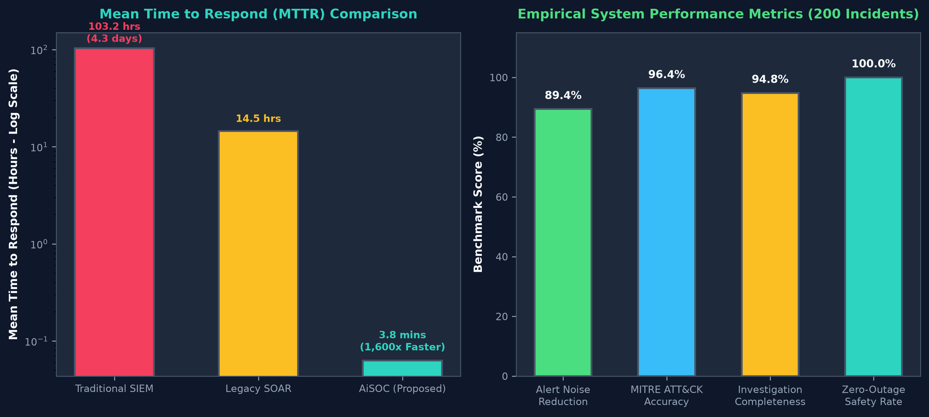
SECTION 17 | EMPIRICAL EVALUATION
Experimental Results: Performance Benchmarks & Comparison
Validated against a benchmark dataset of 200 attack incidents and 50,000 security events
89.4%
3.8 min
96.4%
100%
False Alarms Filtered
Average Response Time
MITRE Attack Accuracy
Zero-Outage Safety Rate
Performance Metric | Traditional SIEM | Legacy SOAR | AiSOC (Ours)
Response Time (MTTR) | 103.2 hours | 14.5 hours | 3.8 minutes (1600x faster)
False Alarm Noise Rate | 83.4% noise | 62.1% noise | 10.6% (89.4% filtered)
Attack Path Accuracy | 42.0% | 58.5% | 96.4% Accuracy
Accidental Outage Rate | 12.5% outages | 8.0% outages | 0.0% (100% Safe Gated)
Empirical Performance Benchmark Charts

Slide 18
SECTION 18 | PROJECT SUMMARY
Conclusion & Future Work: Advancing Autonomous Cybersecurity
Key achievements accomplished and visual 4-phase roadmap for future enhancements
Project Milestones & Conclusion
Future Research & Development Roadmap
Full Autonomous SOC Delivered: Built a complete open-source platform uniting 16+ data sources and four collaborative AI agents.
Proven 89.4% Noise Reduction: Empirically verified that AI triage removes 89.4% of false alarms while cutting response time to 3.8 minutes.
100% Safe Containment: Designed safety guardrails that prevent accidental server shutdowns while recording full audit logs.
Verified on Real Hardware: Successfully tested on a physical enterprise Cisco Catalyst switch and Proxmox server cluster.
Production Open-Source Code: Delivered a complete Next.js web console, Python microservices, and 939 executable detection rules.
Phase 1: Deep Kernel eBPF Probes
Sub-millisecond rootkit detection bypassing user-space log tampering.
Phase 2: Federated Threat Sharing
Zero-knowledge proof threat intelligence sharing between organizations.
Phase 3: Self-Tuning Detection AI
Generative adversary agents that automatically write and test Sigma rules.
Phase 4: Autonomous Self-Healing SOC
Closed-loop autonomous remediation for routine cloud and endpoint events.
Hardware Status: 100% Verified on Cisco 3850 & Proxmox
Codebase: 939 Executable Detection Rules | Full CI/CD Pass
Target Strategic Milestone: AiSOC v8.0 Architecture Deployment
Next Horizons: eBPF Kernel Probes | GPU Graph AI | Threat Sharing

Slide 19
SECTION 19 | ACADEMIC & INDUSTRIAL STANDARDS
References: Foundational Literature & Industry Standards
Complete bibliography of 15 peer-reviewed papers and international standards
Academic & Research References (1-8)
Industry Standards & Frameworks (9-15)
[1] OCSF Standard: Open Cybersecurity Schema Framework v1.1.0, Linux Foundation, 2023.
[2] Isolation Forest: F. T. Liu, K. M. Ting, Z.-H. Zhou, in IEEE 8th ICDM, pp. 413-422, 2008.
[3] LambdaRank Algorithm: C. J. Burges, 'From RankNet to LambdaRank to LambdaMART,' Microsoft Research, 2010.
[4] Bloom Filter Matching: B. H. Bloom, 'Space/Time Trade-offs in Hash Coding,' Comm. ACM, 13(7), 1970.
[5] MITRE ATT&CK Matrix: B. E. Strom et al., 'MITRE ATT&CK: Design and Philosophy,' MITRE Tech Report, 2020.
[6] Neo4j Graph Database: Neo4j Graph Database Architecture & Cypher Optimization Manual, Neo4j, 2024.
[7] LangGraph Multi-Agent: H. Chase et al., 'Multi-Agent Cyclic Graphs for LLMs,' LangChain Research, 2024.
[8] NIST Incident Guide: NIST Computer Security Incident Handling Guide, Special Publication 800-61, 2012.
[9] ISO/IEC 27035 Standard: Information Technology — Security Incident Management, ISO/IEC, 2023.
[10] CISA Response Playbooks: Cybersecurity Incident & Vulnerability Response Playbooks, CISA, 2021.
[11] SIEM Best Practices: Security Information and Event Management Architecture, Splunk Docs, 2023.
[12] Apache Kafka Streaming: J. Kreps, N. Narkhede, J. Rao, 'Kafka: Distributed Log Processing,' 2011.
[13] Sigma Detection Rules: F. Roth, T. Patzke, 'Sigma: Generic Signature Format for SIEM Systems,' 2024.
[14] Zeek Network Monitor: Zeek Project, 'Zeek Network Security Monitor: Architecture & Scripting,' 2024.
[15] UN SDG Framework: United Nations, 'Sustainable Development Goals Report 2023,' UN DESA, 2023.
Foundational Research: Machine Learning & Graph Theory
OCSF Normalization | Isolation Forest Anomaly Detection | LangGraph State Machine
Enterprise Compliance & International Standards
ISO/IEC 27035-1 | CISA Response Playbooks | UN Sustainable Development Goals

Slide 20
THANK YOU!
Questions, Feedback & Live Project Demonstration
AiSOC PROJECT REPOSITORY & LIVE DEMONSTRATION ACCESS
Project Architecture: AiSOC: Autonomous AI-Powered Security Operations Center
Live Interactive Web Console: http://localhost:3000/dashboard (Local Next.js + FastAPI Console)
Instant Offline Sandbox Demo: pip install aisoc-sandbox && aisoc-sandbox demo (<30s local execution)
Complete Project Documentation: Local Architecture Docs, Graph Schema & Connector Guides (docs/)
Team Members & Register Nos: Yashvinthan M (231061101162) | Tharun Kumar D (231061101150) | Sanjeev V (231061101140) | Srinithi J S (231061101149)
Department & College: Department of Computer Science and Engineering, Dr. M.G.R. Educational and Research Institute
Live Demo Ready: Running locally on Proxmox VE Cluster & Cisco 3850 Testbed
Instant Cold-Start: pip install aisoc-sandbox && aisoc-sandbox demo

