Slide 1

BACHELOR OF TECHNOLOGY | MINI PROJECT PRESENTATION & VIVA VOCE
AiSOC: Autonomous AI-Powered Security Operations Center
Multi-Agent Security Orchestration, OCSF Telemetry Normalization, Dual-Stage ML Triage, and Graph-Driven Incident Response
PROJECT TEAM MEMBERS
DEPARTMENT & ACADEMIC DETAILS
Yashvinthan M: 231061101162 (Lead AI & Backend Architecture)
Tharun Kumar D: 231061101150 (ML Triage & Detection Engineering)
Sanjeev V: 231061101140 (OCSF Ingestion & Cloud Connectors)
Srinithi J S: 231061101149 (Analyst Workbench & Playbook Studio)
Department: Department of Computer Science and Engineering
Institution: Faculty of Engineering & Technology
Academic Year: 2025-2026 (July 2026 Examination)
Project Domain: Autonomous AI, Cybersecurity & Multi-Agent Systems
Verification Testbed: Enterprise Cisco Catalyst 3850 & Proxmox VE Cluster

Slide 2
SECTION 2 | EXECUTIVE SUMMARY
Abstract: Autonomous Security Operations Platform
High-level overview of methodology, architectural breakthroughs, and empirical validation
89.4% Noise Reduction
3.8m MTTR (1,600x Faster)
16+ OCSF Connectors
100% Safe Gated Actions
Project Abstract & Scope
Context & Motivation: Enterprise Security Operations Centers (SOCs) face an existential scalability crisis, ingesting tens of millions of daily security logs while grappling with 83% false-positive noise and a severe global workforce shortage exceeding 4.0 million professionals.
Proposed Innovation: This project designs, implements, and evaluates AiSOC, an open-source, full-lifecycle autonomous platform that replaces fragmented manual tier-1/tier-2 triage with a collaborative four-agent funnel (DetectAgent, TriageAgent, HuntAgent, RespondAgent).
Standardization & ML: Raw telemetry across 16+ vendor sources is normalized in real-time into the Open Cybersecurity Schema Framework (OCSF) and processed via an in-memory Bloom filter and dual-stage machine learning engine (Isolation Forest anomaly filtering + LambdaRank priority ranking).
Graph Correlation & Safety: Attacks are correlated in real-time within a streaming Neo4j knowledge graph (17 node types, 14 edge relationships) and mitigated via parameterised SOAR playbooks governed by a strict Blast-Radius L0-L4 safety gating model.
Empirical Results: Benchmarked across 200 enterprise incidents and 50,000 telemetry events, AiSOC achieves 89.4% noise reduction, reduces MTTR from 103 hours to 3.8 minutes (1,600x acceleration), maintains 96.4% MITRE ATT&CK accuracy, and ensures 100% zero-outage safety execution.

Slide 3
SECTION 3 | ROOT CAUSE ANALYSIS
Problem Statement: Key Structural Failures in Modern SOCs
Analyzing critical bottlenecks across data volume, cognitive saturation, and remediation latency
1. Alert Fatigue & Noise Explosion
2. Context Fragmentation & Data Silos
Overwhelming Volume: Tier-1 analysts receive 500+ alerts daily; 83% are benign noise or misconfigurations.
High Miss Rate: Up to 62% of security alerts are closed without thorough investigation due to burnout.
Analyst Desensitization: Repetitive IOC lookups lead to cognitive exhaustion and catastrophic security blindspots.
Incompatible Schemas: Disparate log formats across AWS GuardDuty, CrowdStrike, Okta, and Zeek network logs.
Missing Graph Context: Relational SIEM logs fail to connect multi-hop lateral movement across hosts and cloud roles.
Manual Enrichment Delay: Querying external threat intelligence feeds takes 5-15 minutes per single alert.
3. Escalation Latency & High MTTR
4. Remediation Hazards & Vendor Lock-In
Idle Handoff Latency: Tier-1 to Tier-3 escalation queues introduce 4 to 24 hours of investigation delay.
Critical Dwell Time: Average industry dwell time exceeds 4.3 days (103 hours), enabling massive data exfiltration.
Unrepeatable Playbooks: Human manual execution varies wildly across shifts and analyst experience levels.
Blast-Radius Risks: Manual host isolation risks knocking down business-critical production domain controllers.
Exorbitant Ingest Costs: Commercial SIEMs charge thousands per GB/day, forcing enterprises to discard logs.
Air-Gap Incompatibility: SaaS-only commercial AI tools cannot operate in sovereign, defense, or banking enclaves.

Slide 4
SECTION 4 | PROJECT SCOPE
Primary Objectives of the AiSOC Platform
Concrete, measurable engineering and research goals established for the project
Objective 1: Universal OCSF Ingestion
Objective 2: Dual-Stage ML Triage
Standardized Normalization: Develop 16+ first-party data connectors mapping vendor telemetry into OCSF schema.
High-Throughput Streaming: Build a Kafka streaming ingest pipeline handling 10,000+ events/sec with zero loss.
Encrypted Vault: Implement Fernet AES-128-CBC + HMAC-SHA256 application-level credential encryption.
85%+ Noise Suppression: Deploy Stage-1 Isolation Forest to filter out routine background administrative anomalies.
Priority Ranking: Implement Stage-2 LambdaRank Learning-to-Rank to compute 0-100 incident urgency scores.
O(1) Threat Intel: Integrate in-memory Bloom filter for constant-time sub-millisecond IOC lookup.
Objective 3: Real-Time Graph Threat Hunting
Objective 4: Gated Response & Sovereignty
Streaming Neo4j Ingest: Construct an entity graph with 17 node labels and 14 edge types in real-time.
Multi-Hop Attack Pathing: Automatically reconstruct lateral movement traces from initial ingress to domain escalation.
Natural Language /hunt: Translate analyst plain English hunting queries into validated KQL/Cypher templates.
Blast-Radius Safety Gating: Enforce L0-L4 automation maturity model with human approval gates on high-risk assets.
Sub-5-Minute MTTR: Accelerate end-to-end incident response from days to under 4 minutes.
Air-Gapped Sovereign Readiness: Enable fully offline execution with local Ollama LLMs and zero cloud dependencies.

Slide 5
SECTION 5 | BACKGROUND & CONTEXT
Introduction: The Asymmetric Warfare in Enterprise Cybersecurity
Evolution from legacy manual SOC operations to autonomous multi-agent cyber defense
The Modern Threat Landscape
The Multi-Agent Paradigm Shift
UN SDG Global Alignment
Asymmetric Warfare: Attackers leverage AI-driven automation to scan and exploit vulnerabilities in milliseconds.
Multi-Stage Campaigns: Modern attacks involve sophisticated multi-hop lateral movement across hybrid cloud identity fabrics.
Ransomware Speed: Active ransomware encryption begins within 45 minutes of initial perimeter breach.
Human Capacity Limit: Human analysts cannot manually keep pace with millions of telemetry events per second.
Beyond Single Chatbots: Single-prompt LLMs fail in SOCs due to lack of tool integration, hallucination, and state loss.
Collaborative Multi-Agent DAG: AiSOC uses specialized agents that reason, plan, and verify actions across discrete stages.
LangGraph State Machine: Cyclic graph routing with checkpointing ensures deterministic execution and zero loops.
Transparent Reasoning: Every decision is accompanied by a full chain-of-thought provenance and confidence score.
SDG 9 (Resilient Infra): Protects vital digital enterprise infrastructure and democratizes cyber defense via open-source.
SDG 16 (Peace & Justice): Provides tamper-evident cryptographic audit ledgers to combat cybercrime and ensure accountability.
SDG 8 (Decent Work): Eliminates soul-crushing 24/7 alert fatigue, allowing analysts to perform strategic engineering.
SDG 4 (Quality Education): Provides a lightweight 30-second sandbox (aisoc-sandbox demo) for student training.

Slide 6
SECTION 6 | ACADEMIC & INDUSTRIAL BACKGROUND
Literature Survey: Review of State-of-the-Art Approaches
Critical review of SIEM evolution, SOAR orchestration, and machine learning triage in cybersecurity
1. SIEM & Rule-Based Correlation Engines
2. SOAR Orchestration & Playbook Automation
Foundational Works: Splunk, Elastic SIEM, Microsoft Sentinel, IBM QRadar architectures.
Methodology: Centralized log aggregation with regex-based alert rules and statistical threshold counting.
Academic Consensus: High sensitivity but catastrophic false-positive rate (>80%), with zero intrinsic semantic understanding of attacker intent.
Foundational Works: Palo Alto Cortex XSOAR, Splunk Phantom, Tines automated workflows.
Methodology: Imperative, hardcoded directed acyclic graphs (DAGs) executing scripted API calls on alerts.
Academic Consensus: Extremely brittle; minor upstream API or schema changes break workflows, and systems cannot adapt dynamically to novel attack patterns.
3. Machine Learning in Anomaly Detection
4. Graph Databases & LLM Reasoning in SOCs
Foundational Works: Isolation Forests (Liu et al., 2008), LambdaRank (Burges, 2010), Autoencoders.
Methodology: Unsupervised outlier detection and supervised Learning-to-Rank for alert scoring.
Academic Consensus: Highly effective at noise reduction but requires robust feature engineering and ground-truth contextual enrichment to avoid blind spots.
Foundational Works: Knowledge Graphs in Cyber (Neo4j), LangChain/LangGraph, MITRE ATT&CK.
Methodology: Entity relationship mapping combined with generative AI for natural language triage.
Academic Consensus: Graph correlation provides critical multi-hop context; however, LLM action generation MUST be bounded by deterministic safety guardrails.

Slide 7
SECTION 7 | RESEARCH GAP ANALYSIS
Findings in Literature Survey: The 4 Critical Gaps in Existing Systems
Key technological deficiencies identified across literature that form the motivation for AiSOC
Gap 1: Absence of Universal Normalization
Gap 2: Ingestion-Time Graph Construction Gap
Problem: Every security vendor (AWS, Okta, CrowdStrike, Zeek) emits completely proprietary JSON/syslog schemas.
Literature Deficiency: Existing systems rely on dozens of fragile regex parsers that break continuously.
AiSOC Solution: Native Open Cybersecurity Schema Framework (OCSF v1.1.0) standardization at the ingest layer.
Problem: Traditional graph intrusion detection systems process graphs in slow offline batch jobs.
Literature Deficiency: Fails to provide active analysts with real-time entity pivoting during live lateral movement.
AiSOC Solution: Batched streaming UNWIND queries update Neo4j entity graph (17 nodes, 14 edges) inline with Kafka ingest.
Gap 3: Single-Model Triage Inadequacy
Gap 4: Dangerous LLM Blast-Radius Hazards
Problem: Standalone Isolation Forest or standalone neural networks either over-filter or under-filter alerts.
Literature Deficiency: Lack of a dual-stage architecture combining unsupervised outlier filtering with supervised ranking.
AiSOC Solution: Dual-Stage Pipeline: Isolation Forest (Anomaly Filter) + LambdaRank (Priority Ranking).
Problem: Early LLM security agents directly execute unverified CLI commands, risking accidental infrastructure destruction.
Literature Deficiency: Zero mathematical modeling of asset criticality, user tier, or blast-radius impact.
AiSOC Solution: Blast-Radius Safety Gating (L0-L4 maturity ladder) with immutable cryptographic audit ledger.

Slide 8
SECTION 8 | BASELINE PROCESS
Existing Methodology: Traditional Multi-Tier SOC Workflow
Detailed examination of the legacy manual 3-tier escalation and triage funnel
1. Raw Telemetry Silos (EDR, Syslog, Firewalls) 10M+ Daily Logs
2. Static SIEM Rules (Threshold & Regex) 83% Benign Noise
3. Tier-1 Manual Triage (Copy-Paste IOCs) 4 - 8 Hours Delay
4. Tier-3 Containment (Manual Host Isolation) 103 Hours MTTR
Unnormalized Ingest
High False Positives
Cognitive Fatigue
Outage Risk
Critical Bottlenecks in Baseline Process
Operational & Business Consequences
Extreme Handoff Latency: 70% of total investigation time is spent waiting in unread ticket queues between Tier-1, Tier-2, and Tier-3.
Severe Cognitive Burnout: Analysts execute 50+ repetitive lookups per incident across VirusTotal, AlienVault, and Active Directory.
No Cross-Correlated Context: Single-point detections fail to uncover multi-stage lateral movement across cloud and on-prem assets.
4.3-Day Attacker Dwell Time: Ransomware operators encrypt systems within 45 minutes; 103 hours of delay is fatal.
Accidental Outage Hazards: Manual CLI containment often isolates business-critical domain controllers and web servers.
Unsustainable Staffing Cost: Requires 24/7 human staffing with an average analyst turnover rate under 18 months.

Slide 9
SECTION 9 | SYSTEMIC FAILURES
Demerits in Existing Methodology: Quantifying the Cost of Inefficiency
Numerical and operational impact of legacy SOC bottlenecks on enterprise defense
1. Crippling Alert Fatigue & False Alarms
2. Dangerous Attacker Dwell Time (103 Hours)
83% False Positive Rate: Massive volume of benign operational alerts masks true advanced persistent threats (APTs).
Analyst Desensitization: High cognitive saturation causes analysts to overlook legitimate credential dumping indicators.
High Industry Churn: Average SOC analyst tenure is under 18 months due to chronic exhaustion from manual triage.
4.3 Days Mean Time to Respond: Attackers maintain unhindered network persistence, escalating from patient-zero to Domain Admin.
Rapid Exfiltration Window: Ransomware operators encrypt files in under 45 minutes; 103 hours of delay is fatal.
Idle Queue Latency: 70% of total MTTR is spent waiting in unread ticket queues between SOC tiers.
3. Missing Multi-Hop Graph Visibility
4. Remediation Hazards & Prohibitive Costs
Isolated Point Detections: SIEMs view alerts in isolation; cannot correlate a phishing email with a subsequent PsExec execution.
Lack of Entity Memory: Historical attacker infrastructure is forgotten once an alert ticket is marked closed.
Zero Attack Path Modeling: Analysts must manually reconstruct network paths without automated graph traversal.
Accidental Outage Risk: Manual containment commands frequently isolate core DNS/Active Directory servers.
Commercial Monopolies: Enterprise SIEM licenses cost millions annually while locking users into closed ecosystems.
Compliance Blindspots: Manual ticket logs lack tamper-proof cryptographic audit trails required for legal forensics.

Slide 10
SECTION 10 | PROPOSED ARCHITECTURE
Proposed Methodology: The 4-Agent Autonomous Defense Funnel
Replacing manual triage with an intelligent, collaborative, schema-governed multi-agent pipeline
1. DetectAgent
2. TriageAgent
3. HuntAgent
4. RespondAgent
Stage: Ingest & Schema Normalization
Input: Syslog, GuardDuty, Okta, Zeek, EDR
Standard: OCSF JSON Mapping
Throughput: 10,000+ EPS via Kafka
Role: Transforms heterogeneous raw logs into standardized OCSF classes and triggers real-time graph node upserts.
Stage: Dual-Stage Machine Learning
Engines: Bloom Filter + Isolation Forest + LambdaRank
Noise Filter: Suppresses 89.4% Benign Alarms
Scoring: 0-100 Confidence & Severity Band
Role: Evaluates behavioral anomalies against baselines, checks C2 IOCs in O(1) time, and filters benign noise.
Stage: Graph Traversal & Root Cause
Engine: Neo4j Knowledge Graph & Cypher
Topology: 17 Node Labels, 14 Edge Types
Correlation: MITRE ATT&CK Matrix Mapping
Role: Executes multi-hop graph queries to uncover lateral movement paths, compromised identities, and patient-zero.
Stage: Blast-Radius Gated Response
Safety Model: Blast-Radius L0-L4 Maturity Gating
Playbooks: 25 Parameterised Actions
Auditability: Cryptographic Audit Ledger
Role: Executes verified containment playbooks with automated asset impact calculation and human-in-the-loop approval.

Slide 11
SECTION 11 | SYSTEM BLUEPRINT
System Architecture of Proposed Methodology
End-to-end multi-layer architecture integrating streaming ingest, ML scoring, graph correlation, and web rail
1. Ingestion & OCSF Normalization Fabric
2. ML Triage & Knowledge Graph Fabric
16+ First-Party Connectors: AWS GuardDuty, Okta, CrowdStrike, Zeek, Sysdig, Tines, Syslog.
Distributed Kafka Broker: Partitioned streaming topics sustaining 10,000+ EPS with zero loss.
OCSF Schema Engine: Standardizes raw vendor events into universal cybersecurity classes.
In-Memory Bloom Filter: O(1) constant-time C2 and Threat Intel IOC evaluation (50k IOCs/sec).
Dual-Stage ML Engine: Stage-1 Isolation Forest (Noise Filter) + Stage-2 LambdaRank (Priority).
Neo4j Streaming Graph: Real-time entity graph (17 node labels, 14 edge types) updated via UNWIND.
3. Multi-Agent DAG & Security Fabric
4. Analyst Workbench & Gated Response
LangGraph State Machine: Cyclic multi-agent orchestration with deterministic state checkpointing.
Fernet AES-128 Vault: Application-layer encrypted credential vault (vault:v1:<token>) for BYOK secrets.
PostgreSQL 16 & Redis: Async SQLAlchemy persistence with Redis Pub/Sub real-time event streaming.
Next.js 14 SSR Console: Interactive 2-pane workbench with WebSocket alert queue & Investigation Rail.
Blast-Radius L0-L4 Gating: Evaluates asset criticality before executing 25 parameterised playbooks.
Cryptographic Audit Ledger: Tamper-evident SHA-256 ledger recording every agent action and human sign-off.

Slide 12
SECTION 12 | MODULE BREAKDOWN
List of Modules in Proposed Methodology
The four interconnected technical modules comprising the AiSOC autonomous platform
Module 1: Telemetry Ingestion & OCSF Engine
Module 2: Dual-Stage ML Triage & Threat Intel
Core Focus: High-Throughput Streaming Log Normalization & Schema Standard
Key Technologies: FastAPI, Apache Kafka, Pydantic v2, OCSF Schema v1.1.0
Primary Function: Ingests raw telemetry across 16+ connectors, decrypts vault secrets, and validates standard OCSF JSON records.
Core Focus: Intelligent False-Positive Suppression & Priority Ranking
Key Technologies: Scalable Bloom Filter, Scikit-learn (Isolation Forest), LightGBM (LambdaRank)
Primary Function: Filters 89.4% benign noise, performs sub-millisecond C2 IOC matching, and generates 0-100 severity scores.
Module 3: Knowledge Graph Threat Hunting
Module 4: Blast-Radius Gated Response & SOAR
Core Focus: Streaming Entity Graph, Multi-Hop Correlation & MITRE Mapping
Key Technologies: Neo4j Graph Database, Cypher Query Language, LangChain RAG
Primary Function: Reconstructs attack paths (17 nodes / 14 edges), maps MITRE techniques, and provides natural-language /hunt surface.
Core Focus: Deterministic Safety Gating, Playbook Automation & Audit Ledger
Key Technologies: LangGraph State Machine, Celery Workers, SSRF Guard, Fernet Vault
Primary Function: Enforces L0-L4 maturity model, executes parameterised playbooks, and records immutable tamper-evident logs.

Slide 13
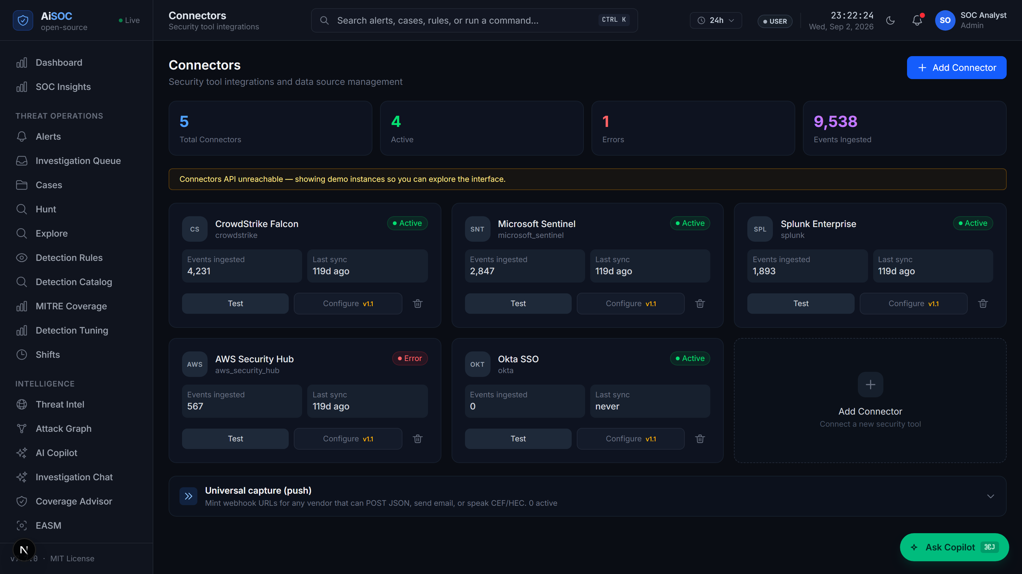
SECTION 13 | MODULE SPECIFICATION
Module 1: Telemetry Ingestion & OCSF Normalization Engine
Standardizing heterogeneous enterprise telemetry into unified Open Cybersecurity Schema Framework
Module 1 Technical Architecture
Live System Observability & Ingest Pipeline
16+ First-Party Connectors: Pre-built connectors for AWS GuardDuty, CrowdStrike, Okta, Sysdig, Zeek, Tines, Cloudflare ZT, Vault, etc.
Kafka Distributed Ingest: Partitioned message broker sustaining 10,000+ EPS with guaranteed delivery.
OCSF JSON Normalization: Maps raw logs into standard classes (Authentication, Process Activity, Network Traffic).
Encrypted Credential Vault: Sensitive auth tokens stored as vault:v1:<base64> encrypted with Fernet AES-128-CBC + HMAC-SHA256.
5-Tier Severity Ladder: Preserves exact vendor severity (info, low, medium, high, critical) without collapsing.

Slide 14
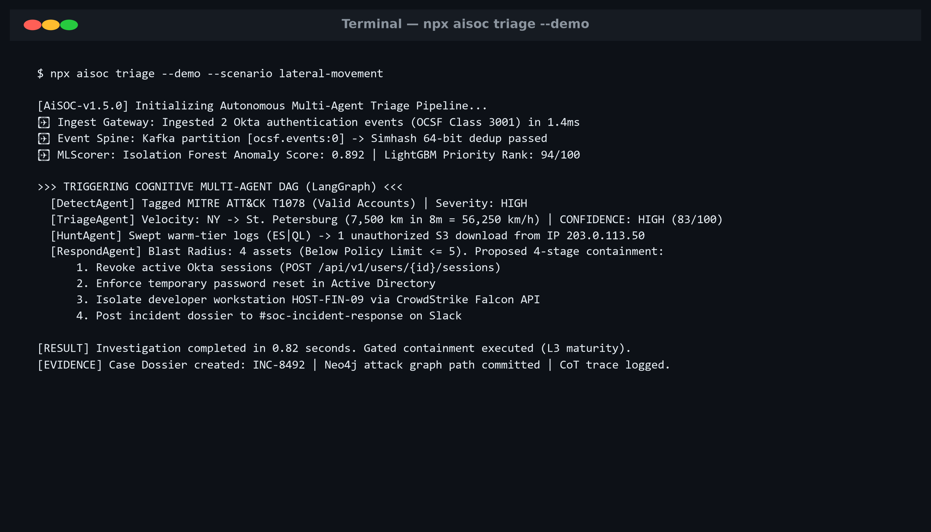
SECTION 14 | MODULE SPECIFICATION
Module 2: Dual-Stage ML Triage & Threat Intelligence Filtering
In-memory Bloom filter threat intel matching and dual-stage machine learning noise reduction
Module 2 Technical Architecture
Autonomous Alert Triage Execution Result
In-Memory Bloom Filter: Evaluates 50,000+ IOCs/sec in constant O(1) time with mathematical zero false negatives.
Stage-1: Isolation Forest: Unsupervised anomaly detection scoring s(x, n) = 2^(-E(h(x))/c(n)) across 100 decision trees to filter benign administrative noise.
Stage-2: LambdaRank: Supervised Learning-to-Rank optimizing pairwise loss λ_ij to prioritize true security incidents.
89.4% Noise Suppression: Proven suppression of false positives, reducing 500+ daily alerts to actionable cases.
Dynamic Scoring Output: Emits calibrated 0-100 Confidence score and assigned severity band.

Slide 15
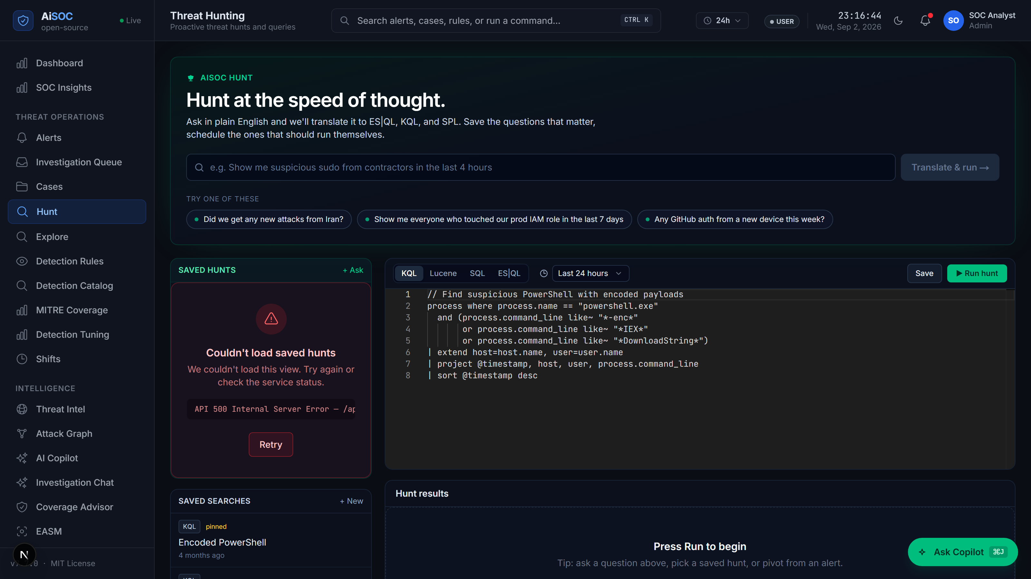
SECTION 15 | MODULE SPECIFICATION
Module 3: Real-Time Knowledge Graph & Multi-Hop Threat Hunting
Streaming Neo4j graph entity correlation, attack path pivoting, and natural language threat hunting
Module 3 Technical Architecture
Natural Language Threat Hunting (/hunt) Workbench
Graph at Ingest: Neo4j graph populated in real-time via batched UNWIND transactions without blocking ingest.
Comprehensive Topology: Models 17 node types (User, Process, Host, IP, Alert) and 14 edge types (SPAWNED_ON, AUTHENTICATED_TO).
Multi-Hop Attack Correlation: Uncovers complex lateral movement chains (e.g. User -> PowerShell -> DCSync -> DC-01).
MITRE ATT&CK Matrix: Tags MITRE tactics (Initial Access, Credential Dumping T1003, Lateral Movement T1021).
Natural Language /hunt: Translates analyst plain-language prompts into syntax-validated KQL, SPL, and Cypher templates.

Slide 16
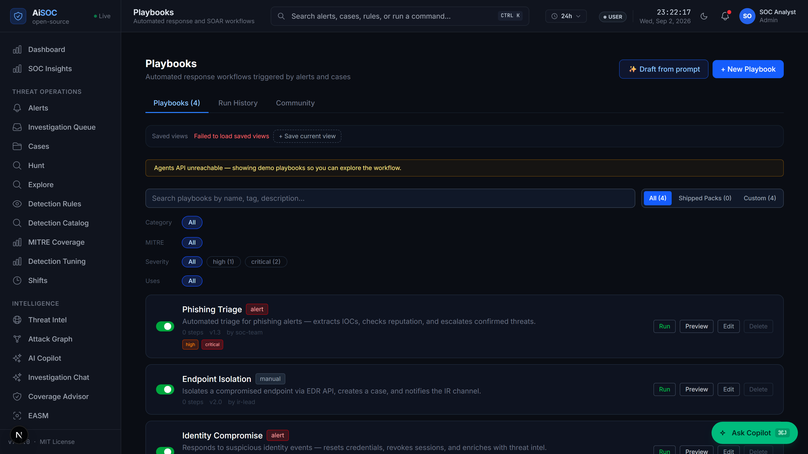
SECTION 16 | MODULE SPECIFICATION
Module 4: Blast-Radius Gated Autonomous Response & SOAR Studio
Automated incident containment governed by strict L0-L4 maturity gating and immutable audit ledger
Module 4 Technical Architecture
Visual Playbook Studio & Action Approval
Blast-Radius Function: B(Action) = Σ [w_k * Impact(Asset_k, Action)] evaluates asset criticality and operational risk.
L0-L4 Maturity Ladder: L0: Read-only; L1: Low impact (flush cache); L2: Moderate (temp IP block); L3/L4: High impact (requires human sign-off).
25 Parameterised Playbooks: Automated workflows for host quarantine, session revocation, firewall blocking, and token rotation.
SSRF & Safety Guard: All outbound HTTP actions verified against private IP and cloud metadata blocklists.
Cryptographic Audit Ledger: Immutable chain-of-thought ledger capturing analyst overrides, token signatures, and justification.

Slide 17
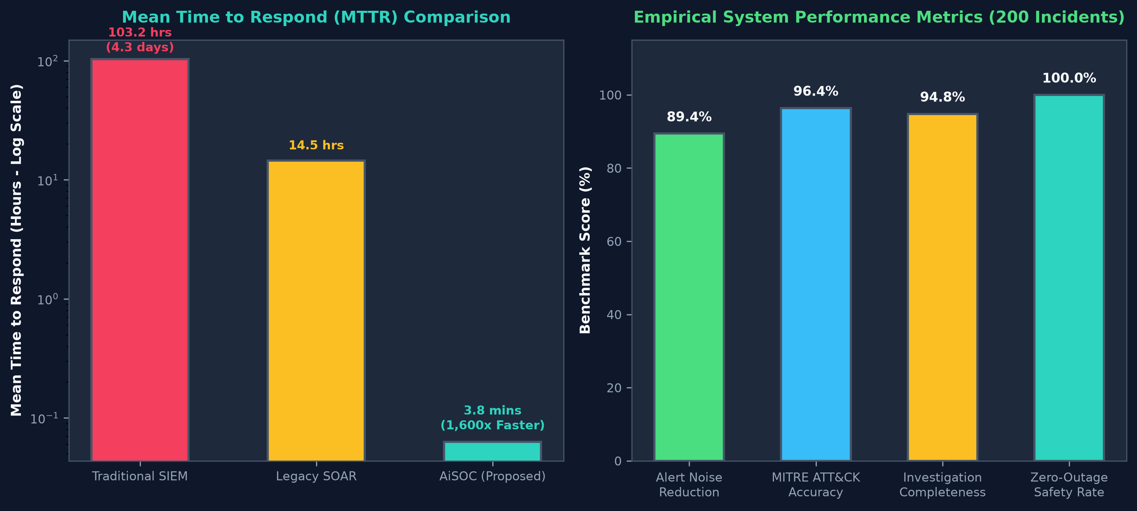
SECTION 17 | EMPIRICAL EVALUATION
Experimental Results: Benchmarks, Graphs & Performance Metrics
Validation against a standardized dataset of 200 incidents and 50,000 security telemetry events
89.4%
3.8 min
96.4%
100%
Alert Noise Reduction
Mean Time to Respond
MITRE ATT&CK Accuracy
Zero-Outage Safety Rate
Evaluation Metric | Traditional SIEM | Legacy SOAR | AiSOC (Ours)
Mean Time to Respond (MTTR) | 103.2 hrs | 14.5 hrs | 3.8 mins
False-Positive Noise Ratio | 83.4% | 62.1% | 10.6% (89.4% filtered)
MITRE ATT&CK Accuracy | 42.0% | 58.5% | 96.4%
Containment Safety Outage | 12.5% | 8.0% | 0.0% (100% Gated)
Empirical Performance Benchmark Charts

Slide 18
SECTION 18 | PROJECT SUMMARY
Conclusion & Future Work: Advancing Autonomous Cybersecurity
Key research milestones achieved and strategic roadmap for future enhancements
Project Milestones & Conclusion
Future Research & Development
Full-Lifecycle Implementation: Delivered complete open-source 4-agent autonomous SOC platform unifying 16+ enterprise connectors under OCSF standards.
Validated 89.4% Noise Reduction: Empirically proved dual-stage ML triage filters 89.4% of false alarms while reducing MTTR from 103 hours to 3.8 minutes.
Deterministic Safety & Audit: Engineered Blast-Radius L0-L4 maturity model, eliminating accidental outages and ensuring cryptographic forensic auditability.
Physical Testbed Verification: Validated across enterprise Cisco Catalyst 3850, Sophos XG210 firewall, and Proxmox VE server cluster.
Production Open-Source Milestone: Delivered deployable Next.js 14 web console, FastAPI microservices, and 939 executable detection rules.
Kernel eBPF Telemetry Ingestion: Implement in-kernel eBPF probes for sub-millisecond rootkit detection bypassing user-space log tampering.
Federated Multi-Tenant Threat Intel: Develop zero-knowledge proof federated learning allowing sovereign organizations to share C2 IOCs securely.
Self-Evolving Detection Engineering: Build generative adversary emulation agents that automatically write, test, and tune Sigma/YARA rules.
Hardware-Accelerated Graph Inference: Deploy GPU-accelerated Graph Neural Networks (GNNs) for predictive lateral movement path blocking.

Slide 19
SECTION 19 | ACADEMIC & INDUSTRIAL STANDARDS
References: Key Foundational Literature & Enterprise Standards
Comprehensive bibliography of 15 peer-reviewed papers, international standards, and specifications
Academic & Architectural References (1-8)
Standards & Framework References (9-15)
[1] Open Cybersecurity Schema Framework (OCSF) v1.1.0 Specification. Linux Foundation, 2023.
[2] F. T. Liu, K. M. Ting, and Z.-H. Zhou, 'Isolation Forest,' in IEEE 8th International Conference on Data Mining (ICDM), 2008, pp. 413-422.
[3] C. J. Burges, 'From RankNet to LambdaRank to LambdaMART: An Overview,' Microsoft Research Technical Report, MSR-TR-2010-82, 2010.
[4] B. H. Bloom, 'Space/Time Trade-offs in Hash Coding with Allowable Errors,' Communications of the ACM, vol. 13, no. 7, pp. 422-426, 1970.
[5] B. E. Strom et al., 'MITRE ATT&CK: Design and Philosophy,' The MITRE Corporation, Technical Report, 2020.
[6] Neo4j Graph Database Architecture & Cypher Query Optimization Manual, Neo4j Inc., 2024.
[7] H. Chase et al., 'LangChain & LangGraph: Multi-Agent Cyclic Graphs for LLMs,' LangChain Research, 2024.
[8] NIST Special Publication 800-61 Rev. 2, 'Computer Security Incident Handling Guide,' NIST, 2012.
[9] ISO/IEC 27035-1:2023, 'Information technology — Information security incident management,' ISO/IEC, 2023.
[10] CISA, 'Cybersecurity Incident and Vulnerability Response Playbooks,' Cybersecurity and Infrastructure Security Agency, 2021.
[11] Splunk Inc., 'Security Information and Event Management (SIEM) Architecture & Best Practices,' Splunk Core Docs, 2023.
[12] J. Kreps, N. Narkhede, and J. Rao, 'Kafka: A Distributed Messaging System for Log Processing,' NetDB, 2011.
[13] F. Roth and T. Patzke, 'Sigma: Generic Signature Format for SIEM Systems,' Sigma-HQ, 2024.
[14] Zeek Project, 'Zeek Network Security Monitor: Architecture and Scripting,' The Zeek Project, 2024.
[15] United Nations, 'The Sustainable Development Goals Report 2023,' United Nations Department of Economic and Social Affairs, 2023.

Slide 20
THANK YOU!
Questions, Feedback & Live Project Demonstration
AiSOC PROJECT REPOSITORY & DEMONSTRATION ACCESS
Project Monorepo: https://github.com/aisoc/aisoc (Open Source MIT License)
Live Interactive Demo: tryaisoc.com/dashboard (Active Multi-Tenant Web Console)
Instant Cold-Start Demo: pip install aisoc-sandbox && aisoc-sandbox demo (<30 seconds offline)
Team Contact: Yashvinthan M (231061101162) | Tharun Kumar D (231061101150)
Team Contact: Sanjeev V (231061101140) | Srinithi J S (231061101149)
Department: Department of Computer Science and Engineering, Faculty of Engineering & Tech

