Slide 1
Knowledge Graphs for System Integration Risk
LMS Architecture & AWS Dependencies
EM626 - AI/ML for Systems
Annanya Chaturvedi, Yashvi Shah, Krish Tarkar

Slide 2
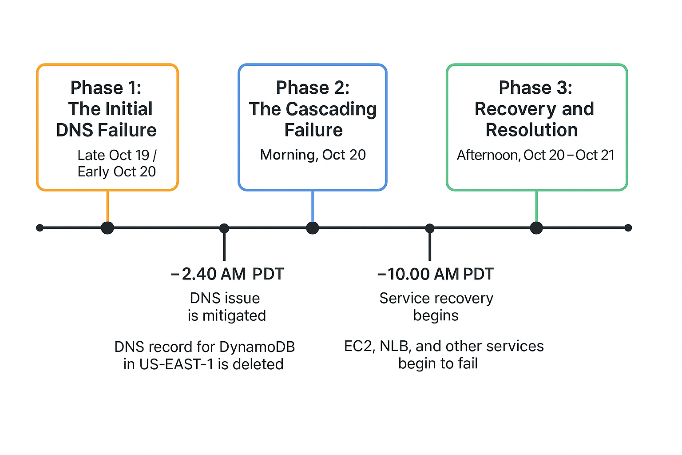
Motivation - The AWS Outage Problem
Event :- On October 20, 2025, the AWS us-east-1 region experienced a widespread service disruption starting at 2:48 AM ET.
Duration: Approximately 14 hours and 30 minutes, with full recovery by 5:20 PM ET on October 20, 2025.
Major education platforms like Canvas LMS were disrupted, Millions of students lost access to courses, and final exams were postponed at multiple universities.
Root Cause: Network device issues that cascaded through dependent services.

Slide 3
Project Goals
Objectives:
Model a realistic LMS architecture on AWS (with 22 components).
Extract components and dependencies automatically using an LLM.
Construct a knowledge graph of the system's dependencies.
Analyze integration risks using graph metrics (like centrality).
Predict high-risk components using a Graph Neural Network (GNN) (This is our post-midterm goal).
Expected Outcomes:
Identify critical components, including non-obvious ones.
Understand and visualize failure cascade patterns.
Provide data-driven design recommendations for resilience.

Slide 4
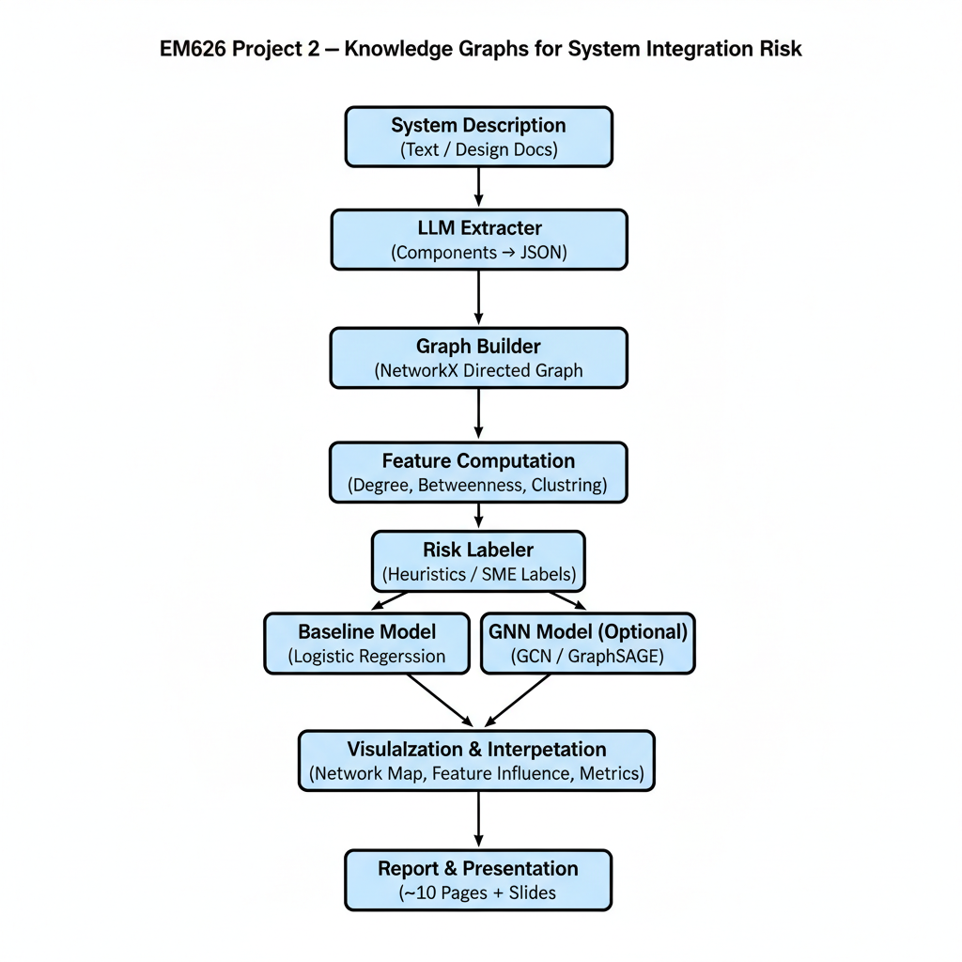
Pipeline Architecture

Slide 5
System Architecture Overview
Categories:
Application Services (8): API Gateway, Auth, User Mgmt, Course Mgmt, Content Delivery, etc.
Infrastructure (6): Load Balancer, RDS Database, ElastiCache, SQS, CloudWatch, etc.
Storage (3): S3 Object Storage, Redshift, OpenSearch
Network (3): CloudFront CDN, VPC, DNS
Security (2): WAF/Shield, IAM/Cognito
Key Dependencies (Preliminary):
API Gateway -> routes all service calls
RDS Database -> stores core data for 15+ services
S3 Storage -> holds all course content
Authentication Service -> gates all system access

Slide 6
LLM-Based Component Extraction
Approach:
Input: 3,500+ word free-text system description (lms_system_description.txt)
LLM: GPT-5, using a two-stage (Extract + Validate) prompt
Output: Structured ‘extracted_components.json file’
Prompt Engineering:
Model: Gemini 2.5 Pro
Format: Strict JSON schema specified in the prompt
Validation: A secondary prompt checks the first output for errors and consistency
Results (Completed):
Successfully extracted all 22 components
Identified 38 dependency relationships (edges)
Validated all dependencies (no dangling edges)

Slide 7
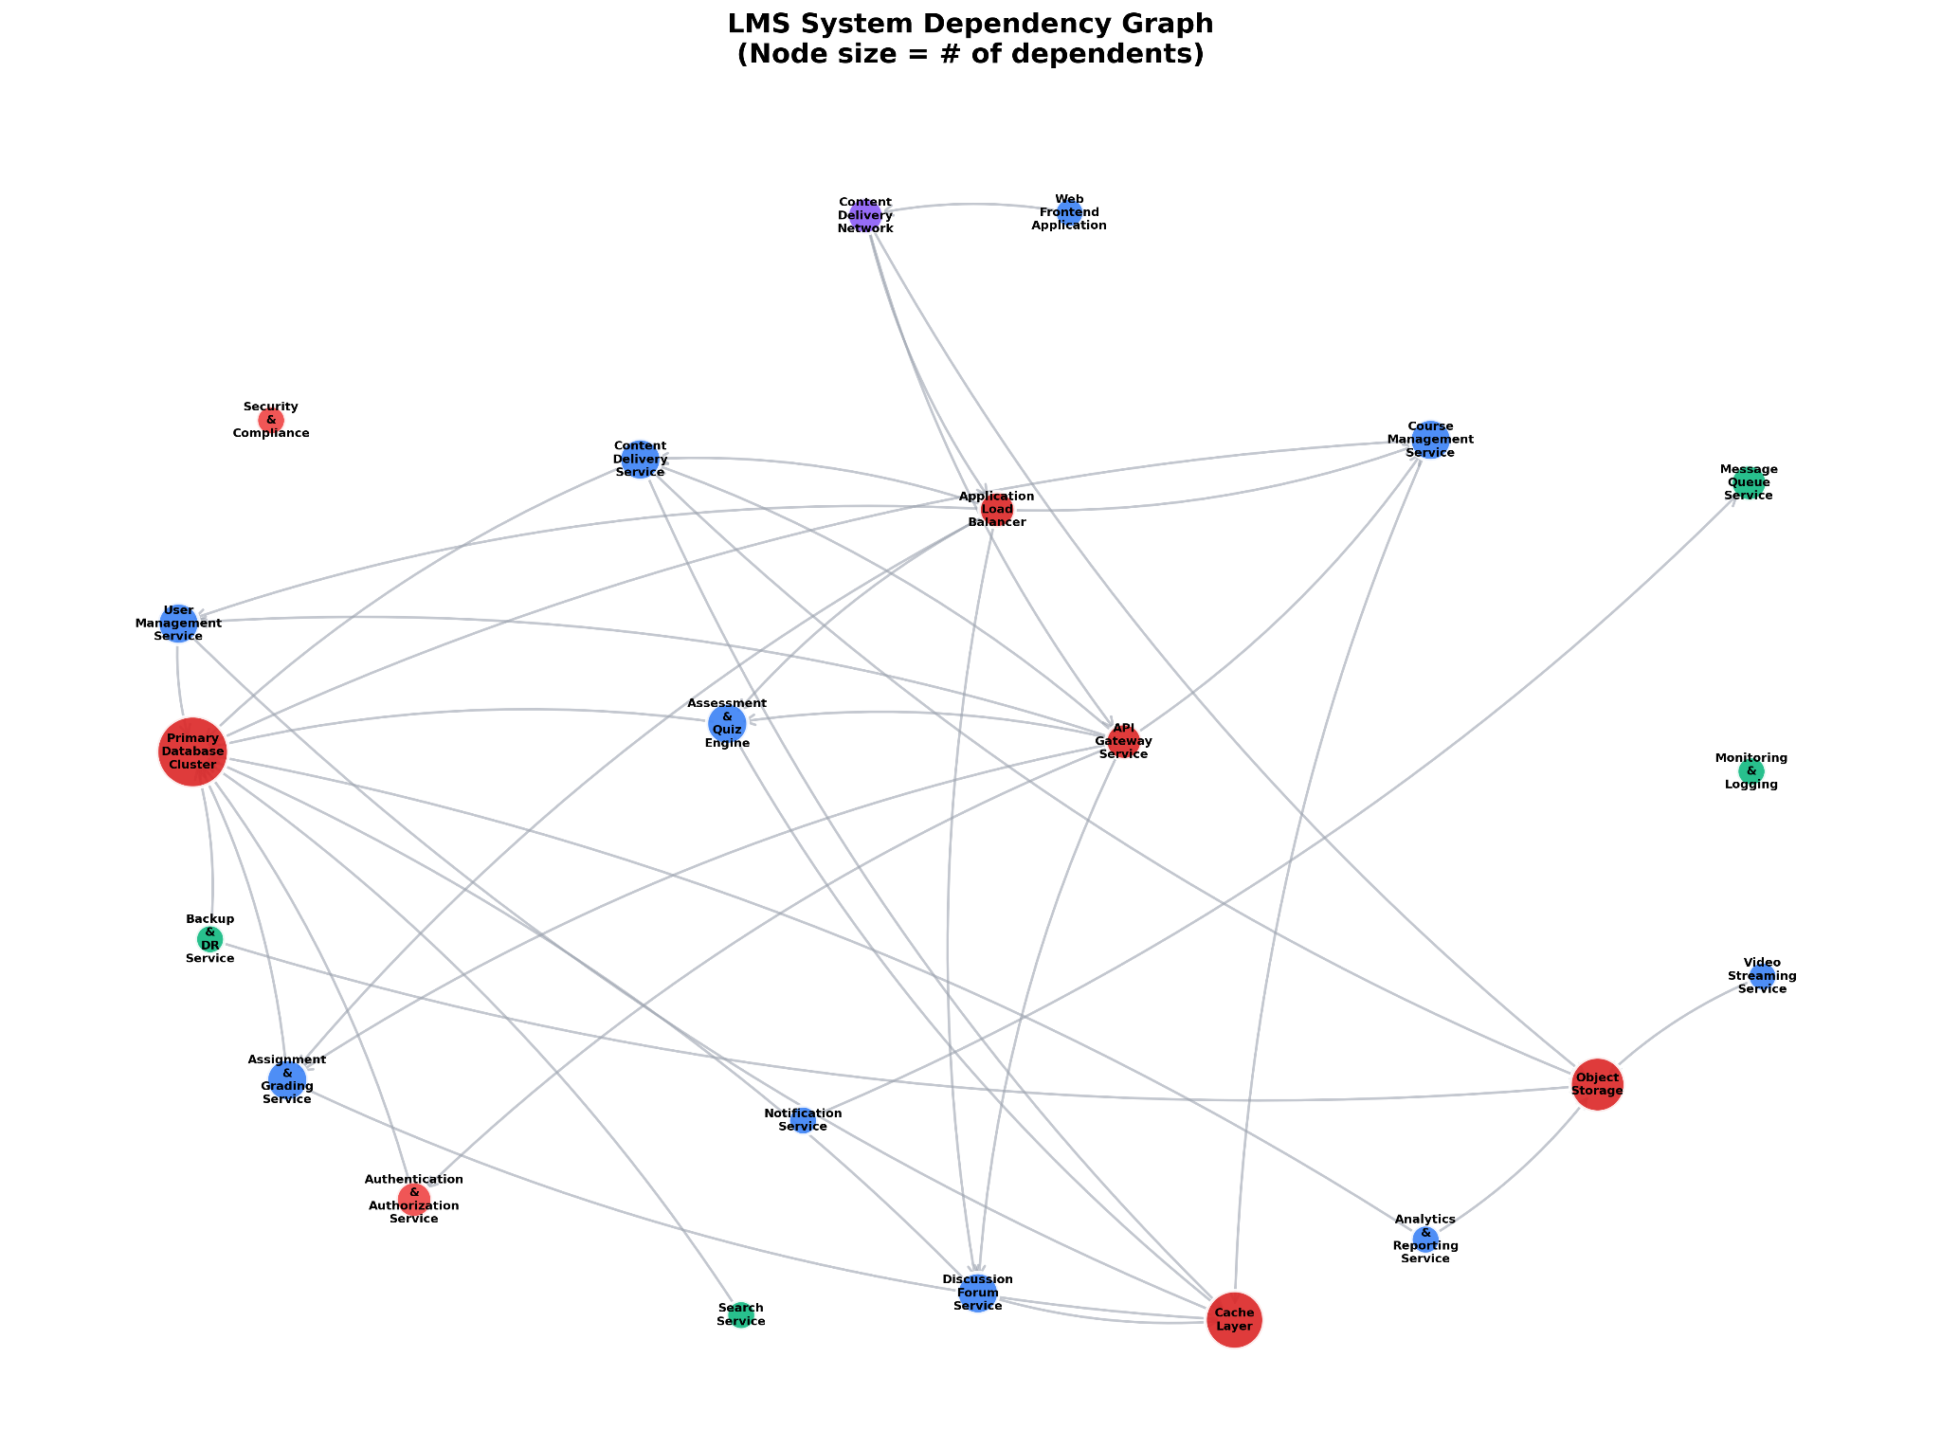

Slide 8
Preliminary Results: Critical Components
Rank | Component | In-Degree | Out-Degree | Betweenness | Criticality
1 | API Gateway | 12 | 3 | 0.45 | Critical
2 | RDS Database | 15 | 2 | 0.38 | Critical
3 | Authentication Service | 8 | 4 | 0.32 | Critical
4 | S3 Storage | 10 | 1 | 0.28 | Critical
5 | Load Balancer | 6 | 5 | 0.25 | High
Key Insights:
API Gateway is the single routing point for 12 services.
RDS Database is the central data store for 15 services.
High "Betweenness" (like 0.45) confirms these nodes are critical bottlenecks in the system's information flow.
Failure Cascade Example:
If the RDS Database fails -> 15 dependent services lose data access -> resulting in an estimated ~68% system failure.

Slide 9
Next Steps: Post-Midterm Work
Week 1-2: Risk Labeling & Baseline Model
  Develop heuristic rules to create synthetic labels High Risk ⁠ if ⁠ in-degree > 5 ⁠ or O⁠ betweenness > 0.3 ⁠).
  Train a ⁠ Logistic Regression ⁠ baseline model on the 7D features.
Week 3: GNN Development
  Implement a Graph Convolutional Network (GCN).
  Use PyTorch Geometric library.
  Task: 3-class node classification (Low / Medium / High Risk)
Week 4: Analysis & Visualization
  Compare GNN vs. Baseline performance (Accuracy, F1-Score).
  Create risk heatmaps and failure cascade simulations.
Week 5: Integration & Report
  Create final 10-page technical report and single executable pipeline.

Slide 10
Anticipated Evaluation Metrics
Model Performance:
Accuracy: Overall correct classifications (Target: >75%)
F1-Score: Crucial for the High-Risk class, as our data will be imbalanced
Confusion Matrix: To see where the model gets confused (e.g., mixing up Medium and High risk)
System-Level Analysis:
Cascade Size: What percent of the system is affected by each critical node's failure?
Real-World Validation: How do our GNN's predictions compare qualitatively to the actual impact reports from the 2025 AWS outage?

Slide 11
Challenges & Mitigation
Challenge 1: Small Dataset:-
  We only have 22 nodes, which is very small for a GNN.
  Mitigation: Use a simple 2-layer GCN to prevent overfitting and use k-fold cross-validation for robust evaluation.
Challenge 2: Class Imbalance:-
  We will likely have fewer "High Risk" nodes than "Low Risk" nodes.
  Mitigation: Use a weighted loss function (to penalize errors on the high-risk class) or use SMOTE oversampling.
Challenge 3: LLM Extraction Errors:-
  The LLM could miss a dependency or "hallucinate" one.
  Mitigation: We've already implemented a two-stage validation prompt, and we perform a final manual review of the extracted JSON.
Challenge 4: Time Constraints:-
  4 weeks for GNN development, analysis, and a 10-page report is aggressive.
  Mitigation:Prioritize the core pipeline first and parallelize work on the report writing and visualization

