Slide 1
Smart Lock Market Analysis
Data Scraping and Analysis Report

Slide 2
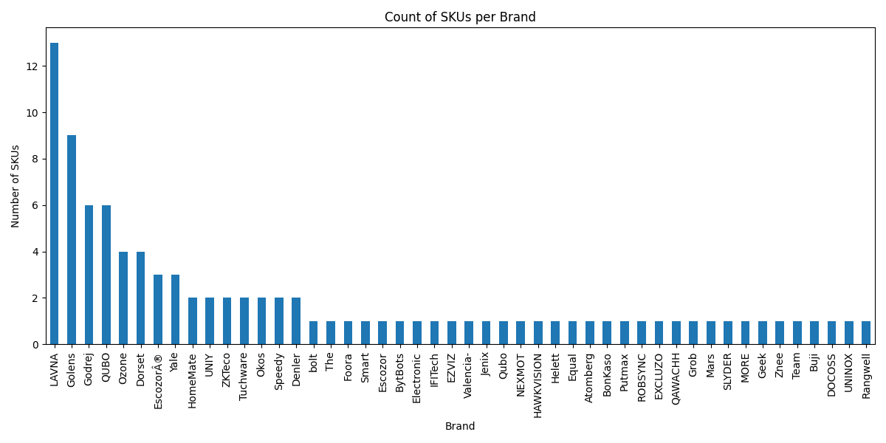
Top Brands by SKU Count

Slide 3
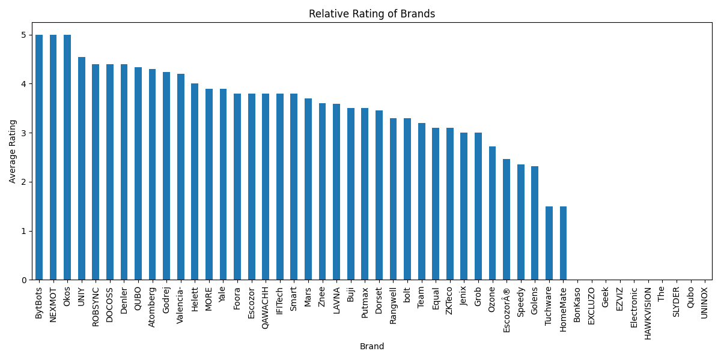
Top Brands by Average Rating

Slide 4
Data Summary
Total Brands: 48
Total Products: 95
Top Brands by SKU Count:
Brand name
13
9
6
6
4
4
3
3
2
2
2
2
2
2
2
1
1
1
1
1
1
1
1
1
1
1
1
1
1
1
1
1
1
1
1
1
1
1
1
1
1
1
1
1
1
1
1
1
Top Brands by Average Rating:
Brand name
5.000000
5.000000
5.000000
4.550000
4.400000
4.400000
4.400000
4.333333
4.300000
4.233333
4.200000
4.000000
3.900000
3.900000
3.800000
3.800000
3.800000
3.800000
3.800000
3.700000
3.600000
3.592308
3.500000
3.500000
3.450000
3.300000
3.300000
3.200000
3.100000
3.100000
3.000000
3.000000
2.725000
2.466667
2.350000
2.311111
1.500000
1.500000
0.000000
0.000000
0.000000
0.000000
0.000000
0.000000
0.000000
0.000000
0.000000
0.000000

