Slide 1
PGC LAB EVALUATION
Parallel Vector Multiplication
using OpenMP
Element-wise multiplication of two 100-million-element vectors: sequential vs parallel
C | OpenMP | GCC -O2 | WSL2 Ubuntu | Python + matplotlib
TEAM MEMBERS
Yashwanth Reddy | Yash Raj | Abhinav Raj | Sushilendr Ekbote
B.E. Computer Science (AI) | KLE Technological University
Notes:
Introduce the project: we speed up an element-wise multiplication of two vectors with 100 million elements using OpenMP in C, and measure how performance changes from 1 to 16 threads. Introduce the four team members.

Slide 2
Aim & Objectives
Parallelize the element-wise multiplication of two 100-million-element vectors using OpenMP, then measure execution time, speedup and efficiency for 1 to 16 threads.
1
Define the problem and the sequential baseline
2
Design a shared-memory parallel solution
3
Implement it with OpenMP in C
4
Run with 1, 2, 4, 6, 8 and 16 threads
5
Plot execution time, speedup and efficiency
6
Explain why scaling stops (bottlenecks)
Notes:
State the aim, then walk through the six objectives. Each objective maps to a later slide: problem and design (3 to 6), code and runs (7 to 9), results (10 to 12), analysis (13 to 14).

Slide 3
Problem Definition
C[i] = A[i] × B[i]
100 M
for i = 0 to N − 1, N = 100,000,000
elements in each vector
Math on huge datasets is a classic HPC bottleneck
One multiplication per element: an O(N) operation
A single core must do all 100 million multiplications, one after another
Goal: use parallel computing to cut the runtime
3
vectors: A, B (inputs) and C (output), all double
≈ 2.4 GB
of RAM: 3 vectors × 100 M × 8 bytes
Notes:
Given two vectors A and B with 100 million doubles each, compute C[i] = A[i] * B[i]. It is O(N) and simple, but the data is large: about 2.4 GB across the three vectors. Sequentially one core does every multiplication, so we want to split the work across cores.

Slide 4
Sequential Algorithm
1
Allocate A, B and C with malloc (N × 8 bytes each)
sequential loop
double start = get_time();
for (long i = 0; i < N; i++) {
C[i] = A[i] * B[i];
}
double end = get_time();
2
Initialize A = 1.0, B = 2.0, C = 0.0
3
Loop i = 0 to N−1 and compute C[i] = A[i] × B[i]
0.692445 s
4
Time the loop, print result, verify C[0] = 2.00
baseline: 1 core, 100 M elements
Notes:
Walk the four steps. Only one worker, the main thread, executes the loop. Timing uses clock_gettime with CLOCK_MONOTONIC and only wraps the multiplication loop, not the initialization. This 0.692445 s is the baseline for every speedup number later. Viva: what is the time complexity? O(N).

Slide 5
Parallel Design with OpenMP
OpenMP: API for shared-memory multiprocessing in C
One directive above the loop does the work:
100,000,000 iterations
▼
#pragma omp parallel for
Thread 1
Thread 2
Thread 3
Thread 4
25 M
25 M
25 M
25 M
Iterations are split into equal chunks automatically
All threads share A, B and C: no message passing
Each thread writes different C[i], so no data races
iterations
iterations
iterations
iterations
▼
Shared memory: A, B (read) C (write)
Example with 4 threads
Notes:
The pragma tells the compiler to divide the 100 million iterations into equal chunks, one per thread. With 4 threads each thread gets 25 million. Shared memory model: every thread reads A and B and writes its own slice of C, so no messages and no locks are needed. Viva: why no race condition? Each iteration writes a different C[i].

Slide 6
Environment & Data Strategy
Experimental setup
Data generation strategy
OS: Windows 10/11 with WSL2 (Ubuntu)
Compiler: GCC (build-essential)
Parallel library: OpenMP, built into GCC
Plots: Python 3, pandas, matplotlib
Threads tested: 1, 2, 4, 6, 8, 16
Vectors are generated in memory, inside the C code
A = 1.0, B = 2.0, C = 0.0
Reading hundreds of MB from a text or CSV file would take longer than the maths
Disk I/O would skew timing and hide the OpenMP speedup
Only the multiplication loop is timed
Notes:
Environment: WSL2 Ubuntu on Windows, GCC with built-in OpenMP, Python for plots. Key design decision: no input files. Generating data in memory avoids disk I/O, so we measure only the computation. Initialization happens before the timer starts.

Slide 7
Source Code: Sequential vs OpenMP
vector_mult_sequential.c
vector_mult_openmp.c
#define N 100000000L
double *A = malloc(N*sizeof(double));
double *B = malloc(N*sizeof(double));
double *C = malloc(N*sizeof(double));
/* init: A=1.0 B=2.0 C=0.0 */
double start = get_time();
for (long i = 0; i < N; i++) {
C[i] = A[i] * B[i];
}
double end = get_time();
scanf("%d", &num_threads);
omp_set_num_threads(num_threads);
/* malloc + init: same as sequential */
double start = omp_get_wtime();
#pragma omp parallel for
for (long i = 0; i < N; i++) {
C[i] = A[i] * B[i];
}
double end = omp_get_wtime();
Same loop body. The only changes: thread count input, the pragma, and omp_get_wtime()
Notes:
Key parts of both programs. Pink lines in the OpenMP file are the differences: the user enters the thread count (1 to 32 allowed), omp_set_num_threads applies it, the pragma parallelizes the loop, and omp_get_wtime measures wall-clock time of the parallel region. Full code is in the src folder.

Slide 8
Compile & Run: Sequential Baseline
$ cd src
$ gcc -O2 vector_mult_sequential.c -o vector_mult_sequential
$ ./vector_mult_sequential
Terminal output of the sequential run
-O2
0.692445 s
C[0] = 2.00
standard compiler optimizations
baseline time for 100 M elements
verified: 1.0 × 2.0
Notes:
Compile with gcc -O2 and run. The output shows the 100 million element size, execution time 0.692445 seconds, and C[0] = 2.00 as a correctness check since A[0] is 1.0 and B[0] is 2.0.

Slide 9
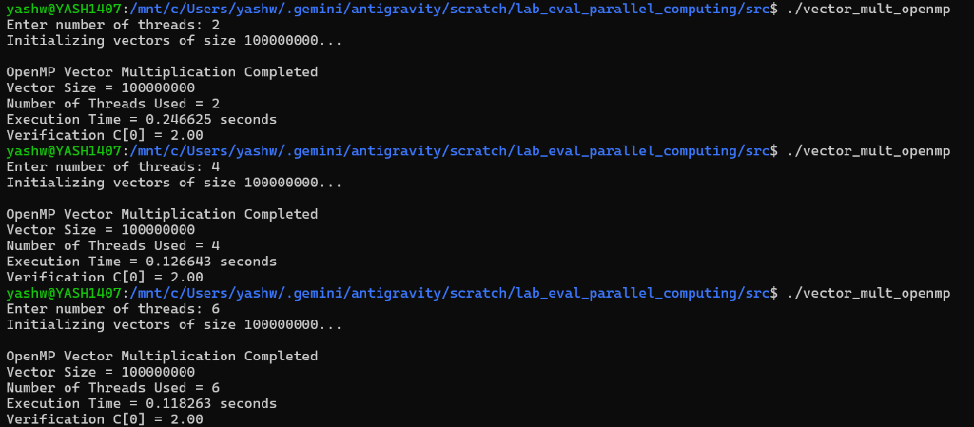
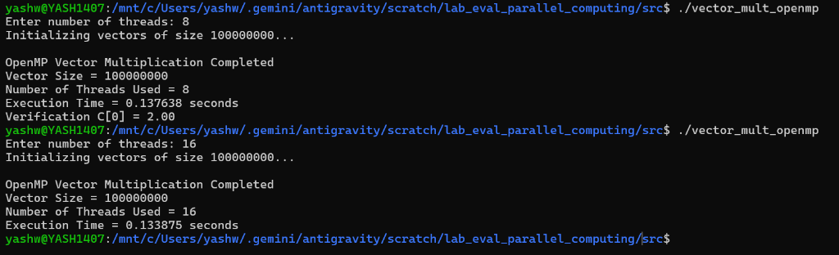
Compile & Run: OpenMP Version
$ gcc -O2 -fopenmp vector_mult_openmp.c -o vector_mult_openmp
$ ./vector_mult_openmp # asks: Enter number of threads
Runs with 8 and 16 threads
-fopenmp enables the directives and links the OpenMP runtime
Runs with 2, 4 and 6 threads
Notes:
The -fopenmp flag is essential: without it the pragma is ignored and the code runs on one thread. The program is interactive: we enter 1, 2, 4, 6, 8 and 16 threads one by one. Times shown: 2 threads 0.246625 s, 4 threads 0.126643 s, 6 threads 0.118263 s, 8 threads 0.137638 s, 16 threads 0.133875 s.

Slide 10
Execution Results
Threads | Time (s) | Speedup | Efficiency
1 (Sequential) | 0.692445 | 1.00× | 100.0%
2 | 0.246625 | 2.80× | 140.3%
4 | 0.126643 | 5.46× | 136.6%
6 | 0.118263 | 5.85× | 97.5%
8 | 0.137638 | 5.03× | 62.8%
16 | 0.133875 | 5.17× | 32.3%
SPEEDUP
S = T_{seq} / T_{par}
how many times faster
EFFICIENCY
E = S / threads × 100%
how well each thread helps
Best: 6 threads, 0.118263 s, 5.85× speedup (0.69 s down to 0.12 s)
Notes:
Read the table row by row. Time drops from 0.69 s to 0.118 s at 6 threads, a 5.85x speedup with 97.5% efficiency. Beyond 6 threads the time goes back up slightly (0.1376 s at 8 and 0.1339 s at 16). Efficiency above 100% at 2 and 4 threads is super-linear: our report puts it down to a hyperthreading anomaly. Each thread count was run once, so small timing noise is possible. Speedup = sequential time divided by parallel time; efficiency = speedup divided by threads.

Slide 11
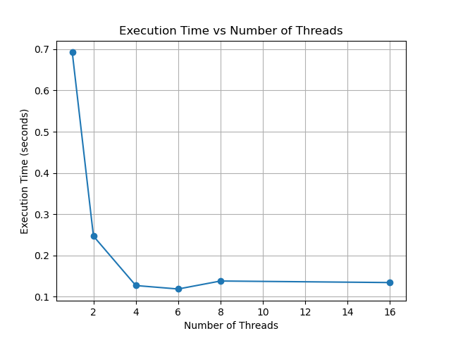
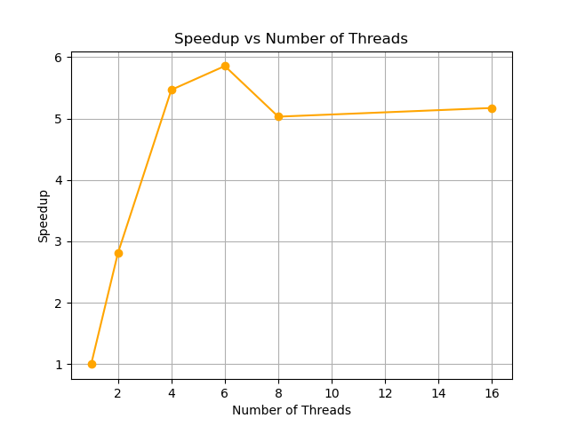
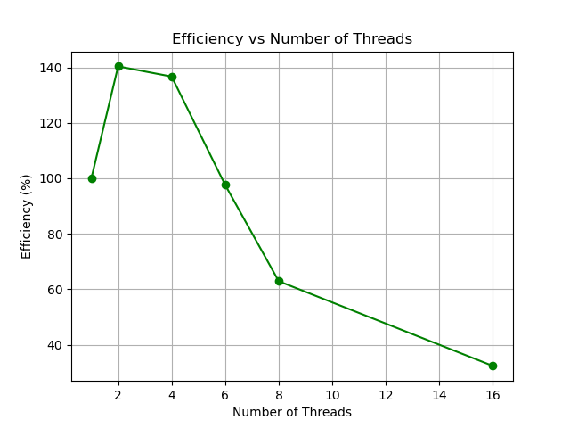
Performance Graphs
Execution time
Speedup
Efficiency
Drops fast, then flattens after 4 to 6 threads
Peaks at about 5.85× with 6 threads
Falls steeply beyond 6 threads
Generated by plot_performance.py (pandas + matplotlib) from results/performance.csv
Notes:
These three plots were generated automatically from the CSV with a Python script. Execution time falls quickly then flattens. Speedup climbs to about 5.85x at 6 threads and then dips. Efficiency drops steeply after 6 threads, which signals diminishing returns.

Slide 12
Speedup vs Ideal & Efficiency
Near-ideal up to 6 threads. After that the curve flattens and efficiency collapses to 32.3% at 16 threads.
Notes:
Left: the red line is our measured speedup, the black line is the ideal where N threads gives N times speedup. We track or beat ideal up to 4 threads, match it at 6, then fall away. Right: efficiency. Above 100% at 2 and 4 threads is super-linear, reported as a hyperthreading anomaly in our README. At 16 threads only 32.3% of the thread capacity is being used effectively.

Slide 13
Why Not a 16× Speedup?
1. Memory bandwidth bottleneck
2. Thread management overhead
The multiply is trivial; the cost is moving data to and from RAM
Cores finish the maths faster than RAM can supply numbers
The program becomes memory bound: extra threads sit idle
OpenMP must create, schedule and synchronize threads
For a task of about 0.1 s, managing 16 threads costs as much as it saves
Amdahl's Law: diminishing returns, 8 to 16 threads gave no gain
Approx. effective memory bandwidth (about 2.4 GB moved ÷ run time, our estimate)
3.5 GB/s
9.7 GB/s
19.0 GB/s
20.3 GB/s
17.4 GB/s
17.9 GB/s
1 thread
2 threads
4 threads
6 threads
8 threads
16 threads
Notes:
Two reasons for the plateau. First, memory bound: each run moves roughly 2.4 GB (1.6 GB read, 0.8 GB written). Our own estimate of effective bandwidth rises from about 3.5 GB/s at one thread to about 20 GB/s at 6 threads, then stays at 17 to 18 GB/s for 8 and 16 threads. That flat ceiling is why more threads do not help. Second, overhead of creating and synchronizing threads on a job that takes about 0.1 s. Amdahl's Law: speedup is limited by whatever cannot be parallelized or sped up, here memory access. The bandwidth numbers are an approximation we calculated, not a measurement.

Slide 14
Conclusion & Future Scope
What we achieved
Future scope
One pragma cut runtime from 0.69 s to 0.12 s
Best speedup 5.85× with 6 threads (97.5% efficiency)
Time falls fast up to 4 threads, then flattens
Memory bandwidth and thread overhead limit scaling (Amdahl's Law)
Repeat each run and average to reduce timing noise
Try schedule(static / dynamic) and thread pinning
Add SIMD vectorization on top of threads
Compare with a GPU (CUDA) or MPI version
Test on a CPU with more memory channels
Notes:
Summarize: parallelism with OpenMP is highly effective, best at 6 threads, and scaling is limited by memory bandwidth and thread overhead. Future scope items are suggestions beyond the lab: averaging multiple runs, scheduling options, SIMD, GPU or MPI comparison, and hardware with more memory bandwidth.

Slide 15
THANK YOU
Questions?
100 M
5.85×
0.69 s → 0.12 s
elements per vector
best speedup, 6 threads
execution time
TEAM MEMBERS
Yashwanth Reddy | Yash Raj | Abhinav Raj | Sushilendr Ekbote
B.E. Computer Science (AI) | KLE Technological University
Notes:
Close by repeating the headline result: 100 million elements, 5.85x speedup at 6 threads, runtime from 0.69 s to 0.12 s. Invite questions. Likely viva questions: why does 16 threads not give 16x (memory bound plus overhead), what does -fopenmp do (enables pragmas and links the runtime), why generate data in memory (avoid disk I/O), how are speedup and efficiency defined.

