Slide 1
SDS - Mini-Project PRESENTATION
Project Title : Cricket Players Data Analysis
Project Team : PES1201902010 – Yogith Aras H
PES1201901384 – Yashwal S Kanchan
PES1201901599 – Vaibhav S
PES1201902167 – Vrunda Patil

Slide 2
Selection of Dataset and Sampling and Cleaning
Dataset – Cricket Players Dataset
Require Libraries – NumPy, Pandas, Matplotlib, Seaborn, SciPy
Selected dataset contains 30 columns and 2491 rows .
We just deleted some of the Unwanted Columns in our data frame
We Used Random Sampling Technique take the sample from the population .We took 750 observations in population
Data Cleaning :
we Handled Missing data for both Categorical Data and numerical
variables by
1.Imputing
2.Dropping

Slide 3
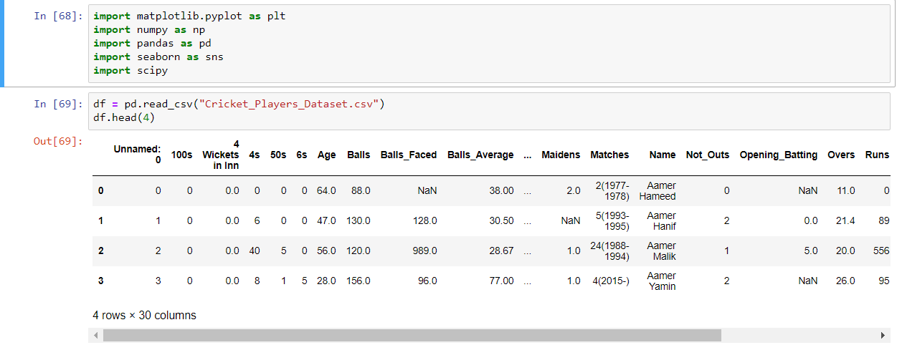

Slide 4
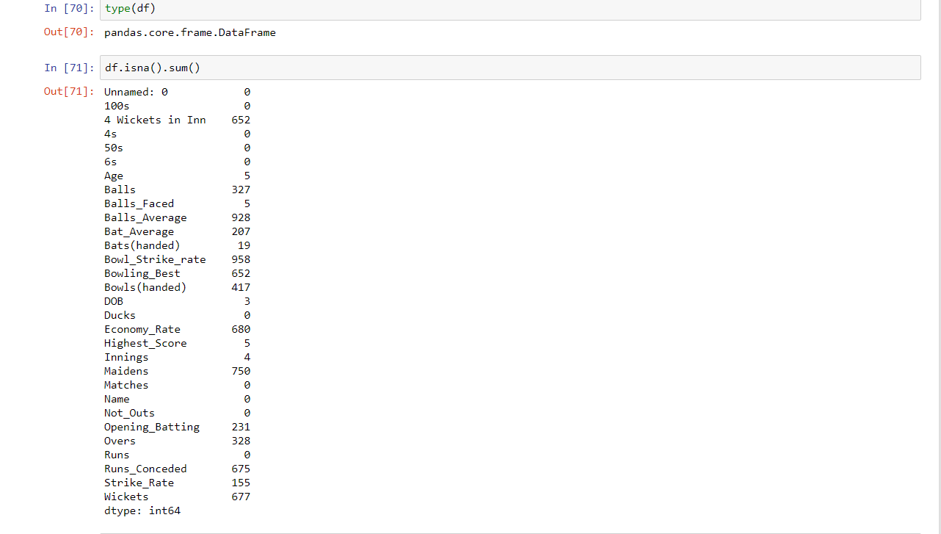

Slide 5
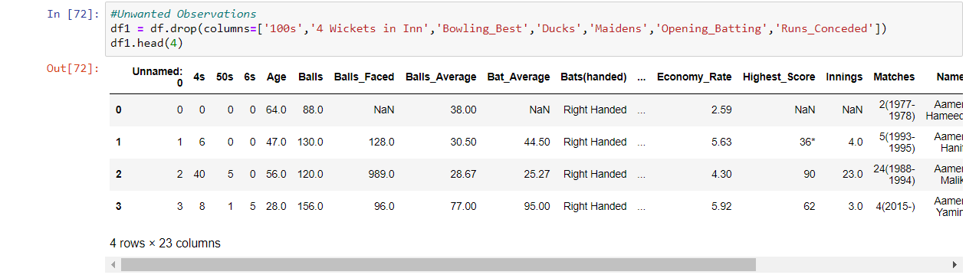
Notes:
5

Slide 6
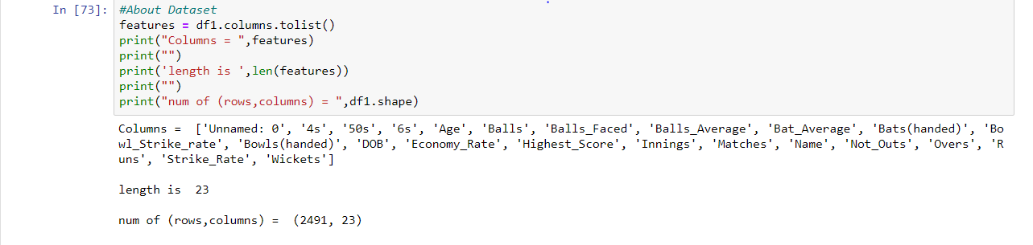
Notes:
6

Slide 7
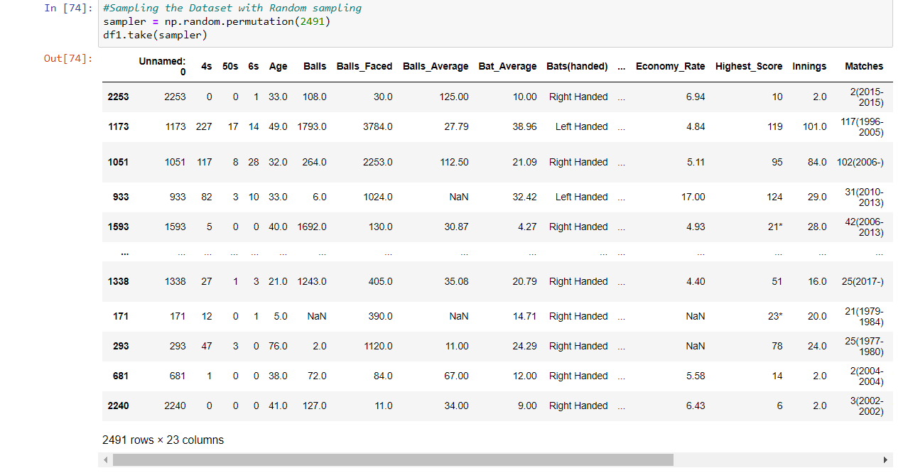
t
Notes:
7

Slide 8
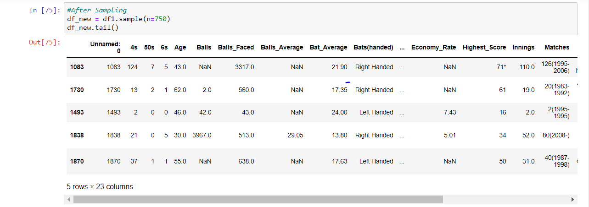
Notes:
8

Slide 9
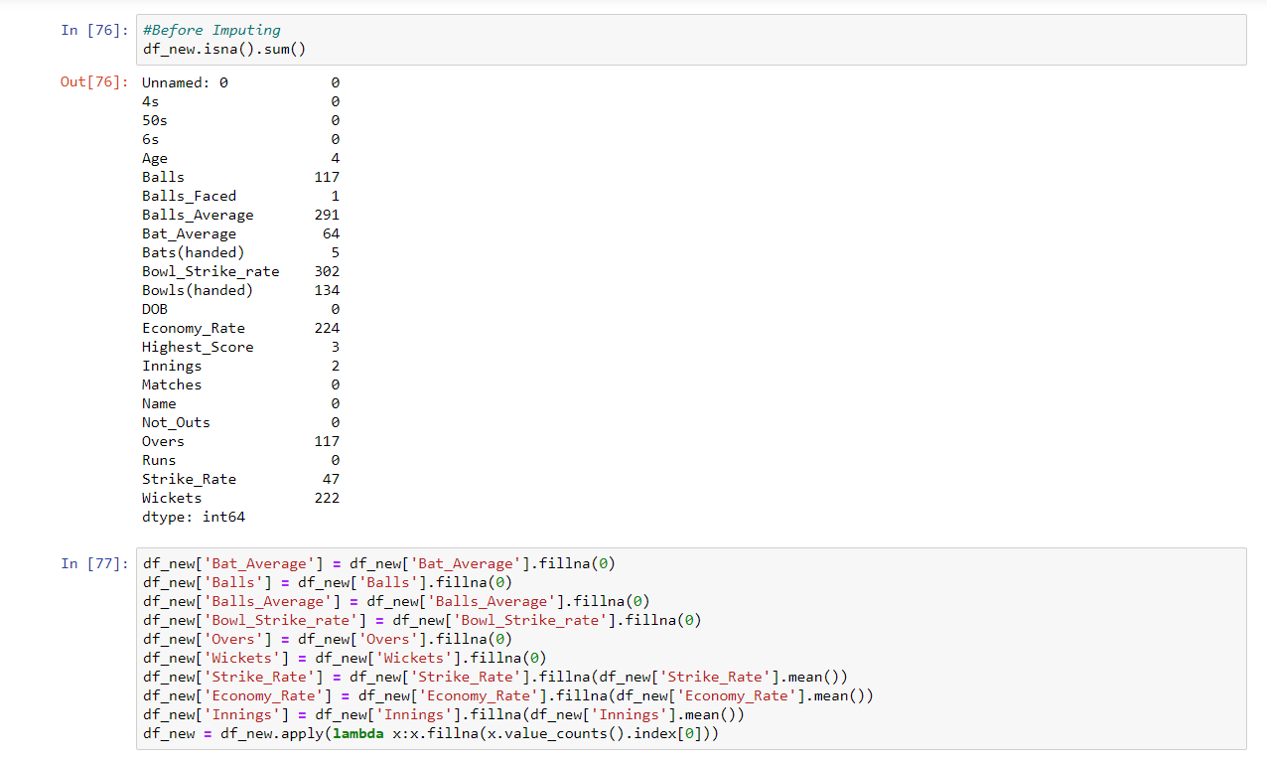
Notes:
9

Slide 10
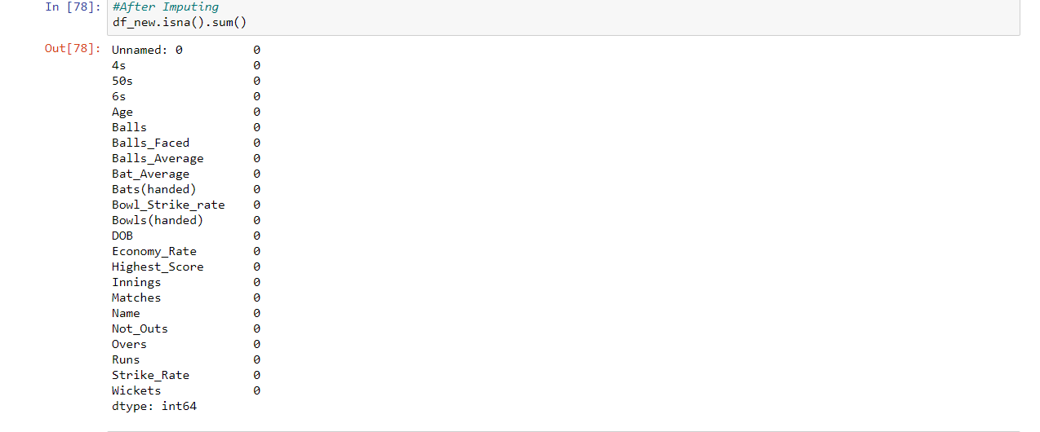
Notes:
10

Slide 11
Graph Visualization
We plotted the Numerical Variables using Histogram
Using Boxplot we have removed the Outliers
We used Count Plot to count the number of Left handed and Right Handed Batsmen
We plot the Bar Plot Between Age and Runs

Slide 12
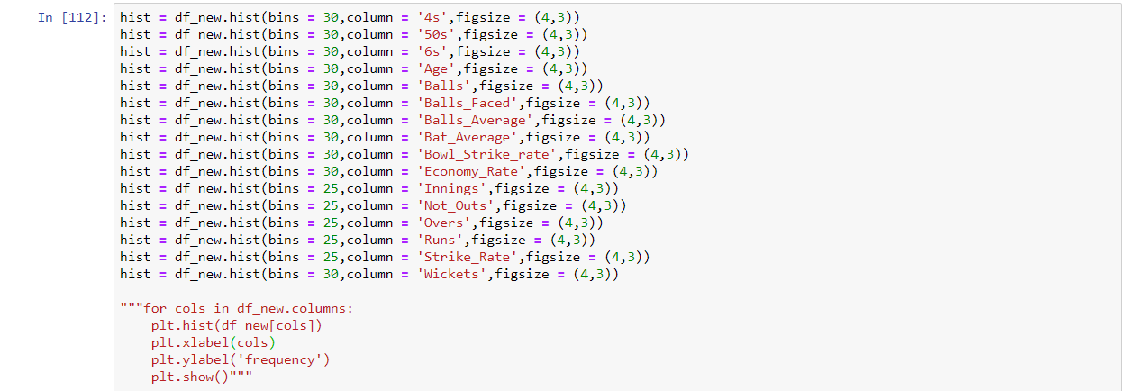
Notes:
12

Slide 13
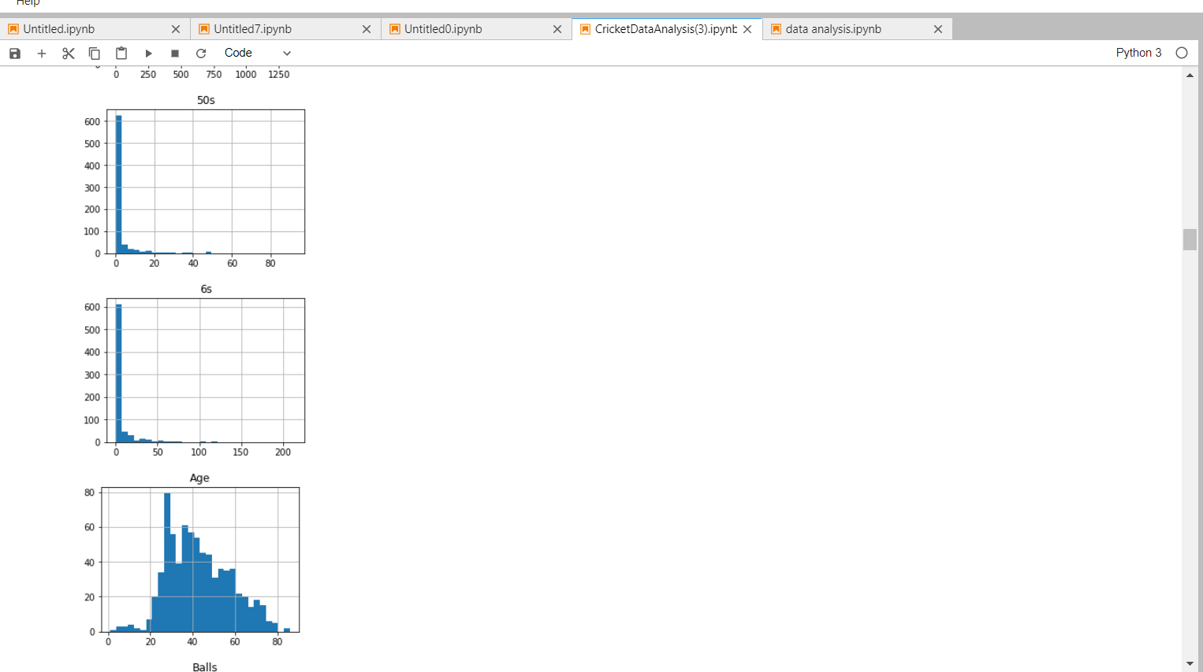

Slide 14
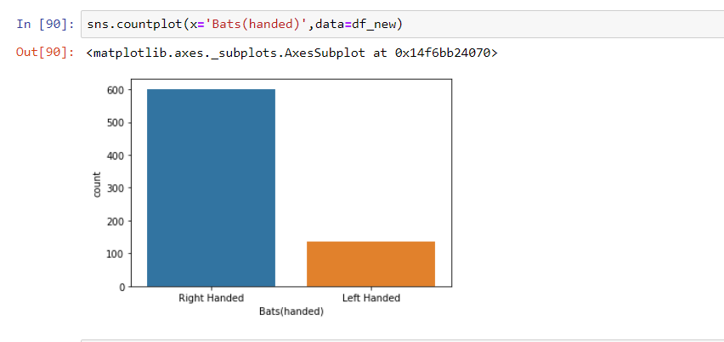
Notes:
14

Slide 15
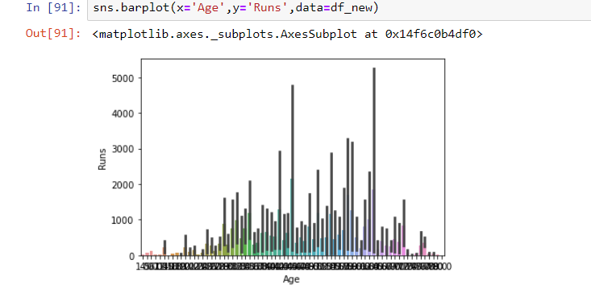
Notes:
15

Slide 16
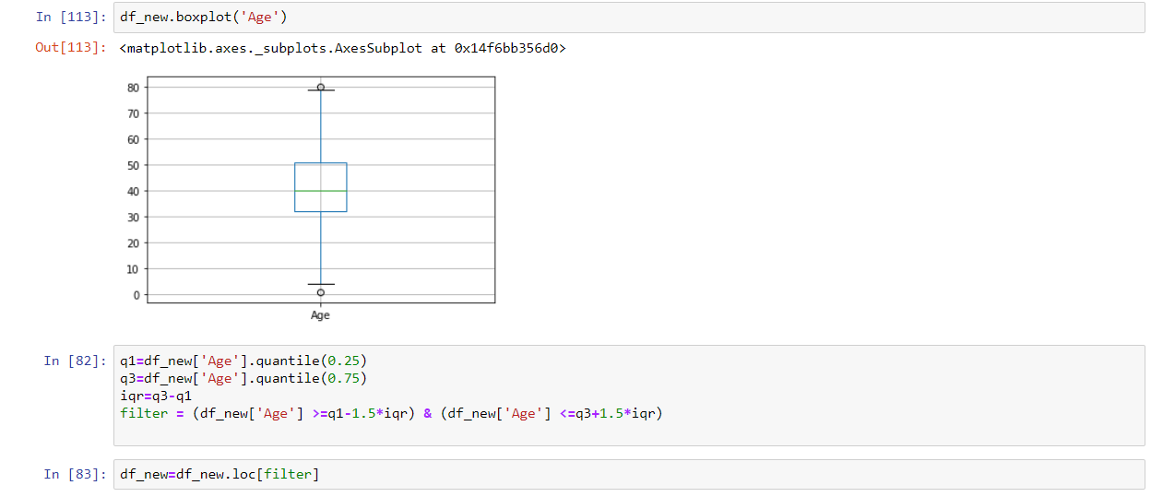
Notes:
16

Slide 17
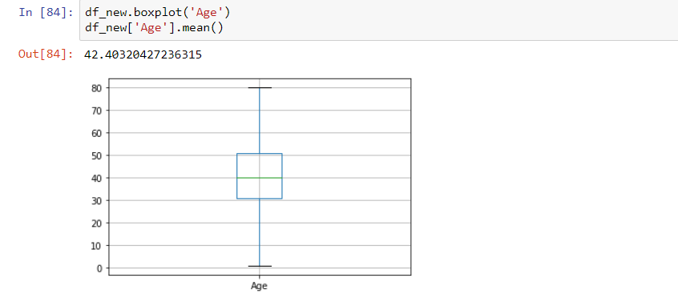
Notes:
17

Slide 18
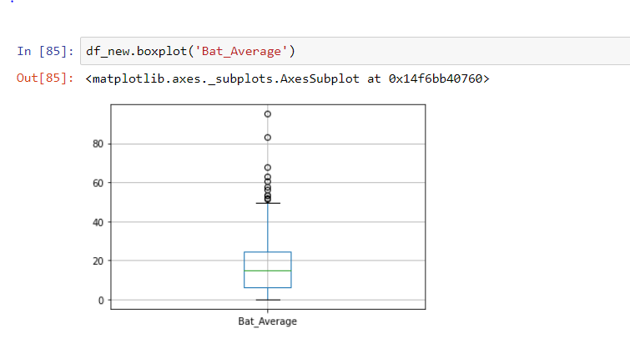
Notes:
18

Slide 19
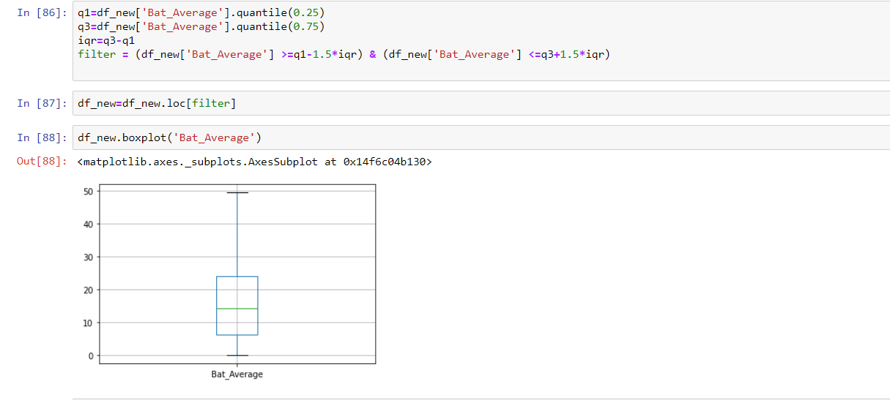
Notes:
19

Slide 20
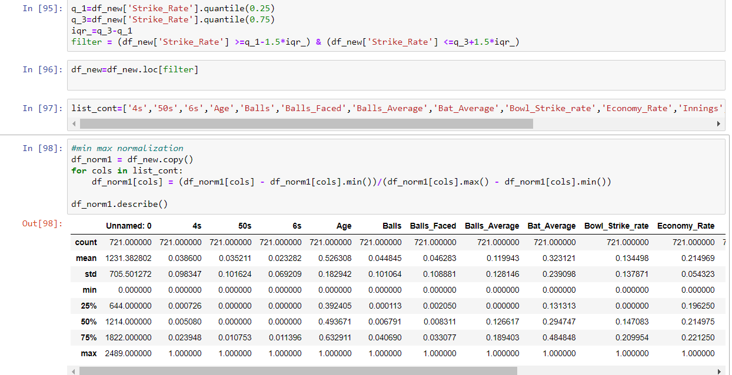
Notes:
20

Slide 21
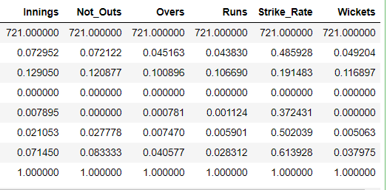
Notes:
21

Slide 22
Normalization and Standardization
We normalize the data to bring all the variables to the same range.
We performed Min-Max Normalization and
Z-Normalization(Standardization) for our Dataset
The need of normalization is to change the numerical columns of the Data frame to common scale.
After the normalization every column of the data frame has a same range
Standardization is similar to normalization, where the mean is equal to zero and standard deviation is equal to one

Slide 23
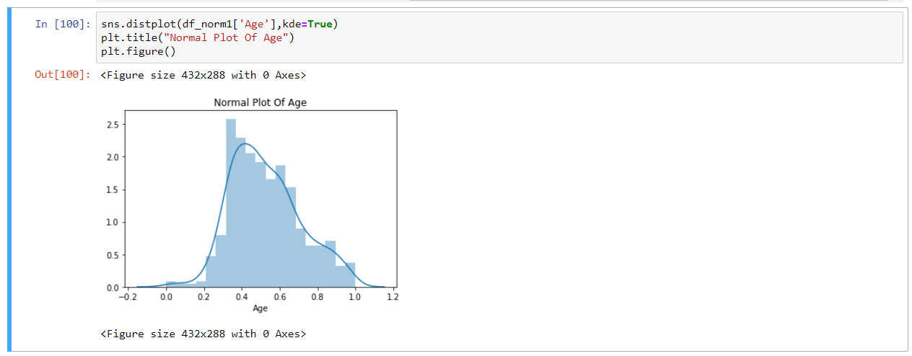
Notes:
23

Slide 24
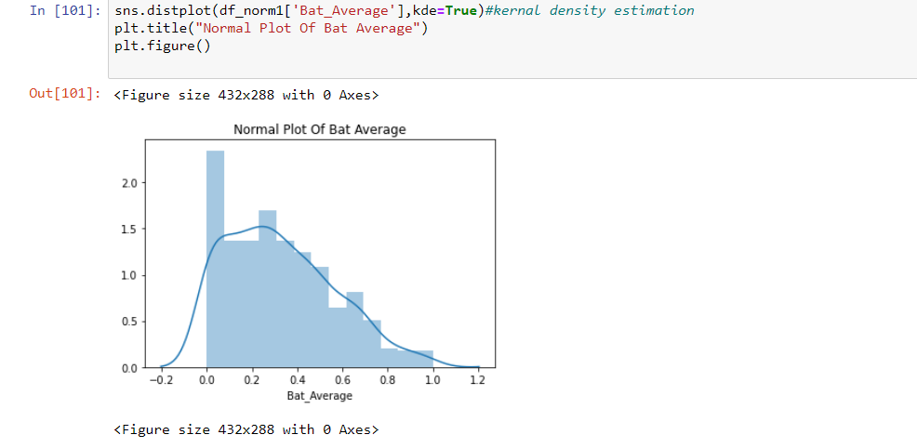
Notes:
24

Slide 25
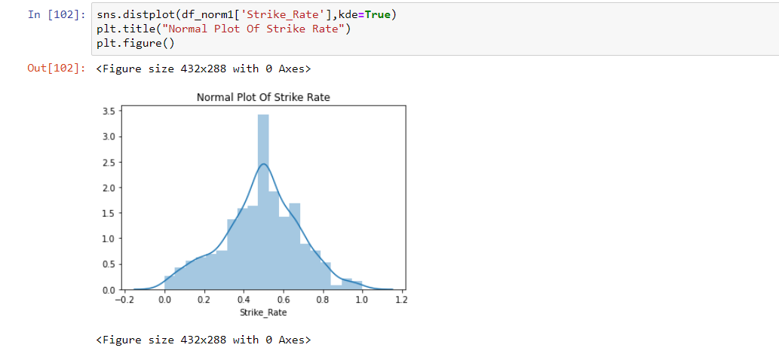
Notes:
25

Slide 26
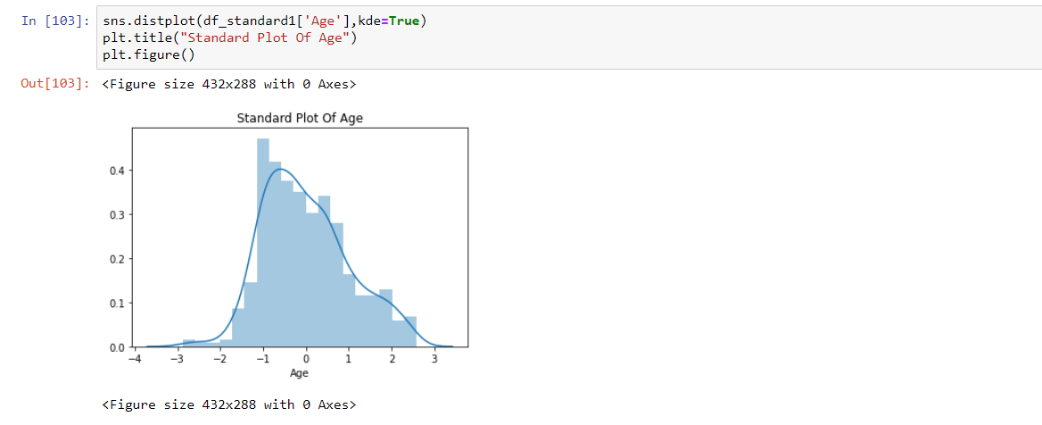
Notes:
26

Slide 27
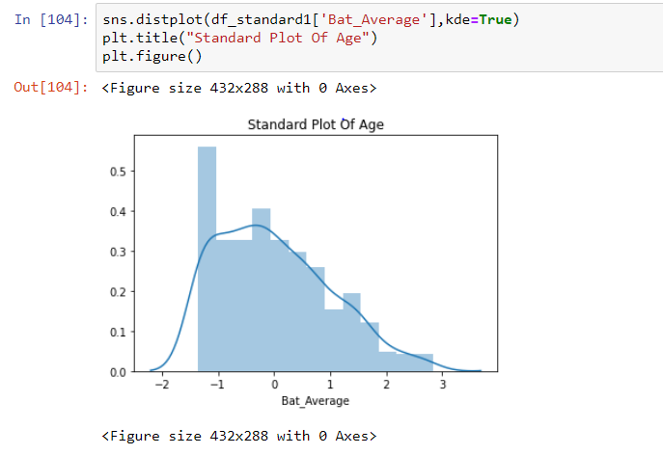
Notes:
27

Slide 28
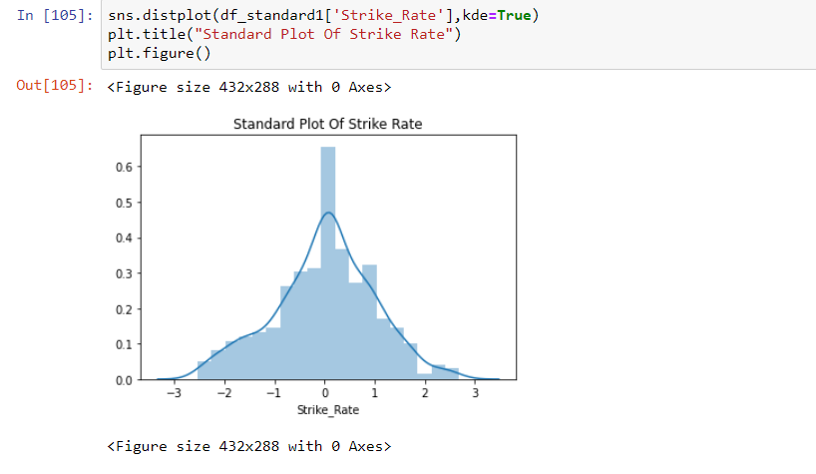
Notes:
28

Slide 29
Hypothesis Testing
Using hypothesis testing we try to interpret or draw conclusions about the population using sample data. A hypothesis test evaluates two manually exclusive statements about a population to determine which statement is best supported by sample data.

Slide 30
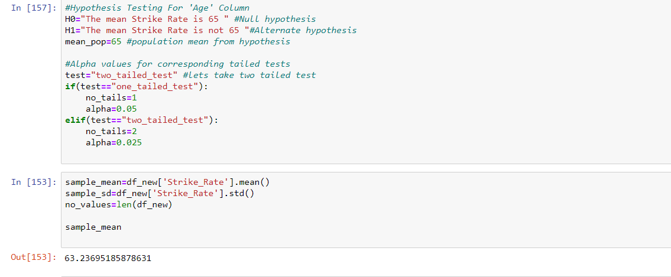
Notes:
30

Slide 31
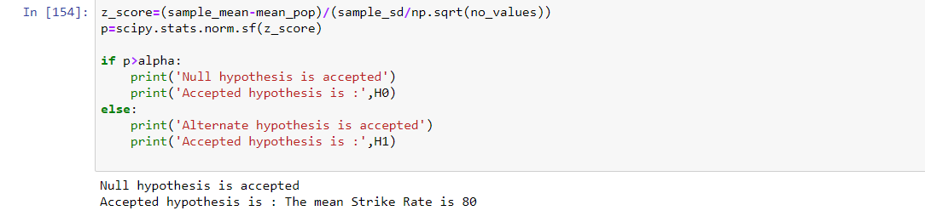
Notes:
31

Slide 32
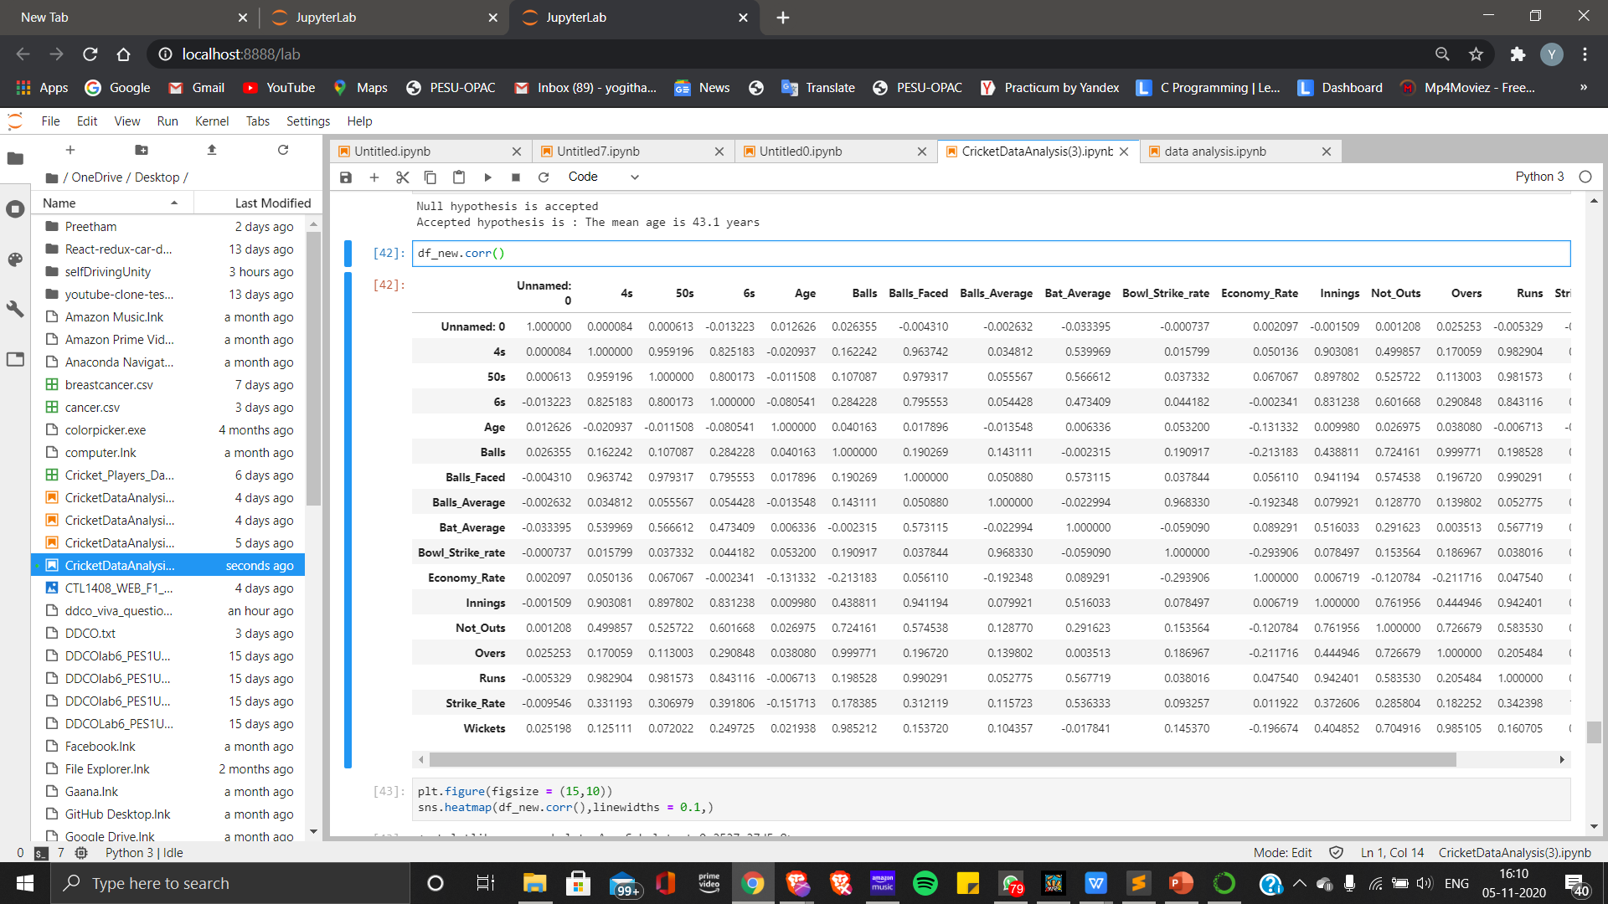
Correlation

Slide 33
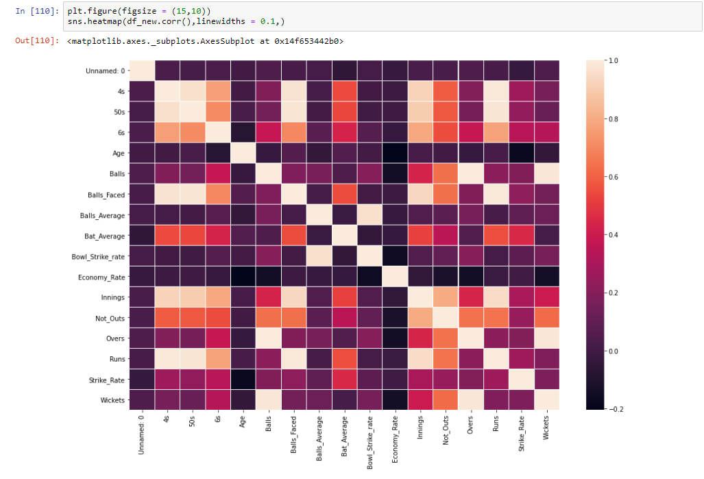
Notes:
33

Slide 34
Thank You

