Slide 1
CS 7641 Machine Learning
Final Project Presentation
Predicting Probabilities of getting into the playoffs in NBA
TEAM - 42
Akshay Jadiya
Carlos Aguilar
Saurabh Aggarwal
Yashwant Singh
Notes:
Hello, in this video, we will present our project for CS-7641 about Predicting the Probabilities of getting into the playoff in the NBA.

Slide 2
Agenda
Motivation
Literature Review
Data Collection and EDA
Process Flow
Methods Used
Results and Discussion
Conclusions
Notes:
We start by discussing our motivation, then proceed with Literature Review, data collection, and exploratory data analysis. Next, we move to talk about our process flow and methods used. Lastly, we present our results, discussion, and conclusions.

Slide 3
Motivation and Problem Statement
Being a sports analyst requires one to efficiently predict outcomes.
Fantasy Gaming enthusiasts may bet on teams more effectively.
We employed various ML approaches to figure out which teams would make it to the playoffs, given regular season statistics for NBA
Notes:
Being a sports analyst requires one to efficiently predict outcomes of games and figure out which players are most likely to score a high number of points, provide assists, gather rebounds, etc., in each team.
Predicting game outcomes and the variables that affect the odds also helps Fantasy Gaming enthusiasts to bet on teams more effectively.
We employed various ML approaches to figure out which teams would make it to the playoffs, given regular season statistics for NBA.

Slide 4
Agenda
Motivation
Literature Review
Data Collection and EDA
Process Flow
Methods Used
Results and Discussion
Conclusions

Slide 5
What has already been done?
1
2
3
Hybrid Fuzzy-SVM (HFSVM) to predict outcomes of basketball games and assess variable importance
Using Naïve Bayes to predict wins and regression to predict spread in 2009-2010 NBA
Applying Bayesian Belief Networks and Neural Networks to predict game outcomes from dataset of 650 NBA matches
Notes:
There have been some efforts focused on predicting wins and game outcomes in the prediction scene, which aggregated can be analyzed to predict teams that will make the playoff.
In 2017 Sushma et al. studied the use of Hybrid Fuzzy-SVM (HFSVM) to predict outcomes of basketball games and assess variable importance.
Other authors have explored Naive Bayes and Bayesian Belief neural networks to predict wins, game outcomes, and spread.
Our work focuses on exploring several Machine Learning techniques to determine which one yields better results in predicting the Probabilities for the teams to make the playoffs in an NBA season.

Slide 6
Agenda
Motivation
Literature Review
Data Collection and EDA
Process Flow
Methods Used
Results and Discussion
Conclusions
Notes:
Now we will talk about the data we used for this project.

Slide 7
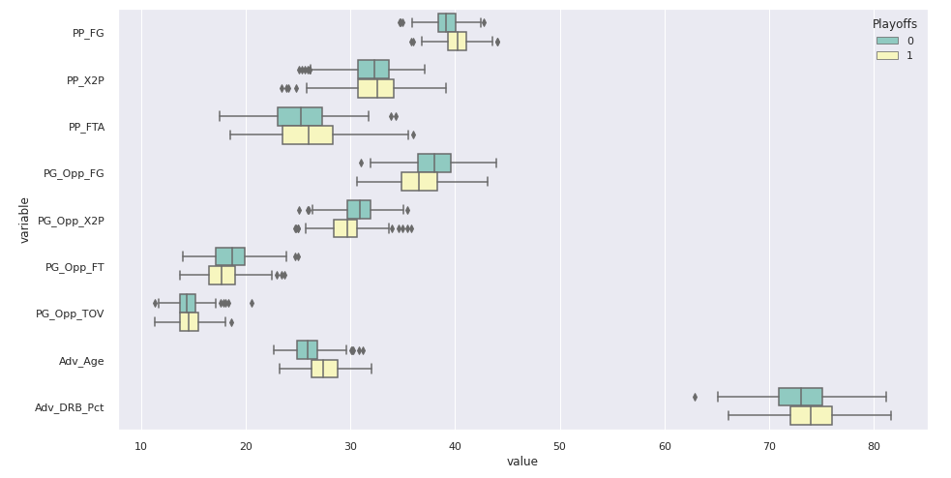
Data Collection and EDA
Collected from https://www.basketball-reference.com/
Focus on data after the 97-98 season.
Regular and Advanced Statistics.
Notes:
We collected our data from the website https://www.basketball-reference.com/ which contains season and game-wise statistics for NBA players and teams.
We will focus on NBA data after the 97-98 season when the association extended the 3-pt line length and added the “no-charge” rule, which includes a circle around the basket where it is not allowed to call offensive charge fouls.
Some of the variables we would be focusing on are regular statistics like points, assists, blocks, steals, rebounds, turnovers, and personal fouls.
We also consider advanced metrics such as effective field goal percentage, true shooting percentage, and offensive and defensive ratings.
The boxplots show two insights:
First, teams that make it to the playoffs generally make a higher number of field goals (PP_FG), make a higher number of free throws (PP_FTA), have a higher average age (Adv_Age), and have a higher defensive rebound percentage (Adv_DRB_pct) as compared to teams that fail to make it to the playoffs.
Second, teams that make it to the playoffs generally limit their opponents: Number of shots (PG_Opp_FG), Number of 2 point shots (PG_Opp_X2P), Number of Free Throws (PF_Opp_FT)

Slide 8
Agenda
Motivation
Literature Review
Data Collection and EDA
Process Flow
Methods Used
Results and Discussion
Conclusions
Notes:
Now we discuss the steps we took to clean, analyze and tune the data.

Slide 9
Process Flow
Extract datasets from basketball-reference.com and merge them
1
Data collected from 4 tables
Remove highly correlated variables / irrelevant features
2
27 features removed
3
Perform PCA to reduce the dimensionality
5 PCs were selected.
Variance explained 99%
4
Run 8 different models of varying complexity and compare results
5
Tune hyperparameters of top 5 models, select top performing model and predict on test data
Notes:
The first step was to extract datasets from the Basketball-reference website and merge them into one data collection.
In the second step, we removed highly correlated variables or irrelevant features.
Third, we used Principal Component Analysis to select variables that explain at least 99% of the variability in the response. We determined that the resulting dataset has no class imbalance in this step. Therefore, we didn't need to perform transformations to account for it.
Fourth, we ran eight different models and compared their results.
Finally, we performed hyperparameter tuning for the top 5 models to find the best possible configurations.

Slide 10
Agenda
Motivation
Literature Review
Data Collection and EDA
Process Flow
Methods Used
Results and Discussion
Conclusions
Notes:
Following, we explained the methods used for the models and their comparison.

Slide 11
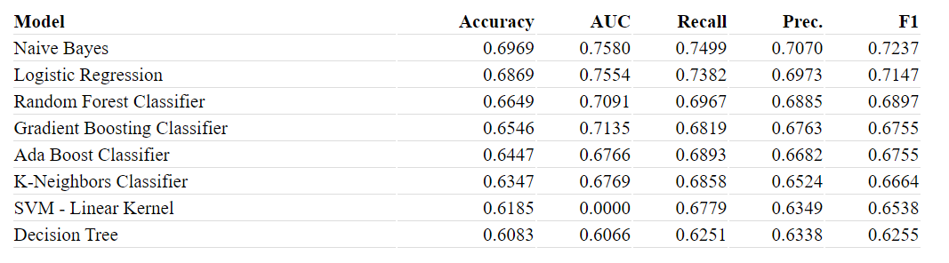
Methods
We ran 8 different models to classify whether a team would make it to the playoffs or not.
As we can see from the above table, Naive Bayes, Logistic Regression, Random Forest Classifier and Gradient Boosting Classifier are top performing models.
We select these 4 models for hyperparameter tuning along with SVM.
We are comparing and selecting the model based on accuracy because there is no class imbalance in the dataset and, hence, accuracy is a fair metric to make comparisons on.
Notes:
We ran eight different models to classify whether a team would make it to the playoffs or not:
Naive Bayes,
Logistic Regression
Random Forest
Gradient Boosting
Ada Boost
K-Neighbors
Support Vector Machine and
Decision Tree
We also collected their accuracy, Area Under the Curve, Recall, Precision, and F1 Score for all the models. To clarify the scenario, a True positive will be when the model predicts the team will make the playoffs and the team actually goes to the playoffs.
We are comparing and selecting the model based on accuracy because there is no class imbalance in the dataset and, hence, accuracy is a fair metric to compare the models.

Slide 12
Methods
We ran 8 different models to classify whether a team would make it to the playoffs or not.
As we can see from the above table, Naive Bayes, Logistic Regression, Random Forest Classifier and Gradient Boosting Classifier are top performing models.
We select these 4 models for hyperparameter tuning along with SVM.
We are comparing and selecting the model based on accuracy because there is no class imbalance in the dataset and, hence, accuracy is a fair metric to make comparisons on.
Notes:
As we can see from the above table, Naive Bayes, Logistic Regression, Random Forest Classifier, and Gradient Boosting Classifier are top-performing models. Therefore we decided to use those four models and SVM to perform hyperparameter tuning.

Slide 13
Agenda
Motivation
Literature Review
Data Collection and EDA
Process Flow
Methods Used
Results and Discussion
Conclusions
Notes:
Now we present our results and discussion for the hyperparameter tuning.

Slide 14
Hyperparameter Tuning and Model Comparison
Notes:
We performed Hyperparameter tuning using 10-fold cross-validation, and the metrics for each fold are shown in the following slides. We chose the best model using the mean accuracy for the cross-validation.
As we can see, the best model in terms of accuracy is the Naïve Bayes model

Slide 15
Agenda
Motivation
Literature Review
Data Collection and EDA
Process Flow
Methods Used
Results and Discussion
Conclusions
Notes:
Finally, we present our conclusions.

Slide 16
Conclusion
Accuracy on the test set is 63.55%.
Naive Bayes performed the best.
Why?
Simple dataset.
Naive Bayes fewer assumptions.
After performing PCA, we get 5 independent predictors which satisfy Naive Bayes' assumption of feature independence.
Notes:
We calculated accuracy on the test set by the trained and hyperparameter tuned Naive Bayes model. The final accuracy that we get on the test is 63.55%.
As mentioned before, after comparing several models of varying complexity, we found that Naive Bayes performed the best.
We could think of a couple of reasons for Naive Bayes model's best performance for our dataset.
The dataset that we have chosen is simple (only 5 features after PCA). Our result is in accordance with Occam's razor which states that the simplest explanation is preferable to one that is more complex.
Naive Bayes is a relatively simple model with fewer assumptions and hence, works well on a simple dataset
Finally, after performing PCA, we get 5 independent predictors which satisfy Naive Bayes' assumption of feature independence.

Slide 17
Thank you
Notes:
This concludes our presentation, thank you

