Slide 1
House Rate Prediction
Students Name:
Yashwant Gawkar 15
Hiten Lilaramani 26
Aniket More 30
Guide Name:
Prof Varsha Wangikar

Slide 2



TEAM MEMBERS

Slide 3
INDEX
Sr No. | Title
1 | Problem Statement
2 | Design
3 | Implementation Technology
4 | Result
5 | Differentiation with other algorithm
6 | Advantages and Limitations
7 | Conclusion and Future Scope
8 | References

Slide 4
Problem Statement
House sales are determined based on the Standard home price indices and the housing price index of the Office of Federal Housing Enterprise Oversight (OFHEO). These reflect the trends of the housing market. In addition to these housing price indices, the development of a housing price prediction model can greatly assist in the prediction of future housing prices and the establishment of real estate policies. This study uses machine learning algorithms as a research methodology to develop a housing price prediction model. To improve the accuracy of housing price prediction, this paper analyzes the housing data of 506 townhouses in Fairfax County, Boston, gathered by the Multiple Listing Service (MLS) of the Metropolitan Regional Information Systems (MRIS). We develop a housing price prediction model based on machine learning algorithms such as Decision tree algorithm classification accuracy performance. We then propose an improved housing price prediction model to assist a house seller or a real estate agent make better informed decisions based on house price valuation. The experiments demonstrate that the algorithm, based on accuracy, consistently outperforms the other models in the performance of housing price prediction.
Decision Tree Analysis is a general, predictive modelling tool that has applications spanning a number of different areas. In general, decision trees are constructed via an algorithmic approach that identifies ways to split a data set based on different conditions. It is one of the most widely used and practical methods for supervised learning. Decision Trees are a non-parametric supervised learning method used for both classification and regression tasks. The goal is to create a model that predicts the value of a target variable by learning simple decision rules inferred from the data features.

Slide 5
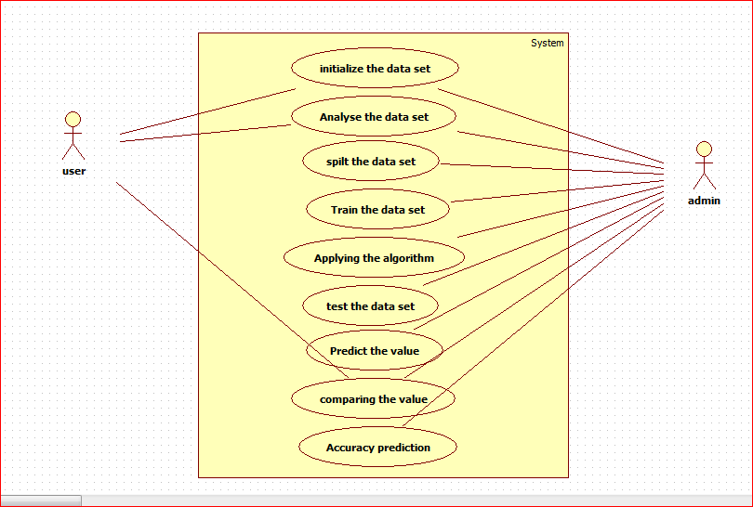
Design

Slide 6
Implementation Technology
Hardware requirement:
All components able to be executed on personal computers with Windows OS platforms an other platforms like Linux,Unix.
1.Operating system:window
2.Hard disk:40GB
3.RAM:256 MB
4.Processor :Pentium Dual-core CPU
Software Requirement:
Python 3.7- Python is fast,secure and reliable.From laptops to datacenters,cell phones to the data internet

Slide 7
Implementation Technology
Dataset details
1. CRIM per capita crime rate by town
2. ZN proportion of residential land zoned for lots over 25,000 sq.ft.
3. INDUS proportion of non-retail business acres per town
4. CHAS Charles River dummy variable (= 1 if tract bounds river; 0 otherwise)
5. NOX nitric oxides concentration (parts per 10 million)
6. RM average number of rooms per dwelling
7. AGE proportion of owner-occupied units built prior to 1940
8. DIS weighted distances to five Boston employment centres
9. RAD index of accessibility to radial highways
10. TAX full-value property-tax rate per $10,000
11. PTRATIO pupil-teacher ratio by town
12. B 1000(Bk - 0.63)^2 where Bk is the proportion of blacks by town
13. LSTAT % lower status of the population
14. MEDV Median value of owner-occupied homes in $1000's

Slide 8
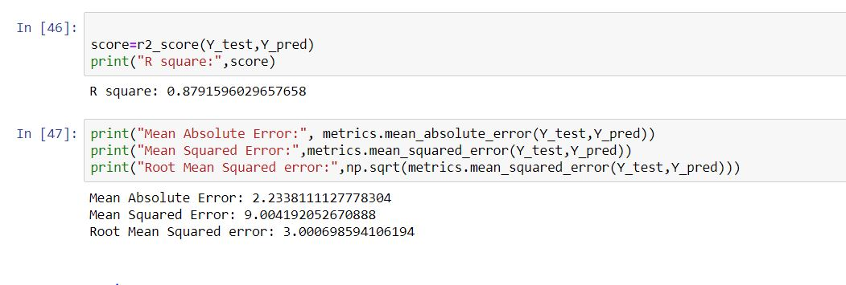
Result
Screenshot
Result Analysis:
After Testing several time on dataset it was found that model result accuracy is 87.9%

Slide 9
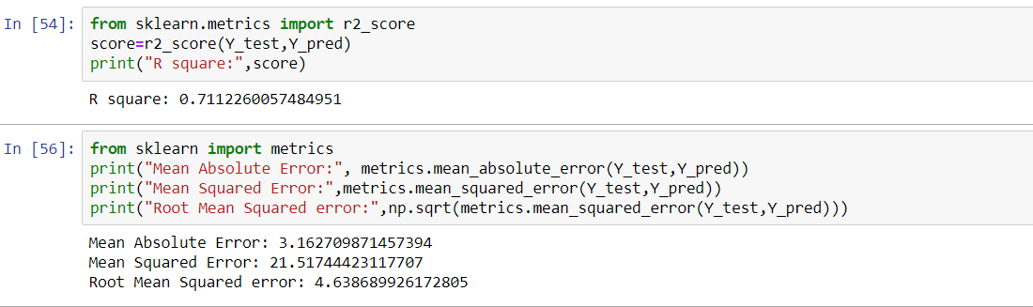
Differentiation with other algorithm
Linear Regression
With linear regression it was found that accuracy is low as compared to Decision Tree Algorithm

Slide 10
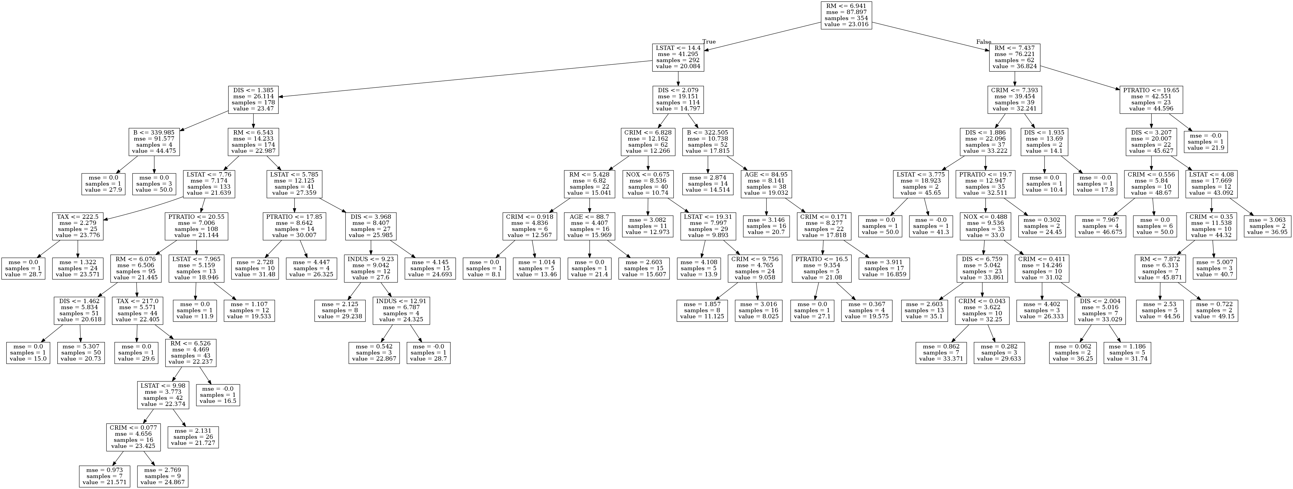
Differentiation with other algorithm
Decision tree Algorithm
With Decision Tree it was found that the accuracy is 87.9% and higher compared to Linear Regression, Decision Tree result is formed as:

Slide 11
Advantages and Limitations
Advantages of your model
1.No involvement of middle men in the buying process
2.Buyer can easily get an idea about the price and easily detect the fake price of a house
Disadvantages of your model
1.Improper use of input data can give improper rate of house
2.The dataset inputs should be checked right format and should not involve any none values.

Slide 12
Conclusion and Future Scope
Conclusion
The conclusion of the project is “House Rate Prediction” is that is used to predict the house rate on the basis of its properties
Future Scope:
In the current implementation of “House Rate Prediction” we can deploy this model into a website and based on its properties it can predict the rate, the user should input properties into the website and based on it the model predict the rate and it is shown.

Slide 13
References
[1]https://www.ijitee.org/wp-content/uploads/papers/v8i9/I7849078919.pdf
[2]https://ieeexplore.ieee.org/document/6208293/
[3]https://ieeexplore.ieee.org/document/4679917/

Slide 14
Thank you

