Slide 1
BUSINESS ANALYTICS · COGNIFYZ
40
Investment
Respondents
Behavior
24
Analysis
Variables
Internship Project · Cognifyz Technologies
10
Yashwanth M
Tasks

Slide 2
OBJECTIVES
What We Set Out to Discover
01
Investor Behavior
02
Preferred Avenues
Understand how individuals make investment decisions and what drives their choices.
Identify the most selected investment options across 40 survey respondents.
03
Risk vs Return
04
Decision Influencers
Analyze the mismatch between risk tolerance and return expectations.
Explore what factors — advisors, media, objectives — shape financial choices.

Slide 3



DATASET OVERVIEW
Survey Data at a Glance
40
24
100%
Total
Respondents
Feature
Columns
Survey
Data
Dataset Features Include:
Demographics
Investment Options
Gender · Age · Income
Mutual Funds · Equity · Debentures · Bonds · FD · PPF · Gold
Behavioral
Objectives
Duration · Reasons · Source of Info · Expectations
Retirement · Healthcare · Education

Slide 4





TECH STACK
Tools & Technologies
Python
Pandas
Matplotlib
Seaborn
VS Code
Primary Language
Data Wrangling
Visualization
Statistical Plots
IDE
Core programming language for data analysis and scripting.
Data manipulation — loading CSV, selecting columns, aggregation.
Custom bar charts for gender, investment preference and duration.
Statistical heatmap and styled count plots with coolwarm palette.
Development environment for writing, running and debugging Python.
import pandas as pd import matplotlib.pyplot as plt import seaborn as sns

Slide 5
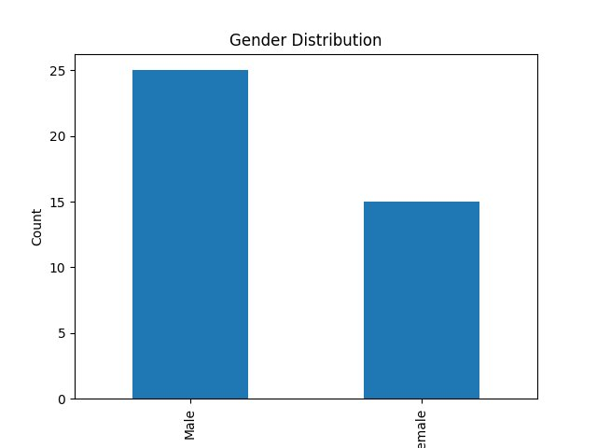
TASK 1 · GENDER ANALYSIS
Gender Distribution
25
Male Respondents
15
Female Respondents
💡 Male participation is higher (62.5%), indicating a gender imbalance in investment activity among young earners.
62.5% Male
37.5% Female

Slide 6
TASK 2 · DESCRIPTIVE STATS
Demographic Profile of Investors
Age Range
Std Deviation
22 – 40 yrs
Low
~28
Mostly 20s
Homogeneous group
Average Age
Years
Dominant Age
Profile Type
25–30
Salaried
Early-stage
earners
Low age variation
across dataset
Peak demographic
Early career stage
💡 Investors are primarily early-stage earners (~28 yrs) — a key segment for targeted financial advisory products.

Slide 7
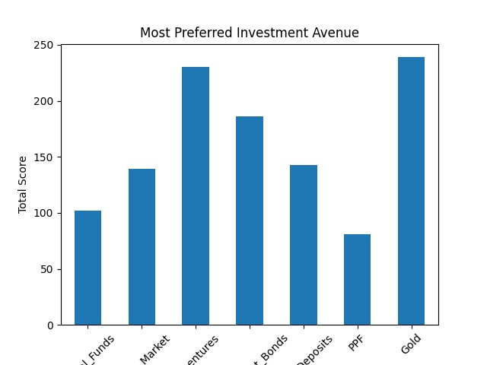
TASK 3 · INVESTMENT PREFERENCE
Most Preferred Investment Avenues
Gold
#1
Total Score: 238
Debentures
#2
Total Score: 230
Govt Bonds
#3
Total Score: 186
💡 Gold leads with a score of 238 — investors prefer safe, tangible and traditional assets over volatile equity.

Slide 8




TASK 4 · INVESTMENT REASONS
Why Investors Choose Each Avenue
Equity Market
Mutual Funds
Capital Appreciation
Better Returns
Investors see equity as a long-term wealth builder despite its high risk.
Preferred for diversification and professionally managed higher yields.
Bonds
Fixed Deposit
Assured Returns
Risk-Free
Bonds provide fixed income and capital safety, ideal for risk-averse investors.
Guaranteed returns make FDs the safest and most predictable instrument.
💡 Investment choice is driven by risk mindset — risk-takers prefer equity, while conservative investors choose FDs and bonds.

Slide 9
TASK 5 · SAVINGS OBJECTIVES
What Are Investors Saving For?
Retirement
Focus Area
1
60%
24 respondents
Long-term
Financial
Security
Healthcare
2
32.5%
13 respondents
Retirement alone
accounts for 60%
of all responses
Education
3
7.5%
3 respondents
💡 Retirement savings dominate at 60% — investors are focused on long-term security, not short-term gains.

Slide 10




TASK 6 · INFORMATION SOURCES
Where Do Investors Get Their Info?
1st
2nd
3rd
4th
Financial
Consultants
Newspapers
& Media
Friends &
Family
Internet &
Digital
Trust level
Trust level
Trust level
Trust level
95%
70%
55%
30%
💡 Investors trust financial consultants most (95%) and internet sources least — digital advisory has a massive growth opportunity.

Slide 11
TASK 7 · INVESTMENT DURATION
How Long Do Investors Commit?
< 1 Year
8%
Short-term
~3
1–3 Years
42%
Most common
Years Average
3–5 Years
38%
Investment
Horizon
Second most
> 5 Years
12%
Medium-term
commitment
Long-term
💡 80% of investors prefer 1–5 year horizons — medium-term planning dominates, aligned with salary-cycle financial thinking.

Slide 12
TASK 9 · RETURN EXPECTATIONS
What Returns Do Investors Expect?
EXPECTS
⚠ REALITY CHECK
20–30%
Preferred
Investments:
Gold → 6–8% avg
Annual Returns
Bonds → 7–9% avg
Majority of respondents
target 20–30% returns
FD → 5–7% avg
Gap: ~15–20% shortfall
Expectation vs Reality Mismatch
💡 High return expectations (20–30%) vs low-risk investment choices (Gold/FD/Bonds ~7%) reveals a critical financial literacy gap.

Slide 13
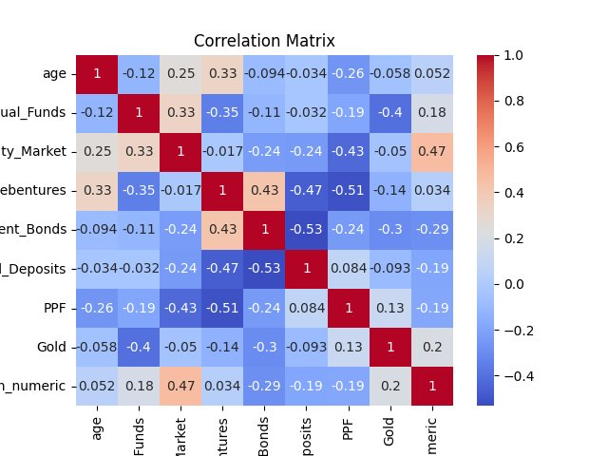
TASK 10 · CORRELATION ANALYSIS
Correlation Matrix — Behavioral Patterns
Equity ↔ Duration
+0.47
Longer horizon → more equity
Gold ↔ Mutual Funds
−0.40
Competing safe-haven choices
Age ↔ Debentures
+0.33
Older investors → more stable
FD ↔ Bonds
−0.53
Substitutes not complements
💡 Correlation patterns show that age, risk profile, and investment horizon together shape which assets investors choose.

Slide 14
SYNTHESIS · KEY INSIGHTS
What the Data Reveals
01
Risk-Averse Investors Dominate
02
High Return Expectations Exist
Gold, Bonds and FDs dominate preferences — over 60% of choices are in low-risk categories, confirming conservative mindsets.
Most investors expect 20–30% returns despite choosing assets that historically deliver only 5–9% annually.
03
Traditional Investments Preferred
04
Expert Advice is Most Trusted
Gold ranks #1 in preferences. Digital or equity-based instruments have low adoption among survey participants.
Financial consultants are the primary information source, with internet and digital platforms being the least trusted.

Slide 15
PROJECT
Thank
SUMMARY
40
You!
Survey Respondents
10
Tasks Completed
Questions & Discussion Welcome
3
Yashwanth M · Statistics & Mathematics · 2024
Python Charts Built
Cognifyz Technologies · Business Analytics Internship
7
Investment Types Analyzed

